Slide 1
DATA LINK LAYER
ETHERNET – HDLC - PPP

Slide 2
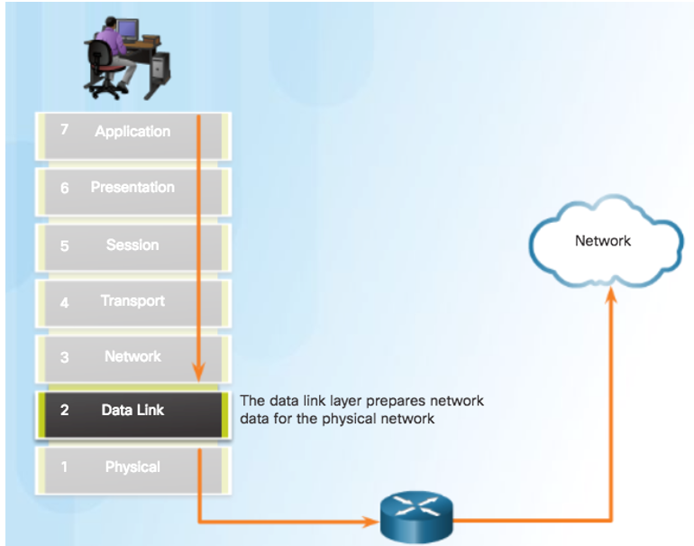
The Data lınk layer

Slide 3
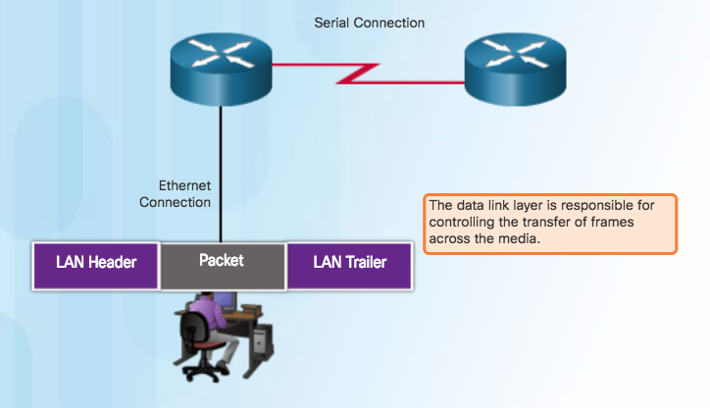
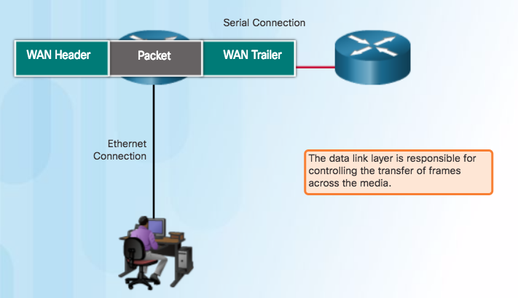
The Data lınk layer

Slide 4
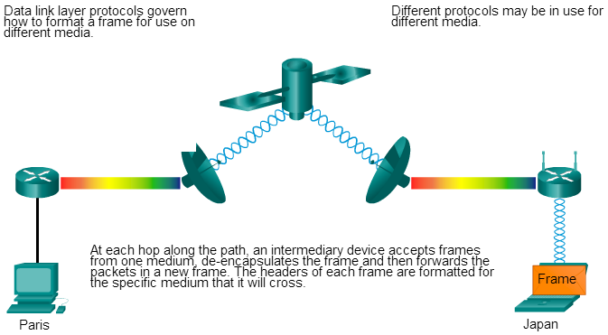
The Data lınk layer
Notes:
As packets travel from the source host to the destination host, they travel over different physical networks.
Physical networks can consist of different types of physical media such as copper wires, optical fibers, and wireless consisting of electromagnetic signals, radio and microwave frequencies, and satellite links.

Slide 5
Data lınk layer STANDARDS
Notes:
Engineering organizations that define open standards and protocols that apply to the network access layer include:
Institute of Electrical and Electronics Engineers (IEEE)
International Telecommunication Union (ITU)
International Organization for Standardization (ISO)
American National Standards Institute (ANSI)

Slide 6
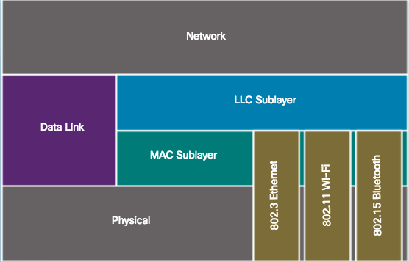
Data lınk SUBlayers
Logical Link Control (LLC)
Communicates with the network layer.
Identifies which network layer protocol is being used for the frame.
Media Access Control (MAC)
Defines the media access processes performed by the hardware.
Provides data link layer addressing and access to various network technologies.

Slide 7
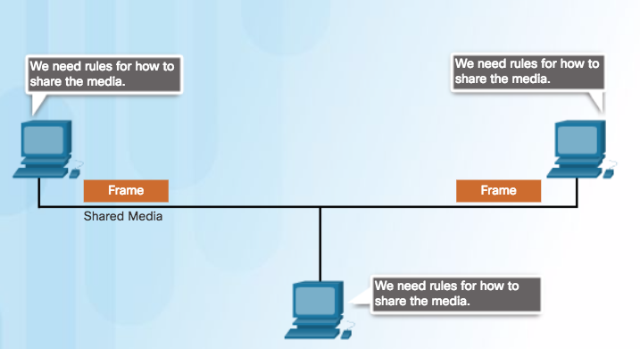
Medıa Access Control
Media access control is the equivalent of traffic rules that regulate the entrance of motor vehicles onto a roadway.

Slide 8
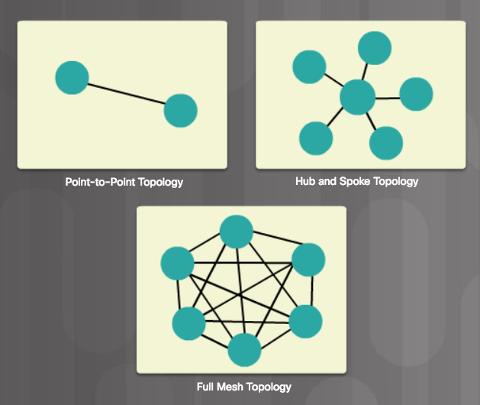
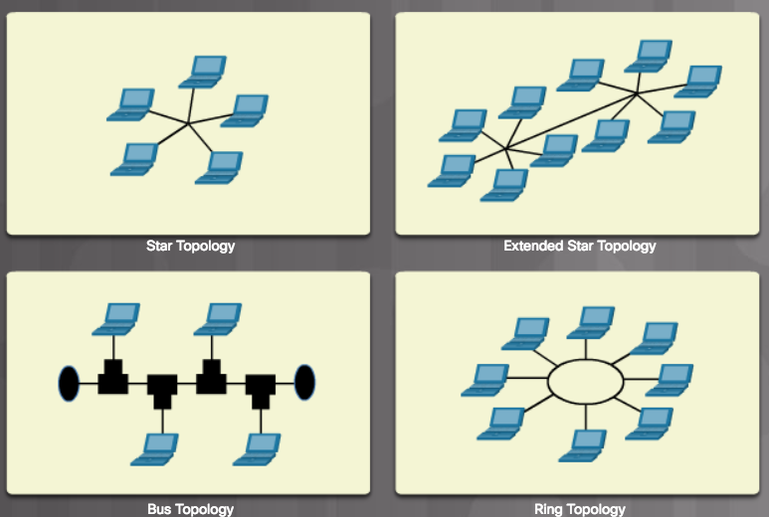
Medıa Access Control
TOPOLOGY
Notes:
Physical topology - Refers to the physical connections and identifies how end devices and infrastructure devices such as routers, switches, and wireless access points are interconnected.
Logical Topology - Refers to the way a network transfers frames from one node to the next. These logical signal paths are defined by data link layer protocols.

Slide 9
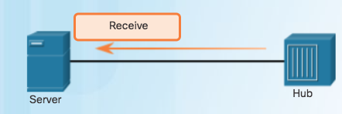
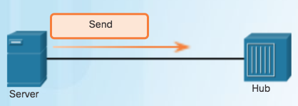
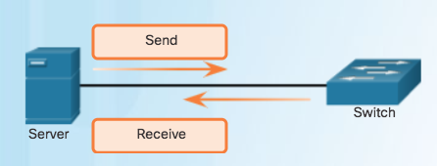
Medıa Access Control
COMMUNICATION
Notes:
Half-Duplex Communication
Both devices can transmit and receive on the media but cannot do so simultaneously.
Full-Duplex Communication
Both devices can transmit and receive on the media at the same time.

Slide 10
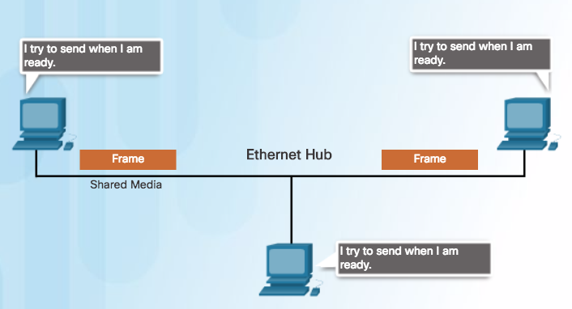
Medıa Access Control
ACCESS CONTROL METHOD
Notes:
Contention-Based Access
Nodes operate in half-duplex.
Compete for the use of the medium.
Only one device can send at a time.

Slide 11
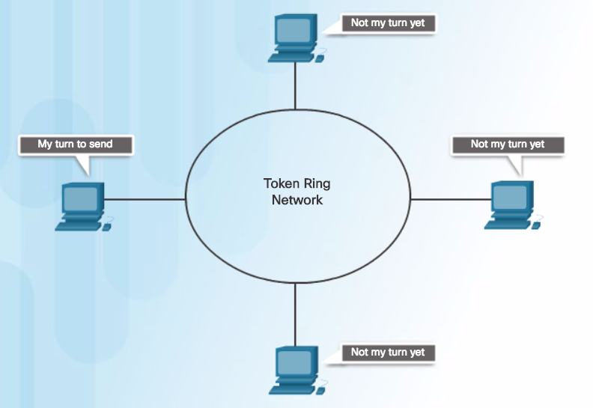
Medıa Access Control
ACCESS CONTROL METHOD
Notes:
Controlled Access
Each node has its own time to use the medium.
Legacy Token Ring LANs are an example

Slide 12
CONTENTION BASED – CSMA/CD
Carrier Sense Multiple Access/Collision Detection (CSMA/CD) process is used in half-duplex Ethernet LANs.
If two devices transmit at the same time, a collision will occur.
Both devices will detect the collision on the network.
Data sent by both devices will be corrupted and will need to be resent.
Jam sıgnal, Back-off algorıthm

Slide 13
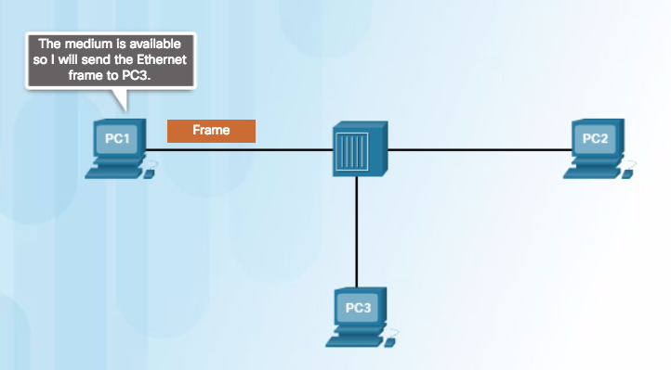
CONTENTION BASED – CSMA/CD

Slide 14
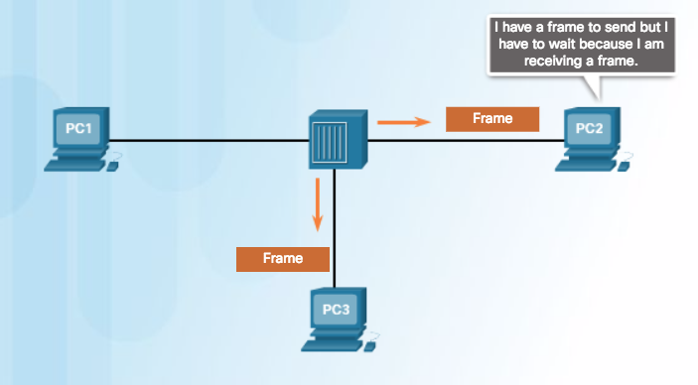
CONTENTION BASED – CSMA/CD

Slide 15
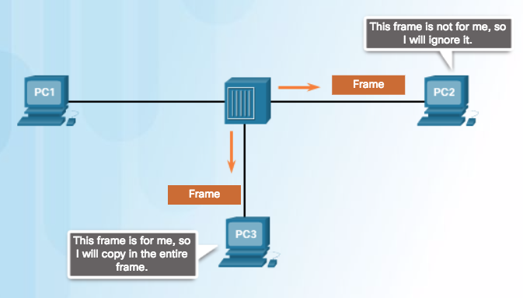
CONTENTION BASED – CSMA/CD

Slide 16
CONTENTION BASED – CSMA/CA
Carrier Sense Multiple Access/Collision Avoıdance (CSMA/CA)
Uses a method to detect if the media is clear.
Does not detect collisions but attempts to avoid them by waiting before transmitting.
Note: Ethernet LANs using switches do not use a contention-based system because the switch and the host NIC operate in full-duplex mode.

Slide 17
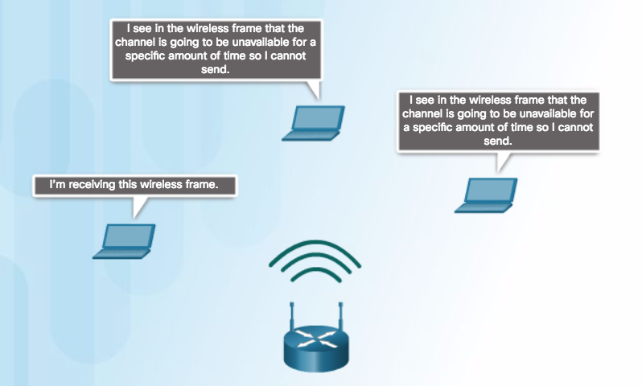
CONTENTION BASED – CSMA/CA

Slide 18
DATA LINK FRAME
Each frame type has three basic parts:
Header
Data
Trailer

Slide 19
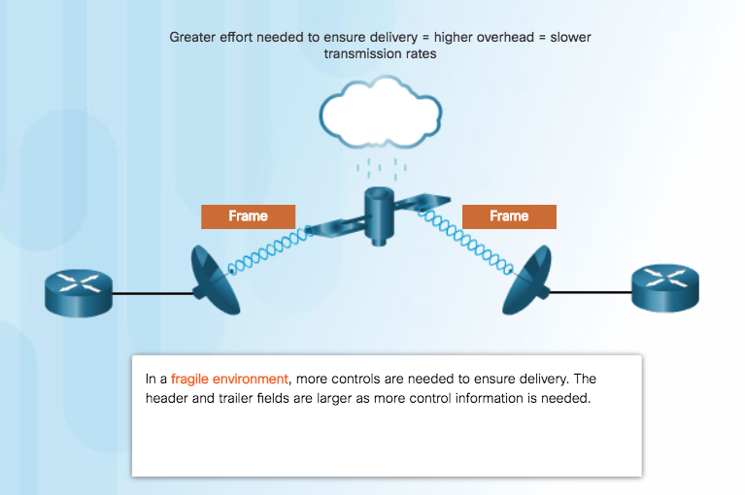
DATA LINK FRAME
Notes:
Structure of the frame and the fields contained in the header and trailer depend on Layer 2 protocol.

Slide 20
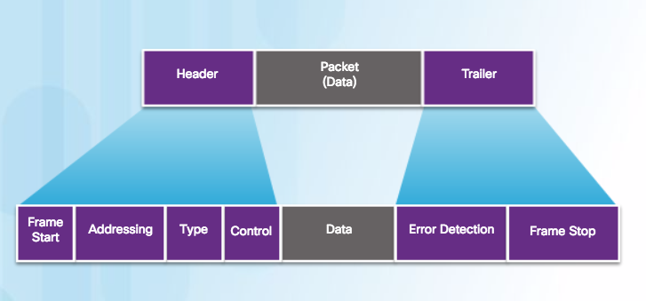
FRAME FIELDS (GENERIC)
Notes:
Frame start and stop indicator flags - Identifies the beginning and end limits of the frame.
Addressing - Indicates the source and destination nodes.
Type - Identifies the Layer 3 protocol in the data field.
Control - Identifies special flow control services such as QoS.
Data - Contains the frame payload (i.e., packet header, segment header, and the data).

Slide 21
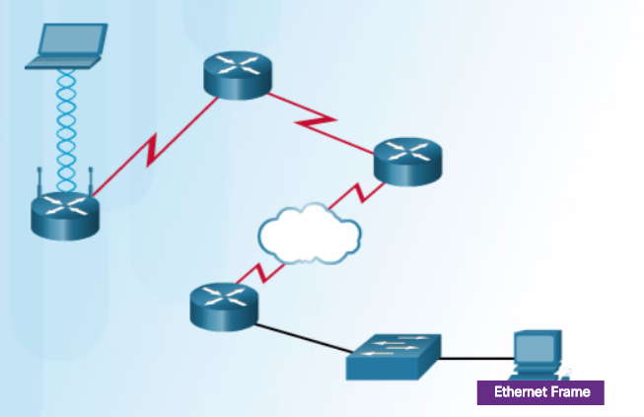
DATA LINK FRAME

Slide 22
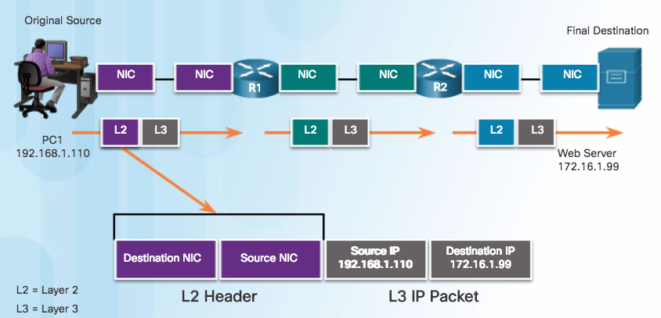
ADDRESSES

Slide 23
Ethernet

Slide 24
ethernet
Defined in the IEEE 802.2 and 802.3 standards.
It supports data bandwidths of 10 Mb/s, 100 Mb/s, 1000 Mb/s (1 Gb/s), 10,000 Mb/s (10 Gb/s), 40,000 Mb/s (40 Gb/s), and 100,000 Mb/s (100 Gb/s).
Ethernet operates in the data link layer and the physical layer.
Ethernet relies on the two separate sublayers of the data link layer to operate, the Logical Link Control (LLC) and the MAC sublayers.

Slide 25
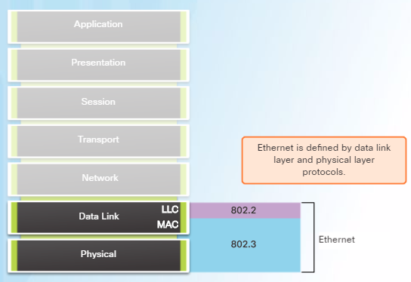
ethernet
The Ethernet LLC sublayer handles the communication between the upper layers and the lower layers. It is implemented in software, and its implementation is independent of the hardware.
The MAC sublayer constitutes the lower sublayer of the data link layer. MAC is implemented by hardware, typically in the computer NIC.

Slide 26
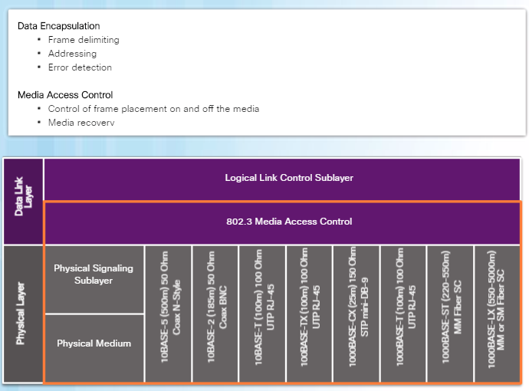
ETHERNET MAC SUBLAYER
Notes:
The MAC sublayer has two primary responsibilities:
Data encapsulation
Media access control

Slide 27
ETHERNET FRAME
The minimum Ethernet frame size from Destination MAC address to FCS is 64 bytes and the maximum is 1518 bytes.
Notes:
PREAMBLE – 8 Bytes
MAC Address – 6 Bytes
EtherType – 2 Bytes
FCS – 4 Bytes

Slide 28
ETHERNET FRAME
PREAMBLE:
Preamble(7 bytes) and Start Frame Delımıter(SFD – 1 byte) fields are used for synchronızatıon between the sendıng and receıvıng devıces.
It ıs used to get the attentıon of the receıvıng nodes. Essentıally, fırst few bytes tell the receıvers to get ready to receıve the a new frame
ETHERTYPE:
Thıs 2-byte fıeld ıdentıfıes the upper layer protocol encapsulated ın the Ethernet frame (0x800 – IPv4; 0x86DD – IPv6; 0x806 – ARP …)
Notes:
PREAMBLE – 8 Bytes
MAC Address – 6 Bytes
EtherType – 2 Bytes
FCS – 4 Bytes

Slide 29
ETHERNET FRAME
FRAME CHECK SEQUENCE:
FCS fıeld (4 bytes) ıs used to detect errors ın a frame
It user a cyclıc redundancy check (CRC)
The sendıng devıces calculates a crc and wrıtes the result ın the FCS fıeld of a frame
The receıvıng devıce generates a crc to look for errors. If the calculatıons match, no error occurred.
Calculatıons that do not match are an ındıcatıon of error, therefore the frame ıs dropped
Notes:
PREAMBLE – 8 Bytes
MAC Address – 6 Bytes
EtherType – 2 Bytes
FCS – 4 Bytes

Slide 30
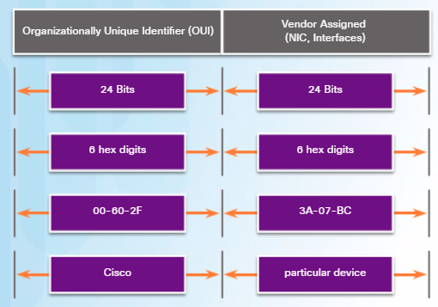
ETHERNET MAC Address
An Ethernet MAC address is a 48-bit binary value expressed as 12 hexadecimal digits (4 bits per hexadecimal digit).

Slide 31
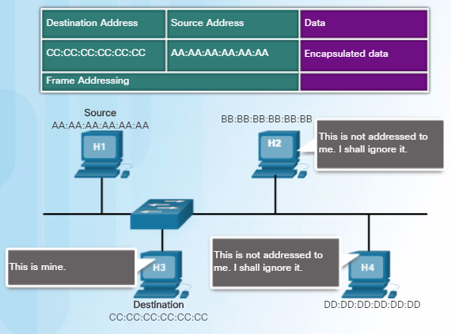
ETHERNET MAC Address
Notes:
When a device is forwarding a message to an Ethernet network, it attaches header information to the frame.
The header information contains the source and destination MAC address.

Slide 32
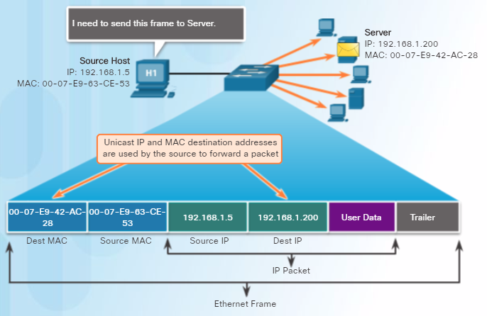
UNICAST MAC Address

Slide 33
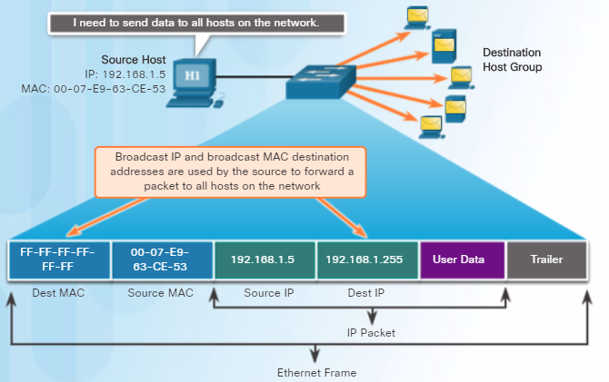
BROADCAST MAC Address
Notes:
When the IPv4 broadcast packet is encapsulated in the Ethernet frame, the destination MAC address is the broadcast MAC address of FF-FF-FF-FF-FF-FF in hexadecimal (48 ones in binary).

Slide 34
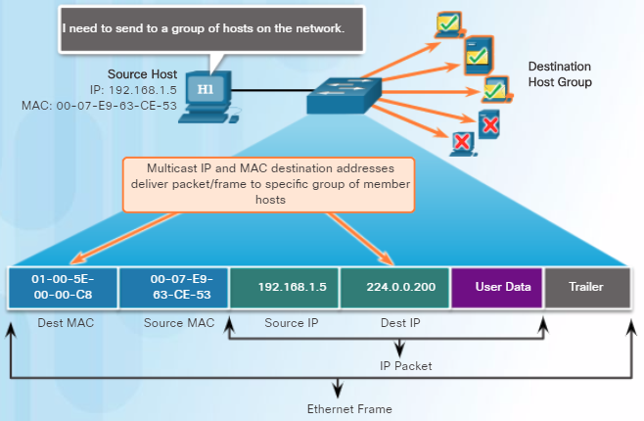
multıCAST MAC Address
Notes:
Multicast addresses allow a source device to send a packet to a group of devices.
Devices in a multicast group are assigned a multicast group IP address in the range of 224.0.0.0 to 239.255.255.255 (IPv6 multicast addresses begin with FF00::/8).
The multicast IP address requires a corresponding multicast MAC address that begins with 01-00-5E in hexadecimal.

Slide 35
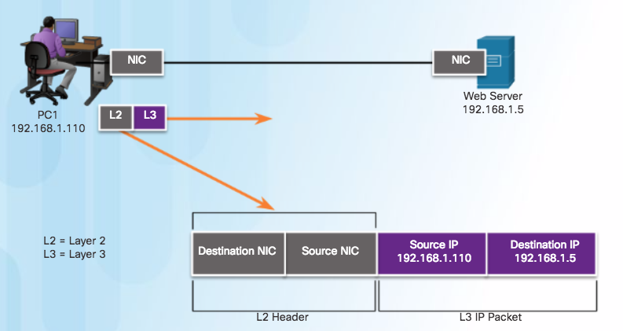
The Data lınk layer

Slide 36
SERıal connectıons

Slide 37
LAN vs WAN
A WAN is owned by a service provider and a LAN is typically owned by an organization.
Point-to-point connections connect LANs to service provider WANs.
A LAN-to-WAN point-to-point connection is also referred to as a serial connection or leased-line connection.
Companies pay for a continuous connection between two remote sites.
Servıce provıders try to the line continuously active and available.

Slide 38
Serıal connectıons

Slide 39
Serıal communıcatıons
Serial Communication:
Method of data transmissions in which the bits are transmitted sequentially over a single channel.
Equivalent to a pipe only wide enough to fit one ball at a time. Multiple balls can go into the pipe, but only one at a time, and they only have one exit point, the other end of the pipe.
Notes:
Parallel communications
Bits can be transmitted simultaneously over multiple wires.
At one time, most PCs included both serial and parallel ports. Parallel ports were used to connect printers, computers, and other devices that required relatively high bandwidth.

Slide 40
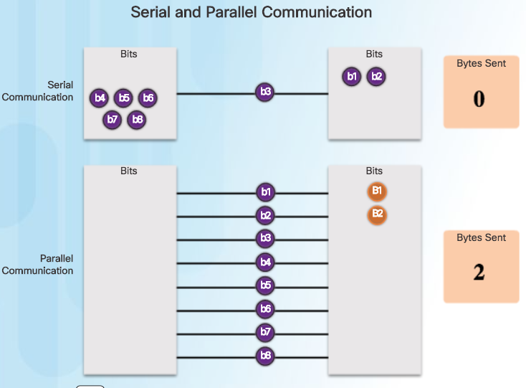
Serıal communıcatıons
Notes:
Parallel communications
Bits can be transmitted simultaneously over multiple wires.
At one time, most PCs included both serial and parallel ports. Parallel ports were used to connect printers, computers, and other devices that required relatively high bandwidth.

Slide 41
Serıal bandwıdth
Bandwidth
Refers to the rate at which data is transferred over the communication link
Carrier technology dictates how much bandwith is available
T-Carrier Specification (North American)
E-Carrier Specification (European)
US Optical Carrier (OC) Specification
In North America, expressed as a digital signal level number (DS0, DS1, etc.), which refers to the rate and format of the signal.
DS0 64 kb/s
DS1 = 24 x DS0 = T1

Slide 42
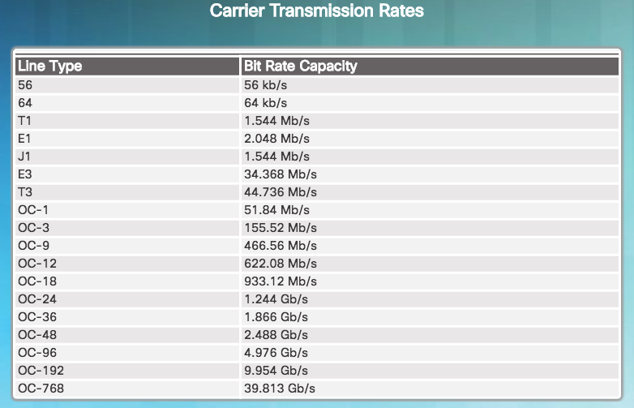
Serıal bandwıdth

Slide 43
WAN FRAME ENCAPSULATION
Data is encapsulated into frames before crossing the WAN link and must be configured for the appropriate Layer 2 protocol. .
Choice of protocol depends on the WAN technology and the communicating equipment.
WAN protocols:
HDLC
PPP
SLIP
X.25
Frame Relay
ATM

Slide 44
HDLC

Slide 45
HDLC
HDLC is a synchronous data link layer protocol developed by the International Organization for Standardization (ISO).
HDLC defines a Layer 2 framing structure that allows flow and error control through acknowledgments.
Uses a frame delimiter, or flag, to mark beginning and end of each frame.

Slide 46
HDLC
There are three types of HDLC frames:
I-FRAME: Information frames carry user data from the network layer. The first bit of control field of I-frame is 0.
S-FRAME: Supervisory frames do not contain information field. They are used for flow and error control. The first two bits of control field of S-frame is 10.
U-FRAME: Un-numbered frames are used for myriad miscellaneous functions, like link management. The first two bits of control field of U-frame is 11.

Slide 47
PPP

Slide 48
PPP
Point-to-Point Protocol contains three main components
HDLC-like Framing: For transporting multiprotocol packets over point-to-point links.
LCP: Extensible Link Control Protocol for establishing, configuring, and testing the data-link connection.
NCP: Network Control Protocol for establishing and configuring different network layer protocols (IPv4 and IPv6 Control Protocol).

Slide 49
PPP
ADVANTAGES of PPP
The link quality management feature (LQM) monitors the quality of the link. LQM can be configured on an interface with a given percentage. If the error percentage falls below the configured threshold, the link is taken down and packets are rerouted or dropped.
PPP supports authentication on a link.
PAP
CHAP
PPP support compression
Notes:
PPP requires a full-duplex circuit, either dedicated or switched, that can operate in an asynchronous or synchronous bit-serial mode.
Most of the work done by PPP happens at the data link and network layers, by LCP and NCPs.

Slide 50
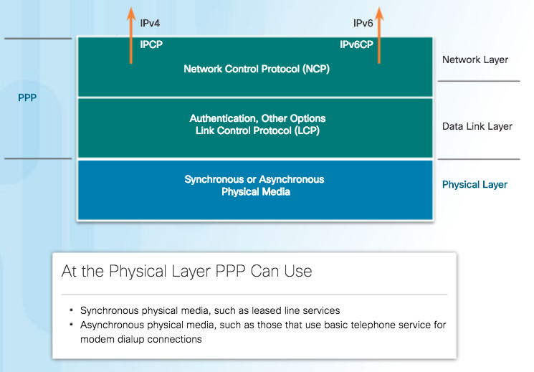
PPP Layered Archıtecture

Slide 51
PPP frame

Slide 52
PPP frame
Flag - A single byte that indicates the beginning or end of a frame. The Flag field consists of the binary sequence 01111110.
Address - A single byte that contains the binary sequence 11111111, the standard broadcast address
Control - A single byte that contains the binary sequence 00000011, which calls for transmission of user data in an unsequenced frame.
Protocol - Two bytes that identify the protocol encapsulated in the information field of the frame.

Slide 53
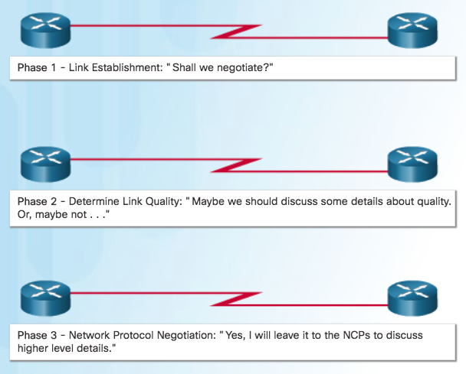
PPP Sessıon

Slide 54
PPP Sessıon
Phase 1: Link establishment and configuration negotiation - LCP must first open the connection and negotiate configuration options. This phase is complete when the receiving router sends a configuration-acknowledgment frame back to the router initiating the connection.
Phase 2: Link quality determination (optional) - The LCP tests the link to determine whether the link quality is sufficient to bring up network layer protocols.
Phase 3: Network layer protocol configuration negotiation - After the LCP has finished Phase 2, the appropriate NCP can separately configure the network layer protocols, and bring them up and take them down at any time. If the LCP closes the link, it informs the network layer protocols so that they can take appropriate action.

Slide 55
PPP - lcp
LCP functions within the data link layer and has a role in establishing, configuring, and testing the data-link connection.
LCP negotiates and sets up control options on the WAN data link, which are handled by the NCPs.
After the link is established, PPP also uses LCP to agree automatically on encapsulation formats such as authentication, compression, and error detection.

Slide 56
LCP OPERATION
LCP operation includes provisions for 3 classes of LCP frames:
Link-establishment frames
Link-maintenance frames
Link-termination frames
During link establishment, the LCP opens the connection and negotiates the configuration parameters. The link establishment process starts with the initiating device sending a Configure-Request frame to the responder.

Slide 57
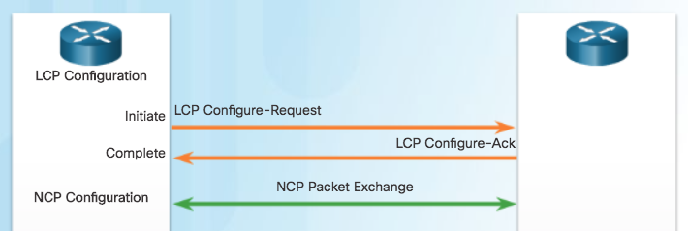
LCP OPERATION

Slide 58
LCP OPERATION
Responder processes the request:
If the options are not acceptable or not recognized, the responder sends a Configure-Nak or Configure-Reject message.
If the options are acceptable, the responder responds with a Configure-Ack message and the process moves on to the authentication stage. The operation of the link is handed over to the NCP.
When NCP has completed all necessary configurations, including validating authentication, the line is available for data transfer. During the exchange of data, LCP transitions into link maintenance.

Slide 59
LCP OPERATION
During link maintenance, LCP can use messages to provide feedback and test the link.
Echo-Request, Echo-Reply, and Discard-Request - These frames can be used for testing the link
Code-Reject and Protocol-Reject - These frame types provide feedback when one device receives an invalid frame. The sending device will resend the packet.

Slide 60
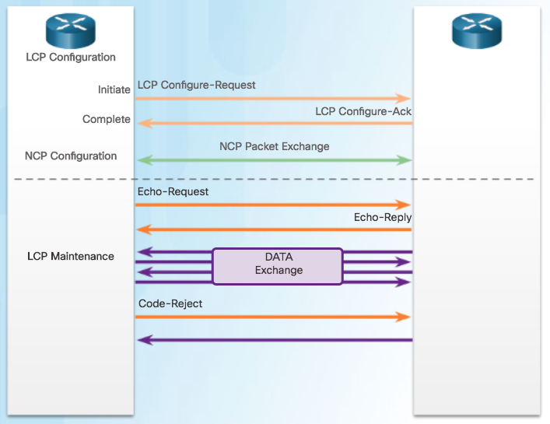
LCP OPERATION

Slide 61
LCP OPERATION
Link Termination
After the transfer of data at the network layer completes, the LCP terminates the link. NCP only terminates the network layer and NCP link. The link remains open until the LCP terminates it.
PPP can terminate the link at any time because of the loss of the carrier, authentication failure, link quality failure, the expiration of an idle-period timer, or the administrative closing of the link.
The LCP closes the link by exchanging Terminate packets.

Slide 62
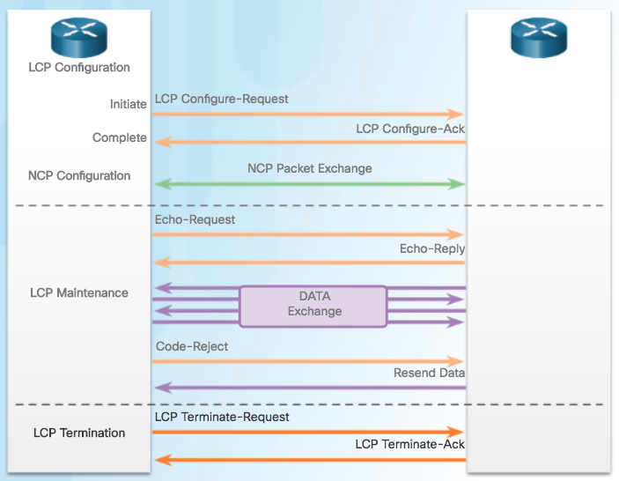
LCP OPERATION

Slide 63
PPP - NCP
PPP permits multiple network layer protocols to operate on the same communications link.
For every network layer protocol used, PPP uses a separate NCP, as shown in the figure. IPv4 uses IP Control Protocol and IPv6 uses IPv6 Control Protocol.
NCPs include functional fields containing standardized codes to indicate the network layer protocol that PPP encapsulates.
Value 8021 = IPCP
Value 8057 = IPv6CP

Slide 64
NCP Operation
After LCP has established the link, the routers exchange IPCP messages, negotiating options specific to IPv4. IPCP is responsible for configuring, enabling, and disabling the IPv4 modules on both ends of the link.
IPCP negotiates two options:
Compression - Allows devices to negotiate an algorithm to compress TCP and IP headers and save bandwidth.
IPv4-Address - Allows the initiating device to specify an IPv4 address to use for routing IP over the PPP link, or to request an IPv4 address for the responder.
After the NCP process is complete, the link goes into the open state and LCP takes over again in a link maintenance phase.

Slide 65
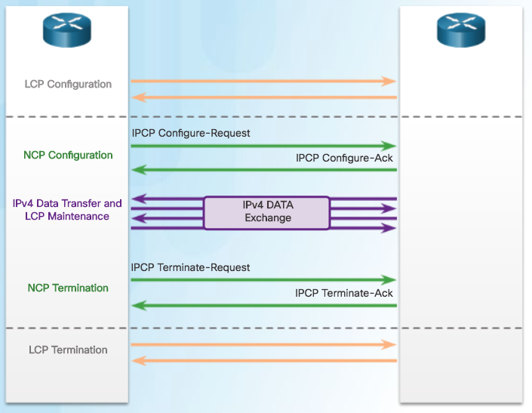
NCP Operation

Slide 66
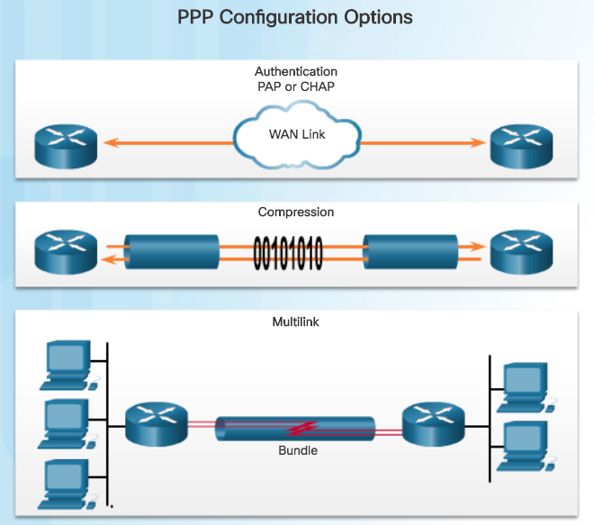
PPP OPTIONS
Notes:
Authentication using either PAP or CHAP : PAP is very basic two-way process with no encryption. CHAP is more secure. It involves a three-way exchange of a shared secret.
Compression using either Stacker or Predictor
Multilink that combines two or more channels to increase the WAN bandwidth

Slide 67
REFERENCES
CISCO NETWORKING ACADEMY SLIDES
www.netacad.com

Slide 68
THANKS

