Slide 1
Lecture 12: Regression Analysis

Slide 2
Correlation Analysis
The goal of correlation analysis is to understand the nature and strength of the linear association between the two numerical variables.
A first step in understanding the relationship between two variables through a scatter diagram.

Slide 3
Correlation Analysis
Population correlation coefficient, denoted ρ, measures the strength and direction of the linear relationship between X and Y (must be between
–1 and 1).
ρ > 0 (positive association) means that as the value of the predictor increases, the value of the response increases;
ρ < 0 (negative association) means that as the value of the predictor increases, the value of the response decreases;
ρ = 0 (zero association) indicates ONLY that there is NO LINEAR association between the predictor and the response.

Slide 4
Correlation Analysis
The sample correlation coefficient, denoted r, is computed as follows:
where 𝐶o𝑣 (X, Y) is the covariance of X and Y, and
Var (X) and Var (Y) are the sample variances of X and Y, respectively.

Slide 5
Example: Correlation Analysis
Correlation Between Body Mass Index and Systolic Blood
Pressure.
– In this analysis independent (or predictor) variable is body mass index and the dependent outcome variable is systolic blood pressure.
X = Body Mass Index | Y = Systolic Blood Pressure
18.4 | 120
20.1 | 110
22.4 | 120
25.9 | 135
26.5 | 140
28.9 | 115
30.1 | 150
32.9 | 165
33.0 | 160
34.7 | 180
200
180
160
140
120
100
80
15
20
25
30
35
40

Slide 6
Example: Correlation Analysis
We now compute the sample correlation coefficient, r, to quantify the degree of linear association between body mass index and systolic blood pressure.
Based on the sign and the magnitude of r, there is linear, positive association between body mass index and systolic blood pressure.

Slide 7
Statistical Inference Concerning
Population Correlation Coefficient
It is often of interest to draw inferences about the correlation between two variables in the population through a formal test of hypothesis.
Describe parameters and set up appropriate hypotheses:
Parameter: 𝝆 is the population correlation coefficient between variable X and variable Y
– 𝑯𝟎: 𝝆 = 𝟎 ( No Linear Association )
– 𝑯𝒂: 𝝆 =! 𝟎 (Linear Association )

Slide 8
Statistical Inference Concerning
Population Correlation Coefficient
The test statistic follows t distribution with df=n-2 degrees of freedom:
Standard error of r
r
t =
SE_{r}
with df = n -2
1−r ²
SE_{r} =
n - 2
– Decision rule is based on two-sided hypothesis:
Reject H0 if

Slide 9
Example
The issue at hand is whether there is a significant correlation between systolic blood pressure and body mass index
The test statistic follows t distribution with n-2 degrees of freedom:
Decision rule is based on two-sided hypothesis:
Reject H0 if p <0.05

Slide 10
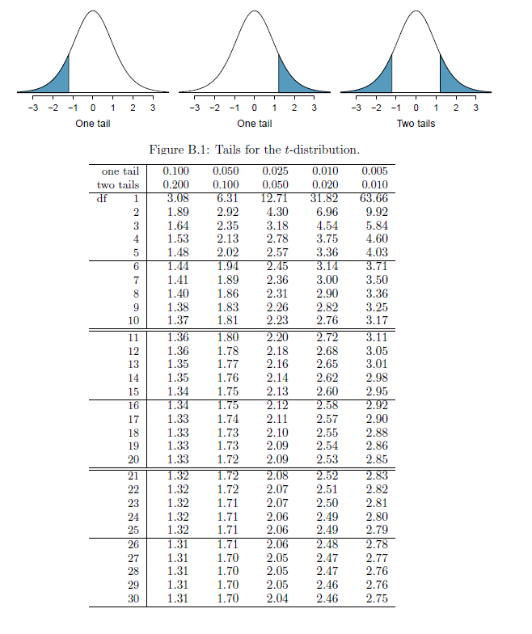

Slide 11
Example
Correlation Analysis of Number of Hours of Exercise on
Systolic Blood Pressure.
We wish to investigate the relationship between the number of hours of exercise per week and systolic blood pressure
# Hours Exercise per Week | Systolic Blood Pressure
4 | 120
10 | 110
2 | 120
3 | 135
3 | 140
5 | 115
1 | 150
2 | 165
200
180
160
140
120
100
80
0
2
4
6
8
10
12

Slide 12
In order to compute r, we must first compute the variances of X and Y as weal as the covariance between X and Y.

Slide 13
Example
Support your claim with an appropriate test of hypothesis
Describe parameters and set up appropriate
hypotheses:
◆ 𝑯𝟎: 𝝆 = 𝟎 ( No Linear Association )
◆ 𝑯𝒂: 𝝆 != 𝟎 (Linear Association )

Slide 14
Example
Support your claim with an appropriate test of hypothesis
The test statistic follows t distribution with n-2 degrees of freedom:
Decision rule is based on two-sided hypothesis:
Reject H0 if t < - 2 , 45 f or p-value <0.05
Decision: Reject H0

Slide 15
Regression Analysis

Slide 16
Linear Regression Analysis
In regression, we are trying to predict a response variable Y using an explanatory variable X.
Specifically, we try to develop the mathematical equation that describes the relationship between two variables, X and Y.
In correlation analysis, it is actually not necessary to specify which of the two variables is independent and which is the dependent variable.
In contrast, with regression analysis the independent and dependent variables must be specified.

Slide 17
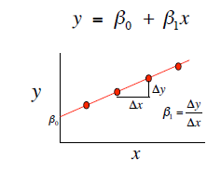
Linear Regression
studying variables that are related to one another
What is slope?
A slope of 2 means that every 1-unit change in X yields a 2-unit change in Y.

Slide 18
Linear Regression Analysis
linear regression models used for either testing a hypothesis regarding the relationship between one or more explanatory variables and a response variable, or predicting unknown values of the response variable using one or more predictors.
We use X to denote explanatory variables and Y to denote response variables.
The variables need to be numerical.

Slide 19
The linear relationship
The linear relationship between Y and X in the entire population can be presented in a similar form,
Y = β₀ +β₁X +ε,
Where β₀ is the intercept, and β₁ is the slope of the regression line, ε is called the error term, representing the difference between the estimated and the actual values of Y in the population.
We refer to the above equation as the linear regression model. We refer to β₀ and β₁ as the regression parameters. More specifically, β₁ is called the regression coefficient for the explanatory variable. The process of finding the regression parameters is called fitting a regression model to the data.

Slide 20
Simple Linear Regression Analysis
In regression analysis we address the following issues:
What mathematical equation best describes the relationship between X and Y (e.g., a line or a curve of some form)?
How do we estimate the equation that describes the relationship between X and Y?
Is the form specified in (1) appropriate?

Slide 21
Linear Regression Analysis

Slide 22
Linear Regression Analysis

Slide 23
Example: Regression Analysis of Body Mass Index on
Systolic Blood Pressure

Slide 24
The Y-intercept is 40.98, which is the expected systolic blood pressure (Y) when body mass index (X) is zero
In this example, the Y-intercept is not meaningful since it is not possible to observe a body mass index equal to zero.
However, the estimated slope, p1 = 3.61, indicates that a 1-unit increase in body mass index (X) is associated with
an expected increase of 3.61 units in systolic blood pressure (Y).
For example, if we compare two males 50 years of age, the first with a body mass index 10 units
higher than the second, we would expect the first subject's systolic blood pressure to be 10(3.61) = 36.1 units higher than the second subject's.

Slide 25
We can also use the equation to generate an estimate of systolic blood pressure (Y) for a person with a specific body mass index (X).
For example, suppose we wish to estimate the systolic blood pressure of a male aged 50 whose body mass index is 20. Using the simple linear regression equation:
Y=40.98+3.61X=40.98+3.61(20) =113.18
Interpretation: It is the expected systolic blood pressure of a male age 50 whose body mass index is 20. It is also the expected (average) systolic blood pressure for all males age 50 with body mass index of 20.

Slide 26
The standard error of Y given X is the average variability around the regression line at any given value of X. It is assumed to be equal at all values of X.
S_{y/x}
S_{y/x}
S_{y/x}
S_{y/x}
S_{y/x}
S_{y/x}

Slide 27
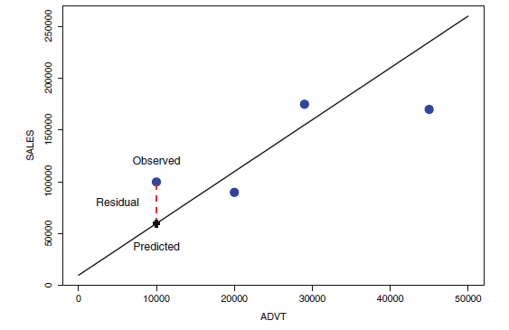
Actual data referred as the observed data point. Also, if we consider the projection of the observed data onto the line as the predicted values.
The difference between observed and predicted points is referred to as the residual.

Slide 28
R2 - Coefficient of Determination for
Linear Regression Model
The coefficient of determination denoted R2, "R- squared," is the ratio of the regression (or Model) sums of squares to the total sums of squares (from the ANOVA table).
Note: for a simple linear regression 𝑅²
Higher values of R² imply that more variation in the dependent variable is "explained" by the independent variable(s).
– For example, about 73% of the variation in systolic blood pressures is explained by body mass index.

Slide 29
Estimating the Standard Deviation for a
Linear Regression Model
Let n be a sample size (the number of subject in the study), then the formula for estimating the standard deviation for a simple linear regression model is
Where represents residual, or estimated individual prediction error between observation and prediction for subject i.

Slide 30
Example

Slide 31
Multiple Linear Regression
More than one predictor…
Y = β₀ + β₁*X + β₂ *W + β₃ *Z…
e.g: Expression = Baseline + Age + Tissue + Sex + Error
In multiple regression analysis, we consider applications involving a single continuous dependent variable, Y, and multiple independent variables,

Slide 32
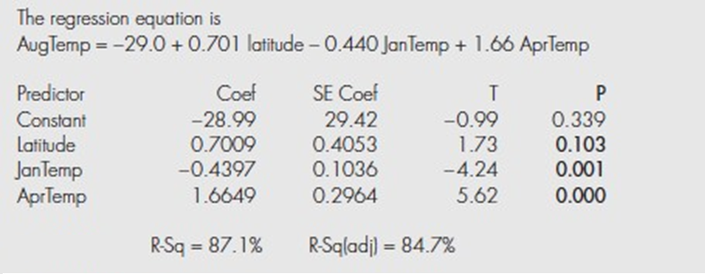
Example: Inference for the August Temperature Model
output for the multiple linear regression models in which Y= August temperature and the three X variables are geographic latitude, January temperature, and April temperature.

