Slide 1
Lecture 7: Estimation and Statistical Inference

Slide 2
Descriptive vs. Inferential Statistics
Descriptive: e.g., Median; describes data you have but can't be generalized beyond that
Inferential: e.g., t-test, that enable inferences about the population beyond our data

Slide 3
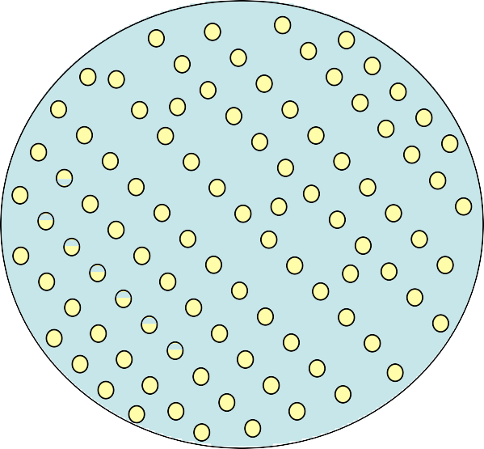
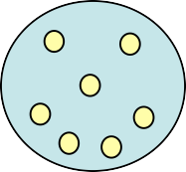
“Central Dogma” of Statistics
Probability
Population
Descriptive Statistics
Sample
Inferential Statistics

Slide 4
Hypothesis
In general, many scientific investigations start by expressing a hypothesis.
For example, Mackowiak et al (1992) hypothesized that the average normal (i.e., for healthy people) body temperature is less than the widely accepted value of 98.6 F .
If we denote the population mean of normal body temperature as µ, then we can express this hypothesis as µ < 98.6.

Slide 5
Null and alternative hypotheses
The null hypothesis usually reflects the “status quo” or “nothing of interest”.
In contrast, we refer to our hypothesis (i.e., the hypothesis we are investigating through a scientific study) as the alternative hypothesis and denote it as H_{A}.
For hypothesis testing, we focus on the null hypothesis since it tends to be simpler.

Slide 6
The Null and Alternative Hypothesis
The null hypothesis, H₀:
States the assumption (numerical) to be tested
Begin with the assumption that the null hypothesis is TRUE
Always contains the ‘=’ sign
The alternative hypothesis, H_{a}:
Is the opposite of the null hypothesis
Challenges the status quo
Never contains just the ‘=’ sign
Is generally the hypothesis that is believed to be true by the researcher

Slide 7
Null and alternative hypotheses
Consider the body temperature example, where we want to examine the null hypothesis H₀ : µ = 98.6 against the alternative hypothesis H_{A} : µ < 98.6.
To start, suppose that σ² = 1 is known.
Further, suppose that we have randomly selected a sample of 25 healthy people from the population and measured their body temperature.

Slide 8
Hypothesis testing for the population mean
To evaluate hypotheses regarding the population mean, we use the sample mean X¯ as the test statistic.
X¯ ∼ N(µ, σ²/n)
For the above example,
X¯ ∼ N(µ, 1/25)
If the null hypothesis is true, then
X¯ ∼ N(98.6, 1/25)

Slide 9
Hypothesis testing for the population mean
In reality, we have one value, x¯, for the sample mean.
We can use this value to quantify the evidence of departure from the null hypothesis.
Suppose that from our sample of 25 people we find that the sample mean is x¯ = 98.4.

Slide 10
Hypothesis testing for the population mean
To evaluate the null hypothesis H₀ : µ = 98.6 versus the alternative H_{A} : µ < 98.6, we use the lower tail probability of this value from the null distribution.
2.0
1.5
Density
1.0
0.5
^{p}obs x
98.0 98.5 99.0
X
0.0

Slide 11
Observed significance level
The observed significance level for a test is the probability of values as or more extreme than the observed value, based on the null distribution in the direction supporting the alternative hypothesis.
This probability is also called the p-value and denoted p_{obs}.
For the above example,
p_{obs} = P (X¯ ≤ x¯ | H₀ )

Slide 12
p-value
A P-value is the probability of getting the data, or something as or more unusual, if the null hypothesis were true.
When the p-value is small, say 0.05 for example, it is rare to find values as extreme as what we have observed.
As the p-value increases, it indicates that there is a good chance to find more extreme values (for the test statistic) than what has been observed.
Then, we would be more reluctant to reject the null hypothesis.
A common mistake is to regard the p-value as the probability of null given the observed test statistic: P(H₀|x¯).

Slide 13
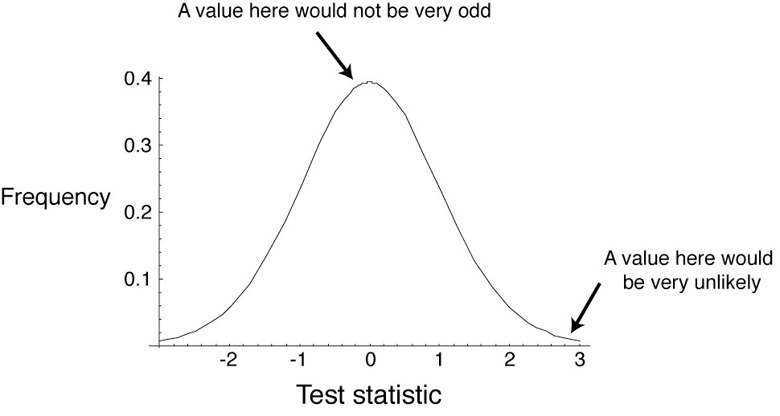
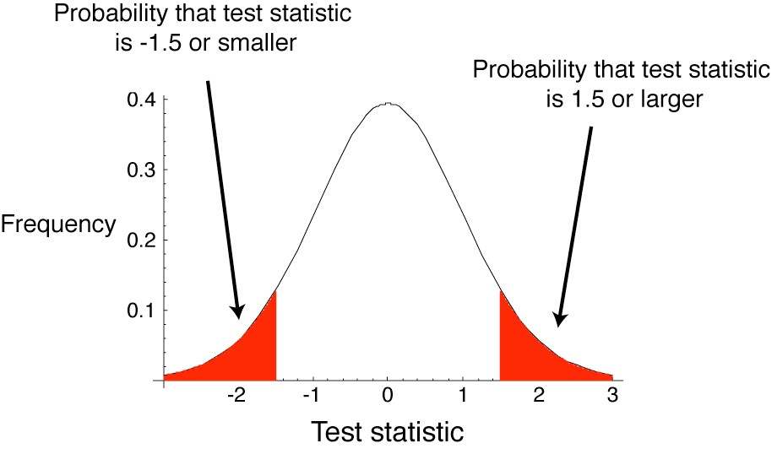
A null hypothesis is specific; an alternate hypothesis is not.
P-value
A test statistic summarizes the match between the data and the null hypothesis

Slide 14
Interpretation of p-value
Calculate a test statistic in the sample data that is relevant to the hypothesis being tested
After calculating a test statistic we convert this to a P- value by comparing its value to distribution of test statistic’s under the null hypothesis
Measure of how likely the test statistic value is under the null hypothesis
P-value ≤ α ⇒ Reject H₀ at level α
P-value > α ⇒ Do not reject H₀ at level α

Slide 15
z-score
In practice, it is more common to use the standardized version of the sample mean as our test statistic.
We know that if a random variable is normally distributed (as it is the case for X¯ ), subtracting the mean and dividing by standard deviation creates a new random variable with standard normal distribution,
Z ∼ N(0, 1).
We refer to the standardized value of the observed test statistic as the z -score,
x¯ − µ₀
z =
σ/ n
√ ,
98.4 − 98.6
0.2
=
= −1.

Slide 16
z-test
We refer to the corresponding hypothesis test of the population mean as the z -test.
In a z -test, instead of comparing the observed sample mean x¯ to the population mean according to the null hypothesis, we compare the z -score to 0.
2.0
0.4
1.5
0.3
Density
1.0
Density
0.2
0.5
0.1
^{p}obs x
98.0 98.5 99.0
X
^{p}obs z
−4 −2 0 2 4
Z
0.0
0.0

Slide 17
One-sided vs. two-sided hypothesis testing
Hypothesis tests can be one or two sided (tailed)
One tailed tests are directional:
H₀: μ₁ - μ₂ ≤ 0
H_{A}: μ₁ - μ₂ > 0
Two tailed tests are not directional:
H₀: μ₁ - μ₂ = 0
H_{A}: μ₁ - μ₂ ≠ 0

Slide 18
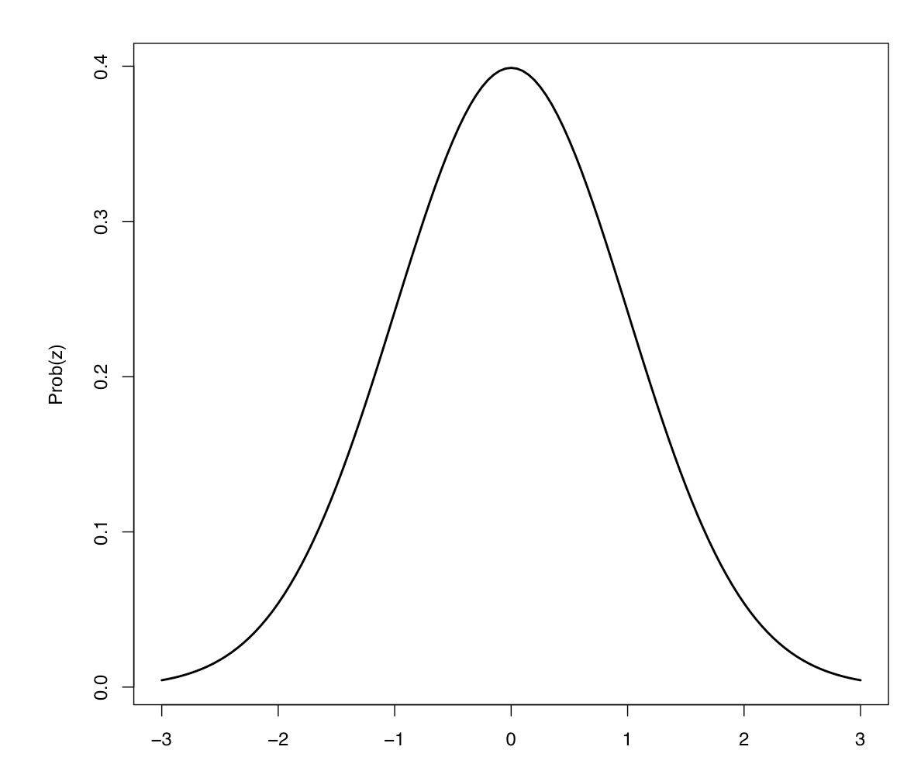
When To Reject H₀
Level of significance, α: Specified before an experiment to define rejection region
Rejection region: set of all test statistic values for which H₀ will be rejected
One Sided
α = 0.05
Two Sided
α = 0.05
Critical Value = -1.64
Critical Values = -1.96 and +1.96

Slide 19
One-sided vs. two-sided hypothesis testing
The alternative hypothesis H_{A} : µ < 98.6 or H_{A} : µ > 98.6 are called one-sided alternatives.
For these hypotheses, p_{obs} = P(Z ≤ z ) and p_{obs} = P(Z ≥ z ) respectively.
In contrast, the alternative hypothesis H_{A} : µ != 98.6 is
two-sided.
For the above three alternatives, the null hypothesis is the same, H₀ : µ = 98.6
In this case, p_{obs} = 2 × P(Z ≥ |z|).

Slide 20
Hypothesis testing using t-tests
So far, we have assumed that the population variance σ² is known.
In reality, σ² is almost always unknown, and we need to estimate it from the data.
As before, we estimate σ² using the sample variance S².
Similar to our approach for finding confidence intervals, we account for this additional source of uncertainty by using the t-distribution with n − 1 degrees of freedom instead of the standard normal distribution.
The hypothesis testing procedure is then called the t-test.

Slide 21
Hypothesis testing using t-tests
Using the observed values of X¯ and S, the observed value of the test statistic is obtained as follows:
x¯ − µ₀
s/ n
t = √ .
We refer to t as the t-score.
Then,
if H_{A} : µ < µ₀, p_{obs} = P(T ≤ t),
if H_{A} : µ > µ₀, p_{obs} = P(T ≥ t),
if H_{A} : µ != µ₀, p_{obs} = 2 × P(T ≥ |t| ) ,
Here, T has a t-distribution with n − 1 degrees of freedom, and t is our observed t-score.

Slide 22
t-test
The assumption that the sampling distribution will be normally distributed holds for large samples but not for small samples
Sample size is large, use z-test
t-test is used when sample size is small
Statistical concept of t-distribution

Slide 23
t-distribution
Sampling distribution based on small samples will be symmetrical (bell shaped) but not necessarily normal
Spread of these symmetrical distributions is determined by the specific sample size. The smaller the sample size, the wider the spread, and hence the bigger the standard error
These symmetrical distributions are known as
student’s t-distribution or simply, t-distribution
The t-distribution approaches the normal distribution when sample size tends to infinity

Slide 24
If sample data is normally distributed, t is almost normally distributed, but not quite because of the presence of $\overline{σ}$.

Slide 25
Hypothesis testing:
an example
Does a red shirt help win wrestling?
The experiment and the results
Stating the hypotheses
H₀: Red- and blue-shirted athletes are equally likely to win (proportion = 0.5).
Does red influence the outcome of wrestling, taekwondo, and boxing?
16 of 20 rounds had more red-shirted than blue- shirted winners in these sports in the 2004 Olympics
Shirt color was randomly assigned
H_{A}: Red- and blue-shirted athletes are not equally likely to win (proportion ! 0.5).

Slide 26
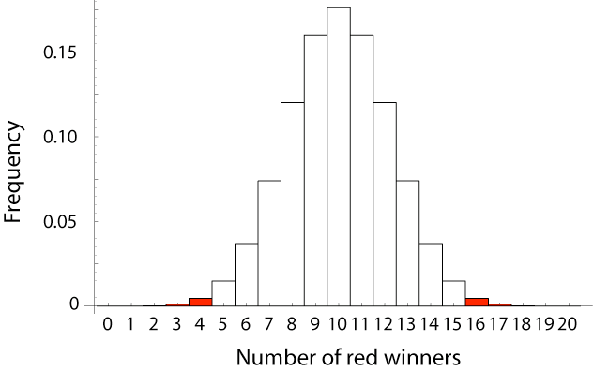
Estimating the value
Is this discrepancy by chance alone?:
16 of 20 is a proportion of proportion = 0.8
Estimating the probability of such an extreme result
This is a discrepancy of 0.3 from the proportion proposed by the null
hypothesis, proportion = 0.5
The null distribution for a test statistic is the probability distribution of alternative outcomes when a random sample is
taken from a population corresponding to the null expectation.
The null distribution of the
sample proportion

Slide 27
Calculating the P-value from the null distribution
The P-value is calculated as
P = 2 ∗ [Pr(16) + Pr(17) + Pr(18) + Pr(19) + Pr(20)] = 0.012.
Significance for the red shirt example
• P = 0.012
P < p, so we can reject the null hypothesis
Athletes in red shirts were more likely to win.

Slide 28
Larger samples give more information
A larger sample will tend to give and estimate with a smaller confidence interval
Hypothesis testing: another example
Do dogs resemble their owners?
A larger sample will give more power to reject a false null hypothesis
Common wisdom holds that dogs resemble their owners. Is this true?
Hypotheses
41 dog owners approached in parks; photos taken of dog and owner separately
H₀: The proportion of correct matches is
proportion = 0.5.
H_{A}: The proportion of correct matches is different from proportion = 0.5.
Photo of owner and dog, along with another photo of dog, shown to students to match
Roy, M.M., & Christenfeld, N.J.S. (2004). Do dogs resemble their owners? Psychological Science, 15, 361–363

Slide 29
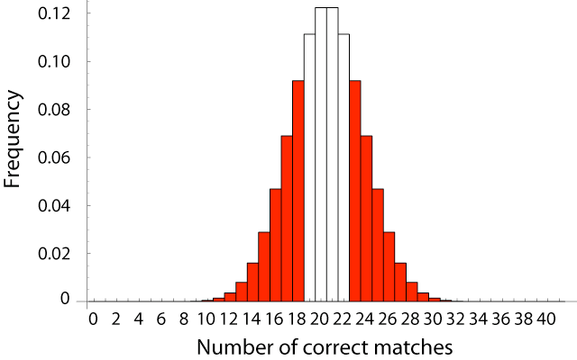
Data
Estimating the proportion
Of 41 matches, 23 were correct and 18 were incorrect.
23
sample proportion =
= 0.56
41
Null distribution for dog/owner resemblance
The P-value:
P =0.53.
We do not reject the null hypothesis that dogs do not resemble their owners.

Slide 30
Errors in Hypothesis Testing
Actual Situation “Truth”
Decision
Do Not Reject H₀
H₀ True
H₀ False
Correct Decision 1 - α | Incorrect Decision Type II Error β
Incorrect Decision Type I Error α | Correct Decision 1 - β
Reject H₀

