Slide 1
Back to the Future
Scientific and technological progress from an historical perspective

Slide 2
Back to the future
The modern advencements in science in technology are based on historical achievements.
There is a very wide array of scientific developments: biology, chemistry, physics, etc.
We will focus on applied mathematics.
Why? Because why not!

Slide 3
Carl Friedrich Gauss (1777-1855)
German scientist, one of the most important mathematicians who has ever lived.
Founder of the least squares technique which is the basis of modern econometrics.

Slide 4
Ceres (Antique Rome)
The Goddess of Soil and Fertility: A dwarf planet
in the Solar system is named after her.

Slide 5
Ceres (Dwarf Planet)

Slide 6
Giuseppe Piazzi (1746 –1826)
Observed the position of Ceres in the
sky for 19 times in 42 days in 1801. However, Ceres
hides herself behind the glares of the sun.
Piazzi, who presents his data to the scientific
community of the time, asks how to locate
the position of Ceres in order to find where it is.
Among all the suggestions put forward, only that
of 24 years old Gauss works.

Slide 7
Curve Fitting
Even though the problem
Gauss solved was more
Complicated, the essence
of the problem that concerns
us is summarized in the figure.
Remark: Gauss used only 3
Observations out of 19.
Remark: His computations
lead him to discover the
normal distribution.
Remark: Form there, «Central
Limit Theorem» is proved by
Laplace.

Slide 8
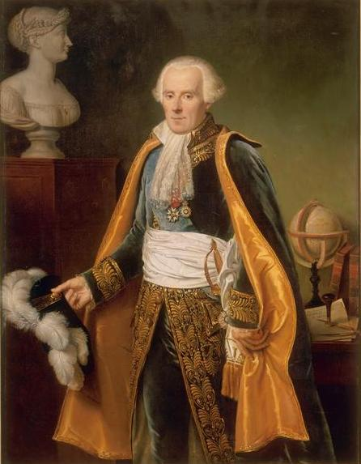
Pierre-Simon Laplace (1749-1827)
Arguably, the most influential French
Mathematician of all times.

Slide 9
Least Squares:
Observe $Y_{t}$ and $X_{t}$. If
${\hat{Y}}_{t}={aX}_{t}+b$
can predict $Y_{t}$ then
$$\min{\sum_{t}{{\left(Y_{t}−{\hat{Y}}_{t}\right)}^{2}}}$$
by choosing $a$and $b$.
In order to solve this problem, we need calculus.

Slide 10
Laplace’s Stability
Laplace demistified how celestial objects rotate around the Sun with an ever-lasting harmony. His approach was to use calculus.

Slide 11
Where does calculus come from?
G. W. Leibniz is the first person to publish a systematic analysis of
calculus. But, most probably, he is not the firt person to discover calculus.

Slide 12
Where does calculus come from?
Sir Isaac Newton (1643 – 1727)
Actually, Sir Isaac Newton invented calculus but did not publish his work. Upon
Seeing the work of Leibniz, he accused him of stealing his ideas. Probably, Leibniz
did not steal his ideas but it is almost sure that Newton was the first to invent
Calculus.

Slide 13
Observatories (Rasathane)
History clearly shows that observing the universe in observatories made tremendous
contributions to the progress human kind. All technoogical devices that we use
today work according to the principles of calculus.

Slide 14
What about Ottoman Empire?
The largest observatory of the time
was built in Istanbul, by Takiyüddin,
an astonomer.
The observatory made very important
and precise calculations from 1575 until
1580.
The observatory was demolished by an
order from the emperor, III. Murat. It was
argued that the observatory brought
bad luck.
No observatory until the end of
the 19th century.

Slide 15
Any economic results?

Slide 16
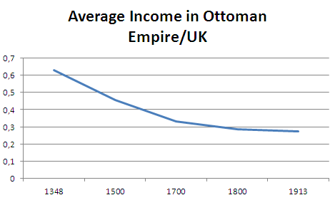
Relatively?

Slide 17
And the Republican Era…

Slide 18
Summary:
Britain improved its position relative to the Ottoman Empire until the end of the 18th centruy.
Then Turkey took-off and started catch-up…
But still Britain is richer.

Slide 19
But this relation is very standard
Britain started grow
faster than all other
countries starting from
the end of the 13th
century.
By the 17th -18th centruy,
Britain took-off leaving
everyone else behind.
Why? Now we will answer
this question.

Slide 20
Why Britain?
Why was Britain so successful with respect to other countries?
A possible answer is: «Industrial Revolution started in Britain».
But we can ask again: Why Britain?
Allen (2011) «Why the industrial revolution was British: commerce, induced invention, and the scientific revolution» Economic History Review

Slide 21
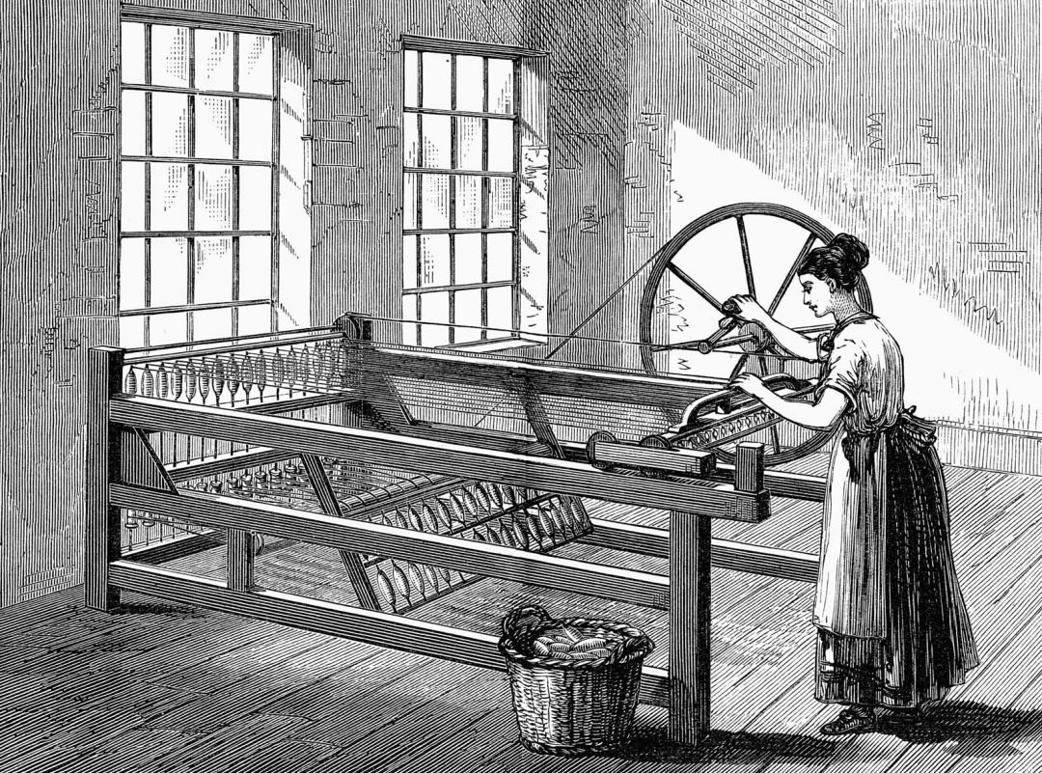
Industrial Revolution
First, what does «Industrial revolution started in Britain» mean?
Spinning jenny: Invented in 1764 by James Hargreaves

Slide 22
Industrial Revolution
The steam engine by Thomas Newcomen, 1712

Slide 23
Industrial Revolution
Coke smelting invented by Abraham Darby in 1708

Slide 24
Why were these invented in Britain?
Recent research has emphasized non-economic factors like the British constitution. or British culture.
But there is a purely economic explanation:
British wages were exceptionally high compared to wages in other parts of Europe and in Asia, while the prices of capital and energy were exceptionally low prior to the Industrial Revolution.

Slide 25
Relevance of High Wages
High wages motivated process innovation: labor saving technology.
The high real wage also stimulated product innovation since it meant that Britain had a broader mass market for ‘luxury’ consumer goods including imports from east Asia.
It also meant that the population at large was better placed to buy education and training than their counterparts elsewhere in the world. The resulting high rates of literacy and numeracy contributed to invention and innovation.

Slide 26
What does «high wage» mean?
Britain was a high-wage economy in four senses. 1) Firstly, British wages were higher than those of its competitors. 2) Secondly, workers’ living standards were higher than elsewhere. 3) Thirdly, British wages were high relative to capital prices. 4) Fourthly, wages in Britain were exceptionally high relative to energy prices.

Slide 27
Relative to other countries

Slide 28
Relative to Subsistance

Slide 29
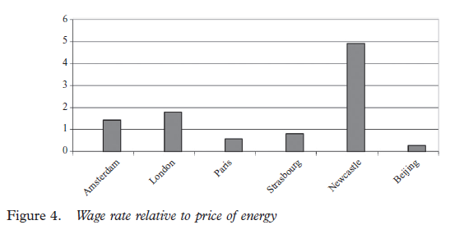
Relative to energy prices

Slide 30
Why were wages high, anyway?
Logically, the next question, therefore, is to explain what determined the wages and prices.
Britain’s unusual wages and prices were due to two factors.
The first was Britain’s success in the global economy, which was in part the result of state policy.
The second was geographical—Britain had vast and readily worked coal deposits.

Slide 31
First One
The superior real wage performance of north-western Europe was due to a boom in international trade. The English boom began with the export of ‘new draperies’ in the late sixteenth century. These were light woolen cloths made in East Anglia and exported to the Mediterranean through London.

Slide 32
Second One
Coal deposits were a second factor contributing to England’s unusual wage and price structure.
First, coal was not just abundant in Britain—it was cheap, at least in northern and western Britain on or near the coalfields.

Slide 33
Biased Technical Change

