Slide 1
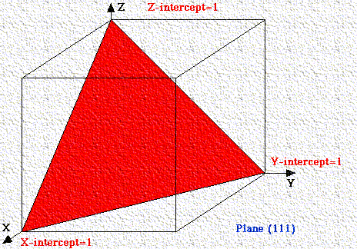
Miller Indices
William Hallowes Miller in 1839 was able to give each face a unique label of three small integers, the Miller Indices
Definition: Miller Indices are the reciprocals of the fractional intercepts (with fractions cleared) which the plane makes with the crystallographic x, y, z axes of the three nonparallel edges of the cubic unit cell.
Miller indices are used to specify directions and planes.
These directions and planes could be in lattices or in crystals.
The number of indices will match with the dimension of the lattice or the crystal.

Slide 2
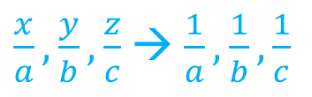
Miller Indices are a symbolic vector representation for the orientation of an atomic plane in a crystal lattice and are defined as the reciprocals of the fractional intercepts which the plane makes with the crystallographic axes.
To determine Miller indices of a plane, we use the following steps:
1) Determine the intercepts of the plane along each of the three crystallographic directions,
a, b, c intercept points for x, y, z cubic system
2) Take the reciprocals of the intercepts, (use 1,1,1 for unit cell)
3) If fractions result, multiply each by the denominator of the smallest fraction.
$\frac{x}{a}, \frac{y}{b}, \frac{z}{c}$ → $\frac{1}{a}, \frac{1}{b}, \frac{1}{c}$

Slide 3
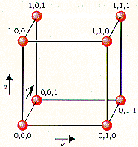
General Rules for Lattice Directions, Planes & Miller Indices
Miller indices used to express lattice planes and directions
x, y, z are the axes (on arbitrarily positioned origin)
a, b, c are lattice parameters (length of unit cell along a side )
h, k, l are the Miller indices for planes and directions - expressed as planes: (hkl) and directions: [hkl]
If a plane is parallel to an axis , we say it cuts at ∞ and 1/ ∞ =0
Round brackets ( ) describe a single plane
Curly brackets { } to describe a family of planes
< > represents a family of directions
[ ] → direction
( ) → plane
{ } → plane family
< > → direction family

Slide 4
[] direction

Slide 5
() plane

Slide 6
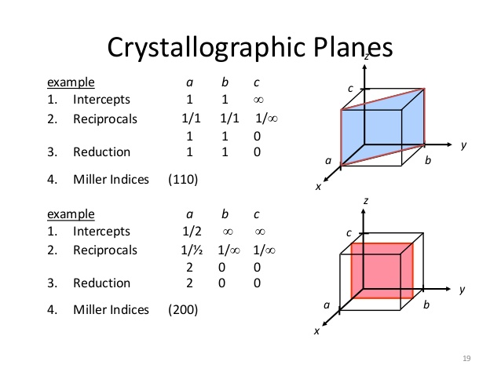

Slide 7
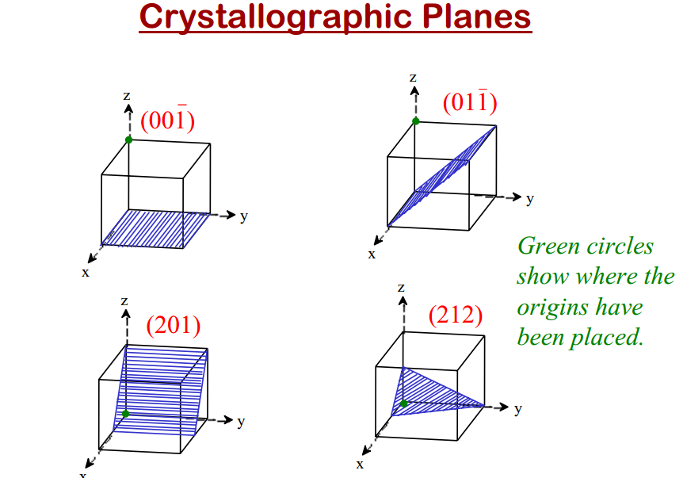

Slide 8
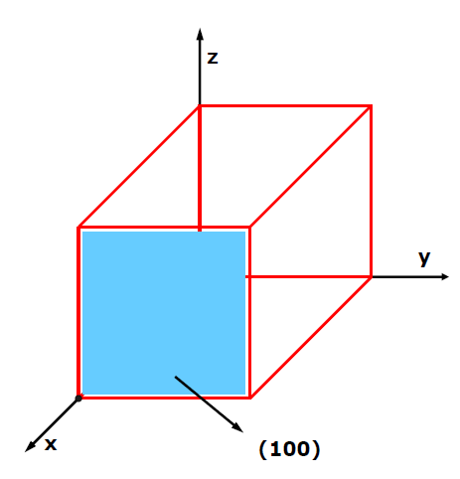
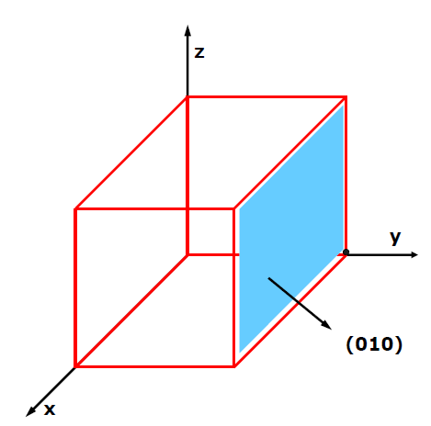
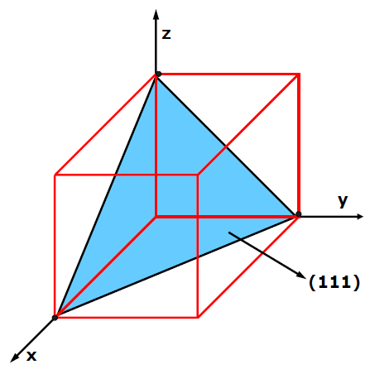
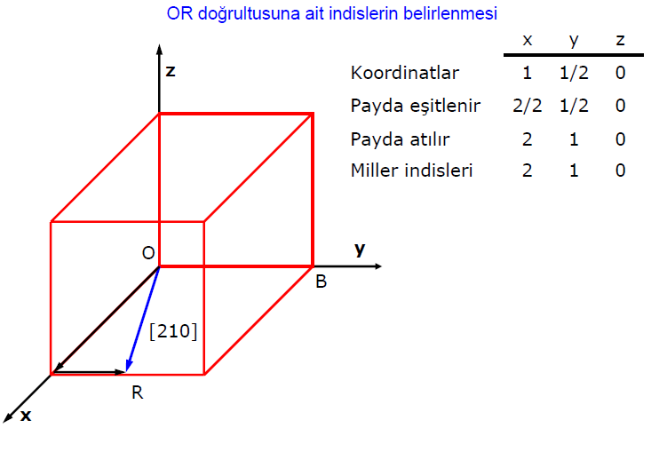
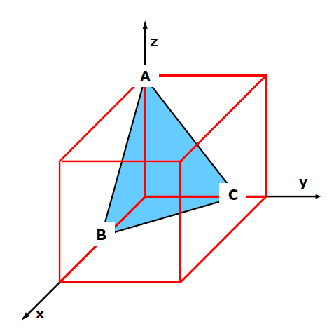
(212)

Slide 9
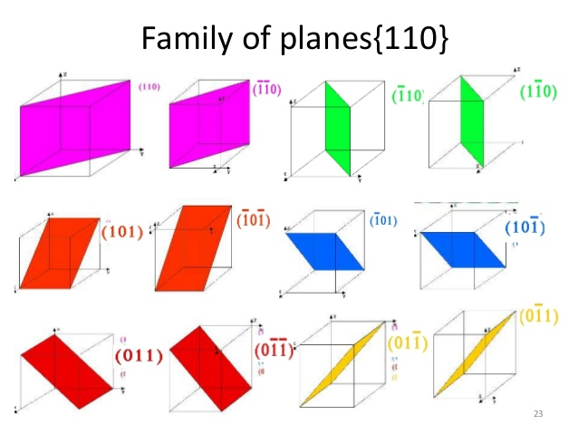

Slide 10
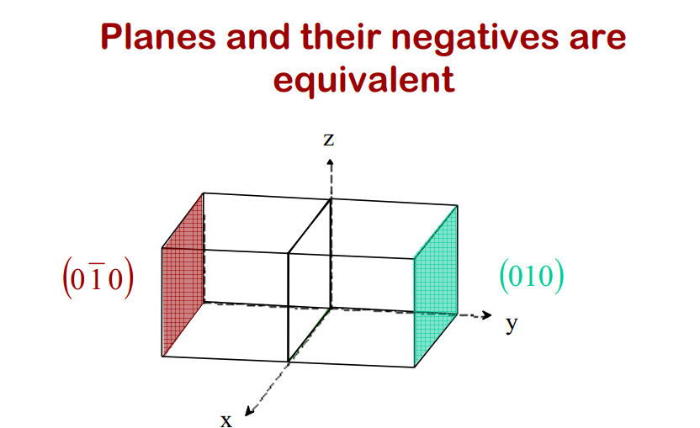

Slide 11
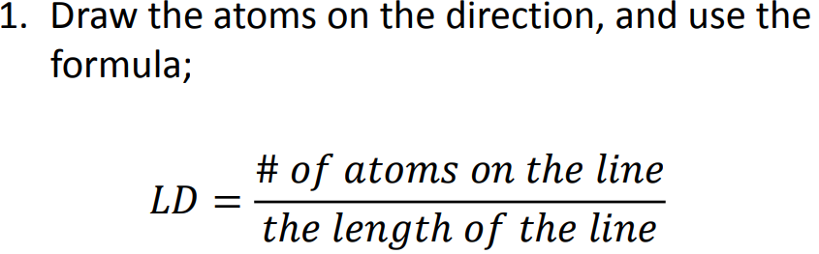
Density
Linear Density (LD)
Draw the atoms on the direction and use the formula:

Slide 12
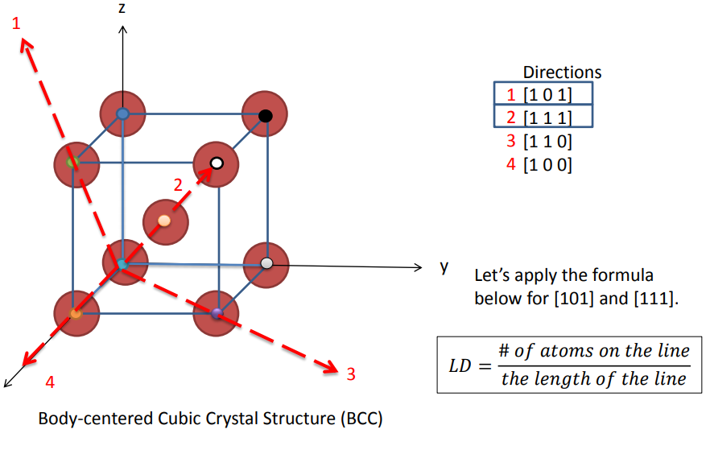

Slide 13
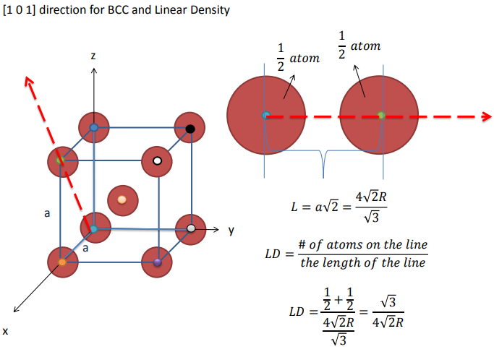

Slide 14
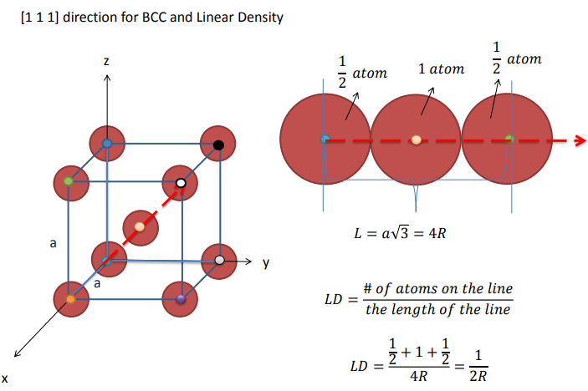

Slide 15
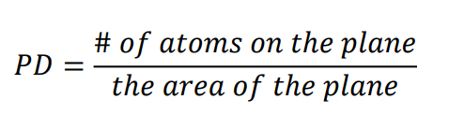
Planar Density (PD)
Draw the atoms on the direction and use the formula:

Slide 16
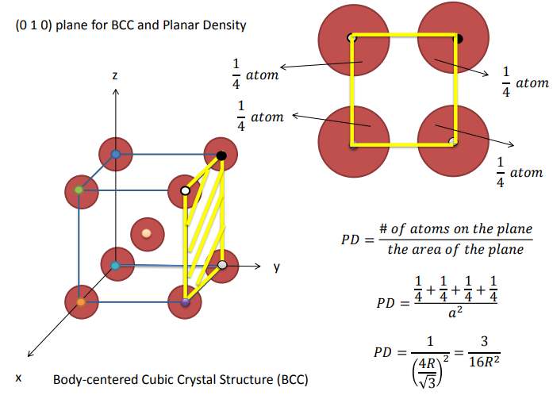

Slide 17
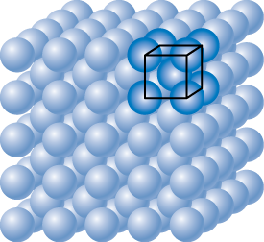
Eg: Planar Density of (100) Iron
Solution: At T < 912ºC iron has the BCC structure.
2D repeat unit
(100)
4
3
a
=
R
3
Radius of iron R = 0.1241 nm
atoms
2D repeat unit
1
1
atoms
atoms
Planar Density =
=
2
=
12.1
= 1.2 x 10¹⁹
a
2
4
3
nm²
m²
area
R
2D repeat unit
3

Slide 18
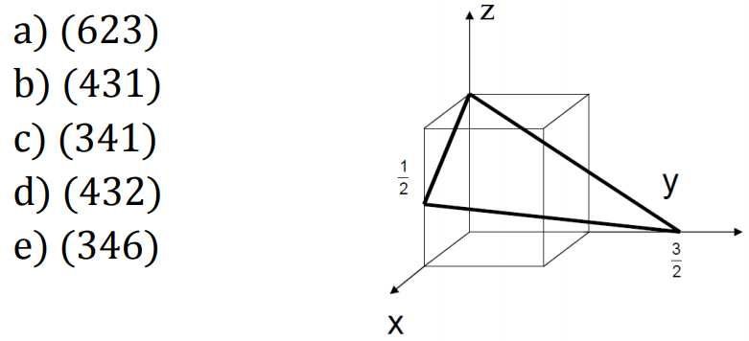
EXERCISES
1) Determine the Miller indices of the plane in the figure below.
(346)

Slide 19
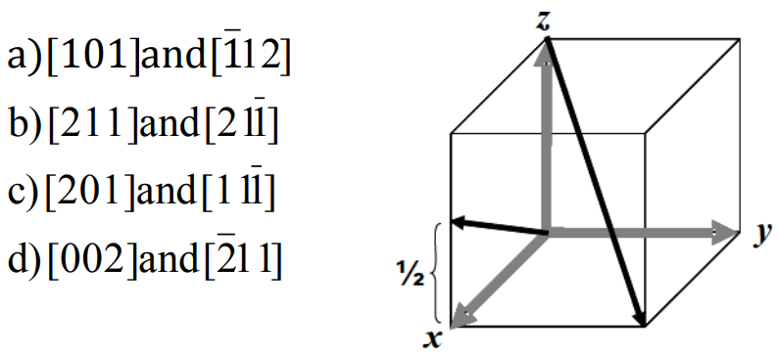
2) Determine the Miller indices of the two directions shown in the figure below:
c)[201] and [111]
Notes:
For the first direction, use (0,0,0) as the point of origin: x=1, y=0, z= ½. Clear the fractions to get [201]
For the second direction, use (0,0,1) as the point of origin: x= 1, y=1, z=-1 or [111]
So the answer is c)

Slide 20
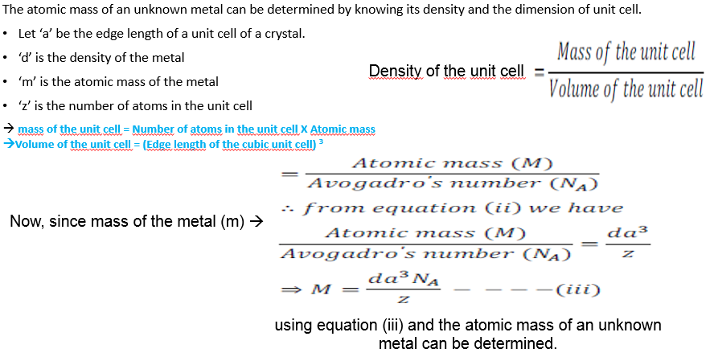
3)How many directions belong to the <100> family?
a) 2 b) 4 c) 6 d) 12
4) What type of defect can arise when a solid is heated? Which physical property is affected by it and in what way?
5) How can you determine the atomic mass of an unknown metal if you know its density and the dimension of its unit cell?
three principal axes [100], [010], [001] and reverse (negative) directions → total 6
When a solid is heated a vacancy defect may arise. Because of vacancy defect the density of the solid
decreases because of leaving of some of the constituent particles.

Slide 21
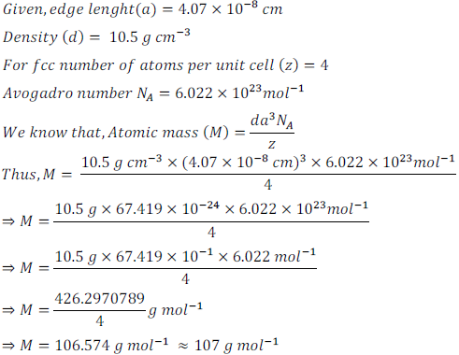
6) Silver crystallizes in FCC lattice. If edge length of the cell is 4.07 x 10^{– 8} cm and density is 10.5 g cm^{– 3}. Calculate the atomic mass of silver.

Slide 22
7) Weight of an Aluminium is 26.98 g and density is 2.7 g/cm³. Calculate the weight of
an Aluminium atom.
Avogadro’s number = N_{A} = 6.02× 10²³ mol⁻¹
On 6.02× 10²³ mol⁻¹ 26.98 g
If 1 x=?
x= 4.48 × 10 ⁻²³ gmol

Slide 23
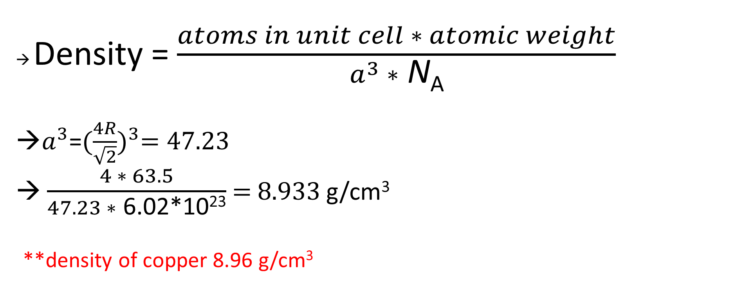
8) Copper has; an atomic radius of 1.278 Å, FCC structure and an atomic weight of 63.5 g/mol. Compute its theoretical density and compare the answer with its measured density.
→ Density = $\frac{atoms in unit cell ∗ atomic weight}{a^{3} ∗ \text{N}\text{A}}$
→$a^{3}$=${(\frac{4R}{\sqrt{2}})}^{3}=47.23$
→ $\frac{4 ∗ 63.5}{47.23 ∗ \text{6.02}\text{∗}\text{10}\text{23}}$ = 8.933 g/cm³
**density of copper 8.96 g/cm³

Slide 24
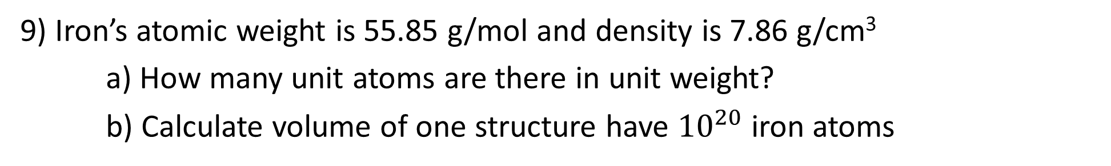

9) Iron’s atomic weight is 55.85 g/mol and density is 7.86 g/cm³
a) How many unit atoms are there in unit weight?
b) Calculate volume of one structure have ${10}^{20}$ iron atoms
a) 6.02× 10²³ atoms 55.85 g
x 1 g
X= 1.07 × 10²² atoms
b) Density = $\frac{atoms in unit cell ∗ atomic weight}{unit cell volume ∗ \text{N}\text{A}}$
7.86= $\frac{{10}^{20} ∗ 55.85}{v ∗ {6.02 ∗10}^{23}} →v=1.18∗{10}^{−3 }$cm³

Slide 25
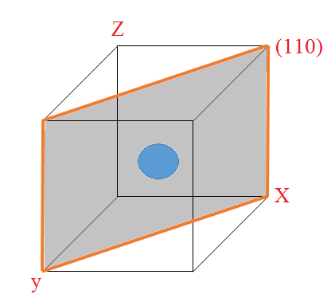
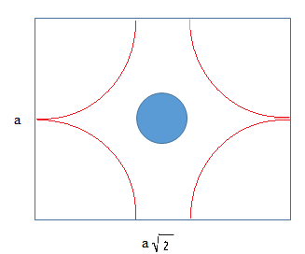
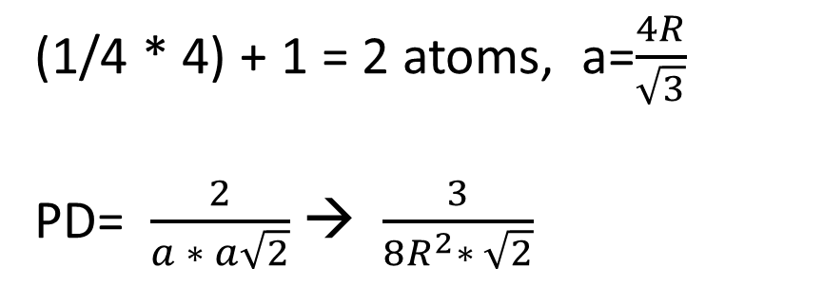
10) On BCC structure, calculate planar density for (110) plane.
(1/4 * 4) + 1 = 2 atoms, a=$\frac{4R}{\sqrt{3}}$
PD= $\frac{2}{a ∗ a\sqrt{2}}$ → $\frac{3}{8R^{2}∗ \sqrt{2}}$

