Slide 1
Nucleation

Slide 2
Nucleation may be defined as the formation of a new phase in a distinct region separated from the surroundings by a discrete boundary. The existence of a driving force, namely a decrease in the free energy is favourable. This driving force is a necessary but not sufficient requirement.
Thermodynamic Aspects
$$G=H−TS$$
$$∆G=∆H−T∆S$$
$∆G=0$ at equilibrium between two phases

Slide 5
ΔGv
Solid
Liquid
T_{m}
Below T_{m} the solid has a lower energy. This term is proportional to the change of ΔG per volume.

Slide 6
$∆G_{V}=G_{L }−G_{S}$
$∆G_{V}=\left(H_{L}−H_{S}\right)−T(S_{L}−S_{S})$
$H_{L}−H_{S}=L_{M}$ (Latent heat of melting (fusion))
$∆G=∆H−T∆S$
At T_{M} $∆G_{V}=0$ $S_{L}−S_{S}=\frac{L_{M}}{T_{M}}$
$∆G_{V}= L_{M}−T\frac{L_{M}}{T_{M}}$
$∆G_{V}=L_{M}\left(1−\frac{T}{T_{m}}\right) T_{m}−T=∆T$
$$∆G_{V}=\frac{L_{M}∆T}{T_{M}}$$

Slide 7
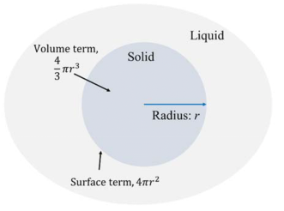
Homogeneous Nucleation
The theory considered homogeneous nucleation the formation of one phase by the aggregation of components of another phase without change of composition and without being influenced by impurities or external surfaces.

Slide 8
$∆G_{S}=4πr^{2}γ_{LC }$(Surface free energy change)
$∆G_{V}=\frac{4}{3}πr^{3}∆G_{V}$ (Volume free energy change)
$∆G_{T}= −\frac{4}{3}πr^{3}∆G_{V}+ 4πr^{2}γ_{LC }$ (Total (net) free energy change)

Slide 10
For critical radius (r*)
$\frac{∂(∆G_{T})}{∂r} =0 r^{∗}=\frac{2γ_{LC}}{∆G_{V}}$ $∆G_{V}=\frac{L_{M}∆T}{T_{M}}$
$r^{∗}=\frac{2γ_{LC}T_{M}}{L_{M}∆T}$ $∆G^{∗}=\frac{16πγ_{LC}^{3}T_{M}^{2}}{3{(L_{M}∆T)}^{2}}$
The work of homogeneous
nucleation

Slide 12
The effect of decreasing temperature on the critical radius for nucleation and on the work of nucleation

Slide 13
The dependence of the rate of nucleation on the undercooling

Slide 16
Heterogeneous Nucleation
In practice, the majority of phenomena in liquids take place at undercoolings significantly less than those predicted by theories of homogeneous nucleation. The nucleation is considered to be heterogeneous and to take place on the surface of the container or on particles present in the system. Heterogeneous nucleation can occur provided some preferential sites exist.

Slide 17
Θ: wetting angle or contact angle
$$γ_{LC}cosθ+γ_{CS}=γ_{LS}$$
$$cosθ=\frac{γ_{LS}−γ_{CS}}{γ_{LC}}$$
$$Volume=\frac{1}{3}πh^{2}\left(3rh\right)=\frac{1}{3}πr^{3}\left(2−3cosθ+\cos^{3}θ\right)$$
$$Surface area=2πrh=2πr^{2}(1−cosθ)$$
$$∆G^{∗}=\frac{\left.4πγ_{LC}^{3}(2−3cosθ+\cos^{3}θ\right)}{3∆G_{V}^{2}}$$
$$\frac{1}{4}(2−3cosθ+\cos^{3}θ)$$
The work of heterogeneous nucleation
Difference from hpmpgeneous nucleation work

Slide 18
If the surface energy γ_{LS} is high and γ_{CS} is low, nucleation on the surface is energetically favorable.
For θ = 180° the energy fluctuation required is the same as for homogeneous nucleation. But for other cases heterogeneous nucleation is more energetically favourable.
For systems in which the contact angle is small it is clear that the barrier to nucleation is also small, and this can satisfactorily account for the low undercoolings observed in practice

Slide 20
The relative rates of nucleation at decreaing temperatures for heterogeneous and homogenous nucleation process

Slide 21
Nucleating Agents
For easy nucleation, low contact angles are required and evidence support the view that when chemical parameters (bond type and bond strength) of the crystal and the substrate are similar the lattice mismatch between crystal and substrate is important.
$δ=\frac{∆a}{a}$ $δ$: lattice mismatch
a: lattice parameter of nucleating crystal
Δa: difference in the lattice parameters of crystal and
substrate

Slide 22
Most grain refiners are added to increase nucleation but some are added to restrict grain growth after solidification.

Slide 23
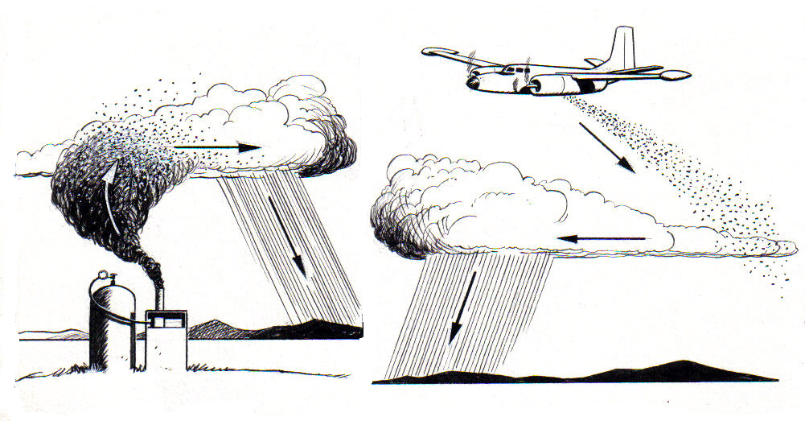
Rain Bomb
An example is the use of AgCl to promote rain by serving as a nucleus for ice crystals. The crystal structure of AgCl is such that its lattice spacing is very near that of ice.

Slide 24
Dynamic Nucleation
So far we have considered nucleation in an essentially static situation. Only temperature and the potency of nucleating substrates have been considered as having any effect. It is possible to induce nucleation by subjection the liquid metal to dynamic stimuli. Two distinct forms can be identified.
(i) an initial nucleation phenomenon induced mechanically and
(ii) a grain refining action which is a consequence of crystal multiplication and is not a nucleation event in the normal sense.
The latter form is usually the result of fragmentation of existing solid. It is an important means of exerting over the grain structure.

