Slide 1
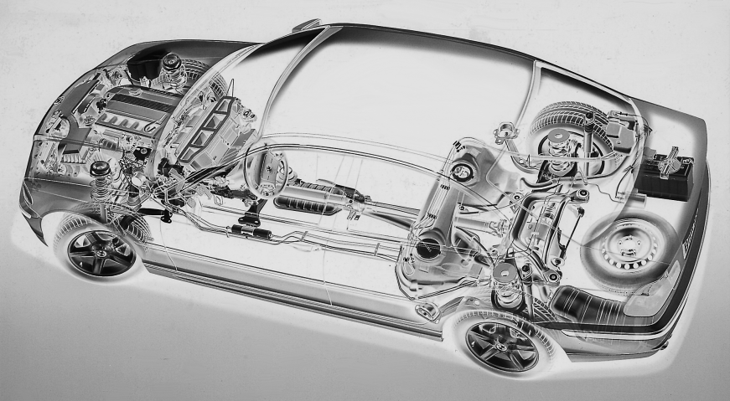
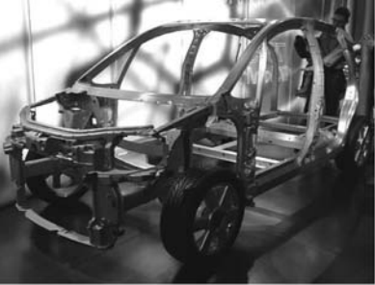
I. Introduction : Automotive Materials The First 135 Years of the Automotive Industry; Evolution to Modern Design
Prof.Dr.Mustafa Çiğdem
Yıldız Technical University
Department of Metallurgy and Materials
Engineering

Slide 9
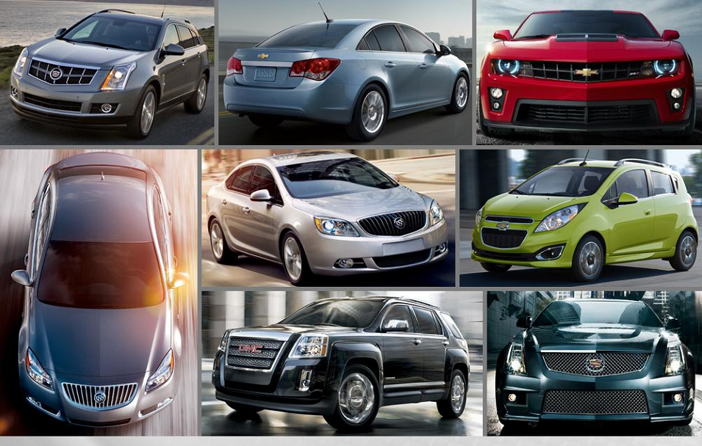

Slide 13
