Slide 1
The Structure of Castings

Slide 2
The structure of castings is of great importance since many material properties, especially mechanical properties, depend on grain shape and grain size. In addition, segregation resulting from the various modes of redistribution of solute can have marked effects. In this chapter we will examine the nature of the macroscopic cast structure and discuss the underlying reasons for the development of the different types off structure. This leads to the consideration of the control of the cast structure, since this is one of the most useful techniques available to the metallurgist or materials scientist concerned with the development of microstructure with the specific intention of improving properties. This is important if the material is to be used in the as-cast form or if it is to be worked to final shape.

Slide 4
Cold etch of disc cut from small steel ingot (10 % aqueous HNO₃)

Slide 5
In most as-cast polycrystalline solids three distinct zones with different grain structures can be identified namely:
The chill zone – a boundary layer adjacent to the mould wall of small equiaxed crystals with random orientations.
The columnar zone – a band of elongated crystals aligned parallel to the directions of heat flow.
The equiaxed zone – a central region of uniforms crystals. The properties of this central region are comparatively isotropic provided the grain size is small. The grain size in the equiaxed zone is, however normally larger than that of the chill zone.

Slide 6
If the object of the control of grain structure is to obtain isotropy, a fine-grained equiaxed structure is required. This is brought about by encouraging those conditions which lead to the breakdown of columnar growth and the formation of the equiaxed zone.
On the other hand if anisotropic properties are required, the columnar zone will need to predominate.
If the equiaxed zone is absent, accumulation of soluble and insoluble impruties in the regions where columnar structures impinge can have disastrous results.

Slide 7
Probably the most important factor in determining subsequent properties is the relative properties of the columnar and equiaxed zones. The chill zones is normally only a small number of grains thick has a very limited influence.
The axes of the columnar grains are parallel to <100> for FCC and BCC metals, with HCP metals any direction in the (0001) plane may be parallel to the columnar axis.
The relative proportions of the different zones can be controlled by altering the material and casting variables.
- Alloy composition
- Pouring temperature
- Cooling rate

Slide 9
In castings, the consequences of grain impingement are particularly bad at sharp corners, in rectangular sections and at perpendicular surface junctions. These can usually be corrected by suitable design procedures.
If the ingot structure is going to be subjected to extensive working in the solid state, the final grain structure will be dictated solid state changes. Nevertheless careful control in the initial stage can have beneficial results particularly attainment of homogeneity is concerned. Controlled fine-grained cast structure facilitates homogenisation.

Slide 10
Planes of weakness caused by unfavourable shape effects

Slide 11
The Chill Zone
The chill crystals nucleate on or near the mould wall. Observations of undercooling make it clear that they are the result of heterogeneous nucleation. The crystals in the chill zone are normally equiaxed and random orientation.
Overall, the numbers of crystal in the chill zone depend on:
- the superheat of the liquid
- the temperature of the mould
- the thermal properties of the metal and the mould
- the nucleation properties of the metal and the mould
- the nucleation potency of the particles in the liquid

Slide 12
Change in preferred orientation with distance from the mould wall for an aluminium - 2% silver alloy poured at the liquidus temperature. Θ is the spread in orientation.

Slide 13
Increase in grain size with distance from the mould wall for the alloy aluminium - 2% silver alloy.

Slide 14
The Columnar Zone
The columnar crystals develop predominantly from the chill zone and show strong preferred crystallographic orientation which corresponds with the preferred crystallographic directions of dendritic growth.
Some few new grains appear in the columnar zone.
The substructure in the columnar zone can show all stages of development through planar to cellular and to cellular dendritic.
The axes of the columnar crystals are normally parallel to the heat flow direction.

Slide 15
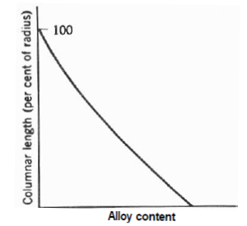
Variation of the length of the columnar zone with pouring temperature.
Variation of the length of the columnar zone with the alloy content for constant pouring temperature.

Slide 16
There is competitive growth between the crystals growing from the chill zone such that those with the steepest thermal gradient parallel to the preferred growth direction (the dendrite arm axes direction) grow more rapidly than their less favourable oriented neighbours. They expand and overwhelm their neighbours to dominate the growth process.
For pure metals it appears that the growth front is essentially planar and dendritic growth does not occur to a significant degree.
With pure metals the as-cast structure is normally columnar and there is little development of preferred orientation.

Slide 17
Change in preferred orientation with distance from the mould wall for pure aluminium. Θ is the spread in orientation.

Slide 18
The Equiaxed Zone
The crystals in the equiaxed zone usually have a grain size larger than that of the chill zone and their orientations is effectively random.
Extensive equiaxed zone is favoured by pouring with low superheat and by higher alloy contents.
As the pouring temperature increases the tendency to form equiaxed grains decreases but on the other hand the equiaxed grains that occur do so with in increasing grain size.

Slide 19
Correlation between columnar length, equiaxed grain size and pouring temperature.

Slide 20
It is important to recognise that there is a significant size effect influencing the development of the equiaxed zone. For instance, the relationships between the columnar zone length and the degree of superheat and the equiaxed grain size and the degree of superheat are only valid for small ingots.
Studies of metal analogue systems show quite clearly that the nuclei of the equiaxed crystal arise from a number of sources:
a) by apparently isolated nucleation events
b) from the growing columnar zone
c) from event occurring at the free surface

Slide 21
Theories of the development of the equiaxed zone
Four major theories have been proposed, three of which are generally agreed to be of importance.
(i) Constitutional Undercooling Theory:
The equiaxed zone formed after some initial columnar growth when constitutional undercooling ahead of the growing crystals become sufficient to induce heterogeneous nucleation. The subsequent growth of these crystals blocked off the columnar zone and the remaining liquid was then considered to solidify in the equiaxed form. This theory was discarded for several reasons.

Slide 22
(ii) Big Bang Mechanism (Free Chill Crystals Theory):
The nuclei for both the columnar and the equiaxed crystals were formed during the initial chill near the mould wall. These then either grew as columnar crystals or drifted into the central zone to become equiaxed crystals.
(iii) Dendrite Fragmentation Theory:
Another mechanism of significance is that in which crystal multiplication occurs by the melting off the arms of growing columnar dendrites. Dendrite arm necks can be remelt in the presence of thermal fluctuations.

Slide 23
(iv) Free Surface Showering Theory:
The nuclei for the equiaxed crystals formed at the free surface of the ingot and showered down into the liquid ahead of the columnar zone growing as they descended. The nuclei may simply be considered as free surface dendrites which detach and sink under their own weight or alternatively dendrite remelting may play a contributory part.

Slide 24
In the light of the above it can only be concluded that all three mechanisms described in (ii), (iii) and (iv) are operative during the solidification of ingots and castings.
Each of the proposed mechanisms can become operative and which mechanisms or combination of mechanisms operates depends on the alloy composition, casting conditions (cooling rate, casting temperature etc.) and the type of nucleating substrates in the melt.

Slide 25
Control of grain structure in cast metals
Mostly fine-grained equiaxed structures are required in castings and ingots. These structures are isotropic and their properties are markedly superior. To develop these structures requires the suppression of columnar growth and this can be achieved by encouraging conditions favourable to the formation of the equiaxed nuclei.
Two main approaches have been adopted namely:
(a) The control of nucleation by control of the casting conditions or by the use of inoculants.
(b) The use of physical methods to induce dynamic grain refinement.

Slide 26
Control of nucleation behaviour
The simplest approach for a given alloy is to cast from near the liquidus temperature so as to promote copious heterogeneous nucleation in the chilled liquid. This has disadvantages with complex castings, where there will be a wide range of thermal conditions and where fluidity requirements often make it necessary to cast with a comparatively high degree of superheat.
It is usual to make additions of inoculants prior to casting.

Slide 28
The addition of an inoculant will only be effective provided it remains uniformly distributed through the melt and does not become contaminated or melt.
One other approach to the introduction of heterogeneous nucleants is the use of mould coating with dyes containing nucleating agents.

Slide 29
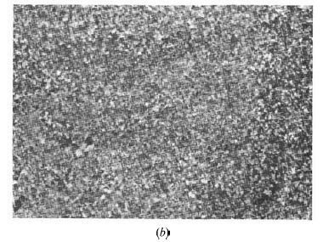
(a) Normal coarse-grabled cast structure in 18% chromium-12% nickel steel; (b) same steel as (a) refined by inoculation.

Slide 30
Dynamic grain refinement
Various methods have been used to produce dynamic fragmentation of the growing dendrites and thus to promote equiaxed growth.
- Mechanical stirring
- Vibration
- Oscillation
- Rotation
- Enhanced natural convection
- Magnetic and electromagnetic stirring
- Sonic and ultrasonic vibrations
- Agitation with gas bubbles

Slide 31
In all cases the principal mechanism for producing the nuclei for the equiaxed grains in dendrite remelting.
The effect of the physical disturbance is to produce localised thermal fluctuations as the liquid metal flows backwards and forwards around the growing dendrites.

Slide 32
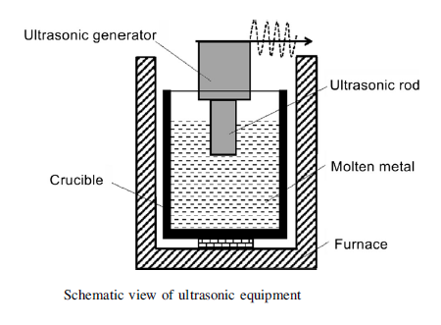

Slide 33
Macrostructure of Fusion Welds
The mechanisms involved in the solidification of fusion welds are basically the same as those of normal castings. The main differences are:
The solidification rates are high
The temperature gradients in the liquid are steep. The temperatures in the centre of the weld pool are significantly higher than the melting temperature.

Slide 34
There is no equivalent of the chill zone in a fusion weld macrostructure.
Partially melted grains at the molten zone boundary act as the sites which initiate columnar growth.
Columnar growth occurs as soon as the heat source moves away and does not require a nucleating event.
Growth structure ranging cellular through cellular dendritic.
Equiaxed zone is not normally observed. Dendrite fragments does not survive without melting. The very high temperatures at the weld pool centre make survival difficult.

