Slide 1
2019/3 FİZİK 1 DERSİ FIZ1001

Slide 2
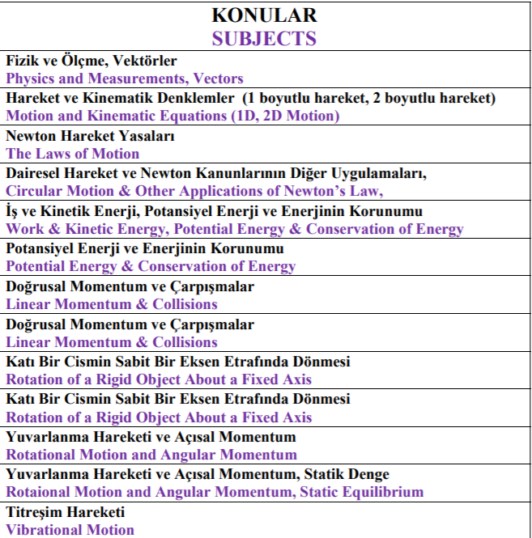
KAYNAK KİTAP

Slide 3
The LAWS of MOTION NEWTON’s LAWS
This section introduces Newton’s three laws of motion and his law of gravity. The three laws are simple and sensible.
The first law states that a force must be applied to an object in order to change its velocity. Changing an object’s velocity means accelerating it, which implies a relationship between force and acceleration.
This relationship, the second law, states that the net force on an object equals the object’s mass times its acceleration.
Finally, the third law says that whenever we push on something, it pushes back with equal force in the opposite direction.
Those are the three laws in a nutshell.

Slide 4
The LAWS of MOTION NEWTON’s LAWS
4.1 Forces
A force is commonly imagined as a push or a pull on some object, perhaps rapidly, as when we hit a tennis ball with a racket.
We can hit the ball at different speeds and direct it into different parts of the opponent’s court.
That means we can control the magnitude of the applied force and also its direction, so force is a vector quantity, just like velocity and acceleration.

Slide 5
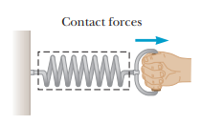
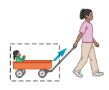
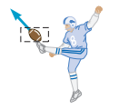
The LAWS of MOTION NEWTON’s LAWS
4.1 Forces
If you pull on a spring, the spring stretches.
If you pull hard enough on a wagon, the wagon moves.
When you kick a football, it deforms briefly and is set in motion.
These are all examples of contact forces, so named because they result from physical contact between two objects.

Slide 6
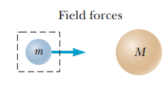
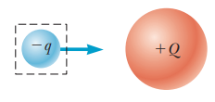
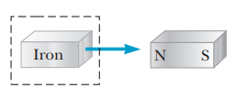
The LAWS of MOTION NEWTON’s LAWS
4.1 Forces
an object of mass M, such as the Sun, creates an invisible influence that stretches throughout space. A second object of mass m, such as Earth, interacts with the field of the Sun, not directly with the Sun itself. So the force of gravitational attraction between two objects, illustrated in Figure, is an example of a field force. The force of gravity keeps objects bound to Earth and also gives rise to what we call the weight of those objects.
Another common example of a field force is the electric force that one electric charge exerts on another.
A third example is the force exerted by a bar magnet on a piece of iron.

Slide 7
The LAWS of MOTION NEWTON’s LAWS
4.1 Forces
The known fundamental forces in nature are all field forces. These are, in order of decreasing strength,
(1) the strong nuclear force between subatomic particles,
(2) the electromagnetic forces between electric charges,
(3) the weak nuclear force, which arises in certain radioactive decay processes, and
(4) the gravitational force between objects.
The strong force keeps the nucleus of an atom from flying apart due to the repulsive electric force of the protons.
The weak force is involved in most radioactive processes and plays an important role in the nuclear reactions that generate the Sun’s energy output. The strong and weak forces operate only on the nuclear scale, with a very short range on the order of 10⁻¹⁵ m. Outside this range they have no influence. Classical physics, however, deals only with gravitational and electromagnetic forces, which have infinite range.

Slide 8
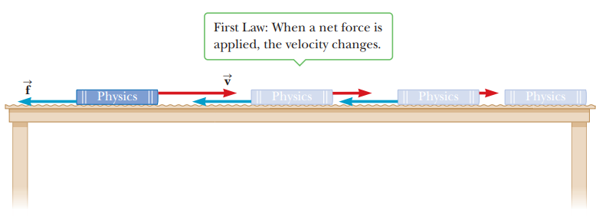
The LAWS of MOTION NEWTON’s LAWS
4.2 Newton’s First Law
Now imagine pushing the book with a horizontal force great enough to overcome the force of friction between the book and the table, setting the book in motion. Because the magnitude of the applied force exceeds the magnitude of the friction force, the book accelerates. When the applied force is withdrawn, friction soon slows the book to a stop.

Slide 9
The LAWS of MOTION NEWTON’s LAWS
4.2 Newton’s First Law
Now imagine pushing the book across a smooth, waxed floor. The book again comes to rest once the force is no longer applied, but not as quickly as before. Finally, if the book is moving on a horizontal frictionless surface, it continues to move in a straight line with constant velocity until it hits a wall or some other obstruction.

Slide 10
The LAWS of MOTION NEWTON’s LAWS
4.2 Newton’s First Law
Before about 1600, scientists felt that the natural state of matter was the state of rest. Galileo, however, devised thought experiments—such as an object moving on a frictionless surface, as just described—and concluded that it’s not the nature of an object to stop, once set in motion, but rather to continue in its original state of motion. This approach was later formalized as Newton’s first law of motion:

Slide 11
The LAWS of MOTION NEWTON’s LAWS
4.2 Newton’s First Law
The net force on an object is defined as the vector sum of all external forces exerted on the object. External forces come from the object’s environment. If an object’s velocity isn’t changing in either magnitude or direction, then its acceleration and the net force acting on it must both be zero.
Internal forces originate within the object itself and can’t change the object’s velocity (although they can change the object’s rate of rotation, as described in after.
As a result, internal forces aren’t included in Newton’s second law. It’s not really possible to “pull yourself up by your own bootstraps.” A consequence of the first law is the feasibility of space travel. After just a few moments of powerful thrust, the spacecraft coasts for months or years, its velocity only slowly changing with time under the relatively faint influence of the distant Sun and planets.

Slide 12
The LAWS of MOTION NEWTON’s LAWS
4.2 Newton’s First Law:
Mass and Inertia
Imagine hitting a golf ball off a tee with a driver. If you’re a good golfer, the ball will sail over two hundred yards down the fairway. Now imagine teeing up a bowling ball and striking it with the same club (an experiment we don’t recommend). Your club would probably break, you might sprain your wrist, and the bowling ball, at best, would fall off the tee, take half a roll, and come to rest. From this thought experiment, we conclude that although both balls resist changes in their state of motion, the bowling ball offers much more effective resistance. The tendency of an object to continue in its original state of motion is called inertia.
Although inertia is the tendency of an object to continue its motion in the absence of a force, mass is a measure of the object’s resistance to changes in its motion due to a force.
The greater the mass of a body, the less it accelerates under the action of a given applied force. The SI unit of mass is the kilogram. Mass is a scalar quantity that obeys the rules of ordinary arithmetic.

Slide 13
The LAWS of MOTION NEWTON’s LAWS
4.3 Newton’s Second Law:
Newton’s first law explains what happens to an object that has no net force acting on it: The object either remains at rest or continues moving in a straight line with constant speed.
Newton’s second law answers the question of what happens to an object that does have a net force acting on it.
Imagine pushing a block of ice across a frictionless horizontal surface. When you exert some horizontal force on the block, it moves with an acceleration of, say, 2 m/s². If you apply a force twice as large, the acceleration doubles to 4 m/s². Pushing three times as hard triples the acceleration, and so on. From such observations, we conclude that the acceleration of an object is directly proportional to the net force acting on it.

Slide 14
The LAWS of MOTION NEWTON’s LAWS
4.3 Newton’s Second Law:
Mass also affects acceleration. Suppose you stack identical blocks of ice on top of each other while pushing the stack with constant force. If the force applied to one block produces an acceleration of 2 m/s², then the acceleration drops to half that value, 1 m/s², when two blocks are pushed, to one-third the initial value when three blocks are pushed, and so on. We conclude that the acceleration of an object is inversely proportional to its mass. These observations are summarized in Newton’s second law:

Slide 15
The LAWS of MOTION NEWTON’s LAWS
4.3 Newton’s Second Law:
The constant of proportionality is equal to one, so in mathematical terms the preceding statement can be written
where $\vec{a}$is the acceleration of the object,
$m$ is its mass, and
$\sum{\vec{F}}$is the vector sum of all forces acting on it. Multiplying through by $m$, we have
Physicists commonly refer to this equation as ‘$\sum{\vec{F}}=m\vec{a}$.’ Figure illustrates the relationship between the mass, acceleration, and the net force.
The second law is a vector equation, equivalent to the following three component equations:
When there is no net force on an object, its acceleration is zero, which means the velocity is constant

Slide 16
The LAWS of MOTION NEWTON’s LAWS
4.3 Newton’s Second Law:
Units of Force and Mass
The SI unit of force is the newton. When 1 newton of force acts on an object that has a mass of 1 kg, it produces an acceleration of 1 m/s² in the object.
From this definition and Newton’s second law, we see that the newton can be expressed in terms of the fundamental units of mass, length, and time as

Slide 17
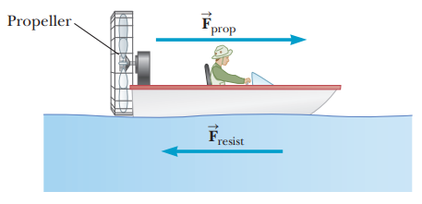
The LAWS of MOTION NEWTON’s LAWS
4.3 Newton’s Second Law:
Units of Force and Mass

Slide 18
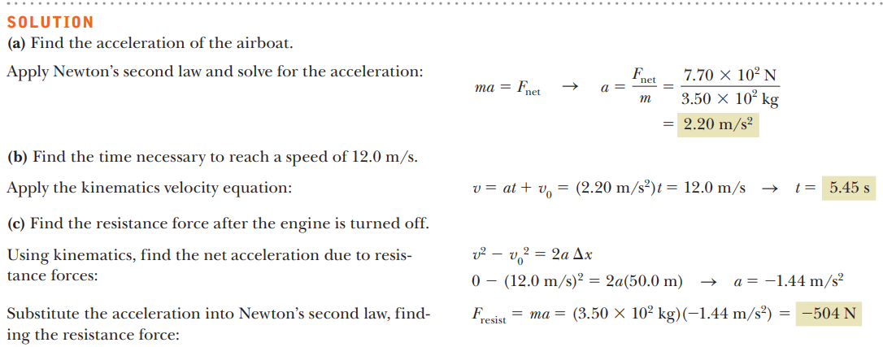
The LAWS of MOTION NEWTON’s LAWS
4.3 Newton’s Second Law:
Units of Force and Mass

Slide 19
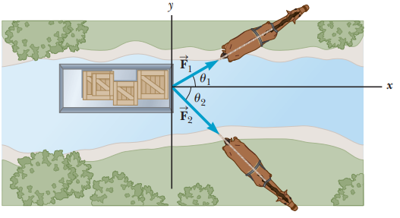
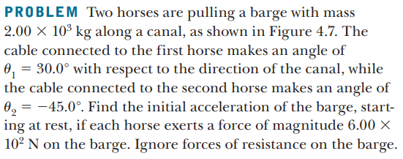
The LAWS of MOTION NEWTON’s LAWS
4.3 Newton’s Second Law:
Units of Force and Mass

Slide 20
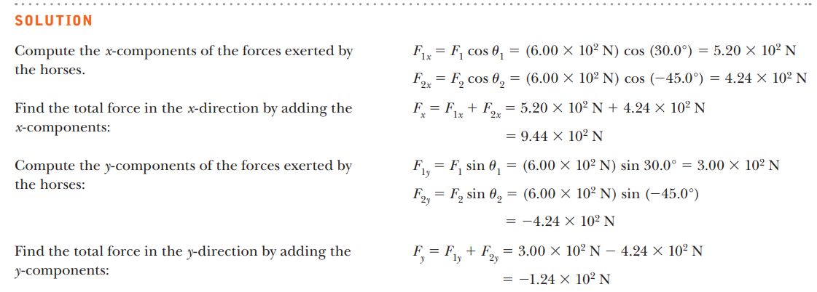
The LAWS of MOTION NEWTON’s LAWS
4.3 Newton’s Second Law:
Units of Force and Mass

Slide 21
The LAWS of MOTION NEWTON’s LAWS
4.3 Newton’s Second Law:
Units of Force and Mass

Slide 22
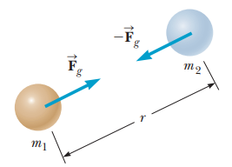
The LAWS of MOTION NEWTON’s LAWS
4.3 Newton’s Second Law:
The Gravitational Force
The gravitational force is the mutual force of attraction between any two objects in the Universe.
Although the gravitational force can be very strong between very large objects, it’s the weakest of the fundamental forces.
A good demonstration of how weak it is can be carried out with a small balloon.
Rubbing the balloon in your hair gives the balloon a tiny electric charge.
Through electric forces, the balloon then adheres to a wall, resisting the gravitational pull of the entire Earth!
In addition to contributing to the understanding of motion, Newton studied gravity extensively.
Newton’s law of universal gravitation states that every particle in the Universe attracts every other particle with a force that is directly proportional to the product of the masses of the particles and inversely proportional to the square of the distance between them.
If the particles have masses m₁ and m₂ and are separated by a distance r, as in Figure,
the magnitude of the gravitational force F_{g} is
where $G=6.67x{10}^{−11} Nm^{2}/{kg}^{2}$is the universal gravitation constant.
We examine the gravitational force in more detail in future lecture.

Slide 23
The LAWS of MOTION NEWTON’s LAWS
4.3 Newton’s Second Law:
The Gravitational Force
an alternate definition of the weight of an object with mass m can be written as
where M_{E} is the mass of Earth and r is the distance from the object to Earth’s center. If the object is at rest on Earth’s surface, then r is equal to Earth’s radius R_{E}.
Because r² is in the denominator of Equation, the weight decreases with increasing r.
So the weight of an object on a mountaintop is less than the weight of the same object at sea level.
Comparing Equations

Slide 24
The LAWS of MOTION NEWTON’s LAWS
4.3 Newton’s Second Law:
The Gravitational Force
Unlike mass, weight is not an inherent property of an object because it can take different values, depending on the value of g in a given location.
If an object has a mass of 70.0 kg, for example, then its weight at a location where g=9.80 m/s² is mg=686 N. In a high-altitude balloon, where g might be 9.76 m/s², the object’s weight would be 683 N.
The value of g also varies slightly due to the density of matter in a given locality.
In this text, unless stated otherwise, the value of g will be understood to be 9.80 m/s², its value near the surface of the Earth.
Equation $g=GM_{E}/r^{2}$ is a general result that can be used to calculate the acceleration of an object falling near the surface of any massive object if the more massive object’s radius and mass are known.
you should be able to show that g_{Sun} =274 m/s² and g_{Moon}= 1.62 m/s².
An important fact is that for spherical bodies, distances are calculated from the centers of the objects, a consequence of Gauss’s law (explained in Chapter 15), which holds for both gravitational and electric forces.

Slide 25
The LAWS of MOTION NEWTON’s LAWS
4.3 Newton’s Second Law:
The Gravitational Force

Slide 26
The LAWS of MOTION NEWTON’s LAWS
4.3 Newton’s Second Law:
The Gravitational Force

Slide 27
The LAWS of MOTION NEWTON’s LAWS
4.3 Newton’s Second Law:
The Gravitational Force

Slide 28
The LAWS of MOTION NEWTON’s LAWS
4.3 Newton’s Second Law:
The Gravitational Force

Slide 29
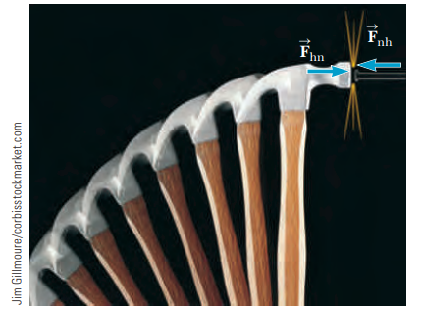
The LAWS of MOTION NEWTON’s LAWS
4.4 Newton’s Third Law :
Before we found that a force is exerted on an object when it comes into contact with some other object. Consider the task of driving a nail into a block of wood, for example, as illustrated in Figure.
To accelerate the nail and drive it into the block, the hammer must exert a net force on the nail. Newton recognized, however, that a single isolated force couldn’t exist. Instead, forces in nature always exist in pairs. According to Newton, as the nail is driven into the block by the force exerted by the hammer, the hammer is slowed down and stopped by the force exerted by the nail.
Newton described such paired forces with his third law:

Slide 30
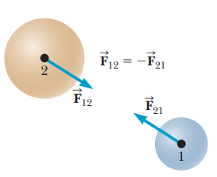
The LAWS of MOTION NEWTON’s LAWS
4.4 Newton’s Third Law :
This law, which is illustrated in Figure, states that a single isolated force can’t exist.
The force $\vec{F_{12}}$ exerted by object 1 on object 2 is sometimes called the action force, and the force $\vec{F_{21}}$exerted by object 2 on object 1 is called the reaction force. In reality, either force can be labeled the action or reaction force.
The action force is equal in magnitude to the reaction force and opposite in direction. In all cases, the action and reaction forces act on different objects.
For example, the force acting on a freely falling projectile is the force of gravity exerted by Earth on the projectile, $\vec{F_{g}}$ , and the magnitude of this force is its weight mg.
The reaction to force $\vec{F_{g}}$ is the gravitational force exerted by the projectile on Earth,
$\vec{F_{g}′}−=\vec{F_{g}}$.
The reaction force $\vec{F_{g}′}$ must accelerate the Earth towards the projectile, just as the action force $\vec{F_{g}}$ accelerates the projectile towards Earth.
Because Earth has such a large mass, however, its acceleration due to this reaction force is negligibly small.

Slide 31
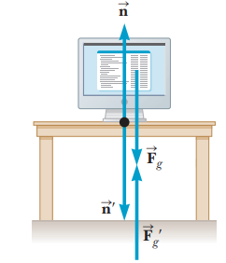
The LAWS of MOTION NEWTON’s LAWS
4.4 Newton’s Third Law :
As mentioned earlier, Earth exerts a gravitational force $\vec{F_{g}}$ on any object. If the object is a monitor at rest on a table, as in Figure, the reaction force to $\vec{F_{g}}$ is the gravitational force the monitor exerts on the Earth, $\vec{F_{g}}′$. The monitor doesn’t accelerate downward because it’s held up by the table.
The table therefore exerts an upward force $\vec{n}$, called the normal force, on the monitor. (Normal, a technical term from mathematics, means “perpendicular” in this context.)
The normal force is an elastic force arising from the cohesion of matter and is electromagnetic in origin.
It balances the gravitational force acting on the monitor, preventing the monitor from falling through the table, and can have any value needed, up to the point of breaking the table. The reaction to $\vec{n}$ is the force exerted by the monitor on the table, $\vec{n′}$. Therefore,

Slide 32
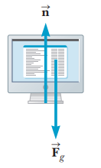
The LAWS of MOTION NEWTON’s LAWS
4.4 Newton’s Third Law :
The forces $\vec{n}$ and $\vec{n′}$ both have the same magnitude as $\vec{F_{g}}$ . Note that the forces acting on the monitor are $\vec{F_{g}}$ and $\vec{n}$, as shown in Figure b. The two reaction forces, $\vec{F_{g}^{′}}$and $\vec{n′}$, are exerted by the monitor on objects other than the monitor. Remember that the two forces in an action–reaction pair always act on two different objects.

Slide 33
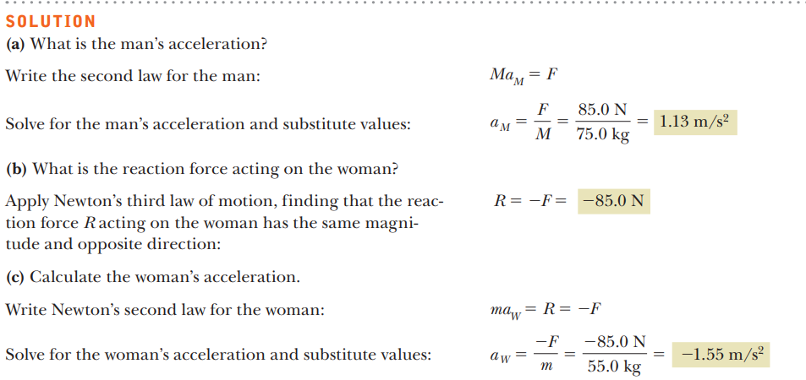
The LAWS of MOTION NEWTON’s LAWS
4.4 Newton’s Third Law :

Slide 34
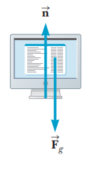
The LAWS of MOTION NEWTON’s LAWS
4.5 Applications of Newton’s Laws:
This section applies Newton’s laws to objects moving under the influence of constant external forces.
We assume that objects behave as particles, so we need not consider the possibility of rotational motion.
We also neglect any friction effects and the masses of any ropes or strings involved.
With these approximations, the magnitude of the force exerted along a rope, called the tension, is the same at all points in the rope.
This is illustrated by the rope in Figure, showing the forces $\vec{T}$ and $\vec{T′}$acting on it.
If the rope has mass m, then Newton’s second law applied to the rope gives $T−T^{′}=ma$.
If the mass m is taken to be negligible, however, as in the upcoming examples, then $T=T^{′}$.
When we apply Newton’s law to an object, we are interested only in those forces which act on the object.
For example, in Figure, the only external forces acting on the monitor are $\vec{n}$ and $\vec{F_{g}}$ . The reactions to these forces, $\vec{n′}$ and $\vec{F_{g}′}$, act on the table and on Earth, respectively, and don’t appear in Newton’s second law applied to the monitor.

Slide 35
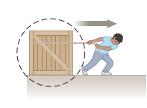
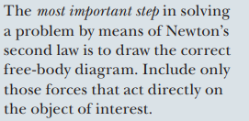
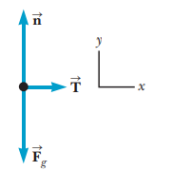
The LAWS of MOTION NEWTON’s LAWS
4.5 Applications of Newton’s Laws:
Consider a crate Consider a crate being pulled to the right on a frictionless, horizontal surface, as in Figure . Suppose you wish to find the acceleration of the crate and the force the surface exerts on it. The horizontal force exerted on the crate acts through the rope.
The force that the rope exerts on the crate is denoted by $\vec{T}$ (because it’s a tension force). The magnitude of $\vec{T}$ is equal to the tension in the rope. What we mean by the words “tension in the rope” is just the force read by a spring scale when the rope in question has been cut and the scale inserted between the cut ends. A dashed circle is drawn around the crate in Figure to emphasize the importance of isolating the crate from its surroundings.
Because we are interested only in the motion of the crate, we must be able to identify all forces acting on it. These forces are illustrated in Figure b. In addition to displaying the force $\vec{T}$, the force diagram for the crate includes the force of gravity $\vec{F_{g}}$ exerted by Earth and the normal force :n exerted by the floor. Such a force diagram is called a free-body diagram because the environment is replaced by a series of forces on an otherwise free body. The construction of a correct free-body diagram is an essential step in applying Newton’s laws. An incorrect diagram will most likely lead to incorrect answers!

Slide 36
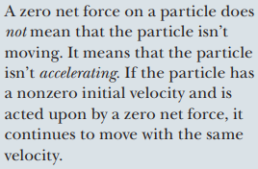
The LAWS of MOTION NEWTON’s LAWS
4.5 Applications of Newton’s Laws:
Now let’s apply Newton’s second law to the crate. First we choose an appropriate coordinate system. In this case it’s convenient to use the one shown in Figure b, with the x-axis horizontal and the y-axis vertical.
We can apply Newton’s second law in the x-direction, y-direction, or both, depending on what we’re asked to find in a problem. Newton’s second law applied to the crate in the x- and y- directions yields the following two equations:

Slide 37
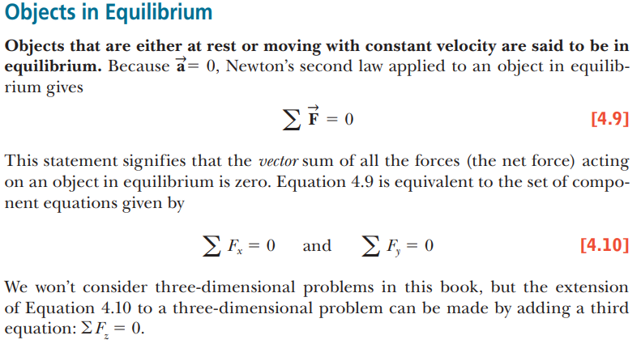
The LAWS of MOTION NEWTON’s LAWS
4.5 Applications of Newton’s Laws:

Slide 38
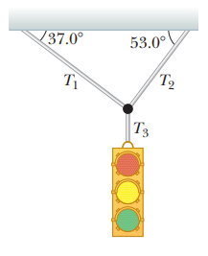
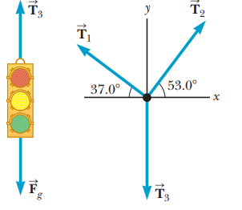
The LAWS of MOTION NEWTON’s LAWS
4.5 Applications of Newton’s Laws:

Slide 39
The LAWS of MOTION NEWTON’s LAWS
4.5 Applications of Newton’s Laws:

Slide 40
The LAWS of MOTION NEWTON’s LAWS
4.5 Applications of Newton’s Laws:

Slide 41
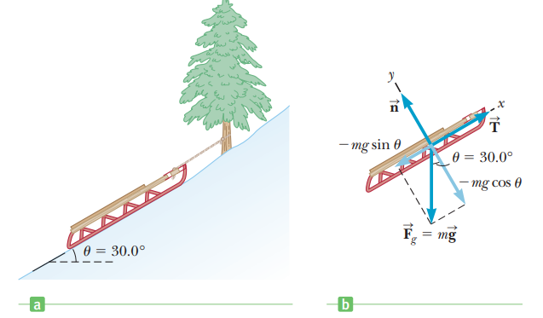
The LAWS of MOTION NEWTON’s LAWS
4.5 Applications of Newton’s Laws:

Slide 42
The LAWS of MOTION NEWTON’s LAWS
4.5 Applications of Newton’s Laws:

Slide 43
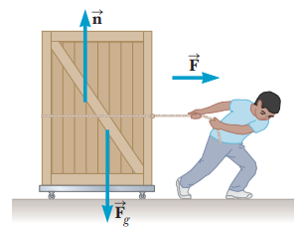
The LAWS of MOTION NEWTON’s LAWS
4.5 Applications of Newton’s Laws:

Slide 44
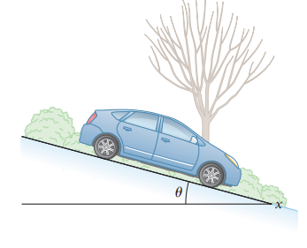
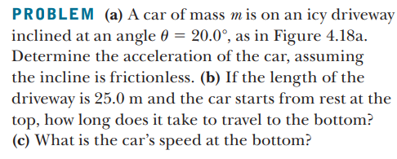
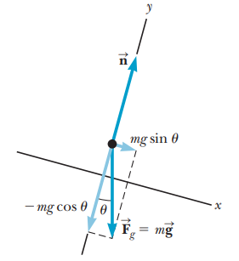
The LAWS of MOTION NEWTON’s LAWS
4.5 Applications of Newton’s Laws:

Slide 45
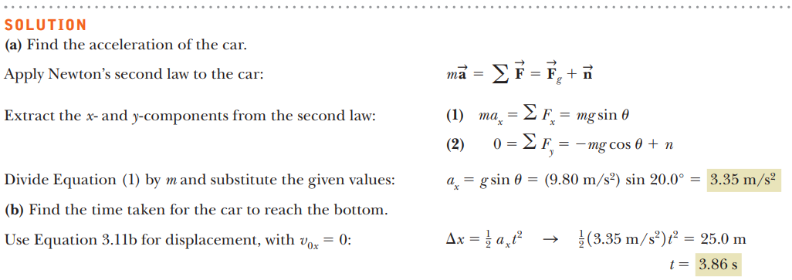
The LAWS of MOTION NEWTON’s LAWS
4.5 Applications of Newton’s Laws:

Slide 46
The LAWS of MOTION NEWTON’s LAWS
4.5 Applications of Newton’s Laws:

