Slide 1
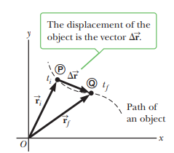
Displacement, Velocity, and Acceleration
in Two Dimensions
In one-dimensional motion, as discussed in before lecture, the direction of a vector quantity such as a velocity or acceleration can be taken into account by specifying whether the quantity is positive or negative.
The velocity of a rocket, for example, is positive if the rocket is going up and negative if it’s going down. This simple solution is no longer available in two or three dimensions. Instead, we must make full use of the vector concept.
Consider an object moving through space as shown in Figure
When the object is at some point P at time t_{i}, its position is described by the position vector $\vec{r_{i}}$, drawn from the origin to P. When the object has moved to some other point at time t_{f}, its position vector is $\vec{r_{f}}$, . From the vector diagram in Figure, the final position vector is the sum of the initial position vector and the displacement
From this relationship, we obtain the following one:
$∆\vec{r}: \vec{r_{f}}=\vec{r_{i}}$+$∆\vec{r}$
$∆\vec{r}≡\vec{r_{f}}−\vec{r_{i}} SI unit:meter (m)$

Slide 2
Displacement, Velocity, and Acceleration
in Two Dimensions
$∆\vec{r}≡\vec{r_{f}}−\vec{r_{i}} SI unit:meter (m)$
Because the displacement is a vector quantity and the time interval is a scalar quantity, we conclude that the average velocity is a vector quantity directed along $∆\vec{r}$
The direction of the instantaneous velocity vector is along a line that is tangent to the object’s path and in the direction of its motion.

Slide 3
Displacement, Velocity, and Acceleration
in Two Dimensions

Slide 4
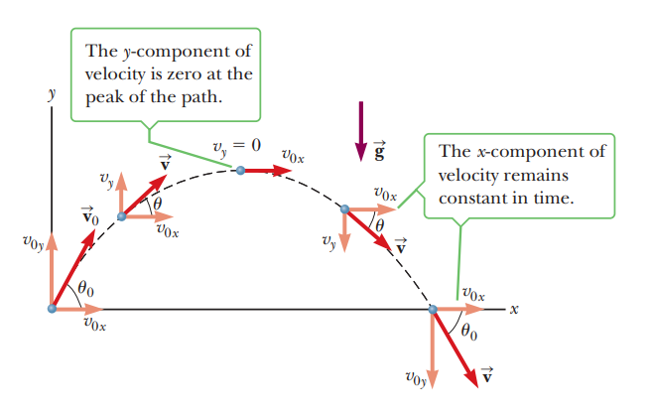
Motion in Two Dimensions
Before we studied objects moving along straight-line paths, such as the x-axis.
In this lecture, we look at objects that move in both the x- and y-directions simultaneously under constant acceleration.
An important special case of this two dimensional motion is called projectile motion. Anyone who has tossed any kind of object into the air has observed projectile motion.
If the effects of air resistance and the rotation of Earth are neglected, the path of a projectile in Earth’s gravity field is curved in the shape of a parabola, as shown in Figure
The positive x-direction is horizontal and to the right, and the y-direction is vertical and positive upward. The most important experimental fact about projectile motion in two dimensions is that the horizontal and vertical motions are completely independent of each other This means that motion in one direction has no effect on motion in the other direction. If a baseball is tossed in a parabolic path, as in Figure, the motion in the y-direction will look just like a ball tossed straight up under the influence of gravity.

Slide 5
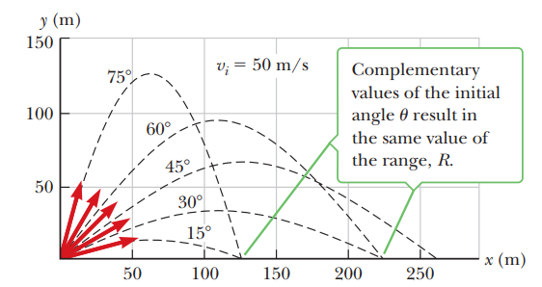
Motion in Two Dimensions
Chapter 2 Motion Along a Straight Line
This Figure shows the effect of various initial angles; note that complementary angles give the same horizontal range
A projectile launched from the origin with an initial speed of 50 m/s at various angles of projection.

Slide 6
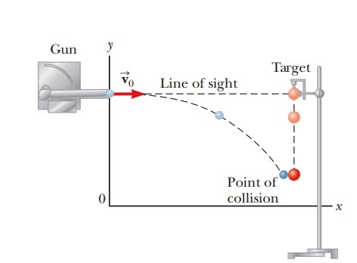
Motion in Two Dimensions
Chapter 2 Motion Along a Straight Line
Figure is an experiment illustrating the independence of horizontal and vertical motion. The gun is aimed directly at the target ball and fired at the instant the target is released. In the absence of gravity, the projectile would hit the target because the target wouldn’t move. However, the projectile still hits the target in the presence of gravity. That means the projectile is falling through the same vertical displacement as the target despite its horizontal motion.
A ball is fired at a target at the same instant the target is released. Both fall vertically at the same rate and collide.

Slide 7
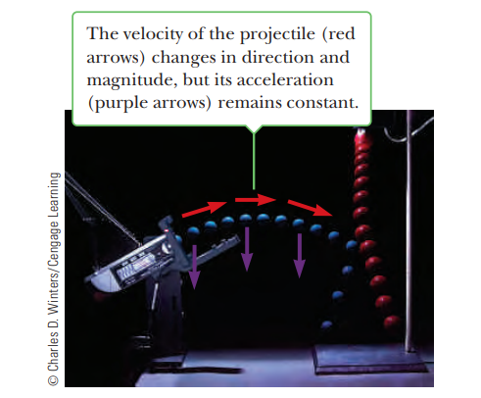
Motion in Two Dimensions
Chapter 2 Motion Along a Straight Line
The experiment also works when set up as in Figure, when the initial velocity has a vertical component.
A projectile launched from the origin with an initial speed of 50 m/s at various angles of projection.

Slide 8
Motion in Two Dimensions
In general, the equations of constant acceleration developed in the before lecture follow separately for both the x-direction and the y-direction.
An important difference is that the initial velocity now has two components, not just one as in that lecture.
We assume that at t=0 the projectile leaves the origin with an initial velocity $\vec{θ_{0}}$ the velocity vector makes an angle $θ_{0}$ with the horizontal, where $θ_{0}$ is called the projection angle, then from the definitions of the cosine and sine functions and figure we have

Slide 9
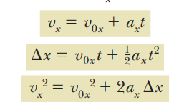
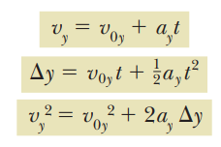
Motion in Two Dimensions

Slide 10
Motion in Two Dimensions
The object’s speed v can be calculated from the components of the velocity using the Pythagorean theorem:
The angle that the velocity vector makes with the x-axis is given by
This formula for u, as previously stated, must be used with care, because the inverse tangent function returns values only between -90° and +90°. Adding 180° is necessary for vectors lying in the second or third quadrant.

Slide 11
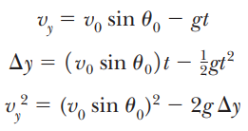
Motion in Two Dimensions

Slide 12
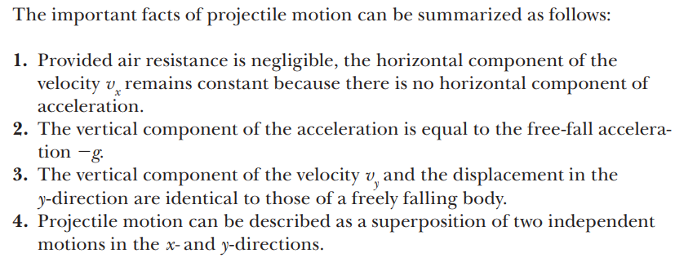
Motion in Two Dimensions

Slide 13
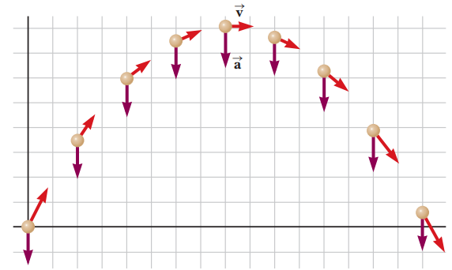
Motion in Two Dimensions

Slide 14
Motion in Two Dimensions

Slide 15
Motion in Two Dimensions
In the motion diagram shown in Figure, the acceleration vectors are all the same, pointing downward with magnitude of nearly 10 m/s². By symmetry, we know that the ball will hit the ground at the same speed in the y-direction as when it was thrown, so the velocity in the y-direction goes from 40 m/s to 240 m/s in steps of 210 m/s every second; hence, approximately 8 seconds elapse during the motion.
The velocity vector constantly changes direction, but the horizontal velocity never changes because the acceleration in the horizontal direction is zero. Therefore, the displacement of the ball in the x-direction is given by

Slide 16
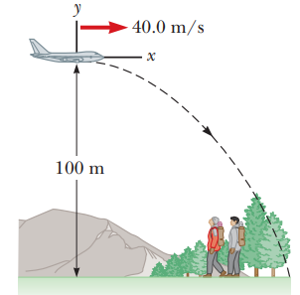
Motion in Two Dimensions

Slide 17
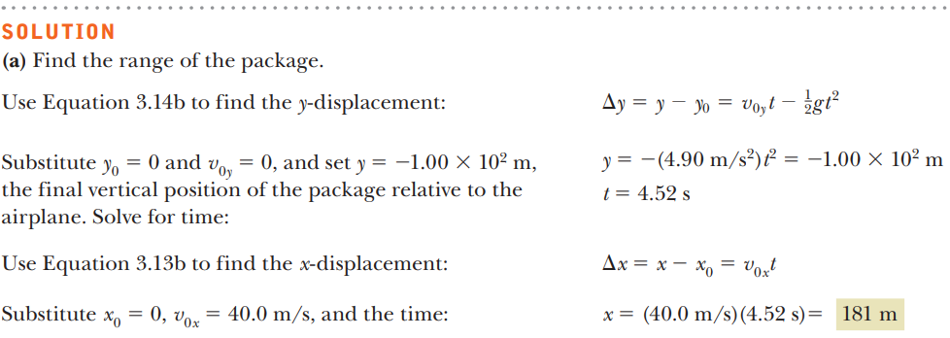
Motion in Two Dimensions

Slide 18
Motion in Two Dimensions

Slide 19
Motion in Two Dimensions

Slide 20
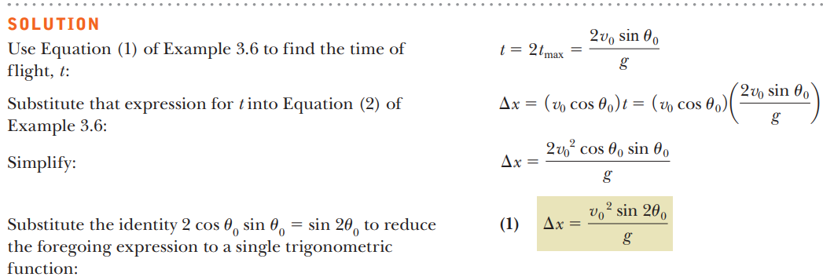
Motion in Two Dimensions

Slide 21
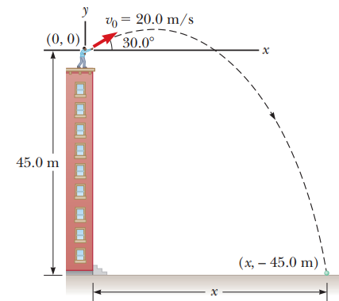
Motion in Two Dimensions

Slide 22
Motion in Two Dimensions

Slide 23
Motion in Two Dimensions

Slide 24
Motion in Two Dimensions

Slide 25
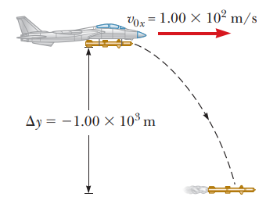
Motion in Two Dimensions

Slide 26
Motion in Two Dimensions

Slide 27
Motion in Two Dimensions

Slide 28
Motion in Two Dimensions

Slide 29
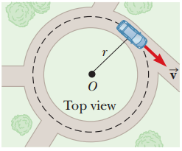
Motion in Two Dimensions Centripetal Acceleration
Figure shows a car moving in a circular path with constant linear speed v. Even though the car moves at a constant speed, it still has acceleration. To understand this, consider the defining equation for average acceleration:

Slide 30
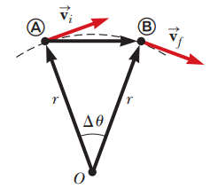
Motion in Two Dimensions Centripetal Acceleration

Slide 31
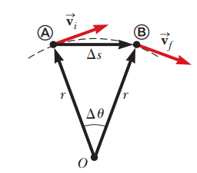
Motion in Two Dimensions Centripetal Acceleration

Slide 32
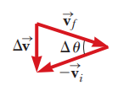
Motion in Two Dimensions Centripetal Acceleration

Slide 33
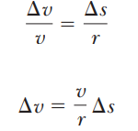
Motion in Two Dimensions Centripetal Acceleration

Slide 34
Motion in Two Dimensions Centripetal Acceleration

Slide 35
Motion in Two Dimensions Centripetal Acceleration

Slide 36
Relative Velocity
Relative velocity is all about relating the measurements of two different observers, one moving with respect to the other. The measured velocity of an object depends on the velocity of the observer with respect to the object. On highways, for example, cars moving in the same direction are often moving at high speed relative to Earth, but relative to each other they hardly move at all. To an observer at rest at the side of the road, a car might be traveling at 60 mi/h, but to an observer in a truck traveling in the same direction at 50 mi/h, the car would appear to be traveling only 10 mi/h. So measurements of velocity depend on the reference frame of the observer. Reference frames are just coordinate systems. Most of the time, we use a stationary frame of reference relative to Earth, but occasionally we use a moving frame of reference associated with a bus, car, or plane moving with constant velocity relative to Earth.

Slide 37
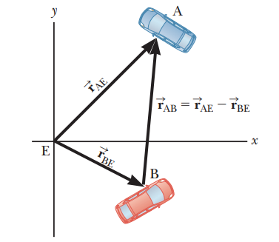
Relative Velocity
In two dimensions relative velocity calculations can be confusing, so a systematic approach is important and useful. Let E be an observer, assumed stationary with respect to Earth. Let two cars be labeled A and B, and introduce the following notation

Slide 38
Relative Velocity

Slide 39
Relative Velocity

Slide 40
Relative Velocity

Slide 41
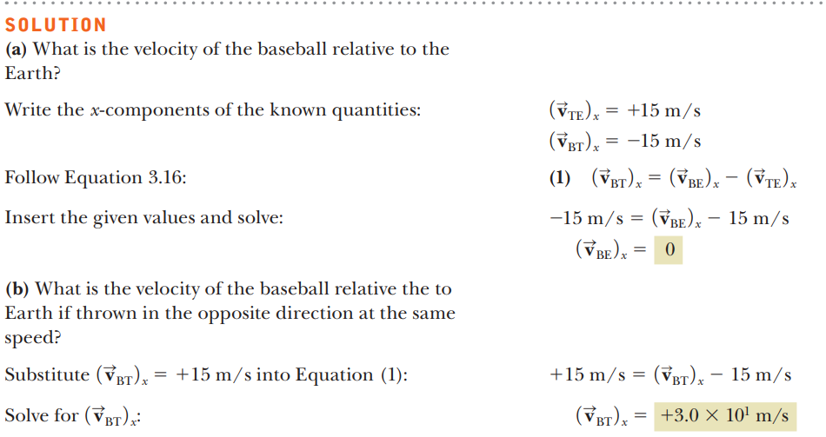
Relative Velocity

Slide 42
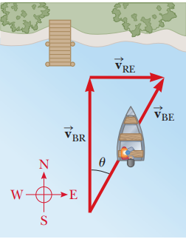
Relative Velocity

Slide 43
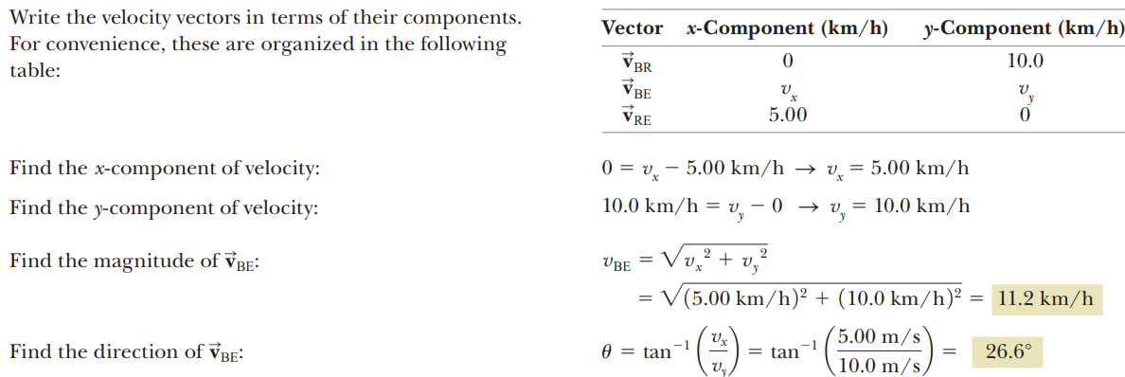
Relative Velocity

Slide 44
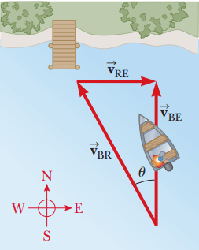
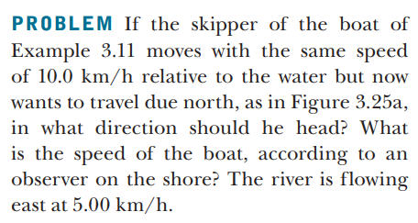
Relative Velocity
Before problem

Slide 45
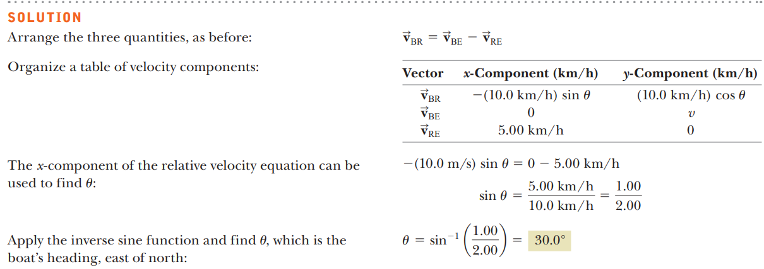
Relative Velocity

Slide 46
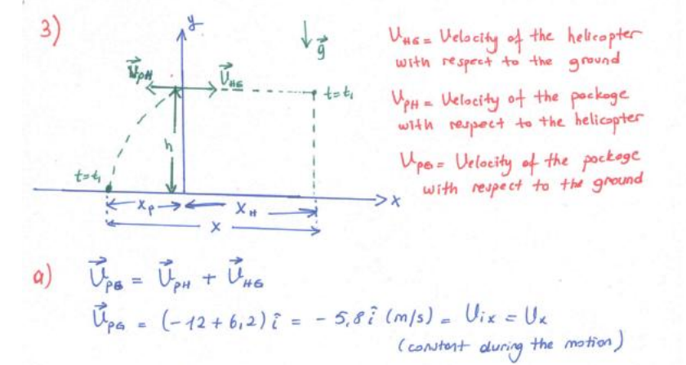
Motion in Two Dimensions

Slide 47
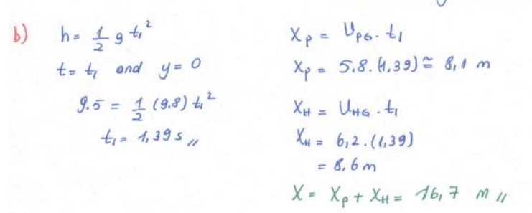
Motion in Two Dimensions

Slide 48
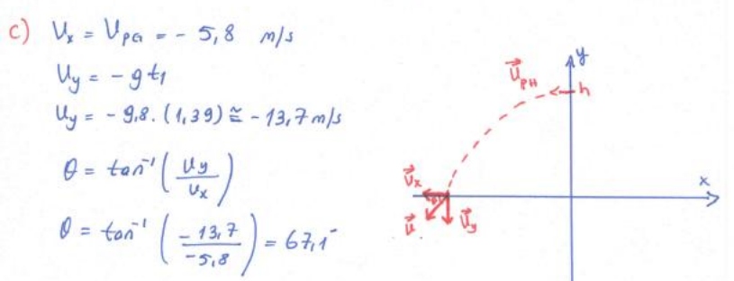
Motion in Two Dimensions

Slide 49
Motion in Two Dimensions

Slide 50
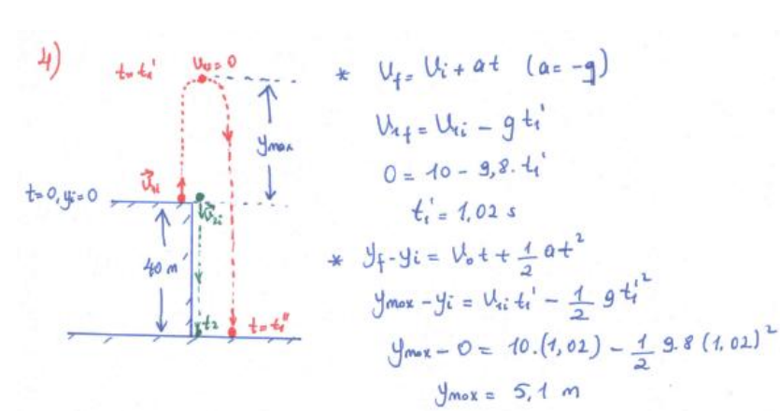
Motion in Two Dimensions

Slide 51
Motion in Two Dimensions

Slide 52
Motion in Two Dimensions

Slide 53
Motion in Two Dimensions

Slide 54
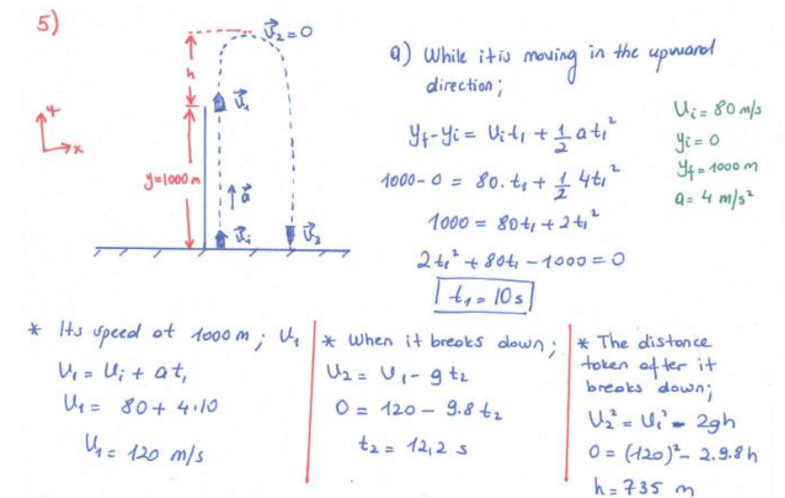
Motion in Two Dimensions

Slide 55
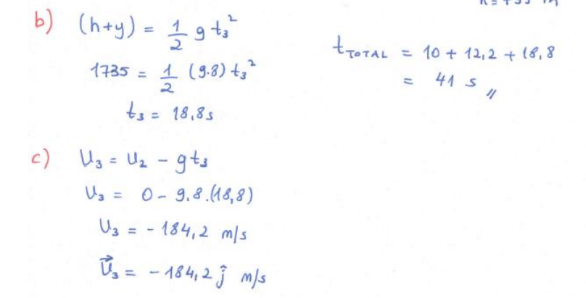
Motion in Two Dimensions

Slide 56
Motion in Two Dimensions

Slide 57
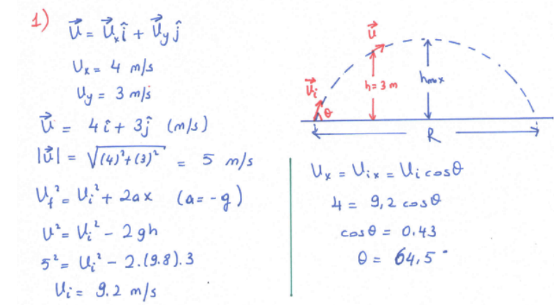
Motion in Two Dimensions

Slide 58
Motion in Two Dimensions

Slide 59
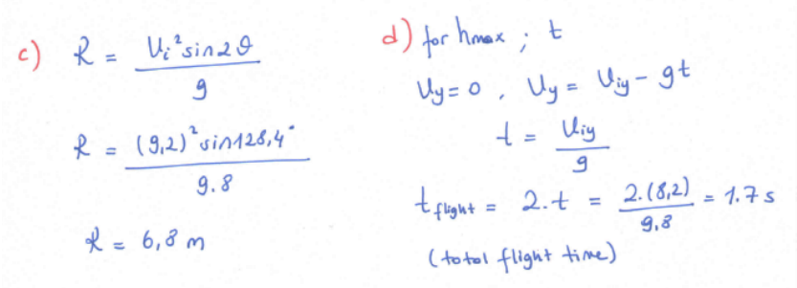
Motion in Two Dimensions

Slide 60
Motion in Two Dimensions

Slide 61
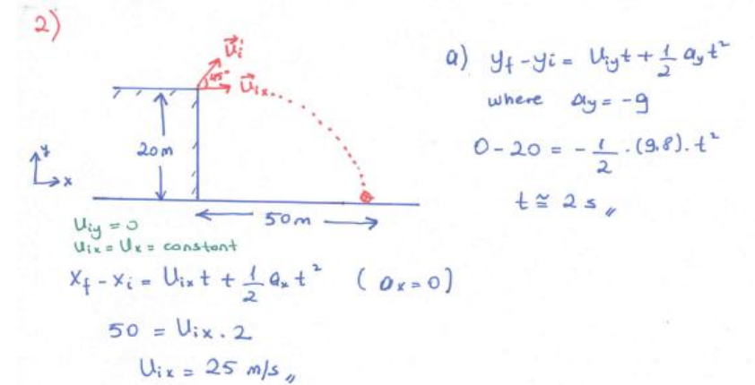
Motion in Two Dimensions

Slide 62
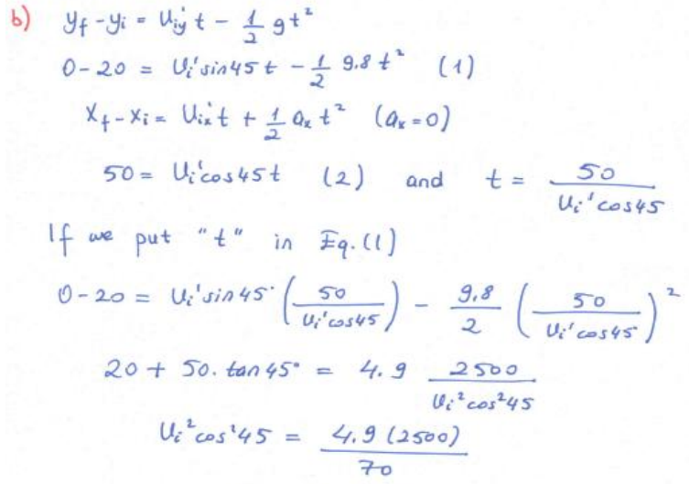
Motion in Two Dimensions

Slide 63
Motion in Two Dimensions

Slide 64
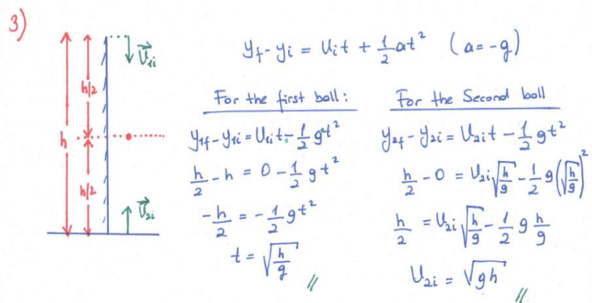
Motion in Two Dimensions

Slide 65
Motion in Two Dimensions

Slide 66
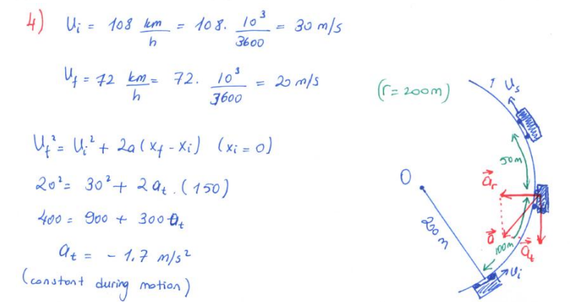
Motion in Two Dimensions

Slide 67
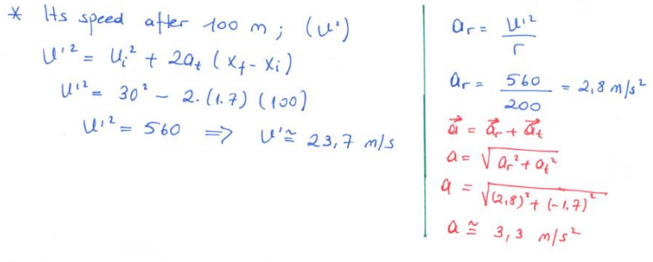
Motion in Two Dimensions

Slide 68
Motion in Two Dimensions

Slide 69
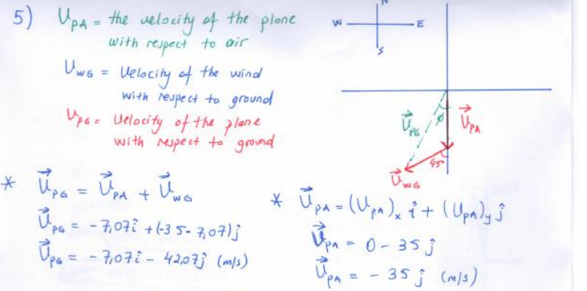
Motion in Two Dimensions

Slide 70
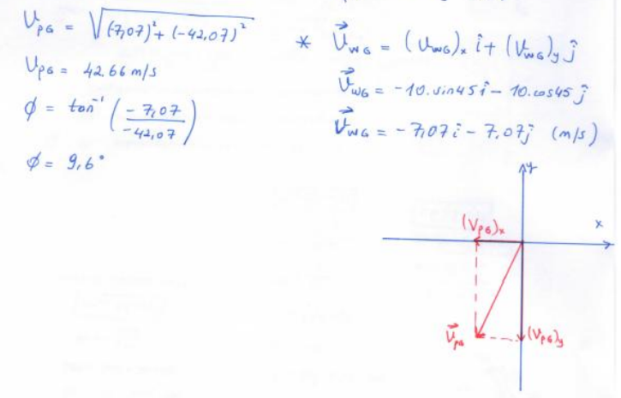
Motion in Two Dimensions

