Slide 1
Chapter 3 Vectors
3.1 Vectors and Their Properties
3.2 Components of a Vector
3.3 Displacement, Velocity, and Acceleration in Two Dimensions
3.4 Motion in Two Dimensions

Slide 2
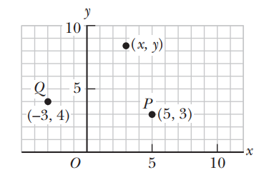
Coordinate Systems
Chapter 3 Vectors
Many aspects of physics deal with locations in space, which require the definition of a coordinate system.
A point on a line can be located with one coordinate, a point in a plane with two coordinates, and a point in space with three.
A coordinate system used to specify locations in space consists of the following:
■ A fixed reference point O, called the origin
■ A set of specified axes, or directions, with an appropriate scale and labels on the axes
■ Instructions on labeling a point in space relative to the origin and axes
Positive x is usually selected as right of the origin and positive y upward from the origin, but in two dimensions this choice is largely a matter of taste. (In three dimensions, however, there are “right-handed” and “left-handed” coordinates, which lead to minus sign differences in certain operations. These will be addressed as needed.)
Designation of points in a two-dimensional Cartesian coordinate system.
Every point is labeled with coordinates (x, y).
For example, the point P in the figure has coordinates (5, 3). If we start at the origin O, we can reach P by moving 5 meters horizontally to the right and then 3 meters vertically upward.
In the same way, the point Q has coordinates (23, 4), which corresponds to going 3 meters horizontally to the left of the origin and 4 meters vertically upward from there.

Slide 3
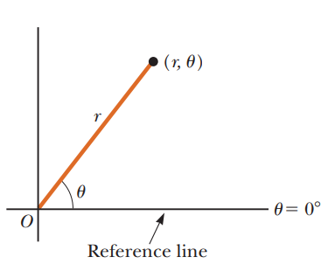
Coordinate Systems
Chapter 3 Vectors
Sometimes it’s more convenient to locate a point in space by its plane polar coordinates (r, u), as in Figure 1.5. In this coordinate system, an origin O and a reference line are selected as shown. A point is then specified by the distance r from the origin to the point and by the angle u between the reference line and a line drawn from the origin to the point. The standard reference line is usually selected to be the positive x-axis of a Cartesian coordinate system. The angle u is considered positive when measured counterclockwise from the reference line and negative when measured clockwise.
The plane polar coordinates of a point are represented by the distance r and the angle u, where u is measured counterclockwise from the positive x-axis.
For example, if a point is specified by the polar coordinates 3 m and 60°, we locate this point by moving out 3 m from the origin at an angle of 60° above (counterclockwise from) the reference line. A point specified by polar coordinates 3 m and 260° is located 3 m out from the origin and 60° below (clockwise from) the reference line.

Slide 4
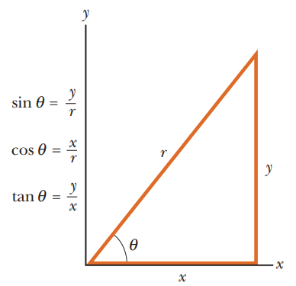
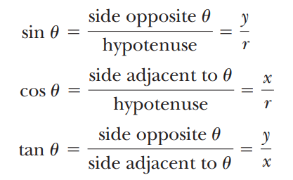
Coordinate Systems
Chapter 3 Vectors
Trigonometry
Consider the right triangle shown in Active Figure , where side y is opposite the angle θ, side x is adjacent to the angle θ, and side r is the hypotenuse of the triangle.
The basic trigonometric functions defined by such a triangle are the ratios of the lengths of the sides of the triangle.
These relationships are called the sine (sin), cosine (cos), and tangent (tan) functions. In terms of θ, the basic trigonometric functions are as follows:
Note that the sine, cosine, and tangent functions are quantities without units because each represents the ratio of two lengths.
Another important relationship, called the Pythagorean theorem, exists between the lengths of the sides of a right triangle:
Certain trigonometric functions of a right triangle.
For example, if the angle θ is equal to 30°, then the ratio of y to r is always 0.50; that is, sin 30° = 0.50.

Slide 5
Coordinate Systems
Chapter 3 Vectors
Finally, it will often be necessary to find the values of inverse relationships.
For example, suppose you know that the sine of an angle is 0.866, but you need to know the value of the angle itself.
The inverse sine function may be expressed as sin⁻¹(0.866), which is a shorthand way of asking the question
“What angle has a sine of 0.866?”
Punching a couple of buttons on your calculator reveals that this angle is 60.0°.
Try it for yourself and show that tan⁻¹ (0.400) = 21.8°.
Be sure that your calculator is set for degrees and not radians.
In addition, the inverse tangent function can return only values between 290° and 190°, so when an angle is in the second or third quadrant, it’s necessary to add 180° to the answer in the calculator window.
The definitions of the trigonometric functions and the inverse trigonometric functions, as well as the Pythagorean theorem, can be applied to any right triangle, regardless of whether its sides correspond to x- and y-coordinates.
These results from trigonometry are useful in converting from rectangular coordinates to polar coordinates, or vice versa, as the next example shows.

Slide 6
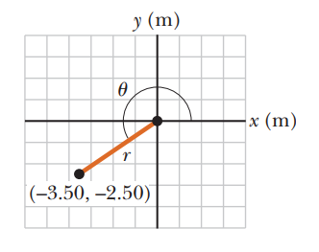
Coordinate Systems
Chapter 3 Vectors
Converting from Cartesian coordinates to polar coordinates.

Slide 7
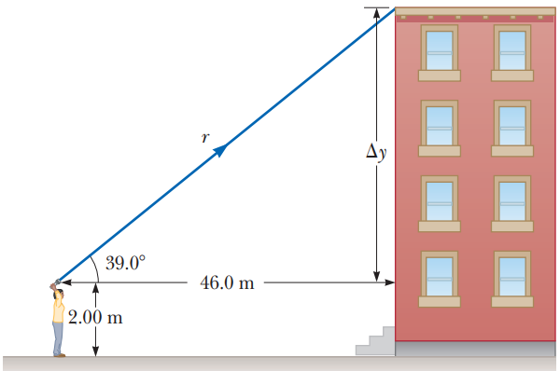
Coordinate Systems
Chapter 3 Vectors

Slide 8
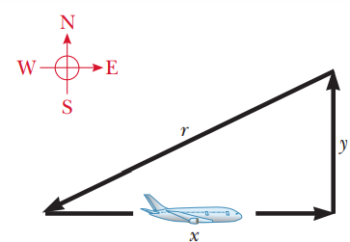
Coordinate Systems
Chapter 3 Vectors

Slide 9
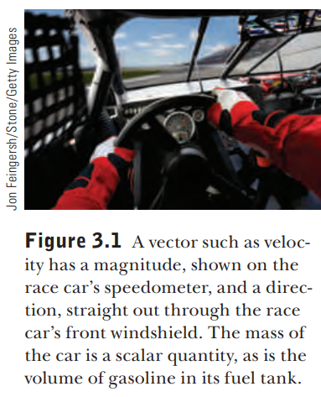
3.1 Vectors and Their Properties
Chapter 3 Vectors
Each of the physical quantities we will encounter in this book can be categorized as either a vector quantity or a scalar quantity.
A scalar can be completely specified by its magnitude with appropriate units; it has no direction.
An example of each kind of quantity is shown in Figure 3.1
Scalar quantities :
• A scalar quantity is completely specified by a single value with an appropriate unit and has no direction.
Temperature is an example of a scalar quantity. If the temperature of an object is 25°C, that information completely specifies the temperature of the object; no direction is required.
Masses, time intervals, and volumes are scalars as well. Scalar quantities can be manipulated with the rules of ordinary arithmetic.
Vector quantities :
A vector quantity is completely specified by a number and appropriate units plus a direction.
displacement, velocity, and acceleration are vector quantities.

Slide 10
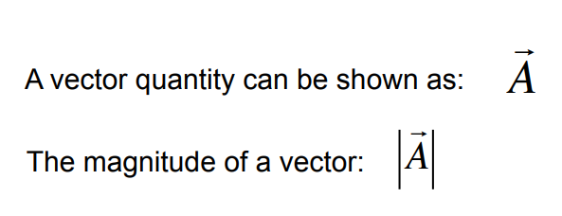
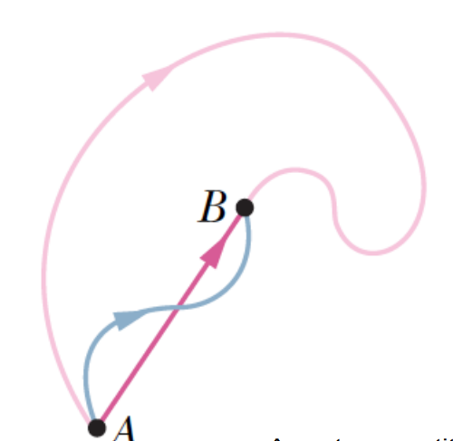
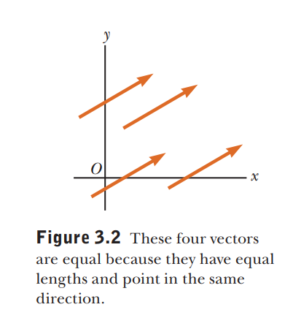
3.1 Vectors and Their Properties
Chapter 3 Vectors
When a vector quantity is handwritten, it is often represented with an arrow over the letter $\vec{A}.$
Equality of Two Vectors
Two vectors $\vec{A}$ and $\vec{B}$ are equal if they have the same magnitude and the same direction.
This property allows us to translate a vector parallel to itself in a diagram without affecting the vector.
In fact, for most purposes, any vector can be moved parallel to itself without being affected.

Slide 11
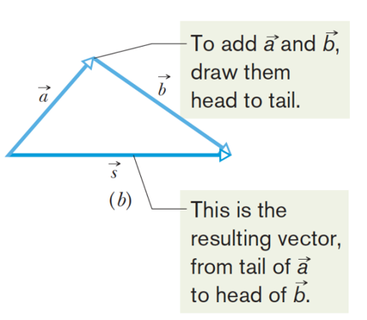
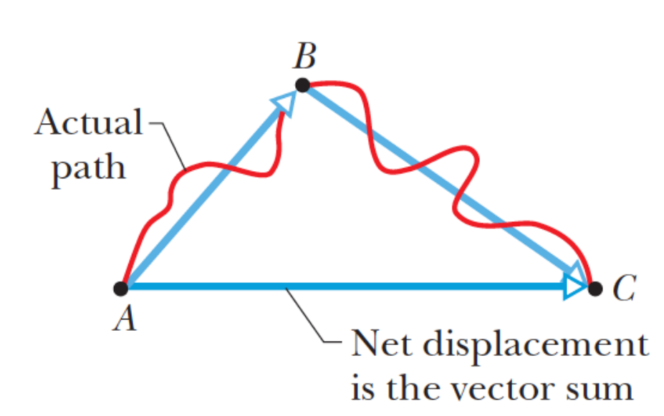
3.1 Vectors and Their Properties
Chapter 3 Vectors
Adding Vectors
When two or more vectors are added, they must all have the same units.
For example, it doesn’t make sense to add a velocity vector, carrying units of meters per second, to a displacement vector, carrying units of meters.
Scalars obey the same rule: It would be similarly meaningless to add temperatures to volumes or masses to time intervals.
Adding Vectors Geometrically

Slide 12
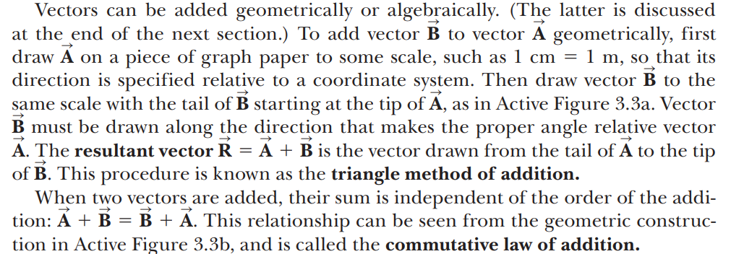
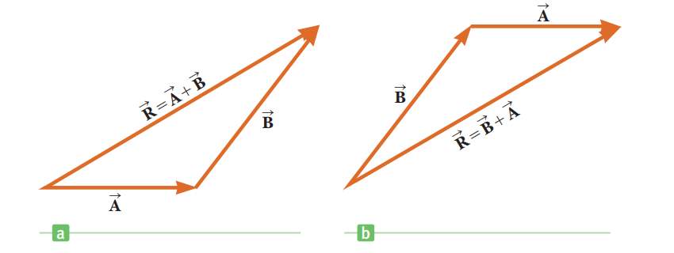
3.1 Vectors and Their Properties
Chapter 3 Vectors
Adding Vectors

Slide 13
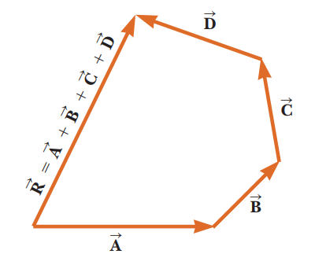
3.1 Vectors and Their Properties
Chapter 3 Vectors
Adding Vectors

Slide 14
3.1 Vectors and Their Properties
Chapter 3 Vectors
Adding Vectors

Slide 15
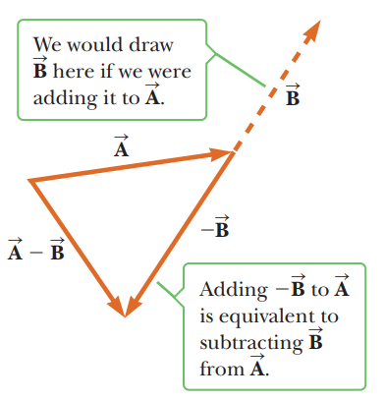
3.1 Vectors and Their Properties
Chapter 3 Vectors
Adding Vectors

Slide 16
3.1 Vectors and Their Properties
Chapter 3 Vectors
Adding Vectors

Slide 17
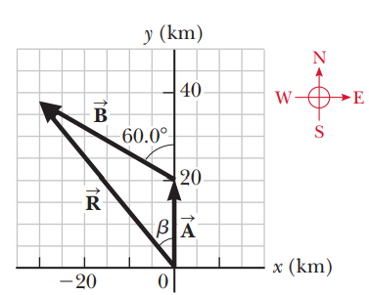
3.1 Vectors and Their Properties
Chapter 3 Vectors

Slide 18
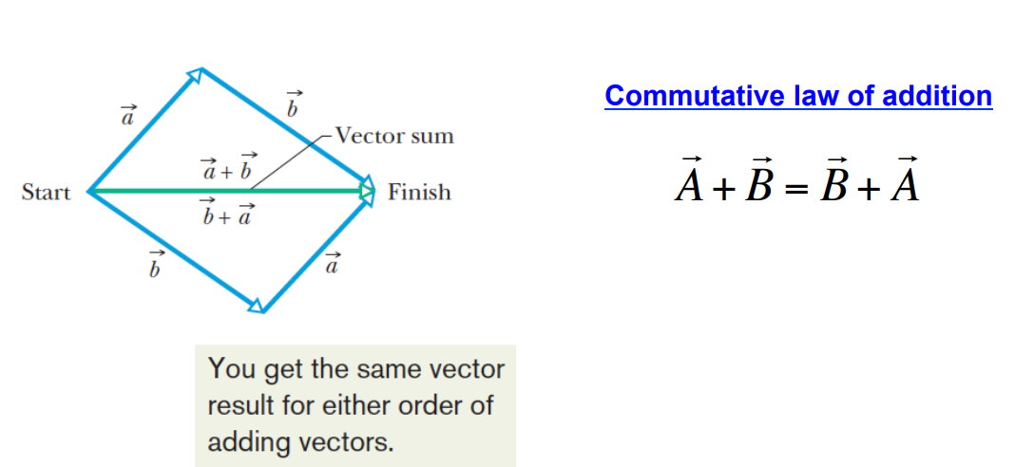
3.1 Vectors and Their Properties
Chapter 3 Vectors
Adding Vectors Geometrically

Slide 19
3.1 Vectors and Their Properties
Chapter 3 Vectors
Adding Vectors Geometrically

Slide 20
3.1 Vectors and Their Properties
Chapter 3 Vectors
Adding Vectors Geometrically

Slide 21
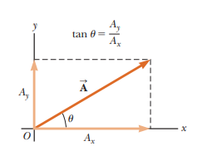
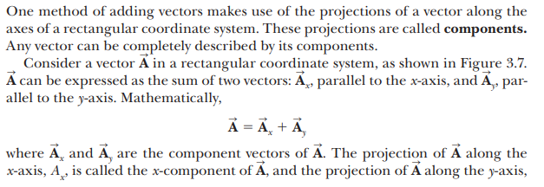
3.1 Vectors and Their Properties
Chapter 3 Vectors
Components of a Vector

Slide 22
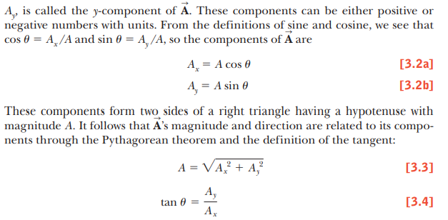
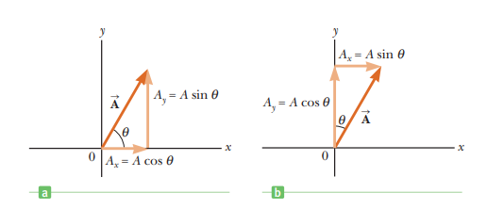
3.1 Vectors and Their Properties
Chapter 3 Vectors
Components of a Vector

Slide 23
3.1 Vectors and Their Properties
Chapter 3 Vectors
Components of a Vector

Slide 24
3.1 Vectors and Their Properties
Chapter 3 Vectors
Components of a Vector

Slide 25
3.1 Vectors and Their Properties
Chapter 3 Vectors
Components of a Vector

Slide 26
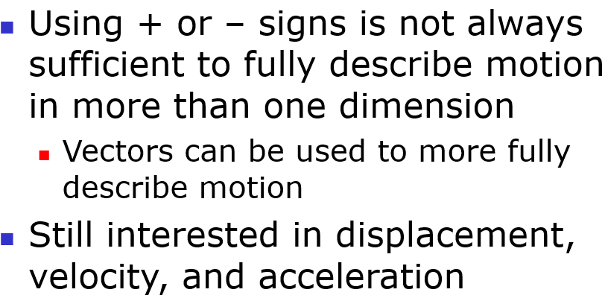
3.1 Vectors and Their Properties
Chapter 3 Vectors
Components of a Vector

Slide 27
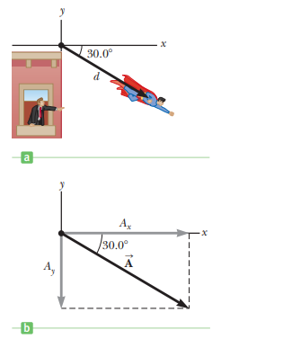
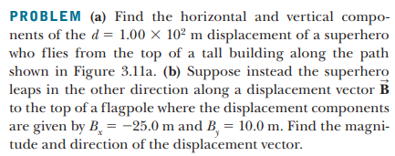
3.1 Vectors and Their Properties
Chapter 3 Vectors
Components of a Vector

Slide 28
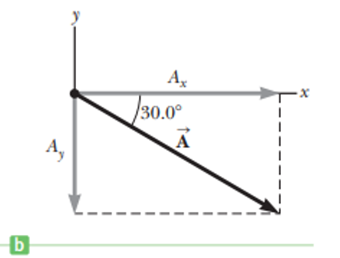
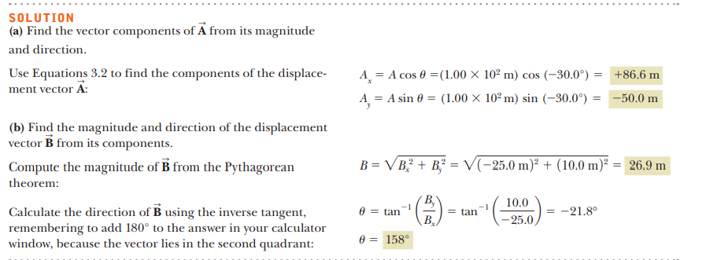
3.1 Vectors and Their Properties
Chapter 3 Vectors
Components of a Vector

Slide 29
3.1 Vectors and Their Properties
Chapter 3 Vectors
Adding Vectors Algebraically

Slide 30
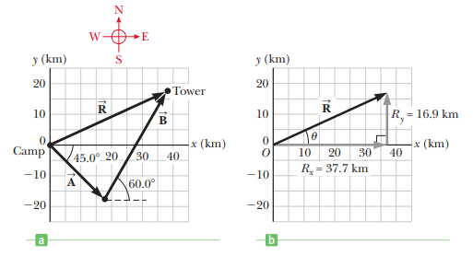
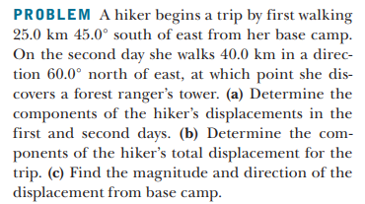
3.1 Vectors and Their Properties
Chapter 3 Vectors
Adding Vectors Algebraically

Slide 31
3.1 Vectors and Their Properties
Chapter 3 Vectors
Adding Vectors Algebraically

Slide 32
3.1 Vectors and Their Properties
Chapter 3 Vectors
Adding Vectors Algebraically

Slide 33
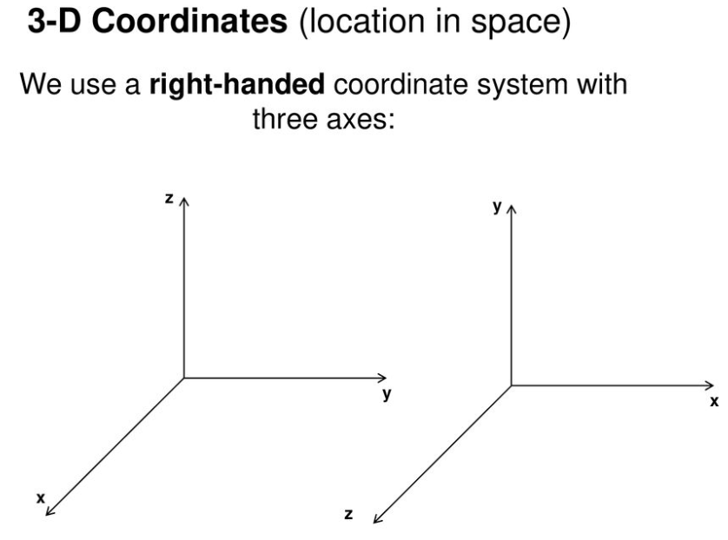
3.1 Vectors and Their Properties
Chapter 3 Vectors

Slide 34
3.1 Vectors and Their Properties
Chapter 3 Vectors

Slide 35
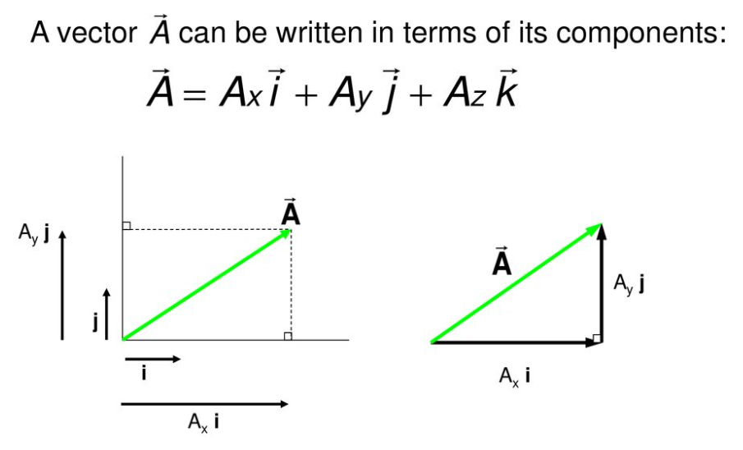
3.1 Vectors and Their Properties
Chapter 3 Vectors

Slide 36
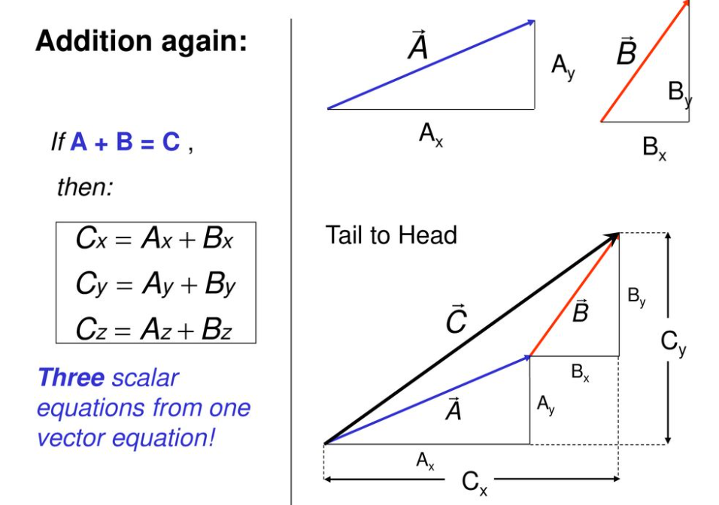
3.1 Vectors and Their Properties
Chapter 3 Vectors

Slide 37
3.1 Vectors and Their Properties
Chapter 3 Vectors

Slide 38
3.1 Vectors and Their Properties
Chapter 3 Vectors

Slide 39
3.1 Vectors and Their Properties
Chapter 3 Vectors

Slide 40
3.1 Vectors and Their Properties
Chapter 3 Vectors

Slide 41
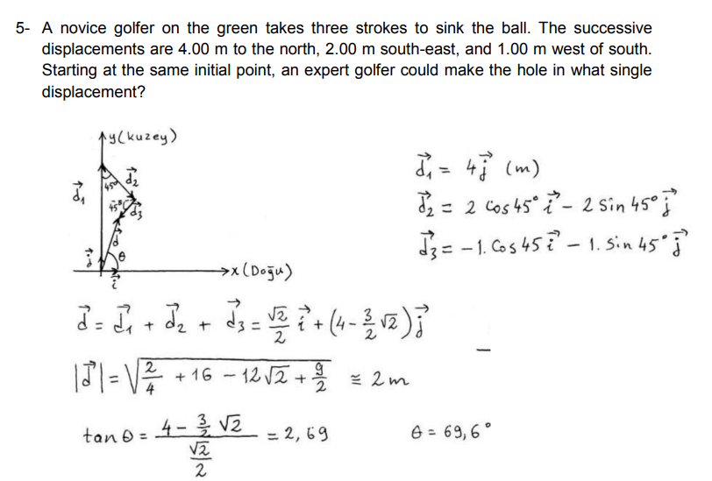
3.1 Vectors and Their Properties
Chapter 3 Vectors

Slide 42
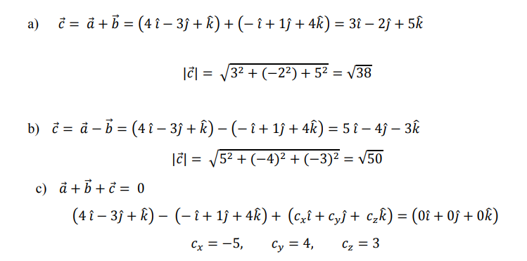
3.1 Vectors and Their Properties
Chapter 3 Vectors

Slide 43
3.1 Vectors and Their Properties
Chapter 3 Vectors

Slide 44
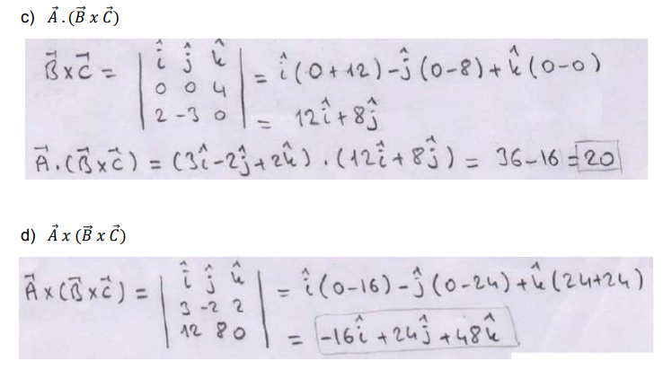
3.1 Vectors and Their Properties
Chapter 3 Vectors

Slide 45
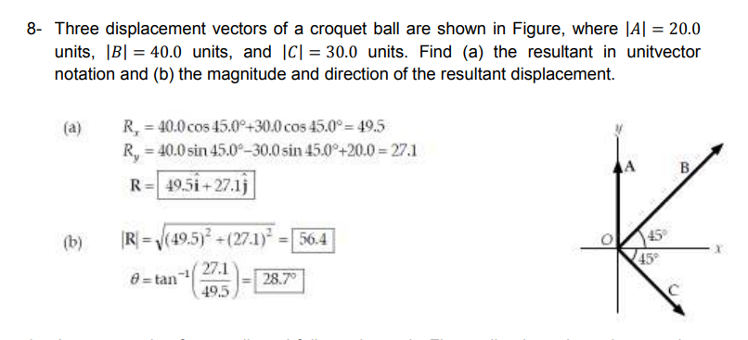
3.1 Vectors and Their Properties
Chapter 3 Vectors

Slide 46
3.1 Vectors and Their Properties
Chapter 3 Vectors

Slide 47
3.1 Vectors and Their Properties
Chapter 3 Vectors

Slide 48
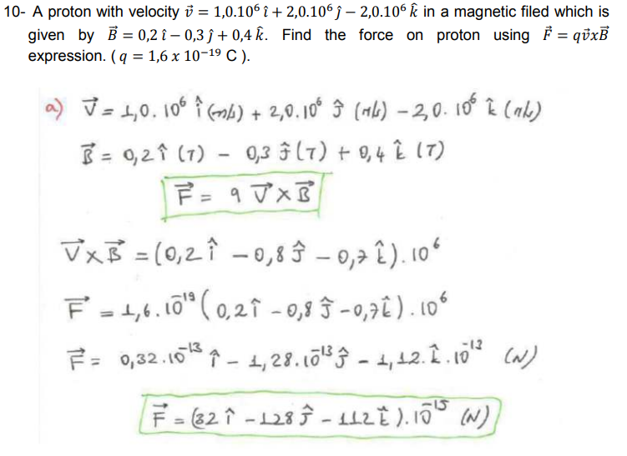
3.1 Vectors and Their Properties
Chapter 3 Vectors

