Slide 1
Chapter 2 Motion Along a Straight Line 2.1. Motion 2.2. Position and Displacement 2.3. Average Velocity and Speed 2.4. Instantaneous Velocity and Speed 2.5. Acceleration 2.6. Constant Acceleration 2.7. Free Fall Acceleration
This early knowledge formed the foundation for the work of Galileo Galilei (1564–1642), who stands out as the dominant facilitator of the entrance of physics into the modern era. In 1609 he became one of the first to make astronomical observations with a telescope.
He observed mountains on the Moon, the larger satellites of Jupiter, spots on the Sun, and the phases of Venus.
Galileo’s observations convinced him of the correctness of the Copernican theory.
His quantitative study of motion formed the foundation of Newton’s revolutionary work in the next century.

Slide 2
2.1. Motion
Chapter 2 Motion Along a Straight Line
Three types of motion are defined in physics
• translational motion: A car moving down a highway
• rotational motion: Earth’s spin on its axis
• vibrational motion: back-and-forth movement of a pendulum
General properties of translation motion
The motion is along a straight line only. The line may be vertical, horizontal, or slanted, but it must be straight.
We discuss only the motion itself and changes in the motion. What causes to this motion will be discussed later.
We will describe the moving object as a particle regardless of its size.

Slide 3
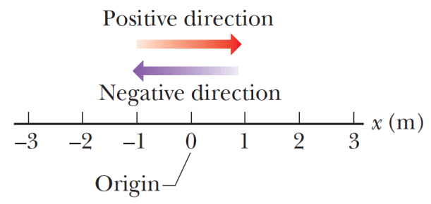
2.1. Motion
Chapter 2 Motion Along a Straight Line
A particle’s position is the location of the particle with respect to a chosen reference point that we can consider to be the origin of a coordinate system.
You can freely choose the positive and negative direction.
Displacement is an example of a vector quantity, which is a quantity that has both a direction and a magnitude.

Slide 4
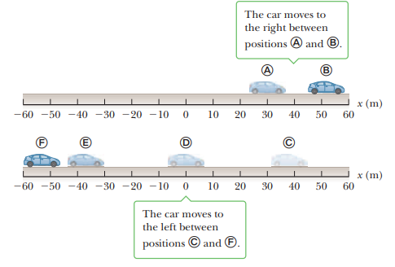
2.2. Position and Displacement
Chapter 2 Motion Along a Straight Line
Motion involves the displacement of an object from one place in space and time to another.
Describing motion requires some convenient coordinate system and a specified origin.
A frame of reference is a choice of coordinate axes that defines the starting point for measuring any quantity, an essential first step in solving virtually any problem in mechanics
In this figure, for example, a car moves along the x-axis. The coordinates of the car at any time describe its position in space and, more importantly, its displacement at some given time of interest
The displacement Δx of an object is defined as its change in position and is given by
where x_{i} is the coordinate of the initial position of the car and
x_{f} is the coordinate of the car’s final position.
(The indices i and f stand for initial and final, respectively.)
We will use the Greek letter delta, Δ, to denote a change in any physical quantity.

Slide 5
2.2. Position and Displacement
Chapter 2 Motion Along a Straight Line
For example, if the car moves from point A to point B so that
the initial position is $x_{i}=30 m$and
the final position is $x_{f}=52 m$,
the displacement is $∆x=x_{f}−x_{İ}=+22 m$.
However, if the car moves from point C to point F, then
the initial position is $x_{i}=38 m$and
the final position is $x_{f}=−53 m$, and
the displacement is $∆x=x_{f}−x_{İ}=−53−38=−91 m$.
positive answer indicates a displacement in

Slide 6
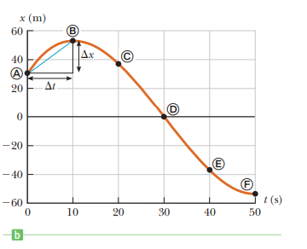
2.2. Position and Displacement
Chapter 2 Motion Along a Straight Line
positive answer indicates a displacement in the positive x-direction, whereas a negative answer indicates a displacement in the negative x-direction.
Active Figure b displays the graph of the car’s position as a function of time.
Because displacement has both a magnitude (size) and a direction, it’s a vector quantity, as are velocity and acceleration.
In general, a vector quantity is characterized by having both a magnitude and a direction.
By contrast, a scalar quantity has magnitude, but no direction. Scalar quantities such as mass and temperature are completely specified by a numeric value with appropriate units; no direction is involved.

Slide 7
2.3. Average Velocity and Speed
Chapter 2 Motion Along a Straight Line
Velocity
In everyday usage the terms speed and velocity are interchangeable.
In physics, however, there’s a clear distinction between them:
Speed is a scalar quantity, having only magnitude, whereas
velocity is a vector, having both magnitude and direction.
Why must velocity be a vector?
If you want to get to a town 70 km away in an hour’s time, it’s not enough to drive at a speed of 70 km/h; you must travel in the correct direction as well.
That’s obvious, but it shows that velocity gives considerably more information than speed, as will be made more precise in the formal definitions.

Slide 8
2.3. Average Velocity and Speed
Chapter 2 Motion Along a Straight Line
Velocity
In everyday usage the terms speed and velocity are interchangeable.
In physics, however, there’s a clear distinction between them:
Speed is a scalar quantity, having only magnitude, whereas
velocity is a vector, having both magnitude and direction.
Why must velocity be a vector?
If you want to get to a town 70 km away in an hour’s time, it’s not enough to drive at a speed of 70 km/h; you must travel in the correct direction as well.
That’s obvious, but it shows that velocity gives considerably more information than speed, as will be made more precise in the formal definitions.

Slide 9
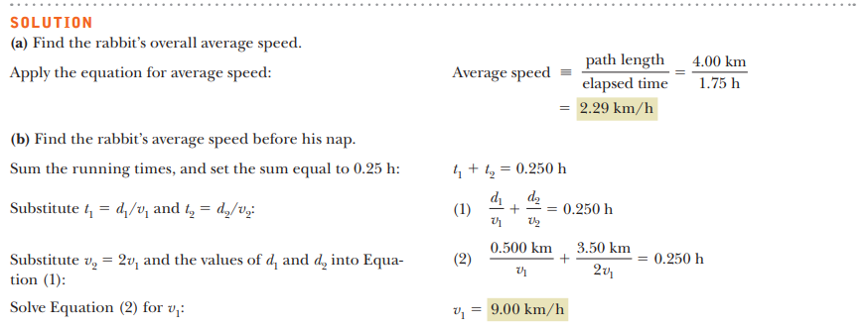
2.3. Average Velocity and Speed
Chapter 2 Motion Along a Straight Line
Velocity

Slide 10
2.3. Average Velocity and Speed
Chapter 2 Motion Along a Straight Line
Velocity
Unlike average speed, average velocity is a vector quantity, having both a magnitude and a direction. Consider again the car of above, moving along the road (the x-axis).
Let the car’s position be x_{i} at some time t_{i} and x_{f} at a later time t_{f} .
In the time interval $∆t=t_{f}−t_{i}$,
the displacement of the car is $∆x=x_{f}−x_{i}$ .

Slide 11
2.3. Average Velocity and Speed
Chapter 2 Motion Along a Straight Line
Velocity
Unlike the average speed, which is always positive,
the average velocity of an object in one dimension can be either positive or negative, depending on the sign of the displacement. (The time interval Δt is always positive.)

Slide 12
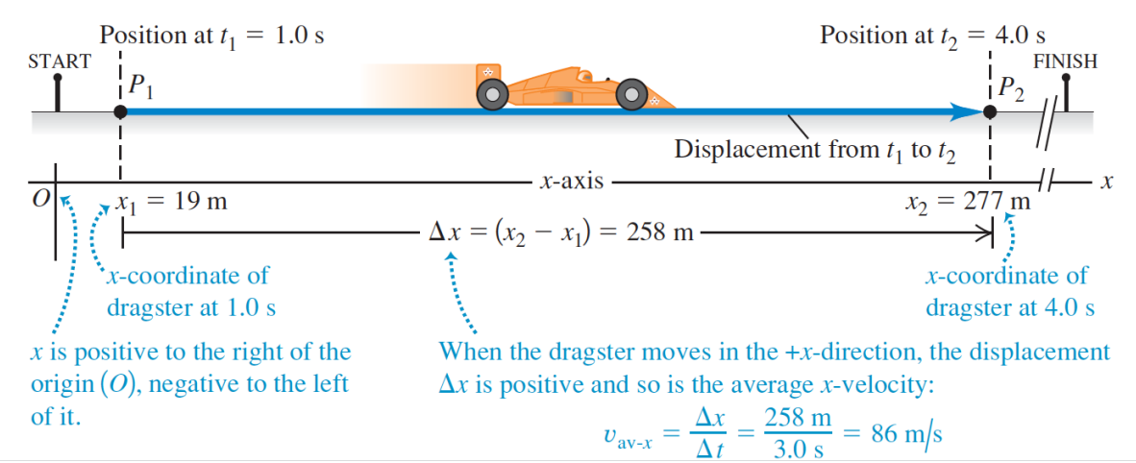
2.3. Average Velocity and Speed
Chapter 2 Motion Along a Straight Line
Velocity
Unlike the average speed, which is always positive,
the average velocity of an object in one dimension can be either positive or negative, depending on the sign of the displacement. (The time interval Δt is always positive.)

Slide 13
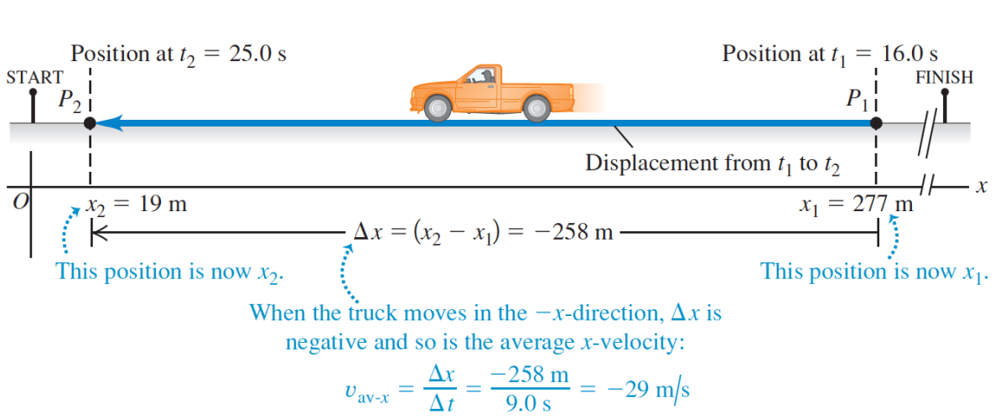
2.3. Average Velocity and Speed
Chapter 2 Motion Along a Straight Line
Velocity
Unlike the average speed, which is always positive,
the average velocity of an object in one dimension can be either positive or negative, depending on the sign of the displacement. (The time interval Δt is always positive.)

Slide 14
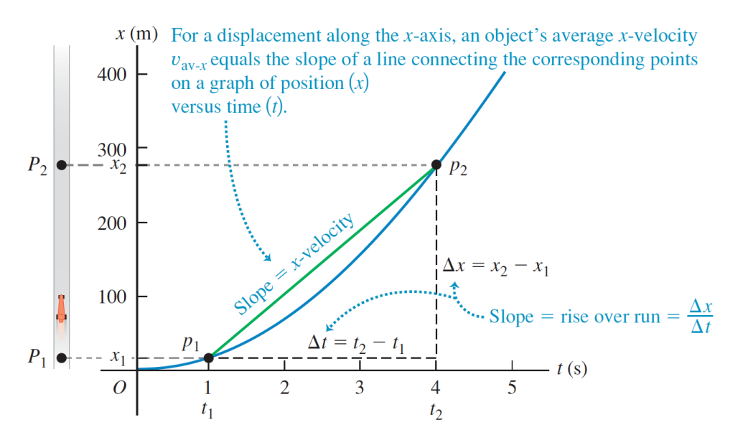
2.3. Average Velocity and Speed
Chapter 2 Motion Along a Straight Line
Velocity
Unlike the average speed, which is always positive,
the average velocity of an object in one dimension can be either positive or negative, depending on the sign of the displacement. (The time interval Δt is always positive.)

Slide 15
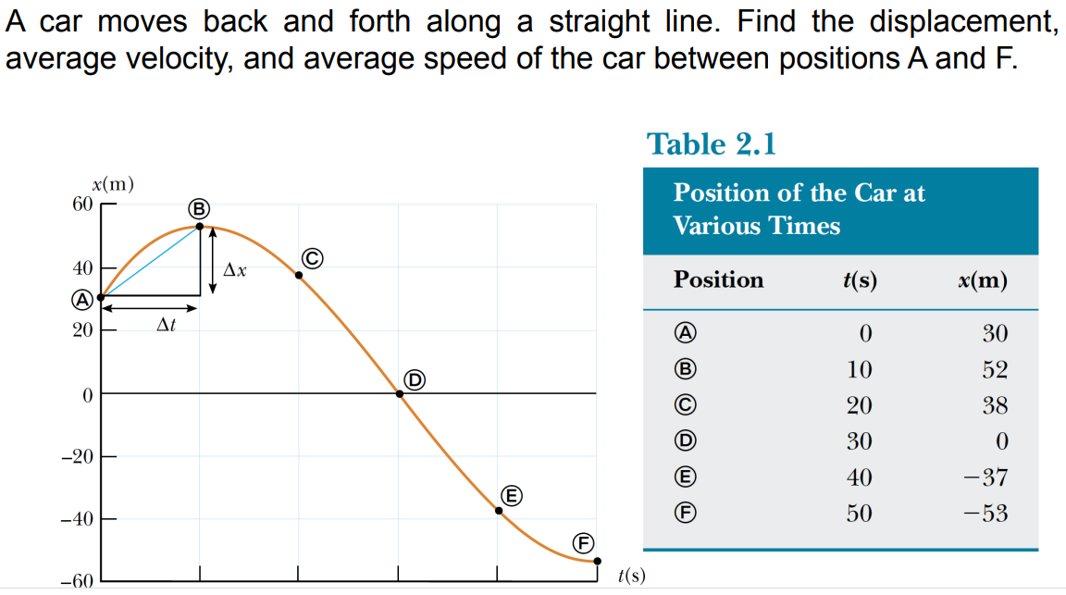
2.3. Average Velocity and Speed
Chapter 2 Motion Along a Straight Line
Velocity

Slide 16
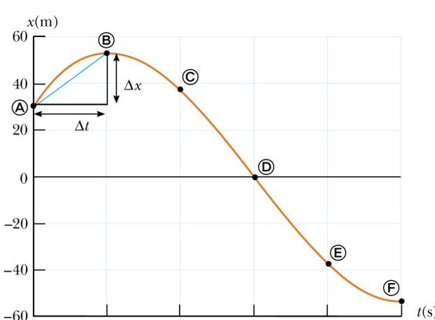
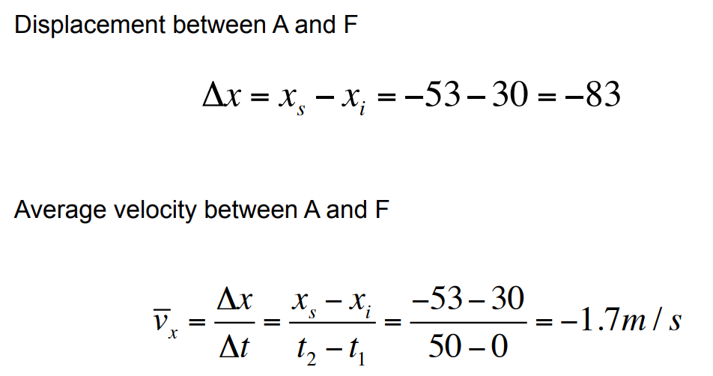
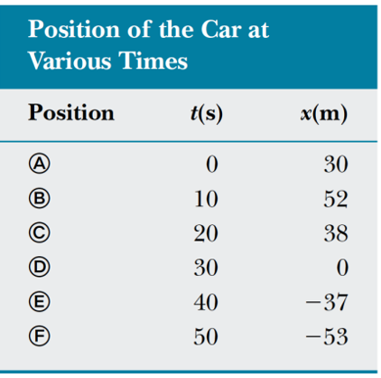
2.3. Average Velocity and Speed
Chapter 2 Motion Along a Straight Line
Velocity

Slide 17
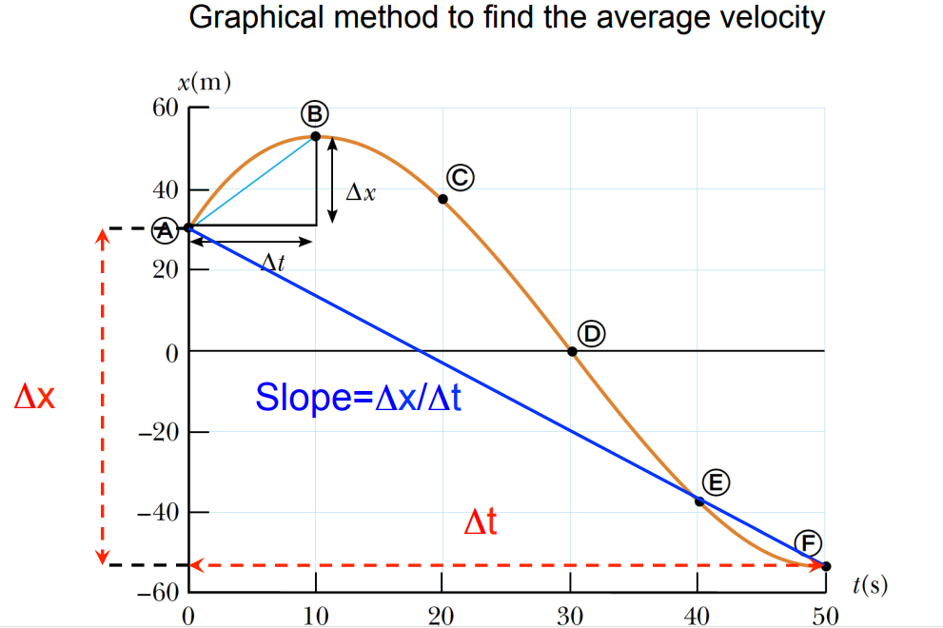
2.3. Average Velocity and Speed
Chapter 2 Motion Along a Straight Line
Velocity

Slide 18
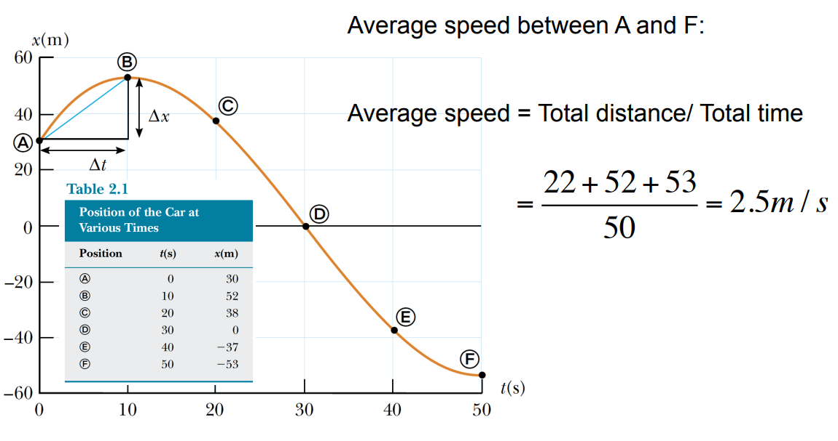
2.3. Average Velocity and Speed
Chapter 2 Motion Along a Straight Line
Velocity

Slide 19
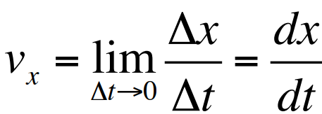
Chapter 2 Motion Along a Straight Line
Instantaneous Velocity
Average velocity doesn’t take into account the details of what happens during an interval of time. On a car trip, for example, you may speed up or slow down a number of times in response to the traffic and the condition of the road, and on rare occasions even pull over to chat with a police officer about your speed.
What is most important to the police (and to your own safety) is the speed of your car and the direction it was going at a particular instant in time, which together determine the car’s instantaneous velocity.
So in driving a car between two points, the average velocity must be computed over an interval of time, but the magnitude of instantaneous velocity can be read on the car’s speedometer.

Slide 20
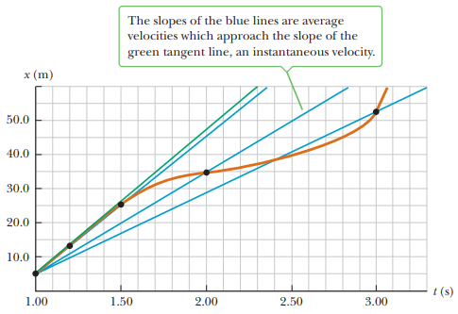
Chapter 2 Motion Along a Straight Line
Instantaneous Velocity
As can be seen in Figure, the chords formed by the blue lines gradually approach a tangent line as the time interval becomes smaller.
The slope of the line tangent to the position vs. time curve at “a given time” is defined to be the instantaneous velocity at that time.
The instantaneous speed of an object, which is a scalar quantity, is defined as the magnitude of the instantaneous velocity.
Like average speed, instantaneous speed (which we will usually call, simply, “speed”) has no direction associated with it and hence carries no algebraic sign. For example, if one object has an instantaneous velocity of +15 m/s along a given line and another object has an instantaneous velocity of -15 m/s along the same line, both have an instantaneous speed of 15 m/s.

Slide 21
Chapter 2 Motion Along a Straight Line
Instantaneous Velocity

Slide 22
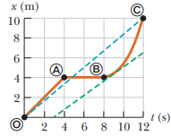
Chapter 2 Motion Along a Straight Line
Instantaneous Velocity

Slide 23
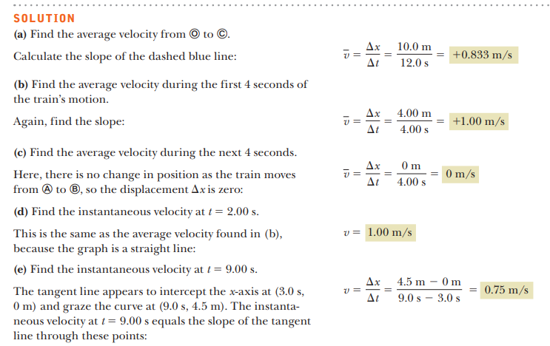
Chapter 2 Motion Along a Straight Line
Instantaneous Velocity

Slide 24
Chapter 2 Motion Along a Straight Line
Instantaneous Velocity

Slide 25
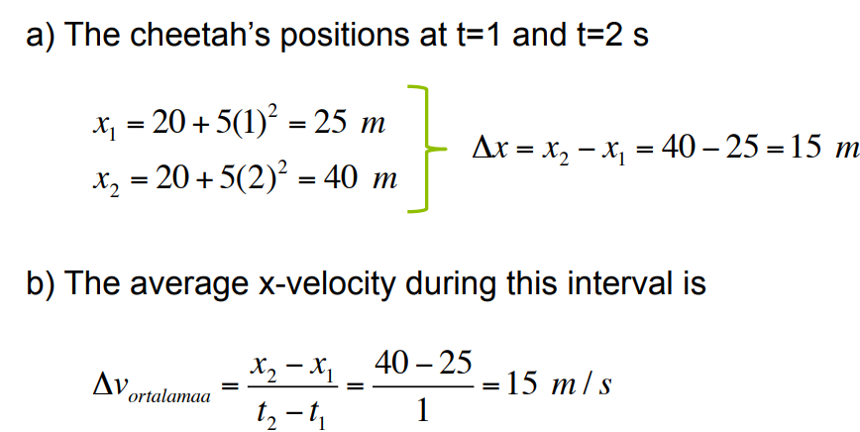
Chapter 2 Motion Along a Straight Line
Instantaneous Velocity

Slide 26
Chapter 2 Motion Along a Straight Line
Instantaneous Velocity

Slide 27
Chapter 2 Motion Along a Straight Line
Instantaneous Velocity

Slide 28
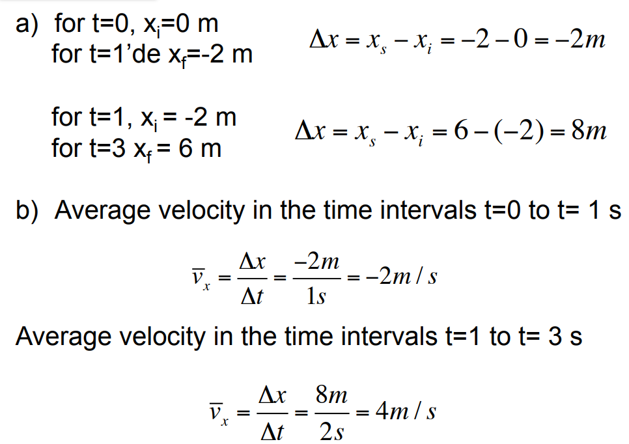
Chapter 2 Motion Along a Straight Line
Instantaneous Velocity

Slide 29
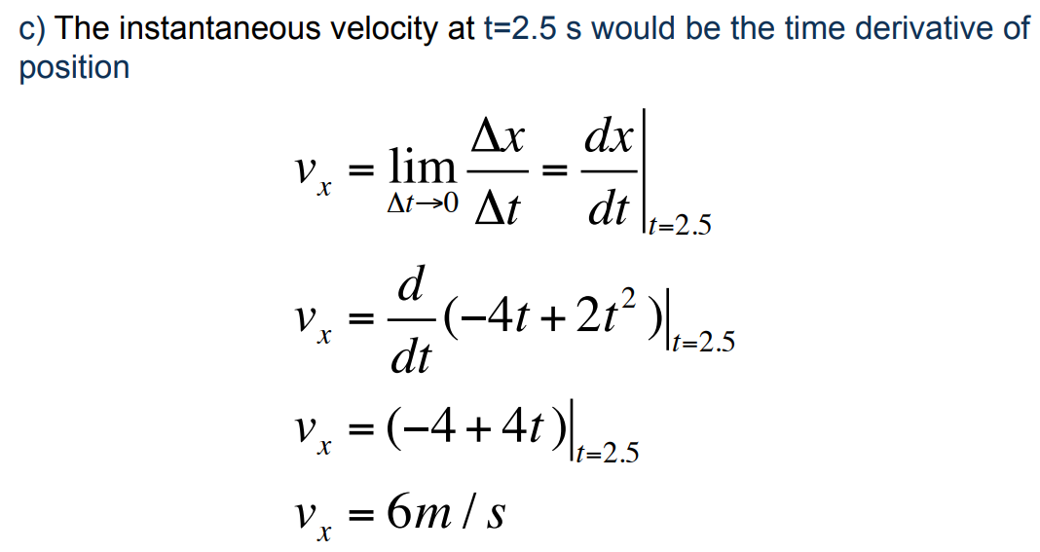
Chapter 2 Motion Along a Straight Line
Instantaneous Velocity

Slide 30
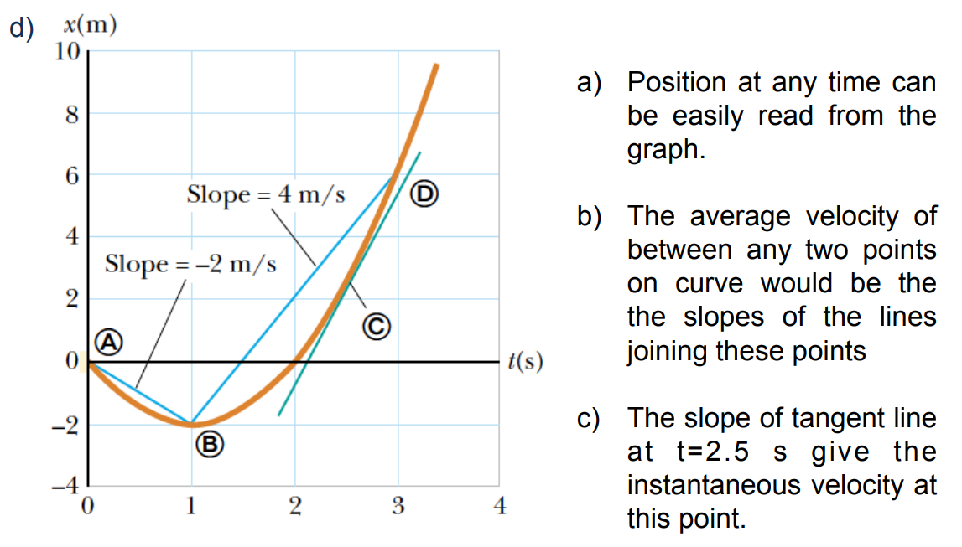
Chapter 2 Motion Along a Straight Line
Instantaneous Velocity

Slide 31
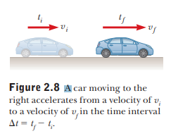
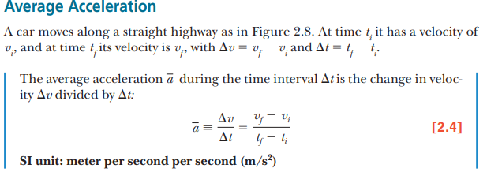
Chapter 2 Motion Along a Straight Line
Acceleration
Going from place to place in your car, you rarely travel long distances at constant velocity. The velocity of the car increases when you step harder on the gas pedal and decreases when you apply the brakes. The velocity also changes when you round a curve, altering your direction of motion. The changing of an object’s velocity with time is called acceleration.

Slide 32
Chapter 2 Motion Along a Straight Line
Acceleration

Slide 33
Chapter 2 Motion Along a Straight Line
Acceleration
Acceleration is a vector quantity having dimensions of length divided by the time squared. Common units of acceleration are meters per second per second ((m/s)/s, which is usually written m/s²) and feet per second per second (ft/s²).
An average acceleration of +5 m/s² means that, on average, the car increases its velocity by 5 m/s every second in the positive x-direction.
For the case of motion in a straight line, the direction of the velocity of an object and the direction of its acceleration are related as follows:
When the object’s velocity and acceleration are in the same direction, the speed of the object increases with time.
When the object’s velocity and acceleration are in opposite directions, the speed of the object decreases with time.

Slide 34
Chapter 2 Motion Along a Straight Line
Acceleration
The minus sign indicates that the acceleration vector is also in the negative x-direction.
Because the velocity and acceleration vectors are in the same direction, the speed of the car must increase as the car moves to the left.
Positive and negative accelerations specify directions relative to chosen axes, not “speeding up” or “slowing down.”
The terms speeding up or slowing down refer to an increase and a decrease in speed, respectively.

Slide 35
Chapter 2 Motion Along a Straight Line
Acceleration

Slide 36
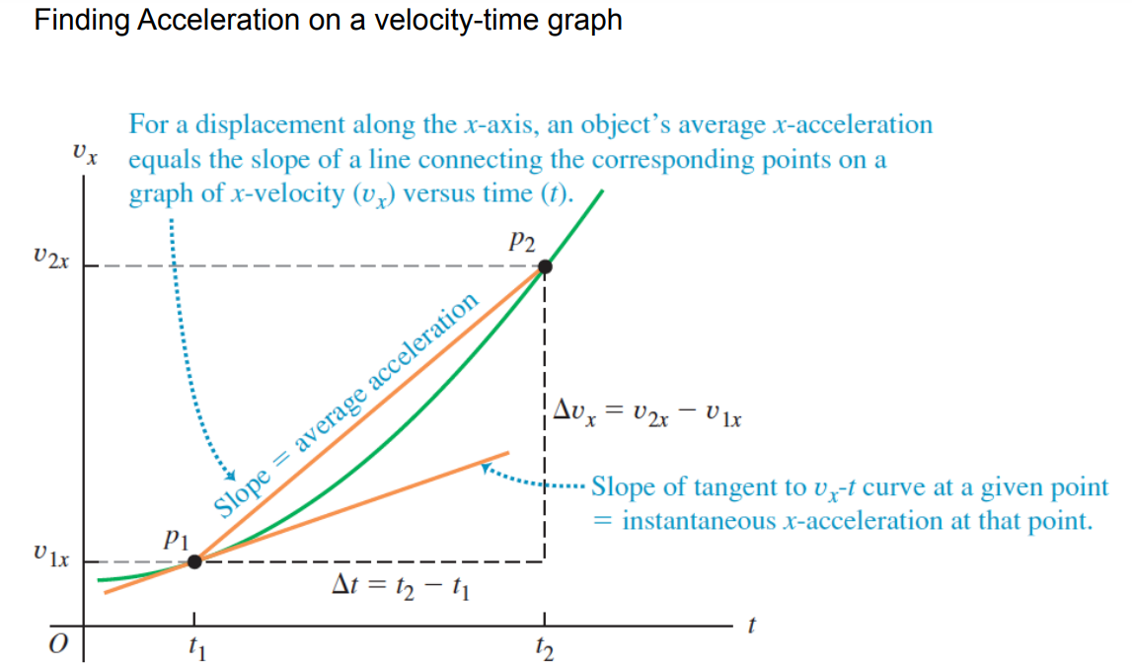
Chapter 2 Motion Along a Straight Line
Acceleration

Slide 37
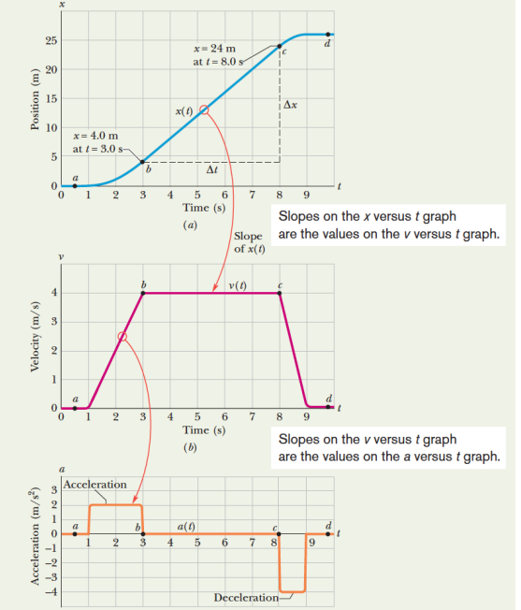
Chapter 2 Motion Along a Straight Line
Acceleration

Slide 38
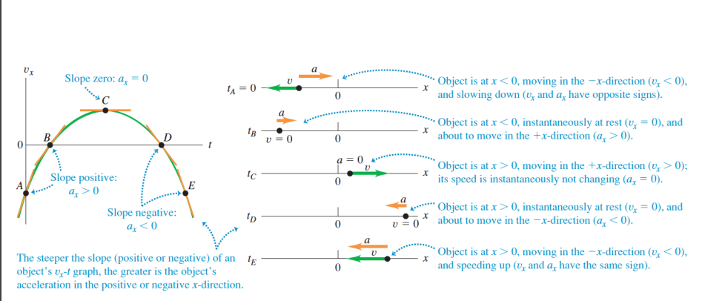
Chapter 2 Motion Along a Straight Line
Acceleration

Slide 39
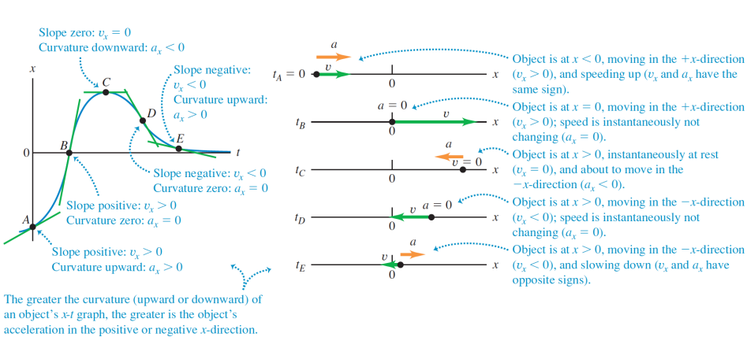
Chapter 2 Motion Along a Straight Line
Acceleration

Slide 40
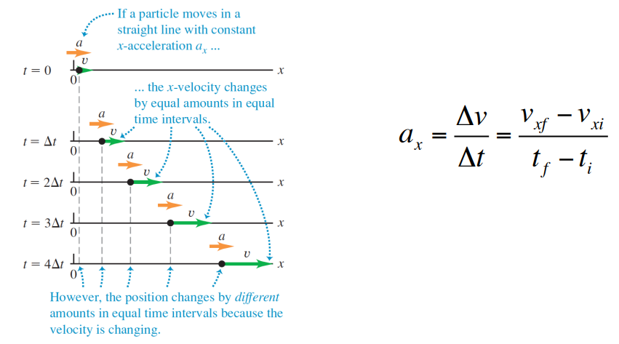
Chapter 2 Motion Along a Straight Line
Acceleration

Slide 41
Chapter 2 Motion Along a Straight Line
Instantaneous Acceleration
The value of the average acceleration often differs in different time intervals, so it’s useful to define the instantaneous acceleration, which is analogous to the instantaneous velocity discussed before

Slide 42
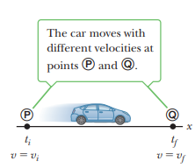
Chapter 2 Motion Along a Straight Line
Instantaneous Acceleration

Slide 43
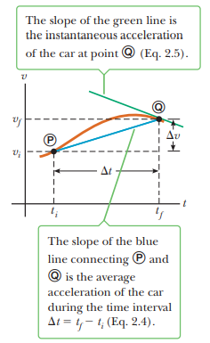
Chapter 2 Motion Along a Straight Line
Instantaneous Acceleration

Slide 44
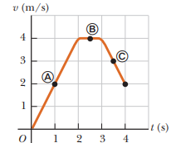
Chapter 2 Motion Along a Straight Line
Instantaneous Acceleration

Slide 45
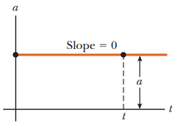
Chapter 2 Motion Along a Straight Line
One-Dimensional Motion with Constant Acceleration
Many applications of mechanics involve objects moving with constant acceleration. This type of motion is important because it applies to numerous objects in nature, such as an object in free fall near Earth’s surface (assuming air resistance can be neglected). A graph of acceleration versus time for motion with constant acceleration is shown in Active Figure
When an object moves with constant acceleration, the instantaneous acceleration at any point in a time interval is equal to the value of the average acceleration over the entire time interval. Consequently, the velocity increases or decreases at the same rate throughout the motion, and a plot of v versus t gives a straight line with either positive, zero, or negative slope. Because the average acceleration equals the instantaneous acceleration when a is constant, we can eliminate the bar used to denote average values from our defining equation for acceleration, writing$\overline{a}=a$, so that Equation 2.4 becomes

Slide 46
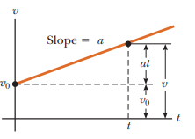
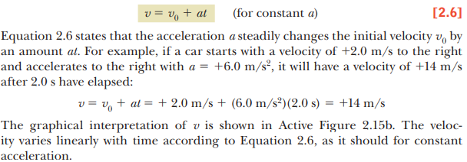
Chapter 2 Motion Along a Straight Line
One-Dimensional Motion with Constant Acceleration

Slide 47
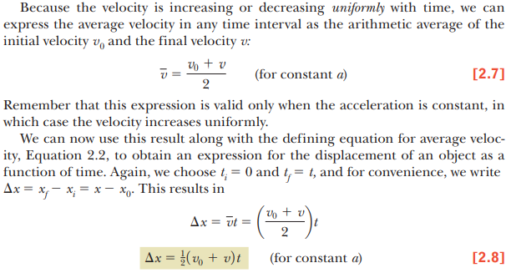
Chapter 2 Motion Along a Straight Line
One-Dimensional Motion with Constant Acceleration

Slide 48
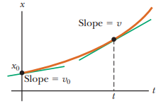
Chapter 2 Motion Along a Straight Line
One-Dimensional Motion with Constant Acceleration

Slide 49
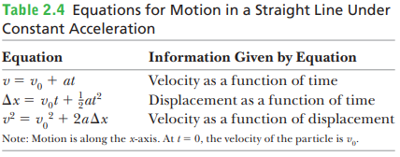
Chapter 2 Motion Along a Straight Line
One-Dimensional Motion with Constant Acceleration

Slide 50
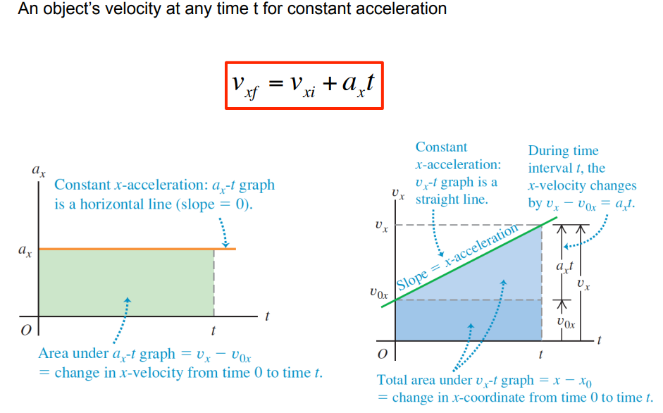
Chapter 2 Motion Along a Straight Line
One-Dimensional Motion with Constant Acceleration

Slide 51
Chapter 2 Motion Along a Straight Line
One-Dimensional Motion with Constant Acceleration

Slide 52
Chapter 2 Motion Along a Straight Line
One-Dimensional Motion with Constant Acceleration

Slide 53
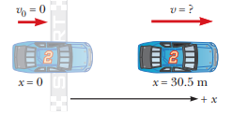
Chapter 2 Motion Along a Straight Line
One-Dimensional Motion with Constant Acceleration

Slide 54
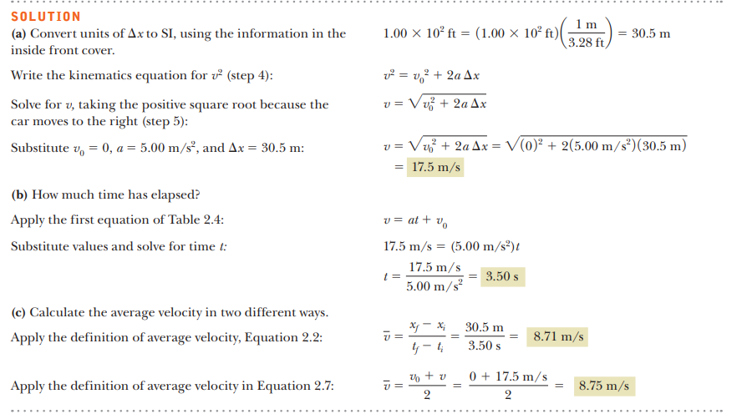
Chapter 2 Motion Along a Straight Line
One-Dimensional Motion with Constant Acceleration

Slide 55
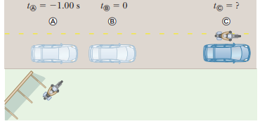
Chapter 2 Motion Along a Straight Line
One-Dimensional Motion with Constant Acceleration

Slide 56
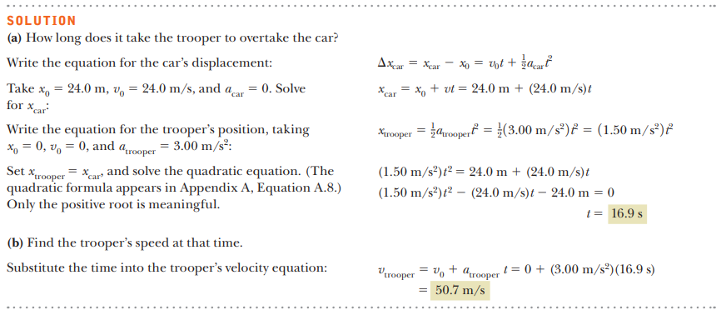
Chapter 2 Motion Along a Straight Line
One-Dimensional Motion with Constant Acceleration

Slide 57
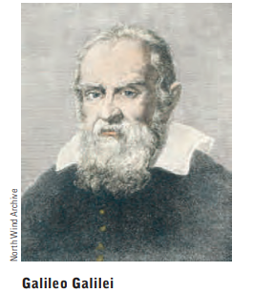
Freely Falling Objects
Chapter 2 Motion Along a Straight Line
When air resistance is negligible, all objects dropped under the influence of gravity near Earth’s surface fall toward Earth with the same constant acceleration. This idea may seem obvious today, but it wasn’t until about 1600 that it was accepted. Prior to that time, the teachings of the great philosopher Aristotle (384–322 b.c.) had held that heavier objects fell faster than lighter ones.
The expression freely falling object doesn’t necessarily refer to an object dropped from rest. A freely falling object is any object moving freely under the influence of gravity alone, regardless of its initial motion. Objects thrown upward or downward and those released from rest are all considered freely falling.
We denote the magnitude of the free-fall acceleration by the symbol g.
The value of g decreases with increasing altitude, and varies slightly with latitude as well. At Earth’s surface, the value of g is approximately 9.80 m/s².
Unless stated otherwise, we will use this value for g in doing calculations.
For quick estimates, use g < 10 m/s²

Slide 58
Freely Falling Objects
Chapter 2 Motion Along a Straight Line

Slide 59
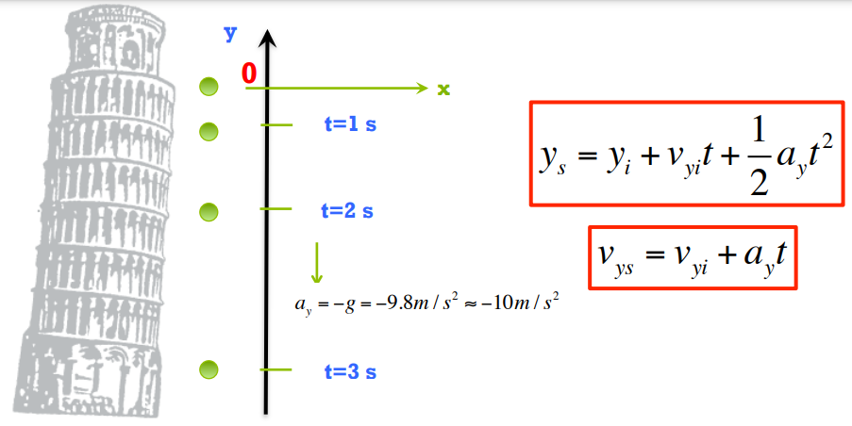
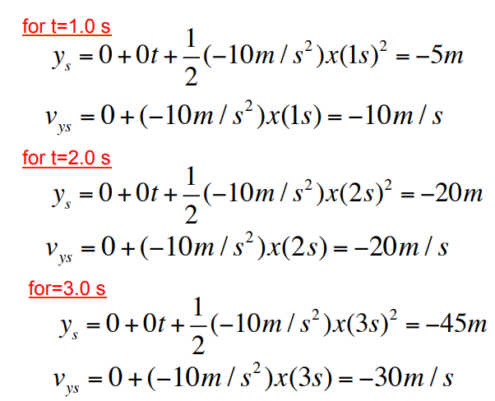
Freely Falling Objects
Chapter 2 Motion Along a Straight Line

Slide 60
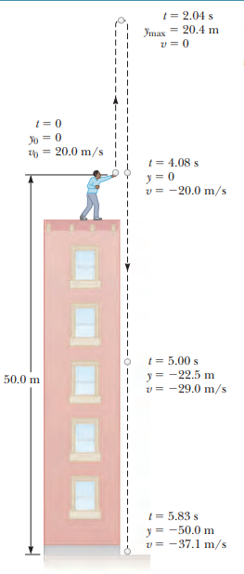
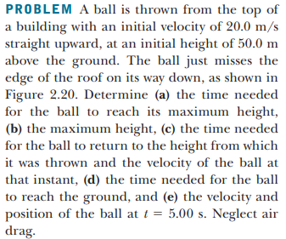
Freely Falling Objects
Chapter 2 Motion Along a Straight Line

Slide 61
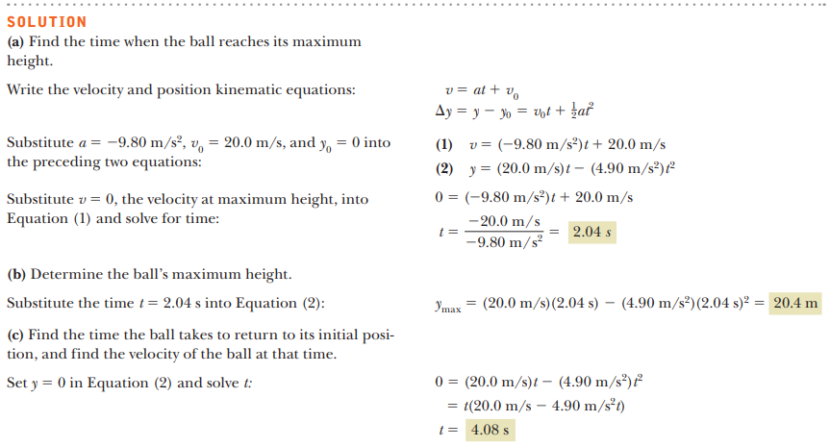
Freely Falling Objects
Chapter 2 Motion Along a Straight Line

Slide 62
Freely Falling Objects
Chapter 2 Motion Along a Straight Line

Slide 63
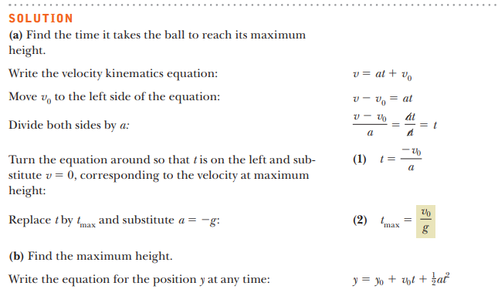
Freely Falling Objects
Chapter 2 Motion Along a Straight Line
Before example

Slide 64
Freely Falling Objects
Chapter 2 Motion Along a Straight Line
Before example

Slide 65
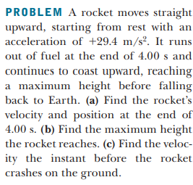
Freely Falling Objects
Chapter 2 Motion Along a Straight Line

Slide 66
Freely Falling Objects
Chapter 2 Motion Along a Straight Line

