Slide 1
Chapter 1 Physics and Measurements 1.1 Standards of Length, Mass and Time 1.4 Dimensional Analysis 1.5 Conversion of Units 1.7 Uncertainty in Measurement and Significant Figures
To communicate the result of a measurement of a certain physical quantity, a unit for the quantity must be defined.
If our fundamental unit of length is defined to be 1.0 meter, for example, and someone familiar with our system of measurement reports that a wall is 2.0 meters high, we know that the height of the wall is twice the fundamental unit of length.
Likewise, if our fundamental unit of mass is defined as 1.0 kilogram and we are told that a person has a mass of 75 kilograms, then that person has a mass 75 times as great as the fundamental unit of mass.
In 1960 an international committee agreed on a standard system of units for the fundamental quantities of science, called SI (Système International). Its units of length, mass, and time are the meter, kilogram, and second, respectively

Slide 2
Chapter 1 Physics and Measurements 1.1 Standards of Length, Mass and Time 1.4 Dimensional Analysis 1.5 Conversion of Units 1.7 Significant Figures

Slide 3
To develop a scientific theory: • Ask appropriate question • Design experiments to try to answer the question • Draw appropriate conclusions from experimental results An Example: The legendary experiment of Galileo Galilei and his theory about the gravitation field.
Chapter 1 Physics and Measurements
Physics is an experimental science.
Observation the phenomena of nature
+
Try the find a pattern relate to this phenomena
THEORY
Experiments require measurements and generally the numbers are used to describe the results of measurements. When we measure a quantity we always compare it with some reference standard.

Slide 4
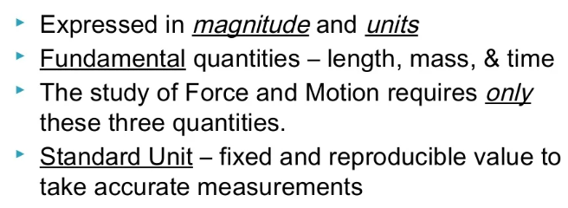
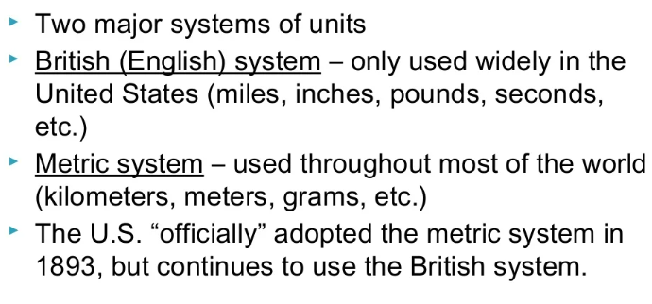
Chapter 1 Physics and Measurements 1.1 Standards of Length, Mass and Time

Slide 5
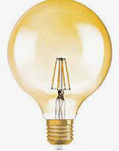
1.1 Standards of Length, Mass and Time
Chapter 1 Physics and Measurements
Definition of the meter
Length
In 1799 the legal standard of length in France became the meter, defined as one ten-millionth of the distance from the equator to the North Pole.
Until 1960, the official length of the meter was the distance between two lines on a specific bar of platinum-iridium alloy stored under controlled conditions.
This standard was abandoned for several reasons, the principal one being that measurements of the separation between the lines are not precise enough.
In 1960 the meter was defined as 1 650 763.73 wavelengths of orange-red light emitted from a krypton-86 lamp.
In October 1983 this definition was abandoned also, and the meter was redefined as the distance traveled by light in vacuum during a time interval of 1/299 792 458 second. This latest definition establishes the speed of light at 299 792 458 meters per second.
One meter (m) is the distance that light travels in vacuum in 1 / 299,792,458 second
1 meter

Slide 6
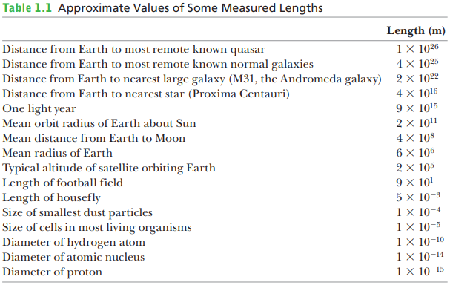
1.1 Standards of Length, Mass and Time
Chapter 1 Physics and Measurements
Definition of the meter
Approximate values of some lengths, intervals are presented in Tables 1.1,

Slide 7
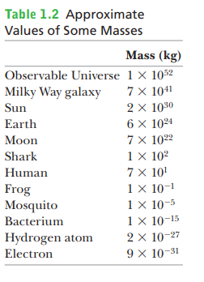
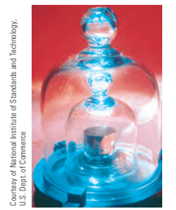
1.1 Standards of Length, Mass and Time
Chapter 1 Physics and Measurements
Definition of the kilogram
Mass
The SI unit of mass, the kilogram, is defined as the mass of a specific platinum– iridium alloy cylinder kept at the International Bureau of Weights and Measures at Sèvres, France.
As we’ll see in lecture, mass is a quantity used to measure the resistance to a change in the motion of an object.
It’s more difficult to cause a change in the motion of an object with a large mass than an object with a small mass.
Approximate values of some masses, intervals are presented in Tables 1.2

Slide 8
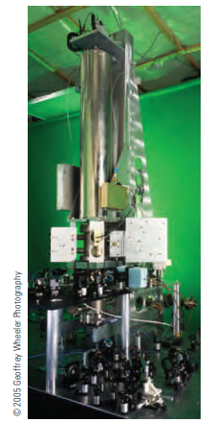
1.1 Standards of Length, Mass and Time
Chapter 1 Physics and Measurements
Definition of the second
Time
Before 1960, the time standard was defined in terms of the average length of a solar day in the year 1900. (A solar day is the time between successive appearances of the Sun at the highest point it reaches in the sky each day.)
The basic unit of time, the second, was defined to be (1/60)(1/60)(1/24) 5 1/86 400 of the average solar day.
In 1967 the second was redefined to take advantage of the high precision attainable with an atomic clock, which uses the characteristic frequency of the light emitted from the cesium-133 atom as its “reference clock.” The second is now defined as 9 192 631 700 times the period of oscillation of radiation from the cesium atom. The newest type of cesium atomic clock is shown in Figure
One second (abbreviated s) is defined as the time required for 9,192,631,770 cycles of this microwave radiation

Slide 9
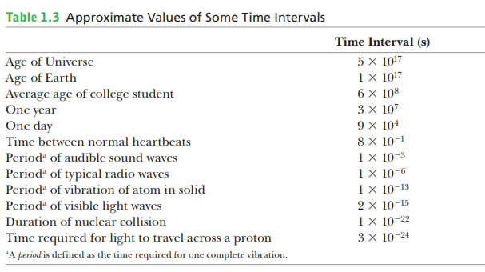
1.1 Standards of Length, Mass and Time
Approximate values of some time intervals are presented in Tables 1.3
Chapter 1 Physics and Measurements

Slide 10
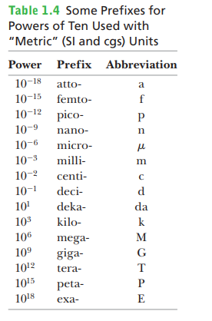
1.1 Standards of Length, Mass and Time
Chapter 1 Physics and Measurements
Some of the most frequently used “metric” (SI and cgs) prefixes representing powers of 10 and their abbreviations are listed in Table 1.4.

Slide 11
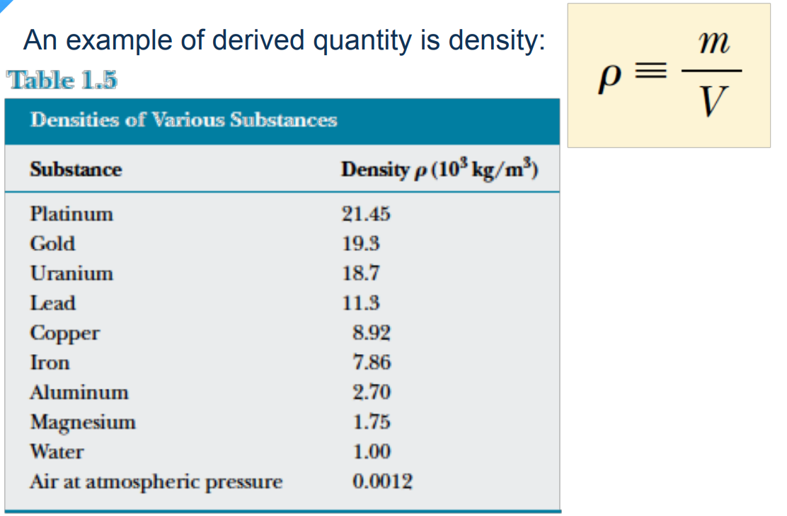
1.1 Standards of Length, Mass and Time
Chapter 1 Physics and Measurements

Slide 12
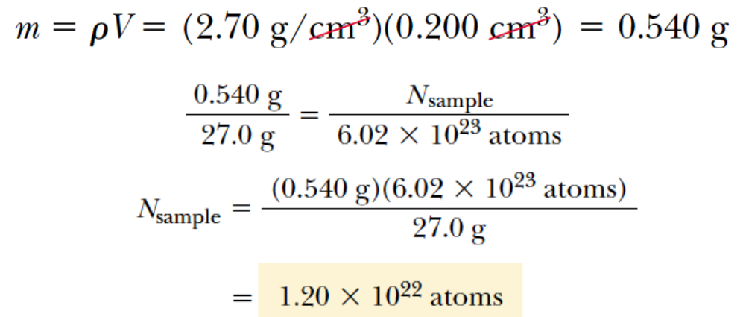
1.1 Standards of Length, Mass and Time
Chapter 1 Physics and Measurements
Example
How many Atoms in the solid cube of aluminum (density 2.70 g/cm³) has a volume of 0.200 cm³.
It is known that 27.0 g of aluminum contains 6.02x10²³ atoms.
How many aluminum atoms are contained in the cube?

Slide 13
Chapter 1 Physics and Measurements
1.4 Dimensional Analysis
In physics the word dimension denotes the physical nature of a quantity.
The distance between two points, for example, can be measured in feet, meters, or furlongs, which are different ways of expressing the dimension of length.
The symbols used in this section to specify the dimensions of length, mass, and time are L, M, and T, respectively.
Brackets [ ] will often be used to denote the dimensions of a physical quantity.
In this notation, for example,
the dimensions of velocity $θ$ are written [$θ$] = L/T,
the dimensions of area A are [A] = L².
The dimensions of area, volume, velocity, and acceleration are listed in Table 1.5, along with their units in the three common systems.
The dimensions of other quantities, such as force and energy, will be described later as they are introduced.

Slide 14
Chapter 1 Physics and Measurements
1.4 Dimensional Analysis
In physics it’s often necessary to deal with mathematical expressions that relate different physical quantities.
One way to analyze such expressions, called dimensional analysis, makes use of the fact that dimensions can be treated as algebraic quantities.
The procedure can be illustrated by using it to develop some relationships between acceleration, velocity, time, and distance.
Distance x has the dimension of length: [x] = L.
Time t has dimension [t] = T.
Velocity $θ$ has the dimensions length over time: [$θ$] = L/T, and
acceleration the dimensions length divided by time squared: [$a$] = L/T².
Notice that velocity and acceleration have similar dimensions, except for an extra dimension of time in the denominator of acceleration. It follows that

Slide 15
Chapter 1 Physics and Measurements
1.4 Dimensional Analysis
From this it might be guessed that velocity equals acceleration multiplied by time, $θ=a.t$, and that is true for the special case of motion with constant acceleration starting at rest.
Noticing that velocity has dimensions of length divided by time and distance has dimensions of length, it’s reasonable to guess that

Slide 16
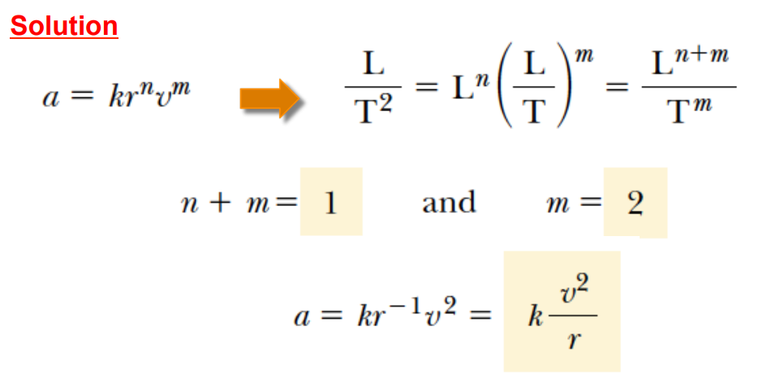
Chapter 1 Physics and Measurements
1.4 Dimensional Analysis
Example
Analysis of Power Law Suppose we are told that the acceleration a of a particle moving with uniform speed $θ$ in a circle of radius r is proportional to some power of r, say r^{n}, and some power of $θ$, say v^{m}.
Determine the values of n and m and write the simplest form of an equation for the acceleration.

Slide 17
Chapter 1 Physics and Measurements
1.4 Dimensional Analysis
Example
Show that the expression $θ=θ_{0}+at$ is dimensionally correct, where $θ and θ_{0}$ represent velocities, $a$is acceleration, and $t$ is a time interval.

Slide 18
Chapter 1 Physics and Measurements
1.4 Dimensional Analysis
Example
Find a relationship between a constant acceleration $a$, speed $θ$, and distance$r$from the origin for a particle traveling in a circle.

Slide 19
1.5 Conversion of Units
Chapter 1 Physics and Measurements
Sometimes it’s necessary to convert units from one system to another. Conversion factors between the SI and U.S. customary systems for units of length are as follows:
For example, suppose we want to convert 15.0 inc. to centimeters. Because 1 inc.=2.54 cm, we find that
If a car is traveling at a speed of 28.0 m/s, is the driver exceeding the speed limit of 55.0 mi/h?

Slide 20
1.5 Conversion of Units
Chapter 1 Physics and Measurements
The traffic light turns green, and the driver of a high-performance car slams the accelerator to the floor. The accelerometer registers 22.0 m/s².
Convert this reading to km/min².

Slide 21
1.5 Conversion of Units
Chapter 1 Physics and Measurements

Slide 22
1.7 Uncertainty in Measurement and Significant Figures
Chapter 1 Physics and Measurements
Physics is a science in which mathematical laws are tested by experiment.
No physical quantity can be determined with complete accuracy because our senses are physically limited, even when extended with microscopes, cyclotrons, and other instruments.
Consequently, it’s important to develop methods of determining the accuracy of measurements.

Slide 23
1.7 Uncertainty in Measurement and Significant Figures
Chapter 1 Physics and Measurements
Suppose that in a laboratory experiment we measure the area of a rectangular plate with a meter stick.
Let’s assume that the accuracy to which we can measure a particular dimension of the plate is 60.1 cm.
If the length of the plate is measured to be 16.3 cm, we can claim only that it lies somewhere between 16.2 cm and 16.4 cm.
In this case, we say that the measured value has three significant figures.
Likewise, if the plate’s width is measured to be 4.5 cm, the actual value lies between 4.4 cm and 4.6 cm.
This measured value has only two significant figures.
We could write the measured values as $16.3±0.1$cm and $4.5±0.1$cm. In general, a significant figure is a reliably known digit (other than a zero used to locate a decimal point).
Note that in each case, the final number has some uncertainty associated with it, and is therefore not 100% reliable.
Despite the uncertainty, that number is retained and considered significant because it does convey some information.

Slide 24
1.7 Uncertainty in Measurement and Significant Figures
Chapter 1 Physics and Measurements
Suppose we would like to find the area of the plate by multiplying the two measured values together.
The final value can range between
(16.3 - 0.1 cm)(4.5 - 0.1 cm) = (16.2 cm)(4.4 cm) = 71.28 cm² and
(16.3 + 0.1 cm)(4.5 +0.1 cm) = (16.4 cm)(4.6 cm) = 75.44 cm².
Claiming to know anything about the hundredths place, or even the tenths place, doesn’t make any sense, because it’s clear we can’t even be certain of the units place, whether it’s the 1 in 71, the 5 in 75, or somewhere in between.
The tenths and the hundredths places are clearly not significant.
We have some information about the units place, so that number is significant.
Multiplying the numbers at the middle of the uncertainty ranges gives
(16.3 cm) (4.5 cm) = 73.35 cm², which is also in the middle of the area’s uncertainty range. Because the hundredths and tenths are not significant, we drop them and take the answer to be 73 cm², with an uncertainty of 62 cm².
Note that the answer has two significant figures, the same number of figures as the least accurately known quantity being multiplied, the 4.5-cm width

Slide 25
1.7 Uncertainty in Measurement and Significant Figures
Chapter 1 Physics and Measurements
In multiplying (dividing) two or more quantities, the number of significant figures in the final product (quotient) is the same as the number of significant figures in the least accurate of the factors being combined, where least accurate means having the lowest number of significant figures.

Slide 26
1.7 Uncertainty in Measurement and Significant Figures
Chapter 1 Physics and Measurements
To get the final number of significant figures, it’s usually necessary to do some rounding. If the last digit dropped is less than 5, simply drop the digit.
If the last digit dropped is greater than or equal to 5, raise the last retained digit by one.
Zeros may or may not be significant figures. Zeros used to position the decimal point in such numbers as 0.03 and 0.0075 are not considered significant figures.
Hence, 0.03 has one significant figure, and 0.0075 has two
When zeros are placed after other digits in a whole number, there is a possibility of misinterpretation.
For example, suppose the mass of an object is given as 1 500 g. This value is ambiguous, because we don’t know whether the last two zeros are being used to locate the decimal point or whether they represent significant figures in the measurement.

Slide 27
1.7 Uncertainty in Measurement and Significant Figures
Chapter 1 Physics and Measurements
Using scientific notation to indicate the number of significant figures removes this ambiguity. In this case, we express the mass as 1.5x10³ g if there are two significant figures in the measured value,
1.50x10³ g if there are three significant figures,
and 1.500x10³ g if there are four.
Likewise, 0.000 15 is expressed in scientific notation as 1.5x10⁻⁴
if it has two significant figures or as 1.50x10⁻⁴ if it has three significant figures.
The three zeros between the decimal point and the digit 1 in the number 0.000 15 are not counted as significant figures because they only locate the decimal point.

Slide 28
1.7 Uncertainty in Measurement and Significant Figures
Chapter 1 Physics and Measurements
For addition and subtraction, it’s best to focus on the number of decimal places in the quantities involved rather than on the number of significant figures.
When numbers are added (subtracted), the number of decimal places in the result should equal the smallest number of decimal places of any term in the sum (difference).
For example, if we wish to compute 123 (zero decimal places) $±$ 5.35 (two decimal places), the answer is 128 (zero decimal places) and not 128.35.
If we compute the sum 1.000 1 (four decimal places) + 0.000 3 (four decimal places) = 1.000 4,
the result has the correct number of decimal places, namely four.
Observe that the rules for multiplying significant figures don’t work here because the answer has five significant figures even though one of the terms in the sum, 0.000 3, has only one significant figure.
Likewise, if we perform the subtraction
1.002 - 0.998 =0.004,
the result has three decimal places because each term in the subtraction has three decimal places.

Slide 29
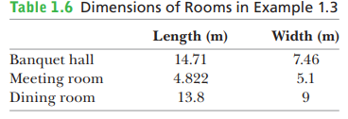
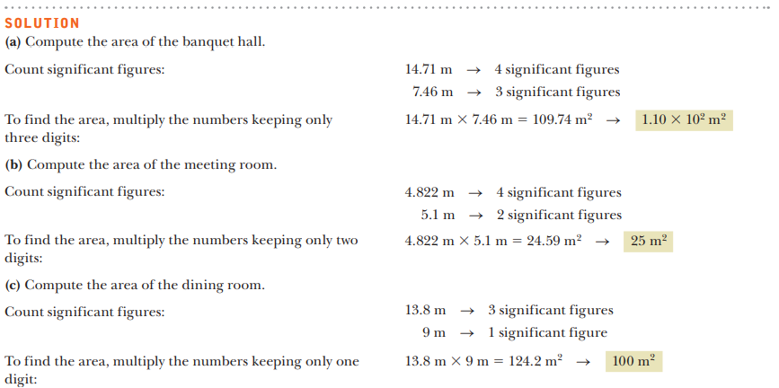
1.7 Uncertainty in Measurement and Significant Figures
Chapter 1 Physics and Measurements
Several carpet installers make measurements for carpet installation in the different rooms of a restaurant, reporting their measurements with inconsistent accuracy, as compiled in Table 1.6. Compute the areas for (a) the banquet hall, (b) the meeting room, and (c) the dining room, taking into account significant figures. (d) What total area of carpet is required for these rooms?

Slide 30
1.7 Uncertainty in Measurement and Significant Figures
Chapter 1 Physics and Measurements
Several carpet installers make measurements for carpet installation in the different rooms of a restaurant, reporting their measurements with inconsistent accuracy, as compiled in Table 1.6. Compute the areas for (a) the banquet hall, (b) the meeting room, and (c) the dining room, taking into account significant figures. (d) What total area of carpet is required for these rooms?

Slide 31
Chapter 1 Physics and Measurements

Slide 32
Chapter 1 Physics and Measurements

Slide 33
Chapter 1 Physics and Measurements

Slide 34
Chapter 1 Physics and Measurements

Slide 35
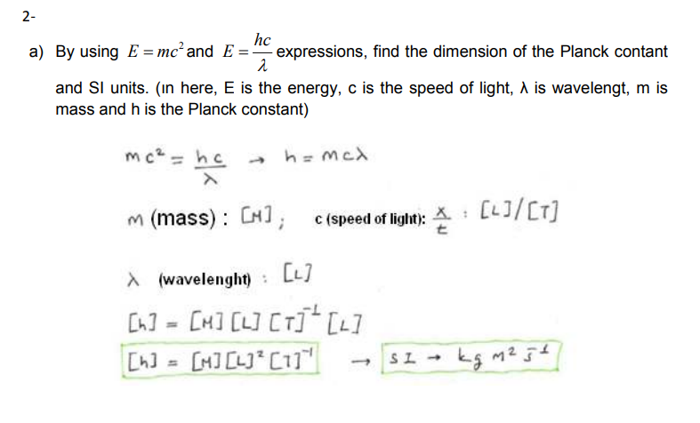
Chapter 1 Physics and Measurements

Slide 36
Chapter 1 Physics and Measurements

Slide 37
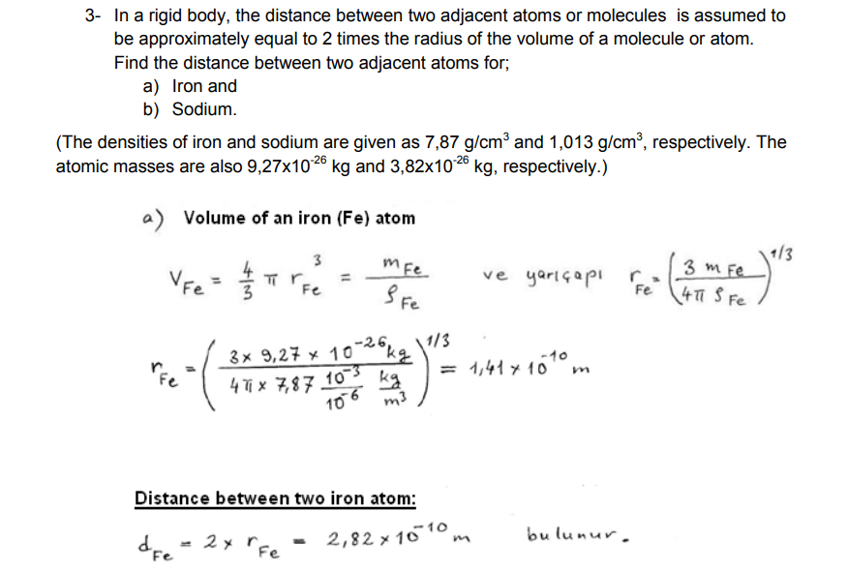
Chapter 1 Physics and Measurements

Slide 38
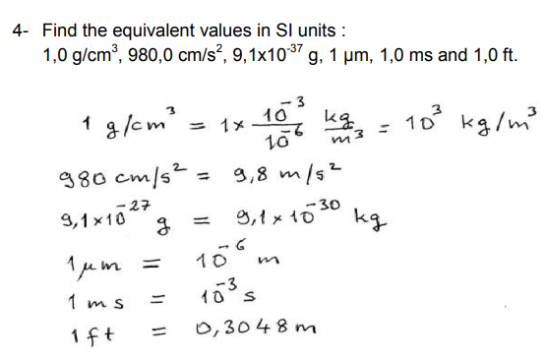
Chapter 1 Physics and Measurements

Slide 39
Chapter 3 Vectors
3.1. Vectors and Scalars
3.2. Adding Vectors Geometrically
3.3. Components of Vectors and Unit Vectors
3.4. Multiplying Vectors

Slide 40
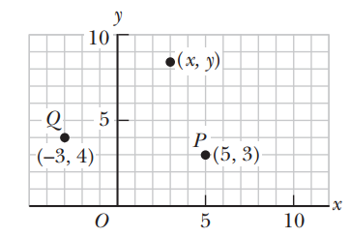
Coordinate Systems
Chapter 3 Vectors
Many aspects of physics deal with locations in space, which require the definition of a coordinate system.
A point on a line can be located with one coordinate, a point in a plane with two coordinates, and a point in space with three.
A coordinate system used to specify locations in space consists of the following:
■ A fixed reference point O, called the origin
■ A set of specified axes, or directions, with an appropriate scale and labels on the axes
■ Instructions on labeling a point in space relative to the origin and axes
Positive x is usually selected as right of the origin and positive y upward from the origin, but in two dimensions this choice is largely a matter of taste. (In three dimensions, however, there are “right-handed” and “left-handed” coordinates, which lead to minus sign differences in certain operations. These will be addressed as needed.)
Designation of points in a two-dimensional Cartesian coordinate system.
Every point is labeled with coordinates (x, y).
For example, the point P in the figure has coordinates (5, 3). If we start at the origin O, we can reach P by moving 5 meters horizontally to the right and then 3 meters vertically upward.
In the same way, the point Q has coordinates (23, 4), which corresponds to going 3 meters horizontally to the left of the origin and 4 meters vertically upward from there.

Slide 41
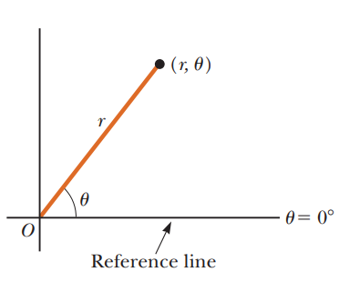
Coordinate Systems
Chapter 3 Vectors
Sometimes it’s more convenient to locate a point in space by its plane polar coordinates (r, u), as in Figure 1.5. In this coordinate system, an origin O and a reference line are selected as shown. A point is then specified by the distance r from the origin to the point and by the angle u between the reference line and a line drawn from the origin to the point. The standard reference line is usually selected to be the positive x-axis of a Cartesian coordinate system. The angle u is considered positive when measured counterclockwise from the reference line and negative when measured clockwise.
The plane polar coordinates of a point are represented by the distance r and the angle u, where u is measured counterclockwise from the positive x-axis.
For example, if a point is specified by the polar coordinates 3 m and 60°, we locate this point by moving out 3 m from the origin at an angle of 60° above (counterclockwise from) the reference line. A point specified by polar coordinates 3 m and 260° is located 3 m out from the origin and 60° below (clockwise from) the reference line.

Slide 42
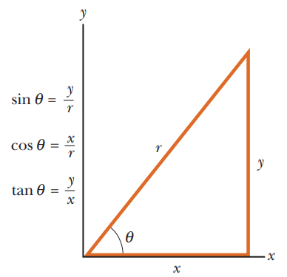
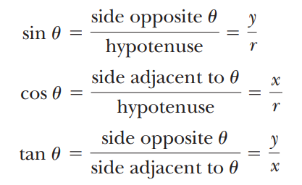
Coordinate Systems
Chapter 3 Vectors
Trigonometry
Consider the right triangle shown in Active Figure , where side y is opposite the angle θ, side x is adjacent to the angle θ, and side r is the hypotenuse of the triangle.
The basic trigonometric functions defined by such a triangle are the ratios of the lengths of the sides of the triangle.
These relationships are called the sine (sin), cosine (cos), and tangent (tan) functions. In terms of θ, the basic trigonometric functions are as follows:
Note that the sine, cosine, and tangent functions are quantities without units because each represents the ratio of two lengths.
Another important relationship, called the Pythagorean theorem, exists between the lengths of the sides of a right triangle:
Certain trigonometric functions of a right triangle.
For example, if the angle θ is equal to 30°, then the ratio of y to r is always 0.50; that is, sin 30° = 0.50.

Slide 43
Coordinate Systems
Chapter 3 Vectors
Finally, it will often be necessary to find the values of inverse relationships.
For example, suppose you know that the sine of an angle is 0.866, but you need to know the value of the angle itself.
The inverse sine function may be expressed as sin⁻¹(0.866), which is a shorthand way of asking the question
“What angle has a sine of 0.866?”
Punching a couple of buttons on your calculator reveals that this angle is 60.0°.
Try it for yourself and show that tan⁻¹ (0.400) = 21.8°.
Be sure that your calculator is set for degrees and not radians.
In addition, the inverse tangent function can return only values between 290° and 190°, so when an angle is in the second or third quadrant, it’s necessary to add 180° to the answer in the calculator window.
The definitions of the trigonometric functions and the inverse trigonometric functions, as well as the Pythagorean theorem, can be applied to any right triangle, regardless of whether its sides correspond to x- and y-coordinates.
These results from trigonometry are useful in converting from rectangular coordinates to polar coordinates, or vice versa, as the next example shows.

Slide 44
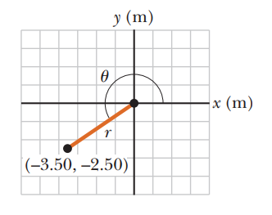
Coordinate Systems
Chapter 3 Vectors
Converting from Cartesian coordinates to polar coordinates.

Slide 45
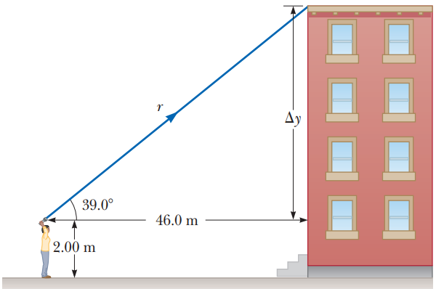
Coordinate Systems
Chapter 3 Vectors

Slide 46
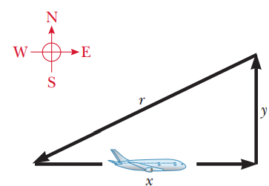
Coordinate Systems
Chapter 3 Vectors

Slide 47
Chapter 3 Vectors

Slide 48
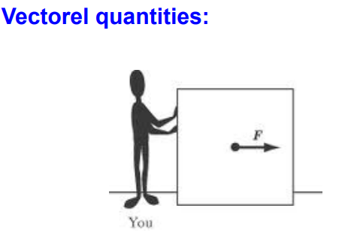
3.1. Vectors and Scalars
Chapter 3 Vectors
A vector quantity is completely specified by a number and appropriate units plus a direction.
Scalar quantities : • A scalar quantity is completely specified by a single value with an appropriate unit and has no direction.

Slide 49
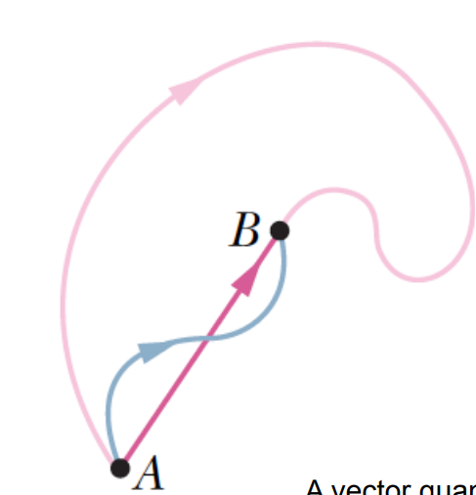
Displecement as a vector quantity:
As a particle moves from A to B along an arbitrary paths represented by the blue or pink line, its displacement is a vector quantity shown by the arrow drawn from A to B.
The displacement vector tells us nothing about the actual path that the particle takes.
A vector quantity can be shown as:  The magnitude of a vector: A  A

Slide 50
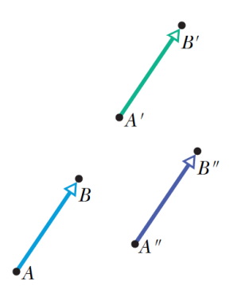
EQUALİTY OF TWO VECTORS
Two vectors are equal only if they have the same magnitude and point in the same direction
Negative of a Vector

Slide 51
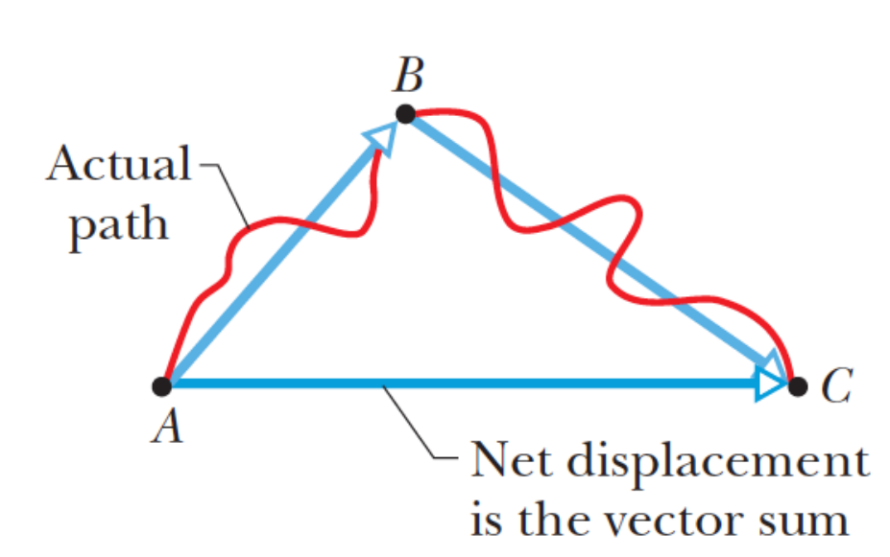
Adding Vectors Geometrically

Slide 52
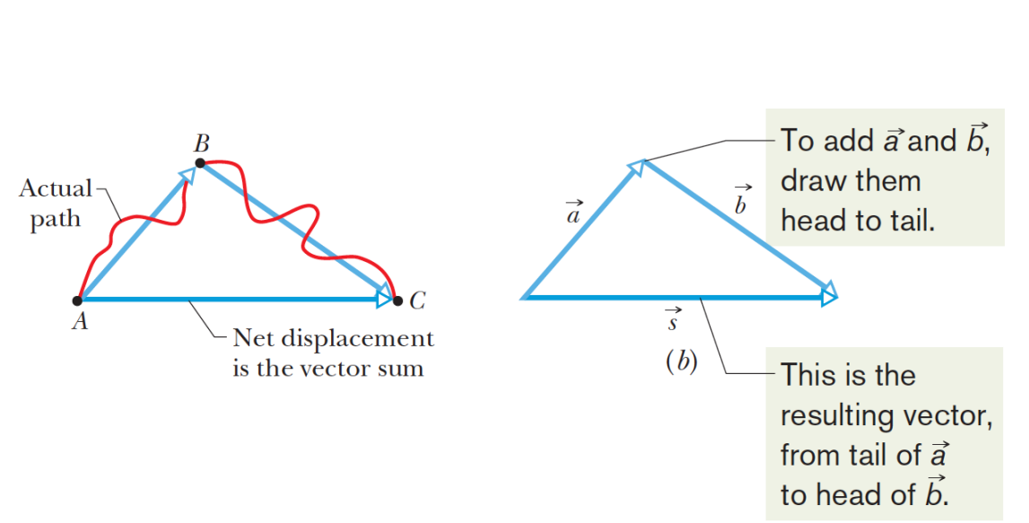
Adding Vectors Geometrically

Slide 53
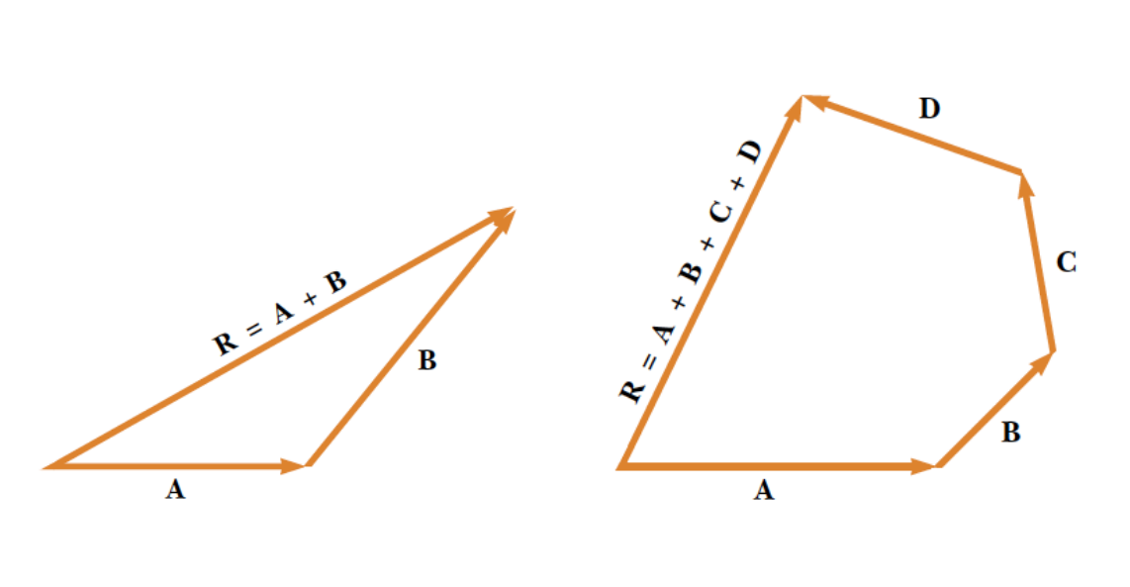
Adding Vectors Geometrically

Slide 54
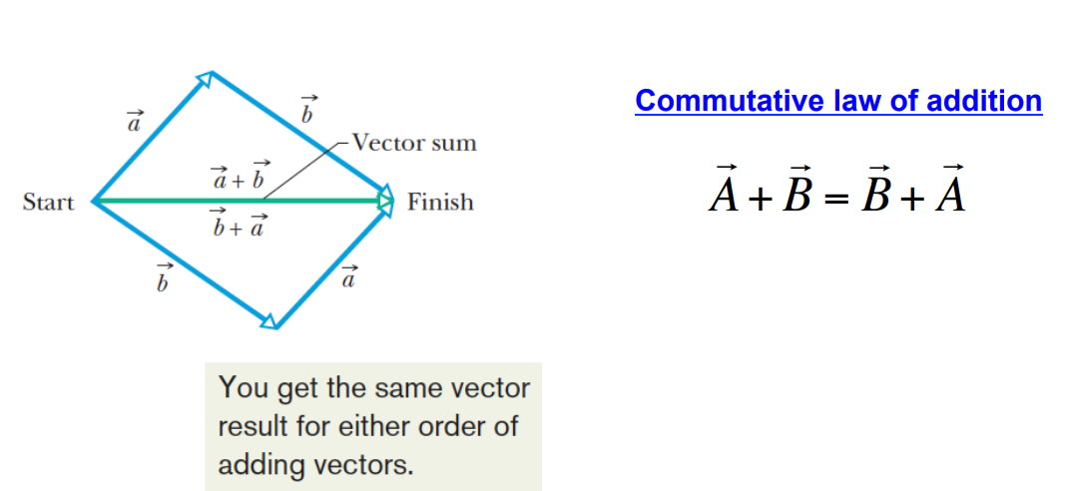
Adding Vectors Geometrically

Slide 55
Adding Vectors Geometrically

Slide 56
Adding Vectors Geometrically

Slide 57
Adding Vectors Geometrically

