Slide 1
2022-2023/Güz FİZİK 1 DERSİ FIZ1001

Slide 2
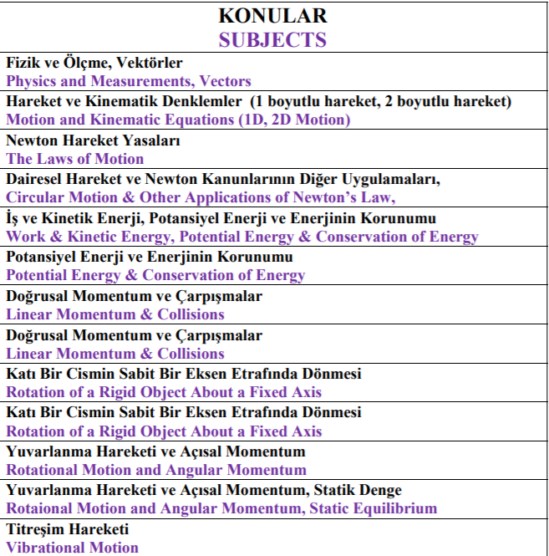
KAYNAK KİTAP

Slide 3
Momentum and Collisions
What happens when two automobiles collide?
How does the impact affect the motion of each vehicle, and what basic physical principles determine the likelihood of serious injury?
How do rockets work, and what mechanisms can be used to overcome the limitations imposed by exhaust speed?
Why do we have to brace ourselves when firing small projectiles at high velocity?
Finally, how can we use physics to improve our golf game?
To begin answering such questions, we introduce momentum.
Intuitively, anyone or anything that has a lot of momentum is going to be hard to stop.
In politics, the term is metaphorical.
Physically, the more momentum an object has, the more force has to be applied to stop it in a given time.
This concept leads to one of the most powerful principles in physics: conservation of momentum.
Using this law, complex collision problems can be solved without knowing much about the forces involved during contact.
We’ll also be able to derive information about the average force delivered in an impact.
With conservation of momentum, we’ll have a better understanding of what choices to make when designing an automobile or a moon rocket, or when addressing a golf ball on a tee

Slide 4
MOMENTUM AND COLLISIONS
6.1 Momentum and Impulse
In physics, momentum has a precise definition. A slowly moving brontosaurus has a lot of momentum, but so does a little hot lead shot from the muzzle of a gun. We, therefore, expect that momentum will depend on an object’s mass and velocity.
Doubling either the mass or the velocity of an object doubles its momentum; doubling both quantities quadruples its momentum.
Momentum is a vector quantity with the same direction as the object’s velocity. Its components are given in two dimensions by
where p_{x} is the momentum of the object in the x-direction and p_{y} its momentum in the y-direction. The magnitude of the momentum p of an object of mass m can be related to its kinetic energy KE:

Slide 5
MOMENTUM AND COLLISIONS
6.1 Momentum and Impulse

Slide 6
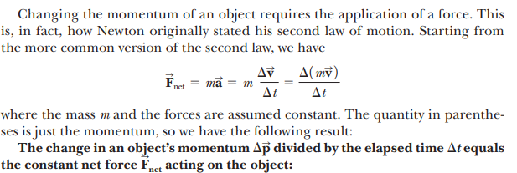
MOMENTUM AND COLLISIONS
6.1 Momentum and Impulse

Slide 7
MOMENTUM AND COLLISIONS
6.1 Momentum and Impulse
This equation is also valid when the forces are not constant, provided the limit is taken as Δt becomes infinitesimally small. Equation says that if the net force on an object is zero, the object’s momentum doesn’t change.
In other words, the linear momentum of an object is conserved when $\vec{F_{net}}=0$.
Equation also tells us that changing an object’s momentum requires the continuous application of a force over a period of time Δt, leading to the definition of impulse:

Slide 8
MOMENTUM AND COLLISIONS
6.1 Momentum and Impulse
Impulse is a vector quantity with the same direction as the constant force acting on the object. When a single constant force $\vec{F}$ acts on an object, Equation can be written as
which is a special case of the impulse-momentum theorem. The equation shows that the impulse of the force acting on an object equals the change in momentum of that object. That equality is true even if the force is not constant, as long as the time interval Dt is taken to be arbitrarily small.

Slide 9
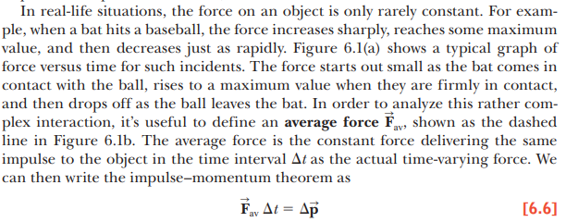
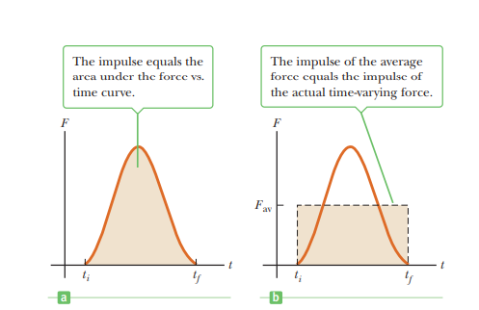
MOMENTUM AND COLLISIONS
6.1 Momentum and Impulse
The magnitude of the impulse delivered by a force during the time interval Δt is equal to the area under the force vs. time graph as in Figure a or, equivalently, to F_{av}Δt as shown in Figure b.

Slide 10
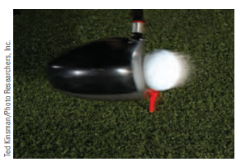
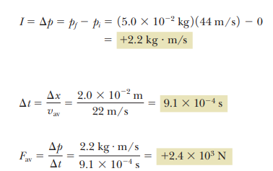
MOMENTUM AND COLLISIONS
6.1 Momentum and Impulse

Slide 11
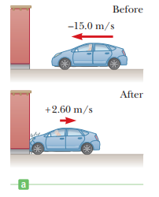
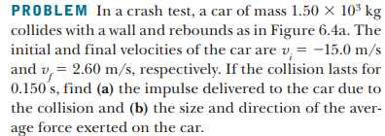
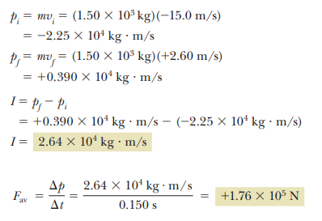
MOMENTUM AND COLLISIONS
6.1 Momentum and Impulse

Slide 12
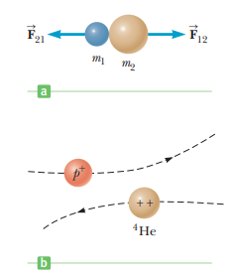
MOMENTUM AND COLLISIONS
6.2 Conservation of Momentum
When a collision occurs in an isolated system, the total momentum of the system doesn’t change with the passage of time.
Instead, it remains constant both in magnitude and in direction.
The momenta of the individual objects in the system may change, but the vector sum of all the momenta will not change.
The total momentum is therefore said to be conserved. In this section, we will see how the laws of motion lead us to this important conservation law.
A collision may be the result of physical contact between two objects, as illustrated in Figure a. This is a common macroscopic event, as when a pair of billiard balls or a baseball and a bat strike each other.
By contrast, because contact on a submicroscopic scale is hard to define accurately, the notion of collision must be generalized to that scale.
Forces between two objects arise from the electrostatic interaction of the electrons in the surface atoms of the objects.
other. To understand the distinction between macroscopic and microscopic collisions, consider the collision between two positive charges, as shown in Figure b. Because the two particles in the figure are both positively charged, they repel each other. During such a microscopic collision, particles need not touch in the normal sense in order to interact and transfer momentum.

Slide 13
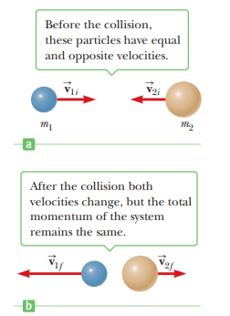
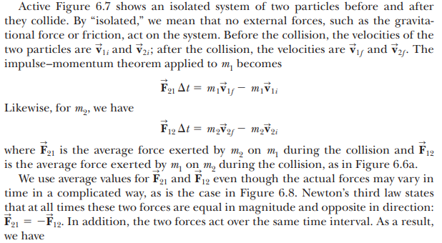
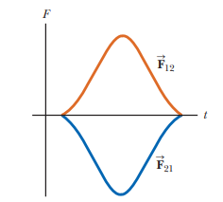
MOMENTUM AND COLLISIONS
6.2 Conservation of Momentum

Slide 14
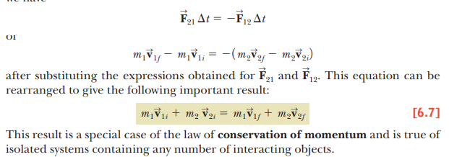
MOMENTUM AND COLLISIONS
6.2 Conservation of Momentum

Slide 15
MOMENTUM AND COLLISIONS
6.2 Conservation of Momentum

Slide 16
MOMENTUM AND COLLISIONS
6.2 Conservation of Momentum

Slide 17
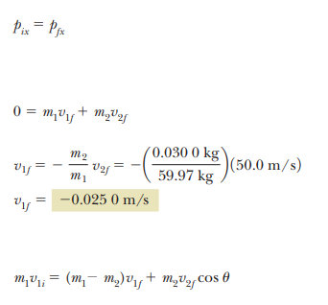
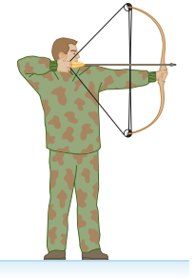
MOMENTUM AND COLLISIONS
6.2 Conservation of Momentum

Slide 18
MOMENTUM AND COLLISIONS
6.2 Conservation of Momentum

Slide 19
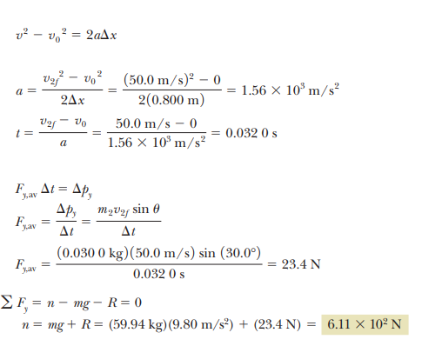
MOMENTUM AND COLLISIONS
6.2 Conservation of Momentum

Slide 20
MOMENTUM AND COLLISIONS
6.3 Collisions
We have seen that for any type of collision, the total momentum of the system just before the collision equals the total momentum just after the collision as long as the system may be considered isolated. The total kinetic energy, on the other hand, is generally not conserved in a collision because some of the kinetic energy is converted to internal energy, sound energy, and the work needed to permanently deform the objects involved, such as cars in a car crash. We define an inelastic collision as a collision in which momentum is conserved, but kinetic energy is not. The collision of a rubber ball with a hard surface is inelastic, because some of the kinetic energy is lost when the ball is deformed during contact with the surface. When two objects collide and stick together, the collision is called perfectly inelastic. For example, if two pieces of putty collide, they stick together and move with some common velocity after the collision. If a meteorite collides head on with Earth, it becomes buried in Earth and the collision is considered perfectly inelastic. Only in very special circumstances is all the initial kinetic energy lost in a perfectly inelastic collision

Slide 21
MOMENTUM AND COLLISIONS
6.3 Collisions
An elastic collision is defined as one in which both momentum and kinetic energy are conserved. Billiard ball collisions and the collisions of air molecules with the walls of a container at ordinary temperatures are highly elastic. Macroscopic collisions such as those between billiard balls are only approximately elastic, because some loss of kinetic energy takes place—for example, in the clicking sound when two balls strike each other. Perfectly elastic collisions do occur, however, between atomic and subatomic particles. Elastic and perfectly inelastic collisions are limiting cases; most actual collisions fall into a range in between them

Slide 22
MOMENTUM AND COLLISIONS
6.3 Collisions
An elastic collision is defined as one in which both momentum and kinetic energy are conserved. Billiard ball collisions and the collisions of air molecules with the walls of a container at ordinary temperatures are highly elastic. Macroscopic collisions such as those between billiard balls are only approximately elastic, because some loss of kinetic energy takes place—for example, in the clicking sound when two balls strike each other. Perfectly elastic collisions do occur, however, between atomic and subatomic particles. Elastic and perfectly inelastic collisions are limiting cases; most actual collisions fall into a range in between them

Slide 23
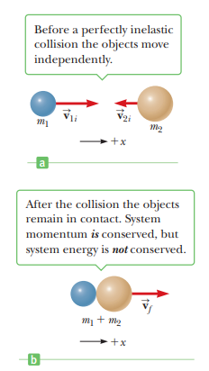
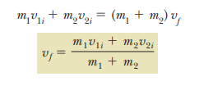
MOMENTUM AND COLLISIONS
Perfectly Inelastic Collisions

Slide 24
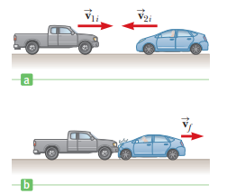
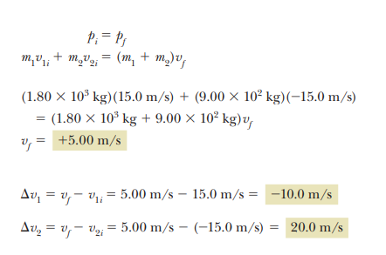
MOMENTUM AND COLLISIONS
Perfectly Inelastic Collisions

Slide 25
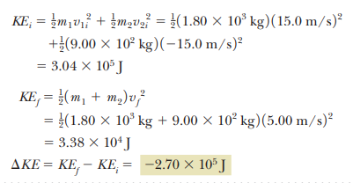
MOMENTUM AND COLLISIONS
Perfectly Inelastic Collisions

Slide 26
MOMENTUM AND COLLISIONS
Perfectly Inelastic Collisions

Slide 27
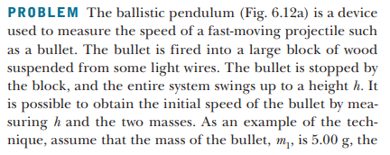
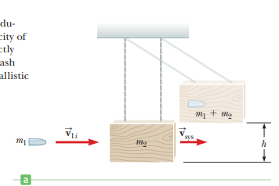
MOMENTUM AND COLLISIONS
Perfectly Inelastic Collisions

Slide 28
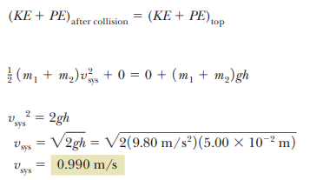
MOMENTUM AND COLLISIONS
Perfectly Inelastic Collisions

Slide 29
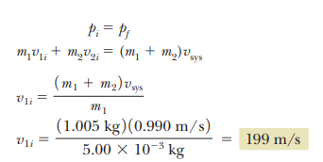
MOMENTUM AND COLLISIONS
Perfectly Inelastic Collisions

Slide 30
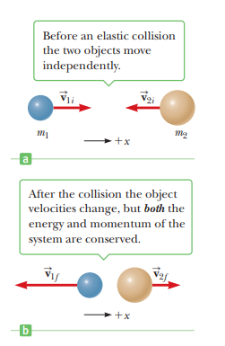
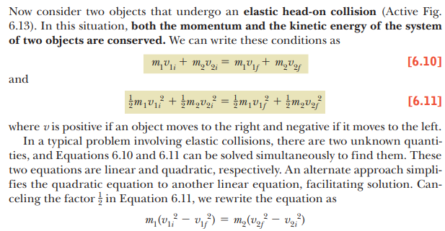
MOMENTUM AND COLLISIONS
Elastic Collisions

Slide 31
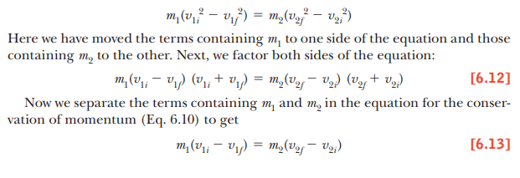
MOMENTUM AND COLLISIONS
Elastic Collisions

Slide 32
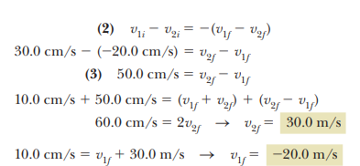
MOMENTUM AND COLLISIONS
Elastic Collisions

Slide 33
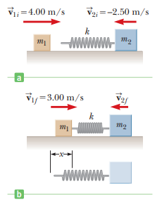
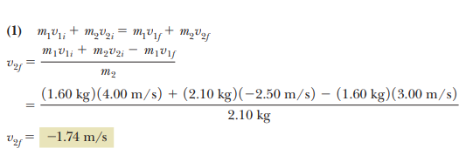
MOMENTUM AND COLLISIONS
Elastic Collisions

Slide 34
MOMENTUM AND COLLISIONS
Elastic Collisions

Slide 35
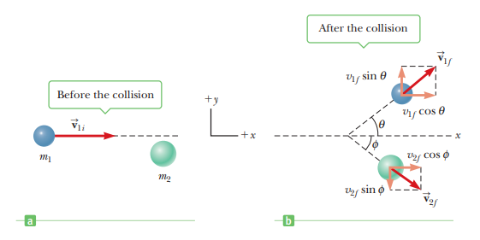
MOMENTUM AND COLLISIONS
6.4 Glancing Collisions
Before we showed that the total linear momentum of a system is conserved when the system is isolated (that is, when no external forces act on the system). For a general collision of two objects in three-dimensional space, the conservation of momentum principle implies that the total momentum of the system in each direction is conserved. However, an important subset of collisions takes place in a plane. The game of billiards is a familiar example involving multiple collisions of objects moving on a two-dimensional surface. We restrict our attention to a single two-dimensional collision between two objects that takes place in a plane, and ignore any possible rotation. For such collisions, we obtain two component equations for the conservation of momentum:

Slide 36
MOMENTUM AND COLLISIONS
6.4 Glancing Collisions
We must use three subscripts in this general equation, to represent, respectively, (1) the object in question, and (2) the initial and final values of the components of velocity.
Now, consider a two-dimensional problem in which an object of mass m1 collides with an object of mass m2 that is initially at rest, as in figure. After the collision, object 1 moves at an angle u with respect to the horizontal, and object 2 moves at an angle f with respect to the horizontal. This is called a glancing collision. Applying the law of conservation of momentum in component form, and noting that the initial y-component of momentum is zero, we have

Slide 37
MOMENTUM AND COLLISIONS
6.4 Glancing Collisions
We must use three subscripts in this general equation, to represent, respectively, (1) the object in question, and (2) the initial and final values of the components of velocity.
Now, consider a two-dimensional problem in which an object of mass m1 collides with an object of mass m2 that is initially at rest, as in figure. After the collision, object 1 moves at an angle u with respect to the horizontal, and object 2 moves at an angle f with respect to the horizontal. This is called a glancing collision. Applying the law of conservation of momentum in component form, and noting that the initial y-component of momentum is zero, we have

Slide 38
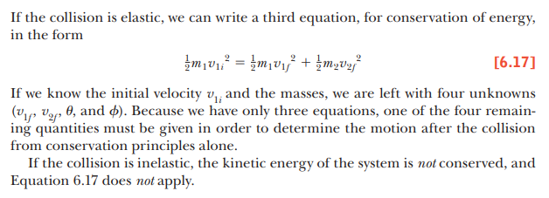
MOMENTUM AND COLLISIONS
6.4 Glancing Collisions

Slide 39
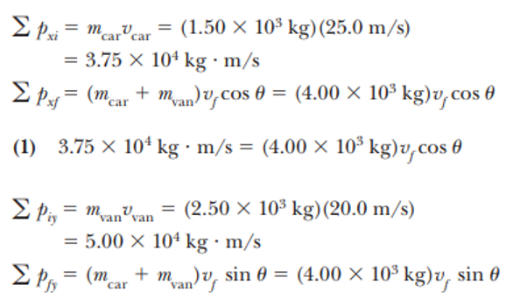
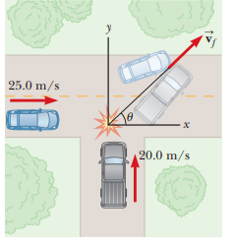
MOMENTUM AND COLLISIONS
6.4 Glancing Collisions

Slide 40
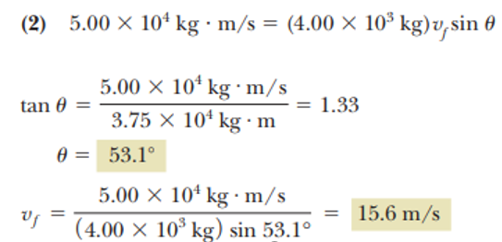
MOMENTUM AND COLLISIONS
6.4 Glancing Collisions

Slide 41
MOMENTUM AND COLLISIONS
6.4 Glancing Collisions

Slide 42
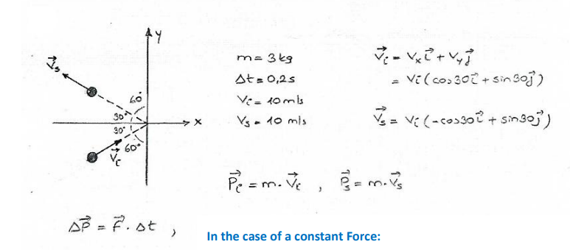
MOMENTUM AND COLLISIONS
6.4 Glancing Collisions

Slide 43
MOMENTUM AND COLLISIONS
6.4 Glancing Collisions

Slide 44
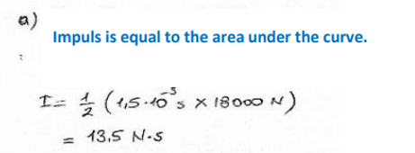
MOMENTUM AND COLLISIONS
6.4 Glancing Collisions

Slide 45
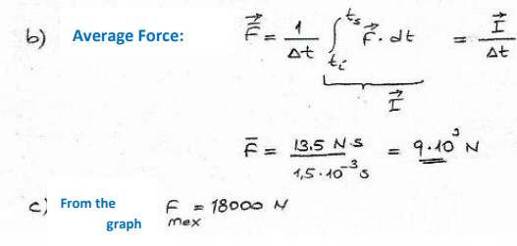
MOMENTUM AND COLLISIONS
6.4 Glancing Collisions

Slide 46
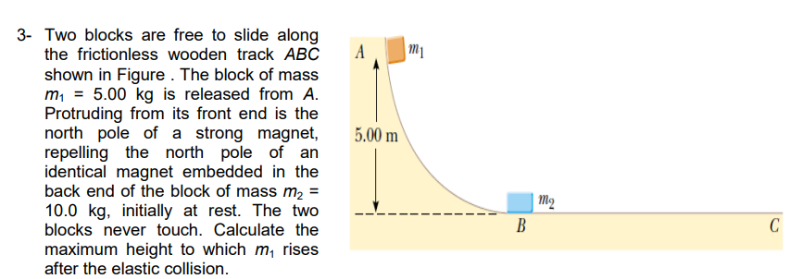
MOMENTUM AND COLLISIONS

Slide 47
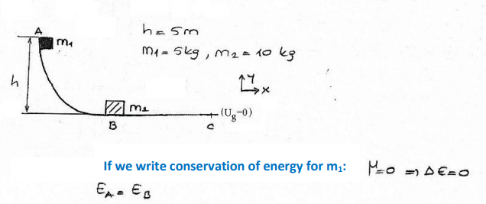
MOMENTUM AND COLLISIONS

Slide 48
MOMENTUM AND COLLISIONS

Slide 49
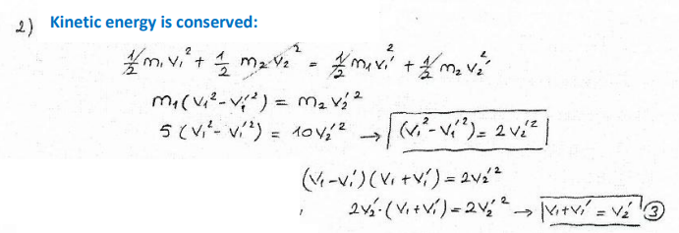
MOMENTUM AND COLLISIONS

Slide 50
MOMENTUM AND COLLISIONS

Slide 51
MOMENTUM AND COLLISIONS

Slide 52
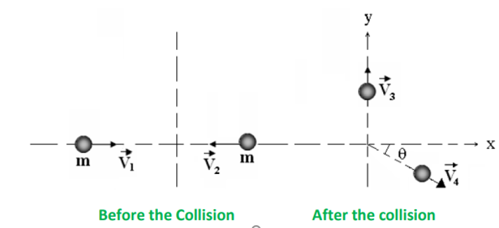
MOMENTUM AND COLLISIONS

Slide 53
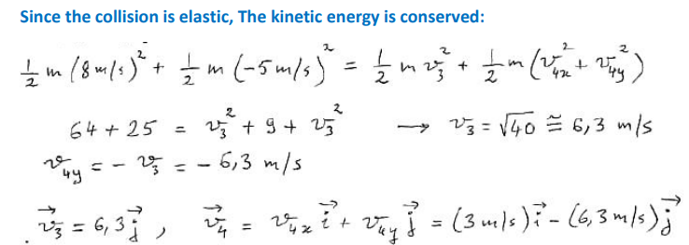
MOMENTUM AND COLLISIONS

Slide 54
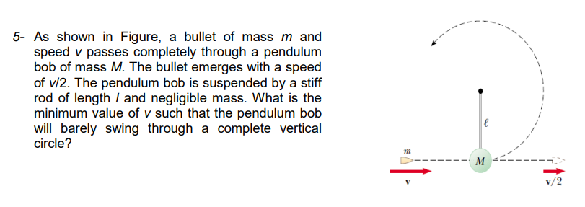
MOMENTUM AND COLLISIONS

Slide 55
MOMENTUM AND COLLISIONS

Slide 56
MOMENTUM AND COLLISIONS

Slide 57
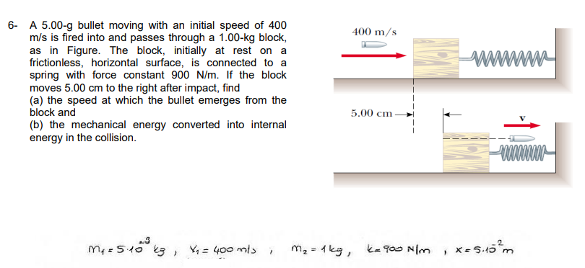
MOMENTUM AND COLLISIONS

Slide 58
MOMENTUM AND COLLISIONS

Slide 59
MOMENTUM AND COLLISIONS

Slide 60
MOMENTUM AND COLLISIONS

Slide 61
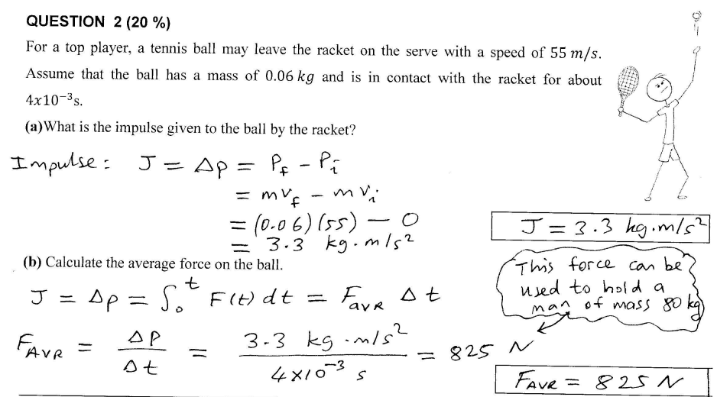
MOMENTUM AND COLLISIONS

Slide 62
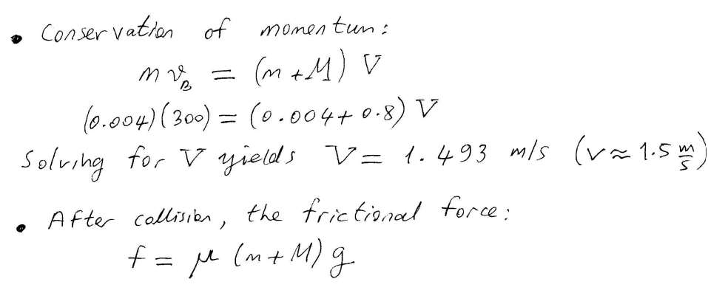
MOMENTUM AND COLLISIONS

Slide 63
MOMENTUM AND COLLISIONS

Slide 64
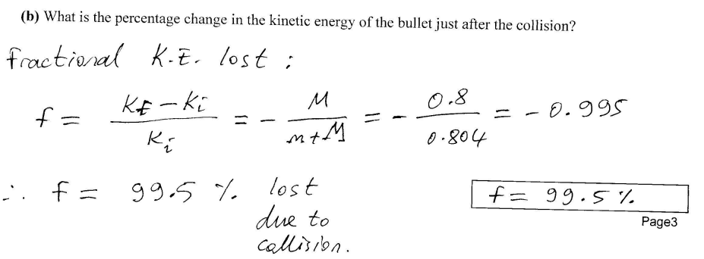
MOMENTUM AND COLLISIONS

Slide 65
MOMENTUM AND COLLISIONS

Slide 66
MOMENTUM AND COLLISIONS

Slide 67
MOMENTUM AND COLLISIONS

Slide 68
MOMENTUM AND COLLISIONS

