Slide 1
Immunology Course 7 Vaccines
Assoc. Prof. Dr. Emrah Sefik Abamor

Slide 2
What is a Vaccine?
They are substances that make the body active immunity against diseases by stimulating the immune system in the living thing they are given.
It contains biological substances that are applied to healthy and at-risk persons (infants, pregnant women, healthcare personnel, etc.)

Slide 3
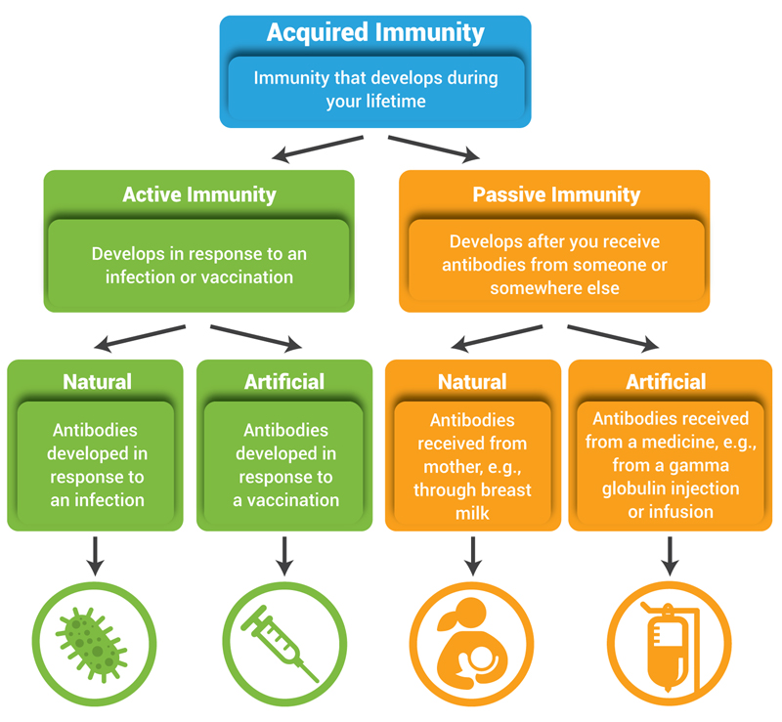

Slide 4
Primary Immunity
When antigens enter the body, T and B lymphocytes multiply. Some of these turn into short-lived cells that fight the antigen, and some turn into memory cells that recognize the antigen.
This event is called primary immunity.

Slide 5
Secondary Immunity
When the same disease agent enters the body for the second time, the reaction occurs in a very short time and powerfully, as it has been previously identified by the memory cells.
This is called secondary immunity.

Slide 6
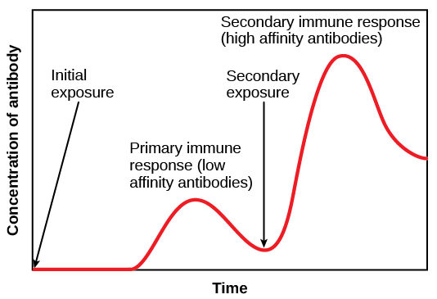

Slide 7
Humoral Immunity
Humoral immunity occurs with B lymphocytes and antibodies. As a result of the antigen entering the body, some of the B lymphocytes turn into memory cells, while some of them turn into plasma cells and produce antibodies.
Antibodies given to the blood and lymph after they are produced go to the infection site and neutralize the antigens.

Slide 8
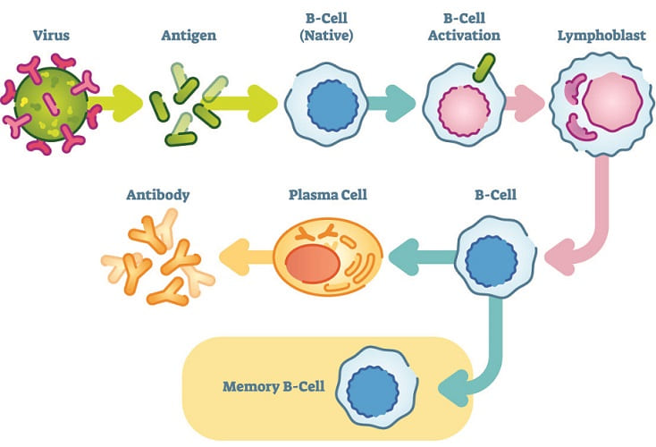

Slide 9
Cellular Immunity
When the antigen enters the body, non-antigen-specific T lymphocytes proliferate rapidly trying to destroy the antigen. Because T lymphocytes come into direct contact with the antigen, it is called cellular immunity.
Cellular immunity acts on cancerous cells, parasites, fungi, tissue transplantation, bacteria and virus-infected cells.

Slide 10
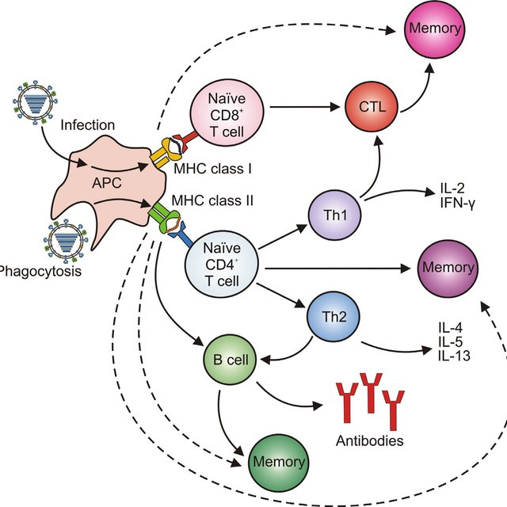

Slide 12
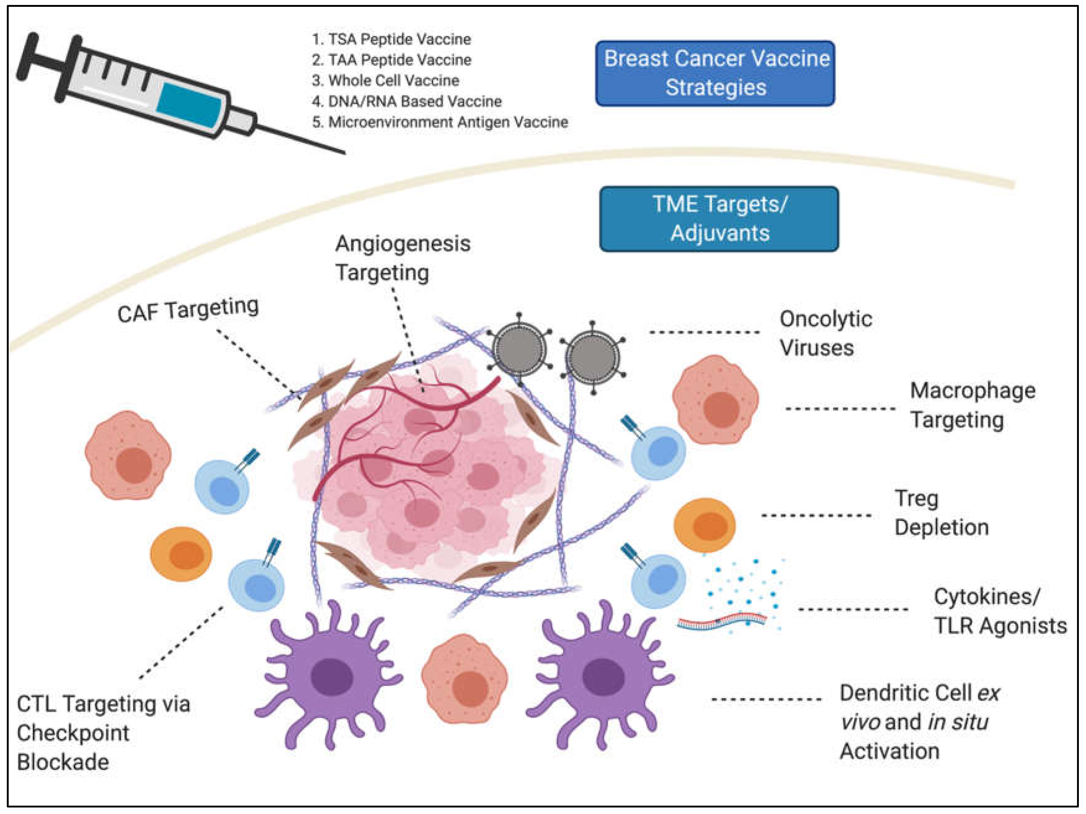

Slide 13
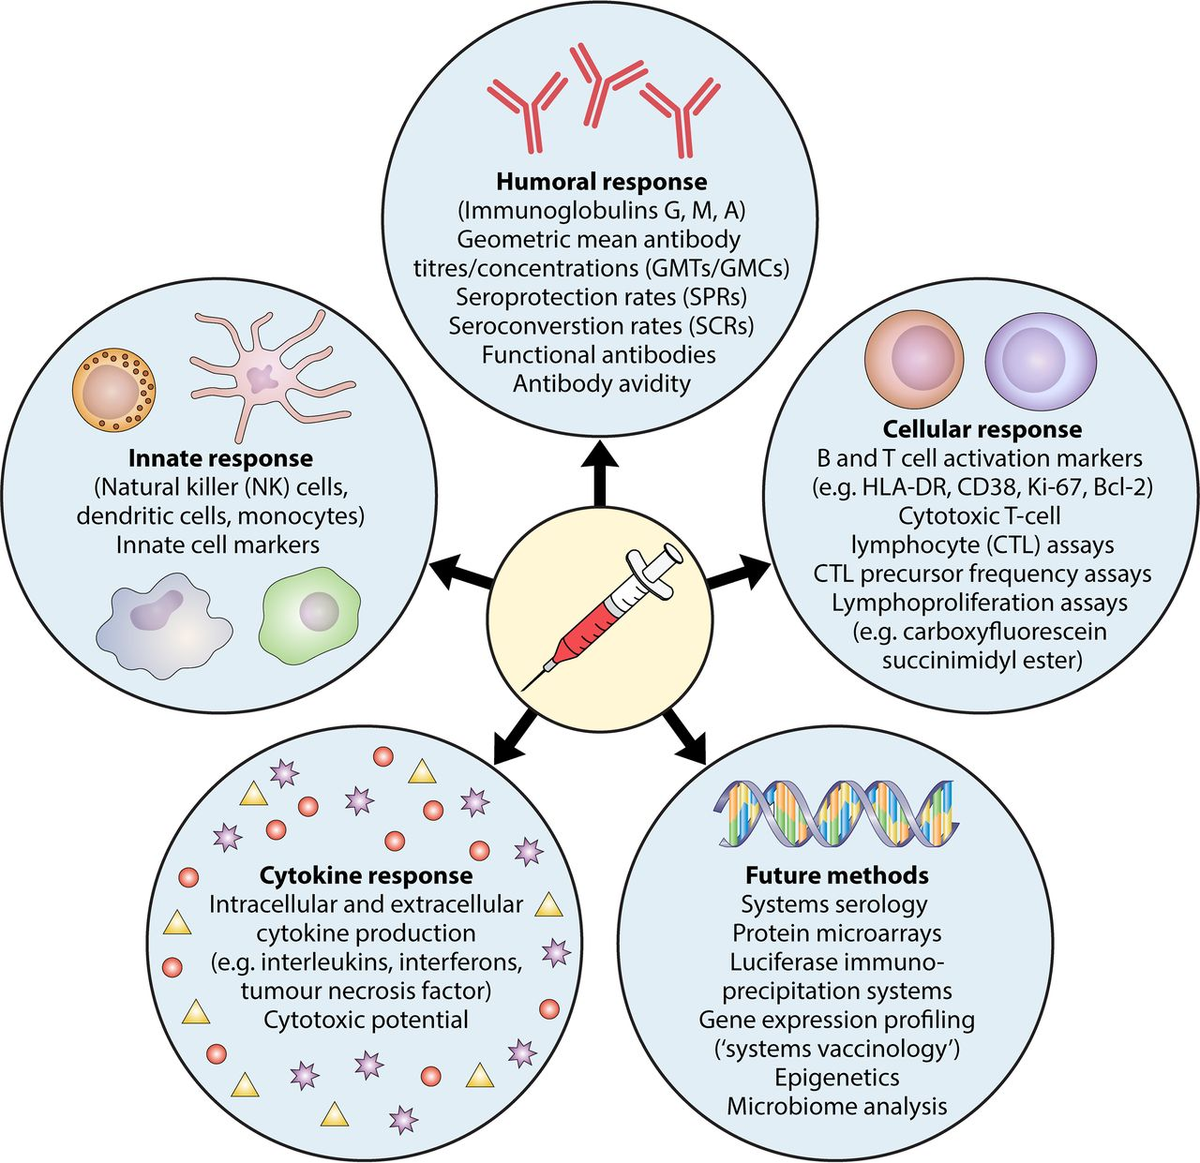

Slide 14
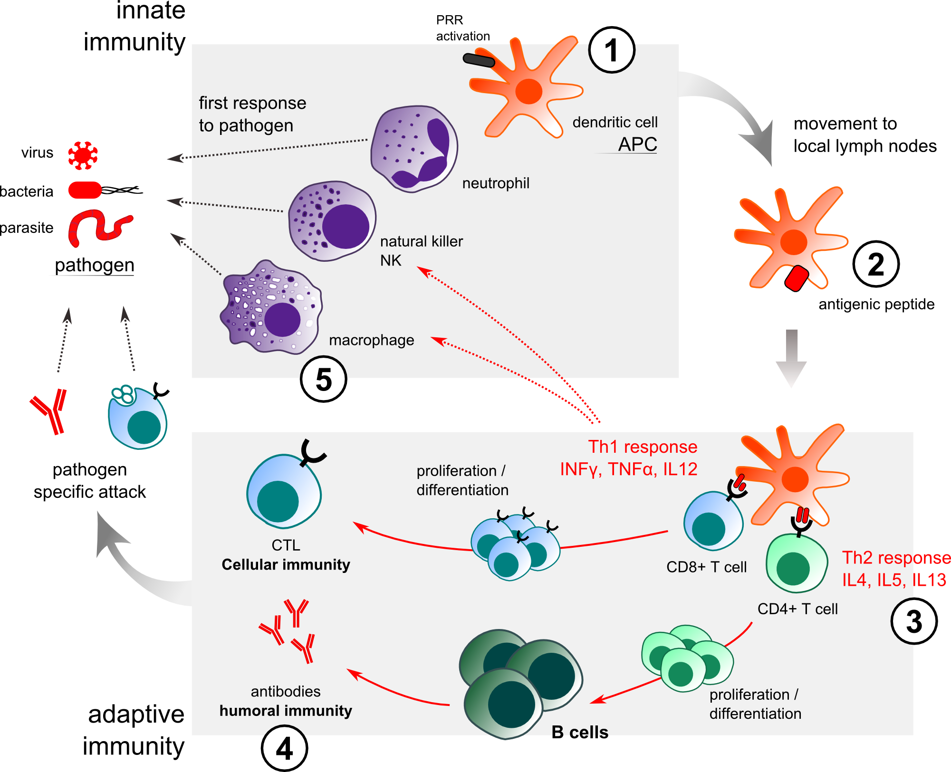

Slide 15
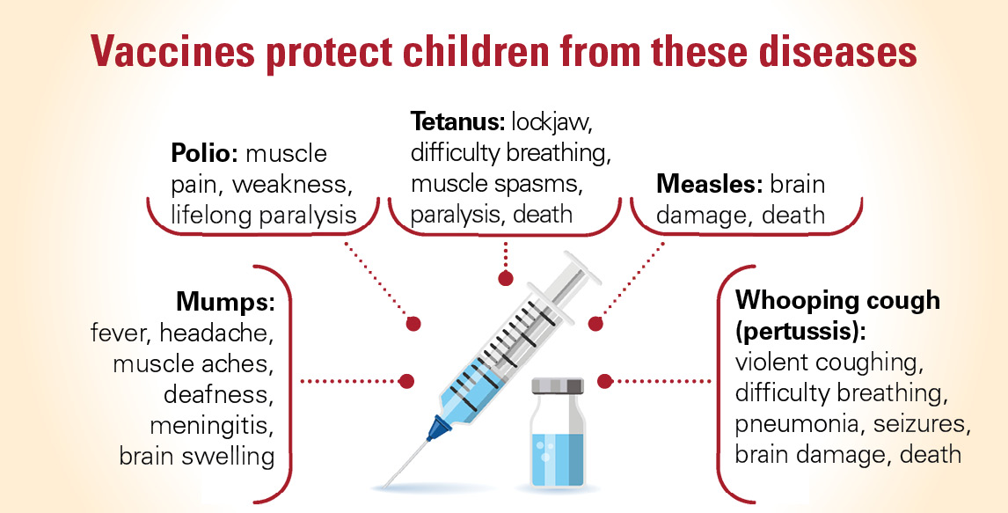

Slide 16
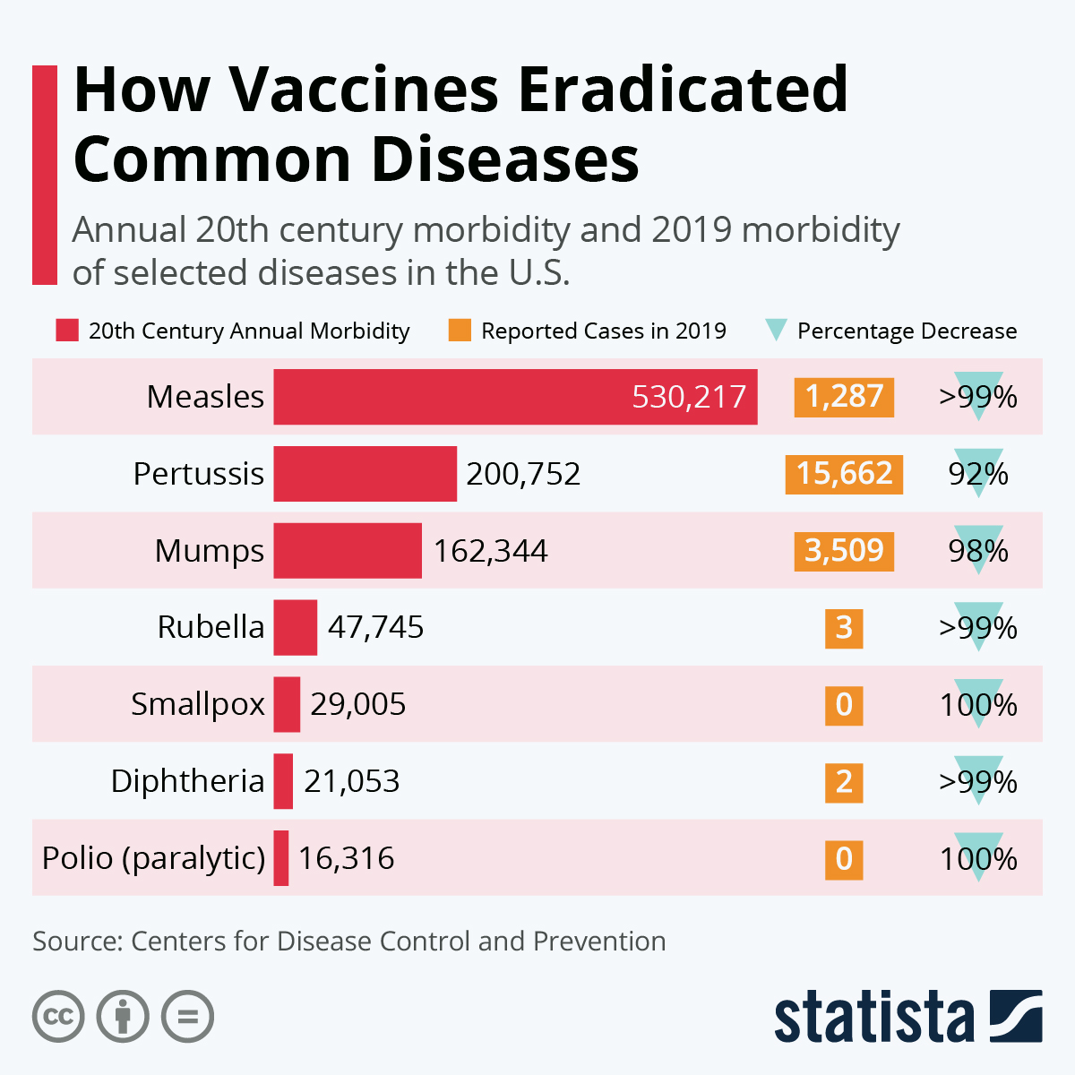

Slide 17
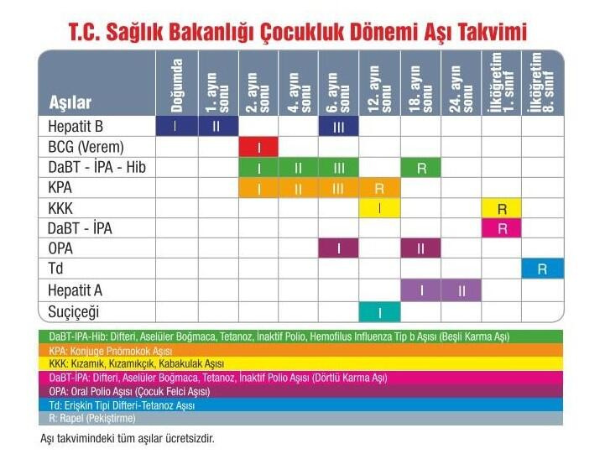

Slide 18
BCG Vaccine
BCG vaccine is an active vaccine that provides some protection against tuberculosis. BCG vaccine will not prevent you from being infected if you are exposed to tuberculosis bacteria (Mycobacterium tuberculosis), but it will allow you to get a mild and localized infection rather than a very impressive disease that threatens your life.
BCG vaccine may take 6-12 weeks to produce the immune effect (protection).

Slide 19
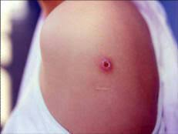
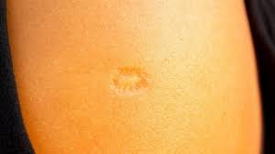
BCG Vaccine

Slide 21
Conventional Vaccines
• The most frequently used vaccines
• Classical methods
1. Live vaccines
2. Inactivated vaccines
3. Toksoid vaccines
4. Subunit vaccines

Slide 22
Live (Attenuated) Vaccines
• Live vaccines are produced by weakening the wild virus or bacteria that cause the disease in laboratory conditions.
• The microorganism in the vaccine obtained in this way has the ability to multiply and create an immune response.
• Its disease-causing properties have been weakened.
• Live vaccines should not be administered to people with a weakened or suppressed immune system.

Slide 23
Live Vaccines
• Contains live microorganisms, eg. Viruses
• stimulate cellular immune response dominated by cytotoxic T lymphocytes
• It is the most effective form of defense against intracellular pathogens
• Since living microorganisms can reproduce in the body, they can stimulate the immune response for a long time, immunity lasts for a long time.
• If the same factors are inactivated and administered to the body, they stimulate the humoral immune response through helper T lymphocytes.
• While the viability and immunogenicity of the pathogens to be vaccinated are preserved, their virulence is reduced to a level that does not cause disease --- attenuation

Slide 24
Inactivated (killed) vaccines
• These are vaccines containing m.o. killed by physical or chemical methods.
• Which type of m.o. no matter what, they are perceived as exogenous antigens. They are processed by antigen presenting cells and presented to helper T lymphocytes and generate humoral immune response.
• They are effective in infections caused by extracellular bacteria
• Duration of immunity is shorter compared to live vaccines

Slide 25
Toxoid Vaccines
• Toxoid vaccines are prepared by inactivating toxins.
• Chemicals such as formaldehyde are used
• Toxoid vaccines only stimulate the humoral immune response and the antibodies formed provide protection by neutralizing the toxins secreted by the bacteria.

Slide 26
Sub-unit Vaccines
• Vaccines can also be prepared using proteins, lipoproteins, carbohydrates that play a role in the pathogenesis of infections --- subunit vaccines
• Since these proteins alone do not have toxic effects, their inactivation is not required.
• It is sufficient to obtain pure molecules to be used in subunit vaccine.

Slide 27
Differences between live and killed vaccines
When compared in terms of immunity duration, live vaccines give longer immunity than dead vaccines.
In terms of immunogenicity, live vaccines usually give better immunity than dead ones.
Inactivated vaccines generally need to be given with adjuvants to achieve effective immunity.
The doses of live vaccines that stimulate the immune response are generally lower.

Slide 28
Differences between live and killed vaccines
5. While a single dose of live vaccines is usually sufficient, inactive vaccines should be given two doses at regular intervals to stimulate immunity.
6. Live vaccines have a higher risk of hypersensitivity and local reactions at the injection site than dead vaccines.
7. Dead vaccines have no risk of infection due to the pathogen in the vaccine. However, there is always a risk that attenuated m.o. in live vaccines become pathogenic.

Slide 29
Differences between live and killed vaccines
8. Dead vaccines are generally not at risk of contamination with other pathogens. However, during the preparation of live vaccines in tissue cultures and other animals, the risk of contamination of the vaccine with other pathogens is high.
9. Dead vaccines are easier to prepare and their associated costs are lower. Preparation of live vaccines requires more complicated procedures, which increases the cost.
10. Dead vaccines are more durable and can remain intact longer after preparation. Live vaccines, on the other hand, are not durable, even if they are stored under suitable conditions, they should be consumed in a shorter time.

Slide 30
Biotechnologic Vaccines
Anti-idiotype antibody vaccines
Peptide vaccines
Recombinant protein vaccines
mRNA vaccines

Slide 31
Anti-idiotype antibody vaccines
It is based on the use of antibodies (anti idiotype antibody-Ab2) obtained by using antibodies against one antigen (idiotype antibody) as an antigen for another test animal.
Anti-idiotype antibodies are antibodies produced to mimic a particular antigen.
These vaccines activate the immune system and enable the body to produce antibodies against cancer cells.

Slide 33
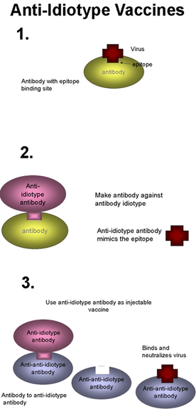

Slide 34
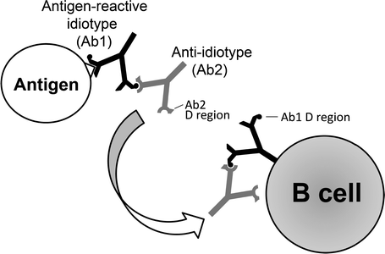

Slide 35
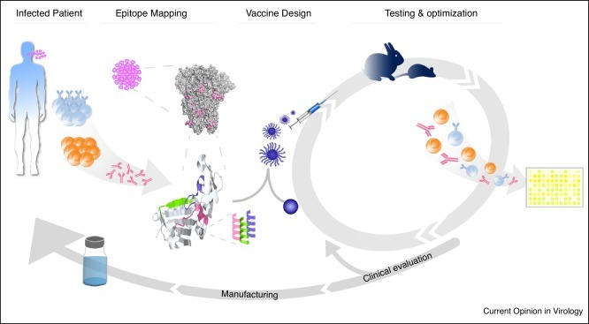
SYNTHETIC PEPTIDE VACCINES
It is prepared on the basis of determining the protein structures of the immunogen components of the infectious agent and synthesizing in vitro conditions and using peptides as vaccines.

Slide 36
Advantages of synthetic peptide vaccines
In these vaccines, it is not possible for the agent to reproduce, spread or cause infection in the body.
Their application in high doses does not pose a problem.
They are easy to maintain.

Slide 37
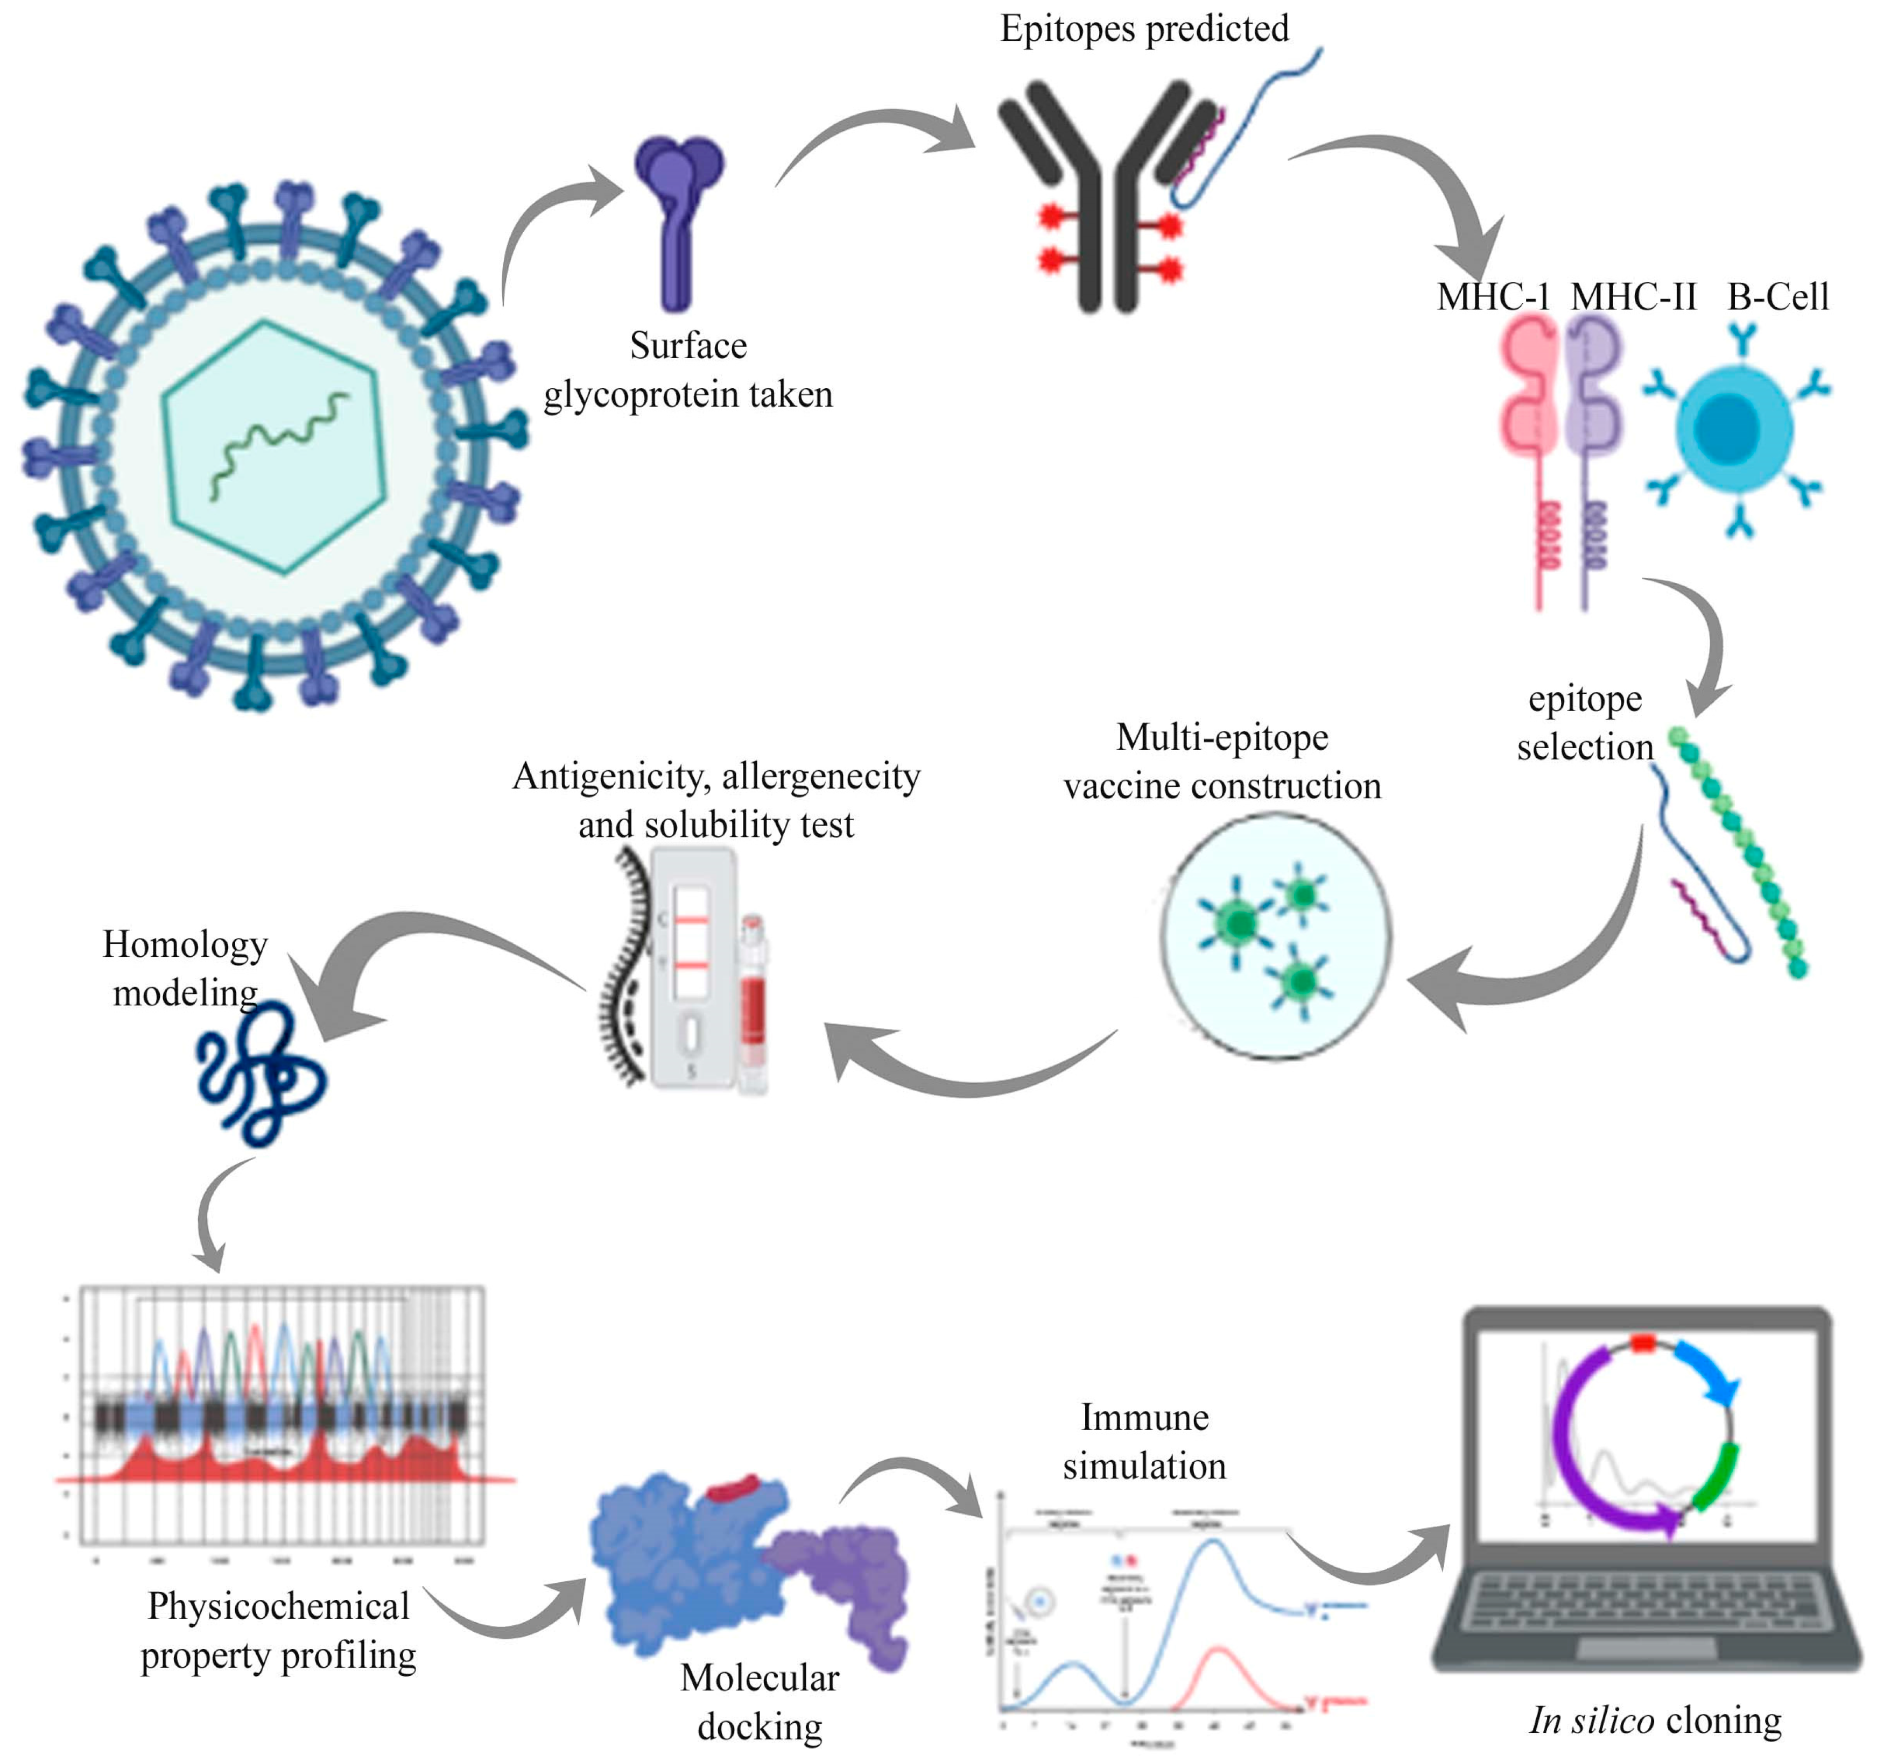

Slide 38
Disadvantages of synthetic peptide vaccines
The antigenic determinant to be synthesized must be well determined.
For effective protection, it may be necessary to use a multicompetent vaccine for more than one antigenic determinant.

Slide 39
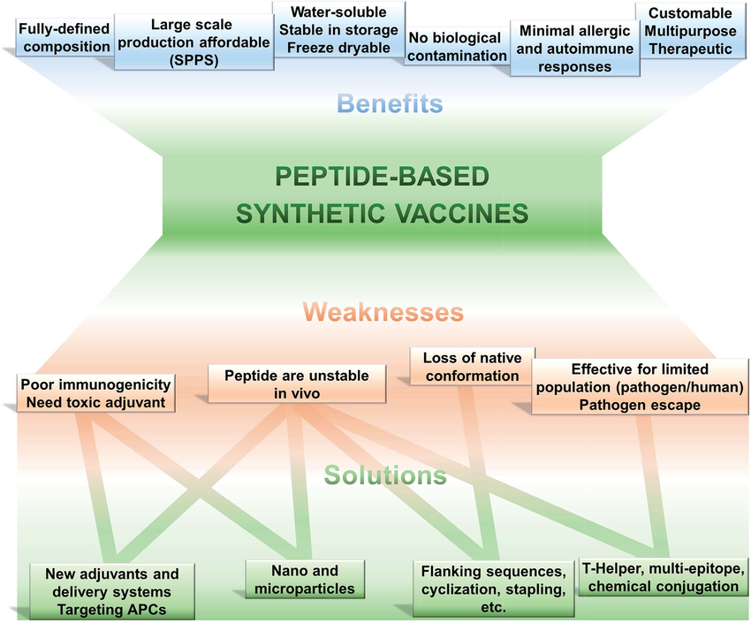

Slide 41
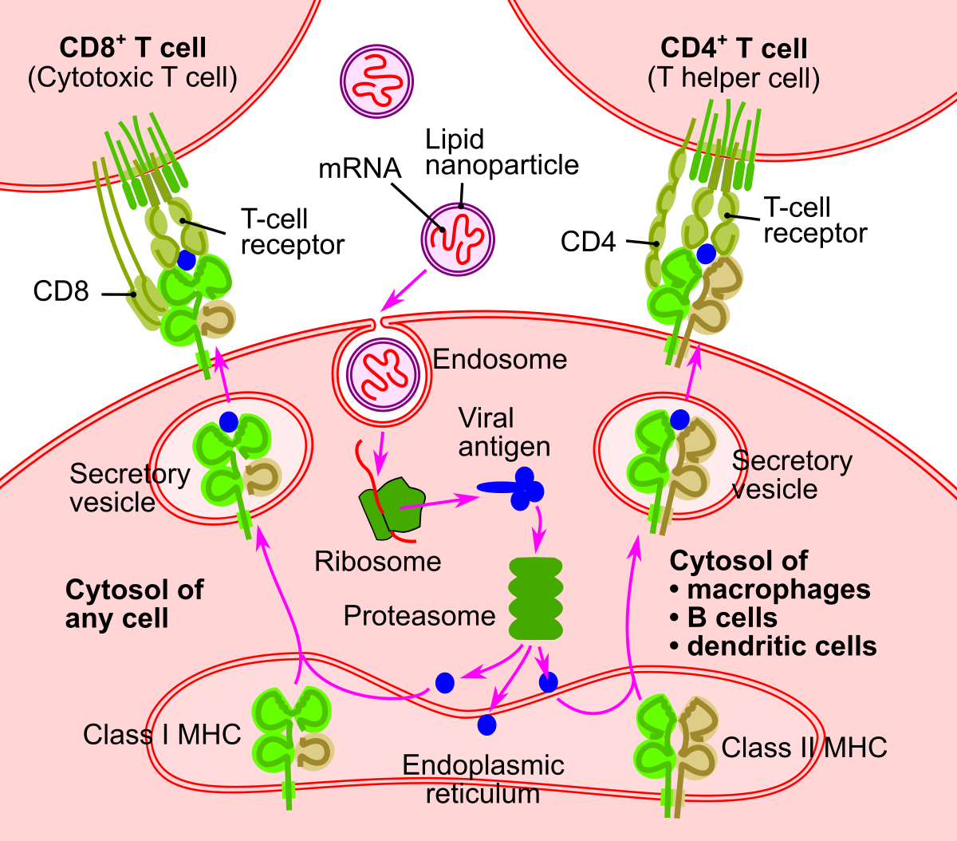

Slide 42
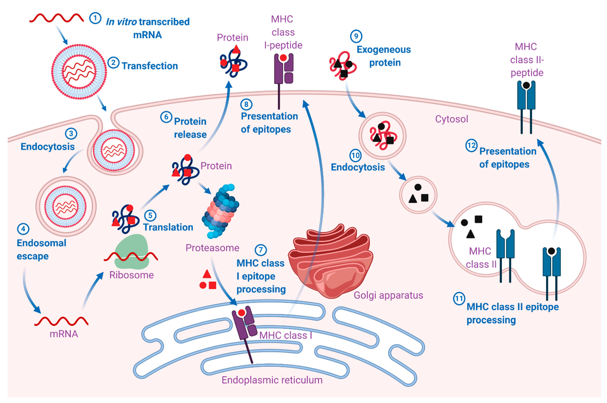

Slide 43
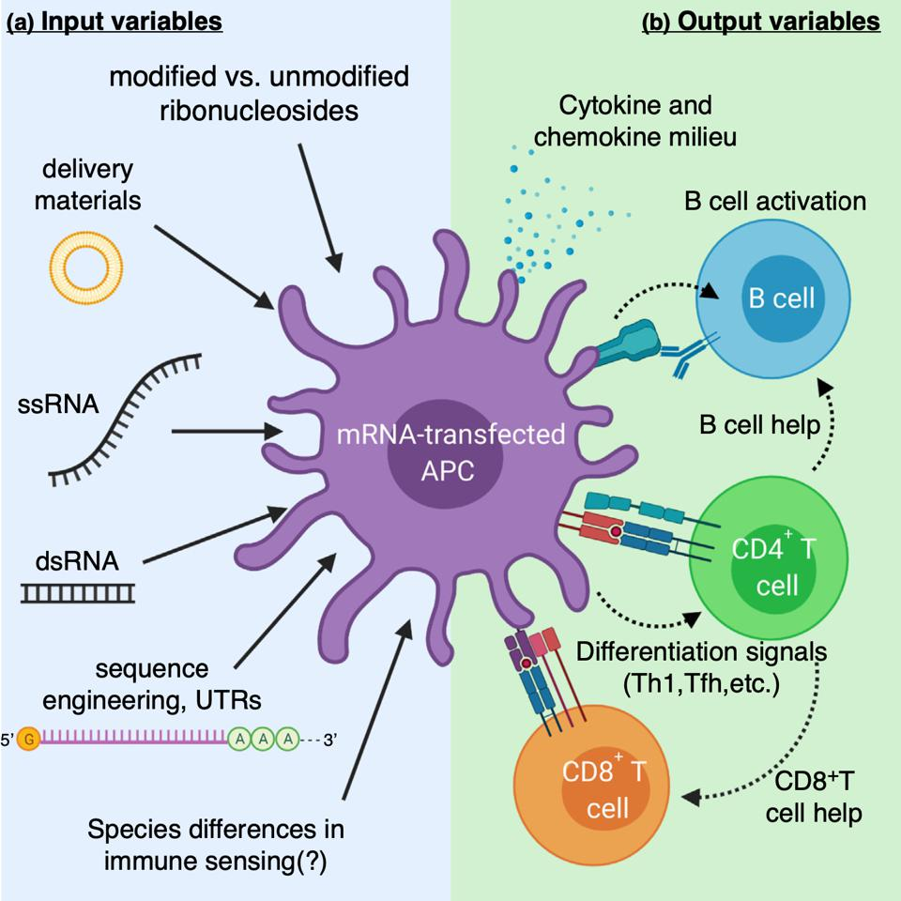

Slide 44
Adjuvant
Adjuvants are biological or chemical components that are used in conjunction with antigens and activate the immune system non-specifically.

Slide 45
Adjuvant
Adjuvants have different mechanisms of action at the cellular and molecular level. These;
Depot effect for slow release of antigen,
targeting to antigen-expressing cells (APCs),
activation of these cells (APCs),
stimulation of cytokines,
conformational changes of antigen molecules or
changing the net polar charges of the molecules.

Slide 46
What should an ideal adjuvant be like?
An ideal adjuvant should provide the desired immunity to whatever type of cellular or humoral protection is desired.
It should create immune memory, that is, long-term immunity
It should be safe and have few side effects (it should be shown to be effective and safe in 5000-25000 cases before license)
It should not have a stimulating effect on autoimmunity.
Should not be mutagenic, carcinogenic or teratogenic
Must be biodegradable
It should be cheap and has a long shelf life.

Slide 47
Adjuvants
Aluminium salts (alum)
Saponins
Cytokines
Oil emulsions
Bacterial derivatives
Carbohydrates
Liposomes

Slide 48
Alum
Aluminum salts cause the antigen to be stored at the injection site, providing slow and continuous release and stimulating antibody production.
Aluminum salts lead to a high concentration of antigen at the injection site, thereby increasing the uptake of the antigen by Antigen Presenting Cells (APC).
In addition, aluminum compounds act by stimulating dendritic cells (DH) directly or indirectly, stimulating complement activation or chemokine release.

Slide 49
Alum
Antigens / Proteins attach to aluminum adjuvants by basically two mechanisms.
Electrostatic effect
Ligand change

Slide 50
Alum
Aluminum-based components are the most commonly used adjuvants in vaccine studies.
However, it has some important disadvantages:
Low immunity in peptide vaccines
Inability to activate the Th1 pathway
Development of serious allergic reactions at the injection site

Slide 51
Oil emulsions
Oil emulsions also show a good adjuvant effect.
The oldest example of this is Freund's adjuvant, an emulsion containing Arlacel A as a surfactant and mineral oil as an oil phase.
It is available in two forms as IFA (Incomplete Freund's Adjuvant) and CFA (Complete Freund's Adjuvant).
CFA enhances both humoral and cellular immune response and contains inactivated mycobacteria.

Slide 52
Freund adjuvant
Freund's adjuvant is a Water / Oil emulsion. Freund's Complete Adjuvant (FCA)
It contains mineral oil (marco 52), Arlacel A (Dianhydromannitol monooleate) and 500 μg / ml dead Mycobacterium tuberculosis.
Incomplete Freund's adjuvant (Freund's Incomplete Adjuvant, FIA) does not contain Mycobacterium tuberculosis.

Slide 53
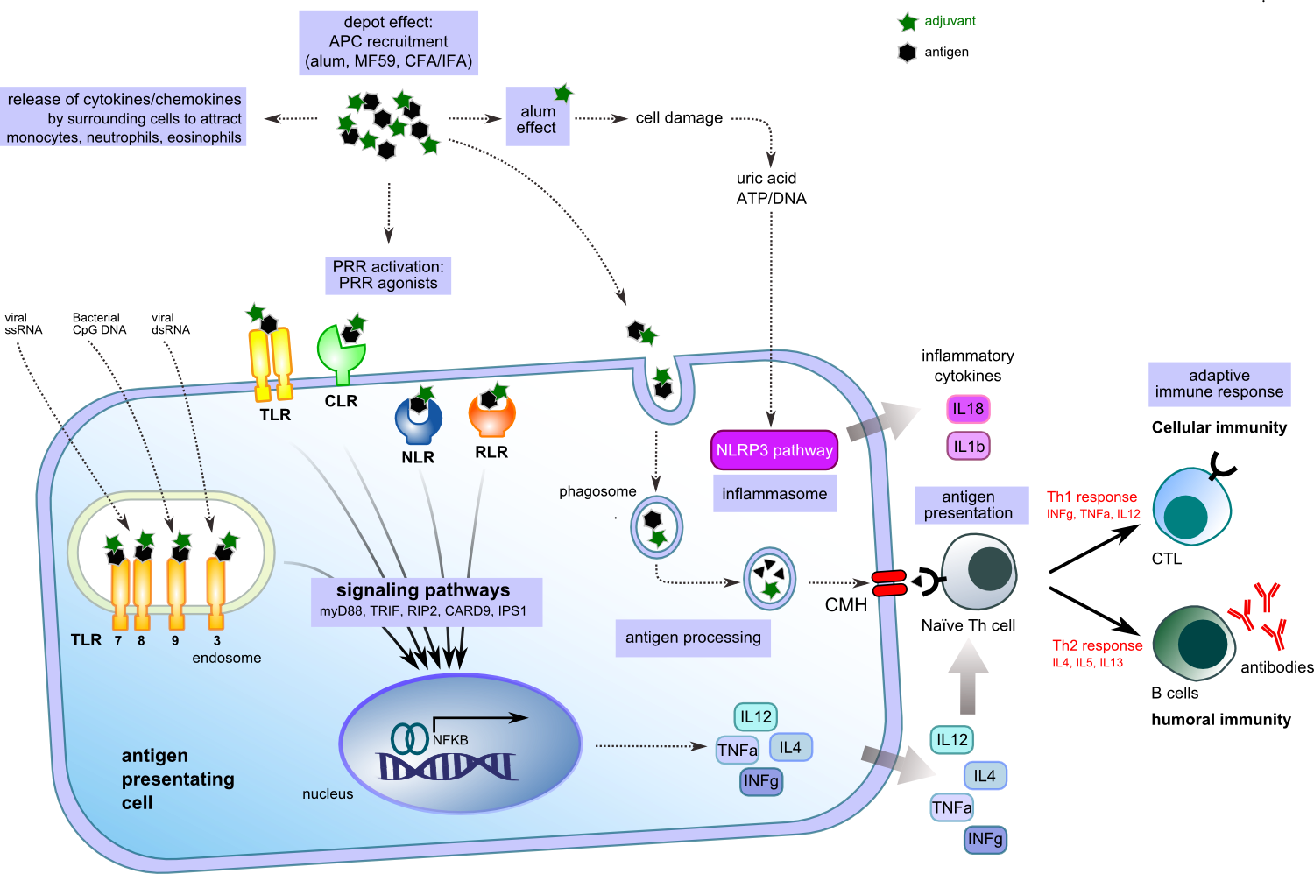

Slide 54
Saponins
Steroid or triterpenoid glycosides found in plants, marine life and bacteria.
They stimulate both cellular and humoral immunity.
Low doses are sufficient for adjuvant effect.
They increase CD8 (+) cytotoxic lymphocyte response, enhance the immune response against mucosal antigens.
Since they are surfactants, they can cause hemolysis.

Slide 55
Saponins
Quillaja saponaria
It is obtained from the bark of Quillaja saponaria Molina.
It increases immune cell proliferation and antibody formation.
Quillaja saponins have a mitogenic effect and in this way cause T and B cell proliferation.

Slide 56
Saponins
Quil A
Derived from Quillaja saponaria
Contains more than 23 saponins
Used in veterinary medicine
It is highly toxic to humans.
In addition to forming granulomas, it causes severe hemolysis by affecting the cholesterol in the erythrocyte membrane.

Slide 57
Saponins
QS-21
It is obtained from Quil A by reverse phase chromatography method.
It creates a strong cellular response. Th1 cytokines (IL-2, IFN-γ) and IgG2a antibodies. It creates both mucosal and systemic immunity.

Slide 58
Microorganism-based adjuvants
Although the bacterial cell wall and lipopolysaccharides (LPS) are not strong immunogen as antigens, they strengthen the immune response and have an adjuvant effect.
They achieve their adjuvant effects by activating "Toll-like receptors" on Antigen Presenting Cells.

Slide 59
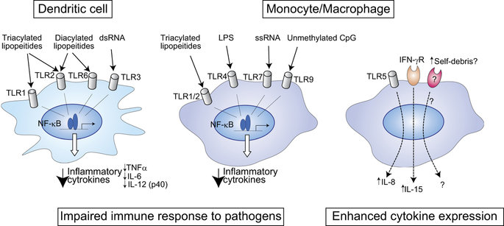

Slide 60
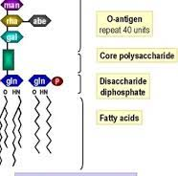
Lipopolysaccharides
It is obtained from the gram negative bacterial cell wall.
Lipid A is the part responsible for the adjuvant effect.
At high pH, ​​lipid A hydrolyzes and monophosphoryl lipid A (MPL) is formed.
It stimulates the cellular immune response but is toxic.

Slide 61
Monofosforil lipid A (MPL)
It is derived from the lipopolysaccharide of the bacterium Salmonella minnesota.
MPL is an adjuvant that is as effective as lipid A but less toxic than it.
It stimulates the cellular immune response by increasing the synthesis and release of IL-2 and IFN-gamma.
MPL is usually formulated together with liposomes, emulsions, aluminum or QS21.

Slide 62
CPG Motifs
Six deoxynucleotide-long DNA molecules with a CpG dinucleotide in the middle is called a CpG motif.
This frequently repeated CpG motif in bacterial cells is immediately recognized by TLRs in mammalian cells (innate immunity) as foreign and dangerous, and interferons (α and β) and IL-12 are secreted by immune system cells.
Thus, while the cellular immune response is stimulated, the allergic response is also suppressed. This demonstrates that DNA molecules containing the CpG motif can be used as adjuvants in therapeutic applications and vaccines.

Slide 63
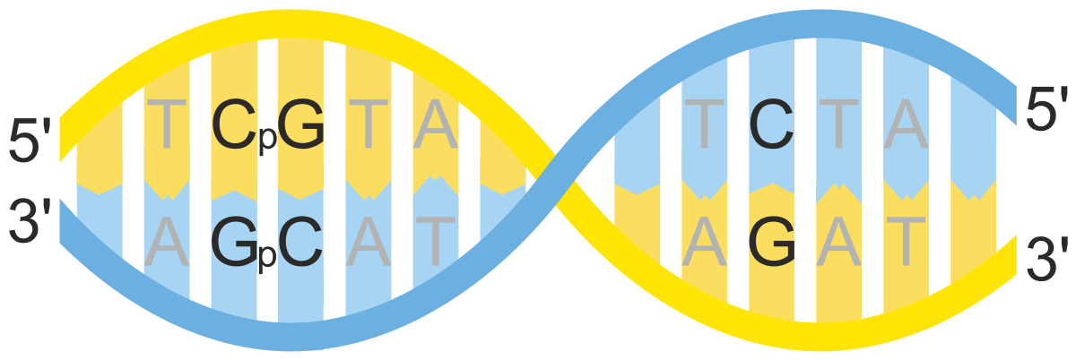
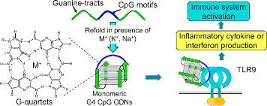

Slide 64
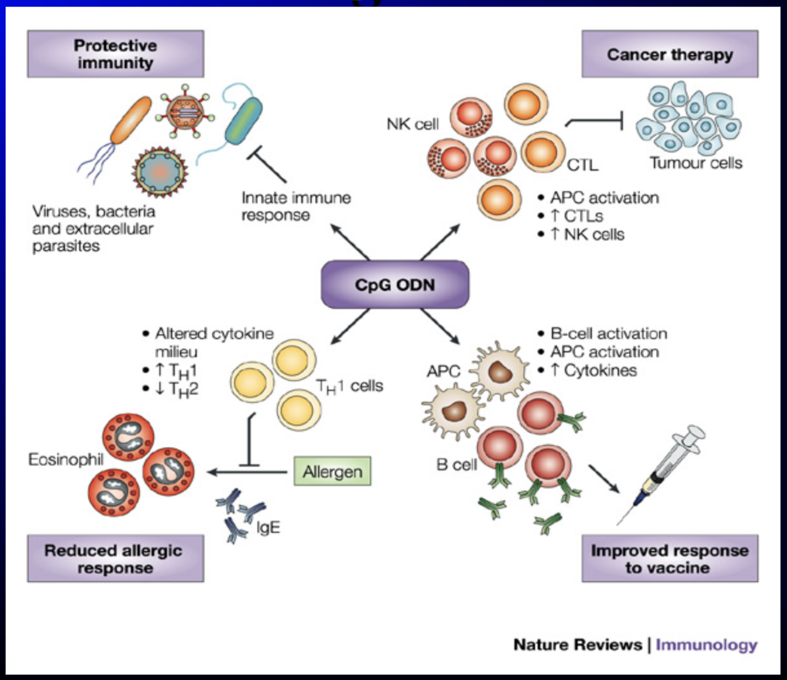

Slide 65
Emulsions
MF59 O/W (Squalene)
It is a triterpenoid hydrocarbon (C30H50) produced by plants and found in most foods.
It is present in most of the adjuvants because it is naturally found in the human body and is biodegradable.

Slide 66
MF59 O/W (Squalene)
MF59, which has low toxicity, has increased the efficacy of influenza vaccine in small animal models.
MF59 adjuvant influenza vaccine was found to be more effective against pandemic influenza strains than other vaccines. MF59 adjuvant hepatitis B vaccine was found to be 100 times more effective than aluminum adjuvant vaccines.
MF59 appears to be a safe and effective vaccine adjuvant that is well tolerated in humans.

Slide 67
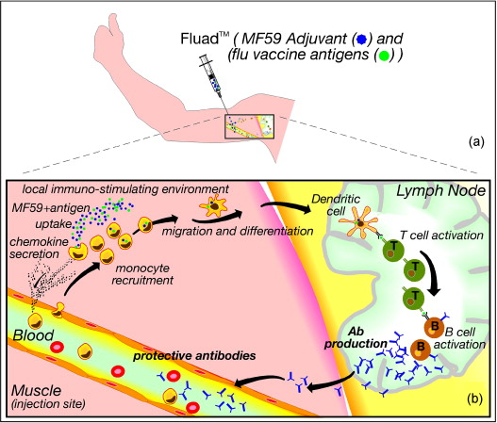

Slide 68
Nano-vaccines
Nanoparticles are used for two purposes in vaccine studies.
1. Delivery agents for antigens
2. Adjuvant properties

Slide 69
Advantages of nano-vaccines over sub-unit vaccines
1. Antijenlerin nanotaşıyıcıların içerisine enkapsülasyonu antijenik degredasyonu önler ve antijen stabilitesini arttırır
2. Antijenlerin ve adjuvanların eş zamanlı enkapsülasyonu sağlanabilir
3. Nanopartiküller ASH’lar tarafından yüksek düzeyde alınabilir ve antijenler işlenebilir
4. Çapraz reaksiyonu mümkün kılar ve böylece sitotoksik T hücreleri aktive eder.
5. Yüzeyleri modifiye edilerek lenfoid organlara yönlendirilebilirler.

Slide 70
Advantages of nano-vaccines over sub-unit vaccines
Encapsulation of antigens into nanocarriers prevents antigenic degradation and increases antigen stability.
Simultaneous encapsulation of antigens and adjuvants can be achieved
Nanoparticles can be taken up at high levels by ASHs and antigens can be processed.
It enables cross-reaction and thus activates cytotoxic T cells.
They can be directed to lymphoid organs by modifying their surface.

Slide 71
Liposomes
They are spherical structures with an outer shell formed by bilayer lipids and a hydrophilic inner compartment.
Thanks to its structural feature, it protects the encapsulated antigen from rapid extracellular destruction.
Liposomes can be used together with DNA and protein as a "co-delivery" system. Thanks to DNA, MHC type 1, thanks to the protein MHC type 2 is presented, and both CD8 (+) and CD4 (+) cells are activated.

Slide 72
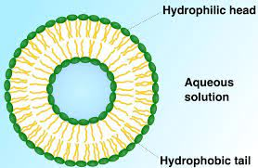

Slide 73
Virus-like Particles
VLPs structurally look like viruses
Not infectious because do not contain nuclear material
They are synthesized by self-complex formation of viral structural proteins expressed in vitro.
Virus-like particles that can contain both B and T cell epitopes may provide longer lasting and stronger protection.

Slide 74
Virus-like Particles
They are quite safe
They can easily penetrate through host cells and tissues.
They can trigger both cellular and humoral immune response.
Licensed product against rotavirus and HPV

Slide 75
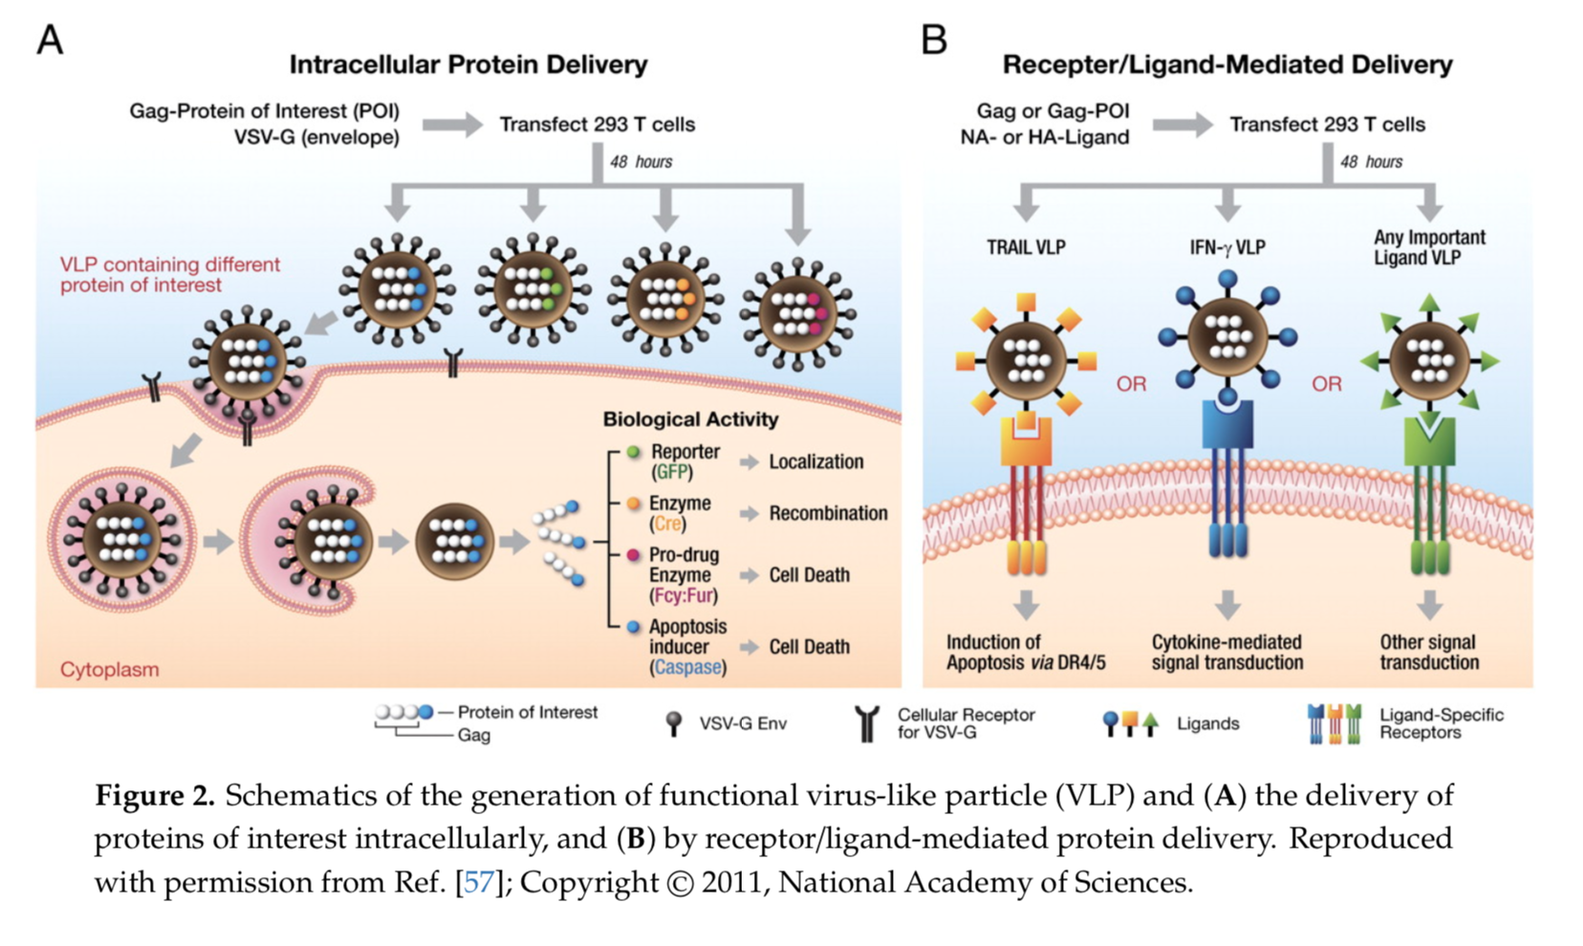

Slide 76
Virosomes
They are complexes formed by the combination of liposomes with viral envelope proteins.
Virosomes do not replicate
The viral proteins they contain allow them to remain in immune system cells for a long time.
This helps the virosomes to be used as active carrier systems.

Slide 77
Virosomes
The desired antigen can be encapsulated within virosomes or bound outside the virosomes by hydrophobic interactions
Thus, they play the role of both a carrier and an adjuvant in triggering the immune system.

Slide 78
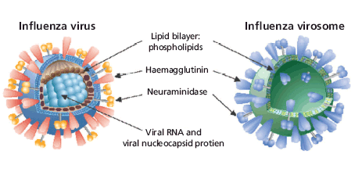

Slide 79
