Slide 1
Hypersensitivity
Assoc. Prof. Dr. Emrah Şeﬁk Abamor

Slide 2
Hipersensitivity
Hypersensitivity is called an excessive, undesirable (dangerous, disturbing and sometimes fatal) reaction of normal immune system components.
In order for a hypersensitive reaction to develop, the host must become sensitized (immune).

Slide 3
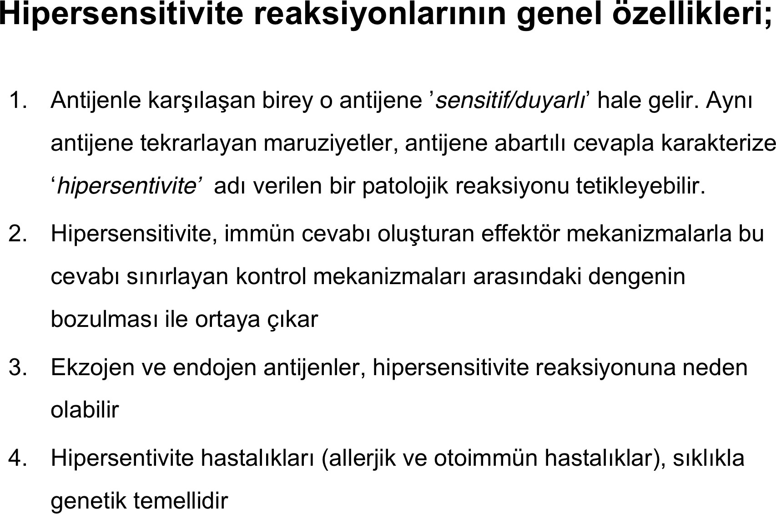

Slide 4
Types of Hypersensitivity Diseases
Hypersensitivity diseases are examined in 4 classes according to tissue damage and basic immunological mechanisms responsible for the disease:
Type 1 Hypersensitivity
Type 2 Hypersensitivity
Type 3 Hypersensitivity
Type 4 Hypersensitivity

Slide 5
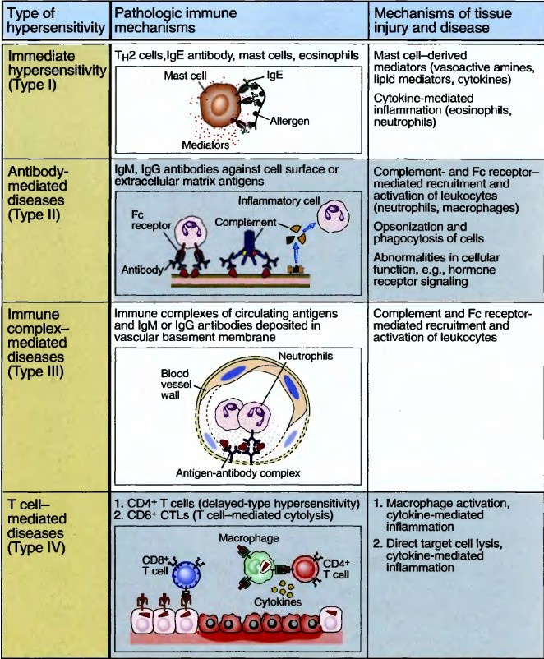

Slide 6
Type 1 Hipersensitivity
Immediate hypersensitivity (type 1 hypersensitivity) is a pathological reaction that develops through mediators released from mast cells.
This response is triggered by IgE antibodies developed against environmental antigens and binding of these antibodies to mast cells in various tissues.

Slide 7
Type 2 Hipersensitivity
Antibodies against certain cells or tissues can damage these cells or tissues or impair their function.
These diseases are called antibody-mediated (type II hypersensitivity) diseases.

Slide 8
Type 3 Hipersensitivity
Sometimes antibodies against soluble antigens can form complexes with these antigens, and the immune complexes formed can accumulate in the vessels of various tissues and cause inflammation and tissue damage.
These types of diseases are also called immune complex diseases (type III hypersensitivity).

Slide 9
Type 4 Hipersensitivity
Some diseases also develop as a result of the reactions of T lymphocytes to self-antigens in tissues.
These T cell-mediated diseases are called type IV hypersensitivity.

Slide 10
Innate Hypersensitivity (Type 1)
Ani aşırı
duyarlılık, bazı kişilerde, çeşitli yabancı
antijenlerle gelişebilen,
tekrar karşılaşma sonrasında
genelde enflamasyonla seyreden
hızla
IgE
antikoru ve mast hücresi aracılı damar ve düz kasların tepkisidir.

Slide 11
Innate Hypersensitivity (Type 1)
Reaction can involve:
skin (urticaria and eczema),
eye (conjunctivitis),
nasopharynx (rhinorrhea, rhinitis),
bronchopulmonary tissue (asthma) and
gastrointestinal system (gastroenteritis)

Slide 12
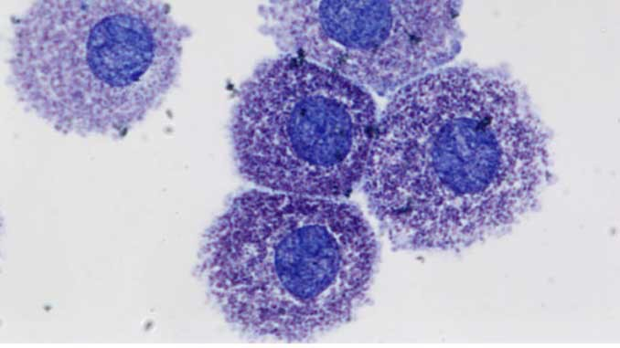
Mast hücreleri
Mast cells are involved in the immune system. Two types of mast cells have been identified; mast cells found in connective tissues and mucosal mast cells.
The activities of mucosal mast cells are T-cell dependent. Mast cells in connective tissues contain numerous basophilic granules.

Slide 13
Functions of Mast Cells
Mast cells perform phagocytosis.
They process antigen, produces cytokines
They secrete vasoactive substances.
Although it is known that it can kill bacteria by phagocytosis, this effect is less than phagocytes.

Slide 14
Functions of Mast Cells
Mast cells also ensure the normal functions and integrity of tissues.
For example, it has been shown in various studies that it regulates bowel movements, mucus and fluid secretion, and intestinal permeability in the digestive tract.

Slide 15
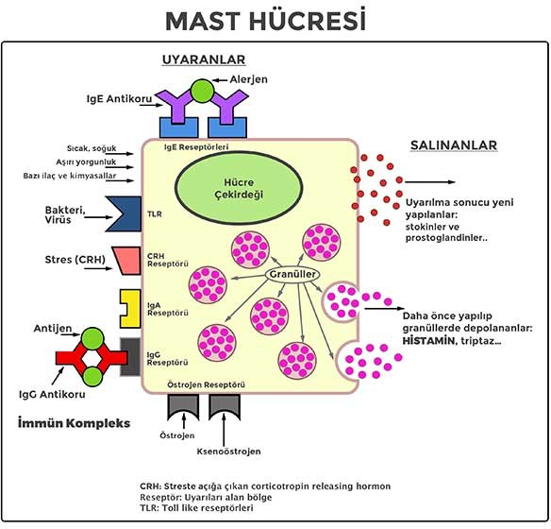

Slide 16
Mast cells
Mast cells have Immunoglobulin E (IgE) receptors as well as Immunoglobulin G (IgG) and complement receptors on their membranes.
Because of its high affinity, IgE molecules cannot be separated once bound, resulting in the mast cells being coated with IgE. IgE antibodies are produced by B cells.

Slide 17
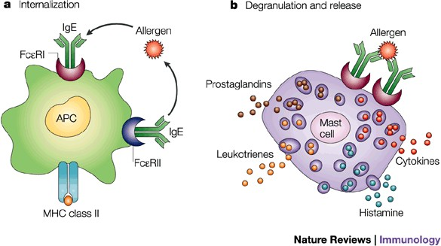

Slide 18
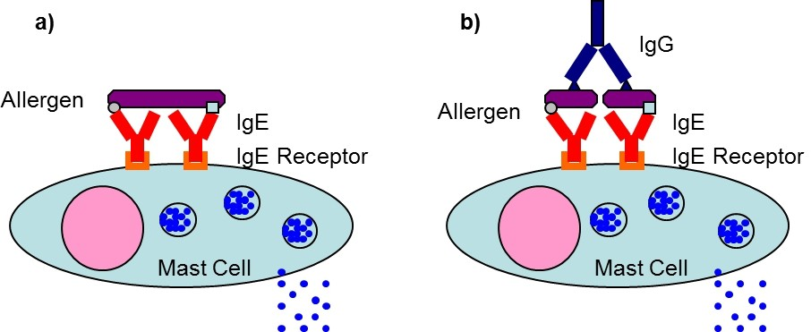

Slide 19
Mast cells
In allergic reactions, mast cells remain inactive until an allergen binds to an IgE. Allergens are usually proteins or polysaccharides. The allergen binds to IgE on the surface of the mast cell via the Fab portion.
According to the findings, the mast cell is activated as a result of the binding of antigens (ie the formation of cross-links) to two or more IgE molecules.

Slide 20
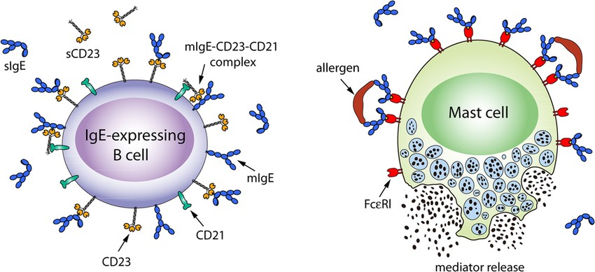

Slide 21
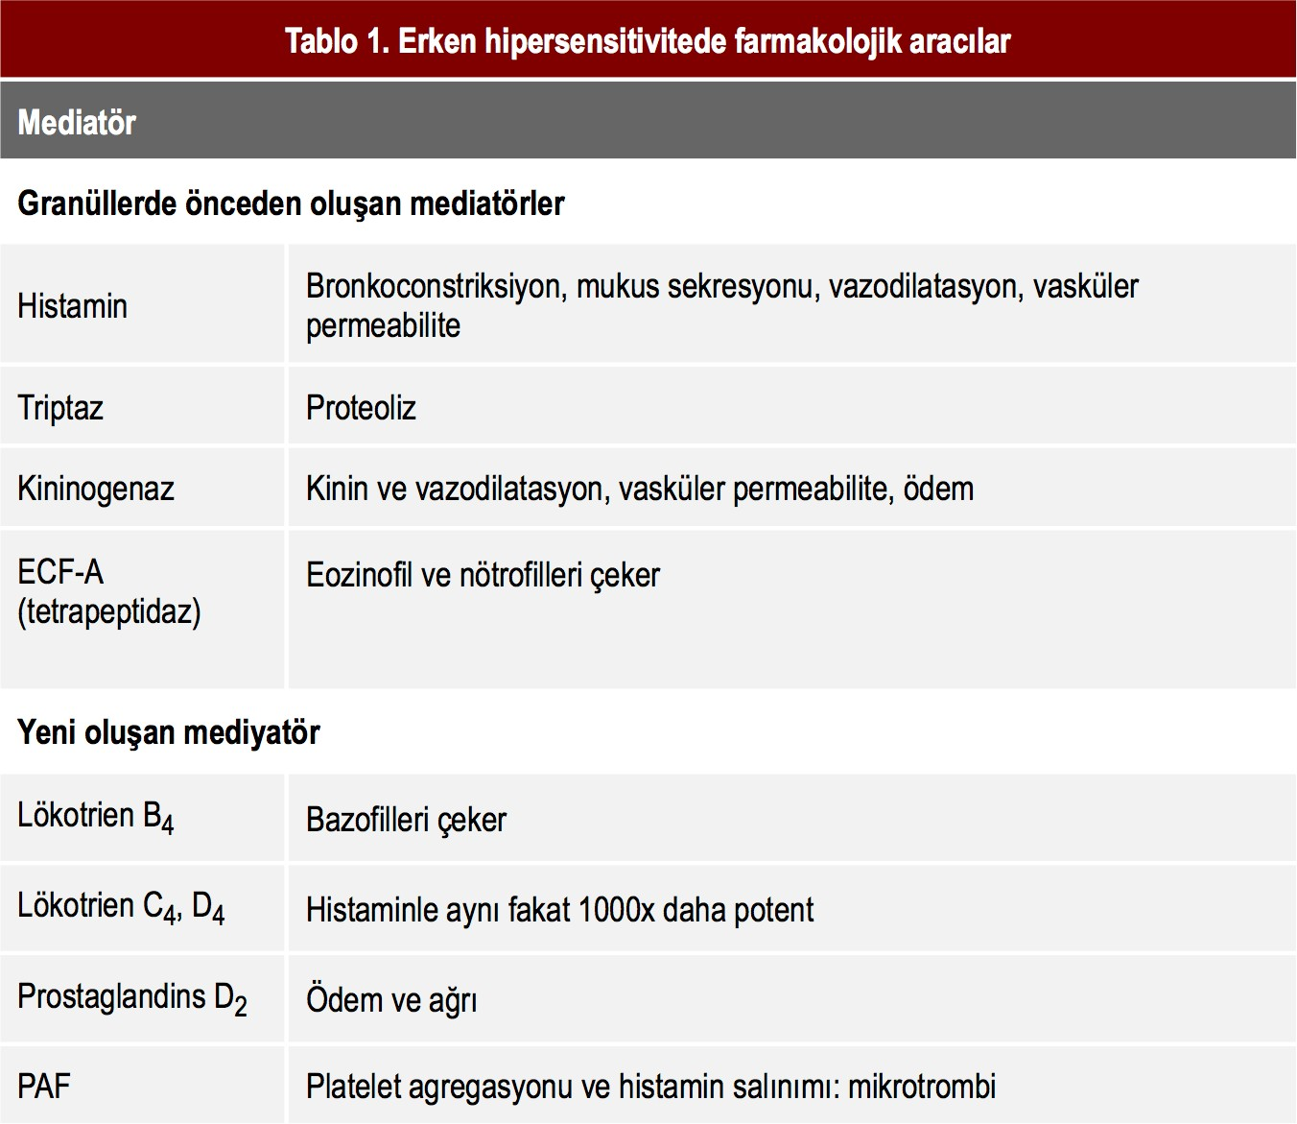

Slide 22
Mast cells
Some of the molecules released into the intercellular environment as a result of activation:
Pre-synthesized and stored in granules:
histamine
proteoglycans,
mainly heparin serine proteases
Synthesized after stimulation and immediately released:
prostaglandin D2,
leukotriene C4
cytokines,
In addition, tumor necrosis factor alpha (TNF-α) is both pre-synthesized and stored in mast cells and synthesized in activated cells.

Slide 23
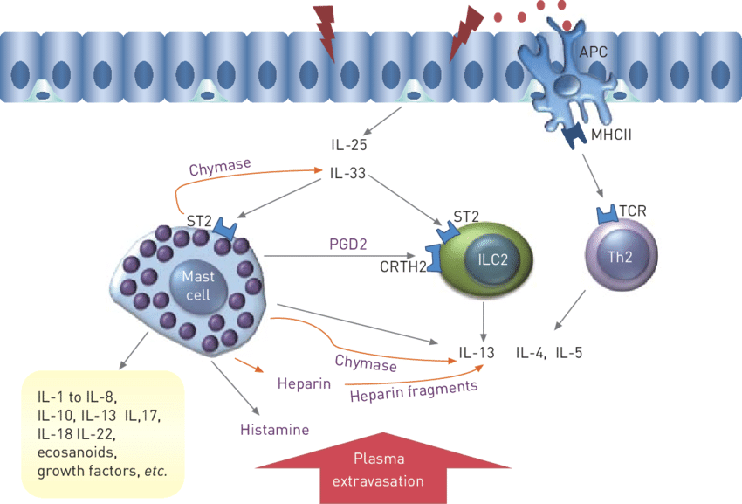

Slide 24
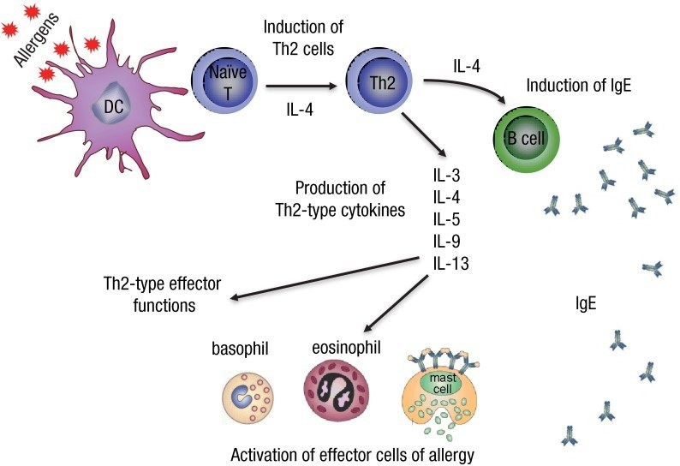

Slide 25
Anaphylaxis
In anaphylaxis, a kind of severe antigen-antibody reaction caused by the introduction of a hypersensitive antigen into the body, mast cells all over the body degranulate and as a result vasodilation occurs.

Slide 26
ALLERGY/ ATOPY
Immediate hypersensitivity reactions are also called allergies or atopy.
People who are prone to developing these reactions are called "atopics."
These types of reactions can affect various tissues in different intensities in individuals.

Slide 27
Immediate Hypersensitivity Reactions
Hay fever, food allergies, asthma and anaphylaxis are the most common immediate hypersensitivity reactions.
Allergies are the most common disorders of the immune system that affect approximately 20% of the population.

Slide 28
The immediate sequence of hypersensitivity responses begins with the production of an IgE antibody against an antigen.
This IgE antibody then binds to the Fc receptor on the mast cell surface.
When the antigen is encountered again, the bound IgE antibody cross-links with the antigen and causes the release of mediators from the mast cell.

Slide 29
Some mediators of mast cells rapidly increase vascular permeability and contract smooth muscles, leading to clinical manifestations in these reactions.
This vascular and smooth muscle reaction can develop within minutes after re-exposure to the antigen in susceptible individuals.

Slide 30
Other mediators of mast cells are cytokines that cause neutrophils and eosinophils to collect in the reaction zone in the following hours.
Immediate hypersensitivity inflammatory component, called late phase reaction, is responsible for tissue damage resulting from repetitive immediate hypersensitivity responses.

Slide 31
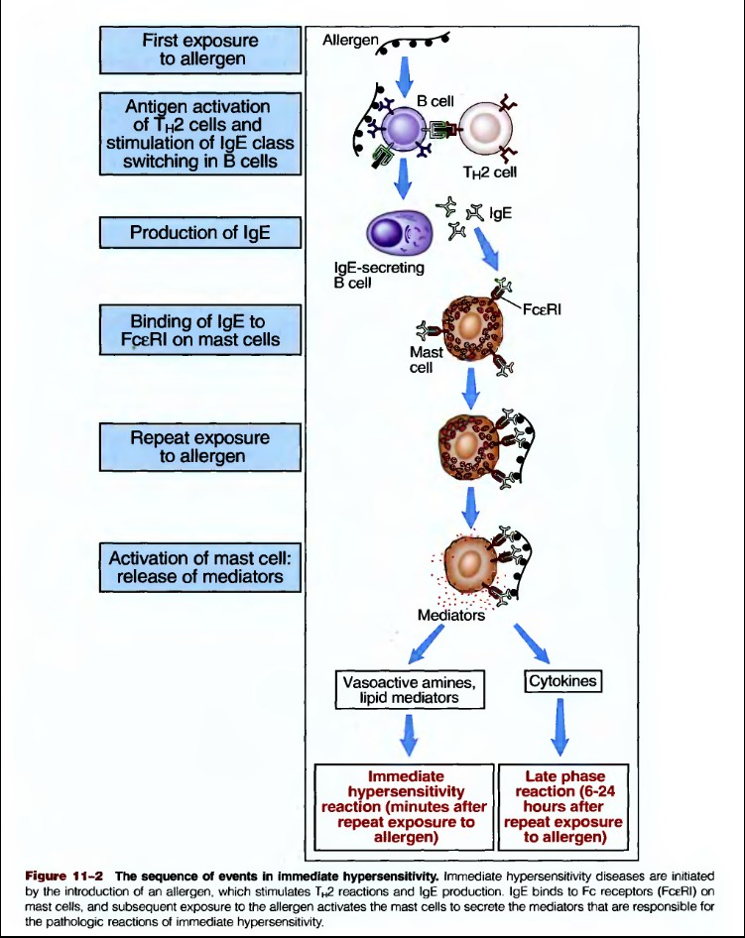

Slide 32
Production of IgE Antibodies
In allergy-prone individuals, exposure to certain antigens causes the activation of Th2 cells and the production of IgE antibodies.
Normal individuals, on the other hand, do not develop a strong TH2 response to most foreign antigens.

Slide 33
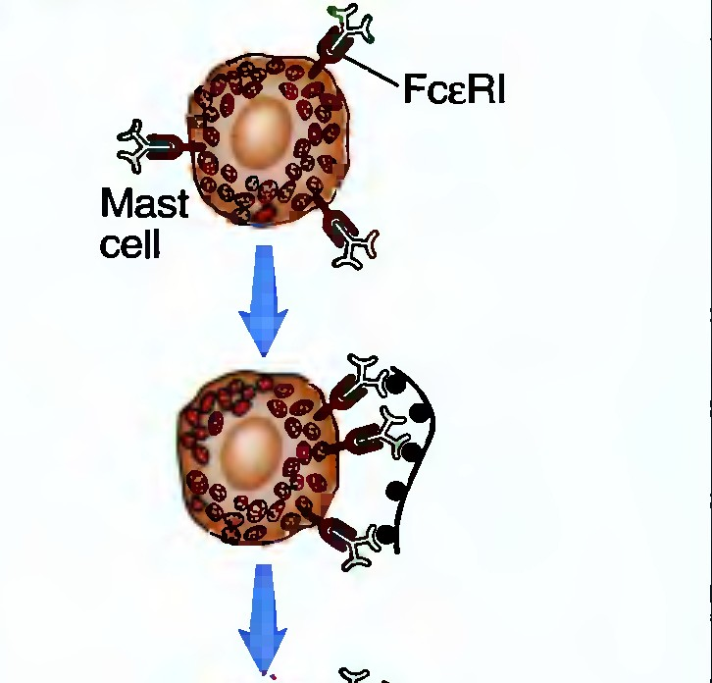
On the other hand, the presence of many IgE antibodies of varying specificity on the surface of mast cells in normal individuals is not sufficient to develop an immediate hypersensitivity reaction against antigens.

Slide 34
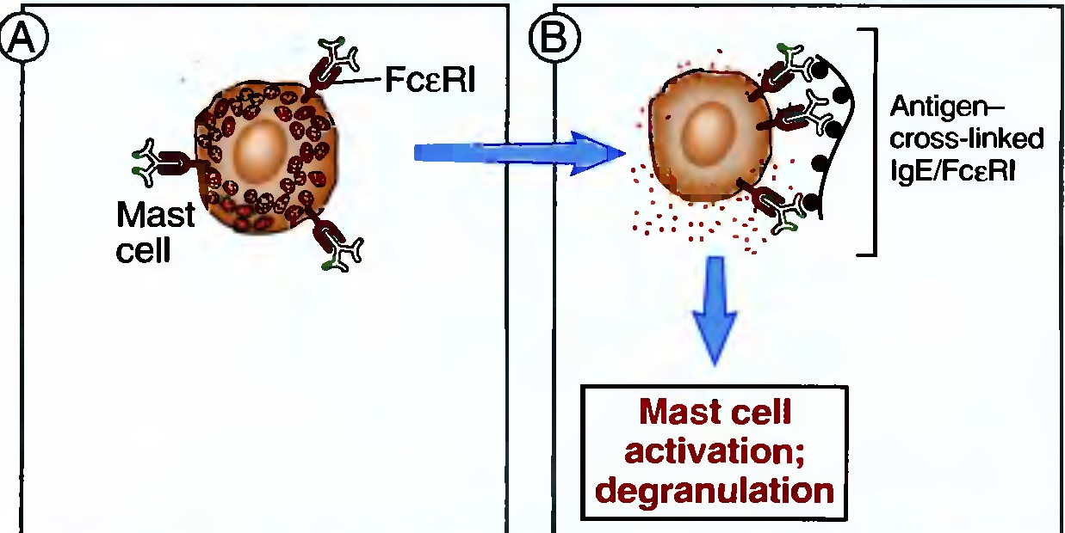
Although mast cells are found in all tissues, the way the allergen enters the body determines which cells will be activated.
For example, inhaled allergens activate mast cells in the submucosal tissues of the bronchi, while ingested allergens activate those in the intestinal walls.

Slide 35
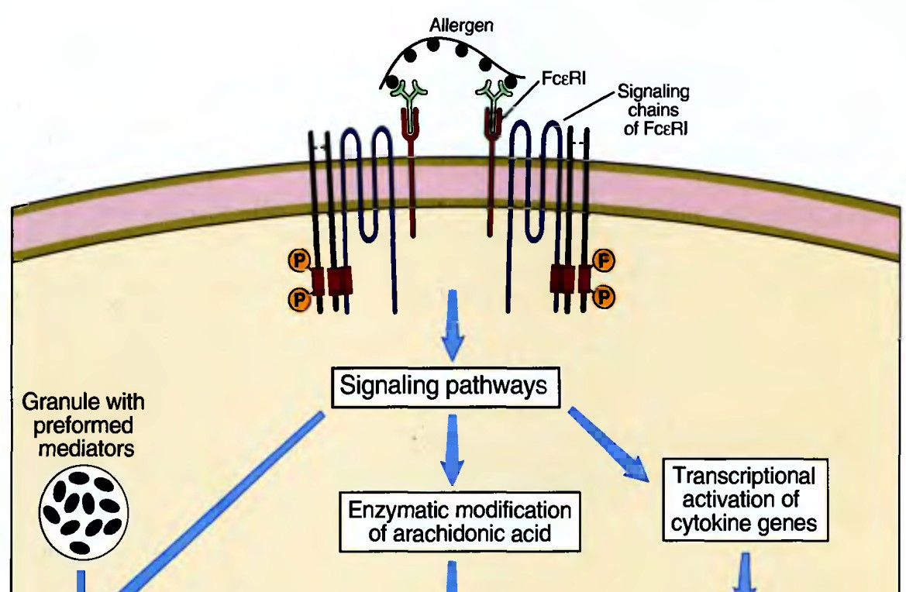
In sudden hypersensitivity reactions, specific IgE production occurs as a result of the first contact with the allergen, and sensitive mast cells are activated in re-encounter with the antigen.

Slide 36
These mediators have different effects:
Histamine is the most important amine and causes dilation of small diameter blood vessels, increase in vascular permeability, and temporary contractions in smooth muscles.
Proteases cause local damage to tissues.
Prostaglandins from arachidonic acid metabolites cause vascular dilatation,
Leukotrienes cause prolonged smooth muscle contractions

Slide 37
Cytokines produced by mast cells stimulate the aggregation of leukocytes, which causes a late reaction.
The main cells involved in this reaction are eosinophils, neutrophils and TH2 cells. Mast cell-derived tumor necrosis factor (TNF) and IL-4 increase neutrophil- and eosinophil-rich inflammation.

Slide 38
Eosinophils are important components of allergic reactions and are responsible for tissue damage in these reactions.
These cells are activated by IL-5 cytokine produced by mast cells and TH2 cells.

Slide 39
Clinical Syndromes and Treatment
Immediate hypersensitivity reactions exhibit variable clinical and pathological features due to the effects of mast cell mediators in varying amounts and in various tissues.

Slide 40
Allergic rhinitis and sinusitis, which are mild reactions seen in hay fever, can be evaluated as a kind of immune response against inhaled pollen allergens.
Histamine, produced by mast cells in the nasal mucosa, causes an increase in mucus secretion.
Late reactions cause prolongation of inflammation.

Slide 41
Allergens taken in food allergies cause histamine release and increase in peristalsis as a result of mast cell degranulation.
Asthma, on the other hand, may cause the release of mediators, including leukotrienes, by stimulating mast cells in the bronchi of inhaled allergens, resulting in contraction of the smooth muscles in the bronchi and congestion in the airways.
In chronic asthma, there is an increase in eosinophils and mucus secretion in the bronchial mucosa and hypersensitivity to various stimuli in bronchial smooth muscles.

Slide 42
Anaphylaxis is the most severe clinical form of sudden hypersensitivity and progresses with edema in many tissues, including the larynx, and a sudden decrease in blood pressure.
This reaction occurs with widespread mast cell degranulation to a systemic antigen, and can be life-threatening due to the sudden drop in blood pressure and airway obstruction.

Slide 45
Cytotoxic Hypersensitivity (Type 2)
It is caused by the formation of antibodies against the antigenic component of the cells. The antibodies formed are IgG or IgM in nature.
As a result of the binding of the antibody to the cell surface receptor, cell damage develops or this binding creates a cyto-stimulating effect. Therefore, Type II reaction is divided into Type II a- cytotoxic and Type II b - cell stimulating type.

Slide 46
Cytotoxic Hypersensitivity (Type 2)
In the cytotoxic type, tissue damage occurs due to the antigen-antibody interaction and local anaphylatoxin (C5a) production, polymorphonuclear leukocyte accumulation, and then the release of hydrolytic neutrophil enzymes. The best example of this group is the blood transfusion reaction.

Slide 48
Cytotoxic Hypersensitivity (Type 2)
In type IIb, antibodies that bind to the cell surface receptor cause an increase or decrease in function.
In Graves' disease, when the antibodies of the IgG type against the TSH receptor in the thyroid cells combine with the antigen, thyroid hormone production is stimulated and thyrotoxicosis occurs.
In myasthenia gravis, autoantibodies are formed against acetylcholine receptors and skeletal muscle contraction is reduced, resulting in decreased function.

Slide 50
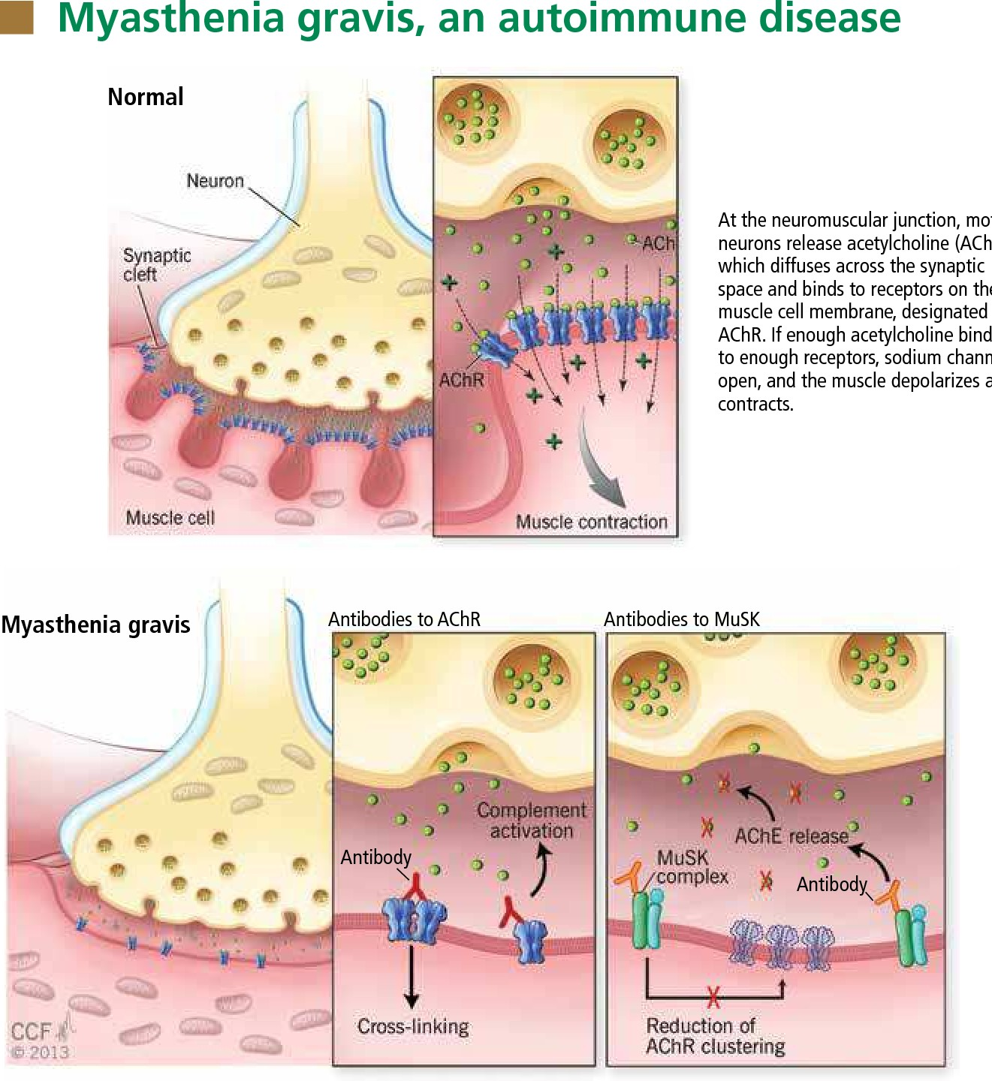

Slide 52
Immune complex mediated hypersensitivity (Type 3)
It is a reaction that occurs as a result of the binding of the antibody against a soluble antigen and activating the complement system. An immune complex is formed as a result of antigen-antibody coupling.

Slide 53
Immune complex mediated hypersensitivity (Type 3)
Antigen can be exogenous (microbes, viruses) or endogenous (serum proteins). The severity of the reaction is related to the size and distribution of the immune complex.
Immune complexes are frequently observed in the vessel wall, the synovial membrane of the joints, the glomerular basement membrane in the kidney, and the choroidal plexus in the brain.

Slide 54
Immune complex mediated hypersensitivity (Type 3)
Events begin when the immune complex activates the complement system.
The main anaﬂotoxins (C3a, C4a, C5a), which are complement degradation products, cause localized mast cell degranulation followed by increased local vascular permeability.
Complement degradation products also cause neutrophils to be recruited to the site. C3b acts as an opsonin by surrounding the immune complex, neutrophils bind to the immune complex through the CR1 receptor, and tissue damage occurs with the contribution of the membrane attack complex.

Slide 55
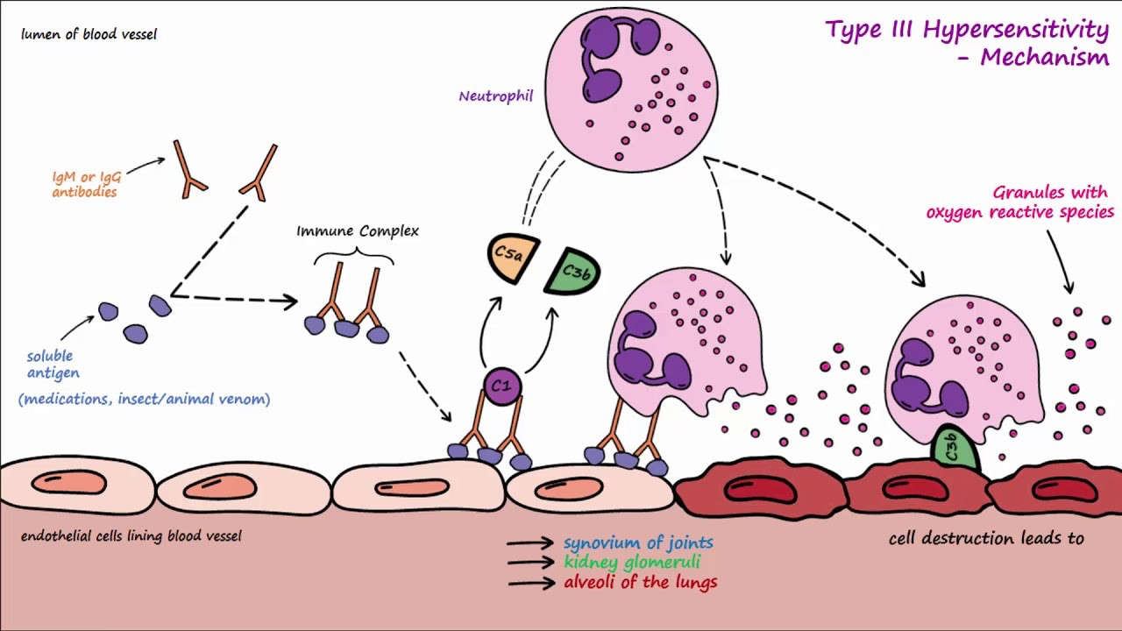

Slide 56
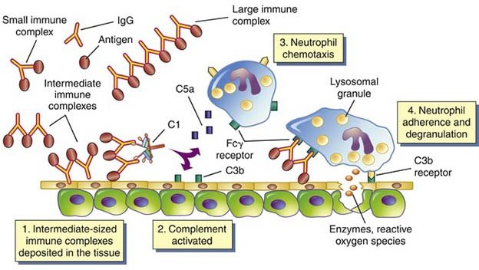

Slide 57
Serum Disease
Serum sickness first appeared when sera obtained from horse and cattle blood had side effects on some people and got its name in this way. When the antigens and antibodies in the serum combine, they can cause serum sickness.
These serums are used in cases such as gas gangrene, tetanus, diphtheria and snake bites.
However, serum sickness does not develop in every patient given serum. The probability of occurrence of this disease is 5%.

Slide 58
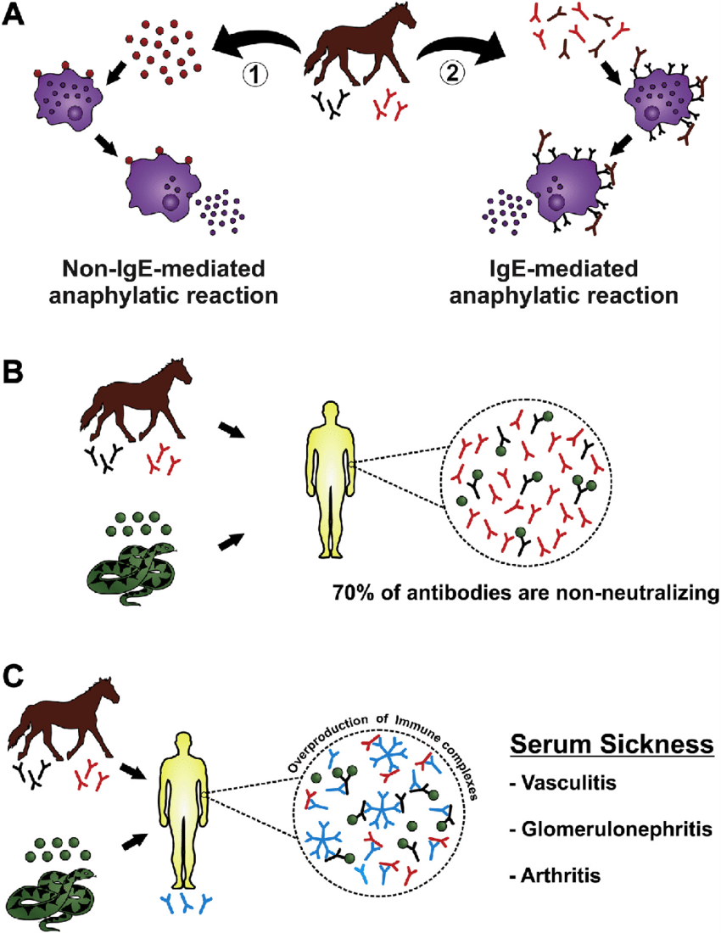

Slide 59
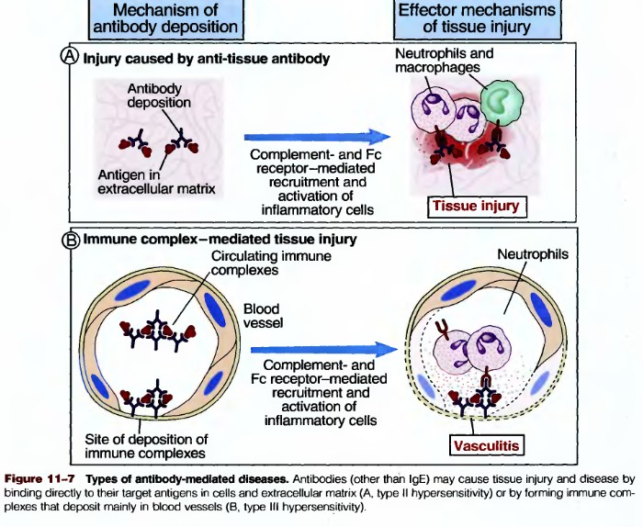

Slide 60
Etiology of T-Cell Mediated Diseases
Most T cell-mediated hypersensitivity diseases are thought to be caused by autoimmunity. Autoimmune reactions are usually directed against cellular antigens in limited tissues.
Therefore, T cell-mediated autoimmune diseases are dependent on several organs and are usually not systemic. A completely normal T-cell response to microbes may accompany tissue damage.

Slide 61
Etiology of T-Cell Mediated Diseases
For example, in tuberculosis, although there is a T-cell-mediated immune response to Mycobacterium tuberculosis, this response becomes chronic because the infection cannot be eliminated.
The resulting granulomatous lesion is the main cause of damage to and dysfunction of normal tissues at the site of infection.
Although the hepatitis virus is not very cytotoxic, liver damage in this infection is caused by the cytolytic T lymphocyte (CTL) response to the infected hepatocytes.

Slide 62
CD4 cell reactions (delayed type hypersensitivity)
After the antigen is presented to the T lymphocyte, T cell activation occurs and proinflammatory cytokines (IL-2, IFN-gamma, macrophage inhibitory factor, TNF-alpha) are released.
Thus, clonal proliferation occurs in activated T cells and other cells (monocyte, neutro l, eosin l, baso l) migrate to the environment. IL-12 released from macrophages contributes to the differentiation of T lymphocytes towards Th1.

Slide 63
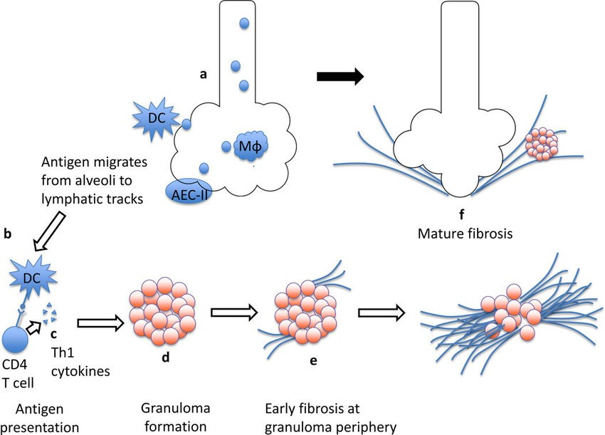
Granulamatous Reactions

Slide 66
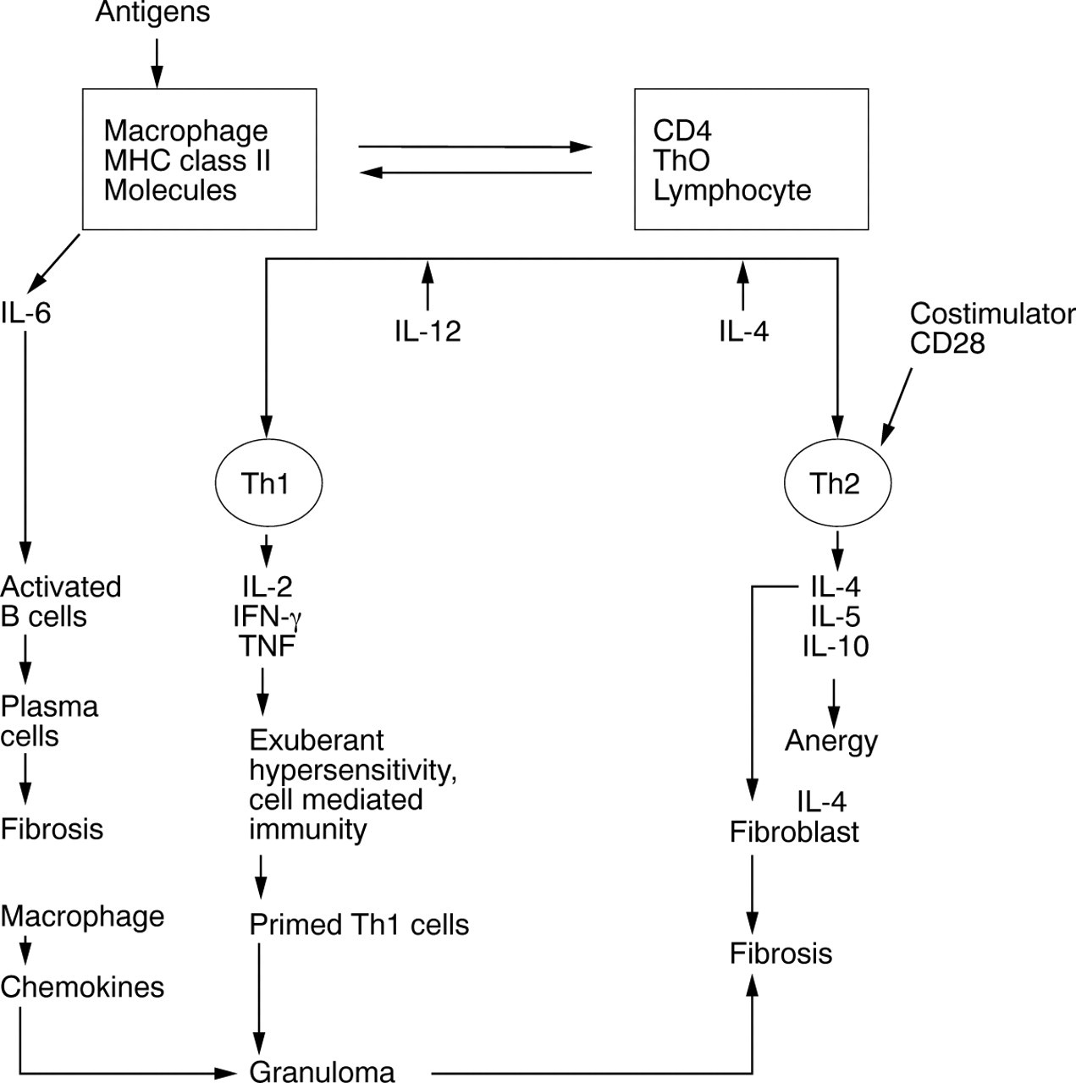

Slide 67
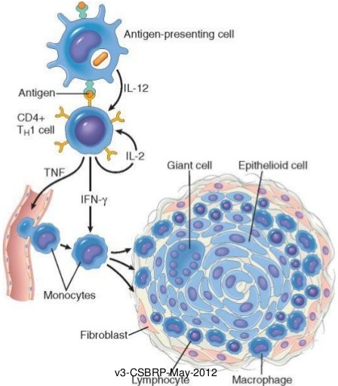
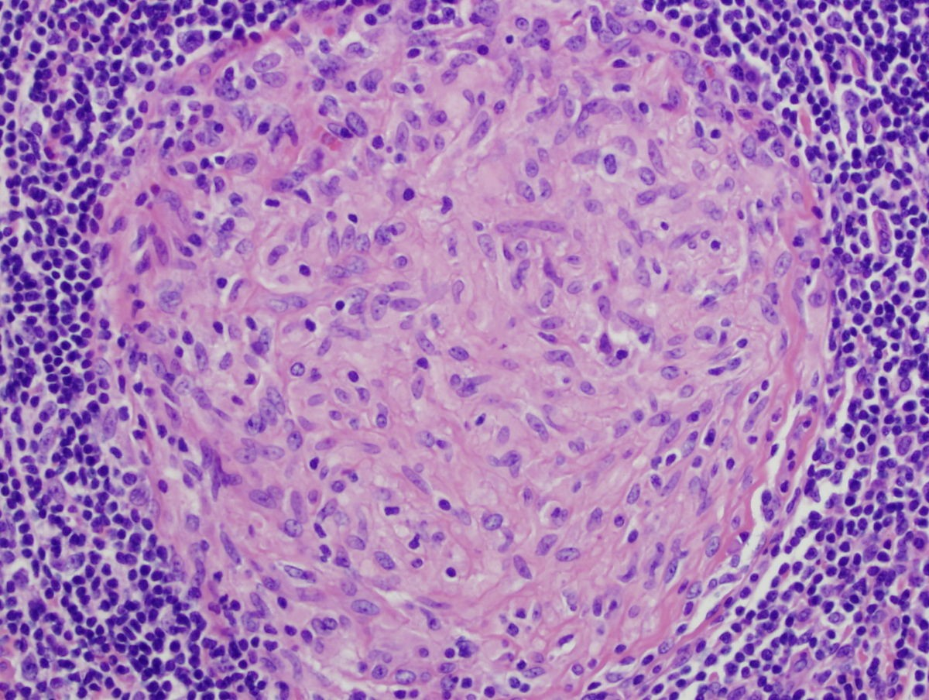
Granulomatous Reactions

Slide 68
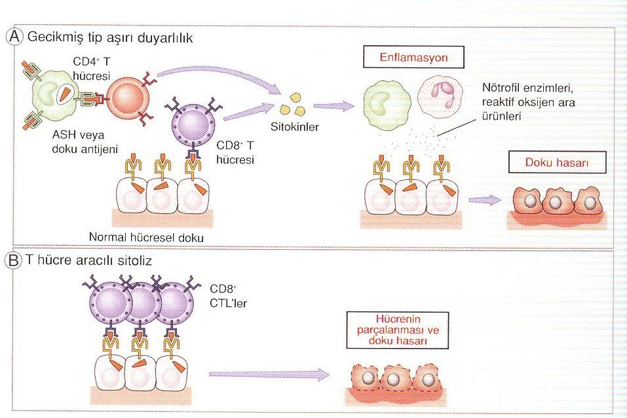
Tissue damages
Tissue damage in T cell-mediated diseases is either CD4+ T cell-mediated delayed-type hypersensitivity response or host cells' CD8+ cytolytic T lymphocytes formed by its breakdown.

Slide 69
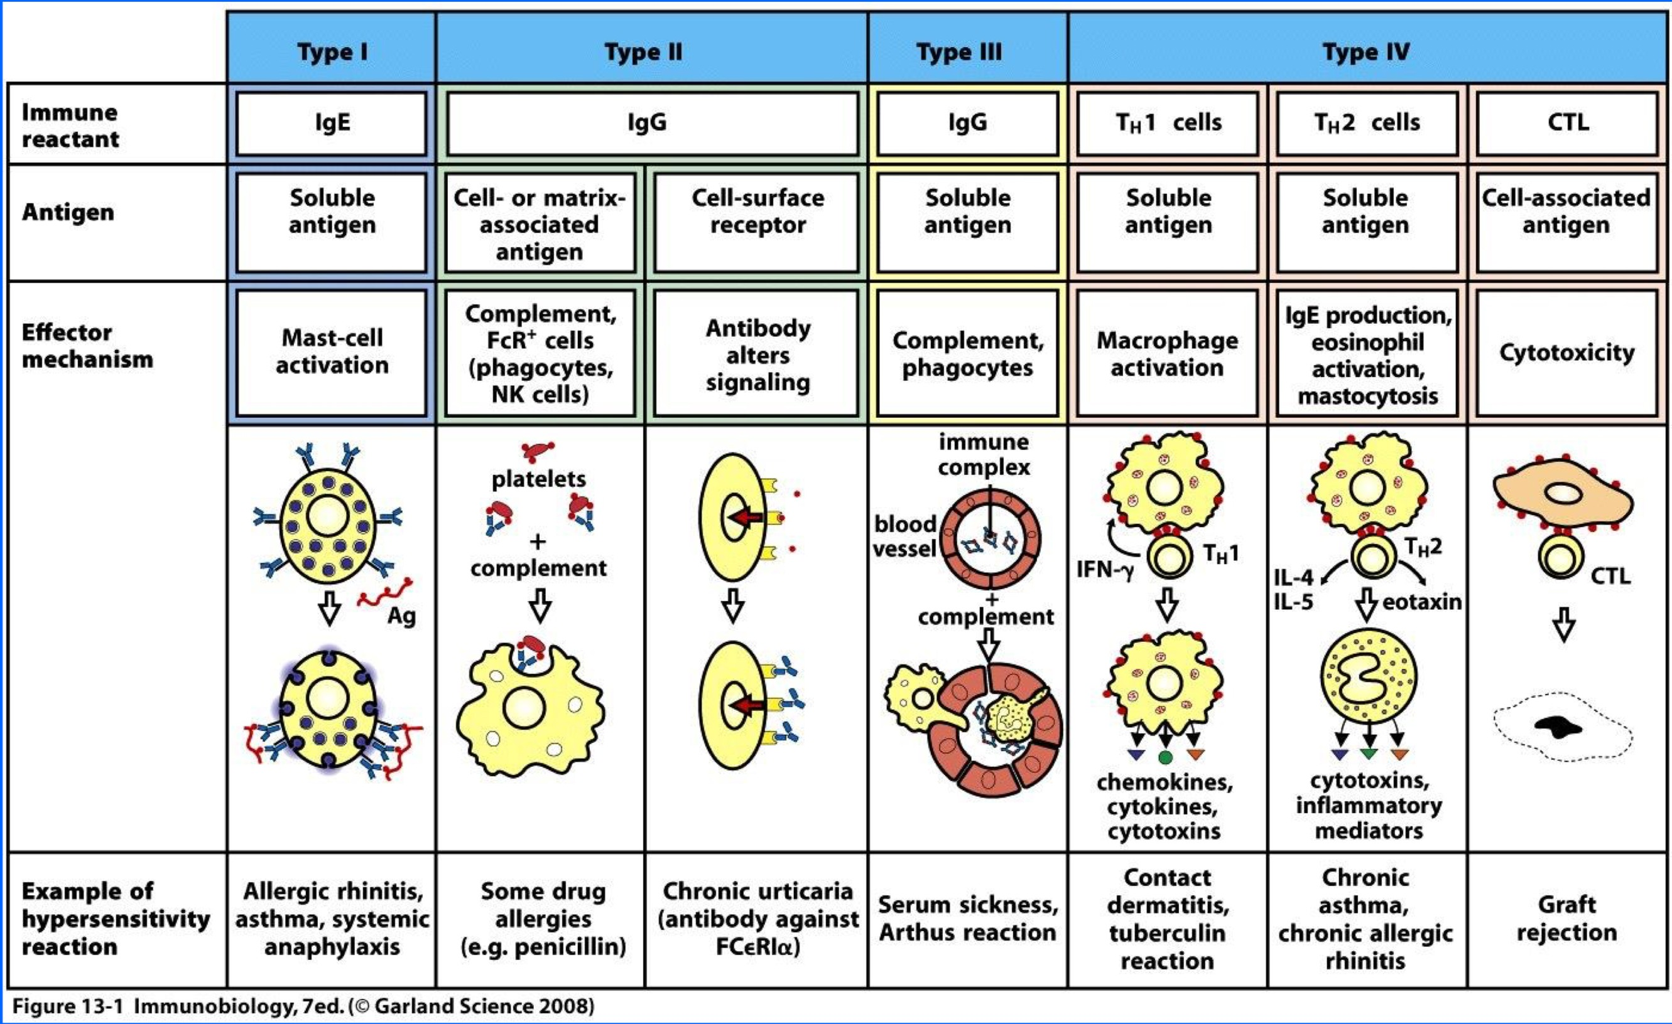

Slide 70
