Slide 1
ULTRASOUND SUPPORTED REACTIONS
EVRIDIKI PINGO

Slide 2
Sonochemistry
Sonochemistry is a powerful and green approach which is being used to accelerate synthesis of organic compounds and involves the use of ultrasound technique to promote chemical reactions.
It is widely used in organic chemistry, offering versatile and facile pathways for a large variety of syntheses.
The study of sonochemistry is concerned with understanding the effect of sonic waves and wave properties of sonchemical systems.
Ultrasound is the part of the sonic spectrum, which ranges from about 20 KHz to 10 MHz and can be roughly subdivided in three main regions: low frequency high power ultrasound (20–100 kHz), high frequency medium power ultrasound (100 kHz–1 MHz), and high frequency low power ultrasound (1–10 MHz).

Slide 3
A large number of organic reactions can be carried out under ultrasonic irradiation in high yields, short reaction times and mild conditions.
Ultrasonic irradiation of liquids causes high energy chemical reactions to occur, often with the emission of light.
The origin of sonochemistry and sonoluminescence is acoustic cavitation which is the formation, growth, and implosive collapse of bubbles.
The collapse of bubbles caused by cavitation produces intense local heating and high pressures, with very short lifetimes (Hot spots).
These hot-spots have an equivalent temperatures of roughly 5.000 K, pressures of about 1.000 atm and increase reactivity by nearly million-fold using the radical mechanism.
A variety of devices have been used for ultrasonic irradiation of solutions.

Slide 4
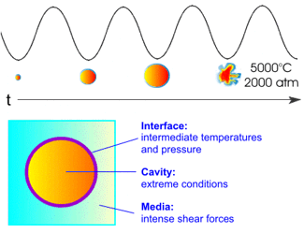
The use of ultrasound in chemical reactions in solution provides specific activation based on a physical phenomenon: acoustic cavitation.
Cavitation is a process in which mechanical activation destroys the attractive forces of molecules in the liquid phase.
Applying ultrasound, compression of the liquid is followed by rarefaction (expansion), in which a sudden pressure drop forms small, oscillating bubbles of gaseous substances.
These bubbles expand with each cycle of the applied ultrasonic energy until they reach an unstable size; they can then collide and/or violently collapse.

Slide 5
Schematic representation of the cavitation phenomenon

Slide 6
Sonochemistry can be roughly divided into categories based on the nature of the cavitation event: homogeneous sonochemistry of liquids, heterogeneous sonochemistry of liquid–liquid or liquid–solid systems and sonocatalysis (which overlaps the first two).
In some cases, ultrasonic irradiation can increase reactivity by nearly a million- fold
Because cavitation can only occur in liquids, chemical reactions are not generally seen in the ultrasonic irradiation of solids or solid–gas systems.

Slide 7
There are three general designs in use presently: the ultrasonic cleaning bath, the direct immersion ultrasonic horn, and flow reactors.
The originating source of the ultrasound is generally a piezoceramic material that is subjected to a high AC voltage with an ultrasonic frequency (typically 15–50 kHz).
The vibrating source is attached to the wall of a cleaning bath, to an amplifying horn, or to the outer surfaces of a flow-through tube or diaphragm.
The ultrasonic cleaning bath is clearly the most accessible source of laboratory ultrasound and has been used successfully for a variety of liquid–solid heterogeneous sonochemical studies.
Transient acoustic cavitation: the origin of sonochemistry and sonoluminescence.

Slide 8
The low intensity available in these devices (1 W cm⁻²), however, means that even in the case of heterogeneous sonochemistry, an ultrasonic cleaning bath must be viewed as an apparatus of limited capability.
The most intense and reliable source of ultrasound generally used in the chemical laboratory is the direct immersion ultrasonic horn (50 to 500 W cm⁻²), as shown in which can be used for work under either inert or reactive atmospheres or at moderate pressures (<10 atm).
These devices are available from several manufacturers at modest cost.

Slide 9
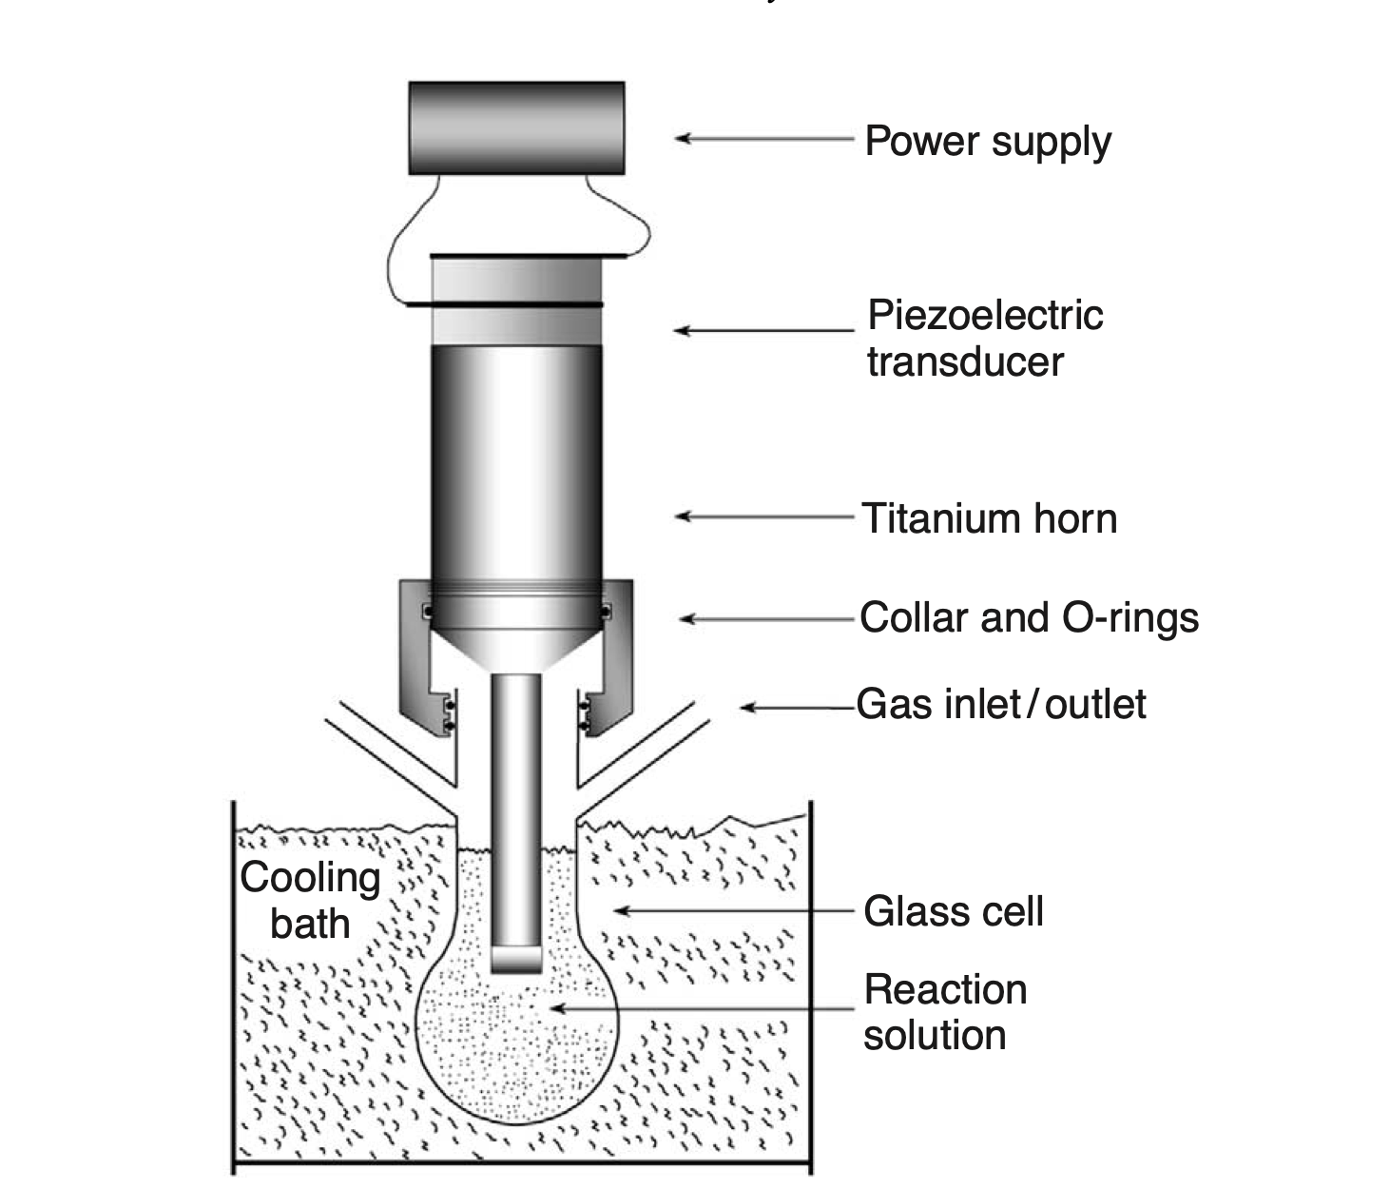
The generally accepted explanation for the origin of sonochemistry and sonoluminescence is the hot-spot theory, in which the potential energy given to the bubble as it expands to maximum size is concentrated into a heated gas core as the bubble implodes.
The transient nature of the cavitation event precludes conventional examination of the conditions generated during bubble collapse. Chemical reactions themselves, however, can be used to probe reaction conditions through the use of ‘‘comparative-rate chemical thermometry.’’
These kinetic studies revealed that there were in fact two sonochemical reaction sites: the first (and dominant site) is the bubble’s interior gas phase while the second is an initially liquid phase.
The latter corresponds either to heating of a shell of liquid around the collapsing bubble or to droplets of liquid ejected into the hot-spot by surface wave distortions of the collapsing bubble.

Slide 10
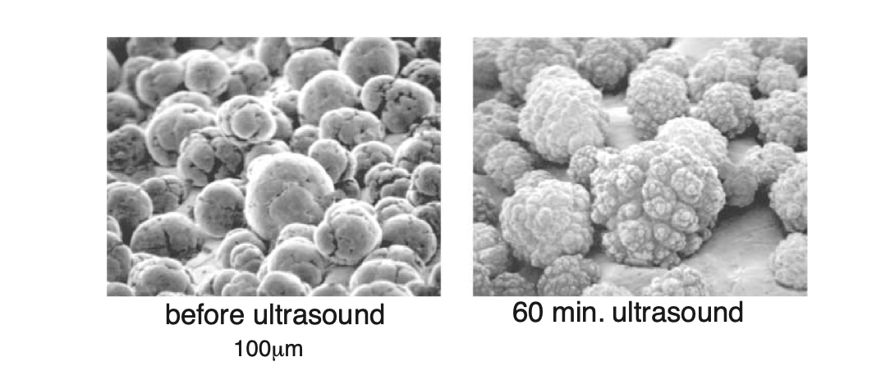
A very different phenomenon arises when cavitation occurs near extended liquid–solid interfaces.
There are two proposed mechanisms for the effects of cavitation near surfaces: microjet impact and shockwave damage.
Whenever a cavitation bubble is produced near a boundary, the asymmetry of the liquid particle motion during cavity collapse induces a deformation in the cavity
The potential energy of the expanded bubble is converted into kinetic energy of a liquid jet that extends through the bubble’s interior and penetrates the opposite bubble wall. Because most of the available energy is transferred to the accelerating jet, rather than the bubble wall itself, this jet can reach velocities of hundreds of meters per second.

Slide 11
Ultrasound in synthetic organic chemistry
There are two types of effects mediated by ultrasound: chemical and physical.
When the quantity of bubbles is low - using standard laboratory equipment - it is mainly physical rate acceleration that plays a role.
For example, a specific effect is the asymmetric collapse near a solid surface, which forms microjets.
This effect is the reason why ultrasound is very effective in cleaning and is also responsible for rate acceleration in multiphasic reactions, since surface cleaning and erosion lead to improved mass transport.

Slide 12
MECHANISM
The chemical effects of ultrasound on aqueous solutions have been studied for many years.
The primary products are H₂ and H₂O₂; there is strong evidence for various high-energy intermediates, including H₂O, H and OH.
The sonolysis of water, which produces both strong reductants, and oxidants is capable of causing secondary oxidation and reduction reactions, as often observed.
Most recently there has been strong interest shown in the use of ultrasound for remediation of low levels of organic contamination of water
The OH radicals produced from the sonolysis of water are able to attack essentially all organic compounds (including halocarbons, pesticides, and nitro aromatics) and through a series of reactions oxidize them fully.
The ultrasonic irradiation of organic liquids creates the same kinds of products associated with very high temperature pyrolysis
The sonochemistry of solutes dissolved in organic liquids also remains largely unexplored.

Slide 13
Reaction mechanism of ultrasound assisted synthesis method

Slide 14
Energy impact proved by ultrasound in comparison with other activation methods

Slide 15
Applications of Ultrasound in Chemical Synthesis

Slide 16
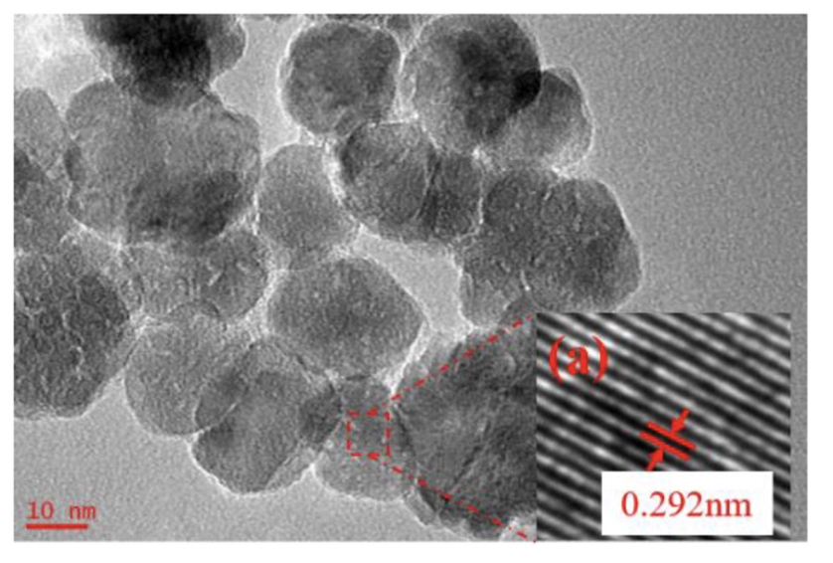
Ultrasound Assisted Synthesis of Size-Controlled Aqueous Colloids for the Fabrication of Nanoporous Zirconia Membrane
HRTEM images of ZrO₂ materials synthesized with 5 min radiation time at ultrasonic power of 90% and when the molar ratio of precursor to precipitant is 1:1.

Slide 17
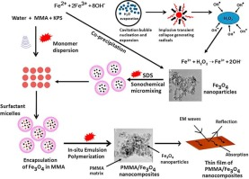
Ultrasound-assisted synthesis and characterization of magnetite nanoparticles and poly magnetite nanocomposites

Slide 18
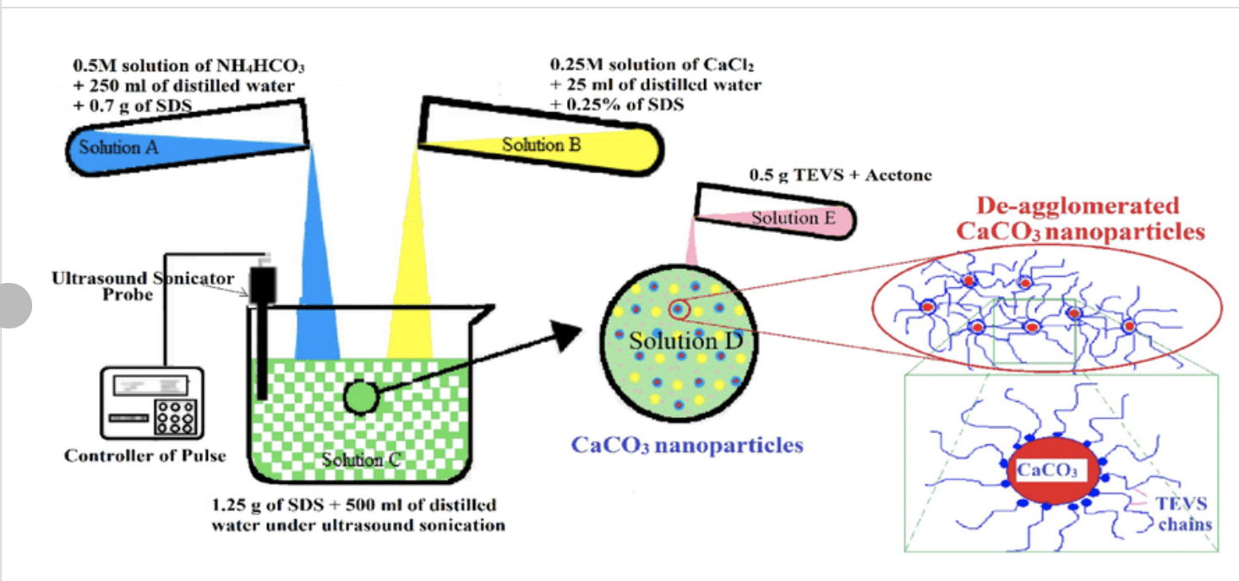
Schematic representation of reaction setup with ultrasonic probe for synthesis of nCaCO₃ particles by ultrasound cavitation technique

Slide 19
Ultrasound-Assisted Expedient and Green Synthesis of a New Series of Diversely Functionalized 7-Aryl/heteroarylchromeno[4,3-d]pyrido[1,2-a]pyrimidin-6(7H)-ones via One-Pot Multicomponent Reaction under Sulfamic Acid Catalysis at Ambient Conditions

Slide 20
Mechanism of formation of PANI/ZnMoO₄ nanocomposites by US in situemulsion polymerization and model for PANI/ZnMoO₄ nanocomposite's sensor mechanism

Slide 21
Formation of Ag NPs in alkaline aqueous solution via US irradiation
Photoactive micro/nanomaterials were also synthesized through a facial sonochemical route

Slide 22
When ultrasound is applied to an Ullmann reaction that normally requires a 10-fold excess of copper and 48 h of reaction time, this can be reduced to a 4-fold excess of copper and a reaction time of 10 h.
The particle size of the copper shrinks from 87 to 25 μm, but the increase in the surface area cannot fully explain the increase in reactivity.

Slide 23
Typically, ionic reactions are accelerated by physical effects - better mass transport - which is also called "False Sonochemistry".
If the extreme conditions within the bubble lead to totally new reaction pathways, for example via radicals generated in the vapor phase that would only have a transient existence in the bulk liquid, we speak about "sonochemical switching".
Such a switch has been observed for example in the following Kornblum-Russel reaction where sonication favors an SET pathway

Slide 24
Transformation of aromatic and aliphatic alcohols in the equivalent carboxylic acids and ketones
Various aromatic, aliphatic and conjugated alcohols were transformed into the corresponding carboxylic acids and ketones in good yields.
70% t-BuOOH in the presence of catalytic amounts of bismuth(III) oxide.
This method does not involve cumbersome work-up, exhibits chemoselectivity and proceeds under ambient conditions as shown in the figure

Slide 25
Enantioselective Michaell addition
A highly enantioselective Michael addition of malonates to α,β-unsaturated ketones in water is catalyzed by a primary-secondary diamine catalyst containing a long alkyl chain.
This asymmetric Michael addition process allows the conversion of various α,β- unsaturated ketones

Slide 26
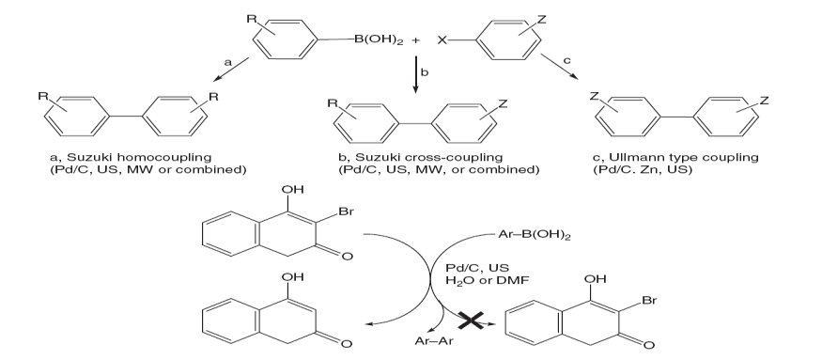
Suzuki Coupling Reactions
Suzuki reaction, especially those friendly to the environment, involve ultrasonic irradiation
In combination with microwave (MW) irradiation, further improvements in yields and reaction time were achieved. It is also reported that Ulmann homo- coupling mediated by zinc also occurred, with CO₂ bubbling into the reaction.
Using the Suzuki procedure under oxygen atmosphere irradiated by ultrasound was investigated, and a mechanism was proposed.

Slide 27
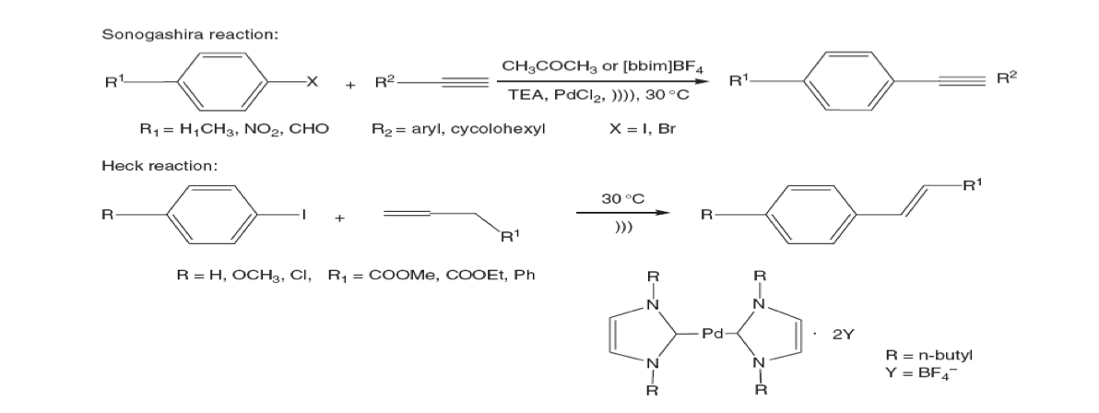
Heck Reaction
Sonogashira reaction or terminal acetylenes in ionic liquids using a cleaning bath. Investigated the leaching of Pd off support during the reaction, by examining the Heck reaction under ultrasound.
Besides noticing that the reaction is accelerated by ultrasound, it is reported that the Pd/C catalyst can be reduced by sodium formate and redeposited, so that the catalyst can be recycled twice as shown in Figure

Slide 28
Diels–Alder Cycloadditions
Diels–Alder cycloadditions, conducted at relatively low temperatures, can be efficiently activated by ultrasound using an ionic liquid (IL) as the reaction medium as shown in the figure

Slide 29
Applications of Sonochemistry to Materials Synthesis
Ultrasound has proved extremely useful in the synthesis of a wide range of nanostructured materials, including high-surface-area transition metals, alloys, carbides oxides, and colloids.
Sonochemical decomposition of volatile organometallic precursors in high-boiling solvents produces nanostructured materials in various forms with high catalytic activities.
Nanometer colloids; nanoporous high-surface-area aggregates; nanostructured carbides, sulfides, and oxides; and supported heterogeneous catalysts can all be prepared by this general route

Slide 30
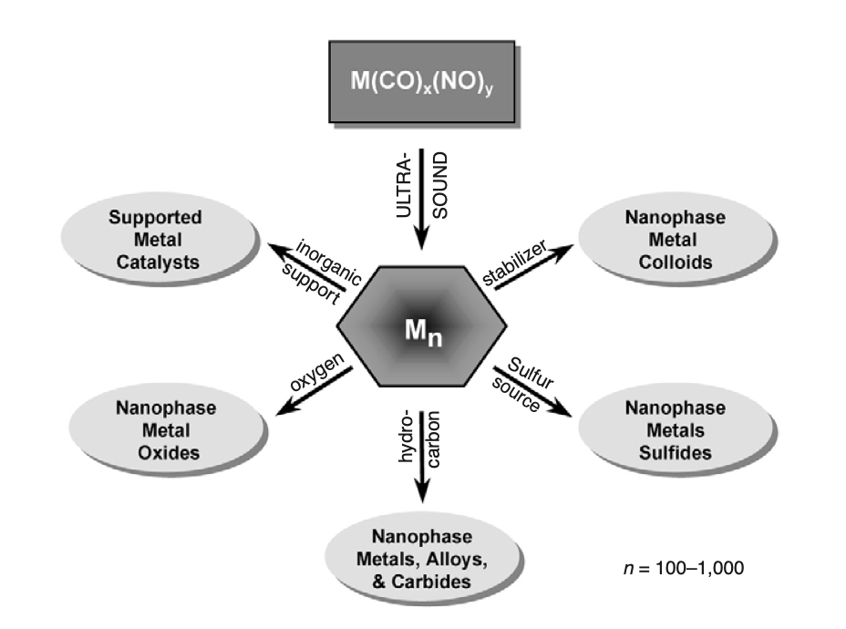
Sonochemical synthesis of nanostructured inorganic materials
Ultrasonic irradiation of Mo(CO)6 produces aggregates of nanometer-sized clusters of face-centered cubic molybdenum carbide, with high porosity and very large surface area. The catalytic properties showed that the molybdenum carbide generated by ultrasound is an active and highly selective dehydrogenation catalyst comparable to commercial ultrafine platinum powder

Slide 31
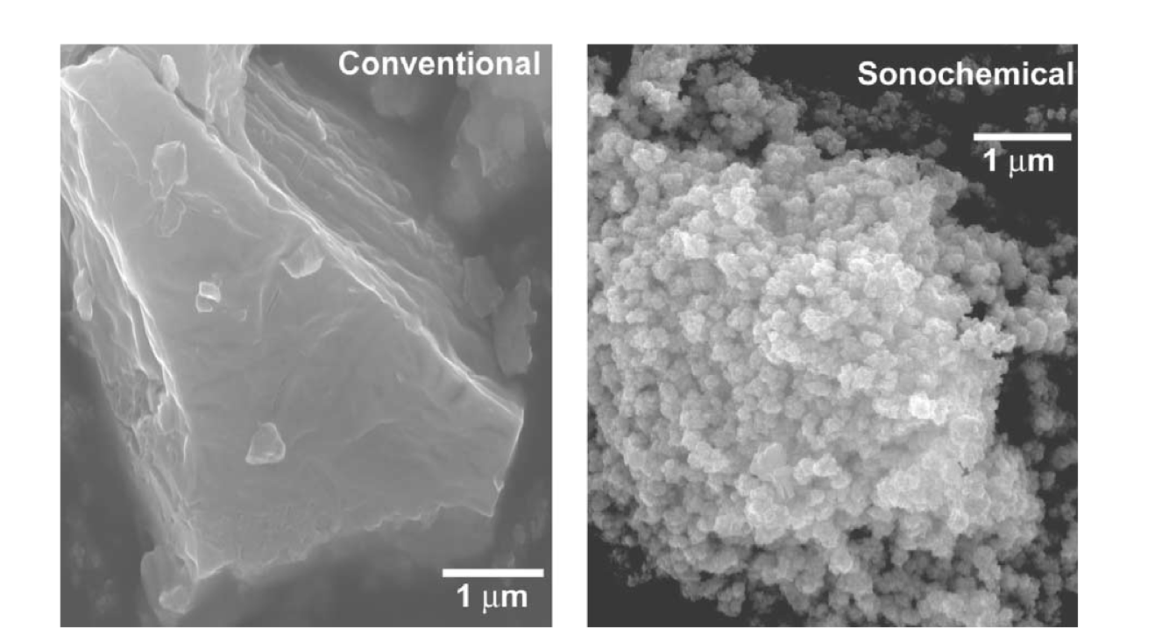
Morphology of conventional and sonochemically prepared MoS₂
The sonochemically prepared MoS₂, however, shows much greater edge and defect content, as the layers must bend, break, or otherwise distort to form the outer surface.
It is well established that the activity of MoS₂ is localized at the edges and not on the flat basal planes.
Given the inherently higher edge concentrations in nanostructured materials, the catalytic properties of sonochemically prepared MoS₂ shows substantially increased activity for hydrodesulfurization.

Slide 32
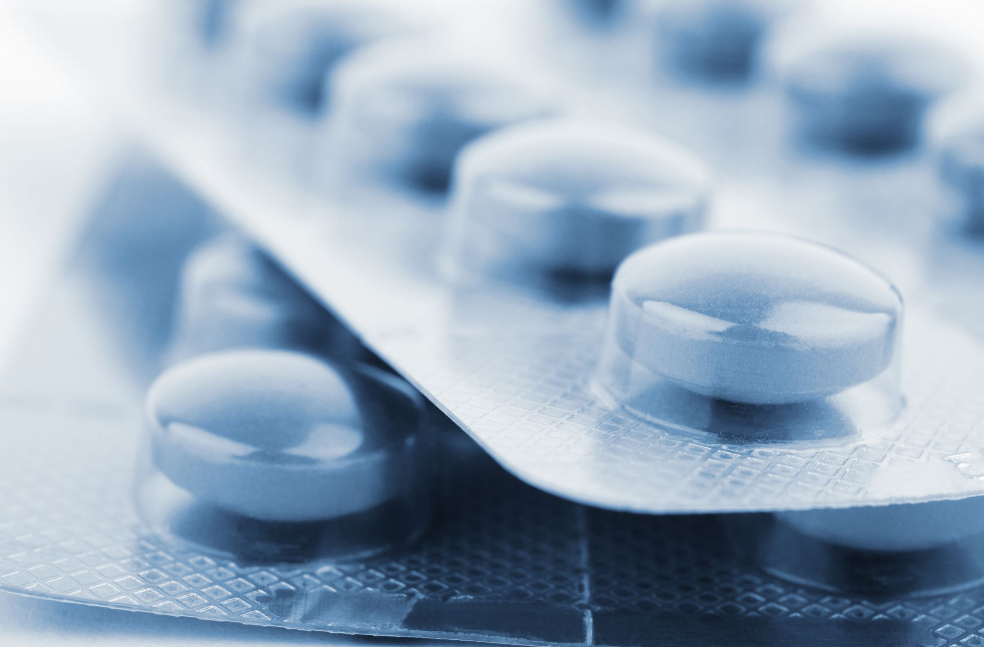
Ultrasound assisted applications in industry
Ultrasound-assisted extraction (UAE) in food ingredients and products, nutraceutics, cosmetic, pharmaceutical and bioenergy applications.
This is a topic, which affects several fields of modern plant-based chemistry.

Slide 34
Ultrasound assisted extraction of food and natural products
All the reported applications have shown that ultrasound-assisted extraction is a green and economically viable alternative to conventional techniques for food and natural products.
The main benefits are decrease of extraction and processing time, the amount of energy and solvents used, unit operations, and CO₂ emissions.

Slide 35
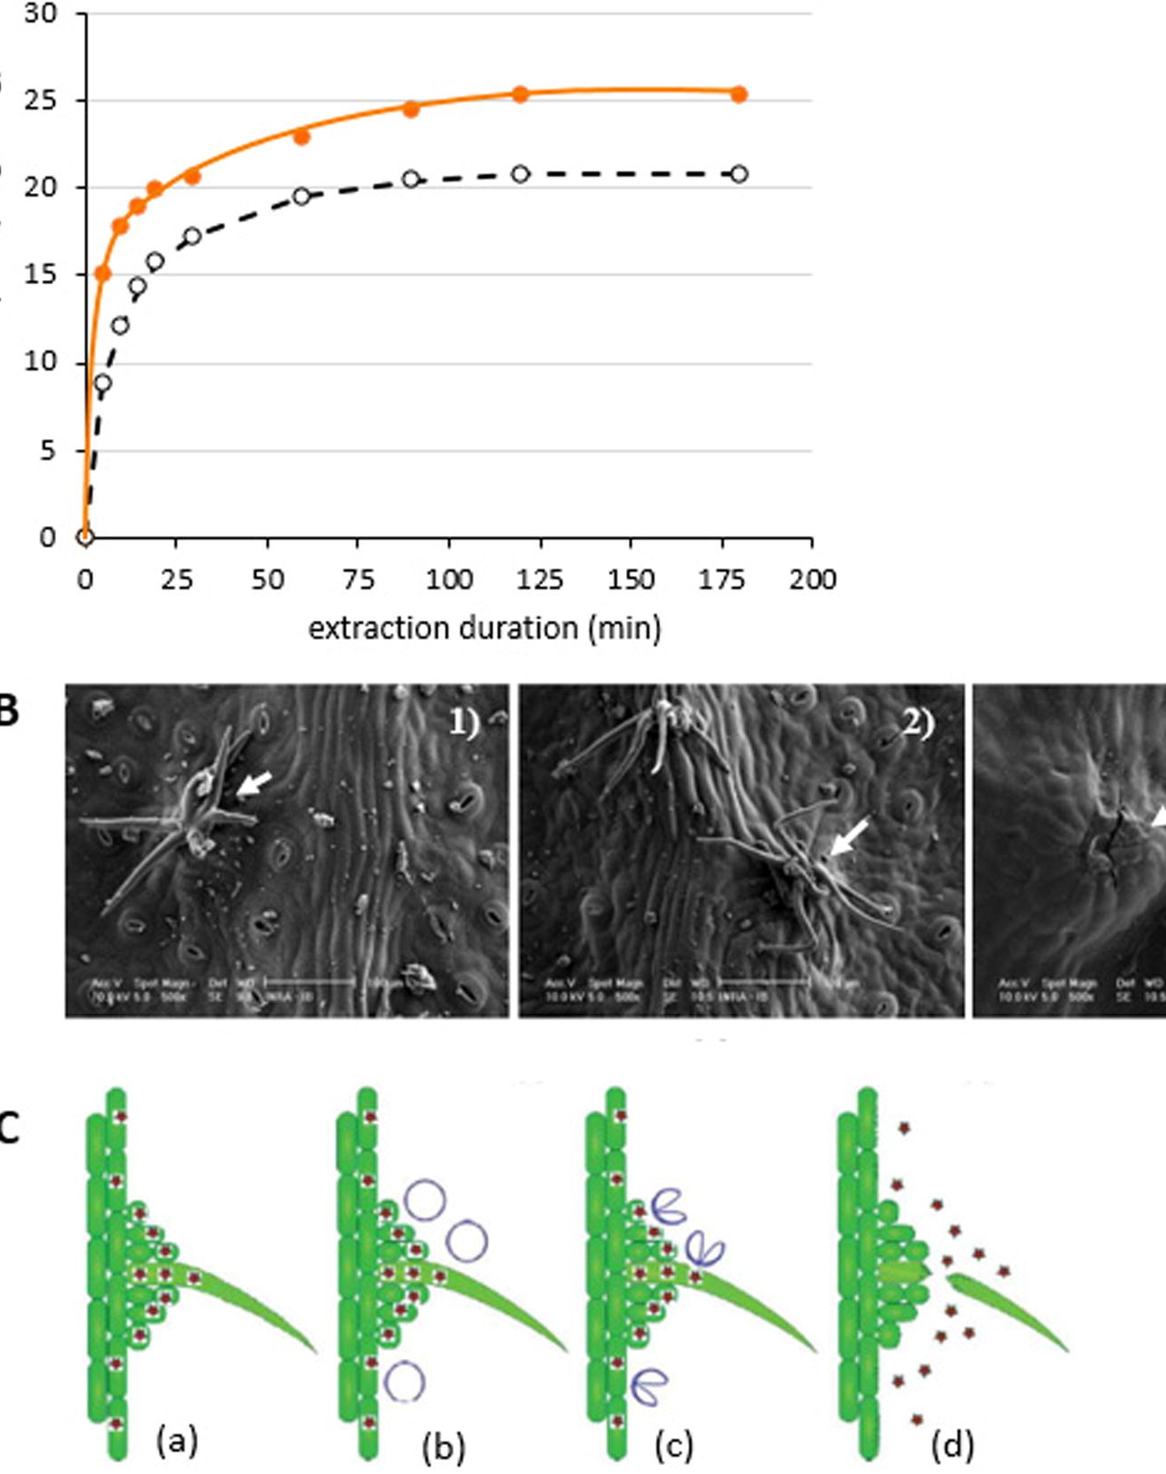
Effect of power ultrasound on boldo leaves
A: Comparison of extraction kinetics of soluble matter in water for UAE, US probe 20 kHz and for maceration
B: SEM microscopic observation of trichomes on leaf surface,
control leaf surface,
leaf surface after conventional process,
leaf surface after UAE
C: Proposed mechanism for effect of cavitation bubbles on boldo leaf surface
Plant profile with a trichome at the surface of the leaf
Generation of a cavitation bubble
Collapse of the cavitation bubble which generates a micro-jet directed towards the surface
Abrasion of the surface, breaking of the trichome, and release of soluble material in the surrounding medium.

Slide 36
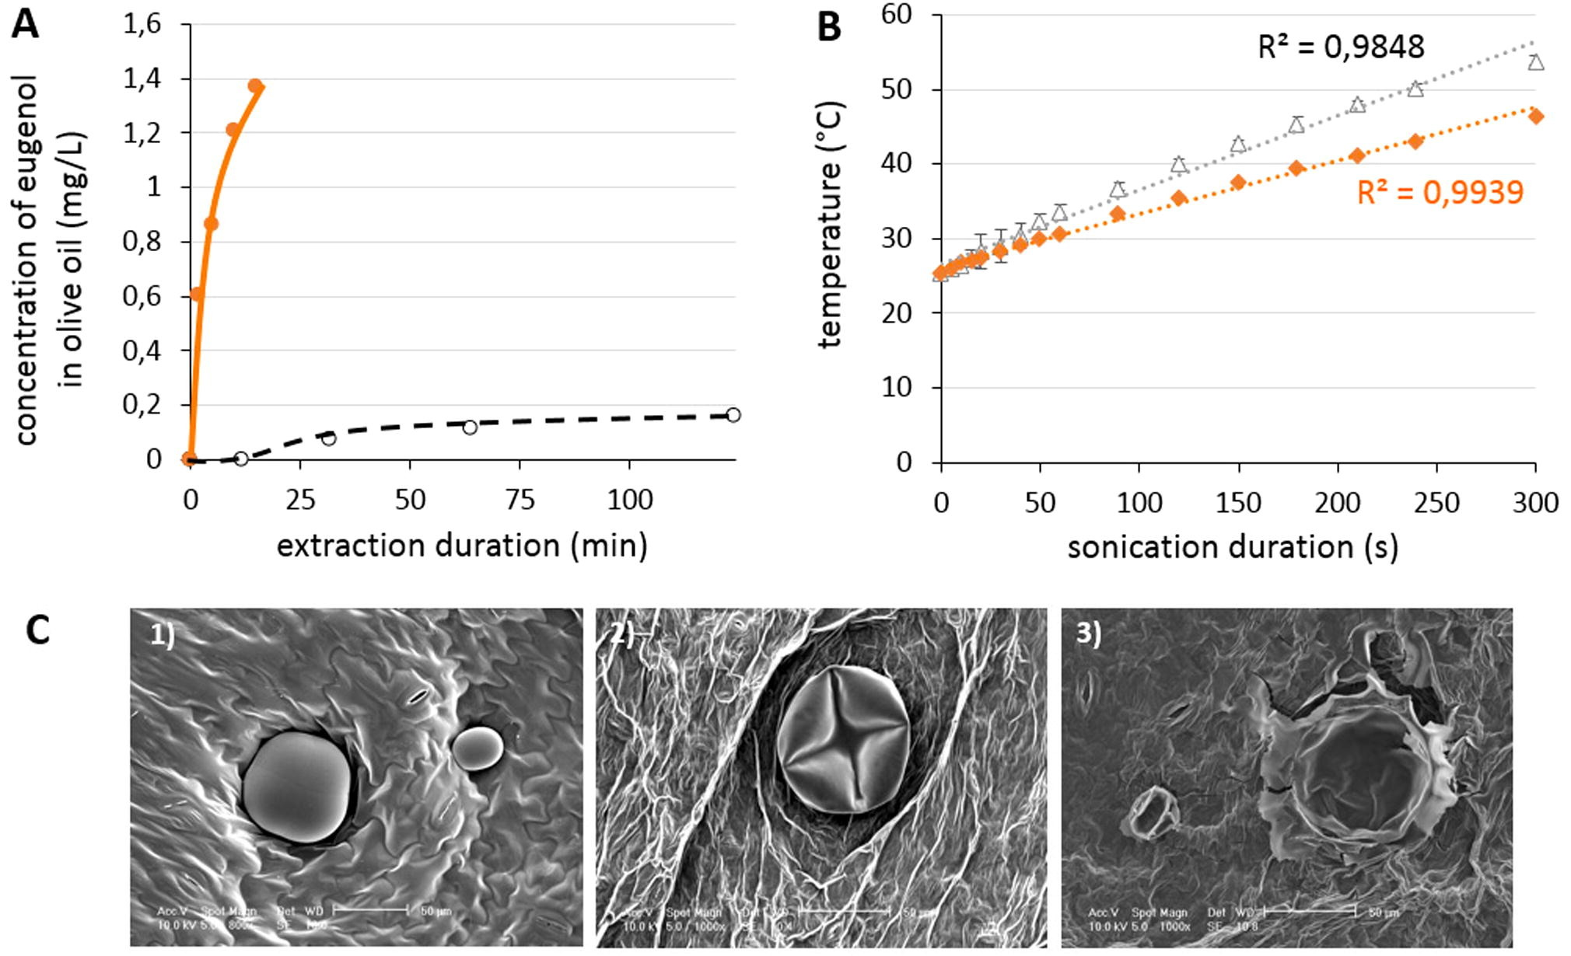
Effect of power ultrasound on basil leaves
A: Comparison of extraction kinetics of eugenol in olive oil for UAE, US reactor 25 kHz and for maceration
B: US power dissipation during sonication for eugenol and olive oil
C: SEM microscopic observation of an essential oil gland
Control
after maceration and
after UAE (US reactor 25 kHz)

Slide 37
Effect of power ultrasound on carvi seeds
SEM microscopy for untreated seeds
1) seeds after conventional extraction
2) and UAE: US probe, 20 kHz after 30 min
3) and after 60 min

Slide 38
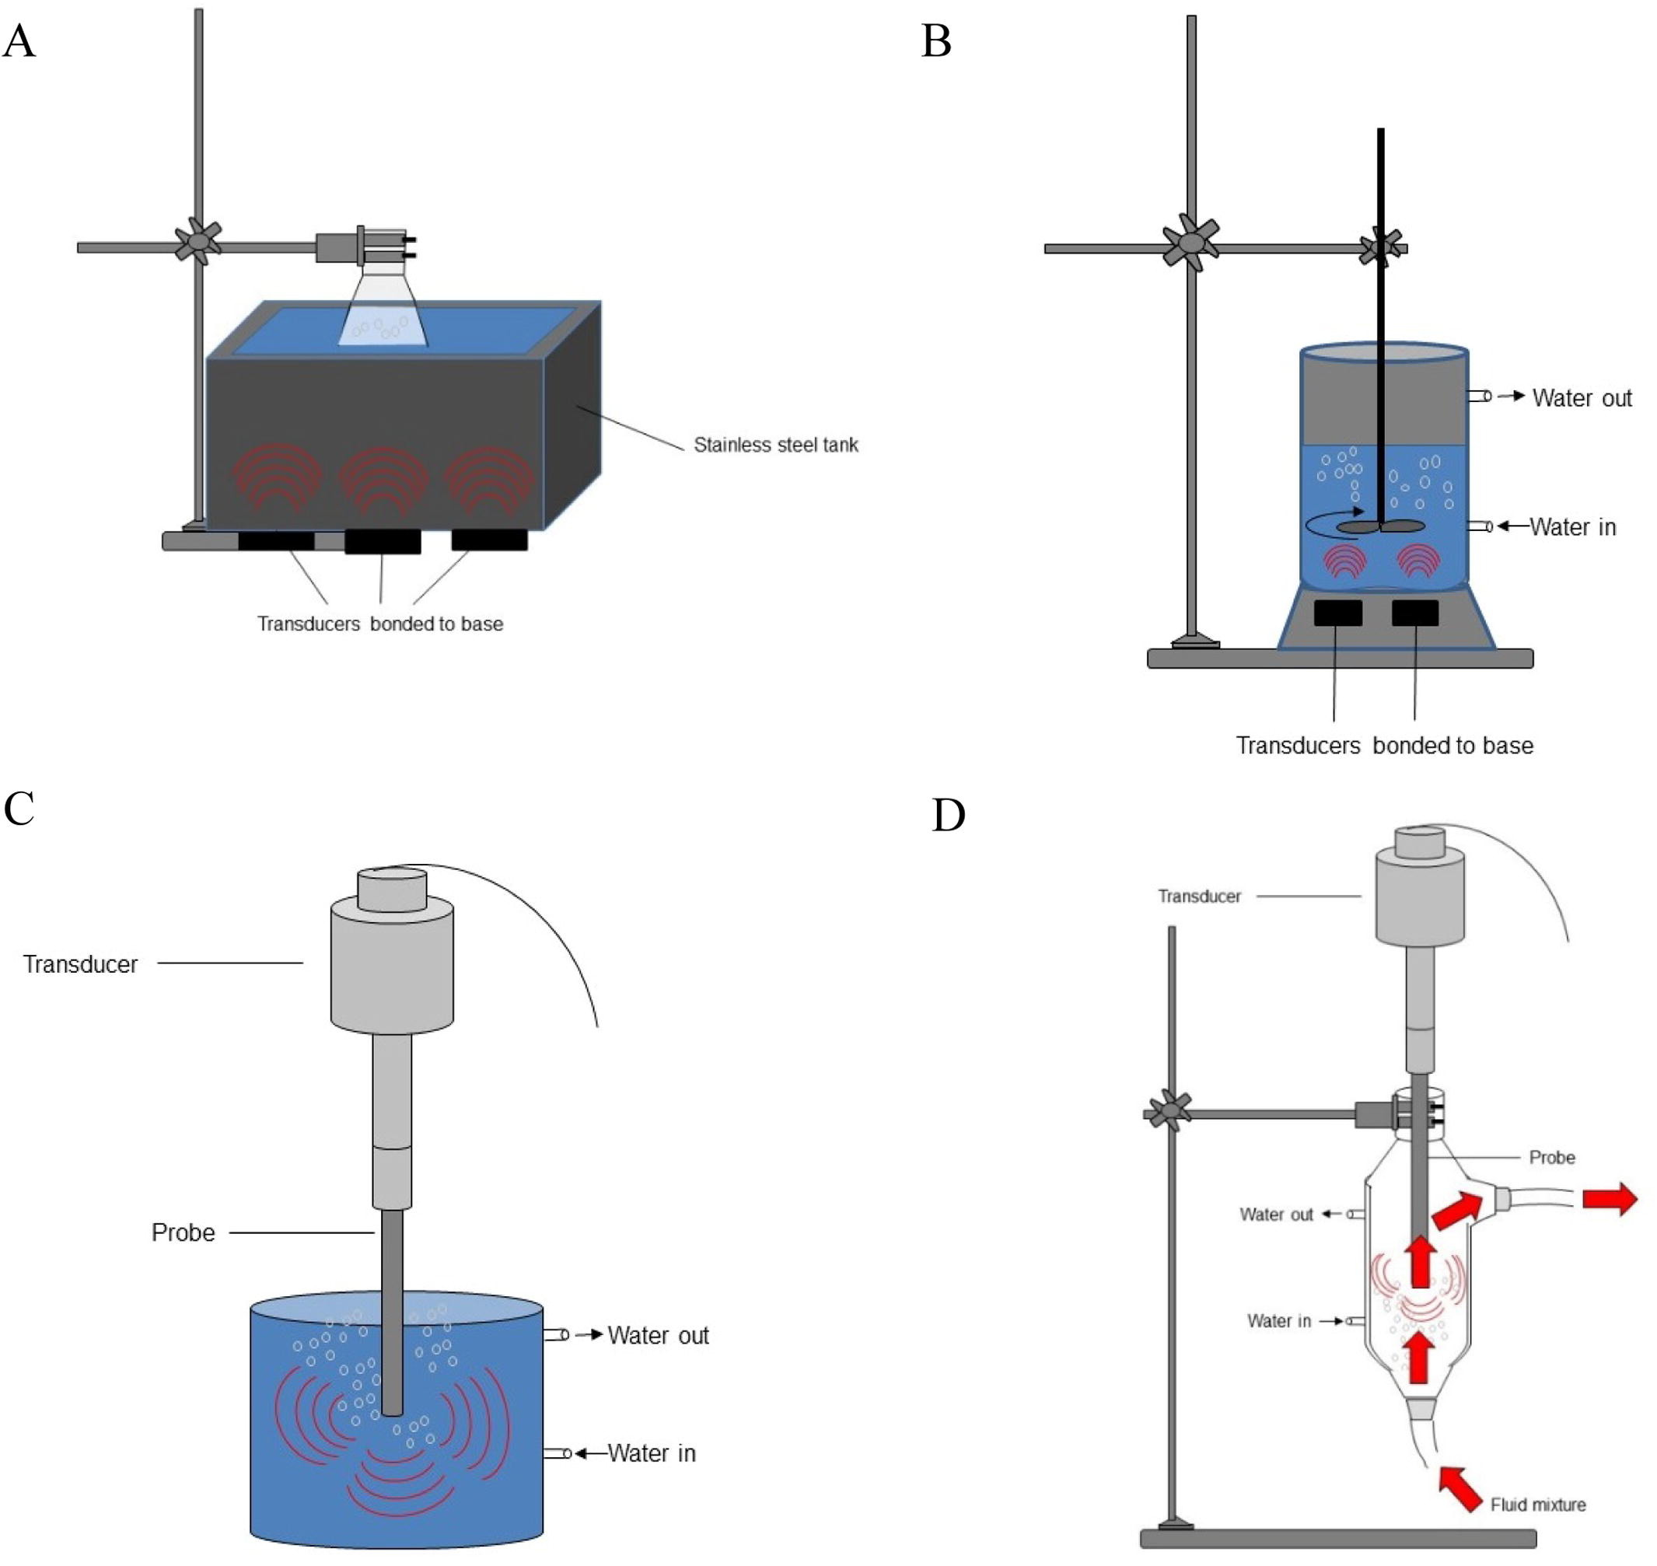
Commonly used ultrasonic systems
A: Ultrasound bath
B: Ultrasound reactor with stirring
C: Ultrasound probe
D: Continuous sonication with ultrasound probe

Slide 39
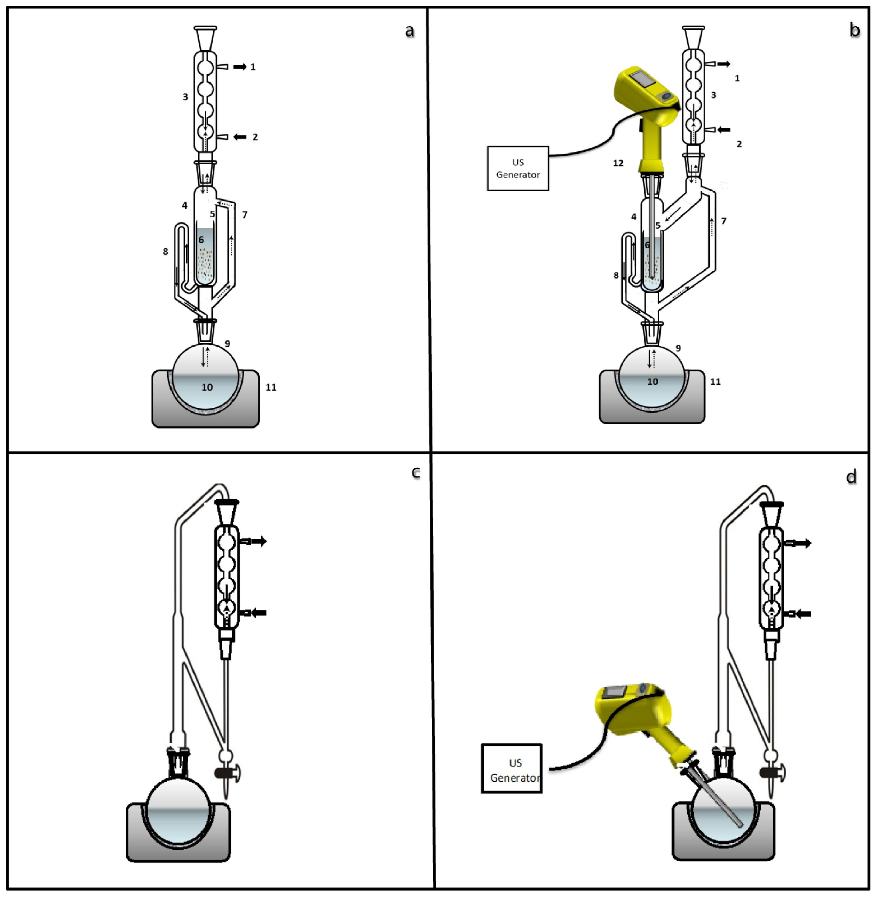
Hybrid extraction techniques
a) conventional Soxhlet
b) Sono-Soxhlet
c) conventional Clevenger
d) Sono-Clevenger

Slide 40
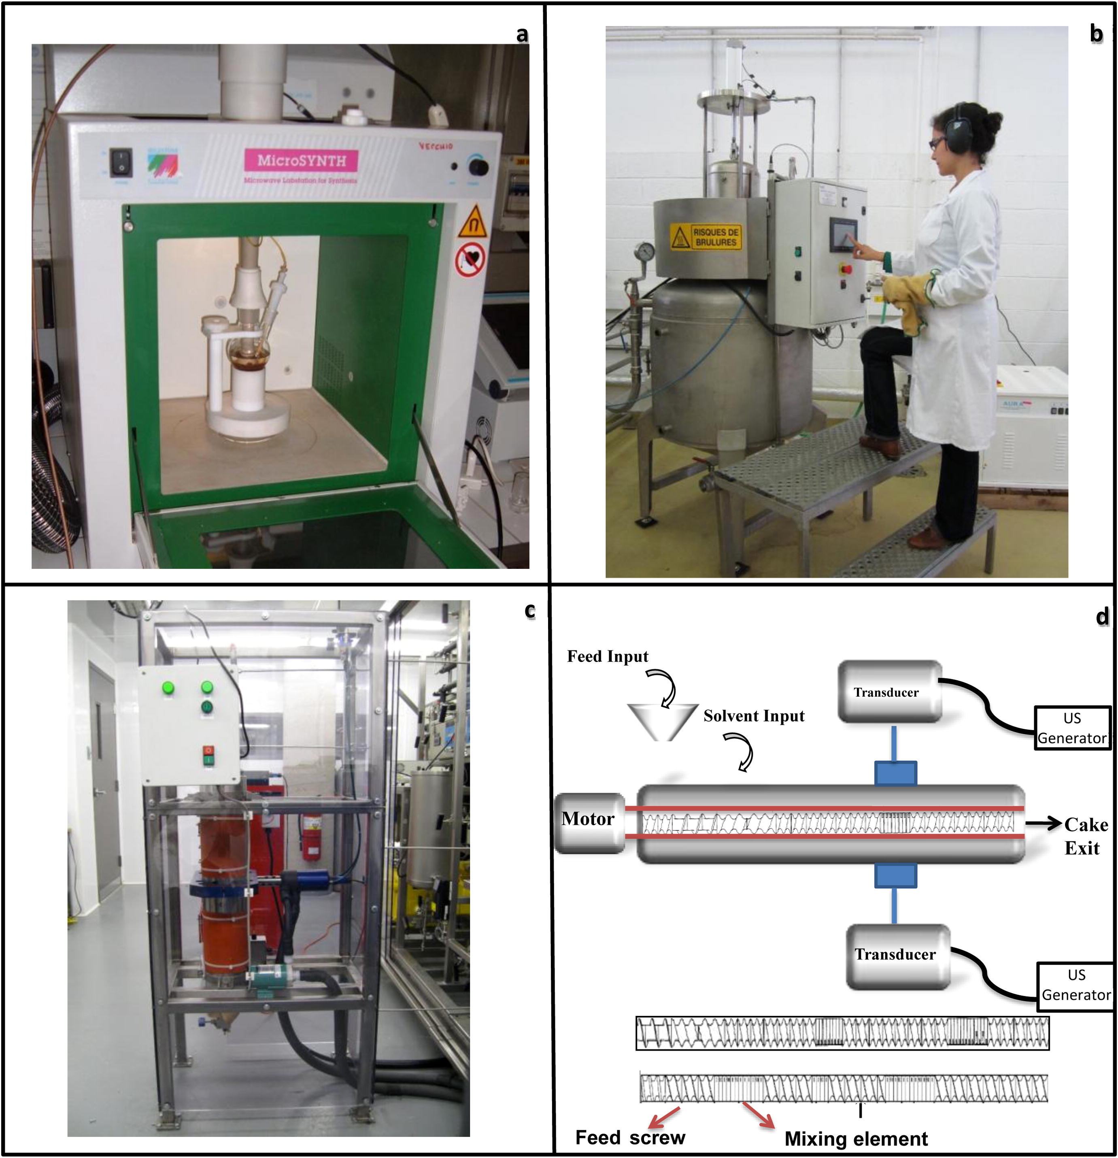
Combined innovative extraction techniques
a) ultrasound-microwave
b) ultrasound – DIC
c) ultrasound-SFE
d) ultrasound-extrusion

Slide 41
BΙBLΙOGRAPHY
Menshawy A. M., (2016) ,Applıcatıons Of Ultrasound In Chemıcal Synthesıs And ReactıonsA, Az. J. Pharm Sci. Sonochemıstry, 53
Brahmachari G., Karmakar I., Nurjamal K., (2018), ACS Sustainable Chem. Eng. , 6, 8, 11018–11028 West Bengal, India
Yan Q, Qiu M, Chen X and Fan Y (2019) Ultrasound Assisted Synthesis of Size-Controlled Aqueous Colloids for the Fabrication of Nanoporous Zirconia Membrane. Frontiers in Chemistry, 7:337
Lupacchini M., Mascitti A., Giachi G., Tonucci L., d'Alessandro a N., Martinez J., Colacino E, (2017), Sonochemistry in non-conventional, Green solvents or solvent-free reactions, Tedrahedron, 609-653
Natacha F. C., Anne-Gaëlle R., MeullemiestreS. A., Sylvie A., Maryline F. T., Vian A., (2017) Ultrasound assisted extraction of food and natural products, Ultrasonics Sonochemistry 34, 540-560

Slide 42
THANK YOU

