Slide 1
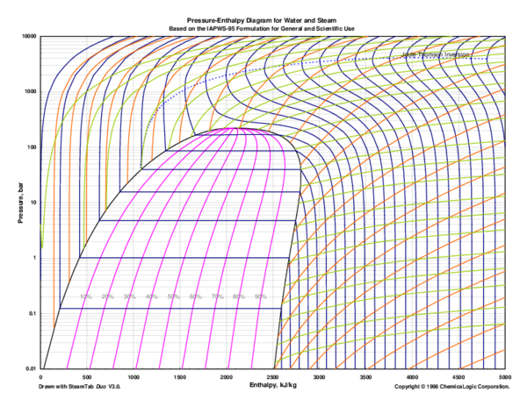
CoolProp Library
CoolProp is a library used to call the thermophysical properties of fluids.
Environments Supported are:
Python (2.x, 3.x)
C++
C#
Modelca
Octave
VB.net
MathCAD
Java
Android
MATLAB

Slide 2
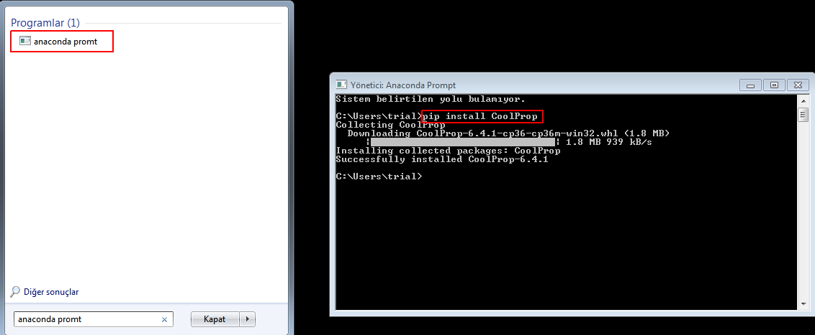
Method 1: Installing CoolProp Library to Python
To include the CoolProp library in the python environment, the following commands are written to anaconda prompt.
pip install CoolProp

Slide 3
Method 2: Installing CoolProp Library to Python
Open Anaconda Navigator. Then, open Powershell prompt and write following command to anaconda prompt
pip install CoolProp

Slide 4
CoolProp Library for Python
After the installation is complete, the following commands can be written to call CoolProp in the python environment. As an example, if we want to call density of the saturated water at 1 atm pressure;
import CoolProp.CoolProp as cp
Density = cp.PropsSI('D','P',1e5,'Q',0, ‘Water’)
>> 958.6315057778091 # kg/m3

Slide 5
CoolProp Library for Python
Density = cp.PropsSI(‘D',‘P',1e5,‘Q', 0, ‘WATER’)
Symbol of the Properties to be called
‘Density’ [kg/m3]
First Input Scala
For this case,
P=100000 Pa
Name of the Fluid
Scala of the Property to be called
‘Density’
[kg/m3]
Second Input Scala
For this case,
Q=0
Symbol of the Second Source Property which is
‘Vapour Quality’
Symbol of the First Source Property which is
‘Pressure’ [Pa]

Slide 6
CoolProp Library for Python
Properties of the Fluid | String of the Property | Unit of the Property
Temperature | T | K
Pressure | P | Pa
Density | D, DMASS, Dmass | kg/m3
Specific Internal Energy | U, UMASS, Umass | J/kg
Specific Enthalpy | H, HMASS, Hmass | J/kg
Specific Entropy | S, SMASS, Smass | J/kgK
Mass vapor quality | Q | -
Specific Heat Constant at Constant Pressure | C, CPMASS, Cpmass | J/kgK
Specific Heat Constant at Constant Volume | O | J/kgK
Specific Gibbs energy | G, GMASS, Gmass | J/kg
Viscosity | V, VISCOSITY | Pa*s
Prandtl number | PRANDTL, Prandtl | -
Speed of sound | A, speed_of_sound | m/s
Thermal conductivity | L, conductivity | W/mK
Surface Tension | I, SURFACE_TENSION | N/m
Compressibility factor | Z | -

Slide 7
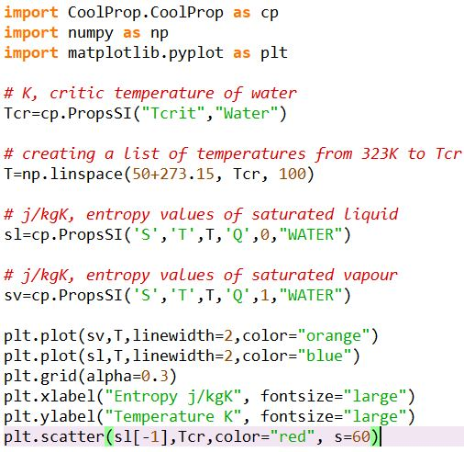
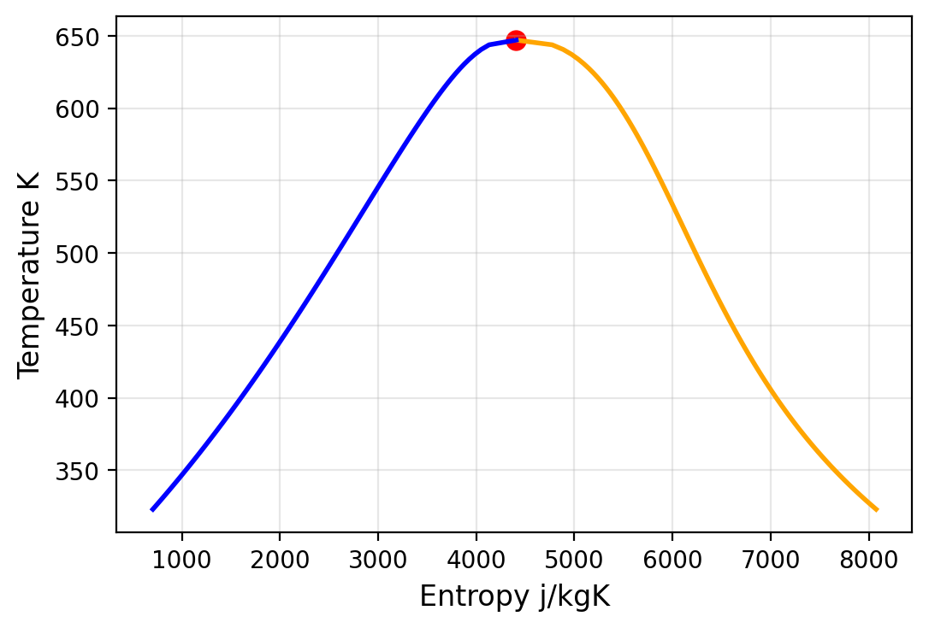
CoolProp Library for Python
List of Supported Fluids:
http://www.coolprop.org/fluid_properties/PurePseudoPure.html#list-of-fluids
An example application in python: T-s curve of saturated water

Slide 8
CoolProp Library for Python
If thermo-physics Properties of the mixtures fluids, the syntax below can be used;
Density_of_humidity_air =
cp.PropsSI('D','T',30+273.15,'P',101323.8,'HEOS::WATER[0.0133]&Oxygen[0.207207]&Nitrogen[0.779493]')
Molar Fraction₁
Molar Fraction₂
Molar Fraction₃
Component₁
Component₂
Component₃

Slide 9
References
http://www.coolprop.org/

