Slide 1
NANOMATERIALS BASED ON CARBON, QUANTUM DOTS, METALLIC NANOPARTICLES

Slide 2
VARIOUS STRUCTURES OF CARBON
Materials of macroscopic dimensions, consisting of carbon;
DIAMOND: It is the well-known crystal structure of carbon. Atoms are connected to each other in the form of sp3. Naturally, it can be produced as a single crystal in the laboratory as well as in the laboratory. The most important feature is that it has a very hard structure.
GRAPHITE: In these structures, carbon atoms are connected to each other in the form of sp2. Graphite can be produced as a single crystal in the laboratory as well as naturally, and this is called "kish" graphite.
CARBON FIBERS: They are materials with graphite properties, filled cylindrical shape and different cross-sectional structures and have mechanical properties in terms of being very robust.
CAMSI CARBONS: These materials, which have a polymerish and/or porous structure, are generally hard materials that show different properties according to the preparation conditions.

Slide 3
VARIOUS STRUCTURES OF CARBON
BLACK CARBONS: They are usually called carbon pellets obtained by extracting hydrogen from hydrocarbons. It is used in industry as a filler to regulate the mechanical, electrical and optical properties of certain materials.
CARBINE and KARBOLITES: These chain- or polymer-shaped structures usually come after rapid cooling processes.
AMORF CARBON: They are carbon materials that are usually formed in irregular structure. Their physical properties may vary according to the conditions of preparation. Atoms with amorphous structure are bonded to each other in the form of sp3 (90%) and sp2 (10%).
LIQUID CARBON: It is a material with high metal properties obtained by melting from diamond, graphite or another structure (4450 ⁰K).

Slide 4
CARBON NANOMATERIALS
The element carbon is the building block of living things.
The most important role in the beginning of the nanotechnology era is carbon nanostructures.
The C60 molecule, which is formed by 60 carbon atoms as a lattice structure in the form of a soccer ball, was experimentally obtained for the first time in 1985 and nanoscience was stepped into.

Slide 5
CARBON NANOMATERIALS
In 1991, the experimental acquisition of carbon nanotube structures for the first time initiated the nanotechnology process.
Thus, experimental and theoretical studies in the field of nanotechnology have accelerated.

Slide 6
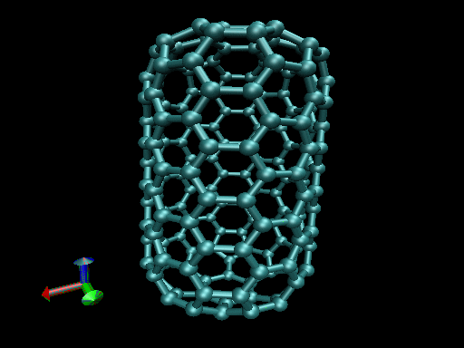
CARBON NANOMATERIALS
Carbon nanomaterials in nanotechnology; it seems to be unrivaled in terms of suitability and ease of processing in terms of many systems.
Carbon materials by size characteristics:
Three-dimensional semiconductor diamond structure
Two-dimensional semimetallic graphite
One-dimensional conductive and semiconductor nanotubes
zero-dimensional nanoballs have different stable structures and many interesting properties.

Slide 7
GENERAL USES OF CARBONACEOUS NANOMATERIALS
Electronics
Biology
Advanced materials
Medicine

Slide 8
USES OF CARBON NANOBALLS AND NANOTUBES
Nanoballs as optical limiting coatings to protect materials from excessive light
Polymers containing carbon nanoballs are used in solar cells as photodiodes and transistors
As a surface coating material due to the fact that they are a good protector against oxidation
Hydrogen storage
In making high-energy batteries
Due to the lack of net dipole moments due to their spherical structure and symmetricality, as a friction-reducing agent
Carbon nanotubes exhibit semiconductor and metallic properties depending on their geometry.
The electronic properties of carbon nanotubes can be changed by changing their geometries.

Slide 9
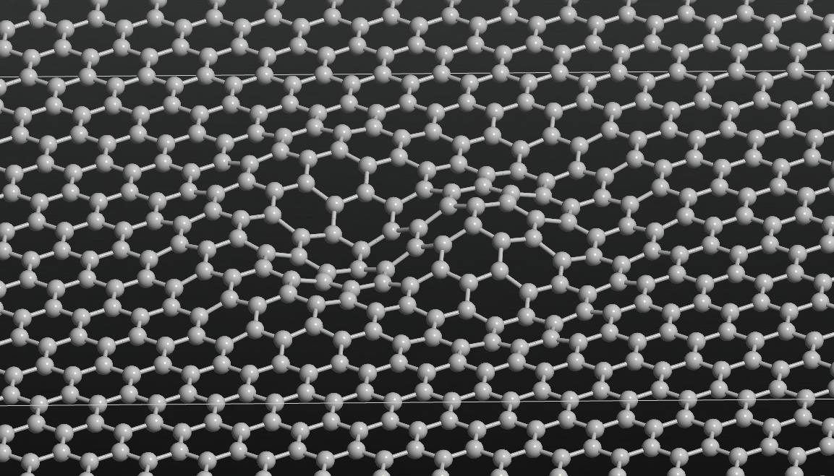
GRAPHENE
Graphene is what is described today as "miracle materials" and has various abilities in both its combined and naturally occurring forms..
Thanks to its hexagonal structure, it has the appearance of a honeycomb.
Graphene takes its name from the two sources that make up it. These; graphite and polycyclic are aromatic hydrocarbons.
This material; it is the thinnest and strongest material with the highest conductivity.

Slide 10
USES OF GRAPHENE
Graphene; As sensors, they can be used to detect biomolecules, pathogens, ions, cell functions, as well as as drug carriers.
Graphene can also be used as a tissue scaffolding for bone regeneration.

Slide 11
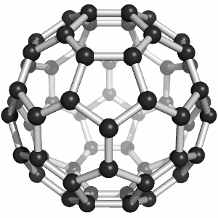
FULLERENES
Fullerenes; are allotropes of carbon, which can take the form of spheres, ellipses, tubes, and many other forms.
The fullerenes are very similar to graphite, which consists of graphene plates in bulk consisting of structurally connected hexagonal rings.
It is 3D.

Slide 12
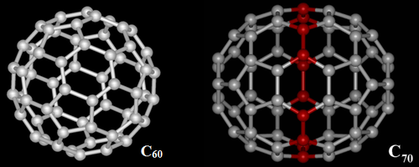
FULLERENES
Cylindrical fullerenes; They are also called carbon nanotubes or buckytubes.
In cases where they are not cylindrical, they contain pentagonal and sometimes heptagonal rings.

Slide 13
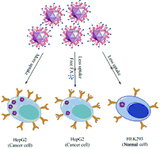
NANODIAMONDS
Diamonds; They are known for their high refractive index, hardness, stability and inertness, as well as their low electrical and high thermal conductivity.
Their small and uniform size support the use of nanodiamonds as drug carriers.

Slide 14
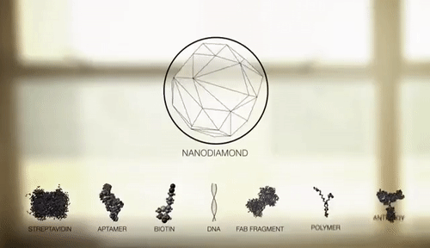
NANODIAMONDS
Thanks to its magnetic properties, it allows them to be used as sensors in electrical, magnetic and temperature fields.
Thanks to the high covalent bond strength between carbon atoms, diamonds are highly inert.
In addition, the rich surface chemistry of diamond allows all kinds of molecules to bind to the surface.

Slide 15
USES
Many features, such as their in vitro biocompatibility and the ability to functionalize diamonds, support the use of nanodiamonds in pharmaceutical, gene and ion transport.
It has uses such as the development of pH and temperature sensitive molecules.
In addition, studies have shown that nanodiamonds have an antibacterial effect on some bacteria.
The composite of nanodiamonds with polymers has shown positive results in studies with bone cells.
It has been seen that nanodiamonds do not reduce biological function, and thanks to their robust mechanical properties, a more effective result is obtained compared to the use of polymers alone.

Slide 16
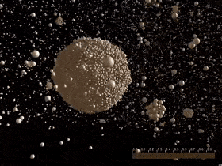
POLYMERIC NANOPARTICLES
Polymeric nanoparticles; They are biocompatible, biodegradable and formed from non-toxic polymers.
Biocompatibility is essential for the use of polymeric nanoparticles in tissue engineering, drug and gene transport, and new vaccine strategies.
They are known for their good protection of the drug they carry in their drug release systems.
Their surfaces are modified and used for the active and passive transport of bioactive substances.
Some problems, such as their sensitivity to pH changes, may limit their use.

Slide 17
POLYMERIC NANOPARTICLES
Natural polymer-based nanoparticles; Although there is a stability problem, they are usually biocompatible and non-toxic.
Chitosan, which is among the natural polymers, is the most widely used polymer today.
When polymers such as chitosan as well as gelatin and sodium alginate are compared in synthetic polymers, these polymers have overcome the problem of toxic effects compared to synthetic polymers.
Natural polymer-based nanoparticles; They offer more effective and efficient alternatives to traditional oral and intravenous methods of drug delivery.

Slide 18
POLYMERIC NANOPARTICLES

Slide 19
POLYMERIC NANOPARTICLES
Various natural polymers such as gelatin, albumin and alginate are used in nanoparticle synthesis.
However, these polymers have some disadvantages, such as their inherent predisposition to degradation and their potential to produce antigens.

Slide 20
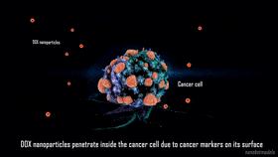
ADVANTAGES
There are many advantages to the use of polymeric nanoparticles in drug release systems, including;
It is biocompatible and biodegradable.
2. Improves the stability of volatile pharmaceutical agents.
3. Slightly toxic or non-toxic.
4. They can be produced in a wide range of affordable prices by many different methods.

Slide 21
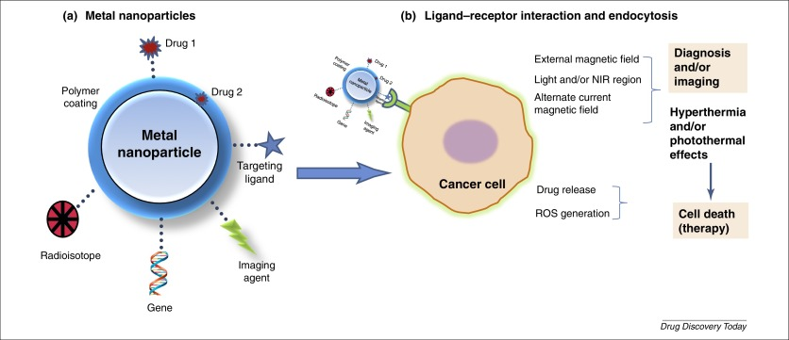
METALLIC NANOPARTICLES
Metallic nanoparticles; It is used in cancer research, as a drug and gene carrier, in highly sensitive diagnostic tests, in the fields of radiotherapy.
They are widely used in drug delivery systems.
They are also frequently used as biosensors.

Slide 22
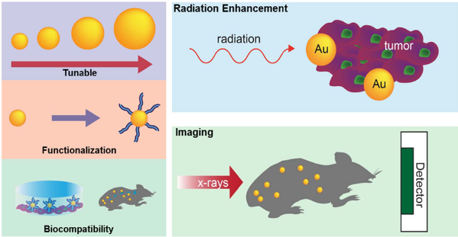
METALLIC NANOPARTICLES
Silver and gold nanoparticles are of primary importance in biomedical applications.
The surfaces of these nanoparticles can be easily functioned and various ligands can be attached to their surfaces.
Various ligands, such as sugars, peptides, proteins and DNA, can bind to nanoparticles.
Due to the fact that the surfaces of metallic nanoparticles can be easily functioned, they can be used in many areas as an alternative to quantum dots.

Slide 23
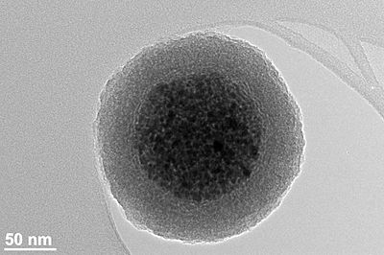
MAGNETIC NANOPARTICLES
Magnetic nanoparticles; nanoparticles with dimensions below 100 nm and can be manipulated in the presence of a magnetic field.
These nanoparticles are composed of magnetic elements such as cobalt, nickel, iron and their own oxides..
A cluster of magnetic nanoparticles contained within the silica shell

Slide 24
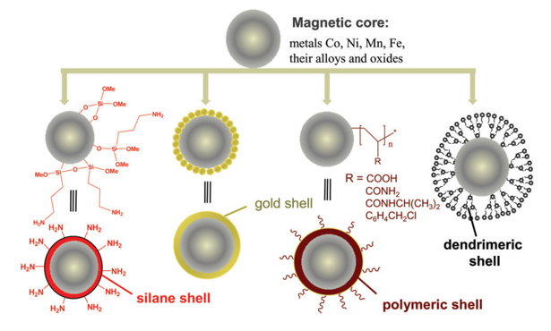
MAGNETIC NANOPARTICLES

Slide 25
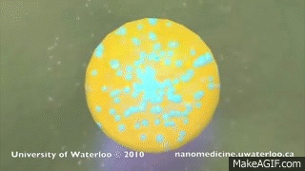
USES
Cancer therapy
Identification of proteins
Imaging
Targeted systems

Slide 26
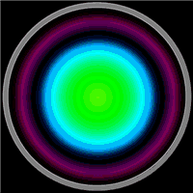
QUANTUM DOTS
Quantum dots are 3D nanocrystals of semiconductor materials that are between 2-10 nm.
These are nanoparticles consisting of cadmium selenide (CdSe) from a semiconductor inorganic nucleus and a shell coated with organic aqueous phase to improve optical properties, capable of fluorescence radiation when stimulated by light.
Quantum dots have a cap that increases their solubility in aqueous environments.
The core of the quantum dot determines the color it will emit, and the aqueous outer membrane is suitable for conjugating with biomolecules.
They can be used in cancer therapy, in real-time imaging.

Slide 27
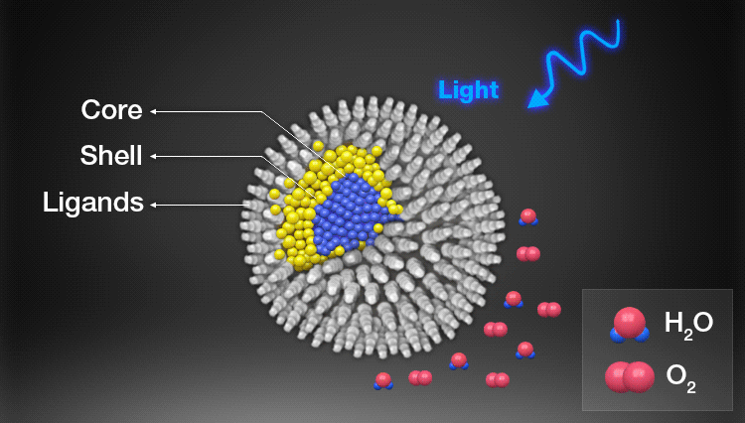
QUANTUM DOTS

