Slide 1
CHARACTERIZATION METHODS OF NANOPARTICLES
Prof.Dr. İbrahim IŞILDAK LESSON 4

Slide 2
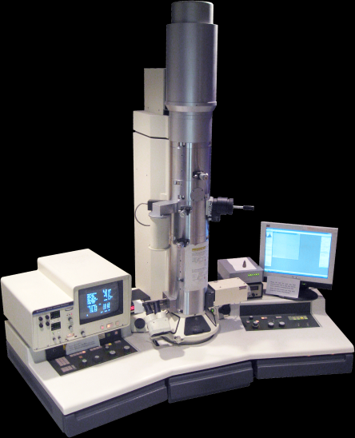
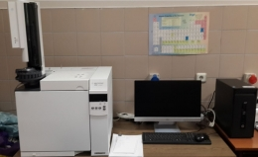
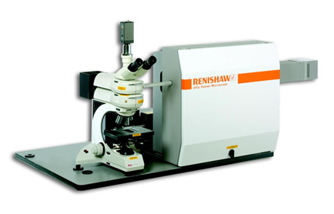
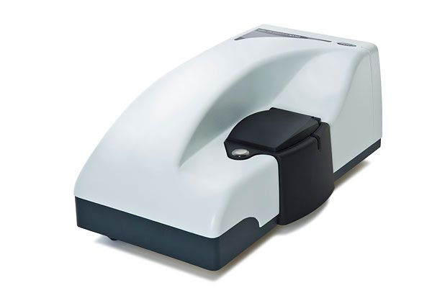
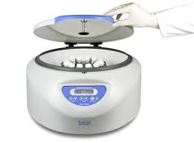
Microscopic techniques
Chromatographic Methods
Spectroscopic Methods
Centrifugation and filtration techniques
Other Techniques

Slide 3
Microscopic Techniques
Microscopic techniques include optics, electron and scanning probe microscopy.
Near-field scanning optical microscopy (NSOM/SNOM);
Since the dimensions of NPs are below the optical microscopy detection limit, it uses the SNOM modified imaging technique with a resolution between 50 and 100 nm to image NP aggregates.
Confocal microscopy/Confocal laser scanning microscopy (CLSM);
It is used to characterize colloid samples because it can detect fluorescence samples and image thick samples.
The most popular techniques for the visualization and characterization of NPs are electron and scanning probe microscopes.

Slide 4
Permeable electron microscopy (TEM);
In TEM, electrons are transmitted through a sample to obtain an image (hence the sample must be very thin).
It also uses scanning transmission electron microscopy (STEM), which is the TEM group, for biological samples.
Dark-field microscopy with STEM allows biological samples to be imaged without staining due to its high contrast characteristics. Along with diffraction and spectroscopic techniques, STEMs can also provide images and chemical data for NPs.

Slide 5
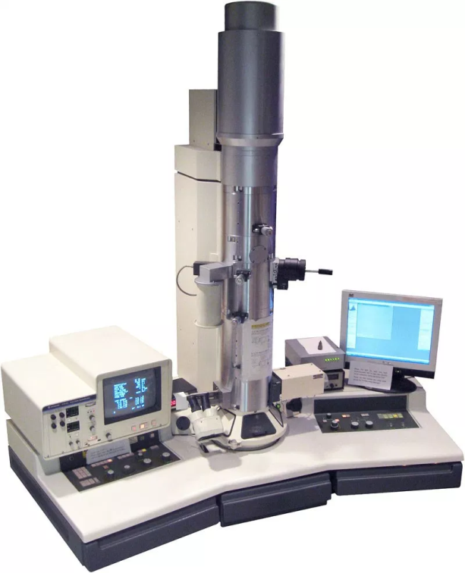
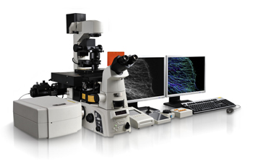
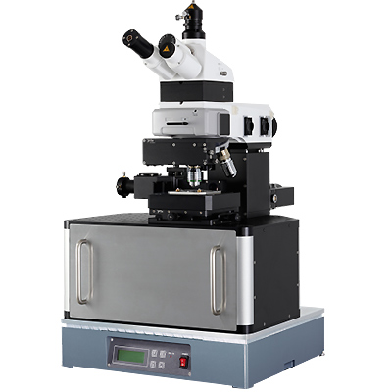
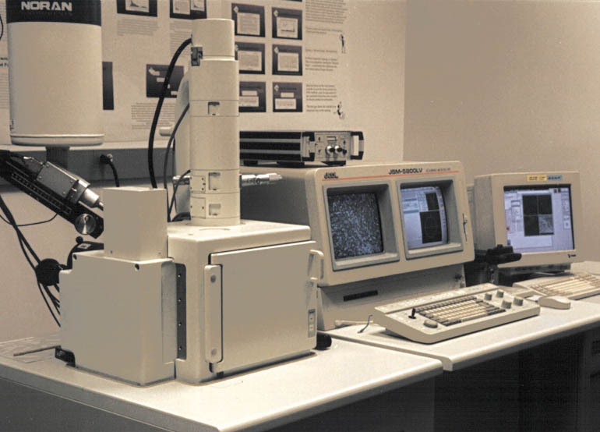
Confocal Microscope
TEM
SNOM
SEM

Slide 6
Analytical electron microscopy (AEM); analytical (mostly spectroscopic) instruments can be combined with electron microscopes for additional elemental composition analysis, commonly known as AEM.
For example, energy-dispersive X-ray spectroscopy (EDS); used for elemental analyses.
When combined with TEM, these give additional information about the basic composition of the sample.
Selected field electron diffraction (SAED); Provides information about the crystal properties of NPs.
The most important disadvantage of these techniques is; samples can be analyzed once as they disrupt the structure of the samples used.

Slide 7
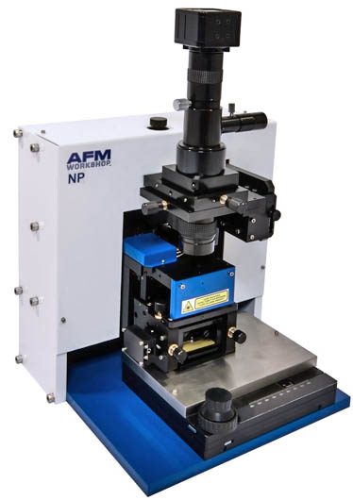
Atomic force microscopy (AFM);
Using atomic force microscopy (AFM), it is possible to image NPs in a completely liquid state.
AFM belongs to the family of scanning probe microscopes (SPM). Therefore, accurate dimensional measurements should only be made on the basis of the height of the particles, and lateral dimensions should be used with extreme caution.

Slide 8
CHROMATOGRAPHIC METHODS
Chromatography-based or related techniques may be used to separate NPs in samples. These techniques are fast, precise and non-destructive, so that samples can be used for later analysis.
Some chromatographic devices use solvents, and also samples often cannot be operated in their original environment, which can cause a change in the number and sample solvent interaction.
With the addition of traditional analytical instruments (e.g. ICP-MS, UV, etc.) as detectors to sizing techniques, NPs can be characterized or elementally analyzed, as well as digitizing different NPs found in food, water, and soil.

Slide 9
Size exclusion chromatography (SEC);
This is the most commonly applied chromatographic method and is used in conjunction with detection techniques such as voltametric.
Field flow fractionation (FFF);
It is a highly promising technique for the size separation of NPs in complex natural samples. Separates NPs without constant phase, which is based only on hydrodynamic forces.
Hydrodynamic chromatography (HDC);
It enables the sizing of various NPs with a wide particle size separation range in different environments. However, HDC is particularly useful in helping to better understand aggregate formation.
Capillary electrophoresis (CE);
These methods are highly sensitive and allow samples to be used for further analysis.

Slide 10
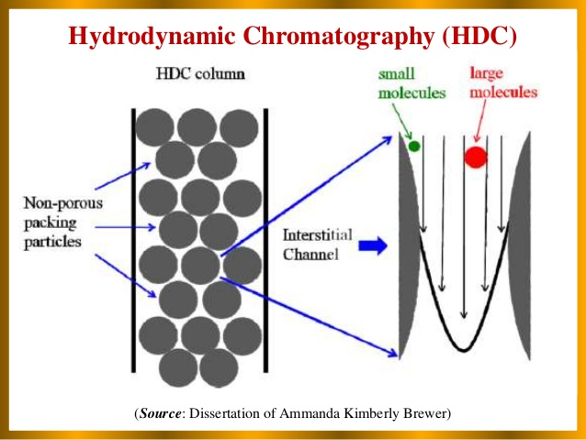
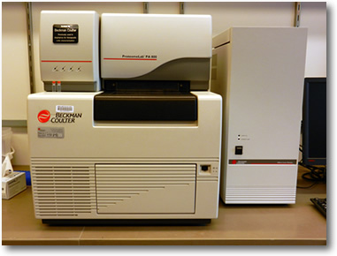
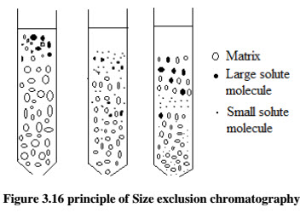
Capillary Electrophoresis

Slide 11
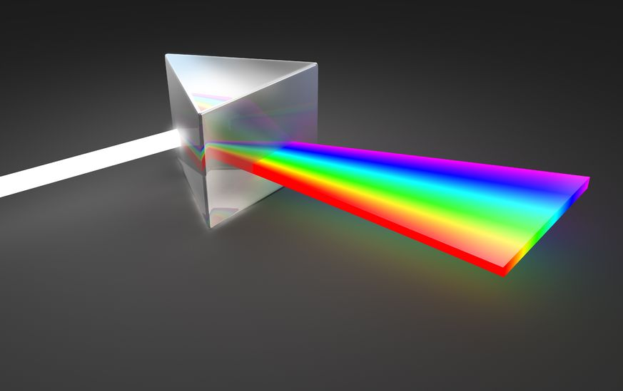
Spectroscopic Methods
A wide range of spectroscopic methods are available for nanoparticle analysis and characterization. The most useful scattering techniques for nanoparticle characterization are light scattering methods such as DLS or neutron scattering such as SANS.

Slide 12
Dynamic Light Scattering Method (DLS);
It is the most common method used for NP sizing and determining its aggregation in suspensions.
At the same time, DLS provides fast, in situ and real-time sizing,
Furthermore, data from samples containing particles with heterogeneous size distributions are difficult to interpret.
DLS is quantitative only, and when the content of the sample is unknown or unpure, the size fractions do not belong to particles of a specific composition.

Slide 13
Photon Correlation Spectroscopy (PCS);
As with DLS, it is particularly useful for sizing NPs and detecting aggregation in suspensions.
Small Angle X-ray Scattering (SAXS);
Can characterize monodisperse (all particles in the medium have the same size) and polydisperse (particle sizes differ from each other) systems.
Laser Induced Diagnostics (LIBD);
It has a very low detection limit and is suitable for size and concentration analysis of colloids.
RAMAN SPECTROSCOPY;
Suitable for structural characterization of NPs.
SMALL-ANGLE NEUTRON SCATTERING (SANS);
It can be used in solid or liquid samples. X-ray spectroscopy covers XPS, XRF and XAS and XRD techniques

Slide 14
X-ray photoelectron (XPS);
Useful for characterizing NP surfaces and coatings.
X-ray diffraction (XRD);
Non-destructive, gives information about the crystallographic structure or elemental composition of natural and manufactured materials.
X-ray absorption (XAS) and emission spectroscopy;
Used in chemical and materials sciences to determine elemental composition and chemical bonds.
X-ray fluorescence (XRF);
This method of spectroscopy does not destroy the samples. Used to determine and identify concentrations of elements in solid, powder or liquid samples.

Slide 15
Mass spectrometry;
consists of an ion source, a mass analyzer and a detector system and includes ESI and MALDI techniques.
Electrospray ionization (ESI) and matrix-assisted laser desorption/ionization (MALDI);
Two ionization techniques often used with liquid and solid biological samples.
UV-visible spectroscopy (UV-vis spectroscopy);
It is a simple and useful analytical technique for measuring the mass concentration of NPs according to Beer's law. It is the technique used to measure the light absorbed and scattered by a sample. NPs have optical properties and are suitable for characterization and examination by UV-vis due to their size, shape, concentration, agglomeration status and sensitivity to the near-surface refractive index of nanoparticles.

Slide 16
Centrifugation and Filtration Techniques
These methods are low cost, high speed and high volume techniques and are suitable for sample preparation and size fractionation.
Ultra centrifugation (UC); Another field-separation technique, ultracentrifugation, involves separation on the basis of the centrifugal force created by very rapid rotation (50,000 revolutions per minute or more). Different species, depending on their masses, will settle at different speeds under these conditions. There are two different types of ultra-centrifuges, analytical and preparatory UC.
Analytical ultra centrifuge (ANUC); the sample can be monitored in real time via an optical sensing system using ultraviolet light absorption and/or optical refractive index sensitive systems.
Preparatory ultra centrifuge; used for pelletization of fine-grained fractions, gradient separation processes and aggregation of colloids and NPs in water in TEM and AFM substrates.
Cross-flow filtration (CFF) or tangent filtration; recirculates the samples and thus reduces blockage, concentration polarization and other artifacts caused by conventional probe filtration.

Slide 17
Other Techniques
Particle counter;
This technique is successfully applied in the size and surface charge characterization of NPs using a carbon nanotube-based coulter counter.
Condensation particle counter (CPC);
The enlarging of particles by condensation process using various operating fluids such as alcohol and water gives information about the number and concentration of individual particles.
Differential mobility analyzer (DMA);
Can be used to determine the size distribution of aerosol particles

Slide 18
Scan mobility particle measuring device (SMPS);
It consists of a DMA and a CPC. First, the particles are separated by their electrical mobility in the DMA, then the size fractions enter the CPC, which determines the particle concentration at that size.
Brunauer-Emmett-Teller (BET);
This method, which is very common, allows the determination of specific surface areas of solids and thus nanoparticles by gas adsorption.
Electrophoretic mobility and zeta potential;
Electrophoresis is used to measure the properties of dispersed particles, especially the zeta potential.
Zeta potential;
It is a measurement of the total load that a particle obtains in a given medium and is indicative of the potential stability of a colloidal system.

