Slide 1
INTERACTION OF NANOSTRUCTURES WITH CELLS AND TISSUES
Prof.Dr. İbrahim IŞILDAK LESSON 5

Slide 2
NANOTECHNOLOGY and TISSUE ENGINEERING
Nanotechnology has found a wide field in tissue engineering as well as in many other areas. First, the cells are multiplied in the laboratory,
then an ideal tissue scaffolding with the function capable of forming the texture is selected, and
a hybrid system is created within the principles of tissue engineering.

Slide 3
NANOTECHNOLOGY and TISSUE ENGINEERING
The tissue scaffolding is biodegradable and serves as a temporary host used by the tissue to be applied to the body until it adapts to the body.
Nanotechnology has an important role in the development of structures with genetic, topographic and functional properties required from the material while preparing tissue scaffolding.
Biocompatible implants with nanofabrication techniques, release of biological agents that will provide tissue formation and cell purification are also among the studies of nanotechnology in tissue engineering.

Slide 4
THE RELATIONSHIP BETWEEN NANOSTRUCTURES AND IMMUNE SYSTEM
Immune system; is our basic protection system that protects us from ANTIGENS that try to enter our body such as particles, pathogens, etc.
When examining the potential toxicities of the nanomaterials produced, the complexity of the immune system, which has a variety of specialized cells, should also be taken into account.
Consideration must be taken into account not only the material-related properties of the pure material, but also the content-dependent identity of the nanomaterial in the living system, which is acquired over time, resulting from the adsorption of biomolecules to the surface of the living system.

Slide 5
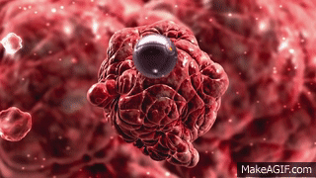
NANOSTRUCTURES AND TOXIC EFFECTS
Bringing the material to nano dimensions gives this material many desired and useful properties as well as undesirable toxic situations.
The physicochemical properties of nanomaterials that cause their toxicity are still a problem.
Establishing the relationship between material properties and toxicity enables the prediction of the possible hazards of nanomaterials, making it possible to design nanomaterials that retain their useful properties.

Slide 6
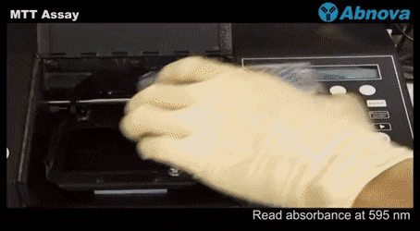
NANOSTRUCTURES AND TOXIC EFFECTS
Possible future hazards of nanomaterials; should be tested with in vivo, in vitro and in silico methods.
At the same time, the optimum doses to be used must be determined by various test methods before they are made available.
While tests such as XTT, MTT, AlamarBlue, LDH and Neutral Red are used to determine the cytotoxicity of nanoparticles; Various tests such as Ames, Comet Assay and in vitro Micronucleus (MN) Assay are used to determine their genotoxicity.

Slide 7
FACTORS AFFECTING THE INTERACTION OF NANOSTRUCTURES WITH CELLS
Surface charge is one of the parameters that affect the interaction between cells and nanoparticles.
The cell membrane is notoriously negatively charged, the high toxicity of positively charged nanoparticles is often associated with their increased cellular uptake.
It is thought that the bio-corona adsroptions of proteins can effectively equalize the surface charges of different nanoparticles.

Slide 8
INTERACTION OF NANOSTRUCTURES WITH BIOLOGICAL SYSTEMS
Nanoparticles that come into contact with biological fluids are thought to be rapidly coated by biomolecules that form interfaces with biological systems and form structures called "corona".
The nanomaterials produced and the interaction between cells and tissue; the physicochemical properties of the material and the content resulting from the bio-corona can be determined based on dependent properties.

Slide 9
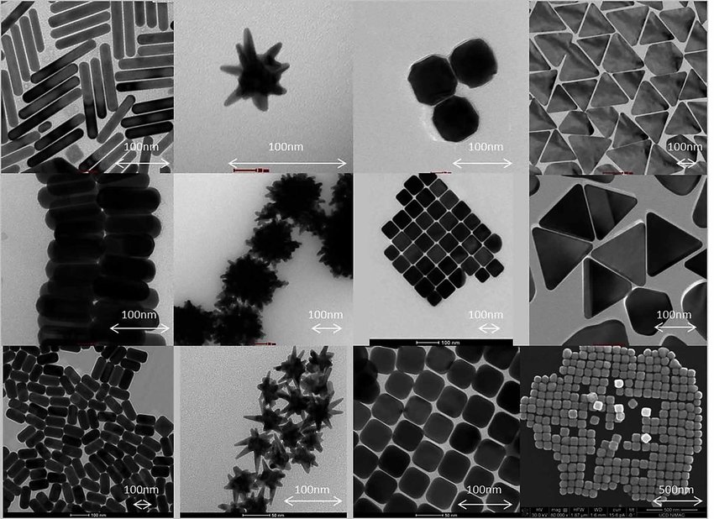
FACTORS AFFECTING THE INTERACTION OF NANOSTRUCTURES WITH CELLS
Nanomaterials take different names according to their unique shape and size, such as nanoparticles, nanotubes, nanofilms, nanoshells, etc.
The properties inherent in the nanomaterial, such as size, shape, surface charge and colloidal stability, are very important.
Together, these properties form the identity of the material.
For example, size; it is of great importance in cellular uptake and during the passage of particles through biological barriers.

Slide 10
FACTORS AFFECTING THE INTERACTION OF NANOSTRUCTURES WITH CELLS
In a study with near-infrared (NIR) fluorescent nanoparticles with systematically varying sizes, surface modifications and core composition; nanoparticles with hydrodynamic diameters of less than 34 nm and non-cationic surface charge were found to translock rapidly from the lungs to regional lymph nodes following inoculation in rats.
Nanoparticles with a hydrodynamic diameter of less than 6 nm have been found to reach the lymph nodes and bloodstream from the lungs, ultimately being cleared from the body by the kidneys.

Slide 11
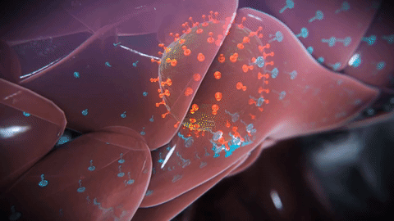
FACTORS AFFECTING THE INTERACTION OF NANOSTRUCTURES WITH CELLS
The behavior of the nanoparticle depends on the interaction of protein adsorption due to surface coatings in body fluids.
The shape of nanoparticles is one of the important parameters that play a role in their interaction with the cell.

Slide 12
FACTORS AFFECTING THE INTERACTION OF NANOSTRUCTURES WITH CELLS
Li et al. have shown that multi-walled carbon nanotubes determine pulmonary toxicity when the functionalization is strongly cationic.
Carbon nanotubes modified with polyethyl (PEI) to perform cationic functionalization markedly induced lung fibrosis, while anionic functionalization (carboxylation) has been shown to reduce fibrous size in mice.

Slide 13
BENEFITS OF NANOSCALE FOR MATERIAL-CELL INTERACTION
The benefits of nanomaterials are based on other physical properties, such as the quantum effect and increased surface area.
The properties of the material are dimension-dependent on this scale, and this dimension gives the material a quantum effect.
When the particle size is on the nanoscale, the properties of the material, such as melting point, fluorensant property, magnetic permeability, chemical reactivity, and electrical conductivity, vary depending on the function of the particle size.

Slide 14
BENEFITS OF NANOSCALE FOR MATERIAL-CELL INTERACTION
Gold is an element that exhibits unique properties on the nanoscale. Contrary to what is thought to be gold in the nanoscale, it is not yellow, but red or purple.
In the nanoscale, the electrons of gold are constrained.
Because of this limitation, gold nanoparticles react differently to light when compared to gold particles on larger scales.
Gold nanoparticles; Thanks to their size and optical properties, they accumulate selectively in tumors, thus providing both precise imaging of the tumor and targeted laser destruction of the tumor without damaging healthy cells.

Slide 15
BENEFITS OF NANOSCALE FOR MATERIAL-CELL INTERACTION
Most of the internal mechanisms of cells occur naturally at the nanoscale..
For example, hemogobin, a protein responsible for carrying oxygen in the bloodstream, is 5.5 nm in size.
The DNA strand, which is also one of the building blocks of living things, is only 2 nm in size.
Given the effects of nanosizes on biology, scientists have conducted nanoscale research while developing more unique, special, specific, and more precise and personalized treatment methods compared to traditional therapeutics.

Slide 16
BENEFITS OF NANOSCALE FOR MATERIAL-CELL INTERACTION
In line with nanomaterials and cell interactions, nanoscale of the substance reduces non-specific protein interactions,
limits immunogenicity,
enables the use of personalized nano drugs,
Creates common target zones in ligand-mediated interactions,
cancer creates specific targets,
allows ligand-mediated in vitro diagnosis.

