Slide 1
BIOCOMPATIBILITY OF NANOMATERIALS
Prof.Dr. İbrahim IŞILDAK LESSON 6

Slide 2
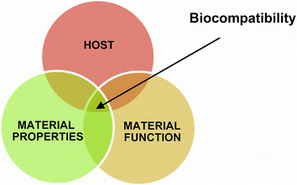
What Is bIocompatIbIlIty?
In order to design effective and safe drugs at nano sizes, it is necessary to have knowledge about the safety and effects of nanoparticles in vivo and in vitro environments.
Many properties such as the composition of the material, the size of the particle, the surface area, the surface chemistry, the surface charge and the agglomeration state affect the biocompatibility of the nanomaterials.
The biocompatibility of the nanomaterial determines the responses of the living system to the nanomaterial.

Slide 3
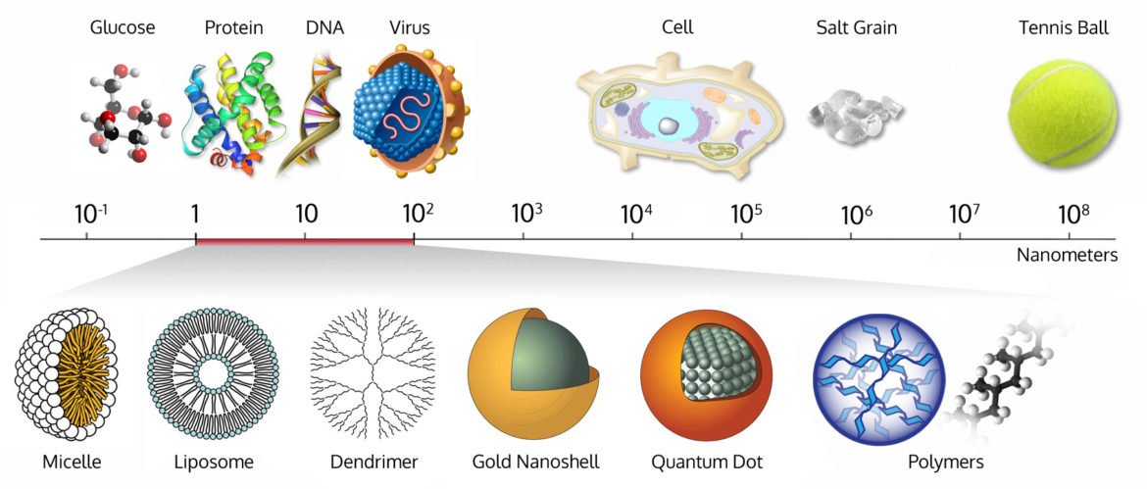
BIocompatIbIlIty of nanomaterIals
Compared to larger particles made of the same material, nanoparticles have a larger surface area, so they can have some desirable advanced properties such as electrical conductivity, tensile strength, and chemical reactivity.
Unlike microparticles, nanoparticles are small enough to be absorbed by biological barriers, so they can penetrate almost any barrier in the body, including cells and intracellular organelles.

Slide 4
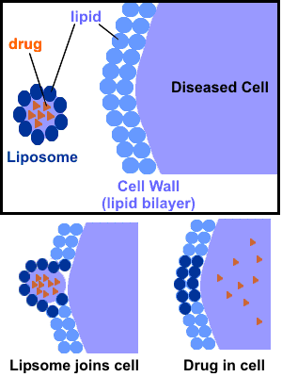
BIocompatIbIlIty of nanomaterIals
Biodegradable lipid nanoparticles and biopolymer-based nanoparticles are used as drug delivery systems. However, applications of non-biodegradable nanoparticles are still being developed.
The toxicity of the nanomaterial is not only related to the effect that the material creates. While It is also related to its concentration and the duration of the nanomaterial remaining in the tissue..
Therefore, in addition to analyzing toxicity, absorption, metabolism and release profiles need to be examined.

Slide 5
BIocompatIbIlIty defInItIon
Biocompatibility; as a result of the application of nanomaterial to the human or animal body, it is the ability to be accepted and not to cause negative tissue or cellular responses such as immune response, toxicity, carcinogenity by the surrounding tissues and the whole organism.

Slide 6
PARAMETERS AFFECTING THE BIOCOMPATIBILITY OF NANOSTRUCTURES
High level of biocompatibility; as long as the material does not generate an unacceptable toxic, immunogenic, thrombogenic, or carcinogenic response when it comes into contact with the body.
The severity of these answers is; it is determined based on how the nanomaterial used interacts with various biological substances such as immune system cells, proteins and lipids.
Structure, size, surface area, surface chemistry, surface charge, agglomeration status and sample purity also affect the biocompatibility of the material..
To clarify the biocompatibility of nanomaterials; First, we need to understand their physical properties and the interaction between biological structures.

Slide 7
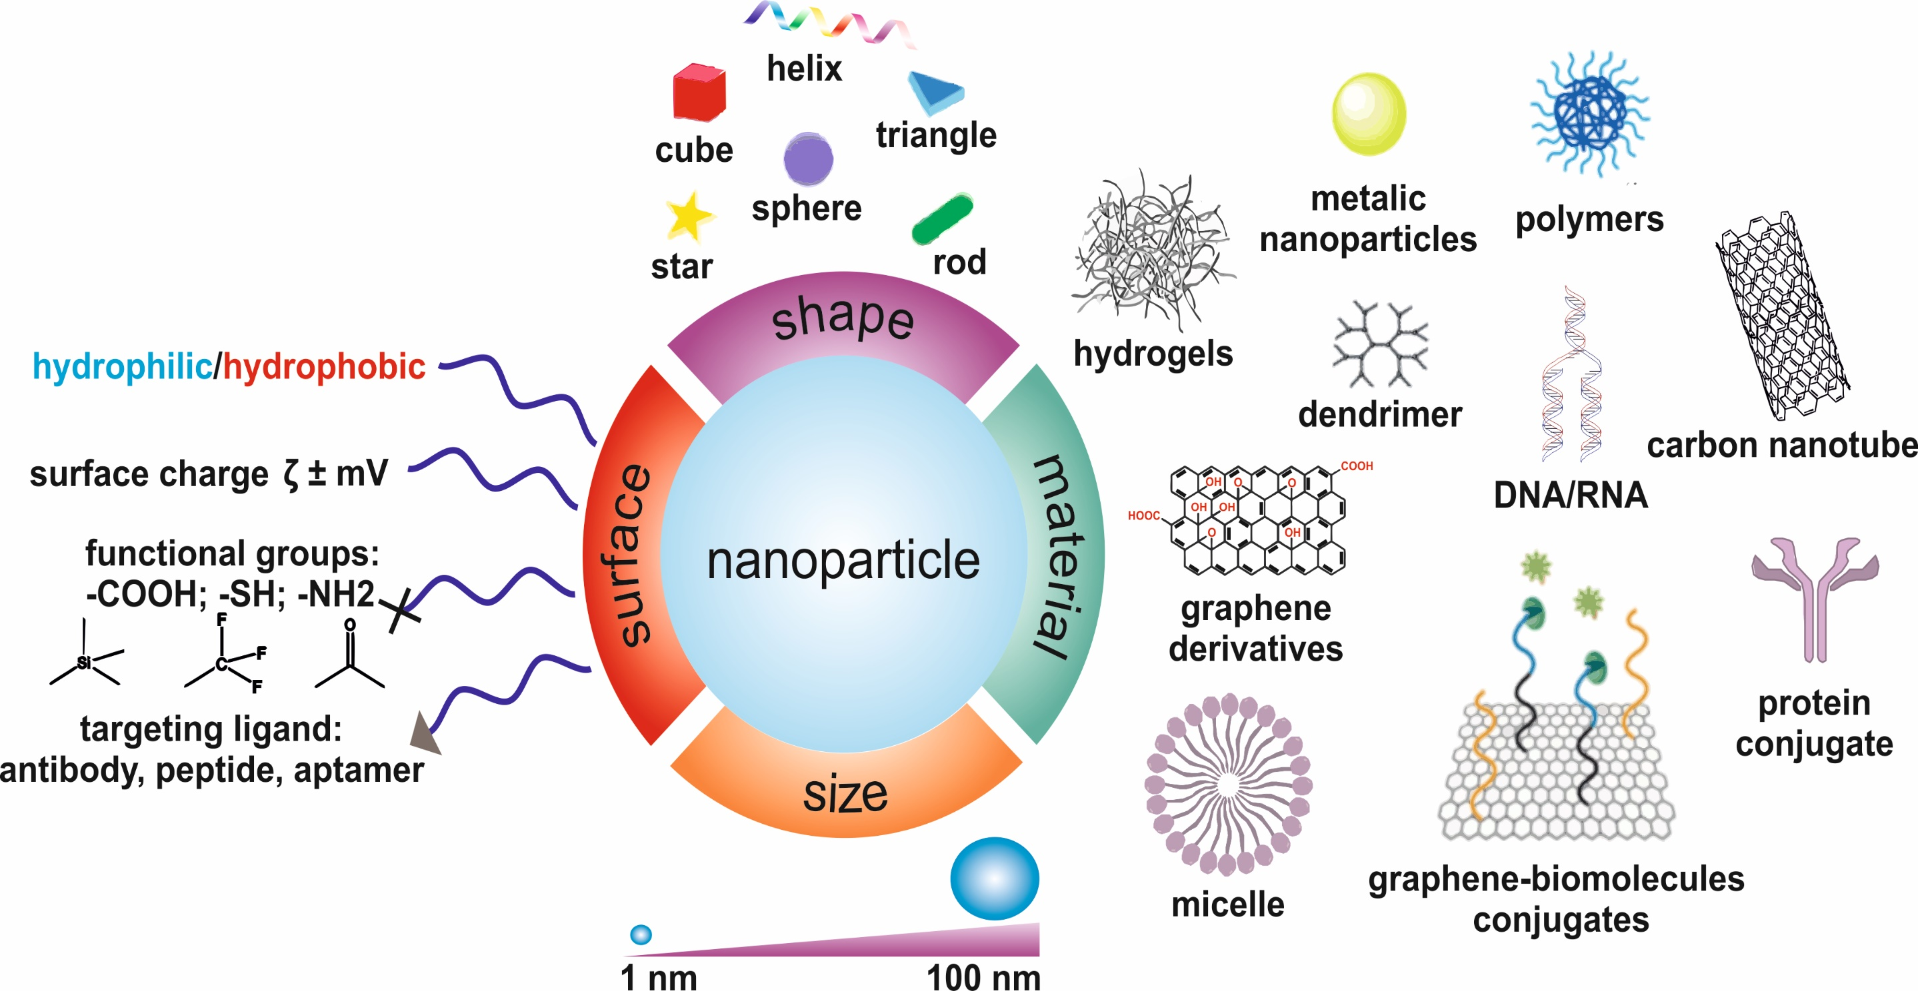

Slide 8
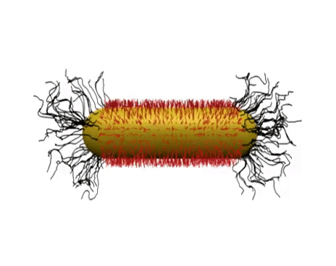
PARAMETERS AFFECTING THE BIOCOMPATIBILITY OF NANOSTRUCTURES
Particle size and surface charge are key parameters in cellular uptake of nanoparticles.
For example, Qiu et al.; in gold nanorods with similar surface load they showed that nanorods with shorter dimensions were taken into the cell to a greater extent compared to longer ones.
This situation; found that the lengths of gold nanorods also affect their cellular uptake.

Slide 9
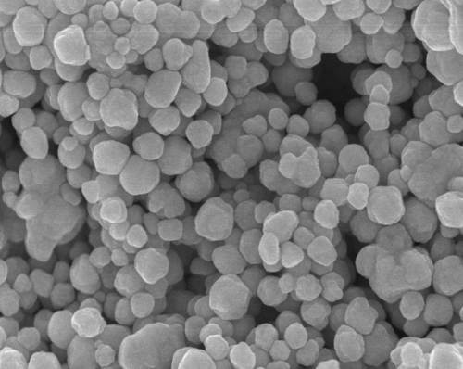
PARAMETERS AFFECTING THE BIOCOMPATIBILITY OF NANOSTRUCTURES
In the literature, the effects of nanoparticles depending on their size have also been shown.
For example; Jiang and colleagues identified the effects of antibody-coated gold and silver nanoparticles linked to the proteinkinase family in a signaling process such as cell death.
While the nanoparticles with diameters in the range of 2 to 100 nm all showed the basic cellular signaling process, those with diameters of 40 or 50 nm showed the greatest effect.

Slide 10
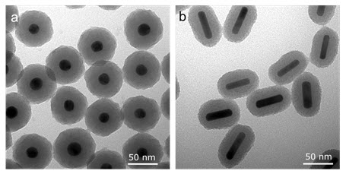
PARAMETERS AFFECTING THE BIOCOMPATIBILITY OF NANOSTRUCTURES
Compared to rod-shaped nanoparticles with spherical gold nanoparticles, rod-shaped gold nanoparticles have been shown to enter the cell less frequently.

Slide 11
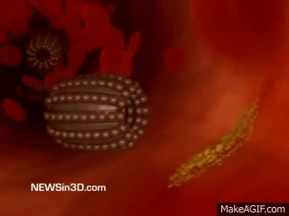
PARAMETERS AFFECTING THE BIOCOMPATIBILITY OF NANOSTRUCTURES
Protein adsorption to the surfaces of nanoparticles is one of the parameters that significantly affects the biological effects and biocompatibility of nanoparticles.
When nanoparticles come into contact with biological fluids such as blood; they are quickly covered by proteins and other molecules.
For example, when nanoparticles are mixed with plasma, a protein corona is formed within 30 seconds.
Covid protein composition may not change markedly over time.

Slide 12
NANOTOXICOLOGY
Investigation of the toxicity of nanomaterials in vitro and in vivo is of great importance to determine their biocompatibility.
When determining the toxicity of nanoparticles, in vivo, in vitro and even in silico methods can be used.

Slide 13
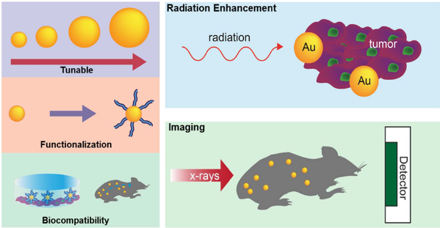
NANOTOXICOLOGY
In vivo methods; especially mammals such as mice, rabbits and rats, which can reproduce quickly and have a similar biological structure to humans, are used.
If we divide in vitro methods into two as cytotoxicity and genotoxicity determination;
MTT, XTT, AlamarBlue, LDH and neutral rejection methods are among the methods used to determine the cytotoxicity of nanoparticles.
In addition, the genotoxicity of nanoparticles can be determined by methods such as Ames test, Comet test and Micronucleus test.

Slide 14
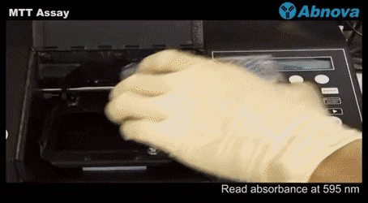
NANOTOXICOLOGY
The MTT method, perhaps the most commonly used method, is based on the mitochondrial activity shown by living cells.
Thanks to the mitochondrial activity in living cells, tetrazolium salts are transformed into formazan crystals and thus the increase or decrease in the number of living cells is determined by means of the plate reader with the concentration of formazan reflected in the optical density.

Slide 15
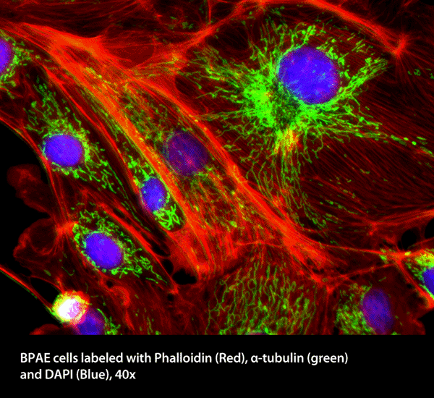
CharacterIzatIon Methods Used to DetermIne the BIocompatIbIlIty of Nanostructures
MICROSCOPIC TECHNIQUES
As a result of the treatment of nanoparticles bound with appropriate fluorescent dyes to the cells propagated in vitro environment, the ingestion of the nanoparticles into the cell and the lethal effects they can have on the cells can be demonstrated by means of fluorescence microscope.
A confocal microscope is also used to detect fluorescent samples.

Slide 16
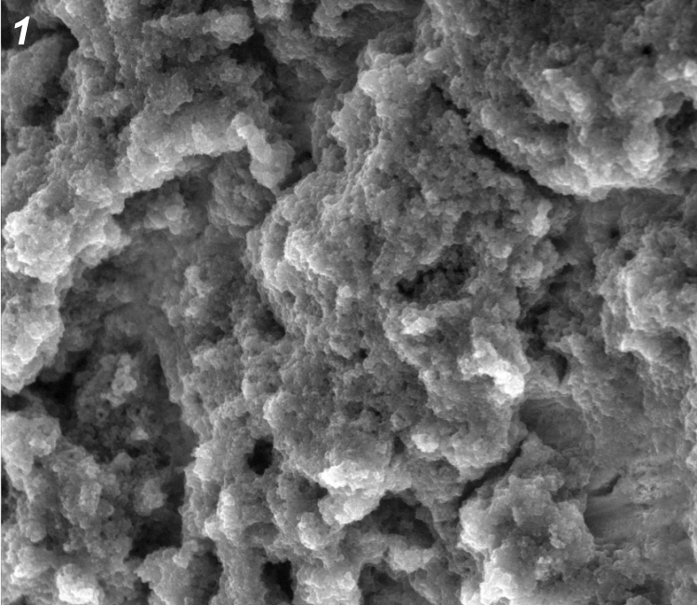
CharacterIzatIon Methods Used to DetermIne the BIocompatIbIlIty of Nanostructures
The most popular techniques used to visualize nanoparticles are; electron microscopes and scanning probe microscopes.
Using AFM, SEM and TEM, nanoparticles are not only visualized, but their properties such as aggregation, dispersion, absorption, size, structure and shape state are observed, which will affect their biocompatibility..

Slide 17
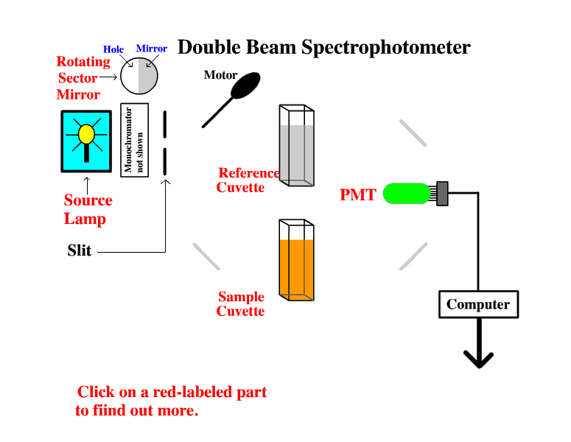
CharacterIzatIon Methods Used to DetermIne the BIocompatIbIlIty of Nanostructures
SPECTROSOSCOPIC METHODS
These methods are used to extract the emission profiles of nanoparticles.
How long the drug/active ingredient in the particle is released in what quantities is of great importance in order to optimize the active dose amount and avoid possible toxic effects.
Minimizing possible toxic effects will increase the chances of biocompatibility.

Slide 18
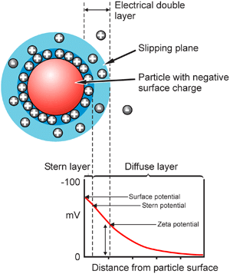
CharacterIzatIon Methods Used to DetermIne the BIocompatIbIlIty of Nanostructures
ZetaSizer
Thanks to devices such as the zetasizer, which can measure both the ELS and DLS properties of nanoparticles, particle size and zeta potential can be determined, which have a high impact on the biocompatibility of the nanoparticle.

Slide 19
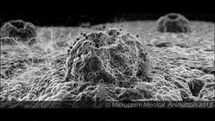
AnalytIcal Methods Used In PotentIal Measurements AccordIng to the PropertIes of Nanostructures
Aggregation: Microscopic technique; STEM, TEM, SEM, AFM, STM, centrifuge and filtration techniques; ANUC, spectroscopic methods; XRD, SANS, other techniques; zeta potential.
Mass concentration measurement: Microscopic technique; AEM, CFM, other technical; gravimetry, thermal analysis.
Chemical composition: Microscopic technique; AEM, CFM, spectroscopic methods; NMR, XPS, Auger, AES, AAS, MS, XRD, EBSD.
Particle count concentrations: Other technique; particle counter

Slide 20
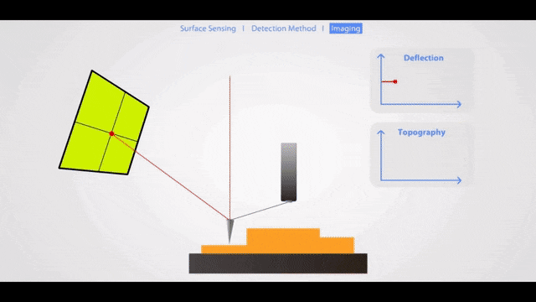
AnalytIcal Methods Used In PotentIal Measurements AccordIng to the PropertIes of Nanostructures
Shape: Microscopic technique; STEM, TEM, SEM, AFM, STM. Centrifugation and filtration techniques; Uc
Dimension: Microscopic technique; STEM, TEM, SEM, AFM, STM.
Size distribution: Microscopic technique; STEM, TEM, SEM, AFM. Chromatographic techniques; SEC Centrifuge and filtration techniques; Uc.
Spectroscopic methods; Techniques such as SAXS.

Slide 21
AnalytIcal Methods Used In PotentIal Measurements AccordIng to the PropertIes of Nanostructures
Thaw: Other techniques; Diffusive gradients in thin films such as voltometry, titration
Speciation structure: Microscopic technique; STEM, TEM, SEM, AFM, STM, other techniques; BET Surface area (porosity)
Surface load: Chromatographic techniques; CE, other techniques; Zeta potential
Surface chemistry: Microscopic technique; AEM, CFM, spectroscopic methods; XPS, Auger etc.

