Slide 1
SNOW & WIND ACTIONS ON STEEL STRUCTURES
Res. Asst. Mehmet Ozan Yilmaz
Structural Engineer, M.Sc.
PhD Candidate, Yildiz Technical University

Slide 2
Structural design, calculation and construction of industrial, residential and public steel structures in Turkey is regulated by «Çelik Yapıların Tasarım, Hesap ve Yapım Esasları» which was published by Turkish Ministry of Enviroment and Urban Planning in 04.02.2016.
The facts about our design specification;
It has superceded TS-648, which was used since 1980 and based on outdated assumptions (not appropriate for modern steel structure solutions)
Most essential features are quite similar to AISC360-16, the most recent design specification used in the U.S.
It adresses engineers to EN1991-1-3 and EN1991-1-4 for defining snow and wind actions respectively which the structure is expected to be subject.

Slide 3
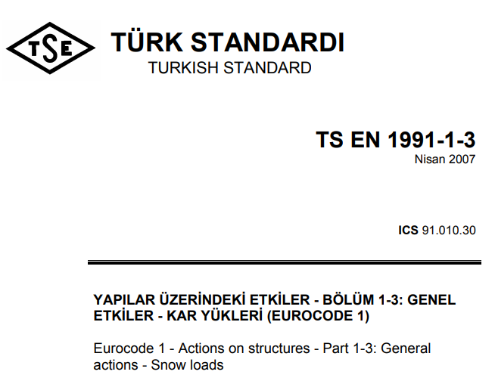
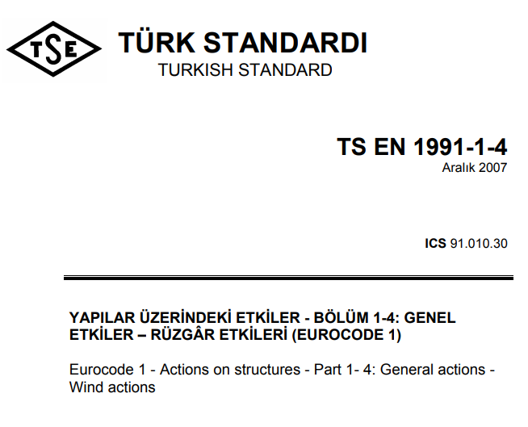
Word-by-word translations of Eurocode 1 – Part 1-3 and Part 1-4

Slide 4
SNOW LOADS
EN 1991-1-1-3 Section 3 defines «Design Situations» for snow loads
Design Situations
Normal
Exceptional
No exceptionally heavy snow falls
No exceptional snow drifts occur
Transient/persistent design situation should be used for both drifted and undrifted snow load
(see 5.2(3)P a) and 5.3)
Exceptional heavy snow falls
Exceptional snow drifts are likely
Not in the scope of our project

Slide 5
SNOW LOADS
EN 1991-1-1-3 Section 3 defines «Design Situations» for snow loads
Design Situations
Normal
Exceptional
No exceptionally heavy snow falls
No exceptional snow drifts occur
Transient/persistent design situation should be used for both drifted and undrifted snow load
(see 5.2(3)P a) and 5.3)
Exceptional heavy snow falls
Exceptional snow drifts are likely
Not in the scope of our project

Slide 6
SNOW LOADS
EN 1991-1-1-3 Section 5 defines snow loads on the roofs
Load Arrangements
Persistent/Transient
Accidental
Exceptional

Slide 7
SNOW LOADS
EN 1991-1-1-3 Section 5 defines snow loads on the roofs
Load Arrangements
Persistent/Transient
Accidental
Exceptional

Slide 8
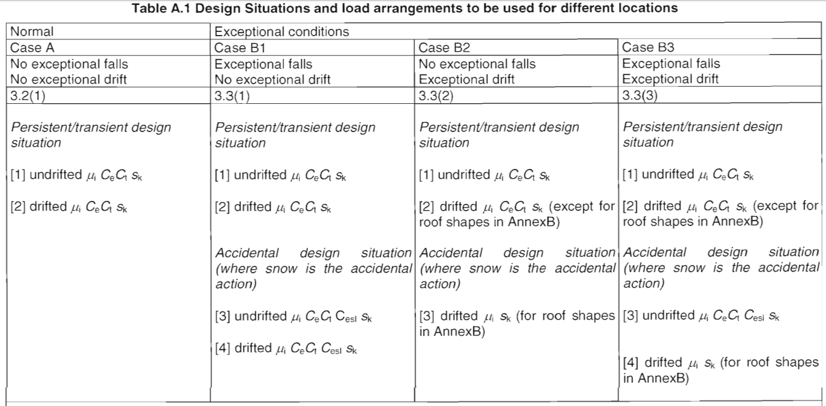
SNOW LOADS

Slide 9
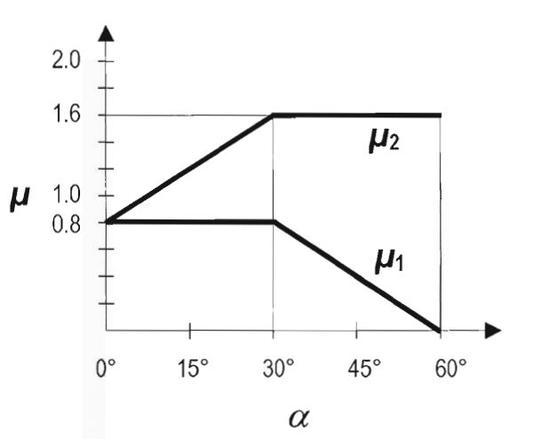
SNOW LOADS

Slide 10
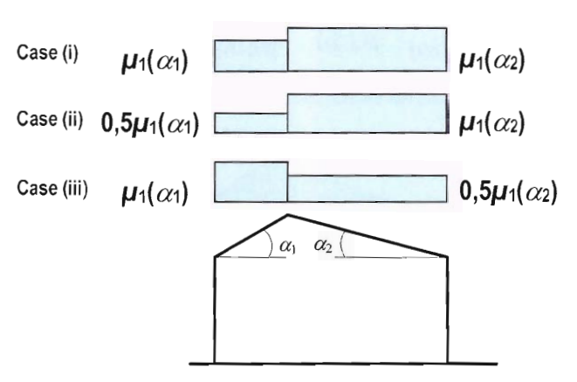
SNOW LOADS

Slide 11
SNOW LOADS

Slide 12
SNOW LOADS

Slide 13
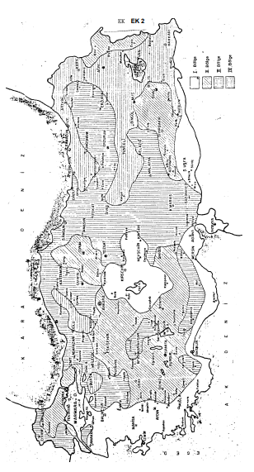
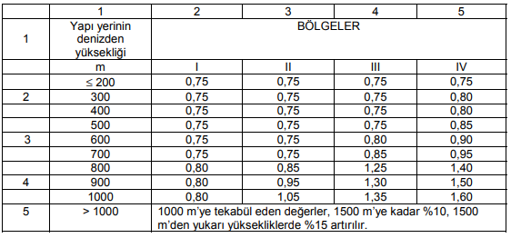
SNOW LOADS
National Snow Map and assigned snow loads on ground for different regions from TS-498:1987: Design Loads for Buildings

Slide 14
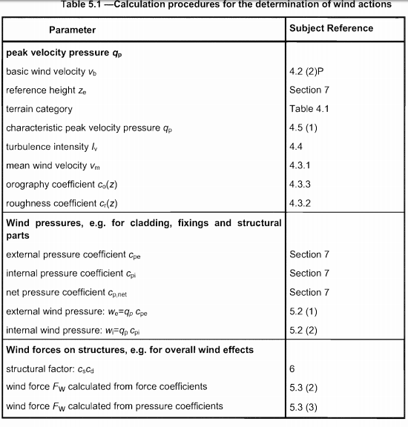

Slide 16
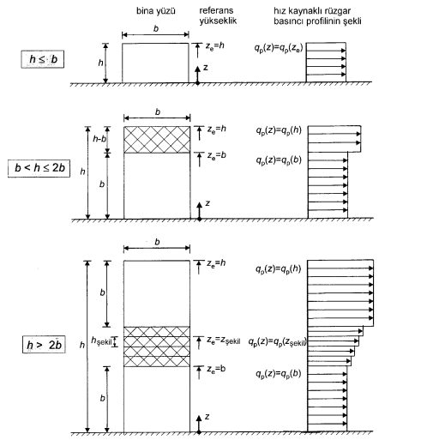

Slide 17
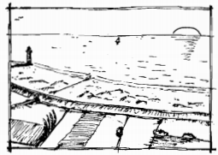
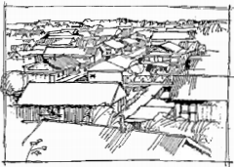
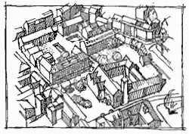

Slide 18
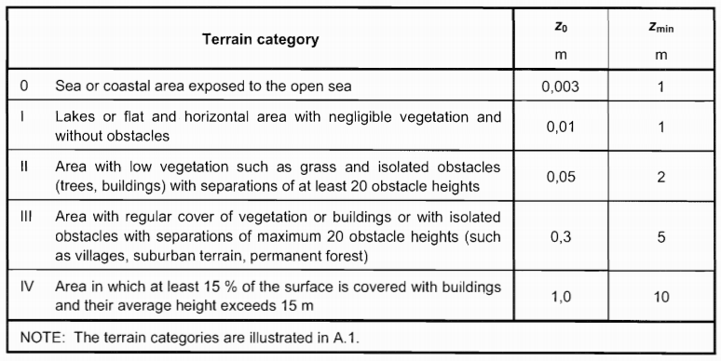

Slide 19
recommended value for kI is 1.0
c0 is 1,0 (see Annex A)
zmax is 200m

Slide 20
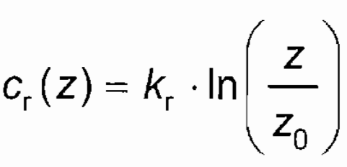
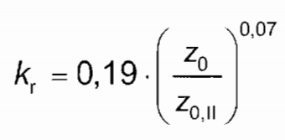
c0 is 1,0 (see Annex A)

Slide 21
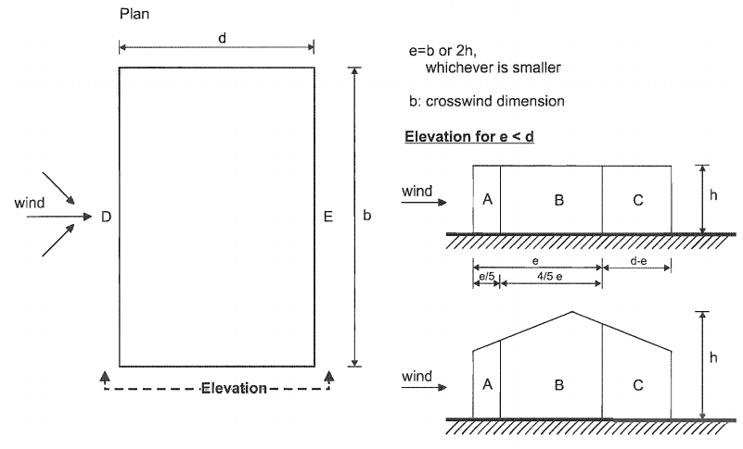

Slide 22
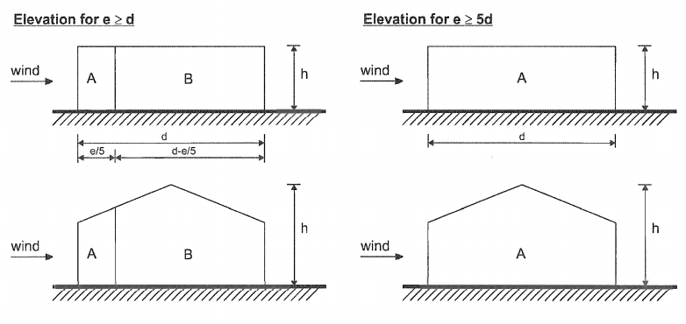

Slide 23
External pressure coefficient (cpe) for side walls

Slide 24
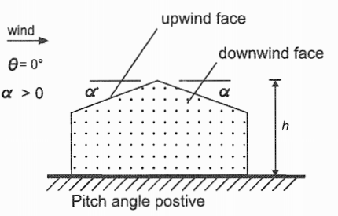
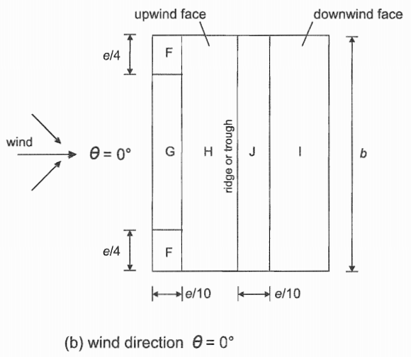
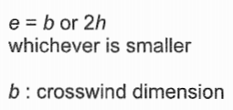

Slide 25
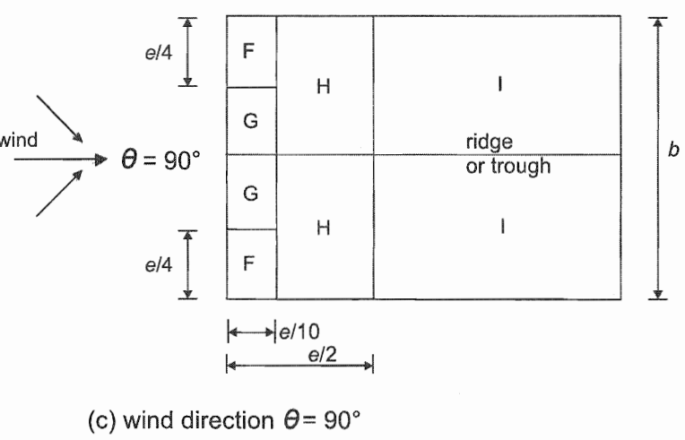

Slide 26
