Slide 1
ENGINEERING CALCULATIONS
Prof. Dr. Nursu TUNALIOĞLU ÖCALAN
Yildiz Technical University
Faculty of Civil Engineering
Department of Geomatic Engineering
Lecture Notes

Slide 2
SPHERICAL TRIGONOMETRY

Slide 3
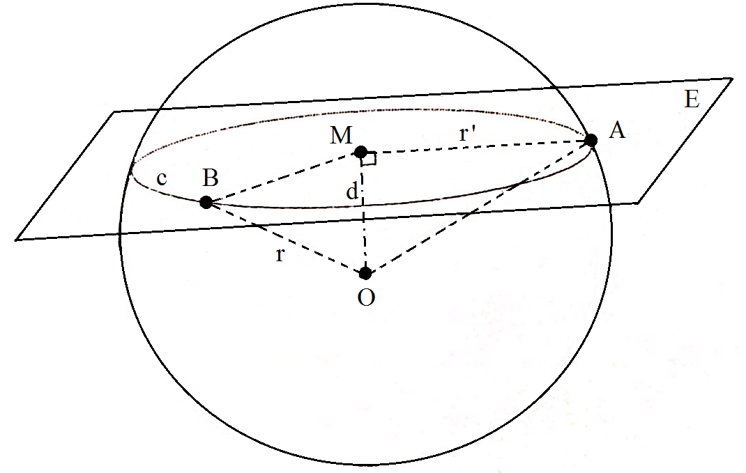
SPHERICAL TRIGONOMETRY/DEFINITIONS:
A sphere is a solid bounded by a surface every point of which is equally distant from a fixed point which is called the centre of the sphere. The straight line which joins any point of the surface with the centre is called a radius. A straight line drawn through the centre and terminated both ways by the surface is called a diameter.

Slide 4
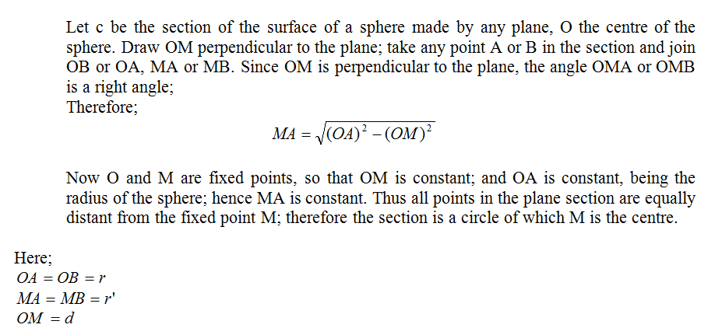
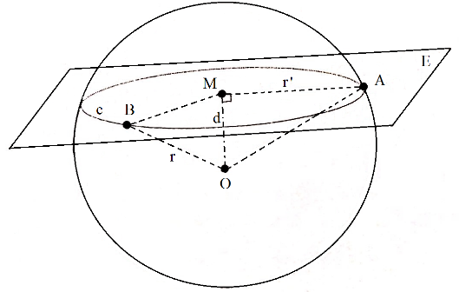
SPHERICAL TRIGONOMETRY/DEFINITIONS:
The section of the surface of a sphere made by any plane is a circle.

Slide 5
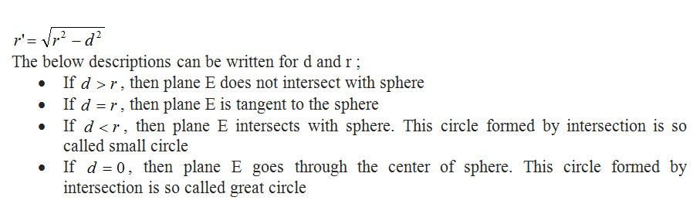
SPHERICAL TRIGONOMETRY/DEFINITIONS:

Slide 6
GREAT AND SMALL CIRCLES
The section of the surface of a sphere by a plane is called a great circle if the plane passes through the centre of the sphere, and a small circle if the plane does not pass through the centre of the sphere. Thus the radius of a great circle is equal to the radius of the sphere.
On the globe, equator circle and circles of longitudes are the examples of great circle and, circles of latitudes are the example of small circle.

Slide 7
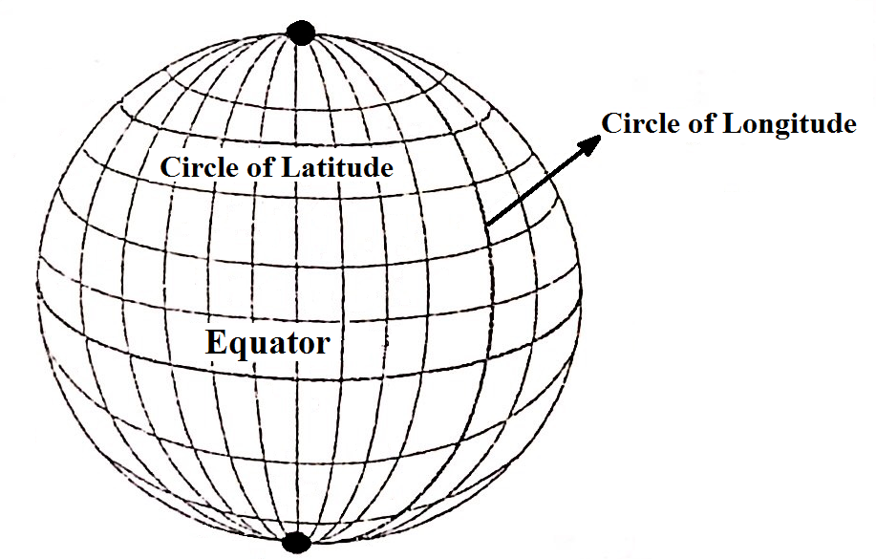
GREAT AND SMALL CIRCLES

Slide 8
Latitude: latitude lines are also known as parallels (since they are parallel to one another). The lines are actually full circles that extend around the earth and vary in length depending on where we are located. The biggest circle is at the equator and represents the earth's circumference. This line is also called a Great Circle. There can be infinitely many great circles, but only one that is a line of latitude (the equator). Any circle that is drawn and is smaller than earth's circumference is called a Small Circle.
Longitude: longitude lines are also known as meridians. The lines extend in a N-S direction, but are used to state locational positions either east or west of a set location. This location is known as the Prime Meridian. Each meridian is exactly half of a great circle. Meridians are not parallel - the spacing between them is the greatest at the equator (111.2 km) and decreases to zero at both poles. Meridians intersect the parallels at right angles.

Slide 9
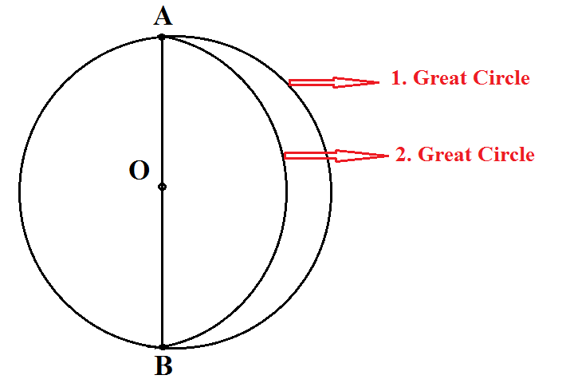
Properties of Great Circles:
A plane intersecting the globe along a great circle divides the globe into equal halves and passes through its center.

Slide 10
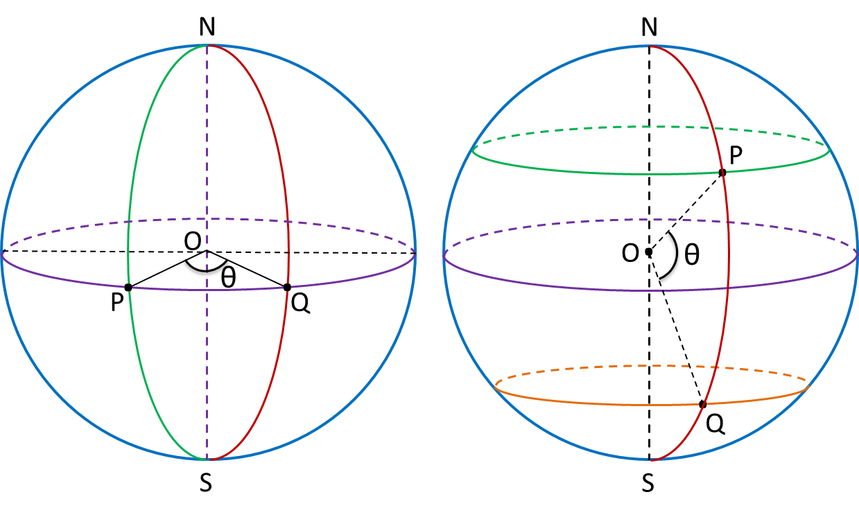
2. Through the centre of a sphere and any two points on the surface a plane can be drawn; and only one plane can be drawn, except when the two points are the extremities of a diameter of the sphere, and then an infinite number of such planes can be drawn. Hence only one great circle can be drawn through two given points on the surface of a sphere, except when the points are the extremities of a diameter of the sphere.

Slide 11
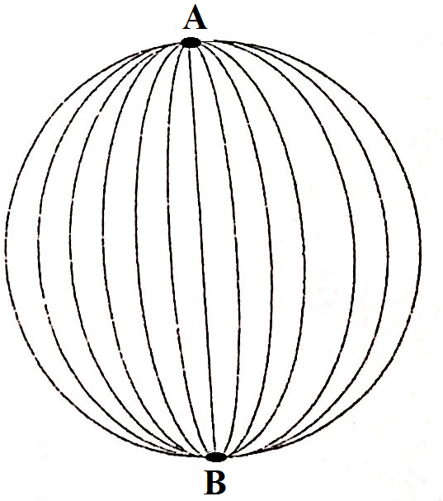
3. If these mentioned two given points are the end points of a diameter, then infinite number of great circle can be drawn.

Slide 12
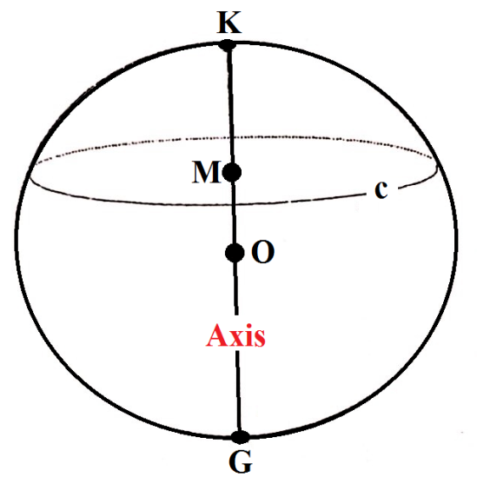
4. The great circle is an imagery line that follows the curve of the earth and represents the shortest distance between two points.
5. The axis of any circle of a sphere is that diameter of the sphere which is perpendicular to the plane of the circle; the extremities of the axis are called the poles of the circle.
The diameter of the circle namely KG is the axis of circle c, and K and G are the poles of this circle (c).

Slide 13
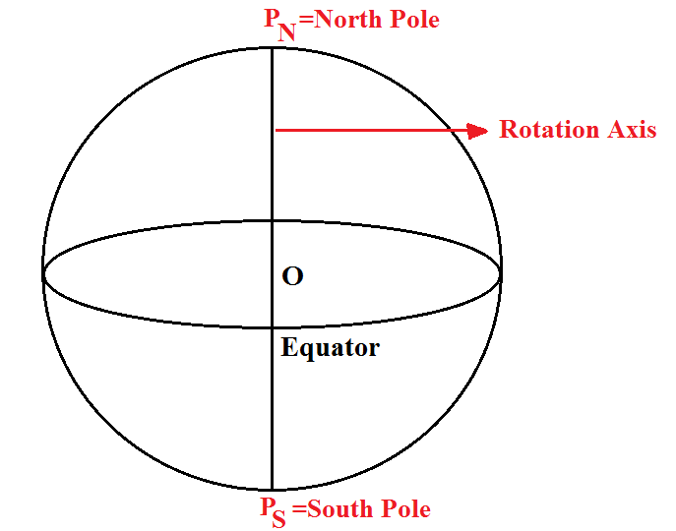
6. The axis of equator which is intersection to a plane passing through the center of the earth is called as rotation axis, which is perpendicular to this circle.
Extremities of the rotation axis on the globe are called as North Pole and South Pole.

Slide 14
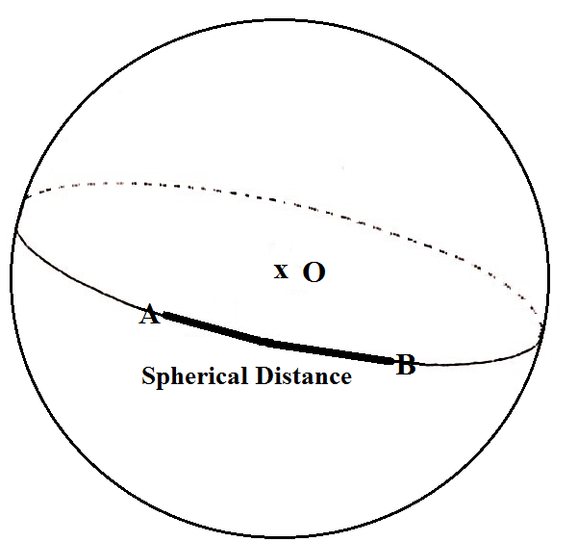
7. The distance between two points on the globe is measured by the arc of great circle passing through these two points. This arc is selected as no bigger than half of the great circle. The distance defined as mentioned above is called as spherical distance. At the below illustration, the bold line represents the spherical distance between A and B.

Slide 15
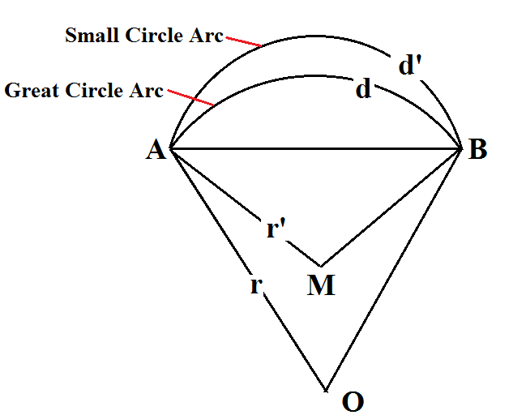
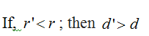
To show that the shortest distance between A and B is the great circle:
  Let O be the centre of the sphere, A and B be any two points on the sphere. Infinite number of plane can be drawn with A and B. the shortest distanced arc is the intersection of one of those planes and sphere. Thus, infinite number of sphere arc can be drawn with these two points. Since, if, the small circle is rounded on AB and the great circle is intersected with it, the below illustration is obtained.

Slide 16
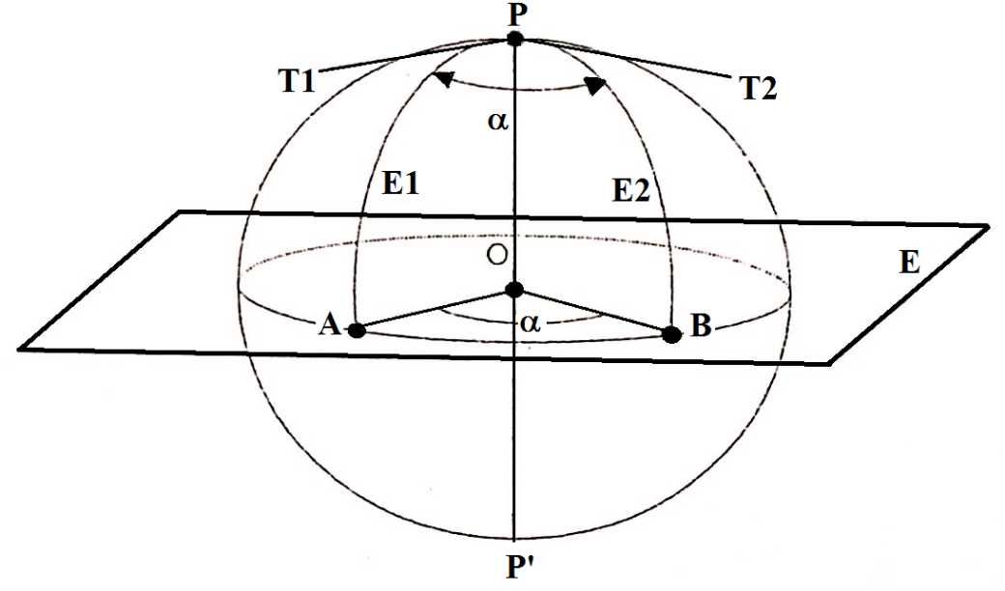
8. By the angle between two great circles is meant the angle of inclination of the planes of the circles. Thus, in the figure, the angle between the great circles PA and PB is the angle AOB.
Angle APB is equal to angle of inclination of planes E1 and E2. In other words, the angle between tangents of PT1 and PT2 is spherical angle. It can be measured by either angle or arc AB.

Slide 17
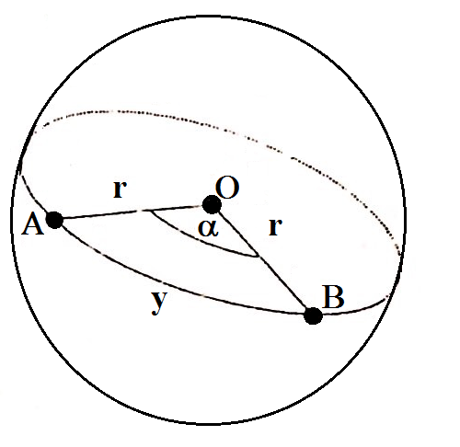
SPHERICAL DISTANCE
If two points on the sphere are connected with a great circle, this interval can be defined as either angle or distance. At the following figure, spherical distance y between A and B subtends to angle at the center of the sphere.

Slide 18
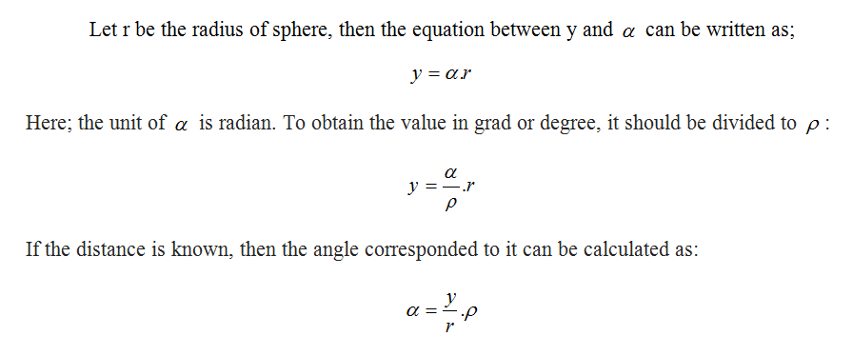
Spherical Distance:

Slide 19
The spherical distance is generally defined as angle unit. For instance; to compute the arc distance of 1’, let the radius be 6370000 m,
This value is so called as nautical mile/geographical mile.

Slide 20
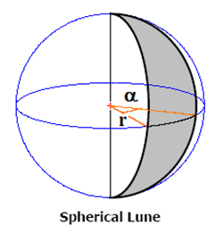
SPHERICAL SHAPES
1- Spherical Lune
Two great circles on the sphere divide the sphere into four pieces. Each piece is so called spherical lune. In other words, the spherical lune is the surface area of a sphere between two planes which intersect at the diameter. Moreover, these spherical lunes are equal to each other correspondingly.

Slide 21
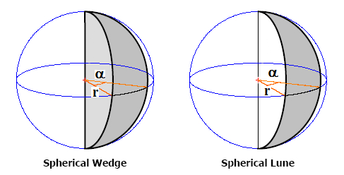
2- Spherical Wedge

Slide 22
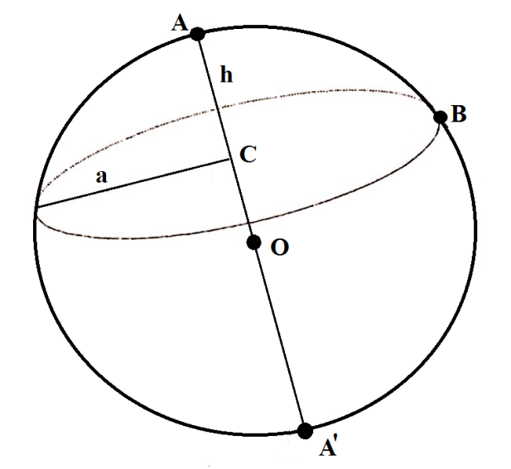
3- Spherical Cap
A spherical cap is the region of a sphere which lies above (or below) a given plane. If the plane passes through the center of the sphere, the cap is a called a hemisphere.

Slide 23
Let C be the center of the circle drawn by B; r be the radius of sphere, and AC=h, the area of the spherical cap surface is computed with the below equation.

Slide 24
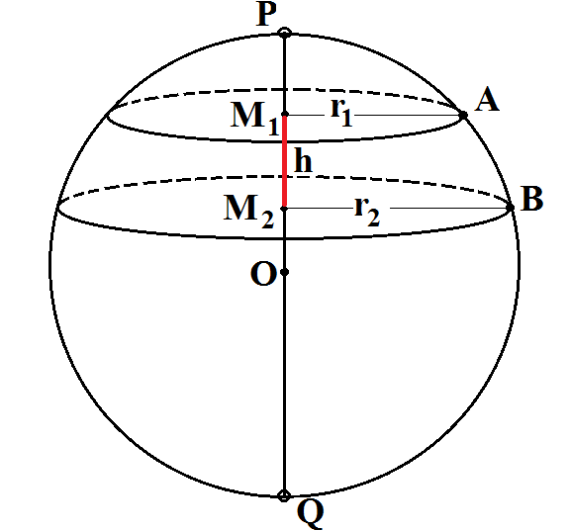
4- Spherical Segment
A spherical segment is the solid defined by cutting a sphere with a pair of parallel planes. It can be thought of as a spherical cap with the top truncated, and so it corresponds to a spherical frustum. The surface of the spherical segment (excluding the bases) is called a zone.

Slide 27
Examples
Please compute the spherical distance for the 1º angle at the center of the sphere (r=6370 km).
Please compute the circle distance for 1º angle at the 40º latitude.
Please compute the area of the spherical lune for the 1º angle.

Slide 28
Solution of Example 1

Slide 30
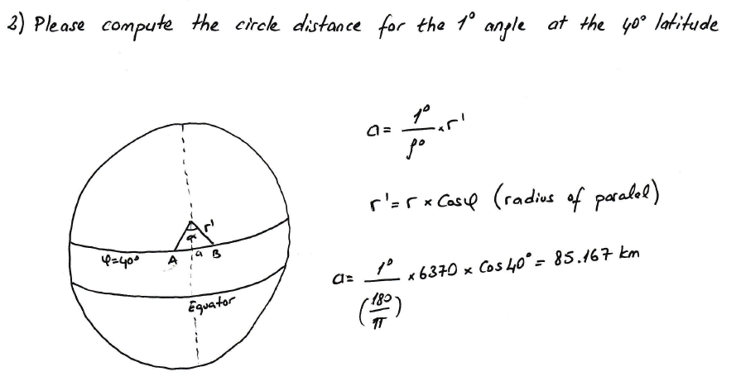
Solution of Example 2

Slide 31
Solution of Example 3

