Slide 1
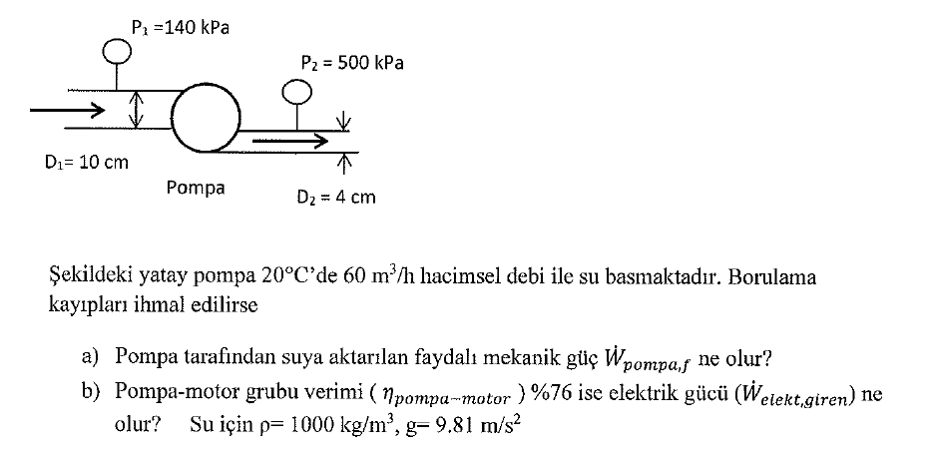

S1

Slide 3
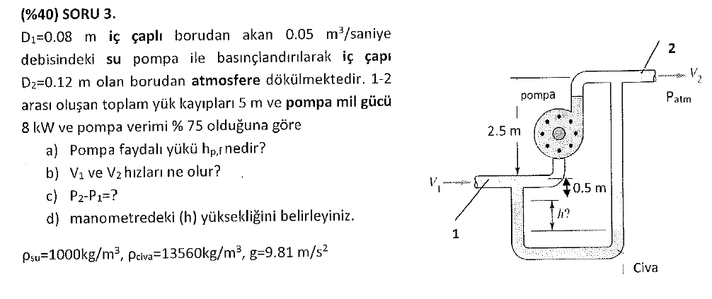
S2

Slide 4
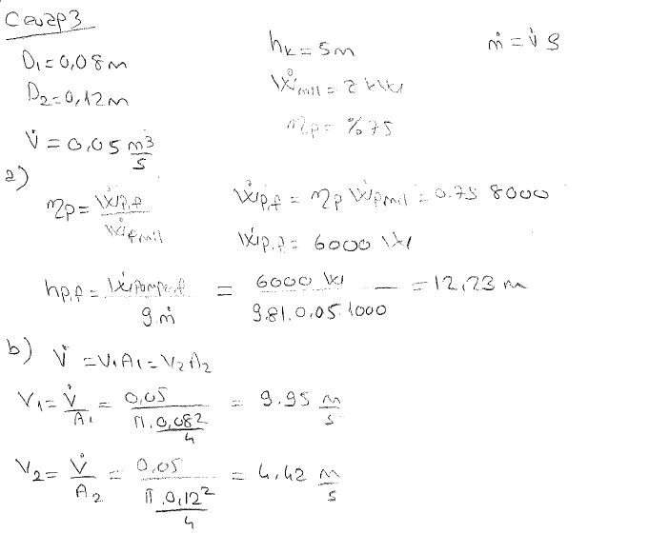

Slide 5
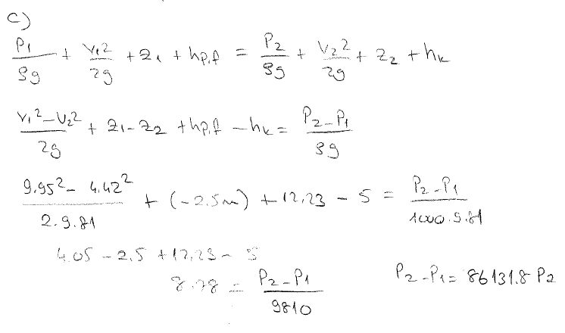
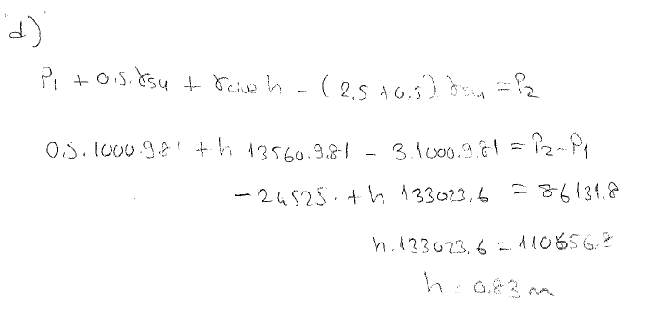

Slide 6
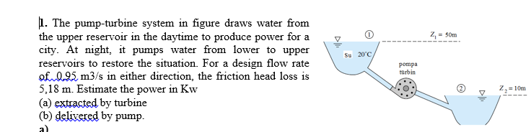
S4

Slide 7
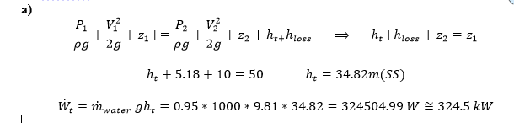
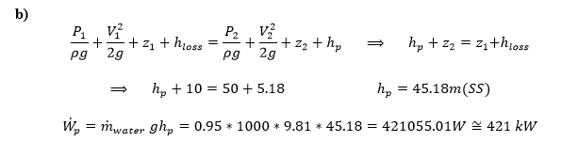

Slide 8
S5-Water (assumed inviscid and incompressible) flows steadily in the vertical variable area pipe shown in figure. Determine the flowrate if the pressure in each of the gages reads 50 Kpa.

Slide 9
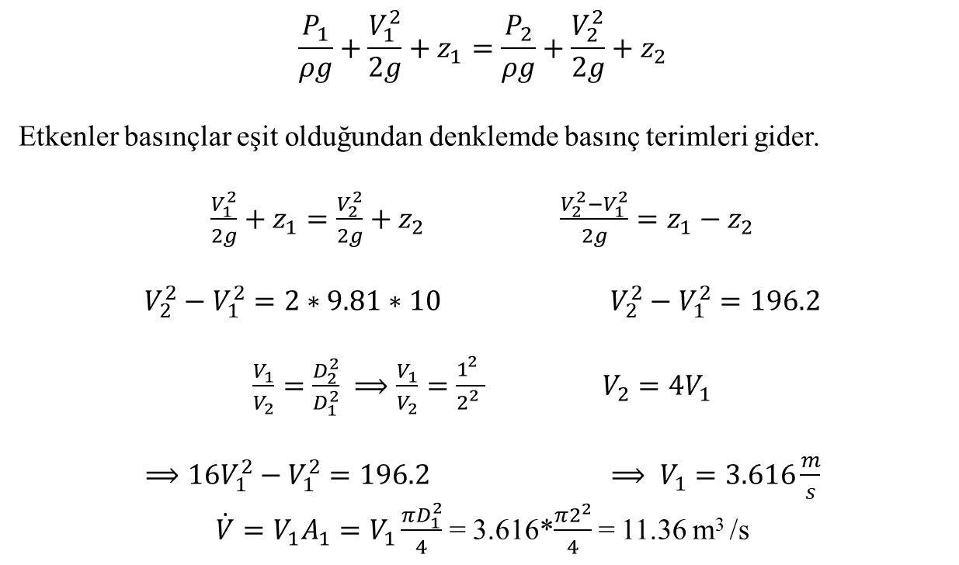
$$\frac{P_{1}}{ρg}+\frac{V_{1}^{2}}{2g}+z_{1}=\frac{P_{2}}{ρg}+\frac{V_{2}^{2}}{2g}+z_{2}$$
Etkenler basınçlar eşit olduğundan denklemde basınç terimleri gider.
$\frac{V_{1}^{2}}{2g}+z_{1}=\frac{V_{2}^{2}}{2g}+z_{2}$ $\frac{V_{2}^{2}−V_{1}^{2}}{2g}=z_{1}−z_{2}$
$V_{2}^{2}−V_{1}^{2}=2∗9.81∗10$ $V_{2}^{2}−V_{1}^{2}=196.2$
$\frac{V_{1}}{V_{2}}=\frac{D_{2}^{2}}{D_{1}^{2}} ⟹\frac{V_{1}}{V_{2}}=\frac{1_{}^{2}}{2_{}^{2}}$ ${V_{2}=4V}_{1}$
$⟹16V_{1}^{2}−V_{1}^{2}=196.2$ $⟹ V_{1}=3.616\frac{m}{s}$
$\dot{V}=V_{1}A_{1}=V_{1}\frac{πD_{1}^{2}}{4}$= 3.616*$\frac{π2^{2}}{4}$= 11.36 m³ /s

Slide 10
S6- When the pump in draws 220 m³/h of water at 20°C from the reservoir, the total friction head loss is 5 m. The flow discharges through a nozzle to the atmosphere. Estimate the pump power in kW delivered to the water.

Slide 11
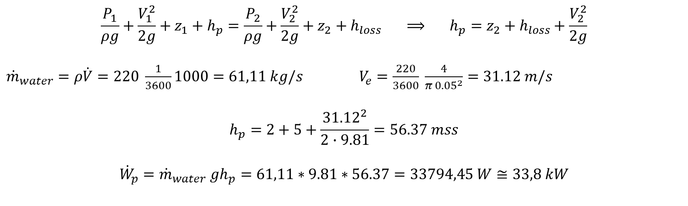
$$\frac{P_{1}}{ρg}+\frac{V_{1}^{2}}{2g}+z_{1}+h_{p}=\frac{P_{2}}{ρg}+\frac{V_{2}^{2}}{2g}+z_{2}+h_{loss} ⟹ h_{p}=z_{2}+h_{loss}+\frac{V_{2}^{2}}{2g}$$
${\dot{m}}_{water}=ρ\dot{V}=220 \frac{1}{3600}1000=61,11 kg/s$ $V_{e}=\frac{220}{3600} \frac{4}{π {0.05}^{2}}=31.12 m/s$
$$h_{p}=2+5+\frac{{31.12}^{2}}{2∙9.81}=56.37 mss$$
$${\dot{W}}_{p}={\dot{m}}_{water} gh_{p}=61,11∗9.81∗56.37=33794,45 W≅33,8 kW$$

Slide 12
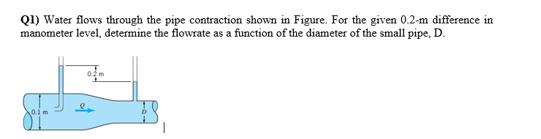
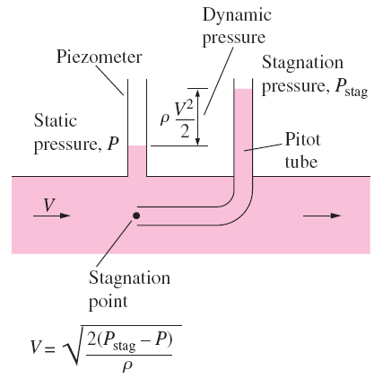
S5
A piezometer and a Pitot tube are tapped into a horizontal water pipe to measure static and stagnation (static + dynamic) pressures.

Slide 13
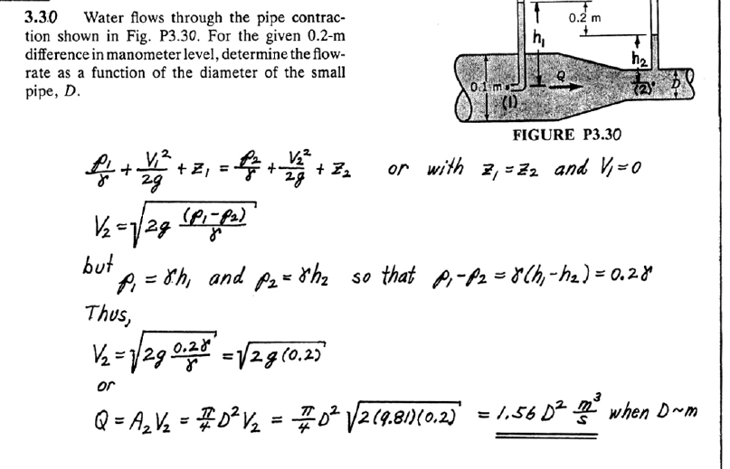

Slide 14
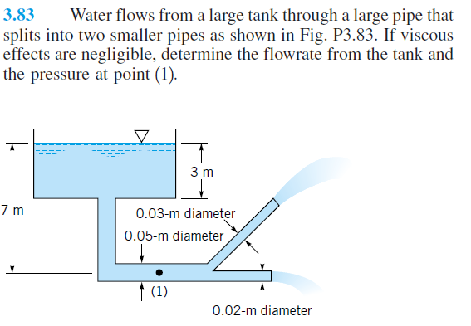
S3

Slide 15
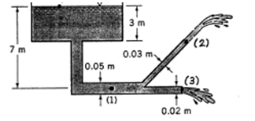
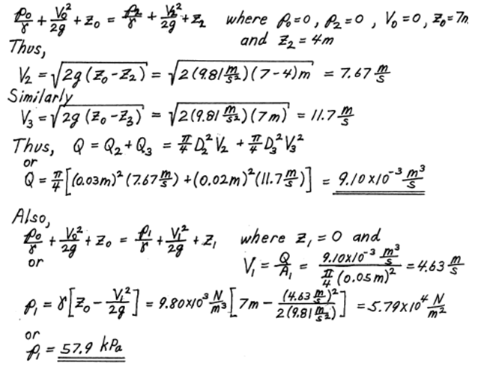

Slide 16
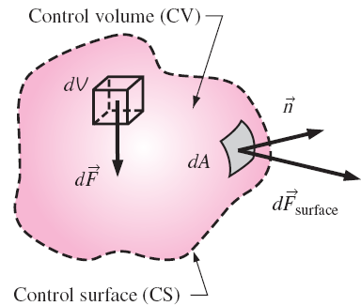
6–3 FORCES ACTING ON A CONTROL VOLUME
The forces acting on a control volume consist of
Body forces that act throughout the entire body of the control volume (such as gravity, electric, and magnetic forces) and
Surface forces that act on the control surface (such as pressure and viscous forces and reaction forces at points of contact).
Only external forces are considered in the analysis.

Slide 17


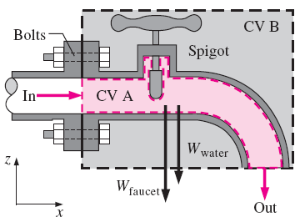
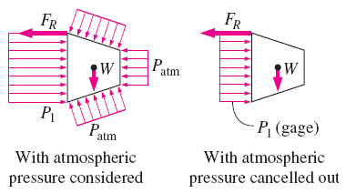
6–3 FORCES ACTING ON A CONTROL VOLUME
Atmospheric pressure acts in all directions, and thus it can be ignored when performing force balances since its effect cancels out in every direction.
Cross section through a faucet assembly, illustrating the importance of choosing a control volume wisely; CV B is much easier to work with than CV A.

Slide 18



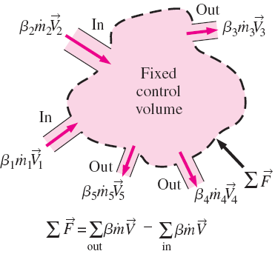
Momentum-Flux Correction Factor, β
Steady Flow

Slide 19
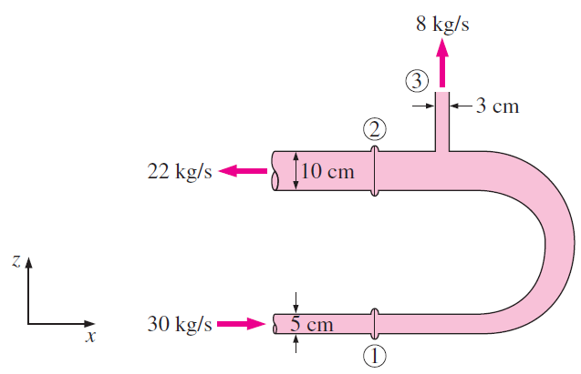
EXAMPLE 6–46
Water is flowing into and discharging from a pipe Usection as shown in Fig. P6–58. At flange (1), the total absolute pressure is 200 kPa, and 30 kg/s flows into the pipe. At flange (2), the total pressure is 150 kPa. At location (3), 8 kg/s of water discharges to the atmosphere, which is at 100 kPa. Determine the total x- and z-forces at the two flanges connecting the pipe. Discuss the significance of gravity force for this problem. Take the momentum-flux correction factor to be 1.03.
Assumptions 1 The flow is steady and incompressible. 2 The weight of the U-turn and the water in it is negligible. 4 The momentum-flux correction factor for each inlet and outlet is given to be β = 1.03.
Properties We take the density of water to be 1000 kg/m³.
Analysis The flow velocities of the 3 streams are

Slide 20
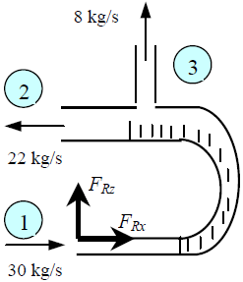
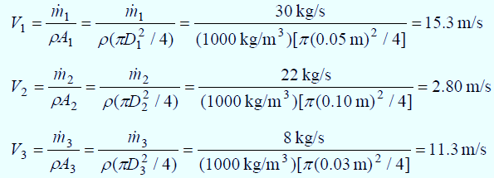
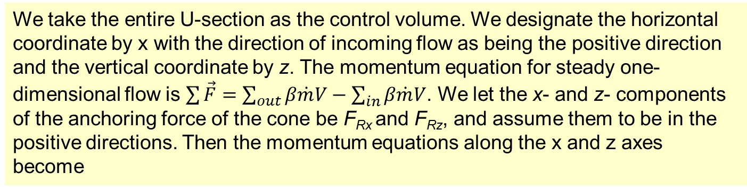
Substituting the given values,

Slide 21
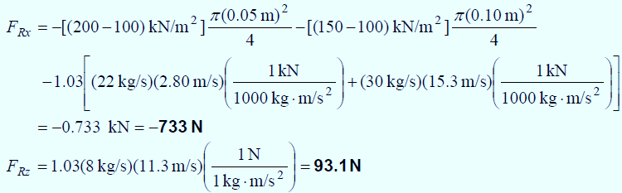
The negative value for F_{Rx} indicates the assumed direction is wrong, and should be reversed. Therefore, a force of 733 N acts on the flanges in the opposite direction. A vertical force of 93.1 N acts on the flange in the vertical direction.
Discussion To assess the significance of gravity forces, we estimate the weight of the weight of water in the U-turn and compare it to the vertical force. Assuming the length of the U-turn to be 0.5 m and the average diameter to be 7.5 cm, the mass of the water becomes
whose weight is 2.2×9.81 = 22 N, which is much less than 93.1, but still significant. Therefore, disregarding the gravitational effects is a reasonable assumption if great accuracy is not required.

Slide 22
A curved nozzle assembly that discharges to the atmosphere is shown in Fig. . The nozzle mass is 4.5 kg and its internal volume is 0.002 m³. The fluid is water (ρ = 999 kg/m3). Determine (a) the velocity V₂ at the nozzle exit and (b) the vertical component of the reaction force, Fy, exerted by the nozzle on the coupling to the inlet pipe.

Slide 23
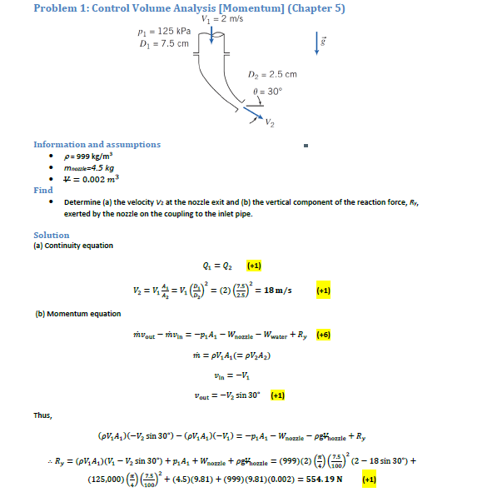

Slide 24
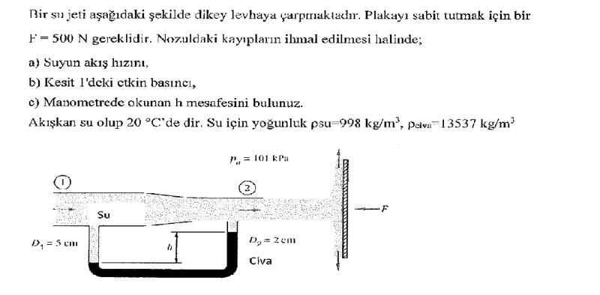

Slide 25
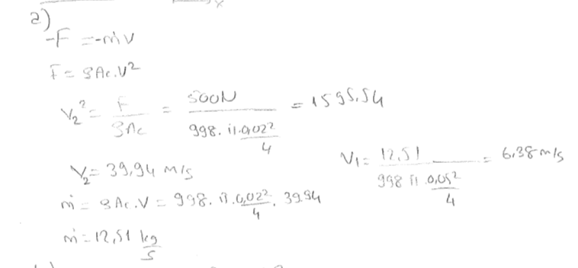
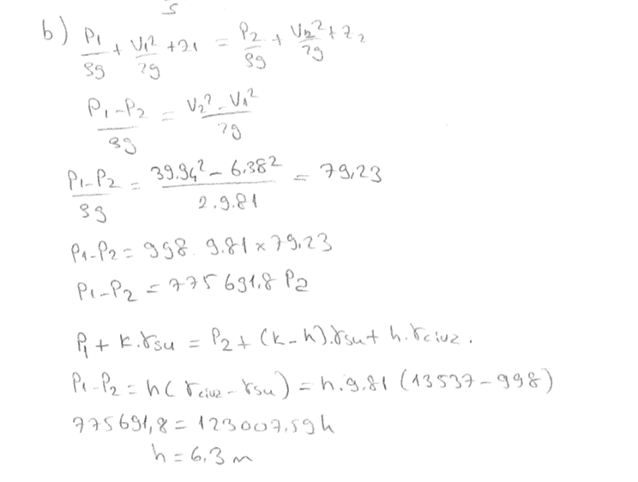


Slide 26
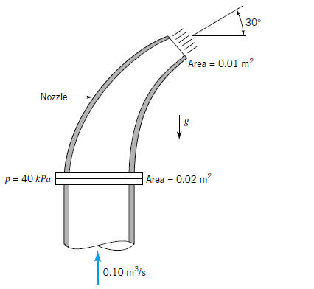
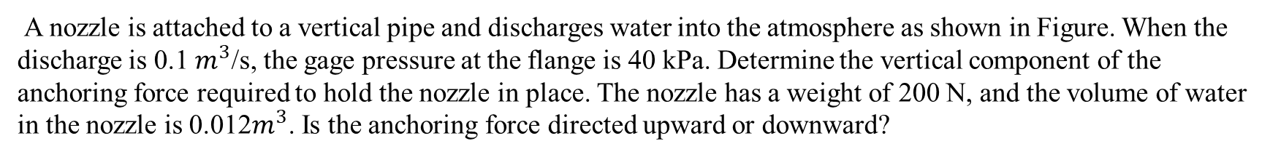
A nozzle is attached to a vertical pipe and discharges water into the atmosphere as shown in Figure. When the discharge is 0.1 $m^{3}$/s, the gage pressure at the flange is 40 kPa. Determine the vertical component of the anchoring force required to hold the nozzle in place. The nozzle has a weight of 200 N, and the volume of water in the nozzle is 0.012$m^{3}$. Is the anchoring force directed upward or downward?

Slide 27
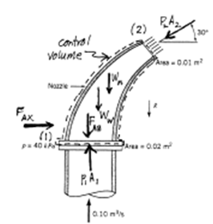
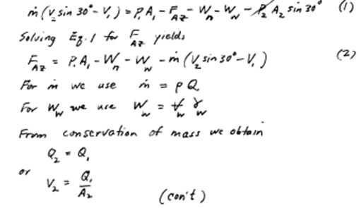
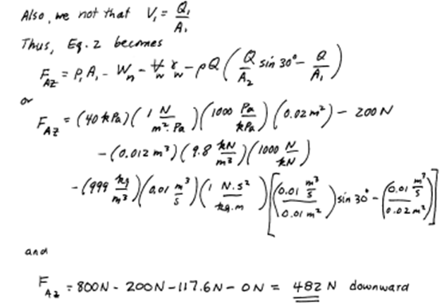

Slide 28
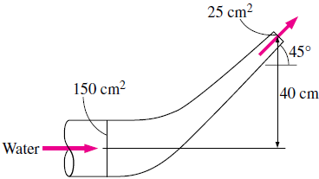
EXAMPLE 6–24
A reducing elbow is used to deflect water flow at a rate of 30 kg/s in a horizontal pipe upward by an angle θ = 45° from the flow direction while accelerating it. The elbow discharges water into the atmosphere. The cross-sectional area of the elbow is 150 cm² at the inlet and 25 cm² at the exit. The elevation difference between the centers of the exit and the inlet is 40 cm. The mass of the elbow and the water in it is 50 kg. Determine the anchoring force needed to hold the elbow in place. Take the momentum-flux correction factor to be 1.03.
Assumptions 1 The flow is steady, frictionless, one-dimensional, incompressible, and irrotational (so that the Bernoulli equation is applicable). 2 The weight of the elbow and the water in it is considered. 3 The water is discharged to the atmosphere, and thus the gage pressure at the outlet is zero. 4 The momentum-flux correction factor for each inlet and outlet is given to be β = 1.03.
Properties We take the density of water to be 1000 kg/m³.
Analysis The weight of the elbow and the water in it is

Slide 29
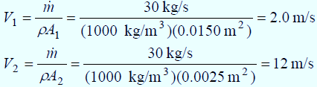
We take the elbow as the control volume, and designate the entrance by 1 and the outlet by 2. We also designate the horizontal coordinate by x (with the direction of flow as being the positive direction) and the vertical coordinate by z. The continuity equation for this one-inlet one-outlet steady flow system is ṁ₁ = ṁ₂ = ṁ = 30 kg/s. Noting that ṁ = ρAV, the inlet and outlet velocities of water are
Taking the center of the inlet cross section as the reference level (z₁ = 0) and noting that P₂ = P_{atm}, the Bernoulli equation for a streamline going through the center of the reducing elbow is expressed as
Substituting,

Slide 30
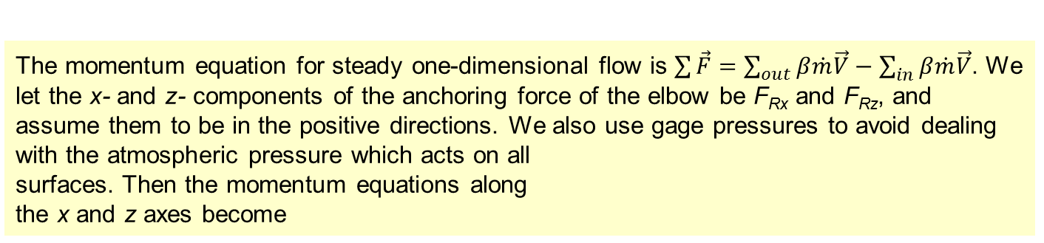
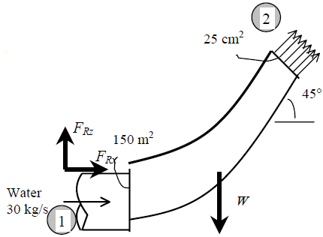
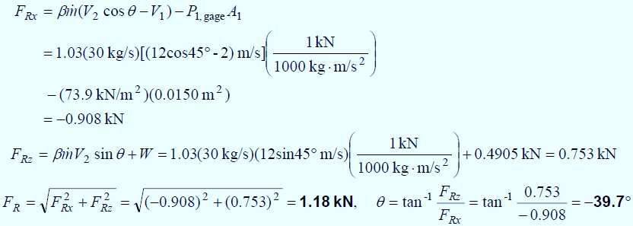
Solving for F_{Rx} and F_{Rz}, and substituting the given values,
Discussion Note that the magnitude of the anchoring force is 1.18 kN, and its line of action makes –39.7° from +x direction. Negative value for F_{Rx} indicates the assumed direction is wrong.

