Slide 1
Political Ideologies
End of Ideologies in a global age?

Slide 2
Endism
Daniel Bell
Francis Fukuyama – End of History thesis
Samuel Huntington – Clash of Civilizations thesis
Theories on scientism and rationality
The end of left-right divide

Slide 4
Globalization
Interconnectedness
Global village
Flows – of what?
1990s – technological changes in communication and transportation

Slide 5
What about boundaries? Are they disappearing?
What about states? Crisis of the nation-state as a result of supranational organizations and/or micronationalisms?
What about the problem solving capacity of the states?
Are these flows (of capital, humans, ideas, goods, fashion, crime etc.) neutral?

Slide 6
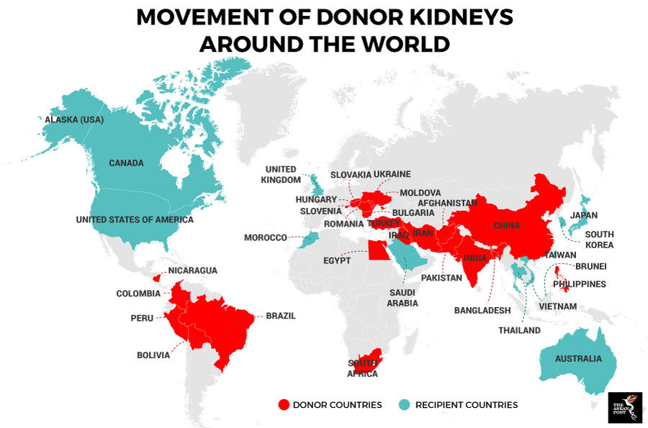
Are these flows neutral?

Slide 7
Economic realm of globalization
Political realm
Cultural realm
https://setenayd.wordpress.com/gorsel/toplumsal-yapilar/kuresellesme/
Next week: Globalization and Ideologies I
Chapter 1, Globalization, p. 21
Chapter 2, Liberalism in a Global Age, p. 59-63.
Chapter 3, New Right, p. 86-93.
Chapter 4, Socialism in a Global Age, p. 136-138.

