Slide 1
Politics and Social Movements in the 20th century
Setenay Nil Doğan
WWI & Bolshevik Revolution

Slide 2
SELLING THE GREAT WAR – advertising
MOBILIZING THE HOME FRONT
The centrality of women's work to the waging of a new kind of war in the twentieth century. The battlefront had to be backed up by a home front-the term used for the first time in the Great War- of working men, women, and even children.
Justice, national glory --- personal sacrifice
Selling the Great War required selectively communicating information and inspiring belief and a commitment to total victory, no matter how high the cost.

Slide 3
Expectations: “a quick and decisive war” in which the fittest and most advanced nation would win. The hope was that war, when it came, would be "over by Christmas.”
“a war to end all wars”
The glory was the promise of ultimate victory in the "crusade for civilization" that each nation's leaders held out to their people. -- When war did come in 1914, it was a choice, not an accident.

Slide 4
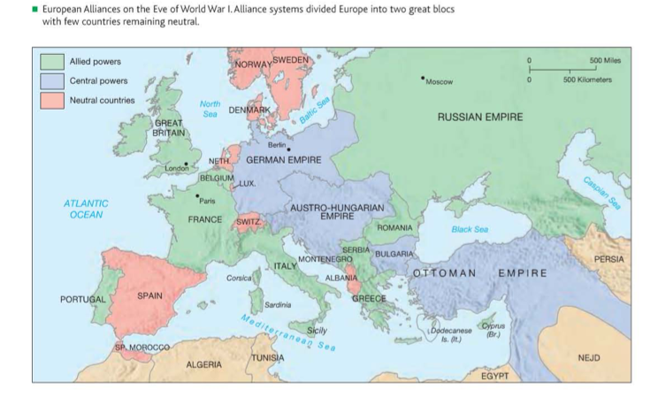

Slide 5
History’s first total war – a war of people’s, not only armies
A war economy – government controls
Great Britain-- there the number of women workers jumped from 250,000 at the beginning of the war to five million by the war's end.
Work stoppages and strikes in 1916
Silencing of dissent-- criticism of the government became treason. Censorship was enforced and propaganda became more virulent. + Every warring nation sought to promote dissension from within the societies of its enemies.

Slide 6
Two events proved decisive in 1917 in determining the course of the war: the collapse of the Russian army and the entry of the United States into the war.

Slide 7
RESULTS
World peace and its protection – League of Nations --- United Nations after the WWII
Failure of empires, birth of new nation-states and new national identities
Peace treaties – diplomatic failure in terms of establishing peace

Slide 8
Bolshevik Revolution
Tsar Nicholas 11 (1894- 1917), presided over an empire in the process of modernization with widening social divisions in 1914.
Still a peasant population, 80%
With the revolution of March 1917 – a political duality emerged. Provincial government + the Soviets (committees or councils elected by workers and soldiers and supported by radical lawyers, journalists, and intellectuals in favor of socialist self- rule)
Bolsheviks – peace, bread and land
The more moderate Mensheviks ( the term means "minority") wanted to work through parliamentary institutions and were willing to cooperate with the Provisional Government. A smaller faction- despite its name- calling themselves Bolsheviks (meaning "majority") dedicated themselves to preparation for revolutionary upheaval.

Slide 9
The leader of the Bolsheviks was Vladimir llyich Ulyanov (I870-1924 ), Lenin.
The war must be ended immediately, he argued, because it represented an imperialist struggle that was benefiting capitalists.
November 1917 (October Revolution)
Execution of the tsar and his family
Russia signed a separate peace with the Germans in March 1918 in the Treaty of Brest-Litovsk.
A socialist revolution – a Bolshevik regime
Civil war

Slide 11
Crisis element.
Armament of the revolution
Propaganda – barracks
“To the east, Russia was engaged in the vast experiment of building a new society. In the west, the absence of war was not peace.”

