Slide 1
Politics and Social Movements in the 20th century
Week 14: Multiparty Era III
Erik Zürcher, “The Coup and its Aftermath,” “Suppression of Terrorism and -of Dissent,” p. 283-290, “The Islamists Take Control,” p. 319- 327.
For the announcement on the midterm, please check https://avesis.yildiz.edu.tr/sdogan/dokumanlar

Slide 2
September 12, 1980
YÖK
Turkish-Islamic synthesis in education
Supression of political parties and groups, civil society organizations, trade unions etc.
Election threshold – 10%
The new rising star of Turkish politics: Kenan Evren as the president and Özal (government of engineers, princes “Özal’ın prensleri”, papatyalar)
Liberalization. Turkey’s integration to global capitalism.
1983 – elections – Motherland party
1982- new constitution

Slide 3
Motherland party + Party of True Path + Nationalist Action Party + Welfare Party….
Social democrats with several parties (DSP with Ecevit, SHP with Erdal İnönü)
1994 local elections
1990s – coalitions between parties (Çiller, Yılmaz, Bahçeli…)
1995- Welfare party coalition with PTP
28 february decisions – 1997 – Kemalist restoration

Slide 4
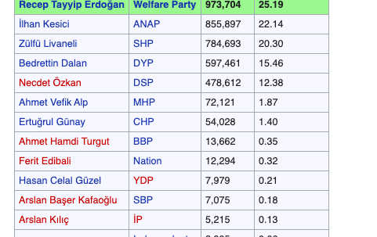
1994 elections- Istanbul

Slide 5
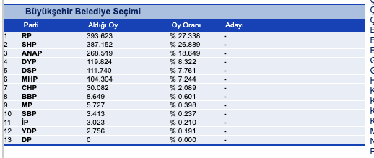

Slide 6
August 17, 1999 – the official death toll was 15,000.
The very visible failure of the state organs in the aftermath of the earthquake angered the population and brought forth an avalanche of criticism in the media. Uniquely for Turkey, the army was not exempt from the public’s anger.
On 16 January 1998 the constitutional court banned the WP and Erbakan personally was banned from politics for five years, a sentence later increased to a life ban.
22 June 2001, the constitutional court indeed banned the Virtue Party.
14 August 2001. Abdullah Gül and Tayyip Erdoğan to form the Justice and Development Party (Adalet ve Kalkınma Partisi or AKP). The Islamists went under a new name yet again, this time that of Party of Happiness (Saadet Partisi).
General elections of 2002: JDP got 34,3 of the votes – 66%of the parliament. RPP got 19.39% of the votes with 178 seats in the parliament.
46.33% of the votes in the election of 2002 has not been represented n the Turkish grand National Assembly.

Slide 7
Next Week:
Globalization (Reading to be announced on my avesis page)

