Slide 1
Social and Political Movements
Pacifism +
Globalization and Social Movements (Week 14)

Slide 2
Pacifism
19th century –
Some of these ideas later realized in the Court of Arbitration in The Hague, the League of Nations, the UN, and temporary disarmament conferences
National pacifism – personal pacifism
conscientious objection
different approaches to antiwar activism
the Women’s International League for Peace and Freedom (WILPF) – 1915 – Jane Addams

Slide 4
Globalization
Interconnectedness
Global village
Flows – of what?
1990s – technological changes in communication and transportation
Economic, cultural and political realms of globalization
Are these flows (of capital, humans, ideas etc.) neutral?

Slide 5
Are these flows neutral?

Slide 6
Economic realm of globalization
Transnational companies
Post-fordism based on flexible forms of production and employment
Neoliberal policies such as gentrification, privatization, urban transformations etc.
Increasing inequalities in the distribution of wealth (next slide) (please explore the interactive webpage wid.world )

Slide 8
https://www.gazeteduvar.com.tr/forum/2019/11/19/insaata-dayali-buyume-modeli-ve-servet-dagilimi-adaletsizligi/

Slide 9
Political realm of globalization
- Nationalism in a global age
The crisis of the nation-state, the capacity of the nation-states diminished? Cosmopolitanism superceding nationalism? a shift from nationalism to multiculturalism? A world composed of transnational communities?
YET --- a revival, rather than a decline, of nationalism. Since the 1990s rise of ethnonationalism, even instances of ethnic cleansing
What about boundaries? Are they disappearing?
What about states? Crisis of the nation-state as a result of supranational organizations and/or micronationalisms?
What about the problem solving capacity of the states?

Slide 10
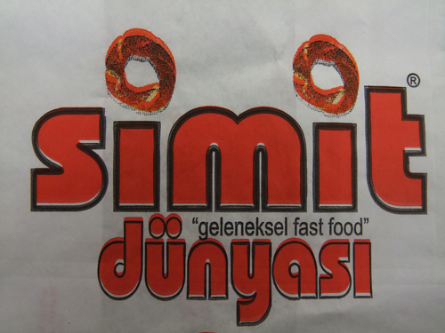
Cultural realm of globalization
McDonaldization or Glocalization / hybridity?
Think global, act local?
https://setenayd.wordpress.com/gorsel/toplumsal-yapilar/kuresellesme/

Slide 11
neoanarchists of the globalization movements
“What can we do? We can hone our memory, we can learn from our history. We can continue to build public opinion until it becomes a deafening roar. We can turn the war on Iraq into a fishbowl of the US government’s excesses. We can expose George Bush and Tony Blair–and their allies–for the cowardly baby killers, water poisoners and pusillanimous long-distance bombers that they are. We can reinvent civil disobedience in a million different ways. In other words, we can come up with a million ways of becoming a collective pain in the ass. When George Bush says “Either you are with us, or you are with the terrorists,” we can say “No thank you.” We can let him know that the people of the world do not need to choose between a Malevolent Mickey Mouse and the Mad Mullahs. Our strategy should be not only to confront empire but to lay siege to it. To deprive it of oxygen. To shame it. To mock it. With our art, our music, our literature, our stubbornness, our joy, our brilliance, our sheer relentlessness–and our ability to tell our own stories. Stories that are different from the ones we’re being brainwashed to believe. The corporate revolution will collapse if we refuse to buy what they are selling–their ideas, their version of history, their wars, their weapons, their notion of inevitability. Remember this: We be many and they be few. They need us more than we need them.”
Arundhati Roy, Confronting Empire, World Social Forum, 2003
https://www.thenation.com/article/archive/confronting-empire/

Slide 12
James Sloam (2014) ‘The outraged young’: young Europeans, civic engagement and the new media in a time of crisis
youth activism as a major feature of the European political landscape: from mass demonstrations of the ‘outraged young’ against political corruption and youth unemployment, to the Occupy movement against the excesses of global capitalism, to the emergence of new political parties.
A crisis in citizenship or ‘digitally networked action’ has enabled a ‘quickening’ of youth participation – an intensification of political participation
“Three common features of the M15M, the M12M, the 5SM and the Piratenpartei are their prominent use of the Internet and new media, their attractive- ness to highly educated young people and their issue-based (rather than programmatic) appeal.”

