Slide 1
Politics and Social Movements in the 20th century
Globalization
(Please check my avesis page for this week’s reading)

Slide 2
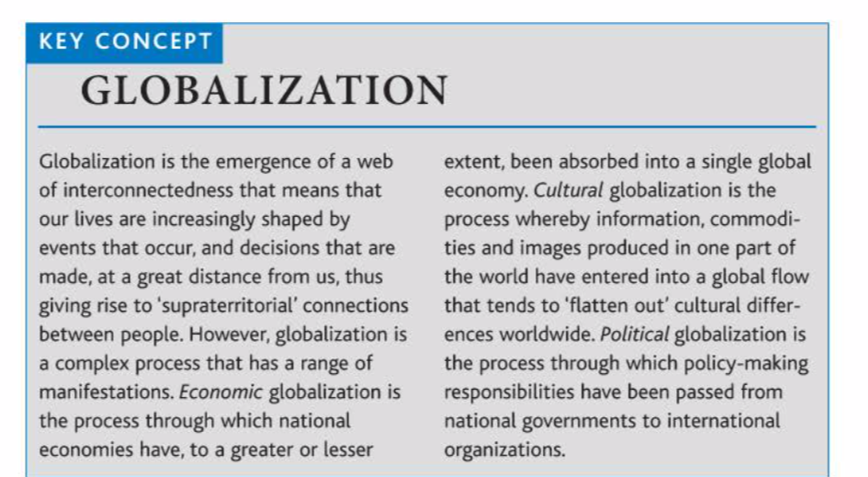

Slide 3
Globalization
Interconnectedness
Global village
Flows – of what?
1990s – technological changes in communication and transportation
What about boundaries? Are they disappearing?
What about states? Crisis of the nation-state as a result of supranational organizations and/or micronationalisms?
What about the problem solving capacity of the states?
Are these flows (of capital, humans, ideas etc.) neutral?

Slide 4
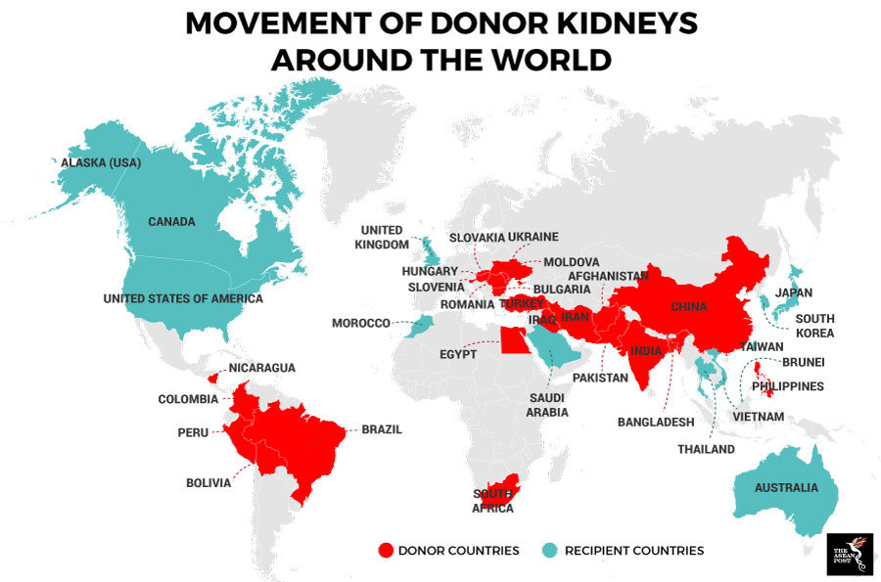
Are these flows neutral?

Slide 5
Economic realm of globalization
Political realm
Cultural realm
https://setenayd.wordpress.com/gorsel/toplumsal-yapilar/kuresellesme/

Slide 6
Nationalism in a global age
The crisis of the nation-state, the capacity of the nation-states diminished? Cosmopolitanism superceding nationalism? a shift from nationalism to multiculturalism? A world composed of transnational communities?
A revival, rather than a decline, of nationalism
Since the 1990s rise of ethnonationalism, even instances of ethnic cleansing

Slide 7
neoanarchists of the globalization movements
“What can we do? We can hone our memory, we can learn from our history. We can continue to build public opinion until it becomes a deafening roar. We can turn the war on Iraq into a fishbowl of the US government’s excesses. We can expose George Bush and Tony Blair–and their allies–for the cowardly baby killers, water poisoners and pusillanimous long-distance bombers that they are. We can reinvent civil disobedience in a million different ways. In other words, we can come up with a million ways of becoming a collective pain in the ass. When George Bush says “Either you are with us, or you are with the terrorists,” we can say “No thank you.” We can let him know that the people of the world do not need to choose between a Malevolent Mickey Mouse and the Mad Mullahs. Our strategy should be not only to confront empire but to lay siege to it. To deprive it of oxygen. To shame it. To mock it. With our art, our music, our literature, our stubbornness, our joy, our brilliance, our sheer relentlessness–and our ability to tell our own stories. Stories that are different from the ones we’re being brainwashed to believe. The corporate revolution will collapse if we refuse to buy what they are selling–their ideas, their version of history, their wars, their weapons, their notion of inevitability. Remember this: We be many and they be few. They need us more than we need them.”
Arundhati Roy, Confronting Empire, World Social Forum, 2003
https://www.thenation.com/article/archive/confronting-empire/

