Slide 1
Political Ideologies
Chapter 1, Globalization, p. 21
Chapter 2, Liberalism in a Global Age, p. 59-63.
Chapter 3, New Right, p. 86-93.
Chapter 4, Socialism in a Global Age, p. 136-138.
FOR announcements about the midterm, please check https://avesis.yildiz.edu.tr/sdogan/dokumanlar

Slide 2
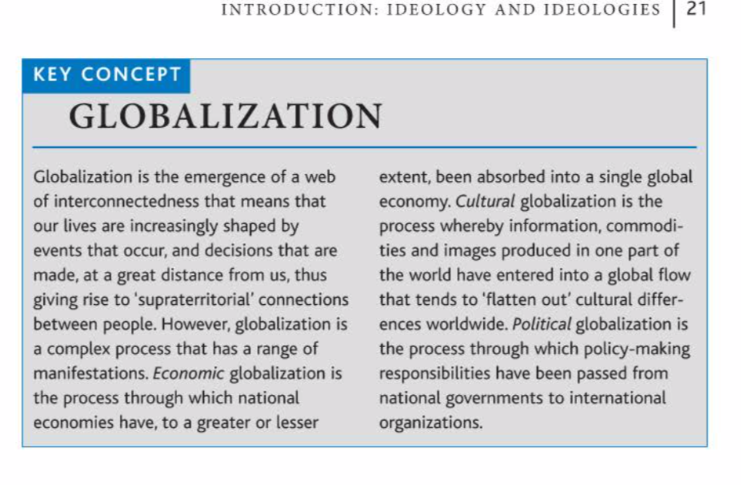

Slide 3
Globalization
Political dimension -
Cultural dimension -
Economic dimension –
Future of Liberalism – liberal democracy?
neoliberal globalization
so a kind of liberal triumphalism
BUT
what about the inequalities of globalization?

Slide 4
The New Right
the new right is a marriage between two apparently contrasting ideological traditions:
The first of these is classical liberal economics, particularly the free -market theories of Adam Smith, which were revived in the second half of the twentieth century as a critique of 'big' government and economic and social intervention. This is called the liberal new right, or neoliberalism.
The second element in the new right is traditional conservative social theory, especially its defence of order, authority and discipline. This is called the conservative new right, or neoconservatism.
The liberal new right is not only anti-statist on grounds of economic efficiency and responsiveness, but also because of its political principles, notably its commitment to individual liberty. The new right claims to be defending freedom against 'creeping collectivism.’
Anti-welfare: because, they argue, 1. welfare creates a culture of dependency
The conservative new right, or neoconservatism, emerged in the USA in the 1970s as a backlash against the ideas and values of the 1960s. It ,.vas defined by a fear of social fragn1entation or breakdown which was seen as a product of liberal reform and permissiveness.
Family, church, company
Calls for a strengthening of social disciplines and authority at every level

Slide 5
Future of Socialism
In the case of social democracy, 'accelerated' globalization undermined its economic viability in a variety of ways.
Hopes for the survival of socialism largely rest on the enduring, and perhaps intrinsic, imperfections of the capitalist system.
Thinking about the inherent inequalities and injustices of global capitalism has been one of the key influences on the anti-globalization, or 'anti-capitalist’ movement that emerged during the 1990s. In these ways, socialism in the twenty-first century may be reborn as global anti-capitalism.

Slide 6
Week 14: Globalization and Ideologies II
Chapter 5, Anarchism in a Global Age, p. 164-166.
Chapter 6, Nationalism in a Global Age, p. 194-197.
Chapter 7, Fascism in a Global Age, p. 222-224.

Slide 7
Anarchism in a global age – neoanarchists of the globalization movements
“What can we do? We can hone our memory, we can learn from our history. We can continue to build public opinion until it becomes a deafening roar. We can turn the war on Iraq into a fishbowl of the US government’s excesses. We can expose George Bush and Tony Blair–and their allies–for the cowardly baby killers, water poisoners and pusillanimous long-distance bombers that they are. We can reinvent civil disobedience in a million different ways. In other words, we can come up with a million ways of becoming a collective pain in the ass. When George Bush says “Either you are with us, or you are with the terrorists,” we can say “No thank you.” We can let him know that the people of the world do not need to choose between a Malevolent Mickey Mouse and the Mad Mullahs. Our strategy should be not only to confront empire but to lay siege to it. To deprive it of oxygen. To shame it. To mock it. With our art, our music, our literature, our stubbornness, our joy, our brilliance, our sheer relentlessness–and our ability to tell our own stories. Stories that are different from the ones we’re being brainwashed to believe. The corporate revolution will collapse if we refuse to buy what they are selling–their ideas, their version of history, their wars, their weapons, their notion of inevitability. Remember this: We be many and they be few. They need us more than we need them.”
Arundhati Roy, Confronting Empire, World Social Forum, 2003
https://www.thenation.com/article/archive/confronting-empire/

Slide 8
Fascism in a global age– neo-fascism –
Uncertainty in the world economy and growing disillusionment with the capacity of established parties to tackle political and social problems
'democratic fascism' is fascism divorced from principles such as absolute leadership, totalitarianism and overt racialism.
The circumstances that have shaped them and the challenges which they confront are very different from those found during the post-World War I period.
+ Multiculturalism + Economic globalization
After 1990 -- rise of forms of extreme national- ism that have exhibited fascist-type features.

Slide 9
Nationalism in a global age
The crisis of the nation-state, the capacity of the nation-states diminished? Cosmopolitanism superceding nationalism? a shift from nationalism to multiculturalism? A world composed of transnational communities?
a revival, rather than a decline, of nationalism
Since the 1990s rise of ethnonationalism, even instances of ethnic cleansing

