Slide 1
Marxism – Social and Political Movements

Slide 2
1846-1850 –Formation of Marxism and its systematization
1848 Communist Manifesto
1860s-1890s – a political movement
1914-1918 – Split on two topics
1. WWI
2. October 1917

Slide 3
Marxist Theory 1. Philosophy
Dialectical Materialism
The aim: To discover the laws of historical and social development
Material is the essence of change is material.

Slide 4
Critiques to Hegel
1. Starting with real people with relationships
X
Hegelian philosophical idealism which tries to explain human existence through abstract categories such as history, spirit, reason etc.
2. Human beings have physical needs and these have precedence over the intellectual needs.
3. Inequality is not rooted in consciousness. But it is rooted in material social conditions.

Slide 5
Marxism – 2. History
Historical materialism: material conditions are the basic source of social and historical development.
Mode of production (infrastructure) determines all aspects of a society.
Superstructure: religion, state, morality, marriage etc.
Tribal society – ancient society – feodalism – capitalism
Next level: Communist society
Human history as a struggle between the oppressor and the oppressed
Subjects of history: Classes

Slide 6
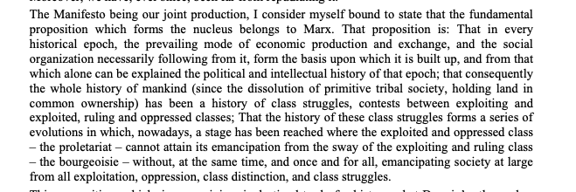
Engel’s Preface, p. 8 (c. manifesto)

Slide 7
Marxism: 3. Economy
The problem of capitalism: Alienation
Alienation from their products (meta fetishization)
Alienation from the work
Alienation from other people
Alienation from themselves
The relationships between classes: constant exploitation and inescapable animosity
Capitalism by its very nature is unjust. It is based on exploitation. Only labor creates surplus.
Capitalism tends to create polarization and pauperization.

Slide 8
Marxism: 4. Politics
Capitalism is doomed to collapse.
Revolution – not only a political revolution but also a social revolution that will establish a new mode of production
Where? In developed countries.
The natural tendency of capitalism to fail + proletariat with class consciousness
The transformation from capitalism to communism: a gradual process. A revolutionary dictatorship of the proletariat to prevent the counter revolution
Ultimate aim: communist society which will be classless and hence stateless.

