Slide 1
Investment Casting
(Lost Wax Casting, Precision Casting)
Dr. Serhat ACAR

Slide 2
Introduction/Historical Aspect
B.C. In the mid-4th millennium, at an unknown date and place, possibly independently in more than one district, a potter or metalworker, possibly both, came up with a brilliant idea. They covered a pattern made of wax with clay, then heated the composite structure and hardened the clay; the wax melted away, and using the mould thus obtained, they cast all the details in the wax. This innovation must have been greeted with great enthusiasm. With many advantages over previous techniques, objects of any shape could be produced in much more detail.

Slide 3
Compared to stone, human arms and legs, animal feet and horns can be processed much more easily and the durability obtained when compared with clay is very high. Wax could be obtained from wild bees and was already a commercial product used for different purposes, while beekeeping was also started early in West Asia. This beginning of the lost wax casting technique (precision casting) is called by archaeologists "cire perdue", which is the French for the name of the technique. The first castings were made with pure copper, followed by arsenic copper and tin bronze castings, shortly thereafter by gold castings.

Slide 4
Some of the first copper samples of precision casting are seen in animal figures mounted on the back of seals carved in limestone or magnesite, used before the invention of writing in Mesopotamia around 3500 BC. Similar specimens from the same time period were found in Elam (South West Iran) in the form of bowed mountain goats and large clothes pins in different animal figures and are now exhibited in the Louvre Museum. A few centuries later, similar examples are encountered again, this time in Troy and in various Greek cities.

Slide 5
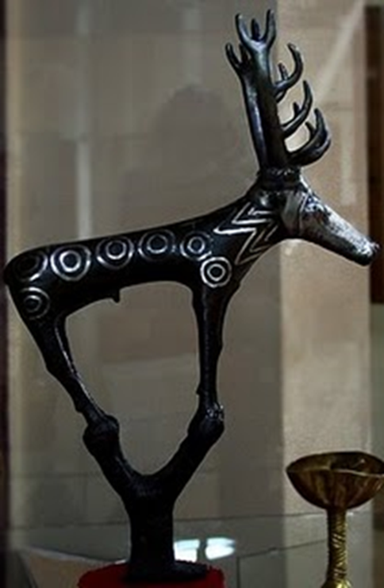
In the figure, located in Alaca Höyük near Corum and determined to belong to the Hittite civilization; The famous bronze deer statue, which was later used in the emblem of Anadol automobiles, is seen. The presence of this statue, which is dated to 2400 BC, on runner pieces indicates that the statue was cast by precision casting. This historical artifact is exhibited in Museum of Anatolian Civilizations (Ankara)

Slide 6
In the investment casting method, a mould prepared by covering an expendable pattern with a refractory slurry that hardens at room temperature is used. Generally, the pattern prepared from wax or similar plastic is then melted or burned to create a mould cavity. For this reason, the investment casting method is also called the «expendable (lost) wax method».

Slide 7
Advantages of investment casting
Mass production of complex shaped parts, which are difficult or sometimes impossible to manufacture using traditional casting methods and machining, is possible with this method.
Compared to other casting methods, it provides higher dimensional accuracy, smoother surface and fine detail parts more precisely.
The method can be applied to all metals that can be melted and cast.
Castings up to 25 kg and sometimes (rarely) parts up to 400 kg can be produced by this method.

Slide 8
The fact that the parts obtained by precision casting do not require almost any additional processing, eliminates the "easily machinable metal selection" factor.
With this method, metallurgical factors such as grain size, grain orientation and directed solidification can be closely controlled and thus the mechanical properties can be kept under control.
The method can be easily applied to metals or alloys that need to be poured under vacuum or protective atmosphere.
Since a single piece mould is used in the investment casting method, there is no parting line. And there is no trace of this surface on the part, like the products of other casting methods.

Slide 9
There are two different investment casting methods in terms of mould preparation.
(Ceramic) Shell Investment Casting
Investment Flask Casting (Solid/Block Mould Investment Casting)

Slide 11
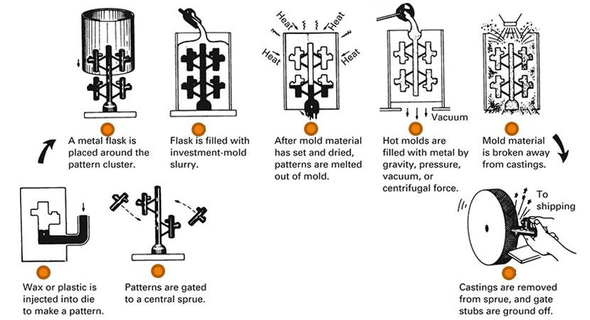

Slide 12
Ceramic Shell Investment Casting
Ceramic shell moulds are widely used for casting carbon and alloy steels, stainless steels, heat resistant alloys and other alloys with a melting temperature above 1000 ° C. It is also used in casting non-ferrous alloys with low melting temperatures. The ceramic shell method is preferred in the casting of titanium based reactive alloys by using different materials than the conventional ones in the formation of the first surface layer that comes into contact with the wax pattern in ceramic shell production.

Slide 13
Process Stages
Design and manufacture of metal wax pattern injection mould (die). (These moulds are generally made of Al 6061 alloy.)
Wax pattern production by injection.
Wax/Pattern tree making: Combining patterns with wax runner(s)
Ceramic shell making: A layered coating by deeping the pattern tree in ceramic slurry and then applying powder ceramic (stucco) on it. Stucco coating is performed by sprinkler or fluidized bed techniques. This process is repeated 6-9 times with different powder sizes and each coating is done after the previous one is completely dry. The shell thickness obtained is between 5-15 mm.

Slide 14
Dewaxing: The common method is to melt the wax with steam pressure in an autoclave. Temperature 120-130°C pressure is between 6-9 bar. While the high temperature enables the wax to melt, the vapor pressure balances the internal pressure caused by the expansion of the wax, preventing the ceramic shell mould from cracking.
Mould firing: Ceramic shell moulds are fired in an furnace at 900-1000°C before casting. This process increases the strength of the mould with the effect of sintering, allows the wax residue ashes to burn away, and increases the thermal shock resistance of the mould. It makes it easy for liquid metal to flow easily through gates and thin sections and to fill the mould.

Slide 15
Casting: Hot moulds removed from the furnace are placed on a sand bed or a suitable ground where they can stand properly and filled with crucible(ladle). It is also possible to fill the moulds directly from the furnace and place them on a suitable floor.
Knock out and finishing processes: Following solidification, the mould starts to crack when it cools down to room temperature. Then the ceramic shell is completely removed from the cast part by vibration and spraying systems. Then operations such as degating and deburring sandblasting and polishing are performed if necessary.

Slide 16
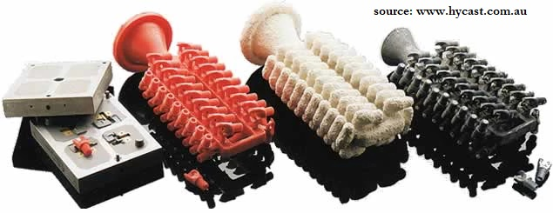

Slide 17
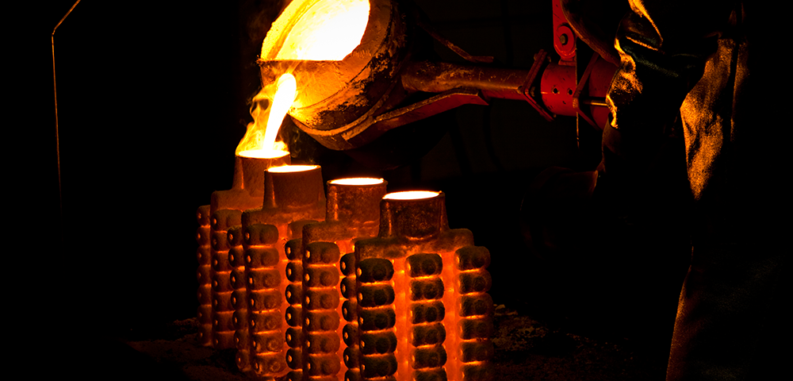

Slide 18
Moulding ceramic materials
Face coat(s)
- Slurry → Binder: Colloidal silica – Silica Sol (liquid)
Aggregate: Fused silica
- Stucco→ Fused silica / Zircon (ZrSiO₄)
Back up layers
- Slurry → Binder: Colloidal silica – Silica Sol (liquid)
Aggregta: Zircon
- Stucco →Molochite (Aluminium silicate)
(increased sizes)

Slide 19
Face coat(s) for titanium alloys
- Slurry → Binder: Colloidal zirconia (ZrO₂)
Aggregate: Zirconia powder
- Stucco) → Zirconia powder
- Alternate materials: Ytrria (Y₂O₃), Alumina (Al₂O₃), Magnesia (MgO) or Calcia (CaO)
- Back up layers consist of the same materials as conventional moulds.

Slide 20
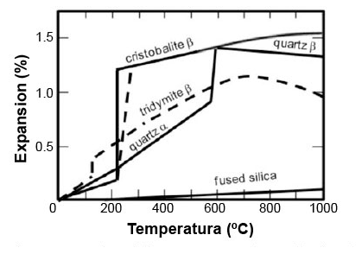
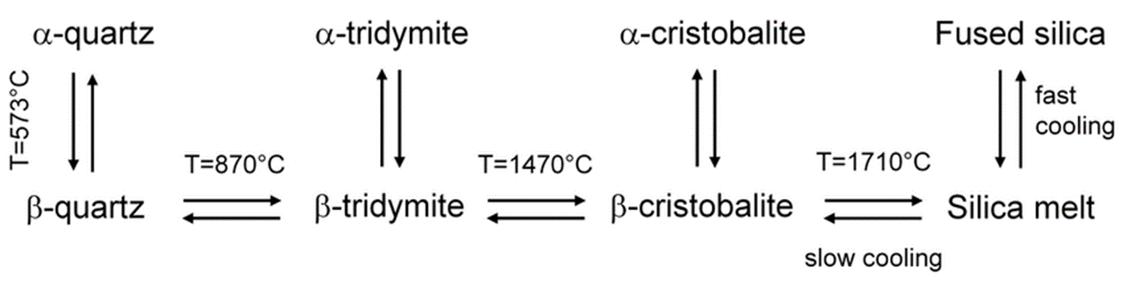

Slide 21
Linear thermal expansion of some refractories common to investment casting

Slide 22
Investment Flask Casting
At the beginning of the modern history of ceramic shell investment casting, it was common practice to use the flask method. Pattern trees, the first layers of which were made with ceramic shell method, were then placed in a metal and usually a cylindrical flask , and the back up layer was formed in one step with a ceramic slurry filled in the flasks. However, for a long time, the sectors they address have largely been separated by specializing in the flask method with the ceramic shell method and on parts of different sizes and types.

Slide 23
Ceramic shell precision casting appeals to a wide range of sectors, especially aviation, defense, automotive, general machinery industry and medical equipment and prosthesis manufacturing. The dimensions of the moulds and cast parts are larger than the flask method. Investment flask casting method is specialized in the production of dental prostheses, jewelery and various special accessories. Production of metal dental prostheses with precision casting started at the end of the 19th century and the method was transferred to jewelry production since the 1930s. As one of the basic manufacturing techniques in this field, it has developed quite a lot until today.

Slide 24
Process Stages
Design and manufacture of wax pattern mould: In the flask method, metal wax injection moulds are used only for fixed-size and simple-shaped parts such as the main runner. Flexible rubber moulds are used in jewelry production because it is not practical to extract relatively complex shaped and small patterns from a metal mould. These moulds are produced by placing a master pattern between the layers of raw rubber and curing it by compressing it in a special screw press (vulcanizer) and heating (vulcanization). An alternative method is to produce polymer-based patterns with 3D printers. For dental prostheses, patterns are produced by using templates taken from the patient's jaw since there are personal productions.

Slide 25
Wax/Pattern tree making: Many identical or different wax patterns are joined to a central runner with a gating piece, usually at an angle of 45°.
Mould making: A ceramic powder consisting of binder, aggregate and a small amount of special additives is mixed with water in the appropriate ratio. This mould powder is usually supplied ready-made. The resulting slurry is filled into flasks. Vacuum is applied to remove air bubbles in slurry mixing and filling processes. Before these operations, the pattern tree was placed inside the flask. There is a rubber base that holds the pattern tree and flask together. This base also shapes the pouring basin and is removed after the mould has set. Flasks are cylindrical and mostly made of stainless steel. If vacuum support will be applied during casting, perforated flasks are used. Before filling the slurry, the holes are covered with adhesive tape, and this tape is removed when the slurry set.

Slide 26
Dewaxing: An autoclave is not used for wax removal in the flask method. Since the mould is not in the form of a shell, it is not possible to break with the expansion of the wax. The dewaxing process is usually carried out as the first step of the burn out process where the moulds are fired.
Mould firing (Burn out): The firing regime is generally determined by the recommendations of the mould material (powder) manufacturer. The polymorphic changes that the mould components will undergo with increasing temperature are taken into consideration, and a gradual firing process is applied by waiting certain times depending on the size of the mould at critical temperatures where these changes occur. In jewelry production, this process usually takes one night (overnight).

Slide 27
Casting: At the end of the burn out process, metal is poured into moulds that have been brought to the right temperature, depending on the alloy to be cast. Gravity casting can be done for relatively large parts, but often requires overpressure, vacuum or centrifugal support to fill thin sections. The casting process is carried out with a machine suitable for the production quantity and speed. Mostly, bottom discharge induction type vacuum and pressure assisted furnaces are used in jewelry production. Since precious metals are mostly cast, a single and separate charge melting is performed for each mould.
Knock out and finishing: After solidification, moulds are generally removed by deeping in water. The casting trees are cleaned in an acid bath and then subjected to degating and polishing.

Slide 28
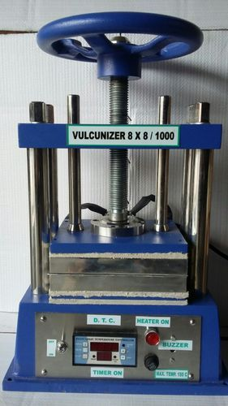
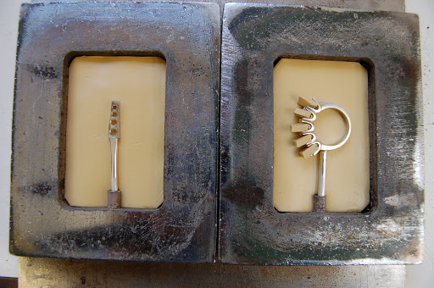

Slide 29
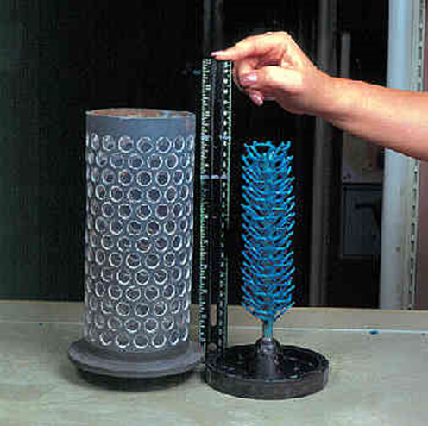
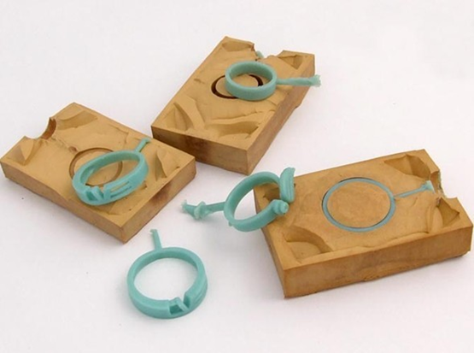
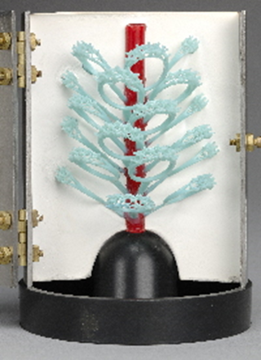
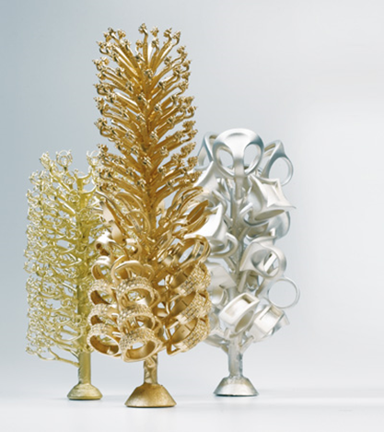

Slide 30
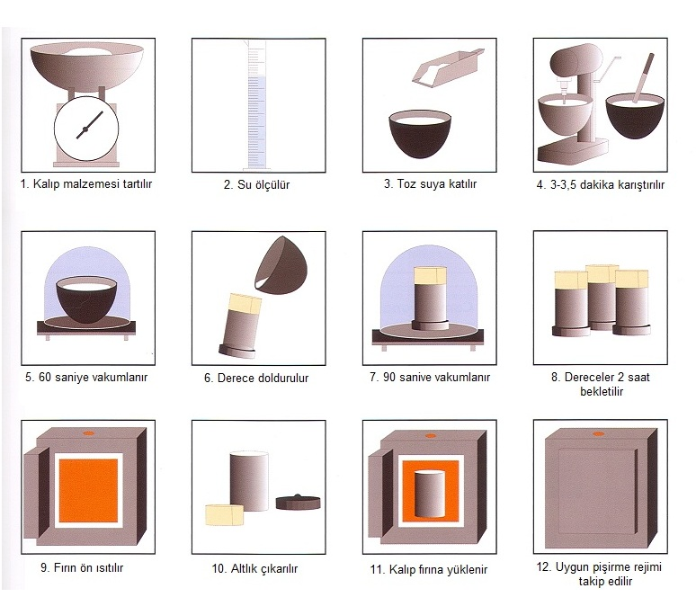

Slide 31
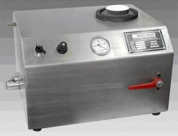


Slide 32
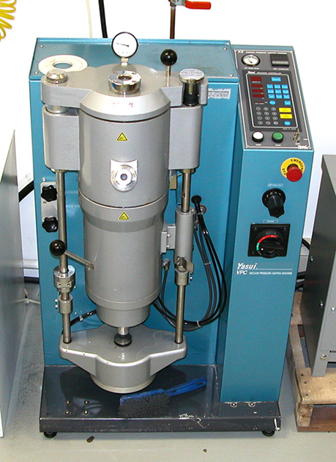
Vacuum and pressure assisted casting machine

Slide 33
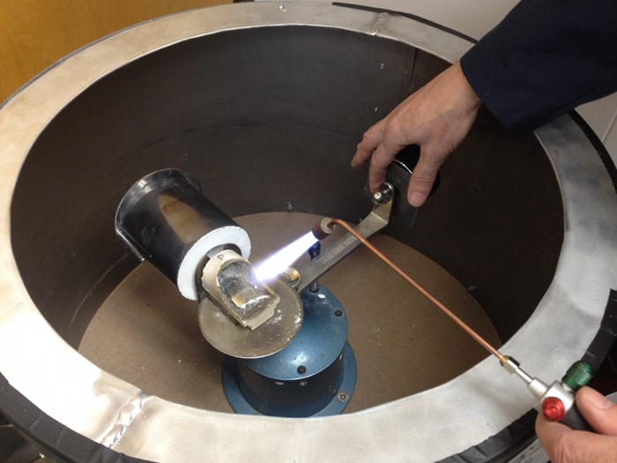
Centrifugal assisted casting machine

Slide 34
Mould materials
For alloys T_{m} < 1200 °C (gold, silver and some copper alloys) gypsum bonded investment powders are used.
- Binder α-plaster (% 25-27)
+ Silica aggregate (quartz and cristobalite)
+ Control additives(~% 1)
For alloys T_{m} > 1200 °C (platinium, stainless steels, Cr-Co and some white gold alloys) phosphate bonded investment powders are used. Also high alumina cements can be used as binder.
- Binder phosphate cement(~% 20-25)→ Monoammonium phosphate(MAP)/Diammonium phosphate (DAP) + Magnesium oxide (MgO)
+ Silica aggregate (quartz and cristobalite)
+ Control additives(~%1)

Slide 35
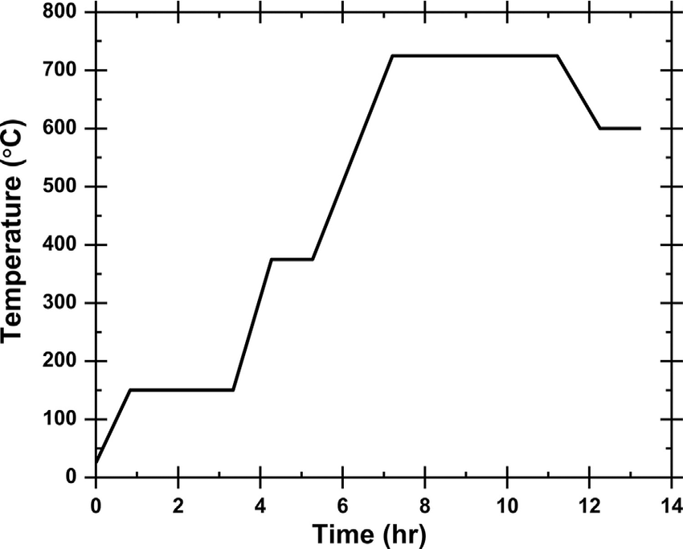
A typical firing regime for gypsum bonded investment flask casting moulds

Slide 36
Wax Types
Filled pattern waxes are a type of investment casting wax that has fillers added. These fillers can provide certain properties to the casting to ensure strength, dimensional stability, lower thermal expansion and minimal shrinkage. The types of fillers that are found in filled pattern waxes will vary based on the supplier, yet some common fillers may include bisphenol-A (BPA), organic fillers, terephthalic acid, and cross-linked polystyrene. Both small and large wax pattern productions can use filled pattern waxes. Two major advantages to these waxes are that they have low thermal expansion and minimal shrinkage. They don’t require wax chills to be placed into the cavity of the patterns to prevent shrinkage as the wax solidifies. This wax is often used when you are looking for more dimensional control of the created part or component and when using a wide range of injection temperatures. Due to the filler added, some wax may remain in the ceramic shell after the dewaxing process as it takes longer for the wax to be burnt out. Filler pattern waxes can be difficult to reclaim and recycle depending on the density of the filler material.

Slide 37
Non-filled, or unfilled, pattern wax blends contain less filler materials. This type of wax offers consistent mechanical performance and thermal performance. They are typically used for small and medium wax patterns when there are complex geometries and very defined patterns. Non-filled waxes have exceptional flow properties. A main advantage to non-filled waxes is that they provide a high surface quality. So the ceramic mold will have fewer cracks and defects. It also completely dewaxes from the ceramic shell as it can be reclaimed and recycled. Care must be taken when using non-filled waxes in investment casting processes. Due to a slower solidification, the surface of the pattern can sink. There may also be unwanted shrinkage along cross sections of the pattern depending on the wax temperature. Depending on the part configuration, the use of wax chills may be necessary with non-filled pattern waxes to avoid material shrinkage.

Slide 38
Runner wax blends are used by investment casting companies when desiring exceptional mechanical strength and lower viscosity. This type of wax has a lower melting point than pattern waxes. So it will drain completely out of the ceramic mold during the dewaxing process without the need to use higher temperatures. Advantages to runner wax is that it has good soldering strength and minimum thermal expansion. The workers can handle the wax without worrying about the part breaking in the ceramic mold. The wax pattern will need to be immersed in water and stored there until it completely solidifies.

Slide 39
Water-Soluble Waxes. Some parts and components will require complex and intricate internal designs. So the wax pattern must have intricate cores placed inside. To create these cores, a water-soluble wax is used. Once the core is completed, it is placed into the wax pattern die and then the pattern wax is injected into the die. When the wax pattern is cooled, the water-soluble cores are dissolved inside by placing the pattern into a water and acid bath.
Sticky waxes are commonly used during mounting and finishing processes. These waxes help bond different pattern waxes together or when constructing a sprue assembly. The wax helps to create a strong adhesion with the parts so that they will stand up to being handled by workers when creating the ceramic shell.

Slide 40
Video links
https://www.youtube.com/watch?v=npHQPXGGkgI
https://www.youtube.com/watch?v=cptlGzWYFEk
https://www.youtube.com/watch?v=FS0uM3OC76I
https://www.youtube.com/watch?v=HtidZOsmFXg
https://www.youtube.com/watch?v=9w8QvO5UQ6Q
https://www.youtube.com/watch?v=WXFRRg8YMT0
https://www.youtube.com/watch?v=GWVli5iY8BI
https://www.youtube.com/watch?v=ifwcOsclBHw
https://www.youtube.com/watch?v=13NwPMDpdAU
https://www.youtube.com/watch?v=gmR8-zjBsik

