Slide 1
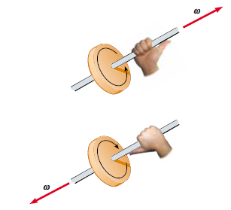
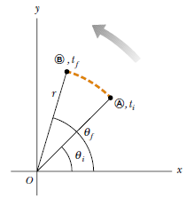
Rotation of a Rigid Object About a Fixed Axis
A rigid object is one that is nondeformable—that is, the relative locations of all particles of which the object is composed remain constant.
Angular Position, Velocity, and Acceleration
instantaneous angular speed
instantaneous angular acceleration
average angular acceleration
angular displacement
average angular speed

Slide 2
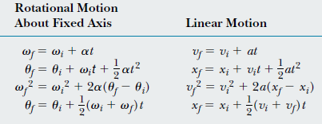
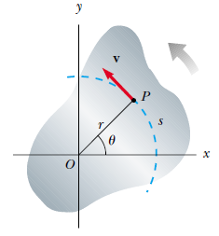
Rotational Kinematics: Rotational Motion with Constant Angular Acceleration
Under constant acceleration
Angular and Linear Quantities

Slide 3
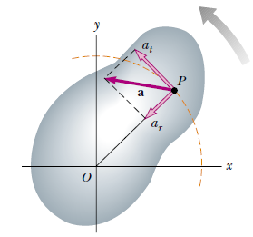
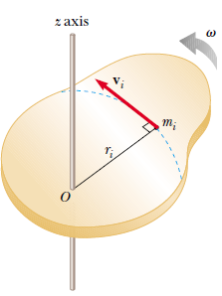
since
Rotational Kinetic Energy
Radial acceleration a_{r} of magnitude v²/r directed toward the center of rotation

Slide 4
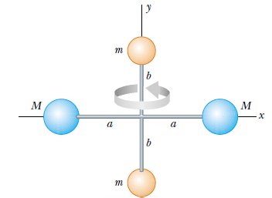
Ex/ Four tiny spheres are fastened to the ends of two rods of negligible mass lying in the xy plane. We shall assume that the radii of the spheres are small compared with the dimensions of the rods.
a) If the system rotates about the y axis with an angular speed ω, find the moment of inertia and the rotational kinetic energy about this axis.
b) Suppose the system rotates in the xy plane about an axis (the z axis) through O. Calculate the moment of inertia and rotational kinetic energy about this axis.
a)
b)

Slide 5
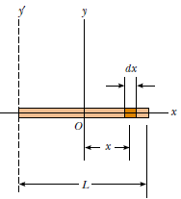
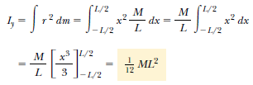
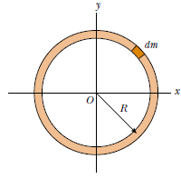
Calculation of Moments of Inertia
moment of inertia of an extended rigid object by imagining the object is divided into many small volume elements, each has mass 𝛥m_{i}
Ex/ Find the moment of inertia of a uniform thin hoop of mass M and radius R about an axis perpendicular to the plane of the hoop and passing through its center.
Ex/ Calculate the moment of inertia of a uniform rigid rod of length L and mass M (Fig. 10.10) about an axis perpendicular to the rod (the y axis) and passing through its center of mass.

Slide 6
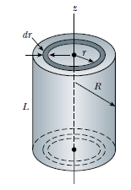
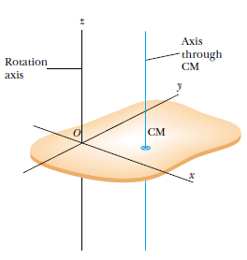
Ex/ A uniform solid cylinder has a radius R, mass M, and length L. Calculate its moment of inertia about its central axis (the z axis in Fig.).
parallel-axis theorem
D
The parallel-axis theorem states that the moment of inertia
about any axis parallel to and a distance D away from
this axis is

Slide 7
Ex/ Consider a uniform rigid rod of mass M and length L shown in Figure. Find the moment of inertia of the rod about an axis perpendicular to the rod through one end (the y’ axis in Fig.).

Slide 8
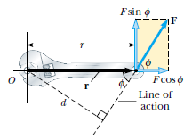
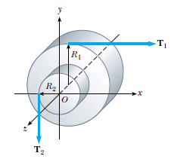
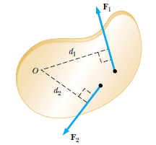
Torque
When a force is exerted on a rigid object pivoted about an axis, the object tends to rotate about that axis. The tendency of a force to rotate an object about some axis is measured by a vector quantity called torque 𝜏.
A one-piece cylinder is shaped as shown in Figure 10.15, with a core section protruding from the larger drum. The cylinder is free to rotate about the central axis shown in the drawing. A rope wrapped around the drum, which has Radius R1, exerts a force T1 to the right on the cylinder. A rope wrapped around the core, which has radius R2, exerts a force T2 downward on the cylinder.
(B) Suppose T1=5.0 N, R1=1.0 m, T2=15.0 N, and
R2=0.50 m. What is the net torque about the rotation axis,
and which way does the cylinder rotate starting from rest?
(A) What is the net torque acting on the cylinder about the
rotation axis (which is the z axis in Figure) ?

Slide 9
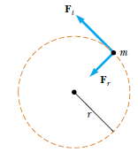
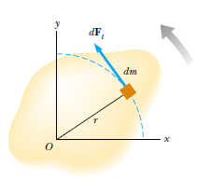
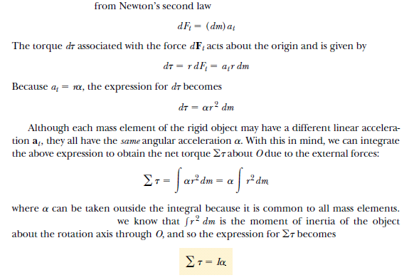
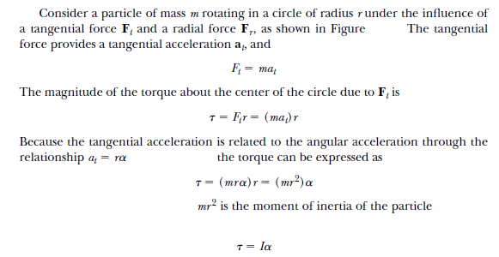
Relationship Between Torque
and Angular Acceleration

Slide 10
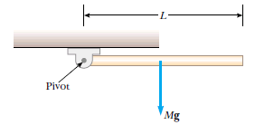
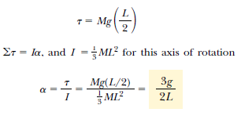
Ex/

Slide 11
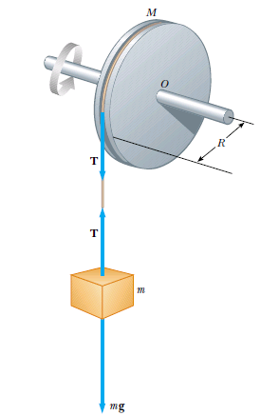
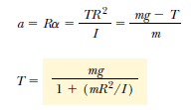
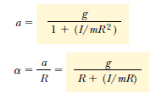
Ex/

Slide 12
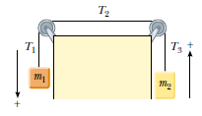
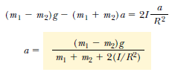
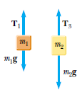
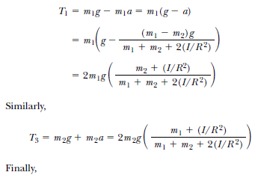
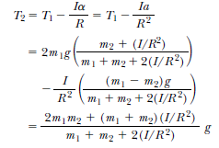
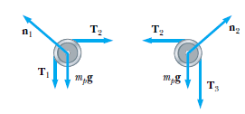
Ex/

