Slide 1
Centrifuge and sedimentation

Slide 2
Centrifugation (separators, clarifiers)
A centrifuge is a device that separates particles from suspensions, or even macromolecules from solutions, according to their size, shape, and density.

Slide 3
Centrifugation can also be used for the separations of immiscible liquids. Industrial centrifugation can be divided into two different classes:
(1) sedimenting and,
(2) filtering.

Slide 4
The sedimenting type of centrifuge relies on density (i.e. specific gravity) differences as a driving force to separate the components of a mixture.
Indeed, the rotation of materials around a fixed axis generates a centrifugal force as much as 10,000 times greater than gravity, which acts differently on components depending on their specific gravity.

Slide 5
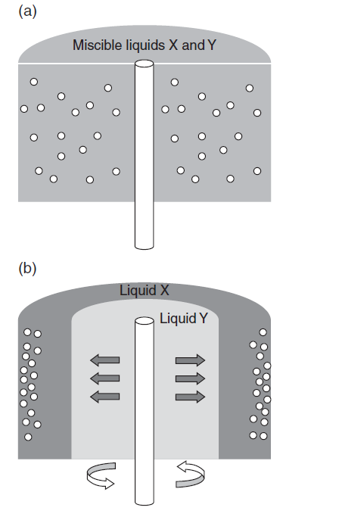

Slide 6
Because denser particles require a greater force to stay close to the rotation axis than lighter particles, the denser constituents are forced to the periphery of the centrifuge bowl.

Slide 7
This type of centrifuge is suitable for the separation of solid–liquid and liquid–liquid mixtures with very small gravity differences, as low as 100 kg/m3

Slide 8
Filtration centrifuge, in contrast to sedimentation centrifuge, uses perforated bowls and is restricted to the separation ofsolid–liquid mixtures.
This type of centrifugal separation allows the liquid phase to permeate through the porous wall on which solids are retained.

Slide 9
Unlike the sedimenting centrifuge, the filtering type of centrifuge has the advantage of allowing the separation of soluble solids without relying on density differences.
Although particles must be at least greater than 10 microns for filtration to be practicable

Slide 10
Centrifugation can thus provide solid–liquid and liquid–liquid separations, such as in milk processing, in which milk fat (i.e. cream) removal and clarification can occur simultaneously.

Slide 11
Centrifugal clarification is also used to treat oils, juices, and beers. Industrial centrifugation equipment used in food processing plants is mainly of the disk-bowl type,

Slide 12
In recent years, high-speed centrifugation has been used to reduce bacterial counts in raw milk (i.e. so-called bactofugation) and thus, allow for the production of extended-shelf life
(ESL) milk.

Slide 13
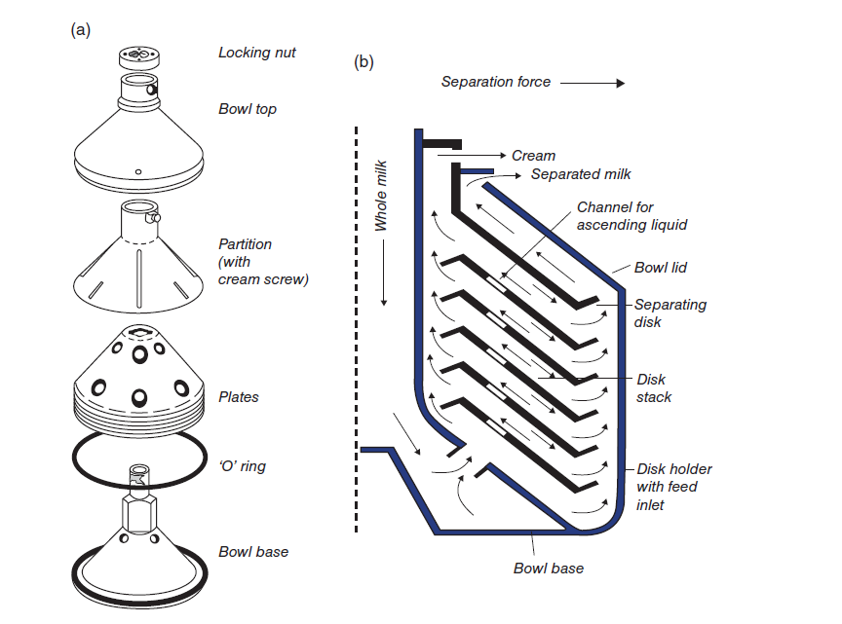

Slide 14
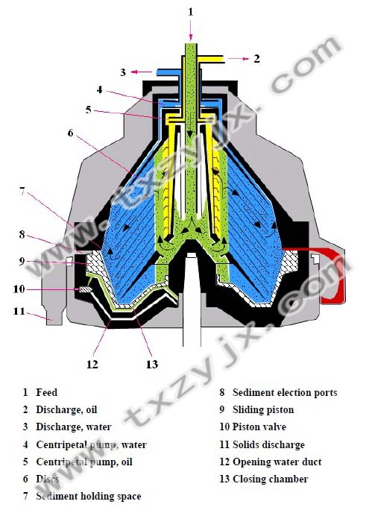

Slide 15
