Slide 1
Solvent extraction
Dr. Salih KARASU

Slide 2
Solvent extraction
Solvent extraction is the separation of a soluble compound, the solute, by diffusion from a solid (e.g. plant material) or liquid (e.g. oil) matrix using a volatile solvent

Slide 3
Solvent extraction
Extraction process involves two stages:
an initiation stage
a diffusion stage.

Slide 4
Solvent extraction
In the initiation stage, solid fragments swell as they absorb solvent and the soluble components are dissolved. Then, diffusion occurs within the. fragments outward

Slide 5
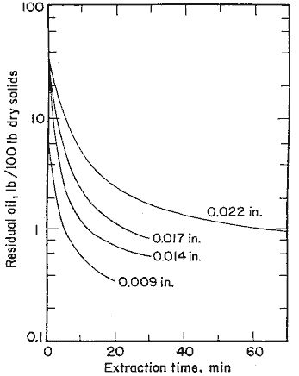
Solution Extraction – Diffusion Extraction
Diffusion

Slide 6
The holding time must be sufficient for solutes to dissolve in the solvent.

Slide 7
Solvent extraction can be performed in batch, semi-batch or continuous mode. A continuous solvent extraction process is presented in following Figure

Slide 8
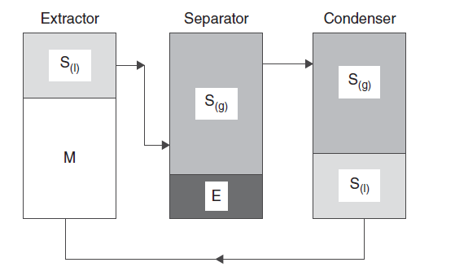

Slide 9
The solvent is then passed into a vessel (i.e. separator) in which the solvent and the extracted compounds are separated, generally by evaporation and finally vacuum distillation.
The solvent vapor is then sent to a condenser to be recycled and crude oil is submitted to a refining process (i.e. degumming, alkali refining, bleaching, and deodorization)

Slide 10
The efficiency of solvent extraction strongly dependson ,
the solid material condition, the diffusion rate in the solid,
the liquid-to-solid ratio,
the temperature,
the solvent selection (i.e. type, viscosity, and flow rate),
the solid’s water content,
and the presence of competing extractable components

Slide 11
Pre-extraction process
A pretreatment step like grinding or flaking, prior to extraction, enhances surface contact between the solvent and the solid matrix and thus extraction efficacy

Slide 12
Also, a higher liquid-to-solid ratio provides an increased gradient which facilitates the solute’s diffusion.
High temperatures increase the solute’s solubility and diffusion rate and result in a higher mass transfer rate. Residual water in solid material can negatively affect the solvent’s capacity to dissolve solutes and thus, affect the mass transfer.

Slide 13
However, the major factor influencing the efficiency of solvent extraction is the nature of the solvent used.
For this reason, most extraction techniques manipulate the physical properties of solvents in order to reduce the surface tension, increase the solute’s solubility, and promote a higher diffusion rate

Slide 14
Solvents range from polar, meaning miscible with water (e.g. ethanol, methanol), to non-polar, which means completely immiscible with water (e.g. hexane).
Thus, polar compounds are more soluble in polar solvents whereas non-polar compounds are more readily dissolved in non-polar ones.
Selection of the solvent is therefore based on the chemistry of the compound of interest as well as on cost and toxicity

Slide 15
Solvent type
For example, water is used to extract sugar, coffee and tea solutes, but oil and fat extractions require a less polar solvent, generally hexane.

Slide 16
Extraction stages
Another important factor influencing the extraction quality is the number of extraction steps or stages.
Indeed, efficiency of the extraction increases along with their numbers.
Although single stages have low operating costs, this type of extractor produces diluted solutions involving the use of expensive solvent recovery systems.
They are rarely used commercially and are restrained to the extraction of specialty oils or to the production of coffee and tea extracts.

Slide 17
Multistages
Multistage apparatus can be viewed as single-stage extractors linked together, allowing the solvent emerging from an extractor’s bases to be pumped cross-currently or counter-currently to the next one. Multistage apparatus offers significant advantages such as higher recovery and purity

Slide 18
Counter current
In the cross-current mode the feed, and thereafter the raffinate or residue, are treated in successive stages with fresh solvent.
Though operation in cross-current mode offers more flexibility, it is not very desirable due to the high solvent requirements and low extraction yields For larger volume operations and more efficient uses of solvent, a counter-current mode is employed

Slide 19
Single Stage Leaching
V₁, x₁
overflow
V₂, x₂
Equilibrium
L₀, N₀, y₀, B
L_{1,} N₁, y₁, B
underflow

Slide 20
Multiple Stage Leaching
overflow
V₁, x₁
V_{n+1}, x_{n+1}
L₀, N₀, y₀, B
L_{n,} N_{n},
y_{n}, B
underflow

Slide 21
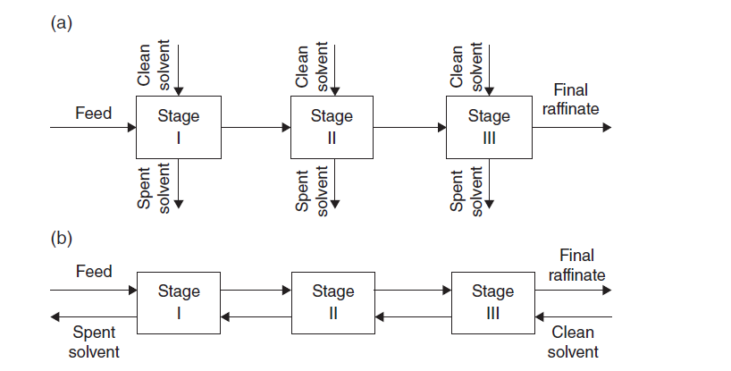

Slide 22
Counter current
In counter-current operation, the feed enters the first stage as the final extract leaves. The last stage receive the fresh solvent as the final raffinate leaves.
The counter-current operation provides a higher driving force for solute’s mass transfer and thus, gives an optimal performance and is the preferred set-up

Slide 23
Despite its widespread use in food processing, solvent extraction has considerable drawbacks related to solvent costs, toxicity and reactivity. Also, potential environmental problems are associated with their use, storage, and disposal.
For these latter reasons, modern environmentally safe and cost-effective extraction techniques are emerging.

Slide 24
Amongst these, supercritical fluid extraction (SFE), pressurized liquid extraction, pressurized hot water extraction (i.e. subcritical water extraction (SWE)), microwave assisted extraction, and membrane-assisted solvent have been proposed .
Even if water is the most environmentally friendly solvent possible, extraction methods using water (e.g. SWE) still give lower yields, require high energy for water removal, and generate large amounts of effluents.

Slide 25
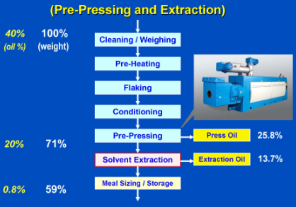
Extractor types in edible technology

Slide 26
Two different methods can be used to bring the solvent to intimate contact with the oilseed material:
percolation
immersion

Slide 27
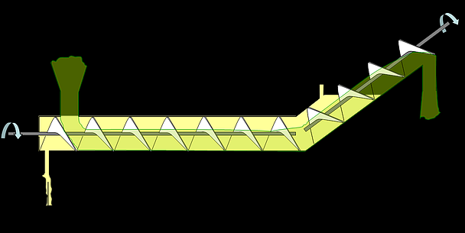
immersion

Slide 28
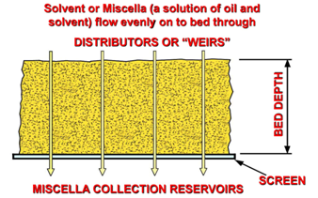
Percolation

Slide 29
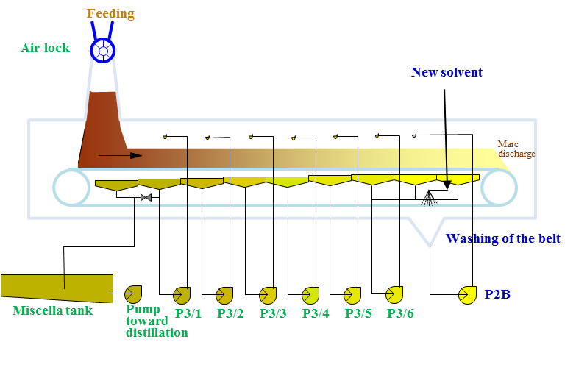
Percolation

Slide 30
