Slide 1
Food Preservation Method
Dr. Salih KARASU

Slide 2
Preservation Chemicals and Microorganism
Fermantation
Fermentation could be described as a process in which microorganisms change the sensory (flavor, odor, etc.) and functional properties of a food to produce an end product that is desirable to the consumer.
Fermentation, along with salting, cooking, smoking, and sun drying, is one of the earliest ancient traditions developed by cultures all around the world to extend the possible storage time of foods.

Slide 3
Fermentation as a Preservation Method
As new preservation techniques have been developed, the importance of fermentation processes for food preservation has declined. Yet fermentation can be effective at extending the shelf life of foods and can often be carried out with relatively inexpensive, basic equipment.
The chemical composition of most foods is relatively stable; therefore, generally preservation is based on eliminating microorganisms or controlling their growth and the overall composition of the microflora

Slide 4
To reduce or prevent microbial spoilage of food, four basic principles can be applied:
1. Minimize the level of microbial contamination onto the food, particularly from “high-risk” sources (asepsis)
2. Inhibit the growth of the contaminating microflora
3. Kill the contaminating microorganisms
4. Remove the contaminating microorganisms
Fermentations use a combination of the first three principles. Fermentations should not be expected to sterilize substandard raw products, but rather should use high-quality substrates

Slide 5
Microorganisms can improve their own competitiveness by changing the environment so that it becomes inhibitory or lethal to other organisms while stimulating their own growth, and this selection is the basis for preservation by fermentation.
A number of different bacteriocidal and bacteriostatic factors that can be produced by lactic acid bacteria (LAB), acetik acid bacteria, yeast and moulds.

Slide 6
Preservation agent produced by LAB
Low pH
Organic acids, e.g., lactic acid, acetic acid, and formic acid
Low redox potential
Nutrient depletion
Accumulation of inhibitors, e.g., toxins, bacteriocins ,
antibiotics, lactococcins, nisin, natamycin, hydrogen peroxide
Ethanol
Diacetyl
Carbon dioxide

Slide 7
Microorganisms Used in Food Fermentations
Lactic Acid Bacteria Lactic acid
Acetic acid bacteria Acetic acid
Yeast Alcohol and CO₂
Molds Enzyme

Slide 8
Natural Antimicrobials for Food Preservation
There is a rapidly growing demand for environment-friendly, safe preservatives to be used for mild food preservation. For a long time, chemical preservatives such as sorbate and benzoate have been used as reliable preservative factors to control a number of microbial hazards.
However, such compounds do not satisfy the concept of “natural” and “healthy” food that consumers prefer and that the food industry, consequently, needs to manufacture.

Slide 9
Nature is well known to contain many different types of antimicrobial compounds that play an important role in the natural defense or competition systems of all kinds of living organisms, ranging from microorganisms to insects, animals, and plants.

Slide 10
Antimicrobial
Plant Origin
Phytoalexins
Organic Acids
Phenolic Compounds
Essential Oils and Their Components
Microbial Origin
Bacteriocin
Nisin
Pediocin..

Slide 11
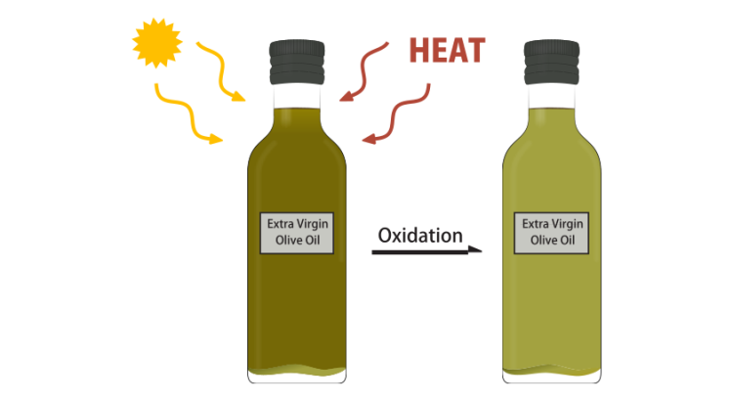
Antioxidant
Rancidity
Rancidity is an objectionable defect in food quality.
Fats, oils, or fatty foods are deemed rancid if a significant deterioration of the sensory quality is perceived.

Slide 12
Types of rancidity
Lipolytic rancidity
Short chain fatty acid in Milk fats (butyric acid),
Coconut or palm kernel oils (6–10 carbon atoms fatty acid, soapy off-flavor).
Oxidative rancidity (oxidation)
Flavor reversion (absorption of oxygen)
is connected with minute absorption of oxygen
Appears during storage of fully refined, bland soybean oils, and imparts a “beany” off-flavor.

Slide 13
Oxidative Rancidity
Initiation Reactions
RH ⇒R* H*,
CH₂-CH=CH-CH₂ ⇒ C*H-HC=HC-CH₂ or CH₂-CH-CH-C*H,
Propagation Reactions (Primary Reactions)
The peroxy radical Hydroperoxide and an alkyl free radical
Termination Reactions,
aldehydes, ketones, alcohols, or even hydrocarbons

Slide 14
Antioxidant
Why Antioxidants Are Necessary
The autoxidation of lipids is initiated by free radicals; hydroperoxides produced by autoxidation are decomposed, producing free radicals, which initiate further oxidation reactions.
In the beginning, the concentration of free radicals is very low, and oxidation is slow. The stage of very slow oxidation in the beginning of storage is called the induction period.
The induction period, and thus the shelf life, may be prolonged by addition of antioxidants, which are not able to entirely eliminate the oxidation reactions even when they are active in prolonging the storage time.

Slide 15
Definitions of Antioxidants and Antioxidant Types
Such compounds should be called oxidation inhibitors, and only those substances that inhibit oxidation by reaction with free radicals should be called antioxidants.
The free radical scavenging potential is an important method for determination of antioxidant activity. Antioxidant may also inhibit the decomposition of lipid hydroperoxides, which would otherwise form free radicals

Slide 16
Group of Compounds | Mechanism of Action | Example of Inhibitor
Antioxidants | Reaction with free radicals | Propyl gallate, tocopherols
Hydroperoxide deactivators | Reaction with hydroperoxides | Cysteine, selenometathione
Synergists | Regeneration of an antioxidant | Ascorbyl palmitate
Singlet oxygen quenchers | Transformation of singlet oxygen into triplet oxygen | Carotenes
Chelating agent | Binding heavy metals into inactive complexes | Polyphosphates, citric acid

Slide 17
Mechanism of antioxidant
Antioxidants react with peroxy radicals produced in oxidized lipids forming a hydroperoxide molecule and a free radical of the antioxidant. Free antioxidant radicals are relatively stable so that the back reaction is extremely slow. They do not initiate a chain autoxidation reaction unless present in excess.
Free antioxidant radicals may react with another lipid hydroperoxide with formation of a quinone. Antioxidants form physical bonds with lipid hydroperoxides, inhibiting thus their decomposition into free radicals

Slide 18
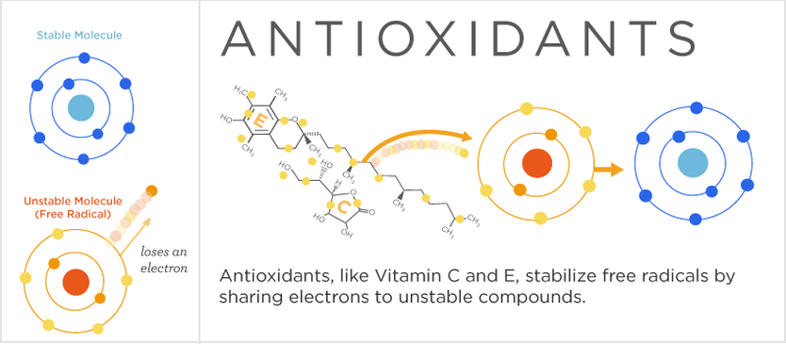
Mechanism

Slide 19
Antioxidant mechanism

Slide 20
Antioxidant types
Synthetic Antioxidants

Slide 21
Natural Antioxidants,
Tocopherols, Oleoeuropein, Hydroxytyrosol, Δ5-Avensaterol, Flavonoids, Phenolic acids, Sulfides, disulfides

Slide 22
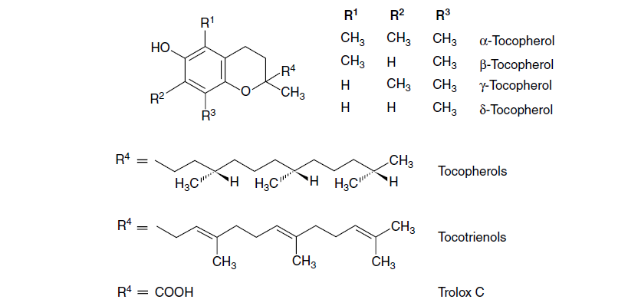

Slide 23
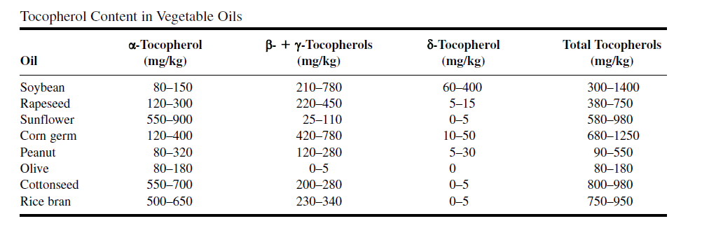
tocopherols

Slide 24
Application of Antioxidants in Foods
Stabilization of Fats and Oils,
Applications of Antioxidants in Fat Emulsions,
Applications of Antioxidants in Foods,
Applications of Antioxidants in Packaging

Slide 25
Controlling pH
Hydrogen-ion concentration is expressed in moles and pH is the negative log ion concentration. The pH scale ranges from 0 to 14.
A neutral solution has a pH of 7.0.
A lower scale reading indicates an acid solution, and a value above 7.0 indicates an alkaline solution.
The pH scale is logarithmic rather than linear in character. Therefore, a pH of 3.0 is 10 times as acidic as a pH of 4.0

Slide 26
pH limit of microorgnism
Microorganisms | pH
Acetobacterium sp. | 2.8–4.3
Bacillus acidocaldarius | 2.0–5.0
Clostridium botulinum | 4.5
Clostridium perfringens | 4.5
Lactic acid bacteria | 3.5
Listeria monocytogenes | 4.3
Most yeasts and molds | 2.0–3.0
Salmonella serovars | 4.0

Slide 27
Mode of Action of pH
Strong acids do not themselves permeate through the cell membrane and may shows their influence by the denaturing effect of low pH on enzymes present on the cell surface and by lowering of the cytoplasmic pH due to increased proton permeability when the pH gradient is very large.
Weak acids, which are lipophilic and permeate through the membrane. The primary effect of such acids is to lower cytoplasmic pH, and the undissociated acid may have specific effects on the metabolism, which amplify the effects of the weak acid.
Acid-potentiated ions such as carbonate, sulfate, and nitrate, which are more potent inhibitors at low pH.

Slide 28
Effects of pH on Heat Stability of Microorganisms
In the canning of foods, one of the most important factors affecting the sterilization times and temperatures is the actual pH value in the food.
The lower the pH values, the lower the degree of heat required for sterilization

Slide 29
pH=4.6
Nonacid or low acid
Acid

Slide 30
Enzyme
Lipoxygenase catalyzed the oxidation of unsaturated fatty acids resulting in off-flavor. Complete inactivation of lipoxygenase was irreversible when treated at pH 3.0 and below.
Pectinesterase deesterifies pectin, which leads to cloud loss in citrus juice. The thermal inactivation rates of pectinesterase in citrus juices increased at lower pH values.
Lysozyme was most stable at pH 5.2, and thermal stability decreased sharply as the pH increased to 9.0. At pH 7.2 and 9.0, sodium chloride had a clear stabilizing effect against heat inactivation of lysozyme

Slide 31
Other characteristic
Gel Formation
Protein Stability
Vitamine Stability

