Slide 1
Filtration
Dr. Salih KARASU

Slide 2
FILTRATION
The filtration process is described by the manner in which the fluid being filtered flows through the filter medium where the solids are deposited.
As the solids are removed from the fluid, they accumulate in the filter medium, resulting in an increased resistance to flow as the filtration process continues. All these factors result in a description of filtration rate

Slide 3
Filtration
Filtration involves the removal of insoluble particles from a suspension by passing it across a porous material, retaining particles according to their sizes and shape to some extent.
As the filter media retain the larger particles and form a “filter cake”, the permeate passes through the filter barrier.
The mean size particles and their distribution will both have a great influence on the type of filter used.

Slide 4
Filtration equipments are mainly used in edible oil refining, sugar refining, beer production, wine making, and fruit juice processing.
The uses of Micro filtration (MF) and ultra filtration (UF) for those latter applications are increasing, as more efficient industrial equipment and membranes become available

Slide 5
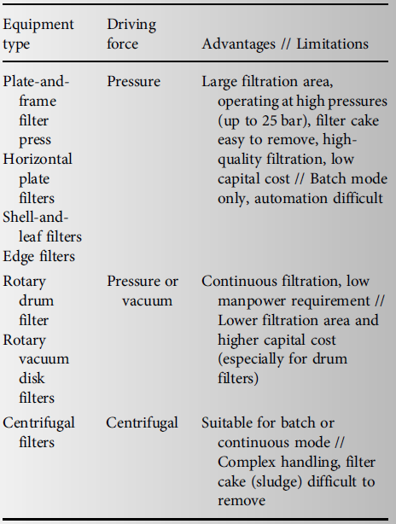

Slide 7
Plate frame filters

Slide 8
Plate frame filter press

Slide 9
Horizontal plate filters

Slide 10
Drum filter

Slide 12
Filter aids
Filtration aids, such as diatomaceous earth, cellulose or charcoal, are often used as absorbents to control the formation and the properties of the filter cake, in order to prevent resistance to fluid flow

Slide 13
Filration

Slide 14
Filtration
Filtration rate depends on several other factors, including
■ The pressure drop across the filter medium
■ The area of the filtering surface
■ The viscosity of the filtrate
■ The resistance of the filter cake as determined by the solids removed from the fluid
■ The resistance of the filter medium.

Slide 15
Filtration rate

Slide 16
Filtration
The driving force is the pressure required to move the fluid through the filter medium and the resistance is dependent on several factors.

Slide 17
Filtration
Lc represents the thickness of accumulated solids in the filter cake,
μ is the fluid viscosity,
L is a fictitious thickness of the filter material or medium.
r’ is the specific resistance of the filter cake and it is a property of the particles forming the filter cake

Slide 18
L_{c} by the following expression;
S is the solids content of the fluid being filtered,
V is the volume that has passed through the filter with cross-sectional area ( A )

Slide 19
The total resistance can be written in the following manner:
Overall an expression for the rate of filtration is obtained as follows:

Slide 20
Filtration
The filtration process may occur in two phases:
(1) constant-rate filtration, normally occurring during the early stages of the process, and
(2) constant-pressure filtration, occurring during the final stages of the process.

Slide 21
Constant-Rate Filtration
This equaiton can be written as,
Other form of equation

Slide 22
Costant rate filtration
Equation can be simplified when L is neglible,

Slide 23
Q1
An air filter is used to remove small particles from an air supply to a quality control laboratory. The air is supplied at a rate of 0.5 m 3 /s through an air filter with a 0.5 m 2 cross-section. If the pressure drop across the filter is 0.25 cm water (24.52 Pa) after one hour of use, determine the life of the filter if a filter change is required when the pressure drop is 2.5 (245.16 Pa) cm of water.

Slide 24
Constant-Pressure Filtration
An expression for describing constant-pressure filtration can be obtained from the following form of Equation filter medium thickness ( L) can be assumed to be negligible;

Slide 25
Q2
A liquid is filtered at a pressure of 200 kPa through a 0.2 m² filter. Initial results indicate that 5 min is required to filter 0.3 m³ of liquid. Determine the time that will elapse until the rate of filtration drops to 5 10 5 m³ /s.

