Slide 1
Curing & Smoking of Meat
ANSC 3404

Slide 2
Background & History
Many methods of preserving meat have been used throughout history.
Sumerians first to salt meat over 5,000 years ago.
Ancient Hebrews used salt from Dead Sea to preserve meat 4000 years ago
Possible that smoking of meats was “accidentally discovered” by Native Americans.
Hung meat from tops of teepees
In 1970’s 80’s ingredients used in curing and smoking were heavily researched
Possible health implications (cancer, etc.)

Slide 3
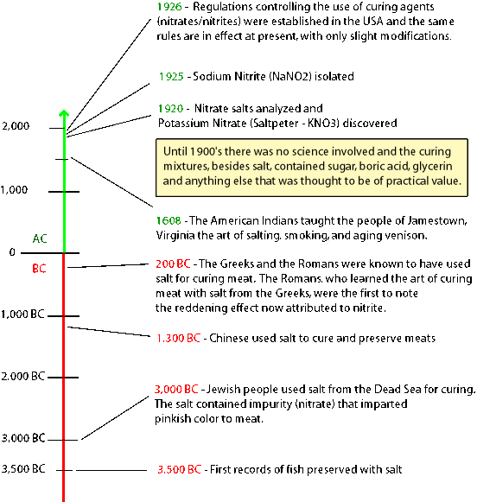

Slide 4
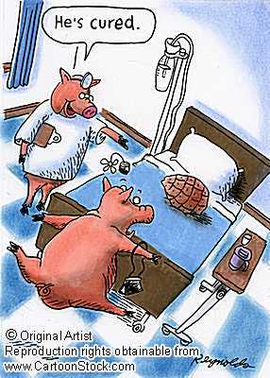
What is Curing?
Curing is addition of salt, sugar, and nitrite or nitrate to meats for purpose of preservation, flavor enhancement, or color development.
Today curing is performed more for flavor
development than for preservation

Slide 5
Other functions of curing
Shelf life extension
Development of unique properties
Resistance to rapid deterioration
Controlling microbial growth.

Slide 6
Curing Ingredients
Salt (NaCl)
Contributes flavor
Preservative effect
Controls microbial growth (doesn’t kill bacteria)
Osmosis (enhances transport of nitrate, nitrite, and sugar)
Can be in granular or rock forms.
Only difference is quantity of NaCl in the salt.

Slide 7
Curing Ingredients
Sugar (C₁₂H₂₂O₁₁)
Contributes flavor
Counteracts salt
Provides source of energy for nitrate converting bacteria
Lowers the acidity of the cure
Can be added in the form of:
Sucrose (table sugar/brown sugar)
Dextrose (refined corn sugar)
Corn syrup solids
RRM uses powdered sugar
Finer particle size→ easier to dissolve in water
Commercial cures use corn syrup solids
Cheaper
May require more to get same flavor

Slide 8
Curing Ingredients
Nitrite (NaNO₂) or Nitrate (NaNO₃)
Contributes flavor
Prevents warmed-over flavor (WOF) in reheated products
Retards development of rancidity during storage
Prevents growth of C. boltulinum in canned products
Bacteriostatic
Contributes cured-pink color to the product.

Slide 9
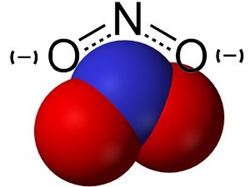
Nitrites & Nitrates
Usually come in the form of potassium or sodium nitrites or nitrates.
FSIS allows use of nitrate (NaNO₃ or KNO₃) ONLY in dry cured meats or dry sausage.
FSIS permits use of Nitrites (NaNO₂ or KNO₂) in bacon
Ingoing nitrite level cannot exceed 120 ppm
Must be accompanied by 550ppm sodium ascorbate or sodium erythorbate
Residual nitrite must not exceed 40 ppm
Nitrites and Nitrates can be carcinogenic.
MIT Study: 40 pounds of bacon/day for 40 years
Currently seeing increase of “No Nitrite” or “Uncured” products

Slide 10
Curing Reaction
Basic Cure Reaction (1st Step)
Deoxymyoglobin + Nitric Oxide = Nitric Oxide Myoglobin
(purplish red) (red)
Nitric Oxide is generated during curing sequence
NaNO₃→NaNO₂→ HONO → NO
Nitrate Nitrite Nitrous Acid Nitric Oxide
Nitric Oxide myoglobin in unstable
Color must be “fixed” by heating to 140 degrees.

Slide 11
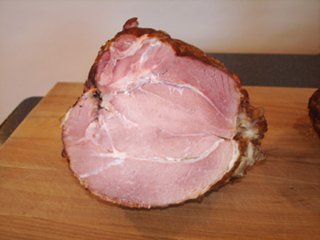
Curing Reaction
Fixation Reaction
Nitric oxide myoglobin +Heat = Nitrosylhemochromagen
(red) (cured pink)
Nitrosylhemochromagen is responsible for stable cured-pink color.
Very Heat Stable- pink color doesn’t change with further cooking
Only occurs with the addition of heat
Overall Reaction
Myoglobin + NO →→Nitric Oxide Myoglobin →→Nitrosylhemochromagen
(purplish red) (red) HEAT (cured pink)

Slide 12
Curing Adjuncts
Proper color development is a function of time
Ascorbic Acid, Sodium Ascorbate and Sodium Erythorbate speed color development
Ascorbates reduce Metmyoglobin to Myoglobin
Metmyoglobin is unable to combine with NO, while Myoglobin can
Ascorbates speed reduction of HONO to NO
Greater quantities of NO available for production
Treatment of cured cuts with 5-10% Ascorbic Acid
Effective in reducing fading of cured color in displays

Slide 13
Alkaline Phosphates
Usually Sodium Tripolyphosphate
Added to decrease shrink during curing & smoking
Cannot exceed 0.5%
Increase water holding capacity (WHC) of muscle proteins

Slide 14
Water
Water is “curing ingredient” when doing Cover Pickle Curing (Brine) or Injection Curing
Disperses cure throughout meat
Use of water reduces cost of products
Products with more water are cheaper
Water remaining in retail product is “Added Water”

Slide 15
Protein Fat Free Method
Method for calculating added water.
Set Standards for measuring minimum meat-protein content in cured pork on fat-free basis
PFF Value = (Percent of meat protein)/(100-percent of fat) X 100
Use of Alkaline Phosphates
Tremendous quantities of cure added to cuts and still remain normal
FSIS uses PFF to regulate amount of moisture in final product
Ham (Minimum 20.5% PFF)
Ham with Natural Juices (Minimum 18.5% PFF)
Ham, Water Added (Minimum 17% PFF)
Ham and Water Product (Less Than 17% PFF)

Slide 16
Application of Curing Ingredients
Dry Curing
Use of salt or salt plus nitrite or nitrate
Dry Sugar Curing
Uses Sugar to overcome harshness of salt flavor
Both methods involve rubbing cure mixture over surface
Penetration of NaCl occurs through osmosis
Bone Sour (souring around bones) occurs in hams
Lack of rapid-enough salt penetration to interior
High levels of shrinking

Slide 17
Application of Curing Ingredients
Curing With Liquid
Can either be Cover Pickle (placing meat in brine) or Sweet Pickle (sugar added to brine)
Penetration of cure occurs via osmosis
More uniform distribution of cure
Can Result in Bone Sour
Can result in yeast growth

Slide 18
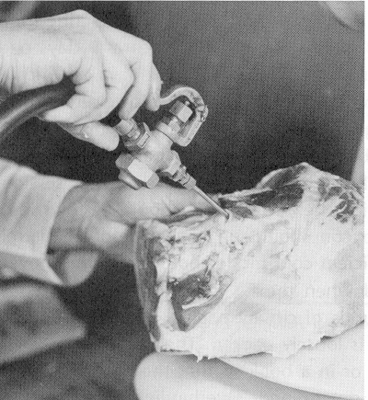
Injection Curing
Three forms of injection curing
Stitch or spray pumping
Cure directly injected into meat with needles
Artery Pumping
Accomplishes best possible distribution of cure
Cure dispersed via capillaries

Slide 19
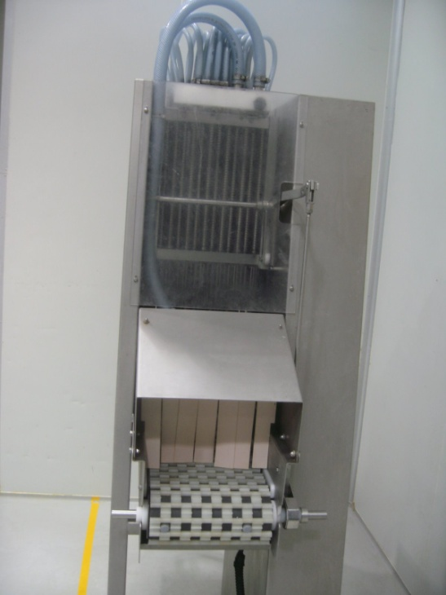
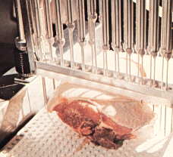
3. Multi-needle Machine Injection
Most commercial facilities use
Rapid penetration of cure into meat (reduce spoilage)
Less spoilage and shrinkage
Not conducive to development of typical flavor, aroma, and texture

Slide 20
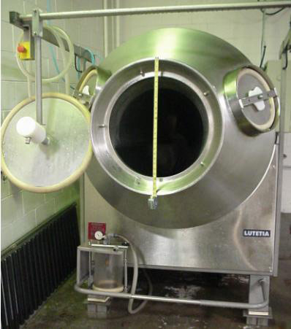
Massaging & Tumbling
Massaging and Tumbling occur after Pumping
Extract muscle proteins to bind the muscles together
Allow for increased pickup & retention of moisture
Function of Massaging and Tumbling
Disruption of Tissue Structure
Hastening of Cure-Ingredient Distribution
Solubilization of muscle proteins
Massaging
Relies on frictional energy
Minimizes the tearing of muscles
Minimizes particle size reduction
Tumbling
Relies on impact energy
Extracts myofibrillar proteins

Slide 21
Smoking of Meat Products
Materials used for smoke come from hardwood sawdust or chips
Softwood products result in sooty deposit.
Over 200 components comprise smoke
At least 80 have been identified
Almost all exhibit bacteriostatic or bacteriocidal properties
Smoke consists of two parts
Dispersed phase- consists of parts that are 2-3 micrometers in size
Tars, soot, charcoal, and resins
Gaseous phase- Not visible
Phenols, acids, and carbonyl compounds

Slide 22
Smoking of Meat Products
Benefits of Smoking
Flavor and Odor Enhancement
Color Development on Outside of Product
Preservation of the product
Liquid smoke- widely used in industry
Wood combustion products dissolved in water
Cheaper and quicker than the smokehouse process

