Slide 1
Membrane separations

Slide 2
Basic principles and separation ranges (RO, NF, UF, MF)
Pressure-driven membrane separation processes have been integrated as unit operations into a large number of food processes and it is one of the fastest growing technologies in the field of separation methods

Slide 3
Overview
Membrane technology requires low capital as well as low utility costs, and for this reason membrane separation has replaced the conventional separation technique in many food processes.

Slide 4
Overview
Conventional separation and concentration techniques usually imply energy-consuming phase changes which can affect both the physical and chemical characteristics of the final product.
Furthermore, membrane systems, when compared with the conventional technology of separation and concentration, only require limited space and thus do not involve expensive installations

Slide 5
Pressure-driven membrane separation operates at a pressure that varies inversely with pore size.

Slide 7
Modes
Pressure-driven membrane separation can be performed in dead-end mode or in tangential flow or crossflow.

Slide 8
Filtration mode
Since in dead-end mode all the fluids to be filtered pass through the membrane’s surface, trapped particles can build a filter cake and thus reduce filtration efficiency.
For this reason, industrial-scale installations operate in the tangential flow mode in which the solution circulates tangential to the membrane’s surface.

Slide 9
Modes
In tangential mode, the particles rejected by the membrane (i.e. retentate) continue to flow, preventing the formation of thick filter cakes and thus, helping to maintain a more constant flux (J) of fluid passing through the membrane (i.e. permeate) and a more steady retention factor (R).

Slide 10
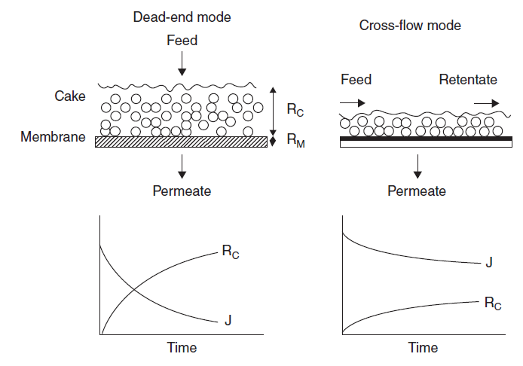

Slide 11
System
Most installations for membrane-based separation processes include the following:
a feed tank,
the membrane,
at least one pump, and
Two manometers located at the inlet (P1) and outlet (P2) of the membrane compartment

Slide 12
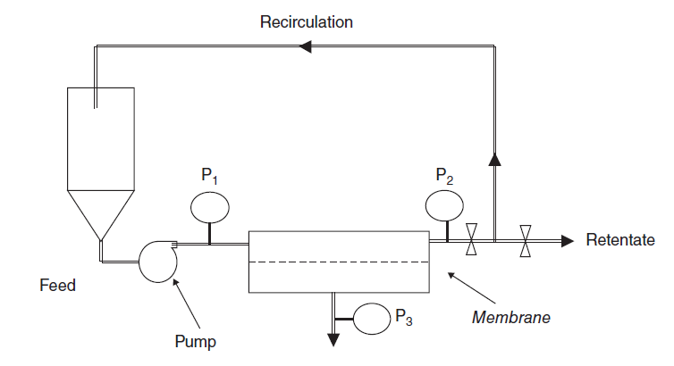

Slide 13
The recirculation speed (v) also constitutes a critical parameter of operation, since it can be adjusted to maintain a turbulent flow regime and thereby maximize membrane surface sweeping and slow down membrane fouling.

Slide 14
Batch and continuous
Membrane separations can be operated in batch or continuous mode. Comparison between the two modes must be made according to several criteria associated with cost and productivity constraints, but also with processing time.

Slide 15
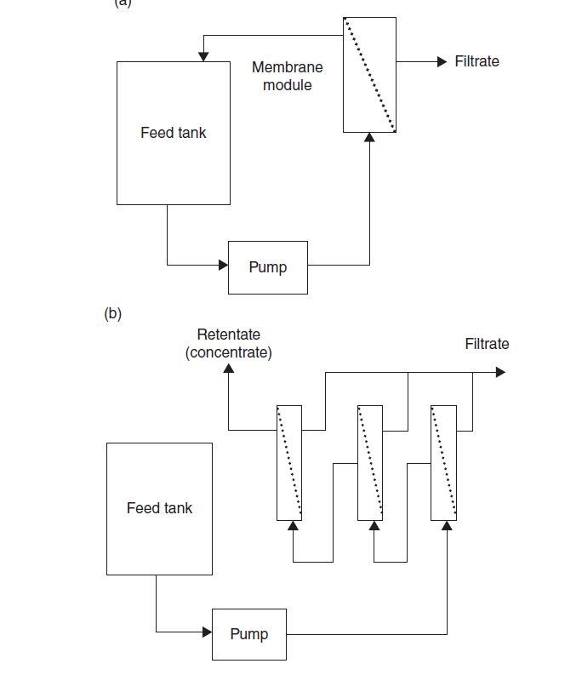

Slide 16
Batch and continuous
In fact, the latter must be minimized to prevent excessive bacterial growth, oxidation of fat, and denaturation of protein constituents due to mechanical shear stress resulting from recirculation.

Slide 17
Batch
A retentate recirculation loop can be inserted to increase the tangential speed of the fluid and thus maintain a higher mean flux. This also decreases the power required from the feeding pump and decreases general operating costs.

Slide 18
Batch
However, for high concentration retentate using a recirculation loop, long residence time can lead to microbiological problems since temperature used is often around 50 C. For this reason, batch mode used is generally well adapted for small-scale applications

Slide 19
Continuous
The continuous process is characterized by feeding the solution to be treated at the same rate as the concentrate removed in what is termed as: feed and bleed.

Slide 20
Continuous
This operation mode offers the main advantages of,
faster processing,
retentate of more uniform quality,
continuous production of the final product,
and lower feeding tank capacity,
offers the possibility of juxtaposing multistage filtration loops

Slide 21
Polarization and fouling phenomena
Polarization can be described as the reversible accumulation of dissolved or suspended species near the membrane’s surface.
Fouling refers as the irreversible formation of a deposit of retained particles in the membrane pores (i.e. pore blocking) or surface (i.e. absorption).
It results in unstable filtration behaviors. In this case, the permeate flux (J) can only be re-established by interrupting the process for membrane cleaning

Slide 22
Fouling
Fouling can be caused by inorganic compounds (e.g. minerals), microorganisms (e.g. biofilms) or macromolecules (e.g. proteins, carbohydrates, and fats).

Slide 23
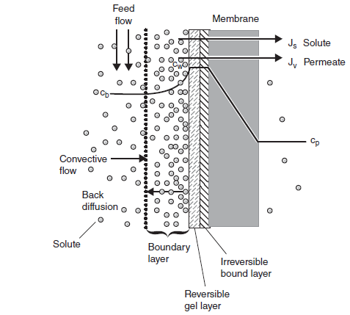

Slide 24
Fouling
Fouling can be controlled by several parameters such as:
the nature and concentration of the feed,
the type of membrane used,
the pore size distribution,
membrane material,
and operational conditions (e.g. filtration mode, trans membrane pressure (TMP), temperature, turbulence, etc.)

Slide 25
Nature of feed
Prefiltration/centrifugation:
pH adjustment
Preheating
Defatting:
Demineralization/calcium ion sequestration:

Slide 26
Type of membrane and membrane material
pores and pore sizes,
surface properties (e.g. smoothness of the surfaces, hydrophobicity or surface charges)
Hydrophilic coat is frequently applied on hydrophobic membranes in order to minimize fouling phenomena

Slide 27
Operational conditions
Indeed, cross-flow technique prevents filter cake formation,
Adjustments of TMP, temperature of operation as well as the use of turbulence promoters can all decrease the tendency toward fouling.

Slide 28
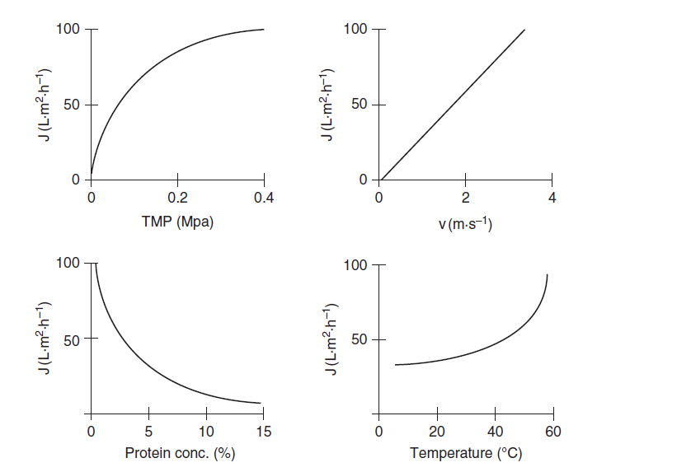

Slide 29
Applications of membranes in food processing
In recent years, the application of membranes in food industry has increased tremendously. The application ranges from the use of microfiltration to RO membranes.
In terms of products, it includes fruit juices, dairy, wine and brewery, fats, and oils.

Slide 30
Fruit Juices
Clarification:
The main application of membrane technology to the fruit juice industry has been for clarification.
The UF and MF allow the combination of fining and filtration step to clarify fruit juices such as apple, pear, cranberry, grape, and citrus.

Slide 31
The main advantages for fruit juices industry
savings in enzymes
short processing time
no addition/removal of fining agents (diatomaceous earth, gelatin, bentonite).
no problems with wastewater due to fining agent,
no over- or underfining, which can result in haze formation,
energy saving;
no clouding of concentrate;
simple cleaning-in-place

Slide 32
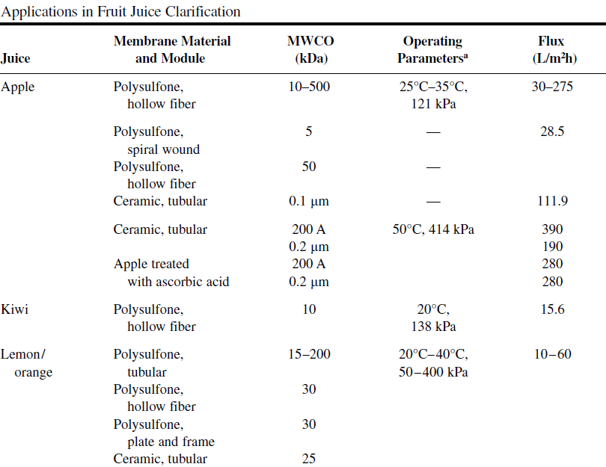

Slide 33
Pretreatments of fruit juices are important to obtain higher flux and better quality of clarified juices such as; Depectinization, Prefiltration and,decantation

Slide 34
Concentration
RO for concentration of a variety of fruit juices such as orange, apple, tomato, pears, grapefruit, kiwi, and passion fruit.
The major constraint with RO is that high concentrations are difficult to obtain due to the high pressures reached by juice retentate.
The most important components in fruit juices contributing to osmotic pressure are sugars (hexoses and disaccharides) and organic acids.

Slide 35
The maximum concentration of apple juice by conventional RO is limited to around 30°Bx–35°Bx, and the most efficient recovery was between 20°Bx and 25°Bx.
This can be viewed as a first-stage process with other methods like freeze concentration or evaporation completing the concentration system.

Slide 36
RO has been used commercially to concentrate tomato juice from 4.5°Bx to 8.5°Bx. Later it can be concentrated in evaporators up to 30°Bx. This RO preconcentration can effectively double the operating capacity and improve color and flavor characteristics.
Similarly, orange juice from 11°Bx–12°Bx to 18°Bx–20°Bx has been concentrated using RO prior to flash evaporation for producing high-quality concentrate.

Slide 37
Dairy
Membrane processes have been investigated in dairy food industry for concentration of fluid milk and whey.

Slide 38
Advantages
The advantages of using ultrafiltered milk were 16%–20%,
increased in the yield of cheese,
better control of dry matter and milk fat in the cheese,
reduction in the quantity of coagulant up to 80%, and
reduced environmental pollution due to protein/fat-free permeate/whey.

Slide 39
Quality of Ultrafiltered Milk
Milk fat is completely retained in the concentrated milk, and this increases yield of cheese due to greater retention of fat in curd than curd made from unfiltered milk.
Most of the protein of milk is also retained in the retentate, and this increases nitrogenous material in cheese made from UF-treated milk.
Calciumbound casein micelles increase in the retentate as the concentration factor increases.
The lactose retention in UF milk is very low (~10%).
The fat- and water-soluble vitamins, folic acid and B12, bound to protein are completely retained by UF.

Slide 40
The viscosity of concentrated milk is increased drastically due to increase in the concentration of protein content.
This creates difficulty in mixing the coagulant and starter culture in the concentrated milk that may lead to textural problem in the cheese.
Another problem associated with the viscous retentate is entrapment of air that can lead to a spongy-type texture of cheese.

Slide 41
The texture abnormalities in the cheese made from homogenized and pasteurized whole milk are fewer than nonhomogenized concentrated milk .
The synthesis of curd made from UF milk tends to be slower than by curd from unfiltered milk.
The curd obtained by UF milk is relatively difficult to cut, stir, and transport by conventional methods; hence, special coagulator is used

Slide 42
Oils and Fats
Solvent Recovery (RO/NF)
Degumming, (UF)
Lipid Separations (UF, RO),
Dewaxing (MF membrane of 0.2 m pore size)
Contaminant

