Slide 1
Color from Interaction of Light with Matter

Slide 2
Refraction (refraksiyon)
Color covered so far includes processes giving rise to color have involved absorption or emission of light. However, there are other physical interactions that give rise to color by change in the direction of the light.
Refraction results from the change in speed of light when passing from one medium to anorayther
When a uniform, non-absorbing medium, such as air or glass or salt, transmits light, the photons are effected by electrons in the material which results in slowing down the light.
Light travels fastest in a vacuum, and more slowly in all other materials. Light travels faster in air than in a solid.

Slide 3
Refraction
Consider the case of monochromatic (i.e., single wavelength) light entering a piece of glass, as shown in Figure 4.1. One edge of the beam enters the prism and is slowed before the other edge hits the glass. This has the effect of bending the light toward the direction perpendicular to the edge of the glass.
When exiting the prism, the side of the beam that exits fist “pulls” the light in the direction that takes it away from the perpendicular direction
This bending of light as its velocity changes with a change in medium can be considered to be a consequence of Fermat’s* principle of least time which states that light rays will always take the path that requires the least time.

Slide 4
Refraction
The index of refraction (also known as the refractive index), n, is defied as: n =v/v′
where v is the speed of light in vacuum and v′ is the speed of light in the medium under consideration
n depends on the material, the wavelength of the light used, and the temperature. Values for a range of materials (for the Na yellow line) are given in Table 4.1

Slide 5
Refraction
Although we are perhaps not aware of it, many optical phenomena are associated with refractive index (see Figure 4.3). For example, if we drop a piece of glass in water, we see the edges of the glass due to bending of light because the refractive index of glass is different from that of water.
Similarly, the change in refractive index of air as it is heated is apparent in viewing an air mass above hot asphalt.

Slide 6
Refraction
Figure 4.1 shows refraction for monochromatic light, but refraction can lead to beautiful effects when dealing with white light. For example, it is responsible for the beautiful colors in a rainbow.
When white light, which we now know to be composed of the light of all visible colors, hits a prism, some colors are more refracted than others. In particular, light is more refracted. higher-energy (shorter-wavelength)
In particular, higher-energy (shorter-wavelength) light is more refracted. This variable refraction causes white light to be dispersed (dagilmak, sacilmak) by a prism, as shown in Figure 4.5.

Slide 7
Refraction
Snell's law (also known as Snell–Descartes law and the law of refraction) is a formula used to describe the relationship between the angles of incidence and refraction, when referring to light or other waves passing through a boundary between two different isotropic media, such as water, glass, or air

Slide 8
Refraction
The largest possible angle of incidence which still results in a refracted ray is called the critical angle; in this case the refracted ray travels along the boundary between the two media
For example, consider a ray of light moving from water to air with an angle of incidence of 50°. The refractive indices of water and air are approximately 1.333 and 1, respectively, so Snell's law gives us the relation
which is impossible to satisfy. The critical angle θ_{crit} is the value of θ₁ for which θ₂ equals 90°
R*Io
Io

Slide 9
Refraction
For diamond, n = 2.42, and this leads to a critical angle of 24.4°
Therefore, a light ray that makes an angle of 65.6° (i.e., 90°–24.4°) or less with the outer surface of a diamond cannot pass through the surface to air but is totally reflected, as shown for monochromatic light in a diamond in Figure 4.7a.
A properly cut diamond will appear opaque when viewed from below because no light from the upper surface will exit the bottom (Figure 4.7a).
When white light hits the diamond’s surface, it is dispersed into its colors. The dispersion is illustrated in Figure 4.7b

Slide 10
Reflectance
When light radiation passes from one medium into another having a different index of refraction, some of the light is scattered at the interface between the two media even if both are transparent. The reflectivity R represents the fraction of the incident light that is reflected at the interface, or
where Io and IR are the intensities of the incident and reflected beams, respectively. If the light is normal (or perpendicular) to the interface, then
If the incident light is not normal to the interface, R depends on the angle of incidence. When light is transmitted from a vacuum or air into a solid s, then

Slide 11
Absorption
Valance band–conduction band electron transitions, which depend on the electron energy band structure of the material; band structures for semiconductors and insulators

Slide 12
Absorption
Interactions with light radiation can also occur in dielectric solids having wide band gaps, involving other than valence band–conduction band electron transitions. If impurities or other electrically active defects are present, electron levels within the band gap may be introduced, such as the donor and acceptor levels, except that they lie closer to the center of the and gap.
Light radiation of specific wavelengths may be emitted as a result of electron transitions involving these levels within the band gap. For example, consider Figure 19.6a, which shows the valence band–conduction band electron excitation for a material that has one such impurity level

Slide 13
Absorption
The intensity of the net absorbed radiation is dependent on the character of the medium and the path length within. The intensity of transmitted or non-absorbed radiation I′T continuously decreases with the distance x that the light traverses:
where I′0 is the intensity of the non-reflected incident radiation and β, the absorption coefficient (in 1/cm), is characteristic of the particular material; β varies with the wavelength of the incident radiation. The distance parameter x (cm) is measured from the incident surface into the material. Materials with large β values are considered highly absorptive.

Slide 14
Absorption
Example:
The fraction of non-absorbed light that is transmitted through a 200-mm thickness of glass is 0.98. Calculate the absorption coefficient of this material.

Slide 15
Transmittance
For an incident beam of intensity I0 that impinges on the front surface of a specimen of thickness l and absorption coefficient β, the transmitted intensity at the back face IT is
where R is the reflectance; for this expression, it is assumed that the same medium exists outside both front and back faces.
Derivation is left for you as an exercise at home.
Thus, the fraction of incident light that is transmitted through a transparent material depends on the losses that are incurred by absorption and reflection.
The sum of the reflectivity R, absorptivity A, and transmissivity T is unity.
Io*(1-R)
Io*(1-R) * e^(-Bl)
Io(1-R)^2*e^(-Bl)

Slide 16
Transmittance
For example, for light having a wavelength of 0.4 μm, the fractions transmitted, absorbed, and reflected are approximately 0.90, 0.05, and 0.05, respectively. However, at 0.55 μm, the respective fractions shift to about .50, 0.48, and 0.02.

Slide 17
Interference (girisim)
To understand interference patterns in light, it is instructive to fist consider two extreme ways in which waves can interact.
When two waves of exactly the same wavelength come together, the resulting wave depends very much on the phases of the waves.
For example, if two identical waves exactly in phase (peaks and troughs at same time and location, as shown in Figure 4.10) interact, the resulting wave will be of the same wavelength, and its amplitude will be the sum of the amplitudes of the incident waves, as shown in Figure 4.10. These waves are said to undergo constructive interference.
Although there is only one way in which waves can be in phase, there are many ways for the waves to be “not in phase.” The most extreme case is two identical waves that are exactly out of phase with one another: when one has a peak, the other has a trough. Two such waves of exactly the same wavelength and exactly the same amplitude will come together to result in total destruction: no wave results (see Figure 4.11). This is called destructive interference
Figure 4.10 Constructive Interference
Figure 4.11 Destructive Interference

Slide 18
Scattering of Light (sacilma)
Light is bent or scattered when it hits the edge of an opaque object. This is usually a minor effect when the object is large but becomes a major effect when the size of the object approaches the wavelength of light involved.
Scattering of light was put on a firm basis by the studies of Rayleigh and Tyndall, and their names are often associated with light-scattering processes.
For a small object, about 10 nm to 300 nm in diameter, that scatters light of incident intensity Ii and wavelength λ, the intensity at a distance d from the scatterer and angle θ between incident and detected intensity, Iθ, is given by (Tyndall scattering)
where α is the polarizability of the sample, a measure of how easy it is to displace electrons in the sample. Polarizability is important for interactions with light because light is electromagnetic radiation.
Since Iθ is proportional to λ–4 in Tyndall scattering, the most intensely scattered light is that at the shortest wavelengths. For the visible range, this means that blue light is much more scattered than red light.

Slide 19
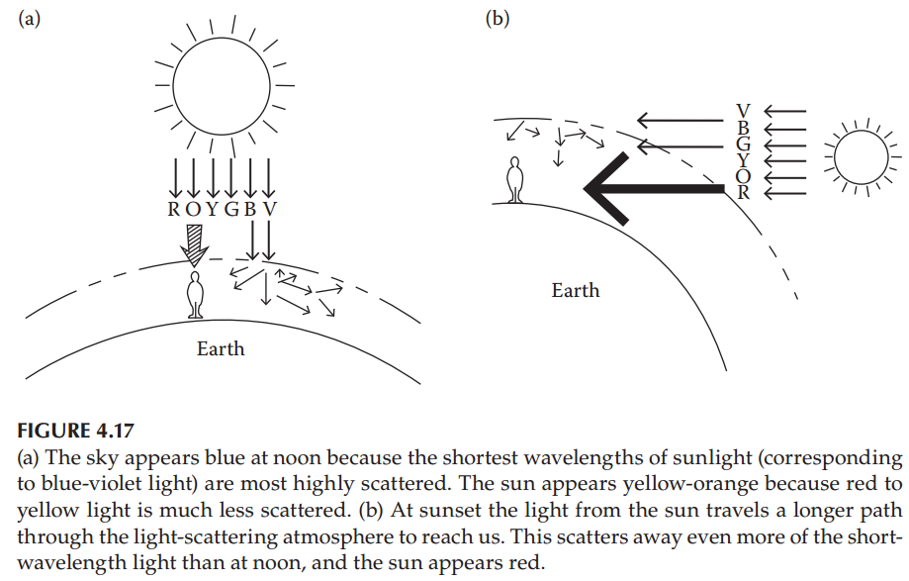
Scattering of Light (sacilma)

Slide 20
8.03 - Lect 14 - Accelerated Charges, Poynting Vector, Power, Rayleigh Scattering - YouTube
For nşce examples of Rayleig scattering; Watch from 1:08:15

Slide 21
Diffraction Grating (Kirinim izgarasi)
Interference and scattering can act together to produce colors in the case of a diffraction grating, which has a very small slit (or number of slits), with each opening of the order of the wavelength of light.
When the light passes through the slit, it is scattered in all directions. Alternatively, a diffraction grating can involve reflection from internal layers.
Assuming a plane wave of monochromatic light of wavelength λ with normal incidence (perpendicular to the grating), each slit in the grating acts as a quasi point-source from which light propagates in all directions (although this is typically limited to a hemisphere)
In both cases, the optical effects arise from constructive and destructive interference.
For a single slit, the scattered light intensity varies with distance from the slit and angle.
For many slits, the light coming from adjacent slits can interfere either constructively or destructively

Slide 22
Diffraction Grating (Kirinim izgarasi)
For practical applications, gratings generally have ridges or rulings on their surface rather than dark lines. Such gratings can be either transmissive or reflective
Reflective Grating:

Slide 23
Diffraction Grating (Kirinim izgarasi)
Reflective Grating:
When the path difference between the light from adjacent slits is equal to half the wavelength, λ/2, the waves are out of phase, and thus cancel each other to create points of minimum intensity.
Similarly, when the path difference is λ, the phases add together and maxima occur.
For a beam incident normally on a grating, the maxima occur at angles θm, which satisfy the relationship
d sin(θm) / λ = | m |, where θm is the angle between the diffracted ray and the grating's normal vector, and d is the distance from the center of one slit to the center of the adjacent slit, and m is an integer representing the propagation-mode of interest.

Slide 24
Diffraction Grating (Kirinim izgarasi)

Slide 25
Diffraction Grating (Kirinim izgarasi)
Transmissive grating: This type of grating is created by scratching or etching a transparent substrate with a repetitive, parallel structure. In a transmission diffraction grating, light passes through the material on which the grating is etched

Slide 26
Bragg Diffraction Grating

Slide 27
Optical Spectrometer
An optical spectrometer (spectrophotometer, spectrograph or spectroscope) is an instrument used to measure properties of light over a specific portion of the electromagnetic spectrum, typically used in spectroscopic analysis to identify materials.
The variable measured is most often the light's intensity but could also, for instance, be the polarization state. The independent variable is usually the wavelength of the light or a unit directly proportional to the photon energy, such as reciprocal centimeters or electron volts, which has a reciprocal relationship to wavelength.

Slide 28
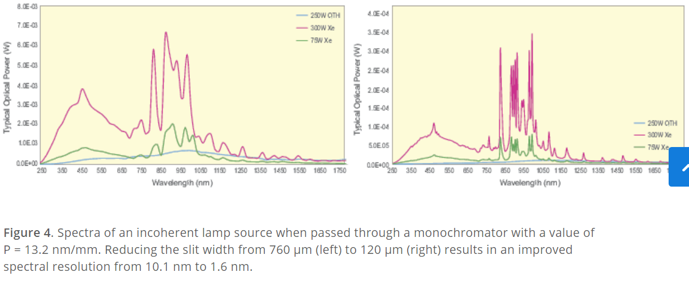
Spectrum of Diffraction Gratings

