Slide 1
Color in Metals and Semiconductors

Slide 2
Color in Metals: Free electrons
Electrons have their maximum possible delocalization in metals
The free electron gas model (i.e., electrons modeled as virtually floating in a sea of positive charges) has been used to describe many features
In a metal, all the conduction electrons are essentially equivalent because they can freely exchange places with one another.
But they do not all have the same energy due to the quantum mechanical limitation that no two electrons in the same system (meaning the metal, in this case) can have the same set of quantum numbers
For a chunk of metal, there will be of the order of 10^23 cm-3 electrons and nearly as many energy levels.
If all the levels were filled, there would be half as many levels as electrons since each level can accommodate only two electrons, one of each spin. This is in keeping with the Pauli* exclusion principle, which states that no two electrons in a system can occupy the same quantum state simultaneously

Slide 3
Color in Metals: Fermi Dirac Probability
Fermi* and Dirac† worked out that P(E), the probability that a state with energy E will be occupied in a free electron gas, is
where EF, the Fermi energy, is the energy at which P(E) = ½, k is the Boltz- mann‡ constant, and T is temperature. Equation 3.1 is known as the Fermi– Dirac distribution function.
This function looks “square” at T = 0 K, as one would expect since all the energy levels are filed up one by one at T = 0 K, up to the Fermi energy. This is shown in Figure 3.2

Slide 4
Color in Metals: Band Structure
From localized molecular orbitals to delocalized molecular orbitals, the increased number of electrons makes the electronic energy levels become more numerous until they become a virtual continuum, as shown schematically as bands in Figure 3.3
At higher temperatures, some energies above the Fermi energy are occupied. The spill-over (to states beyond EF) depends on T, as shown in Figure 3.2.

Slide 5
Color in Metals: Color from Band Structure
Because a metal has a near continuum of excited energy levels (energies above the Fermi energy), a metal can absorb light of any wavelength, including visible wavelengths.
If this were the only effect operable here, all metals would appear black because all visible light would be absorbed by them.
However, when an electron in a metal absorbs a photon of light, it is promoted to an excited state that has many other energy levels available for de-excitation (due to the virtual continuum of levels)
Light can be absorbed easily, and since light is an electromagnetic wave, and a metal is a good conductor of electricity, the absorbed light induces alternating electrical currents on the metal surface
These currents rapidly emit light out of the metal. This rapid and efficient re-radiation means that the surface of a metal is reflective

Slide 6
Colors in Metals: Color from Band Structure
Although all metals are shiny, and this is due to the effects described above, not all metals have the same color. For example, the colors of gold and silver are quite distinct from each other.
This is due to subtle differences in the number of states above the Fermi level.
The reflectance of gold and silver are compared in Figure 3.4. Silver reflects all colors of visible light with high efficiency; gold does not reflect very much high energy visible light (blue and violet) because of the absence of levels in this energy region.
Since gold reflects predominantly at the low-energy end of the visible range, it appears yellow

Slide 7
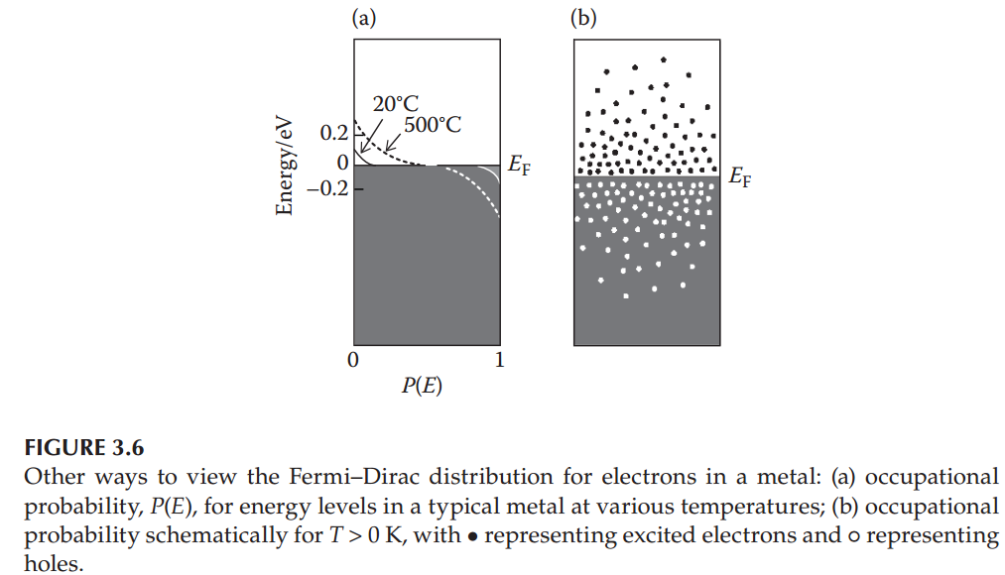
Color in Semiconductors: Pure SC’s
When an electron in a metal is at an energy higher than the Fermi energy, it is said to be conducting as it contributes to the electrical and thermal conductivities of a metal
The probability diagram of Figure 3.2 can be turned on its side to reveal an energy diagram for a metal as shown in Figure 3.6

Slide 8
Color in Semiconductors: Pure SC’s
Materials called semiconductors do not conduct electricity very well due to the gap between their valence band and their conduction band, as shown in Figure 3.7

Slide 9
Color in Semiconductors: Pure SC’s
The distance marked Eg is the energy gap (or band gap); there are no energy levels in this region in pure semiconductors. A similar gap appeared in the energy range between the bonding and antibonding orbitals (see Figure 3.3)
The semiconductor energy gap changes from element to element; for example, it increases on going through the series Sn, Ge, Si, C. This is the same order as increasing bond interaction, and shorter, stronger bonds lead to a larger band gap energy.
If there is sufficient thermal energy available, large numbers of electrons in a semiconductor could be promoted from the valence band to the conduction band, but this thermal energy might correspond to a temperature in excess of 1000 K, and the material could very well melt before achieving electrical conduction comparable to that in a metal.
However, visible light may provide sufficient energy to promote electrons from the valence band to the conduction band of a semiconductor, and this gives semiconductors their colors.

Slide 10
Color in Semiconductors: Pure SC’s
For a pure semiconductor, the color depends on the value of Eg.
If Eg is less than the lowest energy of visible light (red light, λ ~ 700 nm, E ~ 1.7 eV), then any wavelength of visible light will be absorbed by this semiconductor.
Because all visible light is absorbed, the semiconductor will appear black.
If reemission is rapid and efficient (this depends on the energy levels), then this material will have a metal-like luster; Si is an example.
If reemission is not rapid, then this semiconductor will appear black and lusterless (e.g., CdSe)
Silicon ingot
Eg=1.12 eV
CdSe ingot
Eg=1.75 eV

Slide 11
Color in Semiconductors: Pure SC’s
If Eg is greater than the highest energy of visible light (violet light, λ ~ 400 nm, E ~ 3.0 eV), then no visible light is absorbed and the material is colorless.
Pure diamond, with Eg of 5.4 eV (corresponding to light of wavelength 230 nm, i.e., UV), is an example.
Gallium Oxide (Ga2O3) with Eg of 4.8 eV is another wide band gap semiconductor which is much cheaper than Diamond.
Diamond crystal
Ga2O3 ingot

Slide 12
Color in Semiconductors: Pure SC’s
When a semiconductor has Eg falling in the energy range of visible light, the material has a color that depends on the exact value of Eg
The value of Eg depends on two factors: the strength of the interaction that separates bonding and antibonding orbitals, and the spread in energy of each band.
Periodic trends in lattice parameters, bond dissociation energies, and band gap are summarized for one isostructural group of the periodic table in Table 3.1

Slide 13
Color in Semiconductors: Pure SC’s
HgS has Eg of 2.1 eV, which corresponds to λ = 590 nm, that is, yellow light. So, in HgS all light with energies greater less than 2.1 eV (wavelengths longer than 590 nm i.e., red and orange) is transmitted. This means that, in white light, only wavelengths greater than 590 nm are transmitted, and HgS is red-orange.
As another example, consider CdS. Here the band gap energy is 2.4 eV, which corresponds to light of wavelength 520 nm (green light). Since blue and higher-energy (i.e., violet) light are absorbed, this leaves behind a region of the visible spectrum that is centered on yellow, and CdS appears yellow-orange.
If the semiconductor has a large gap, it will be colorless if it is pure, but the presence of impurities can introduce color in the semiconductor the next section.

Slide 14
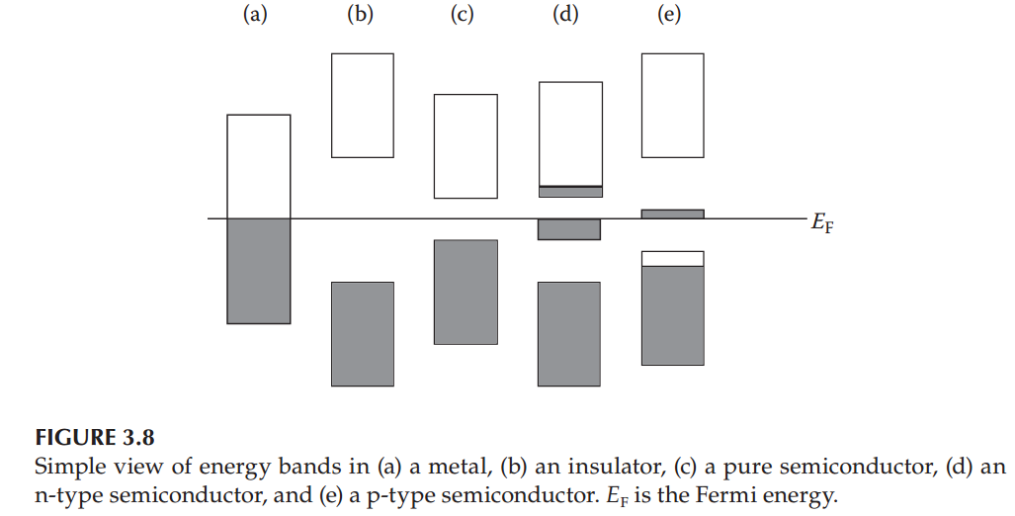
Color in Semiconductors: Doped SC’s
There are two categories of impurities in semiconductors, - n and – p type
An impurity that donates electrons to the conduction band of a semiconductor creates what is known as an n-type semiconductor. The “n” stands for negative as this impurity gives rise to negative charge carriers (electrons in the conduction band). This is also known as a donor impurity.
When an impurity produces electron vacancies that behave as positive charge centers (holes) in the valence band, this is known as a p-type semiconductor. The “p” stands for positive as the holes act as positive charge carriers. Because the impurity accepts an electron (giving rise to the hole), this also is known as an acceptor impurity.
The impurity in a semiconductor often can introduce a set of energy levels intermediate between the valence band and the conduction band, as shown in Figure 3.8

Slide 15
Color in Semiconductors: Doped SC’s
Because the transition to the impurity levels takes less energy than the transition across the entire band gap, this transition can influence the color of a wide-band-gap semiconductor
For example, if a small number of nitrogen atoms are substituted into the diamond lattice, the extra electrons can form a donor impurity level within the wide band gap of diamond since nitrogen has one more electron than carbon. Excitation from this impurity band absorbs violet light, depleting white light of violet and making nitrogen-doped diamonds appear yellow at nitrogen levels as low as 1 atom in 10^5
Conversely, boron has one electron less than carbon, and doping boron into diamond gives rise to acceptor (hole) levels in the band gap. These intermediate levels can be reached by absorption of red light (but not shorter wavelength light—do you know why?) so boron-doped diamonds appear bluish white.

Slide 16
Color in Semiconductors: Doped SC’s
Doped semiconductors also can act as phosphors, which are materials that give off light with high efficiency when stimulated, for example, by an electrical pulse.
(Phosphorescence results when light is emitted some time after the initial excitation; the delay is caused by the change in spin between the excited state and the ground state. In florescence, which is a faster process, the spins of the excited and ground states are the same.)

