Slide 1
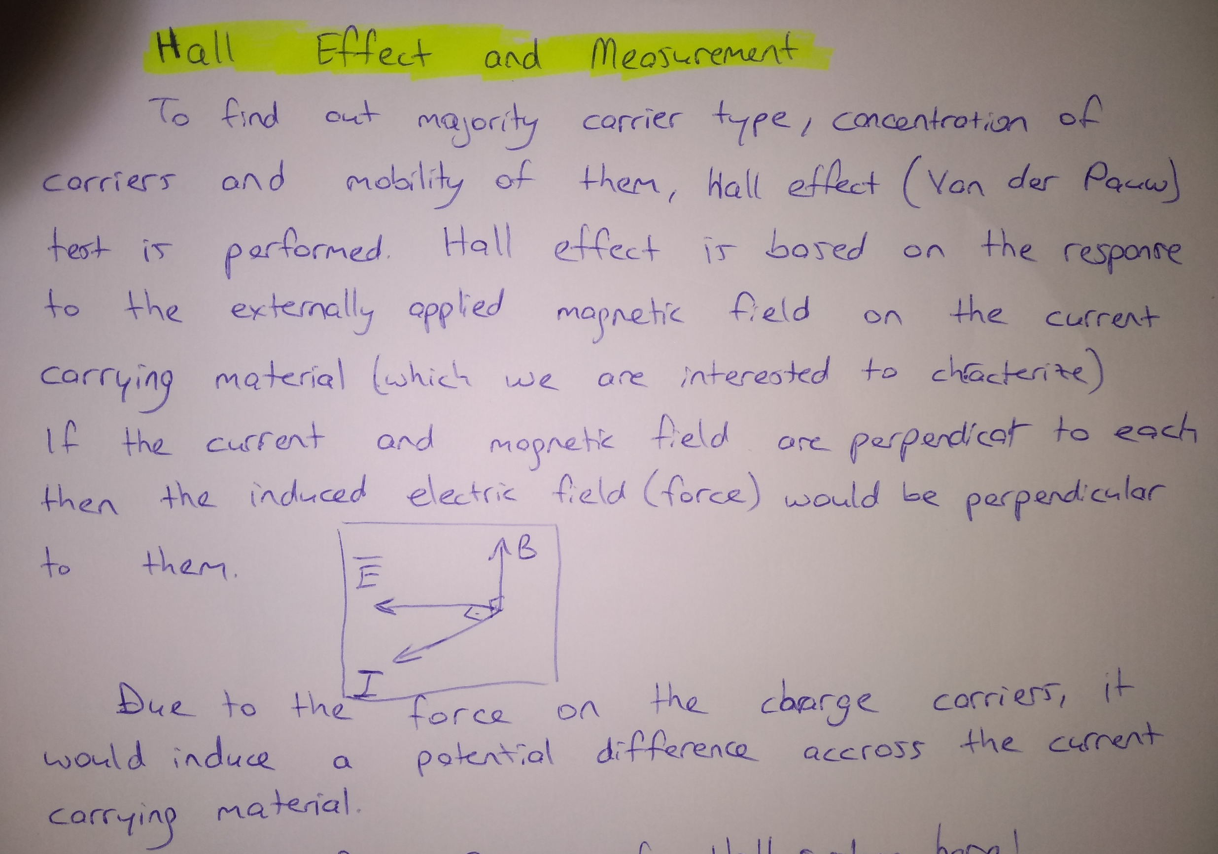

Slide 2
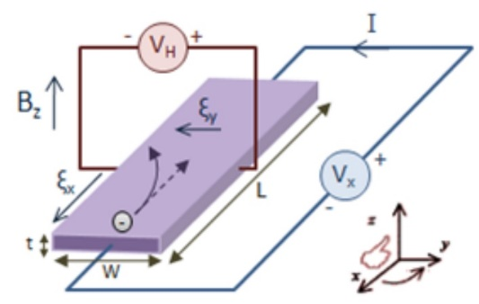

Slide 3
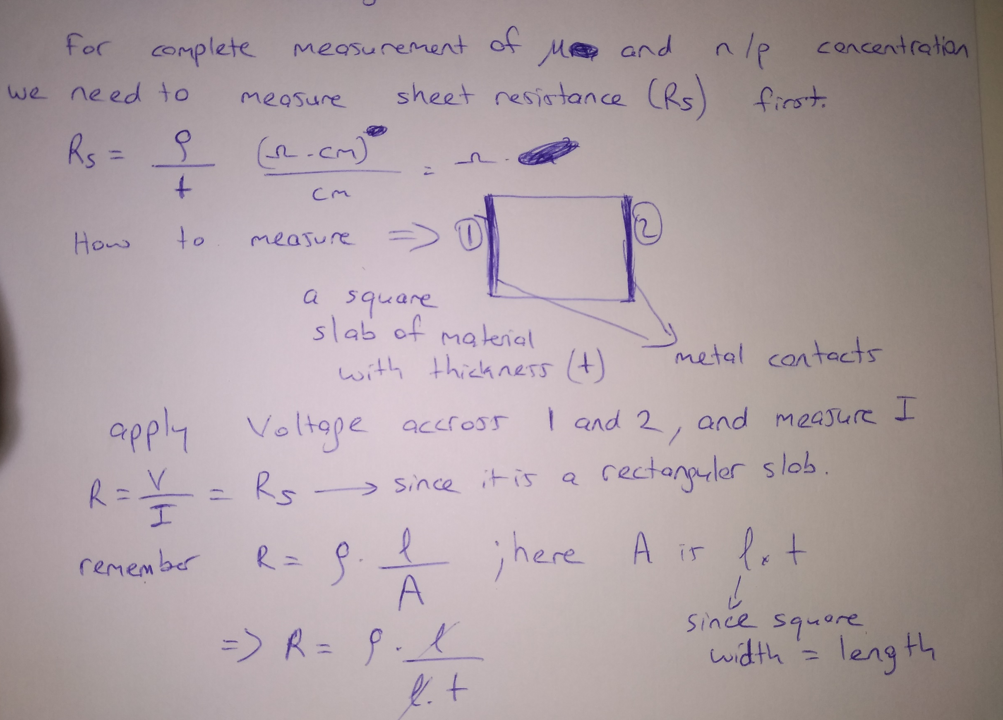

Slide 4
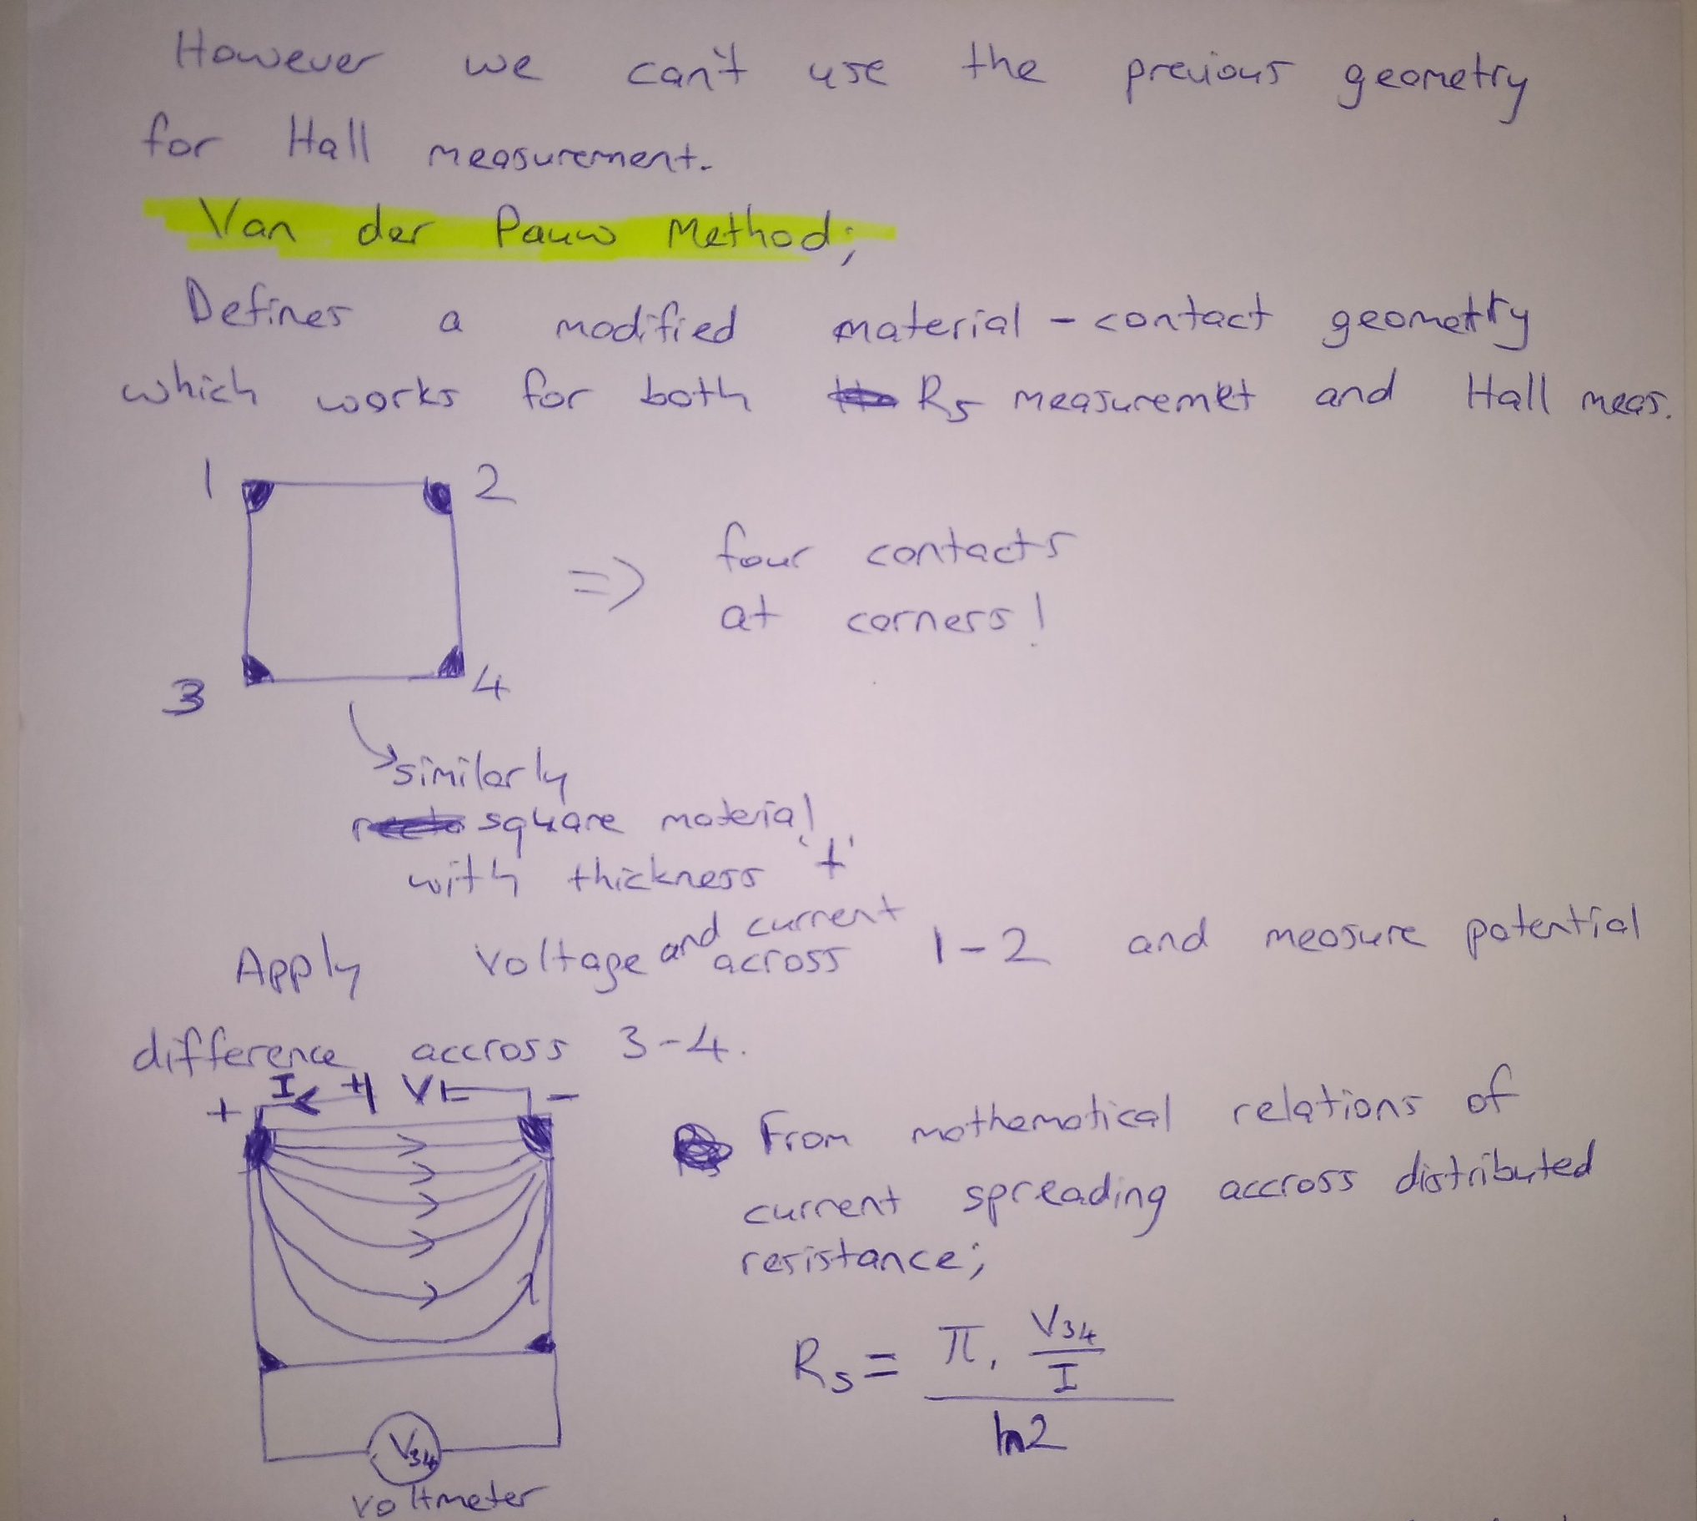

Slide 5
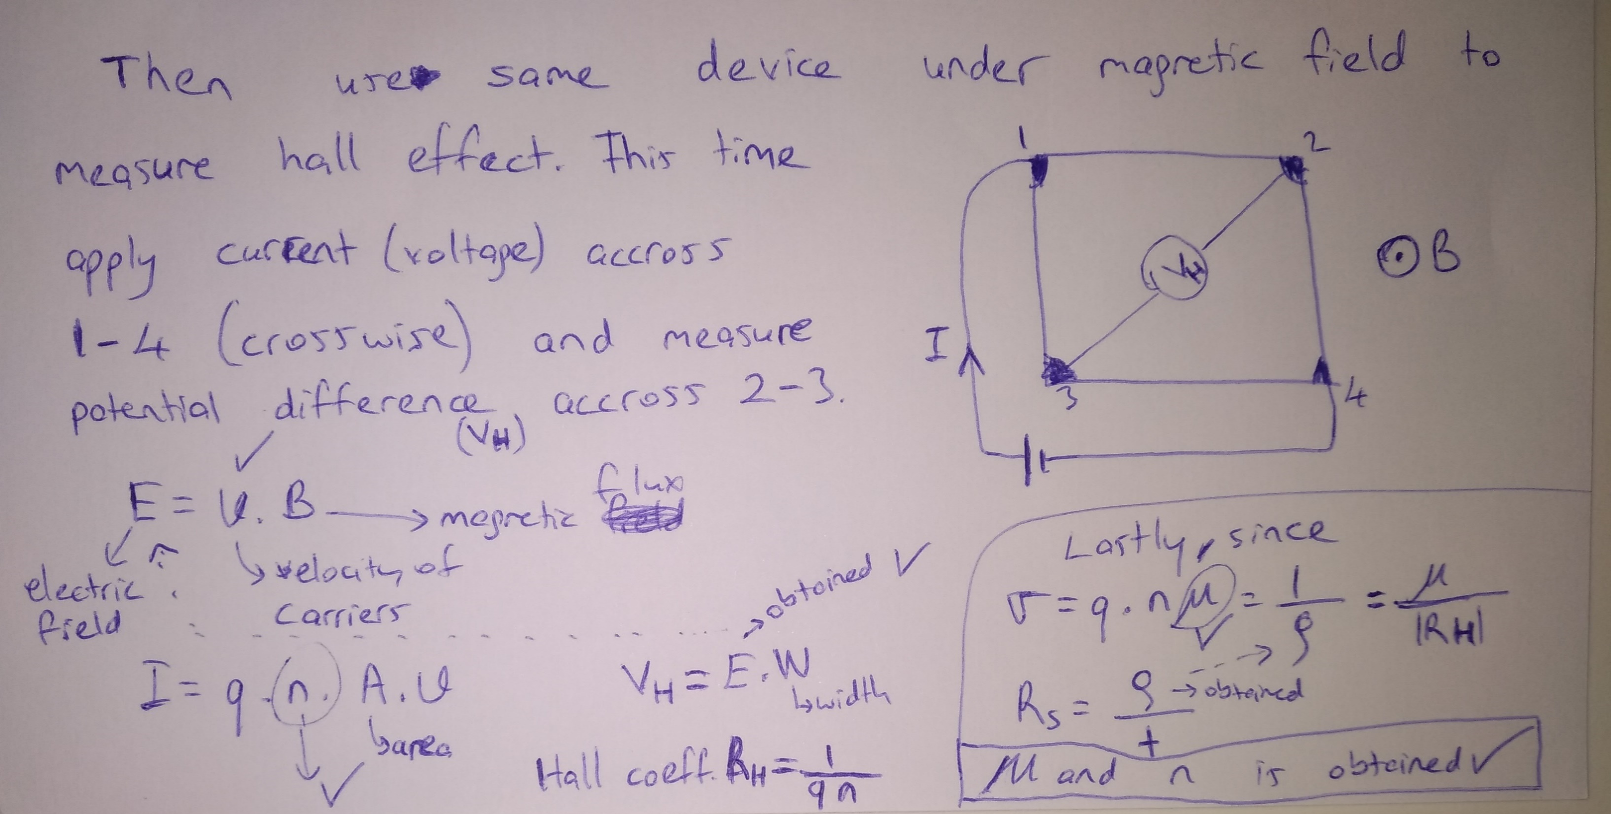

Slide 6
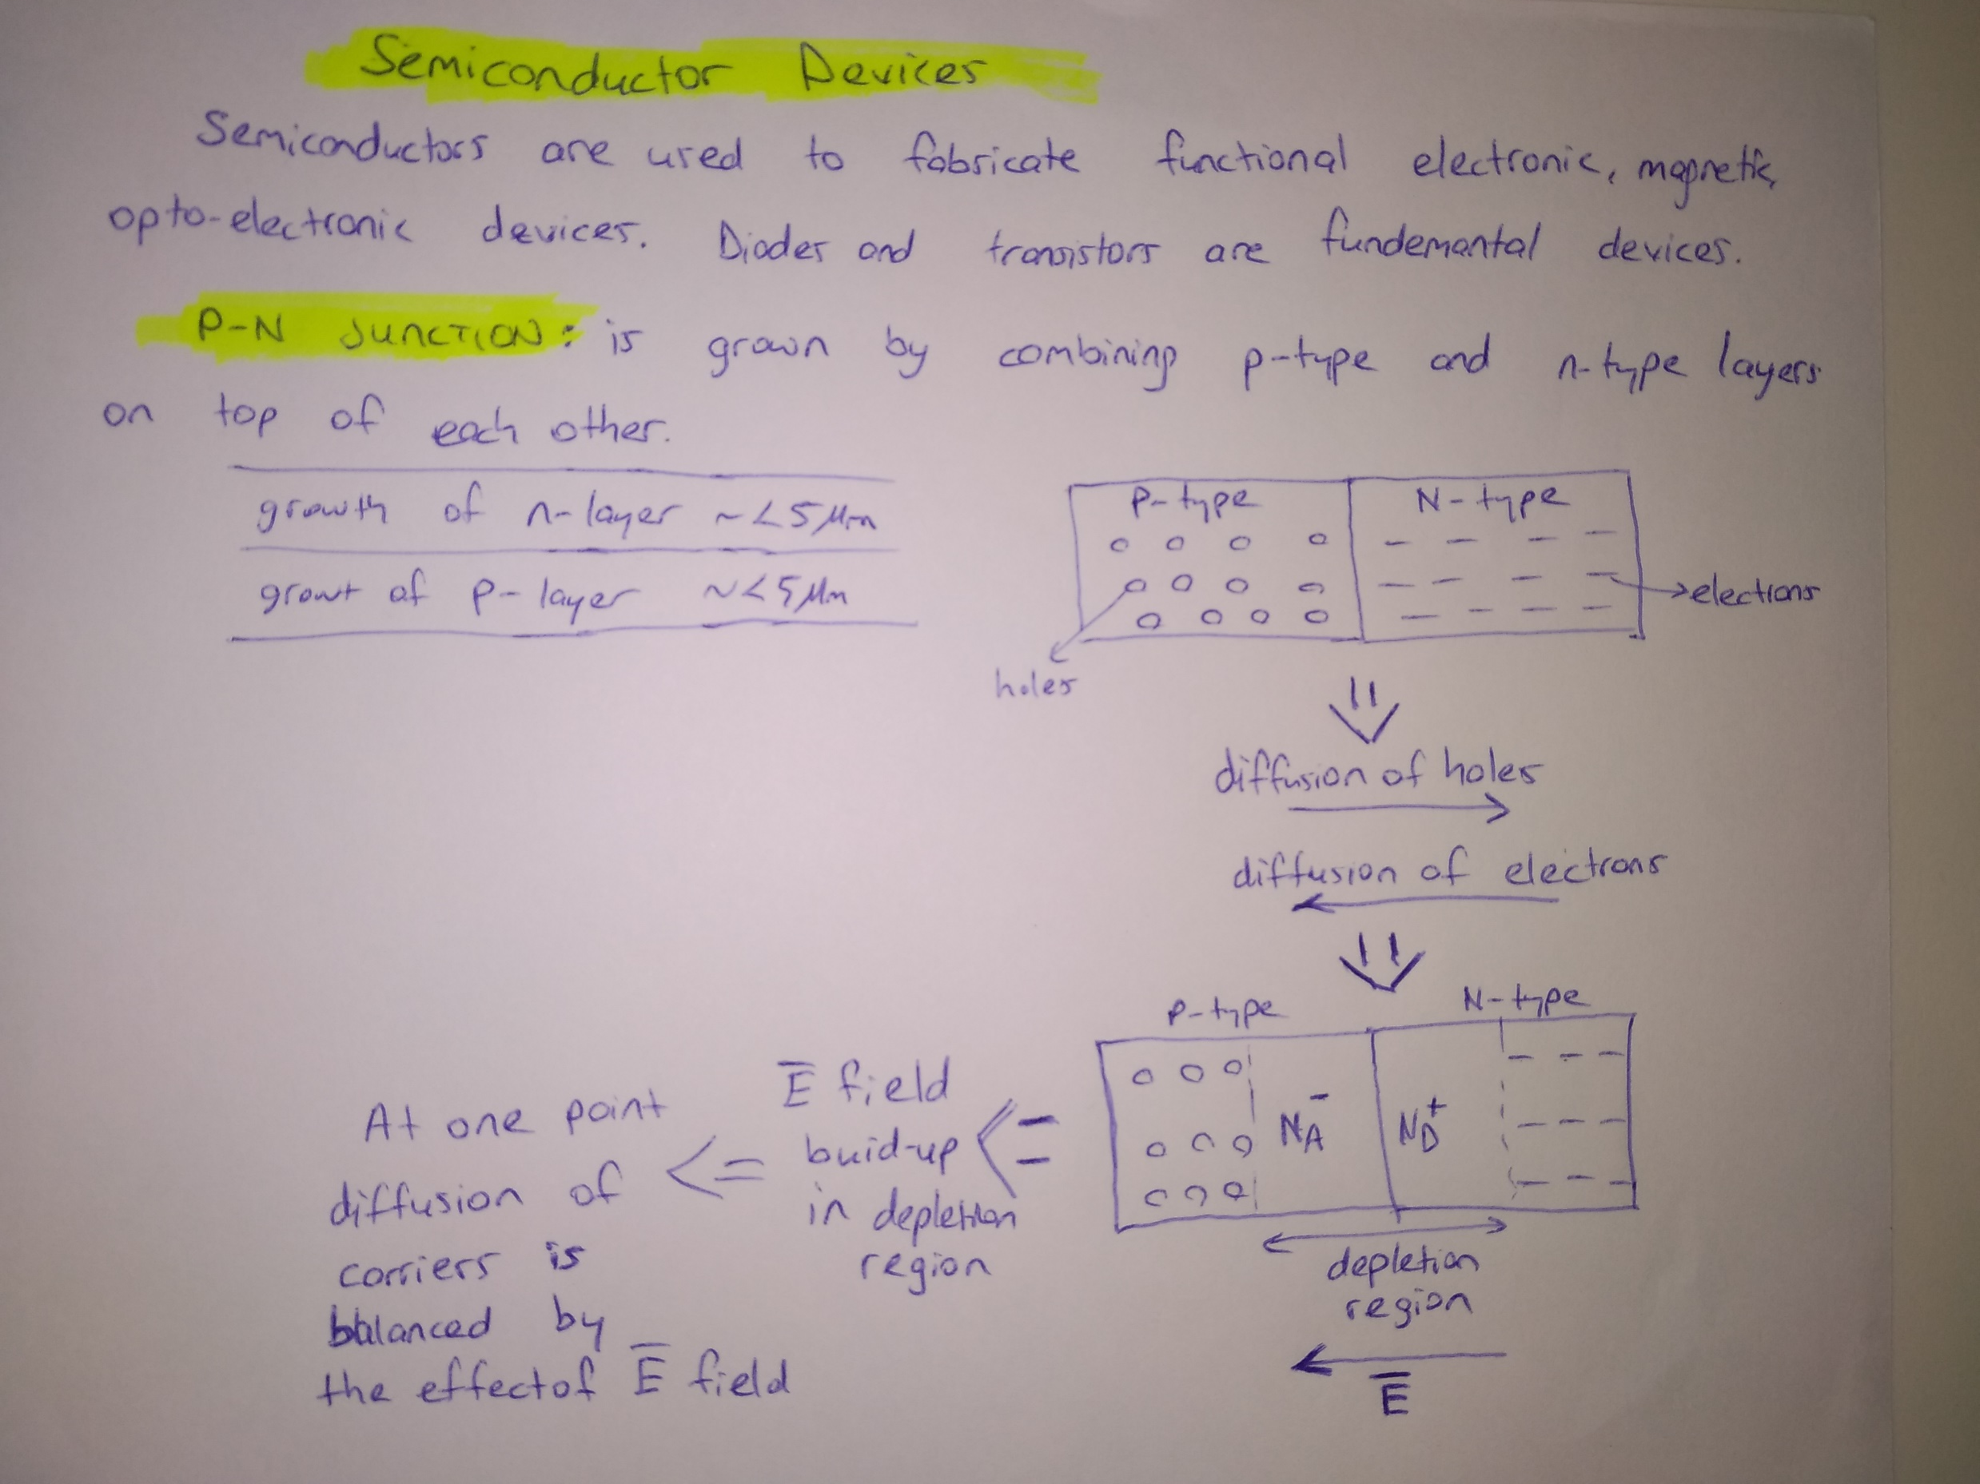

Slide 7
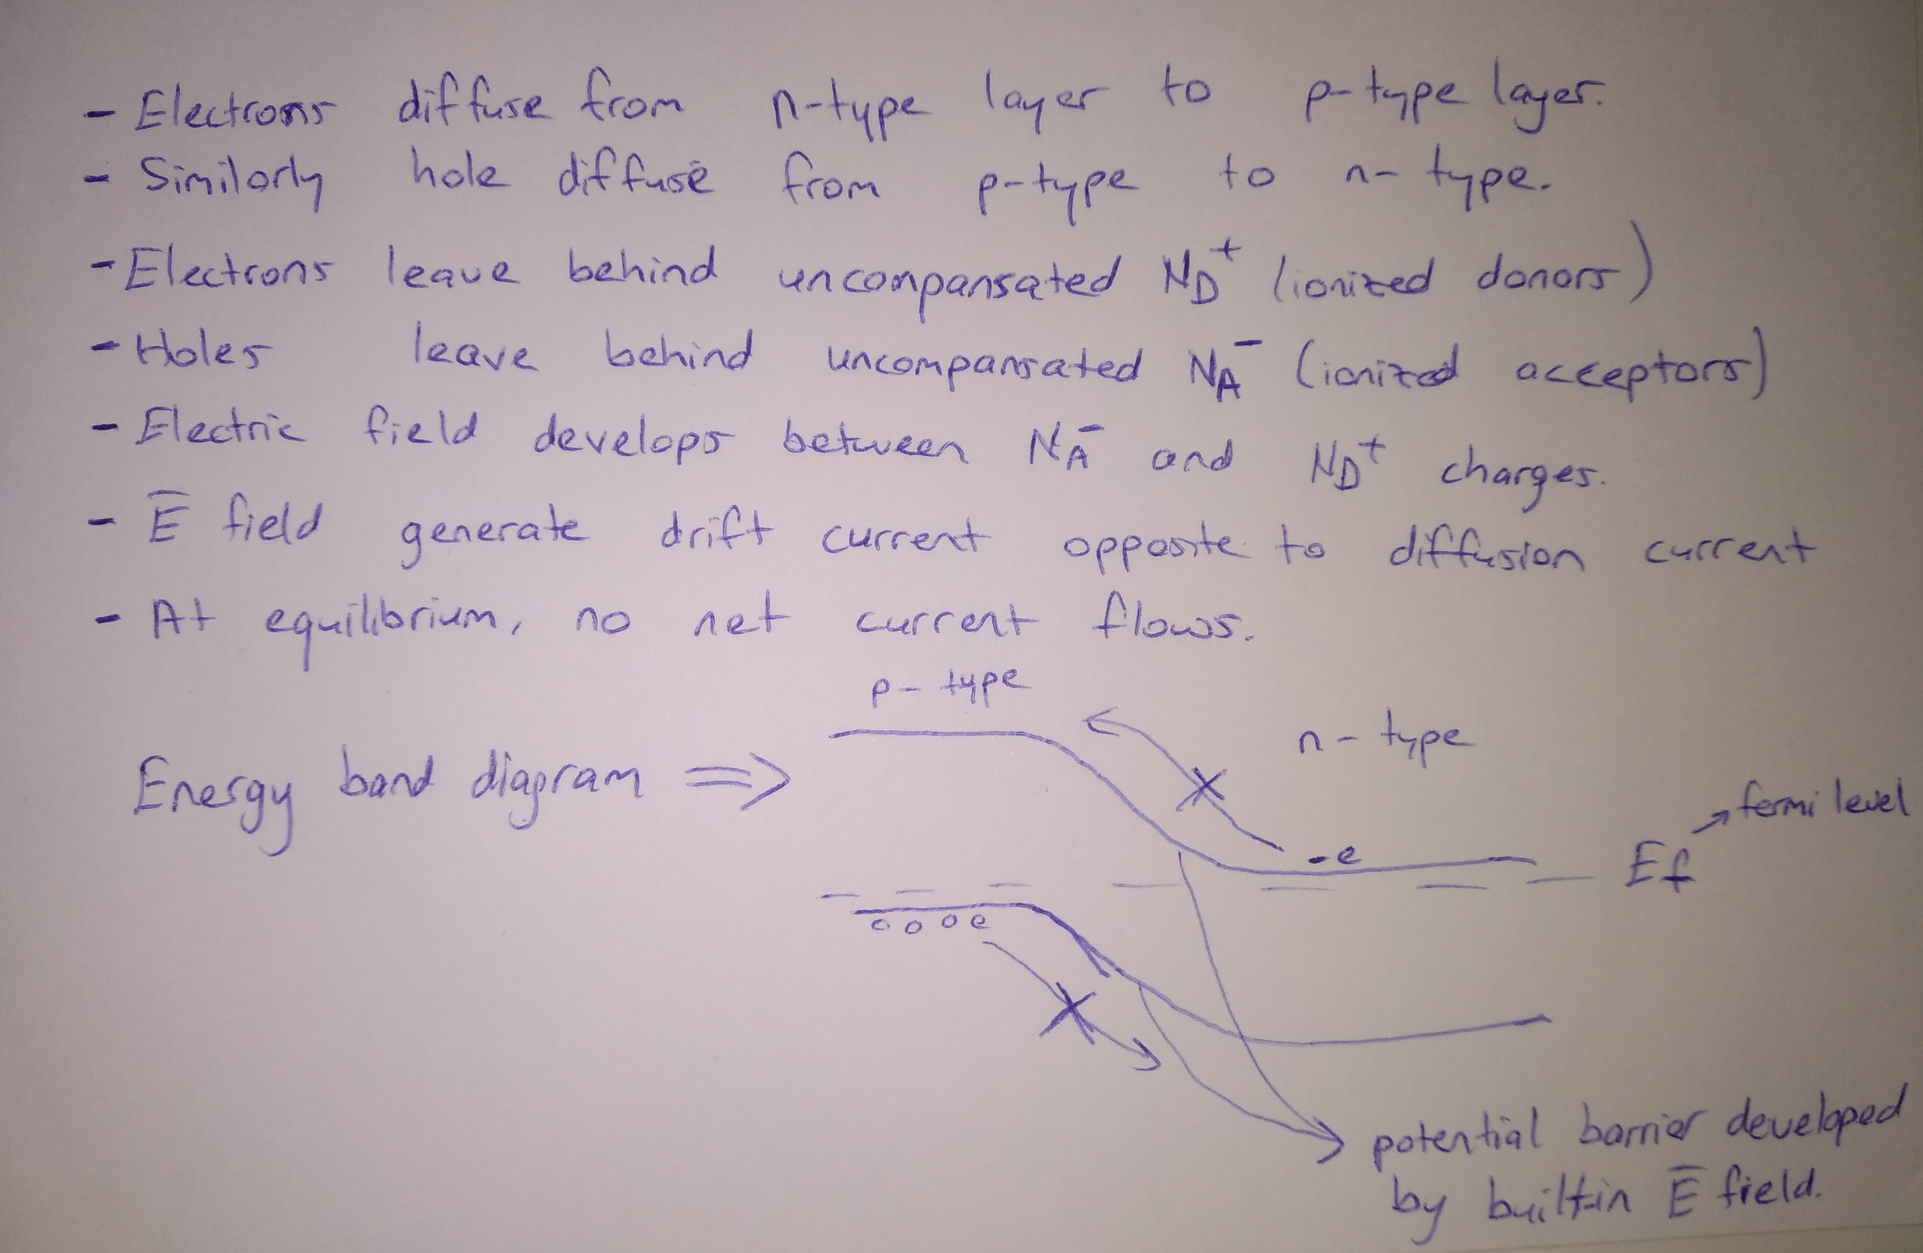

Slide 8
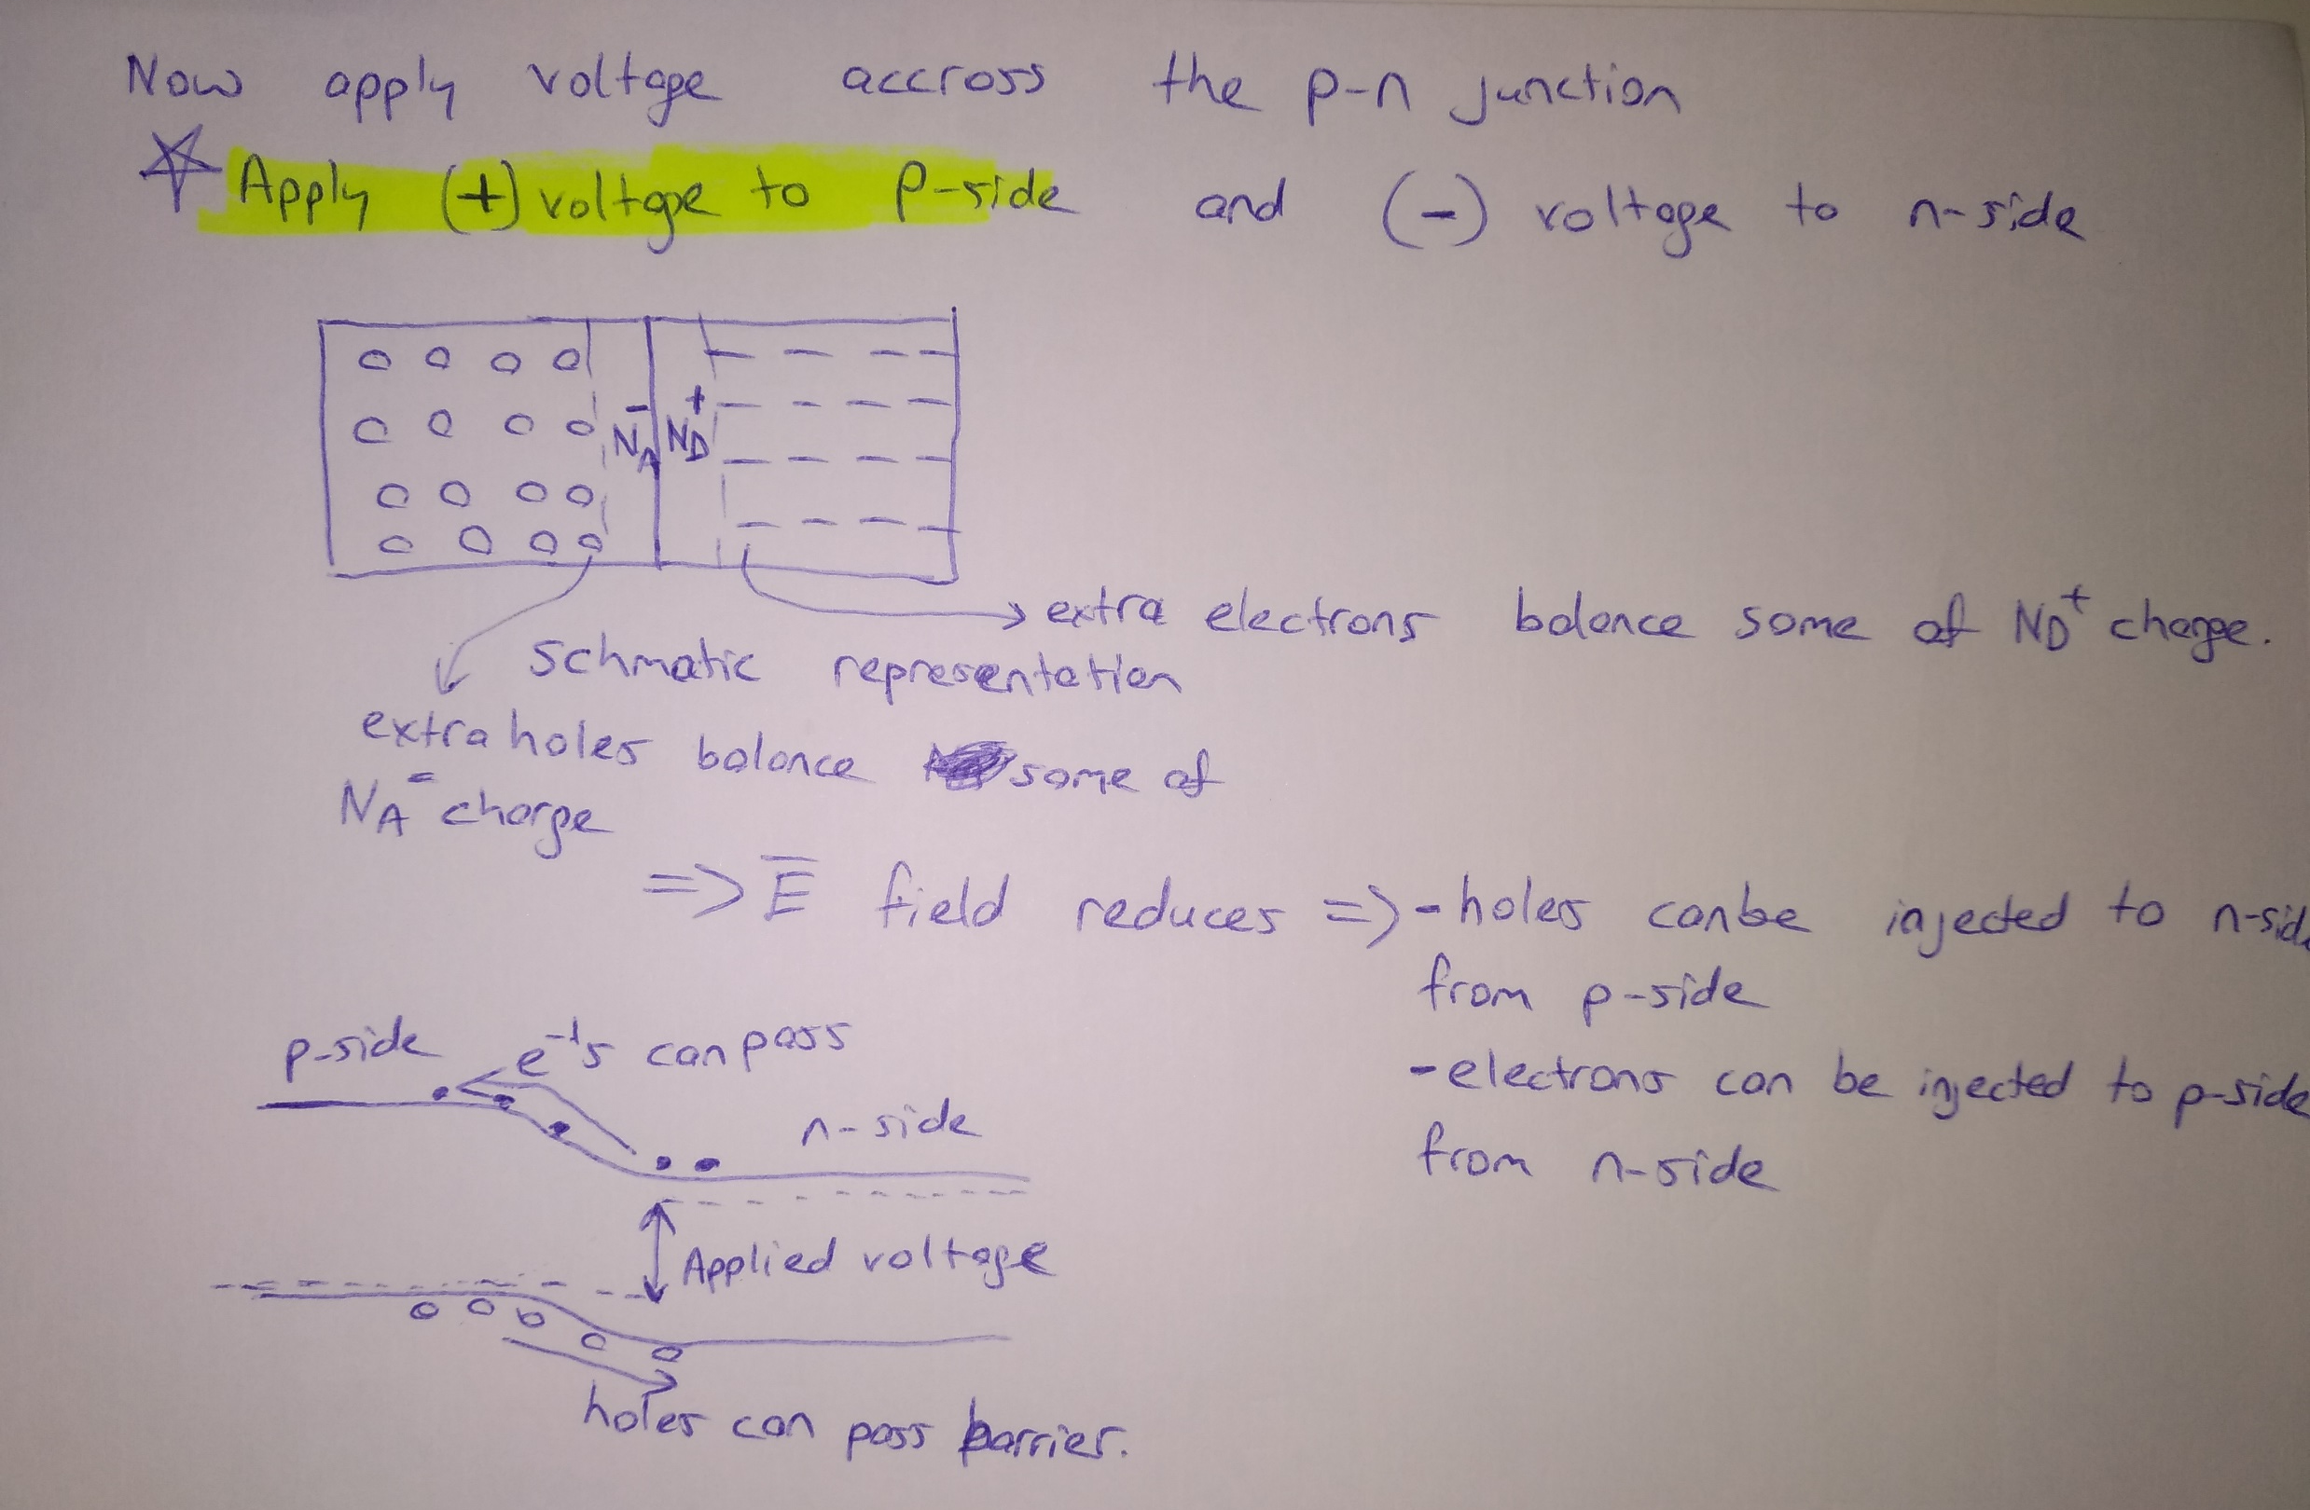

Slide 9
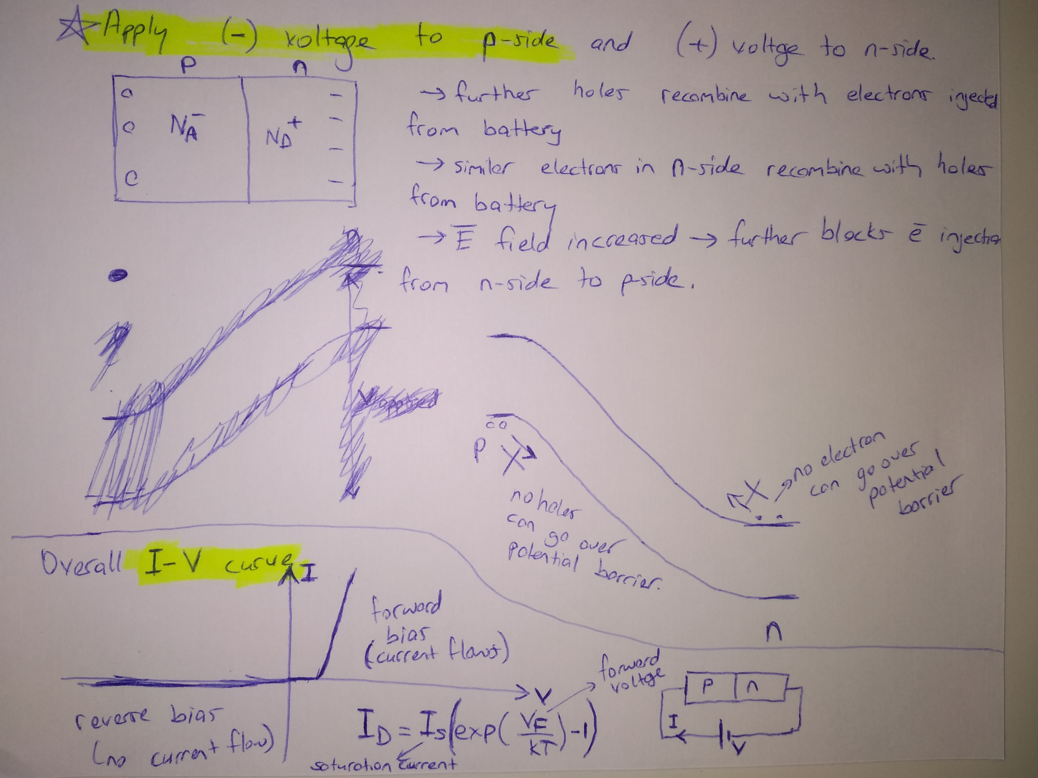

Slide 10
Bipolar Junction Transistor (BJT)
Emitter – base junction is forward biased and a small signal bias is also connected as input bias => A small change in voltage results large hole injection to base => diode
The holes in base travel in thin base and reach the collector.
The reverse bias in collector attracts the holes and holes current flows on the load resulting in large voltage drop on the load (output voltage).
Since a small input bias controls the large output bias, it has gain and shows transistor operation.

Slide 11
Metal-Oxide-Semiconductor Field Effect Transistor (MOSFET)
p- Channel Mosfet Design
Applying small (how small depends on the design) positive bias on Gate metal attracts electrons in p-substrate and generates n-type channel region below the oxide layer in p-region
If a large Source – Drain voltage is applied, large current flows fromn-type source to n-channel to n-type drain.
If no gate bias or a negative gate bias is applied then no n-channel channel formed so no electron current can flow across the MOSFET.
Since a small gate bias and gate current controls the large current flow, there is gain and transistor operation in the device.

Slide 14
