Slide 1
BULB SECTION GEOMETRIC PROPERTIES
Geometrical characteristics of bulb sections are given.
Presented by both tables and a graph

Slide 2
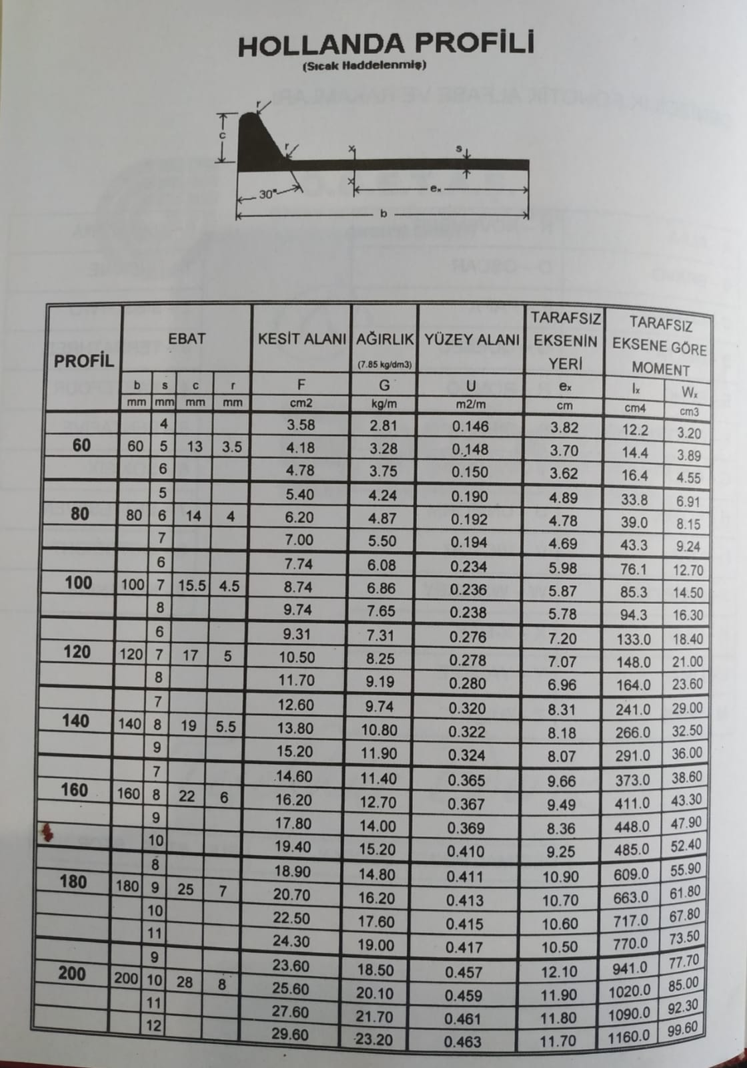

Slide 3
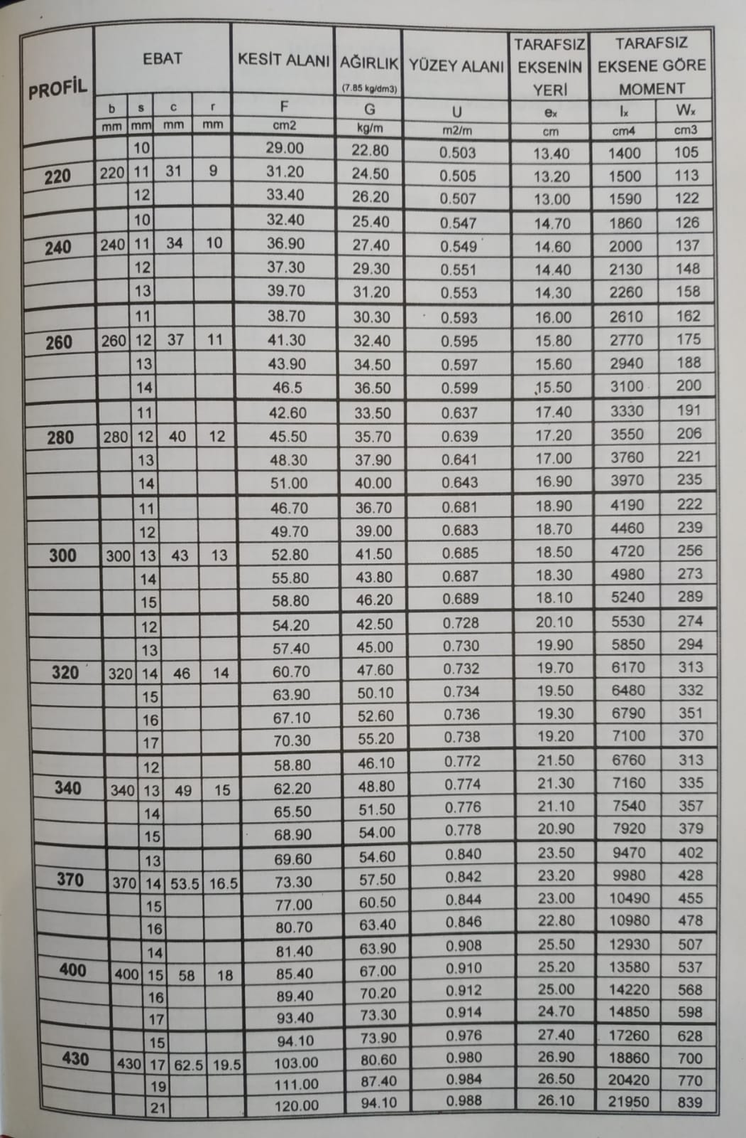

Slide 4
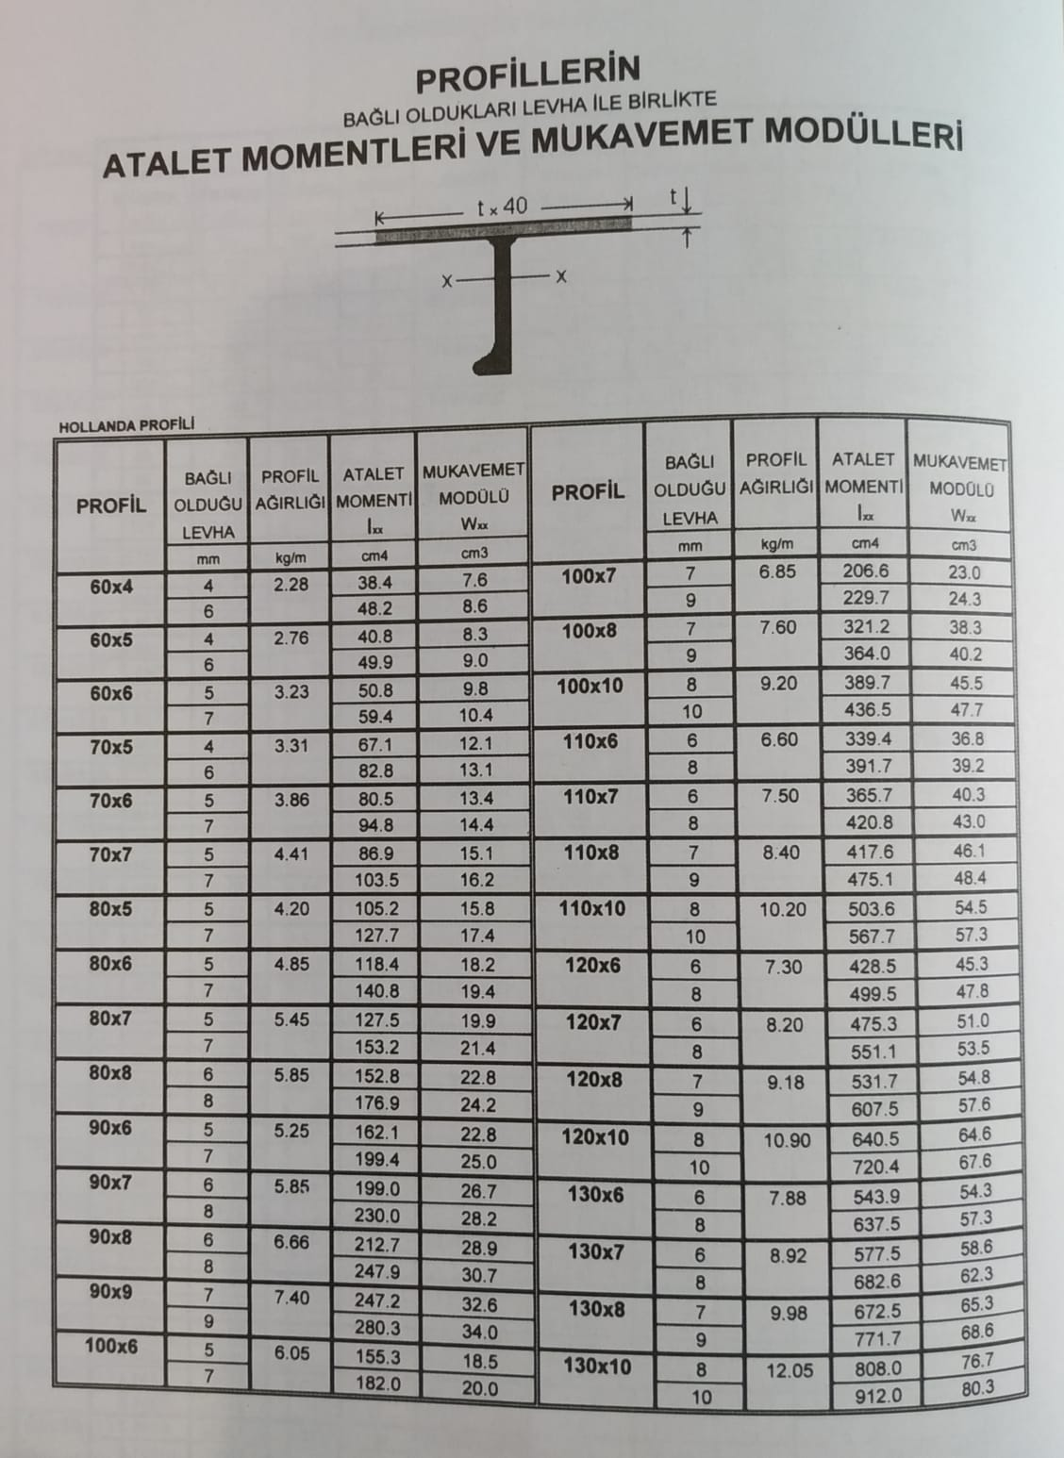

Slide 5
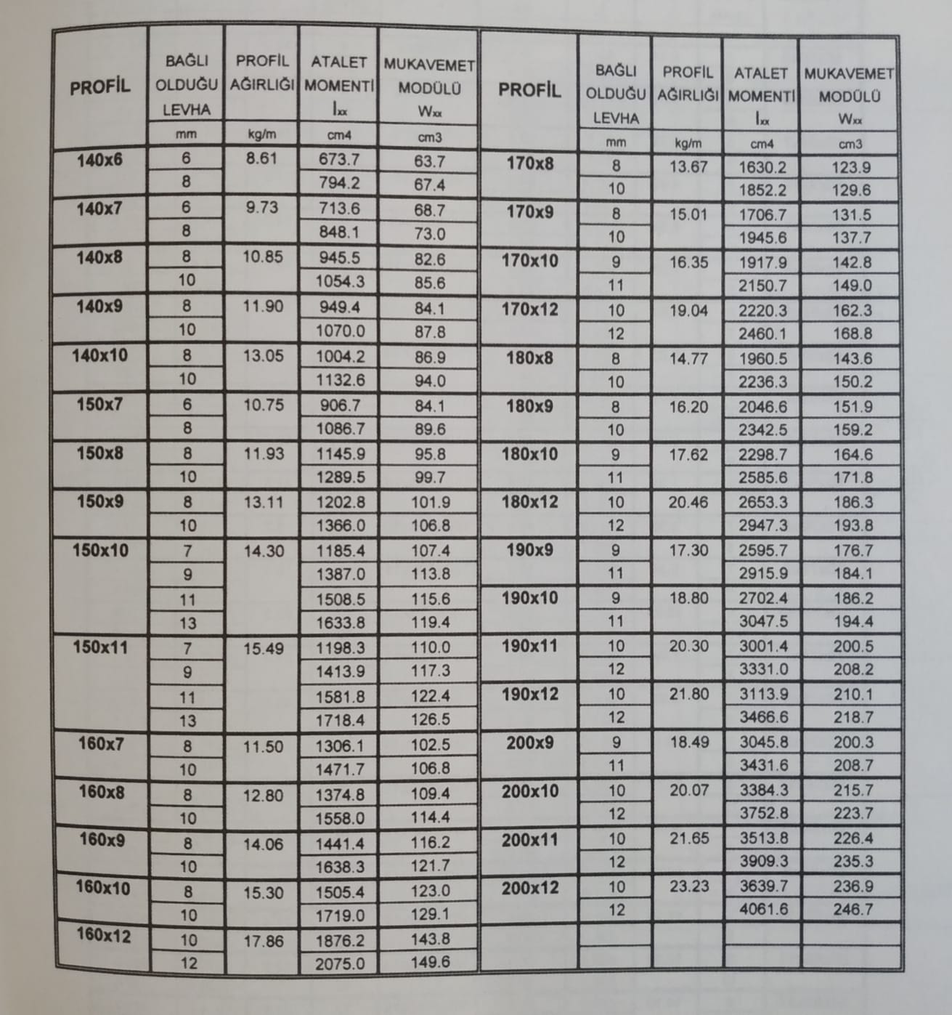

Slide 6
