Slide 1
Segregation
.

Slide 2
Segregation results from the various ways in which the solute elements can become redistributed within the solidified structure.
Types of Segregation
Microsegregation (Short range, grain size or less)
Cellular
Dendritic
Grain boundary

Slide 3
Macrosegregation (Long range, grater than a few grains)
(i) Occurring prior to solidification
Gravity
Ludwig-Soret effect
(ii) Occurring during solidification
Normal
Inverse
Freckle
Banding

Slide 4
Microsegregation
Cellular segregation
Cellular structure develops in single-phase alloys during initial stages of growth with low degrees of constitutional undercooling.

Slide 5
As the interface advances, the liquid adjacent to the interface is richer in solute for values k₀<1 and is depleted in solute for k₀>1. Once the rounded cell projection is stabilised, solute will rejected (k₀<1) from the sides of the projection as well as from the top. Since the projection rejects solute laterally, an accumulation of solute will occur in the cell boundaries.
The most severe segregation will be expected at the junction points (nodes) in the hexagonal array. The variation in solute concentration from the cell centre to the cell boundaries is known as cellular segregation. It extends over distance of the order of the cell size, i.e. approximately 5x10⁻³ cm. To some extent diffusion during cooling of the solid will reduce the degree of cellular segregation.

Slide 6
Dendritic segregation
The microsegregation that results from solute redistribution during dendritic solidification leads to coring, i.e. a variation in the solute concentration between the centre and the outside of a dendrite arm. In extreme cases the accumulation of solute between the growing dendrite arms can lead to formation of second phases in the interdendritic region in amounts significantly greater than those from the equilibrium diagram.
Microsegregation is more severe across and between primary dendrite arms than secondary dendrite arm. The relative severity of segregation is greatest at low alloy contents, even though here is no fundamental difference in the mode of solidification. Both columnar and equiaxed dendrites exhibit essentially the same microsegregation features.

Slide 7
Solute distribution in a volume element (crosshatched area) between dendrites
Isoconcentration profile in an Fe-25Cr-20Ni columnar dendrite

Slide 8
The dendrite arm spacing defines the range of dendritic microsegregation. Measurements of the dendrite arm spacing as a function of the solidification conditions.
The greater the dendrite arm spacing the more difficult is homogenisation by subsequent heat treatment. For a given alloy heat treated at fixed temperature, the homogenisation time is proportional to the square of the dendrite arm spacing.
Complete elimination of dendritic microsegregation leads to enhanced mechanical properties.

Slide 9
Grain boundary segregation
Grain boundary segregation during solidification arises from two sources.
First, if the grain boundary lies parallel to the growth direction, surface energy requirements give rise to a grain boundary groove where the boundary meets the interface. The groove is typically 10⁻³ cm deep. In the presence of constitutional supercooling conditions are energetically favourable for significant segregation to grain boundary groove. Certainly the experimental evidence shows that solute segregation to this type of boundary is marked for growth with a cellular interface.

Slide 10
Schematic representation of a section through a grain boundary groove

Slide 11
The second type of grain boundary segregation results from the impingement of two interfaces moving with a growth component normal to each other. For growth of macroscopically planar boundaries (cell may exist without affecting the situation) in a solidifying alloy there are solute pile-ups (k₀<1) which converge to produce a region of extremely high solute concentration. The impingement boundary receives, in effect, two terminal solute transients. This type of segregation should properly be considered as a form of macrosegregation.

Slide 12
Formation of a grain boundary by impingement (schematic)

Slide 13
Macrosegregation
Long-range segregation can result either from changes that occur in the liquid before the solidification front has proceed very far or as the result of fluid motion in the mushy zone behind the solidification front.
Gravity segregation
This type segregation normally occurs during the early stages of solidification before or just after the initial growth nuclei have formed. It is the result of density differences which lead to differential movement within the liquid.

Slide 14

Stokes equation
V: Sink velocity, r: Radius of particle, η: Viscosity
ρ: Density of solid, σ: Density of liquid
If liquid alloys are made up from atomic species of very different densities, e.g. copper (density 8.24 g/cm³)-lead (density 10.04 g/cm³) alloys, it is commonly observed that the liquid becomes richer at the top in the lower density species, being correspondingly depleted at the bottom and vice versa.
Some tin based bearing metals contain copper and antimony. During the solidification of these alloys two primary intermetallic phases are formed: Cuboids of SbSn (density is less than the liquid), needles of Cu₆Sn₅ (density is greater than the liquid). In isolation, the SbSn cuboids will float at the surface while correspondingly, the Cu₆Sn₅ will sink.
$$V=\frac{2gr^{2}(ρ−σ)}{9η}$$

Slide 15
The Ludwig – Soret effect
This is a very minor but nonetheless interesting form of behaviour where apparently homogeneous liquid of uniform composition held in a temperature gradient becomes non-uniform in composition. For example with lead-tin, copper-tin, and zinc-tin alloys held in a temperature gradient it was found that the tin always migrated to the higher temperature end. Quite large concentration differences could be produced in this way, e.g. for a 36% lead in tin alloys the excess lead content at the cooler end was 5.28%. Again convection must cause a significant divergence from ideal behaviour.

Slide 16
Normal segregation
This type of segregation is usually associated with the movement of a planar or almost planar interface through the liquid and is considered in terms of the solute distribution parallel to the growth direction.
It should be noted that this form of solute distribution is only expected if the interface has not degenerated to a very complex dendritic form, thus only at low overall solute concentrations.
At high solute concentrations a well developed dendrite structure occurs and under these conditions fluid flow between the dendrites becomes dominant. Normal segregation is no longer expected.

Slide 17
Normal segregation in a columnar ingot solidified with an almost planar interface (schematic)

Slide 18
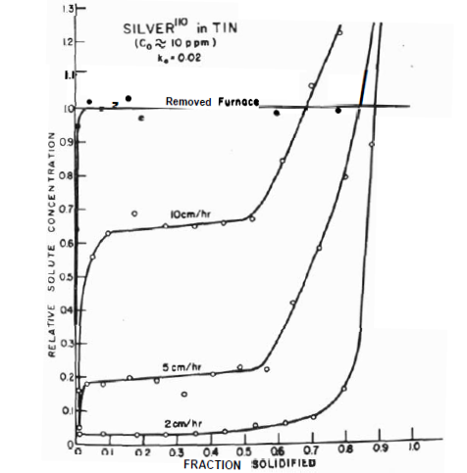
The relative solute concentration of silver in tin plotted as a function of the fraction solidified for a rod progressively solidified from one end at the rates indicated.

Slide 19
Inverse segregation
If we consider the solidification of an ingot of an alloy with k₀<1 as outlined above, we would expect the last liquid to solidify to be solute rich.
If however there is pronounced dendritic growth solute concentrations build up between the dendrites and there is fluid flow in the interdendritic spaces to compensate for the volume changes accompanying solidification.

Slide 20
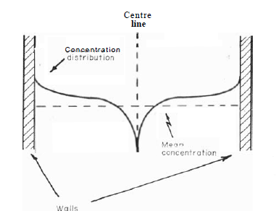
Inverse segregation in a ingot solidified with a dendritic interface (schematic)

Slide 21
For most metals there is a contraction on solidification and thus the flow takes place in a direction opposite to the growth direction.
As a result, solute-rich liquid is fed down the channels between the dendrites to give abnormally high solute concentrations at the outer regions of the ingot.
The condition where the solute distribution is opposite to that expected for normal segregation is known as inverse segregation.
In extreme cases of inverse segregation the interdendritic liquid actually bursts through the surface of the cast metal to form exudations. (sweat or bleeding).

Slide 22
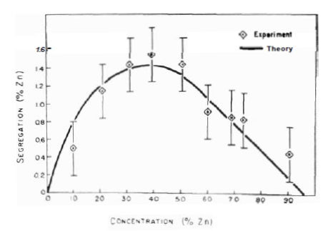
Experimental and theoretical determinations of the maximum inverse segregation in aluminium-zinc ingots

Slide 23
Two observations support inverse segregation
No inverse segregation occurs in alloys which expand on freezing.
The amount of inverse segregation increase with time as solidification progresses and thus as the amount concentration stimulated flow increases.

Slide 24
Freckle
Freckles are chains of equiaxed grains which appear on the surface of some cast metals and the regions enriched in all but the inversely segregated solute.
It has been shown that these are the result of fast flowing liquid jets in the partly solidified zone which are driven by density inversions produced by thermal and solute transport effects.

Slide 25
A freckle line on the surface of a nickel-base superalloy casting

Slide 26
Banding
This form of segregation appears as change in composition and structure in a band parallel to the solid-liquid interface.
The band is produced by growth fluctuations which are the result of thermal or mechanical disturbances.
For instance, in the presence of a solute layer adjacent to the interface, if there is a growth rate fluctuation then changes in the solute boundary layer give rise to compositional variations in the solid.
Banding is very common in fusion welds because of the periodicity of the heat input and is apparent as both substructural bands and interface rippling.

Slide 27
Typical solute distribution in plane front solidification
Structural banding in aluminium alloy fusion weld

Slide 28
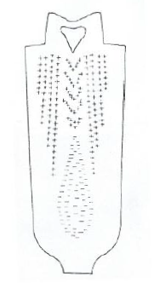
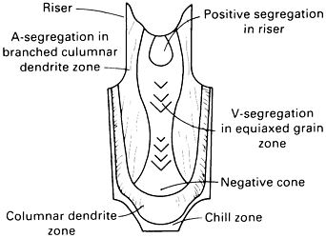
Segregation patterns in ingots
Typical macrosegregation observed in steel ingots.
Typical segregation pattern for sulphur in a killed-steel ingot

Slide 29
The region of high purity material at the bottom of the ingot has been attributed to the gravity segregation of primary dendrites formed by dendrite remelting in the columnar zone or by nucleation on inclusions and also constrained convective fluid flow. Model studies lend considerable support to the gravity segregation mechanism.
The regions of positive segregation have two characteristic forms. The outer bands are referred to as A-segregates and are arranged as rope-like stringers of segregation located on the surface of cones with their bases at the base of the ingot. They occur predominantly in a zone near and almost parallel to the end of the columnar zone.

Slide 30
Inner bands of V-segregates also occur which consist of fairly uniform segregate distributions on the surfaces of cones with their points downwards. These occur at the ingot centre in the equiaxed zone.
The A-segregates seem to be the result of channelled flow in the interdendritic regions of the columnar zone whereas the V-segregates which appear late in the solidification process, are apparently consequence of the general settling of crystals in the equiaxed zone.
In either event, it is clear that interdendritic flow o-plays a most important part in determining the overall macrosegregation patterns in solidifying ingots.

