Slide 1
Ceramic Tiles
Elif Gökhan
Kaleseramik Çanakkale Kalebodur Seramik Sanayi AŞ
09.5.2022

Slide 2
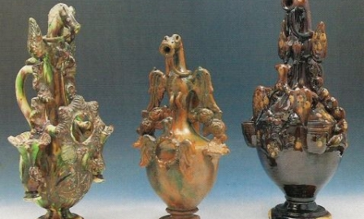
History of Ceramics in Turkey
Water, soil and fire…
Arts of ceramics in Anatolia…
BC 6000 in Çatalhöyük (2000 years before China)
Many kind of ceramics for daily life.
Tradition and art, china
Seljuqs and Ottoman

Slide 3
Production of Ceramics in Turkey
TURKEY
3 rd of Europe and 6 th of the world
%3,2 of the total amount of production of the world, %11 of the total amount of production of Europe
The fourth country by over 104 milyon m² export capacity
The first country of Europe by production capacity of 17 million ceramics sanitary ware products
Employment capacity is 220.000

Slide 4
Types of Ceramic Products
(*) Types of ceramic products:
According to contents of products:
1. Silicate ceramics: Clay, Caolin, Feldspar, Quartz, Pegmatit, Calcite
2. Oxide ceramics: Mono oxide or mixture oxide ceramics
3. Silicate and non Oxide ceramics: No oxygen inside of ceramics
B) According to usage of products:
1.Traditional (silicate) ceramics:Building materials and tableware ceramics
2. Refractory: Industrial kilns
3. Advanced technology ceramics: Use in Machinery
C) According to size of the elements:
1. Thin ceramics products
2. Big ceramics products (*) Afyon Kocatepe Ünv. Prof.Dr.Ö.F..Emrullahoğlu,Yrd.Doç.Dr.S.Akpınar

Slide 5
Ceramic Tiles
Body preparation unit:
In body preparation unit base of the ceramic tiles are prepared.
Grinding: The purpose of grinding is to reduce to size of the raw materials to a final, constant required particul size.
Spray Drying: The purpose of this process is to evaporate a part of the water contained in the slip while forming sphericel particules. Such particules are of a similar size in all types of ceramic tile body.
Raw Materials
Mixture
Grinding
Screening
Storage of mixture
Spray Drying

Slide 6
Ceramic Tiles Production
Masse
Glaze
Forming
Drying
Glazing and decoration
Raw materials and Auxilary materilas:
Clay
Caolin
Quartz
Feldspar
Oxides
Ceramic pigments
Firing
Quality control
Packaging

Slide 7
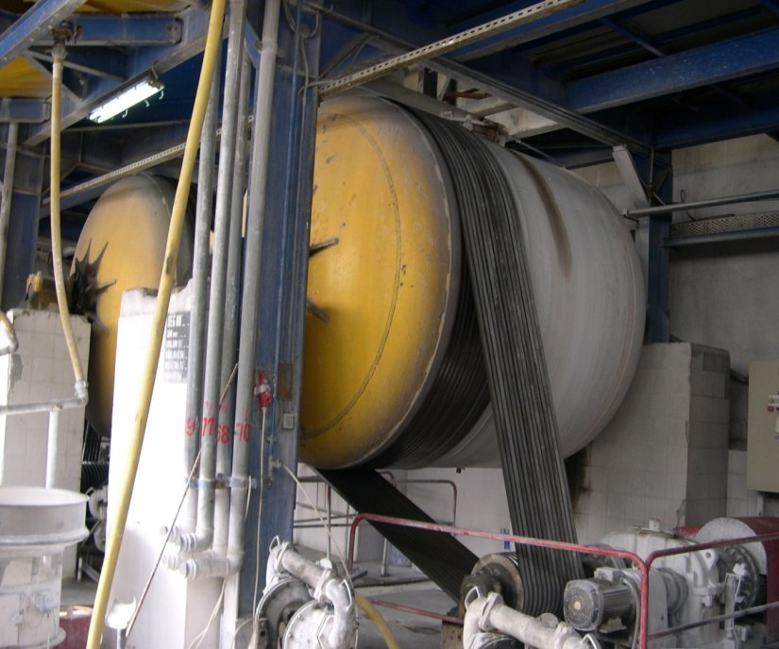
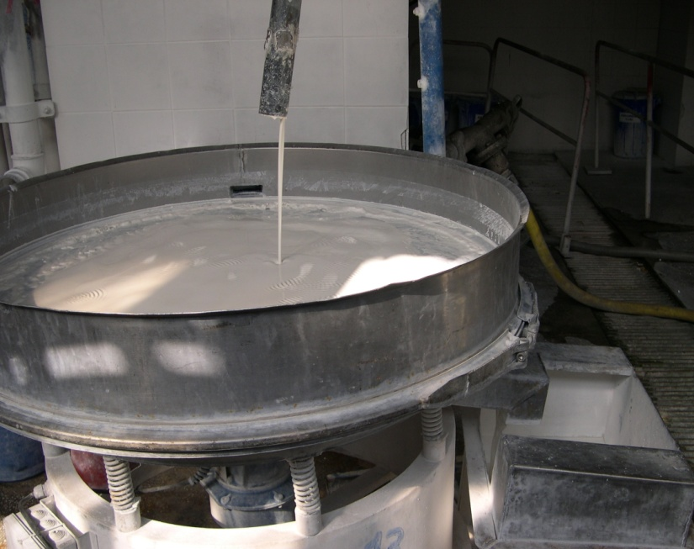
Ceramic Tiles Production
mills
screens
Raw materials are ground with water in the mills and become mixtures by means of chemicals.
The mixtures are screened in order to take the particules etc.
In spray dryers the mixture becomes spherical granules by evaporating the water.

Slide 8
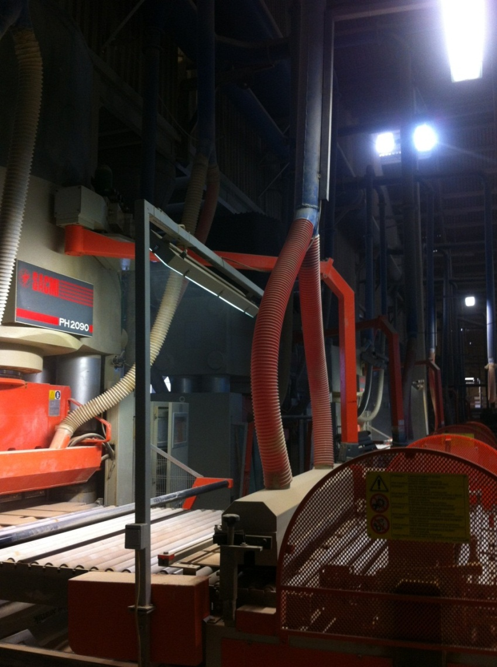
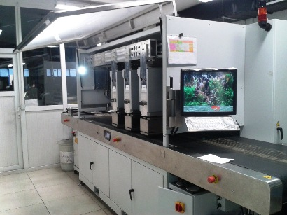
Ceramic Tiles Production
Decoration
Equipment of ceramic tiles production:
Press: Granulated mixture is transfered to
press in order to get shape.
Decoration: Digital printing machines is used in order to apply designs on to surface of ceramic tiles.

Slide 9
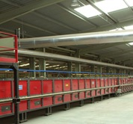
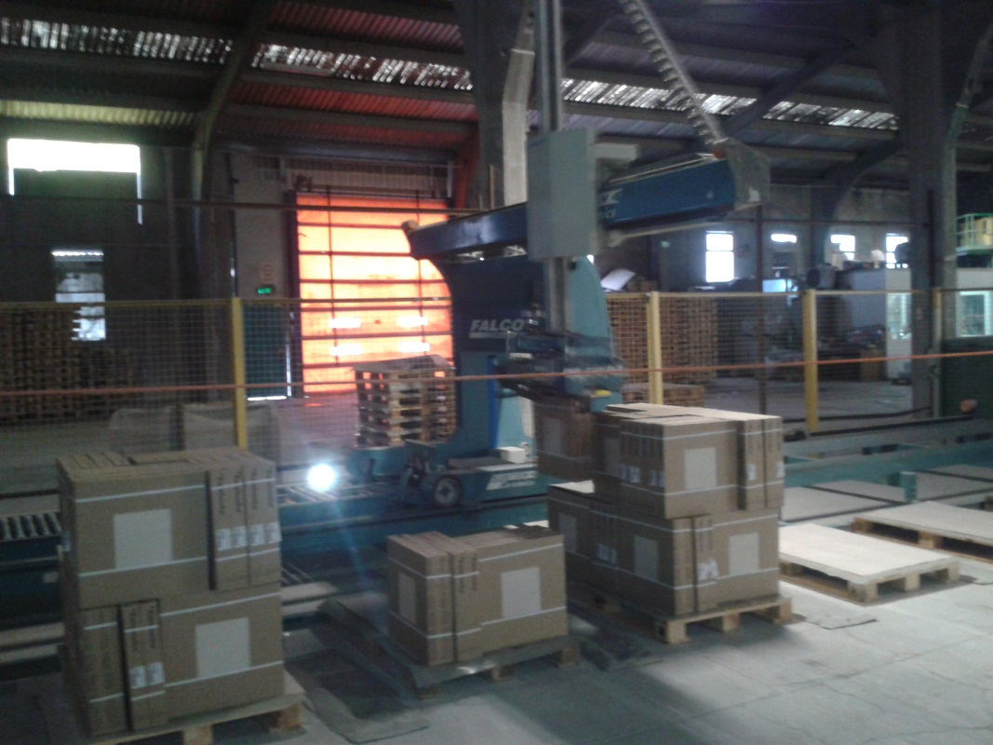
Ceramic Tiles Production
Kiln
Packaging
Equipment of ceramic tiles production:
Ceramic tile kilns have different divisions at different temperature. Firing in kilns occurs about 1250-1280 ⁰C.

Slide 10
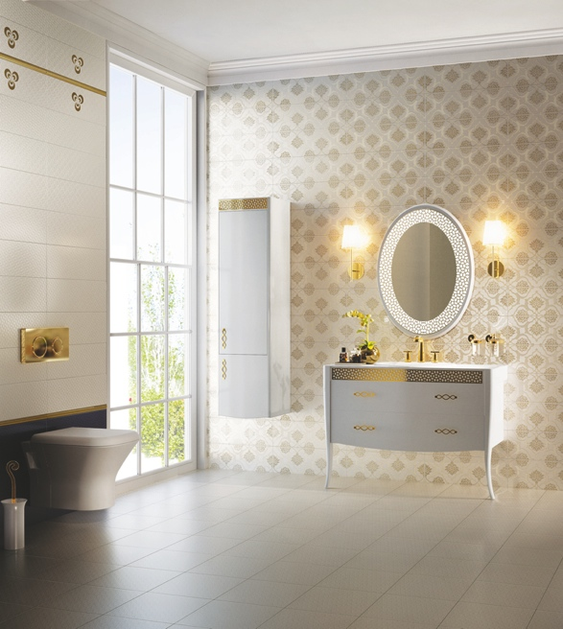
Ceramic Production-Environmental Impacts

Slide 11
Ceramic Production-Environmental Impacts
Environment Sustainability
Waste water
Emission
Waste management
Recycling
Efficiency of natural resources
ISO 14001
Environmental Labelling

Slide 12
Ceramic Production-Environmental Impacts
Waste Water Treatment Systems
Waste water occurs by washing of equipment such as tank, mill, basin, spray dryers and washing of floors in production areas.
Waste water
Screening
homogenization
Sediman tation
Aeration basin
sedimantation
discharge
Control parametres:
pH, SS(Suspended Solids),COD(Chemical Oxygen Demand), Pb, Cd, Zn

Slide 13
Ceramic Production-Environmental Impacts
Air emissions control:
The dust occurs on the production line while mixing, conveying, pressing of raw materials. The dust are handled on the air filtration systems either dry or wet systems and recycled in the process.
Waste gasses Energy source , Process
Natural gas NOx, SO2, Cl, Fl

Slide 14
Ceramic Production-Environmental Impacts
Waste Management:
All wastes occurs in production, maintenance, offices and such departments are handled according to their types.
Categorization collecting: All wastes are categorized and collected seperately.
Storage: All wastes are stored temporarely in storage places. There are two kinds of storage areas which are hazardous or non hazardous.
Recycling or disposal: Wastes can be recycled in the production or wastes are sent to the companies in order to recycling and disposal.
Reduction of the waste at the place where the waste occurs must be important.

Slide 15
Productivity and Innovation
Heat recovery: Firing process is the most energy use process in the production of ceramic tiles. By heat recovery project , the waste heat air which occurs in cooling area of the kilns is used in the other process such as pre drying, spray drying.
By heat recovery Project 10.012 ton CO2/ year is reduced. This amount of CO2 equals approximately 30.035 trees.
2013: Energy efficiency projects: Ministry of Energy and Natural Sources, Energy Efficiency Industrial Plant 1.
2014: Heat recovery Project: İstanbul Chamber of Industry, Environment and Energy Awards 1.

Slide 16
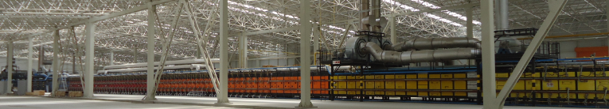
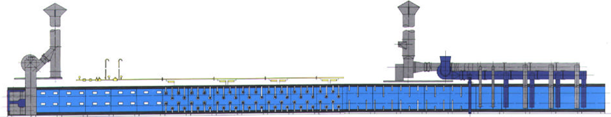
Productivity and Innovation
300 C | 500 C | 800 C | 950 C | 1100 C | 1200 C | 600 C | 500 C | 200 C | 100 C
Kilns

Slide 17
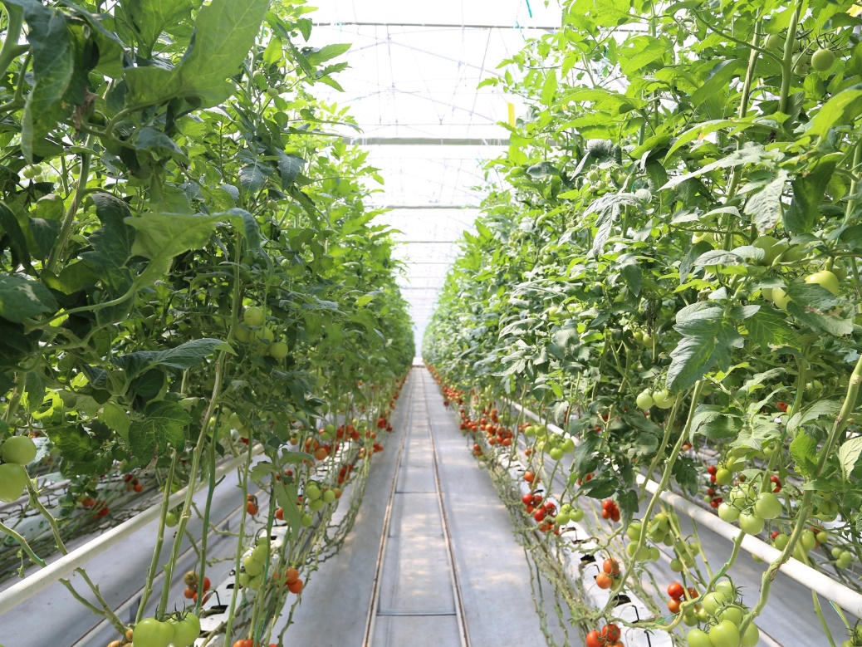
Productivity and Innovation
The excess heat air is used in green house.

Slide 18
Productivity and Innovation
KALESINTERFLEX:
It is the world’s biggest and lightest polished surface porcelain ceramic produced in sizes of 1000mmx3000mm.
%66 less raw material is used in sinterflex production per m2 product.
Sinterflex is translucent. Photovoltaic cells can be combined with the sinterflex. The building which has sinterflex can produce its own energy by doing so.

Slide 19
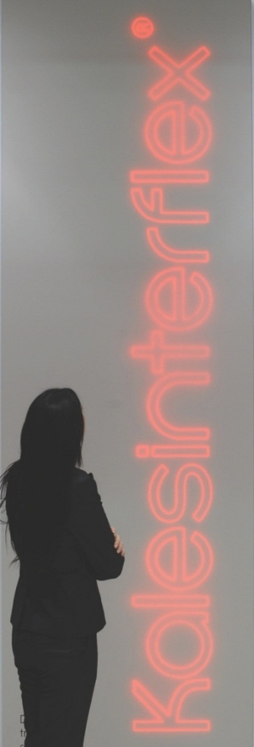
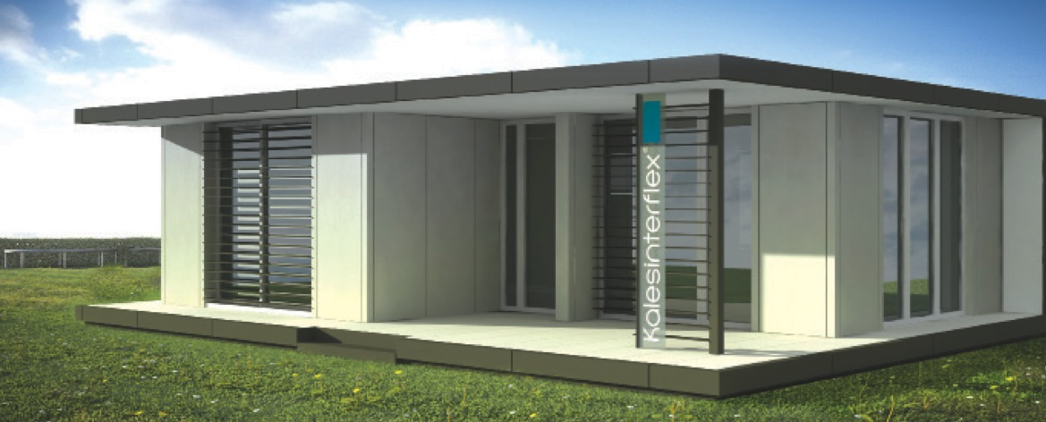
Productivity and Innovation

Slide 20
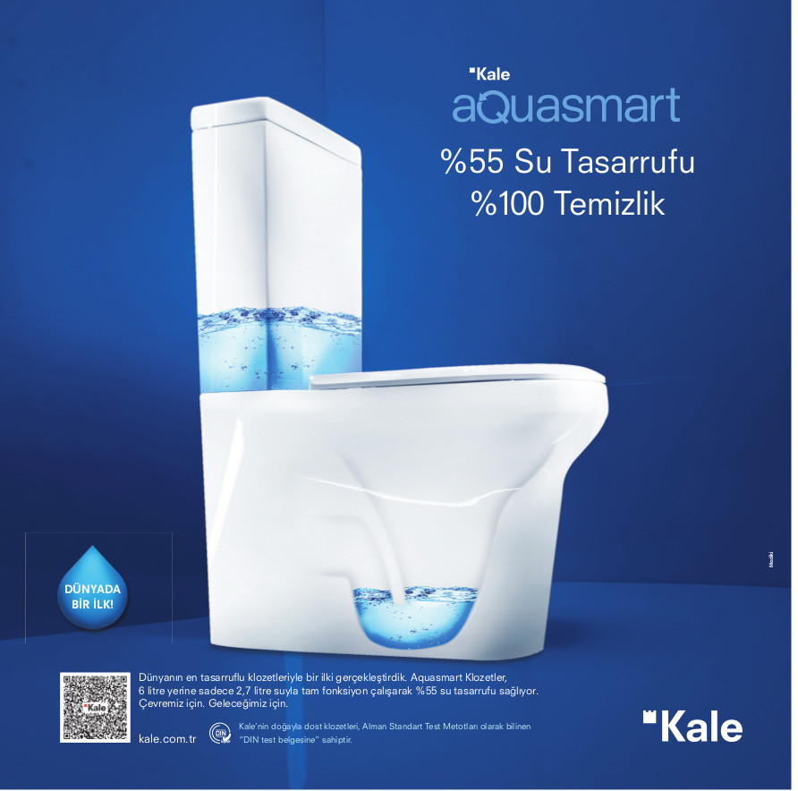
Productivity and Innovation
AQUASMART:
Water saving toilet systems
%55 water saving and %100 cleaning
2,7 litre water consumption.
2014 Golden Çekül Building Materials 1.
2014 İstanbul Chamber of Industry Environment and Energy Awards 2

Slide 21
Productivity and Innovation
By saving 3564 litre water per person per year, Kaleaquasmart closets give an oppurtinity for green buildng systems such as LEED, BREEAM.
For calculation:
Assumed that
4 persons in a family ,
3 times use per person,
total 12 times flushed per day.
Kale Aquasmart closets and standart closets water use

Slide 22
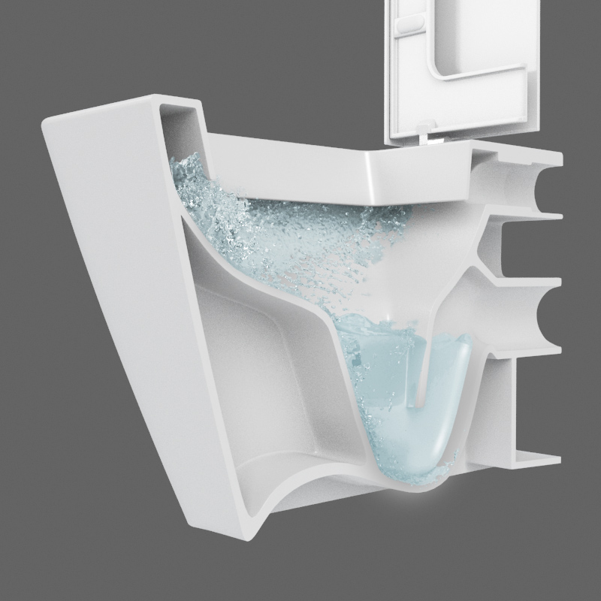
Productivity and Innovation
As well as the water saving systems by 2,7 litre Kaleaqusmart has a special and more efficient cleaning system .
Kale Guard covering system ensures a smooth surface. By doing so, less detergant is used for the cleaning of the closets.

Slide 23
Productivity and Innovation
HUMIDITY CONTROLLED TİLES:
Humidity controlled tiles innovative environmentally friendly products of Kale, have features of getting humidity from air when humidity rises above 65% and giving of the humidity which taken from the air when it falls below 40%. Humidity controlled tiles are produced by Geopolymer technology helps with this feature preventing of diseases and household destruction which dry or humid air that causes. In addition, our company with unfiring tile manufacturing technology do its share of the work about energy savings.
2014 İstanbul Chamber of Industry Environment and Energy Awards 2.

Slide 24
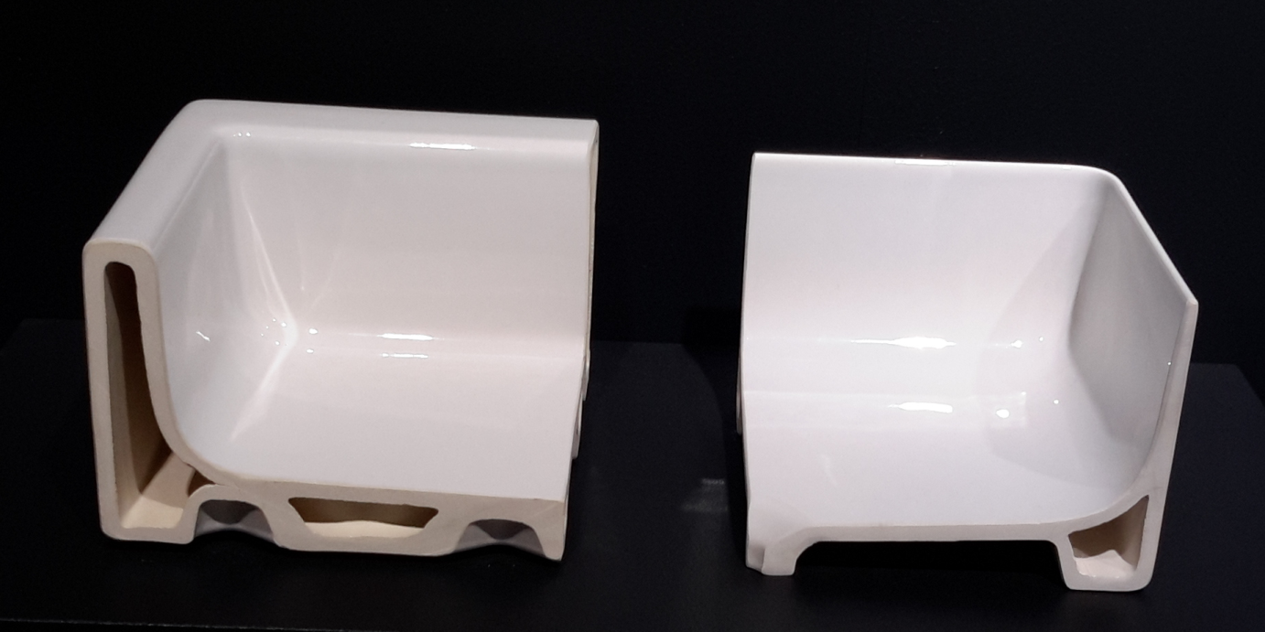
Productivity and Innovation
THIN WASH BASINS:
Standart and thin wash basins

Slide 25
Productivity and Innovation
THIN WASH BASINS:
It is very hard to produce washbasin which has thin walls and sharp edges. Traditional Sanitary Ware products has relatively high deformation and lower strength values. In order to solve this problems “mineral casting” products are used. But these materials are not a ceramic and it contains petroleum source of materials. These kind of materials cause some environmental problem not only on production of mineral casting but also in disposal-recycle process.
Kaleseramik developed innovative ceramic formulation which is based on 2 years R&D studies.
Raw materials consumption of Smart Edge washbasins decreased to 38% with compare to the same size traditional one. It needs less energy for production because its weight also decreased

Slide 26
Productivity and Innovation
THIN WASH BASINS:
Kaleseramik developed innovative ceramic formulation which is based on 2 years R&D studies.
Raw materials consumption of Smart Edge washbasins decreased up to 38% with compare to the same size traditional one. It needs less energy for production because its weight also decreased.
2015 Golden Çekül Building Materials 1.

Slide 27
Environment and Sustainability
Raw material,
Water,
Energy
Production,
Maintanence,
Transportation
Waste water,
Emissions,
Waste manegement
Water water treatment,
Meauserement,
Recycling
Resource Efficiency,
Environmentally friendly

Slide 28
ISO 14001 Environmental Management System
STANDARD:
Made or separated according to a specific type
Suitable for certain dimensions, laws, use
Can be taken as sample or as a basis
A rule in an enterprise to determine a product, a working method, the amount to be produced, the amount of money in the budget.
9000 Quality, 45000 Occupational Health and Safety , 50000 Energy, 10002 Quality Management-Customer Satisfaction , 27001 Information Security Management
ttps://sozluk.gov.tr

Slide 29
ISO 14001 Environmental Management System
The purpose of ISO 14001 is to provide organizations with a framework to protect the environment and respond to changing environmental conditions in balance with socio-economic needs. It specifies requirements that enable an organization to achieve the intended outcomes it sets for its EMS.
An Environmental Management System helps organizations identify, manage, monitor and control their environmental issues.
ISO 14001 is suitable for organizations of all types and sizes, be they private, not-for-profit or governmental. It requires that an organization considers all environmental issues relevant to its operations, such as air pollution, water and sewage issues, waste management, soil contamination, climate change mitigation and adaptation, and resource use and efficiency.
https://int.lead.bureauveritas.com/en/what-is-iso-14001

Slide 30
ISO 14001 Standard
Main terms and definitions:
Auditor, continual improvement, correction, environmental impact, targets, interested party, internal audit, corrective action, procedure, record, policy, planning, environmental aspects, legal and other requirements, objectives, targets, programmes,resources,roles,communication,documentation,operational controls, emergency preparedness, monitoring and measuring, evaluation of compliance, noncorformity,records,audits, review, risks and opportunties

Slide 31
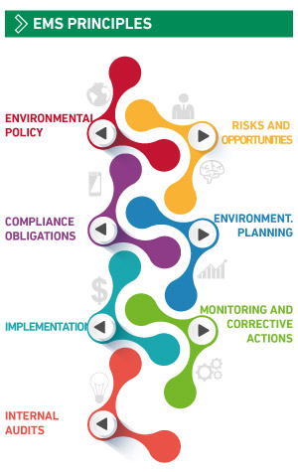
ISO 14001
Key Benefits of ISO 140001:
Better environmental impact management through risks and opportunities assessment
Increased operational control over the environmental aspect of the activities
Better integration of environmental considerations into the business strategy
An improved correlation between the certification and the effective performance of the EMS environmental performance
https://int.lead.bureauveritas.com/en/what-is-iso-14001

Slide 32
ISO 14001 Environmental Management System
Key informations for ISO 14001 EMS:
Determining the scope,needs and expectaitons of interested parties
Identify «Policy»
Identify«Objectives and Targets» compliance with policy
Life cycle
Understanding the needs and expectations of interested parties
Risk management
Records, keep records
Evaluation of compliance
Proper audits and review
The system must provides «CONTINUAL IMPROVEMENT»

Slide 33
ISO 14001 Environmental Management System
Outcomes of ISO 14001;
It reduces waste and energy consumption
Provides a better environmental management in the organization
Contributes to increase efficiency
Contributes to the reduction of costs
Contributes to ensuring customer trust

Slide 34
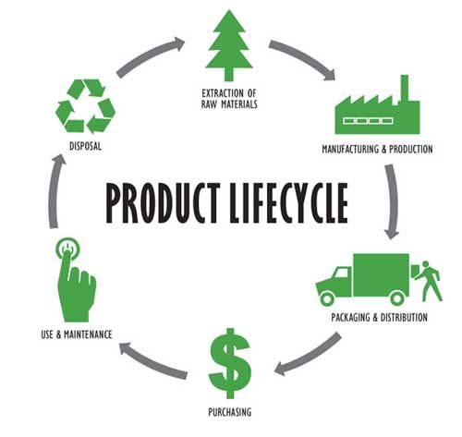
Life Cycle
Life Cycle:
Life Cycle Analysis is a perspective that aims to manage the environmental impacts of a product or process, starting from raw material acquisition, to all stages including disposal and usage.
The life cycle stages include acquisition of raw materials, design, production, transportation, use, disposal.
Environment–Friendly manufacturing and support—Issues and challenges, B. Ghodrati†, H. Al-Chalabi and H. Hoseinie, 2016

Slide 35
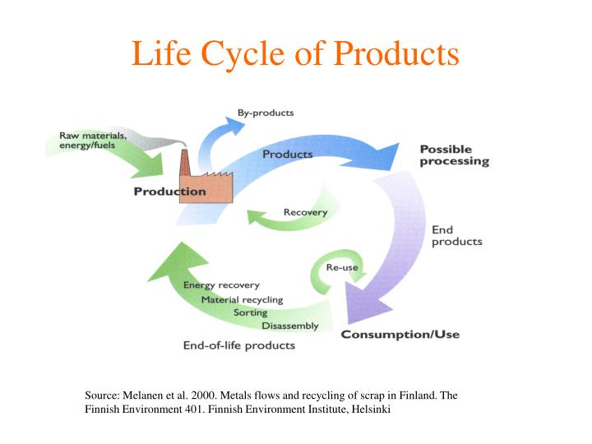
A life cycle perspective includes consideration of the environmental aspects of an organization’s activities, products, and services that it can control or influence.
Reducing environmental aspects
Reducing the consumption of energy and natural resources

Slide 36
Circular Economy
What is a circular economy?
Looking beyond the current take-make-waste extractive industrial model, a circular economy aims to redefine growth, focusing on positive society-wide benefits.
It entails gradually decoupling economic activity from the consumption of finite resources, and designing waste out of the system.
Underpinned by a transition to renewable energy sources, the circular model builds economic, natural, and social capital.
LIFE CYCLE
CRADLE TO CRADLE
RECYCLE, REUSE, REPAIR
RESOURCE EFFICIENCY
INDUSTRIAL SYMBIOSIS
www.ellenmacarthurfoundation.org/circular-economy

Slide 37
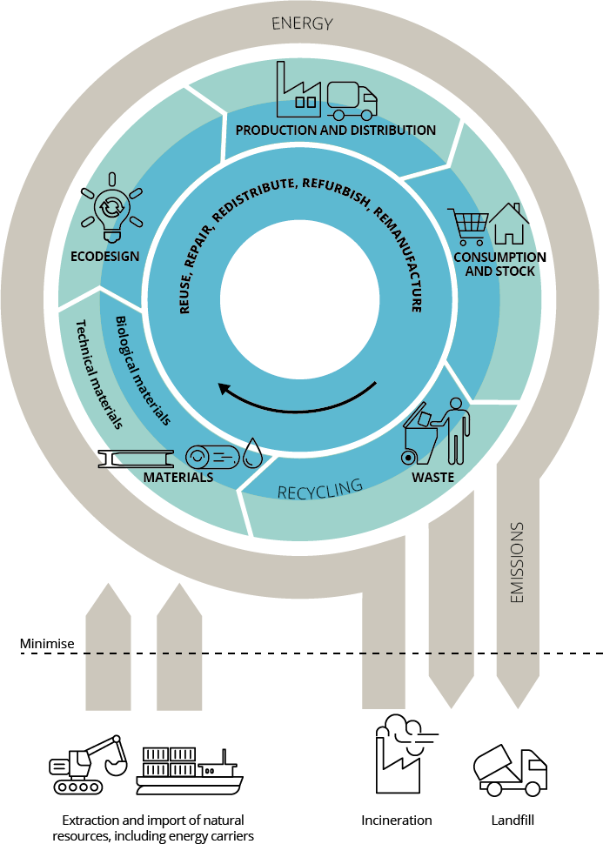
Circular Economy
Circular economy based on three principles:
Keep products and materials in use
Regenerate natural systems
Design out waste and pollution
www.ellenmacarthurfoundation.org/circular-economy
https://youtu.be/zCRKvDyyHmI
https://www.eea.europa.eu/soer/2020/soer

Slide 38
Circular Economy
Elements of the framework for enabling circular business models:
Business model innovation is a term used for innovation in value proposition, creation and delivery, and in value captured by a company.
Technical innovation: It is an iterative process initiated by perceiving a new market and/or new service opportunity for a technology-based invention.
Social innovation is a process encompassing new solutions and processes that meet societal goals
Policy enablers can support business model innovation by providing adequate laws and regulations, financial support, economic incentives
Consumers need to be knowledgeable, able and willing to move towards circular products and services.
Circular business models can enable the meeting of circular strategies through the product life cycle and value chain.
www.eea.europa.eu/publications/a-framework-for-enabling-circular/a-framework-for-enabling-circular

Slide 39
Environmental Labels
Environmental labels, which evaluated the environmental performance of products at various criteria are certifications systems based on the voluntary certification process.
Based on the ISO 14000 series of standards
3 type of labels
It is based on a voluntary basis
Applicable to different product groups

Slide 40
Environmental Labels
Tip I Environmental labels:
              Criteria
              Environmental performance
              EU eco-label
Tip II Environmental labels:
              Criteria
              Self declaration
Tip III Environmental labels:
              Criteria
              Environmental performance
              Third party verification
              LCA (Life cycle assestment)
              EPD

Slide 41
EPD (Environmental Product Declarations)
The most preferred environmental label
Scope
LCA based
Objective
Third party verification
B2B

Slide 42
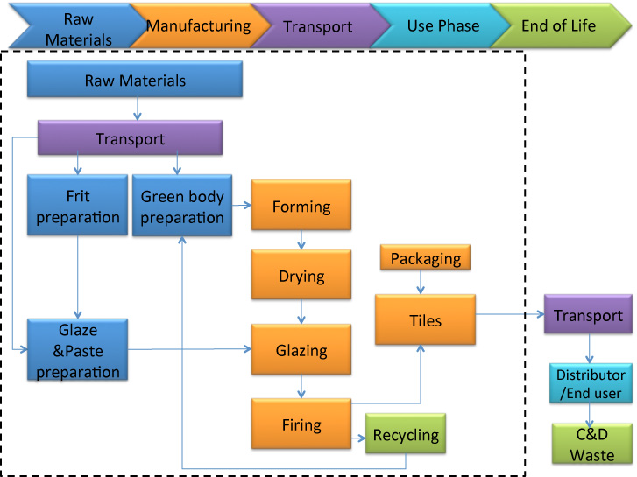
LCA (Life Cycle Assesment)

Slide 43
EPD-LCA (Life Cycle Assesment)

Slide 44
EPD (Environmental Product Declarations)
Kale EPD Experiment
-All products (ceramic tiles, porcelain tiles, sinterflex, ceramic sanitary ware)
-First company which has EPD for ceramic tiles
-First company which has EPD for all products

Slide 45
EPD (Environmental Product Declarations)
EPD Steps:
Functional unit
Flow chart
Scope
Cradle to gate / cradle to cradle
Inventory
Data analyze
Reporting
Verification

Slide 46
Environmental labels (Greenguard/MASCertified):
It is a certificate showing that the product has no negative effect on indoor air quality .

Slide 47
Environmental labels: Health Product Declaration (HPD)
The HPD Standard is a standard specification reporting of product contents and associated health information, for products used in the built environment.
https://www.hpd-collaborative.org/

Slide 48
Thank you...

