Slide 1
CHEMICAL ENGINEERING LABORATORY - II EXPERIMENT 8: DISTILLATION COLUMN APPLICATIONS
YILDIZ TECHNICAL UNIVERSITY
FACULTY OF CHEMICAL AND METALLURGICAL ENGINEERING
DEPARTMENT OF CHEMICAL ENGINEERING
Res. Assist. Enis Muhammet GÜL
2021-2022 FALL

Slide 2
DISTILLATION COLUMN APPLICATIONS FOR BATCH PROCESSING
Experiment Name: Distillation Column Applications
Aim of the Experiment: To analyse mixture concentrations by refractometer, and to compare quantity and composition of products, distillation time and quantity of heat required experimentally with those theoretically predicted.
Content of the Presentation:
Distillation process
Refractometer
Experimental setup
Experimental study
Calibration Curve
Calculations

Slide 3
DISTILLATION PROCESS
Distillation is a process used to separate homogeneous liquid mixtures.
Distillation is the most used separation process in chemistry and related industries.
Its most basic definition, distillation is the separation of components in a solution based on their relative volatility.
Compounds separated by distillation are characterized by their volatility, which is related to the chemical’s vapor pressure.
Distillation is a a physical separation process, not a chemical reaction.
Distillation may result in essentially complete separation (nearly pure components), or it may be a partial separation that increases the concentration of selected components in the mixture.

Slide 4
DISTILLATION PROCESS
Distillation Methods: Distillation, which is based on the process of separating a homogeneous liquid mixture from high boiling points by heating it, allowing the low-boiling ones to partially evaporate, then condensing them again, is done by various methods in today's technology. Single-stage distillation methods:
Flash (Equilibrium) distillation,
Batch (Differential) distillation,
Continuous distillation,
Steam distillation,
Vacuum distillation.

Slide 5
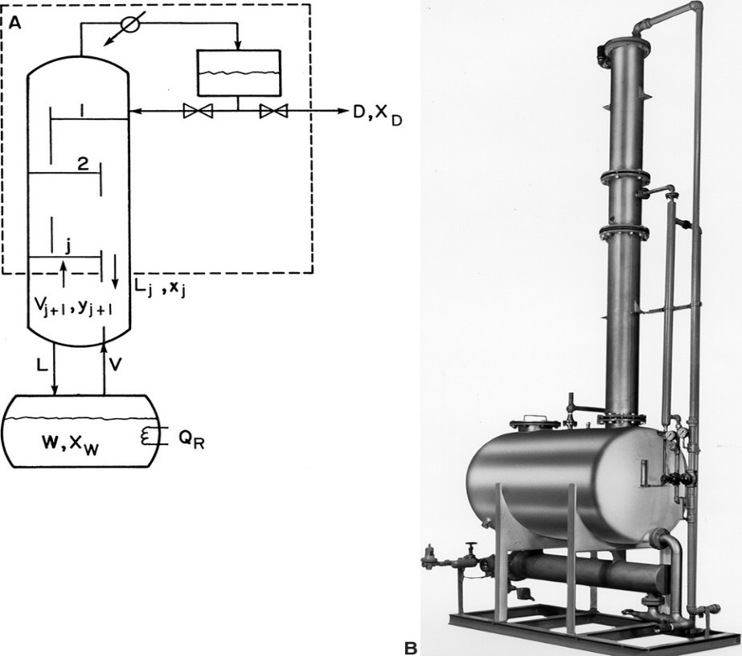
DISTILLATION PROCESS
Flash (Equilibrium) Distillation: In equilibrium distillation, a certain part of the liquid mixture is evaporated in a tank. The vapor phase is left in contact with the liquid phase, allowing the phases to reach equilibrium. The vapor phase is taken and condensed in a condenser.
Batch (Differential) Distillation: In batch distillation, the mixture to be distilled is fed to the system intermittently and the distillation process is continued until suitable top and bottom products are obtained. Batch distillation may be considered in the following situations:
When the amount of distillation is small,
When products need to be produced at certain intervals,
When the feed is produced at irregular intervals.
Batch Distillation System

Slide 6
DISTILLATION PROCESS
Steam Distillation: The process is very similar to the simple distillation process. The main difference is that the system is constantly supplied with hot water. Heating in the presence of water vapor allows the compound to be purified at a lower temperature.
Vacuum Distillation: In the vacuum distillation process, distillation takes place under low pressure conditions. The vacuum distillation process has the same working principle as the normal distillation process. It is applied to components that are sensitive to temperature since components boil at lower temperatures under vacuum.

Slide 7
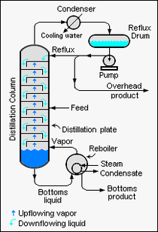
CONTINUOUS DISTILLATION
Continuous distillation is an ongoing separation process in which a liquid mixture of two or more miscible components is continuously fed into the process and physically separated into two or more products by preferentially boiling the more volatile (i.e., lower boiling point) components out of the mixture.
Large-scale, continuous distillation is very commonly used in the chemical process industries.
In a continuous distillation device, the feed liquid enters the column continuously. While the mixture consisting of substances A and B flows downward in the column; the vapor phase rises upward in the column.
The vapor and liquid phases are contacted in the trays or fillers of the column.
In the continuous system, the boiler (reboiler) is separate from the distillation column.
Continuous Distillation System

Slide 8
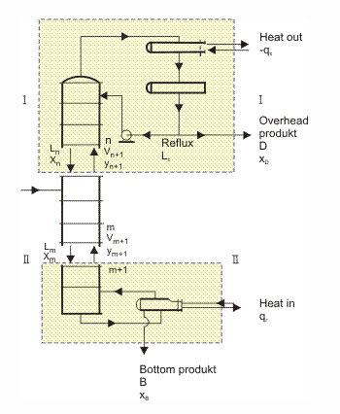
DISTILLATION PROCESS
Reflux(R): Reflux is a technique involving the condensation of vapors and the return of this condensate to the system from which it originated.
The procedure is introduced by first considering a binary mixture; the figure shows a distillation column. Some of the liquid from the condenser at the top of the column, Lc, is returned as reflux. The reflux ratio is defined as the ratio of the liquid returned to the column divided by the liquid removed as product, R = Lc/D.
Distillation column

Slide 9
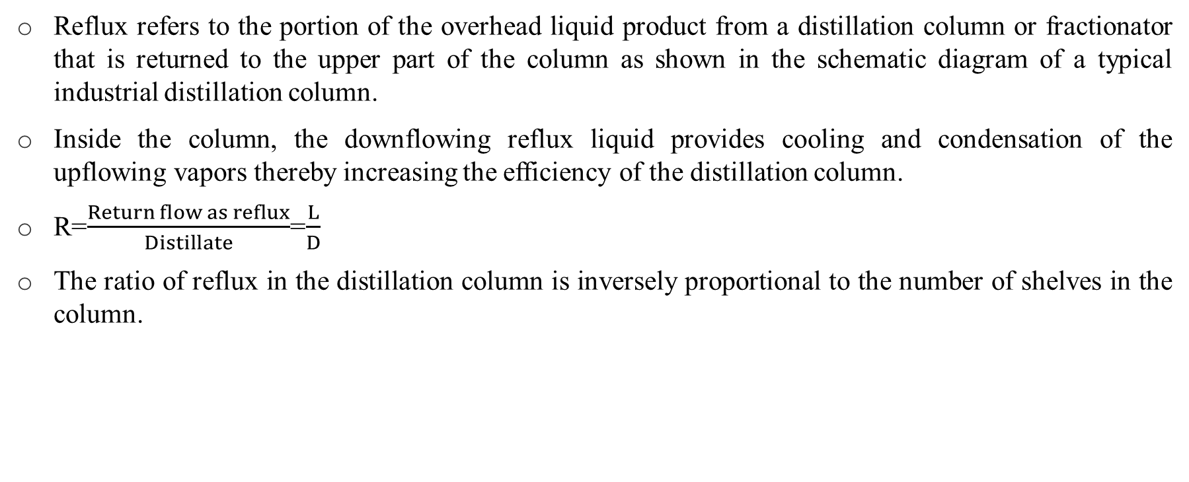
DISTILLATION PROCESS
Reflux refers to the portion of the overhead liquid product from a distillation column or fractionator that is returned to the upper part of the column as shown in the schematic diagram of a typical industrial distillation column.
Inside the column, the downflowing reflux liquid provides cooling and condensation of the upflowing vapors thereby increasing the efficiency of the distillation column.
R=$\frac{Return flow as reflux}{Distillate}$=$\frac{L}{D}$
The ratio of reflux in the distillation column is inversely proportional to the number of shelves in the column.

Slide 10
DISTILLATION PROCESS
Total Backflow: When all of the product taken from the top of the column is condensed and sent back to the column, that is, when the top product is not taken and no feeding is made, it is classified as total backflow.
In the case of total backflow, the number of steps required for a desired separation process is minimal.
Lowest Backflow: The backflow rate can only be reduced to a value that separation can be achieved with an infinite number of steps. This corresponds to the lowest possible backflow rate for the specified separation process.
Optimal Backflow Rate: The optimum backflow rate should be between the lowest and total backflow rates.
Increasing the reflux rate will reduce the number of stages and, accordingly, the cost will decrease. However, this increases operating costs as this will increase auxiliary requirements such as steam and cooling water.

Slide 11
DISTILLATION PROCESS
The Importance of Shelf Number in Distillation Column:
The contact of liquid and vapor phases in the distillation column takes place on the shelves of the column.
Let's consider a mixture of A (volatile component) and B components. The mixture consisting of gaseous A and B components rises in the column, while the return current goes down in the column. The liquid and vapor phase will come into contact on the trays of the column.
With increasing the temperature, the vapor pressure of the volatile component tends to increase more than the other component.
Therefore, when the volatile component (A) in the liquid phase comes into contact with the vapor phase, it will pass into to the gas phase faster than component B.
While A, which leaves the liquid phase, travels towards the distillate; The liquid, which has become more pure than component B, travels towards the boiler.

Slide 12
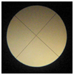
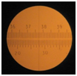
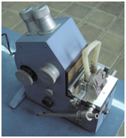
REFRACTOMETER
When the light passes from one medium to another, it refracts with a certain refraction angle. The instrument that measures the angle of refraction of light is called a refractometer. Refractive index is generally a distinctive feature for substances.
Refractometer measures the critical angle of the liquid under test and each concentration shows a different critical angle. Area under critical angle is dark and they are calibrated along the light/dark border. Thus, the refractive index can be read from the refractometer.
Areas during calibration and value of critical angle
Refractometer

Slide 13
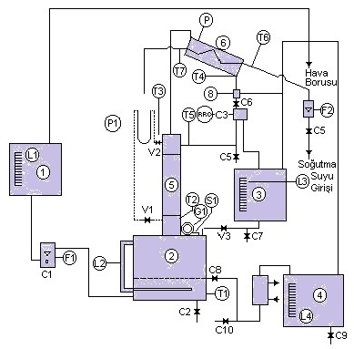
THE EXPERIMENTAL SETUP
The test setup consists of a boiler, top product container (distillate), distillation column, condenser, flow meters, control panel, pipes and valves as shown in the figure.
1. Feed tank,
2. Boiling tank,
3. Top product tank,
4. Bottom product tank,
5. Distillation column
6. Condenser
F.Flowmeters,
L. Level sight gauges,
C,V. Valves.
Experimental Setup

Slide 14
EXPERIMENTAL STUDY
In the experiment, methylene chloride (MC) and 3-chlor ethylene (TCE) components will be separated by distillation.
During the distillation process, the change of components in the bottom and top product collection vessel will be followed both experimentally and theoretically.
In order to obtain experimental data, a previously prepared calibration curve will be used.
The refractive index of the samples taken from the bottom and top product at certain time intervals is measured with a refractometer.
The value corresponding to the refractive index is read using the calibration curve(experimental data).
Rayleigh equation is used to find the composition of the product in the bottom and top product container.
The experimental and theoretical data obtained are compared.

Slide 15
CALIBRATION CURVE
In order to be able to estimate the concentration of a liquid in a mixture of two liquids, it is necessary to draw a calibration curve for the particular mixture.
For the mixture methylene chloride /trichloroethylene, mixtures of known concentrations can be prepared and their refractive indixes are measured.
Calibration curve

Slide 16
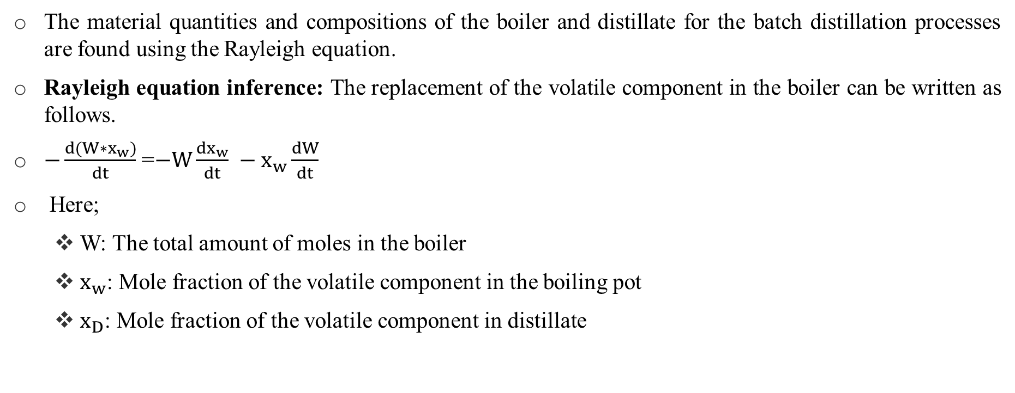
CALCULATIONS
The material quantities and compositions of the boiler and distillate for the batch distillation processes are found using the Rayleigh equation.
Rayleigh equation inference: The replacement of the volatile component in the boiler can be written as follows.
$−\frac{d(W∗x_{w})}{dt}$ =$−W\frac{dx_{w}}{dt} −x_{w}\frac{dW}{dt}$
Here;
W: The total amount of moles in the boiler
$x_{w}$: Mole fraction of the volatile component in the boiling pot
$x_{D}$: Mole fraction of the volatile component in distillate

Slide 17
CALCULATIONS
For an ideal system, the rate of reduction of the volatile component in the boiling vessel is equal to the rate at which it occurs in distillate. This equation can be expressed as follows.
$−\frac{d(W∗x_{w})}{dt}$ = D*$x_{D}$
$−W\frac{dx_{w}}{dt} −x_{w}\frac{dW}{dt}$=D*$x_{D}$
If all sides of the equality are multiplied by dt and dW is written instead of –D*dt, the following equation is obtained.
-W*d$x_{w}$- $x_{w}$*dW= -dW*$x_{D}$
W*d$x_{w}$= dW($x_{D}−x_{W}$)
ln($\frac{W_{1}}{W_{2}}$)= $\int_{X_{W2}}^{X_{W1}}{\frac{{dx}_{W}}{x_{D}−x_{W}}}$ (Rayleigh equation)

Slide 18
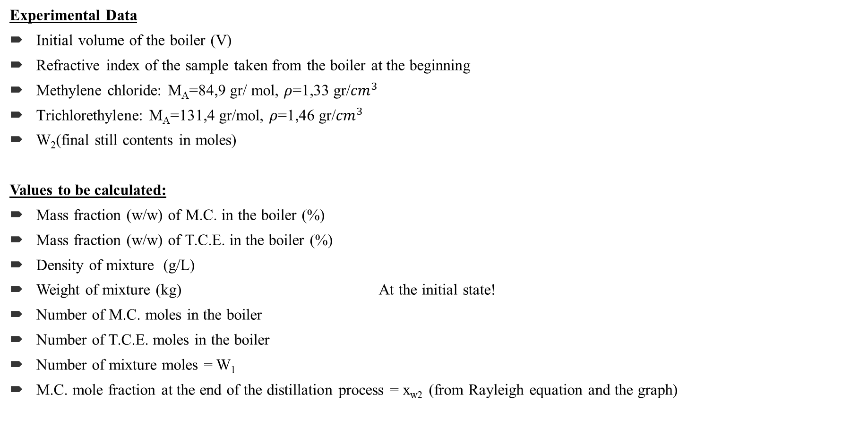
CALCULATIONS
Experimental Data
Initial volume of the boiler (V)
Refractive index of the sample taken from the boiler at the beginning
Methylene chloride: M_{A}=84,9 gr/ mol, $ρ$=1,33 gr/${cm}^{3}$
Trichlorethylene: M_{A}=131,4 gr/mol, $ρ$=1,46 gr/${cm}^{3}$
W₂(final still contents in moles)
Values to be calculated:
Mass fraction (w/w) of M.C. in the boiler (%)
Mass fraction (w/w) of T.C.E. in the boiler (%)
Density of mixture (g/L)
Weight of mixture (kg) At the initial state!
Number of M.C. moles in the boiler
Number of T.C.E. moles in the boiler
Number of mixture moles = W₁
M.C. mole fraction at the end of the distillation process = x_{w2} (from Rayleigh equation and the graph)

Slide 19
CALCULATIONS
HOMEWORK QUESTION:
A mixture of substances A (more volatile component) and B is separated from each other by batch distillation. The molecular weights of A and B are 75 g/mol and 150 g/mol, respectively. The boiler container initially contains 120 moles of mixture, and it is known that the starting mole fraction of A in the same container is 0.20. Accordingly, when 100 mol mixture remains in the boiler;
Calculate the molar fraction of component A (Xw_{A}) in the boiler.
Calculate the molar fraction of component A in the top product (Xd_{A}).
Calculate the mass of top product mixture.

Slide 20
CALCULATIONS
Distillation data for the A-B system

Slide 21
REFERENCES
Sinnott, R., & Towler, G. (2013). Kimya Mühendisliği Tasarımı. Ankara: Nobel Yayıncılık
King, C. J. (1980). Separation Processes (2nd ed.). New York: McGraw-Hill
Geankoplis, C. J. (1993). Transport Processes and Unit Operations (3rd ed.). New Jersey: Prentice-Hall

Slide 22
THANK YOU FOR LISTENING…

