Slide 1
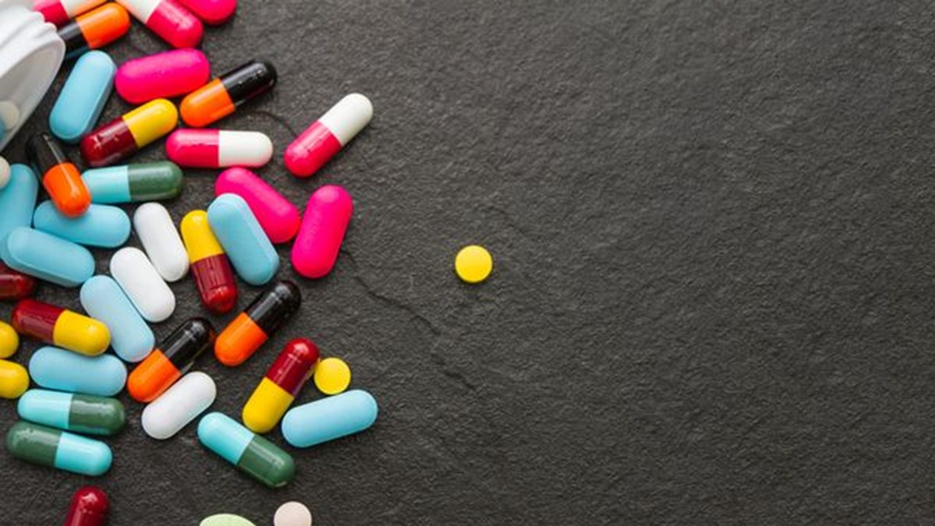
10. Lecture
Biologically active compounds – 10. Lecture
Assoc.Prof. Omer Tahir Gunkara

Slide 2
Biologically active compounds – 10. Lecture
Antidepressants
Assoc.Prof. Omer Tahir Gunkara

Slide 3
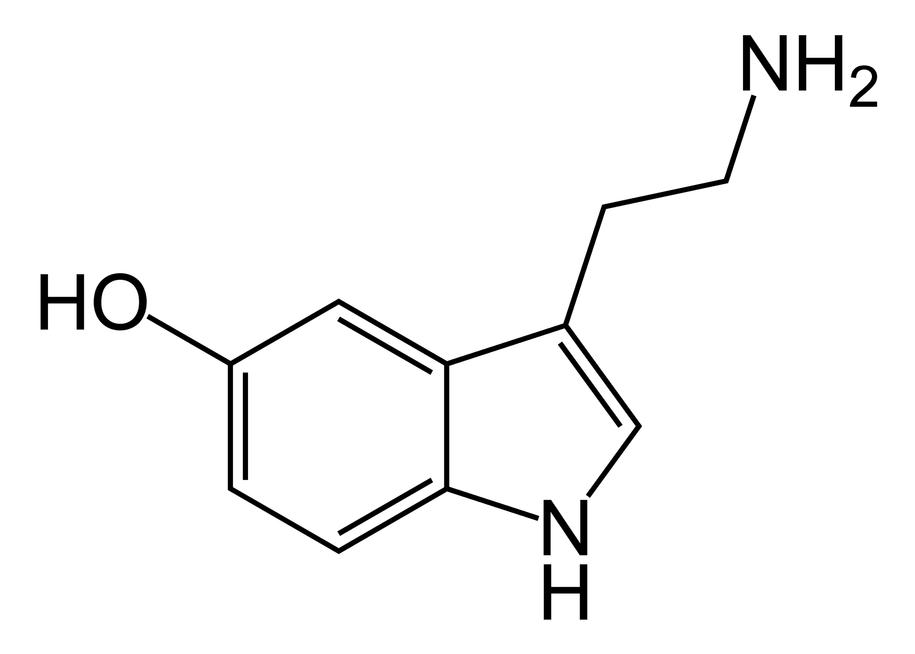
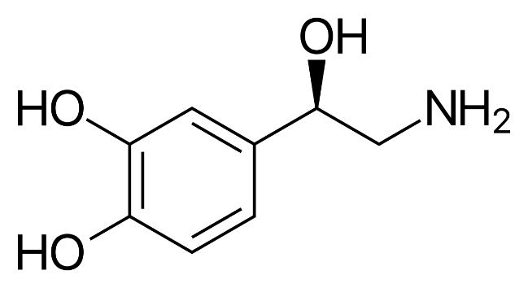
Biologically active compounds – 10. Lecture
Antidepressants
Seratonin (5HT)
Norepineprine
Assoc.Prof. Omer Tahir Gunkara

Slide 4
Biologically active compounds – 10. Lecture
Classes of Antidepressants
Assoc.Prof. Omer Tahir Gunkara

Slide 5
Biologically active compounds – 10. Lecture
Tricyclic Antidepressants
Assoc.Prof. Omer Tahir Gunkara

Slide 6
Biologically active compounds – 10. Lecture
Tricyclic Antidepressants (TCAs)
Assoc.Prof. Omer Tahir Gunkara

Slide 7
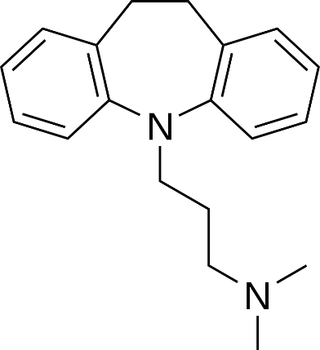
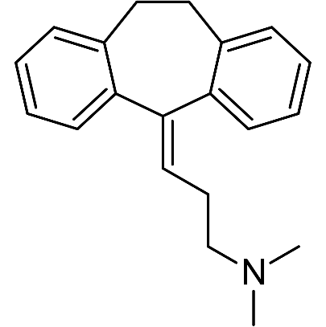
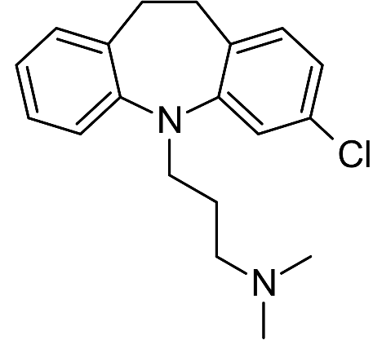
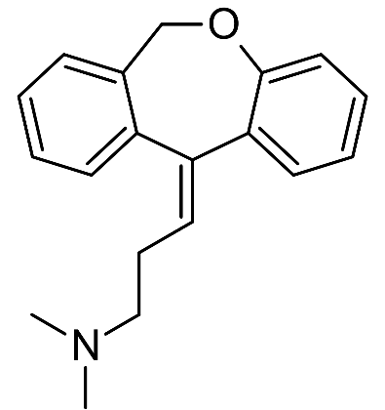
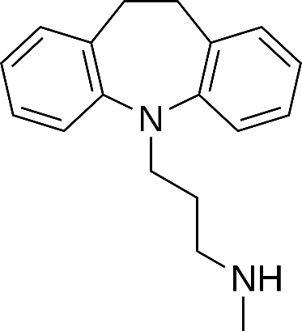
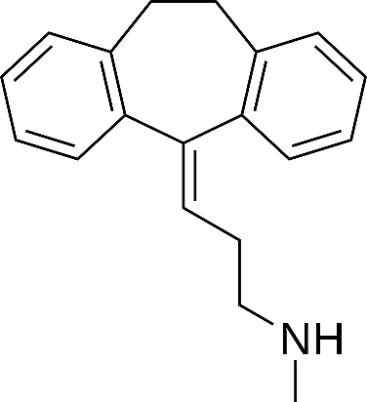
Biologically active compounds – 10. Lecture
Tricyclic Antidepressants (TCAs)
Imipramine
Amitriptyline
Chlorimipramine
Doxepin
Desipramine
Nortriptyline
Assoc.Prof. Omer Tahir Gunkara

Slide 8
Biologically active compounds – 10. Lecture
Assoc.Prof. Omer Tahir Gunkara

Slide 9
Biologically active compounds – 10. Lecture
Assoc.Prof. Omer Tahir Gunkara

Slide 10
Biologically active compounds – 10. Lecture
Assoc.Prof. Omer Tahir Gunkara

Slide 11
Biologically active compounds – 10. Lecture
Assoc.Prof. Omer Tahir Gunkara

Slide 12
Biologically active compounds – 10. Lecture
Assoc.Prof. Omer Tahir Gunkara

Slide 13
Biologically active compounds – 10. Lecture
Assoc.Prof. Omer Tahir Gunkara

Slide 14
Biologically active compounds – 10. Lecture
Assoc.Prof. Omer Tahir Gunkara

Slide 15
Biologically active compounds – 10. Lecture
Assoc.Prof. Omer Tahir Gunkara

Slide 16
Biologically active compounds – 10. Lecture
Assoc.Prof. Omer Tahir Gunkara

Slide 17
Biologically active compounds – 10. Lecture
Assoc.Prof. Omer Tahir Gunkara

Slide 18
Biologically active compounds – 10. Lecture
Assoc.Prof. Omer Tahir Gunkara

Slide 19
Biologically active compounds – 10. Lecture
Assoc.Prof. Omer Tahir Gunkara

Slide 20
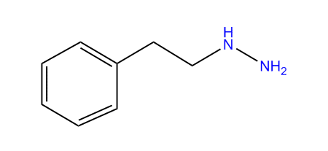
Biologically active compounds – 10. Lecture
Assoc.Prof. Omer Tahir Gunkara

Slide 21
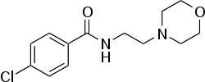
Biologically active compounds – 10. Lecture
Assoc.Prof. Omer Tahir Gunkara

Slide 22
Biologically active compounds – 10. Lecture
Assoc.Prof. Omer Tahir Gunkara

Slide 23
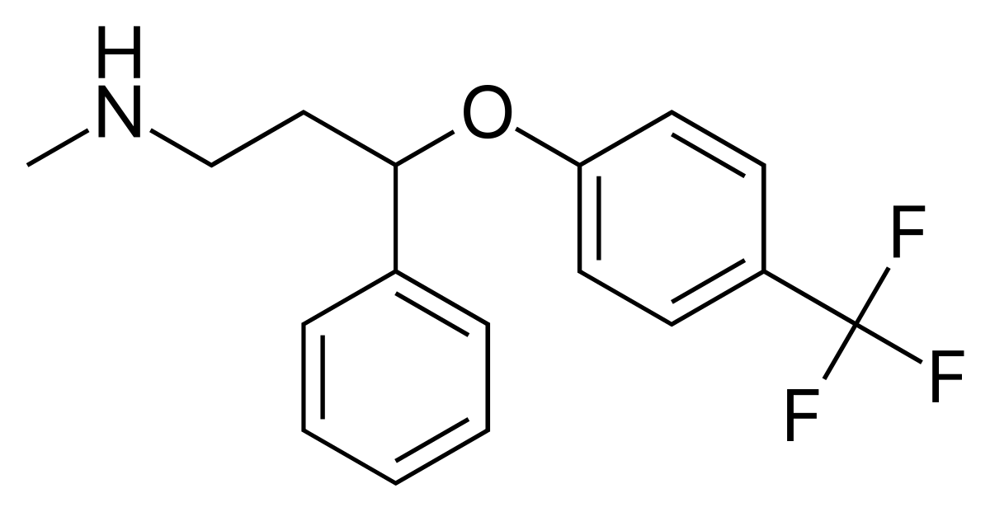
Biologically active compounds – 10. Lecture
Assoc.Prof. Omer Tahir Gunkara

Slide 24
Biologically active compounds – 10. Lecture
Assoc.Prof. Omer Tahir Gunkara

Slide 25
Biologically active compounds – 10. Lecture
Assoc.Prof. Omer Tahir Gunkara

Slide 26
Biologically active compounds – 10. Lecture
Assoc.Prof. Omer Tahir Gunkara

Slide 27
Biologically active compounds – 10. Lecture
Assoc.Prof. Omer Tahir Gunkara

Slide 28
Biologically active compounds – 10. Lecture
Assoc.Prof. Omer Tahir Gunkara

Slide 29
Biologically active compounds – 10. Lecture
Assoc.Prof. Omer Tahir Gunkara

Slide 30
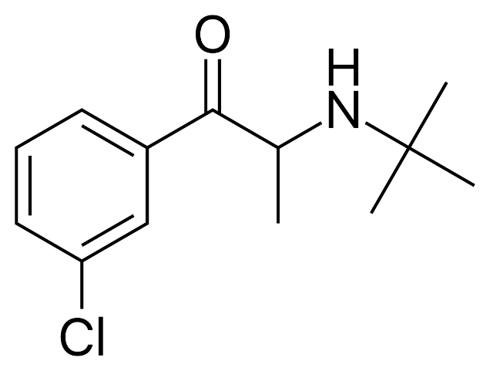
Biologically active compounds – 10. Lecture
Assoc.Prof. Omer Tahir Gunkara

Slide 31
Biologically active compounds – 10. Lecture
Assoc.Prof. Omer Tahir Gunkara

Slide 32
Biologically active compounds – 10. Lecture
Assoc.Prof. Omer Tahir Gunkara

