Slide 1
Ionic Liquids 3. Lecture
Green Chemistry – 3. Lecture
Dr. Omer Tahir Gunkara

Slide 2
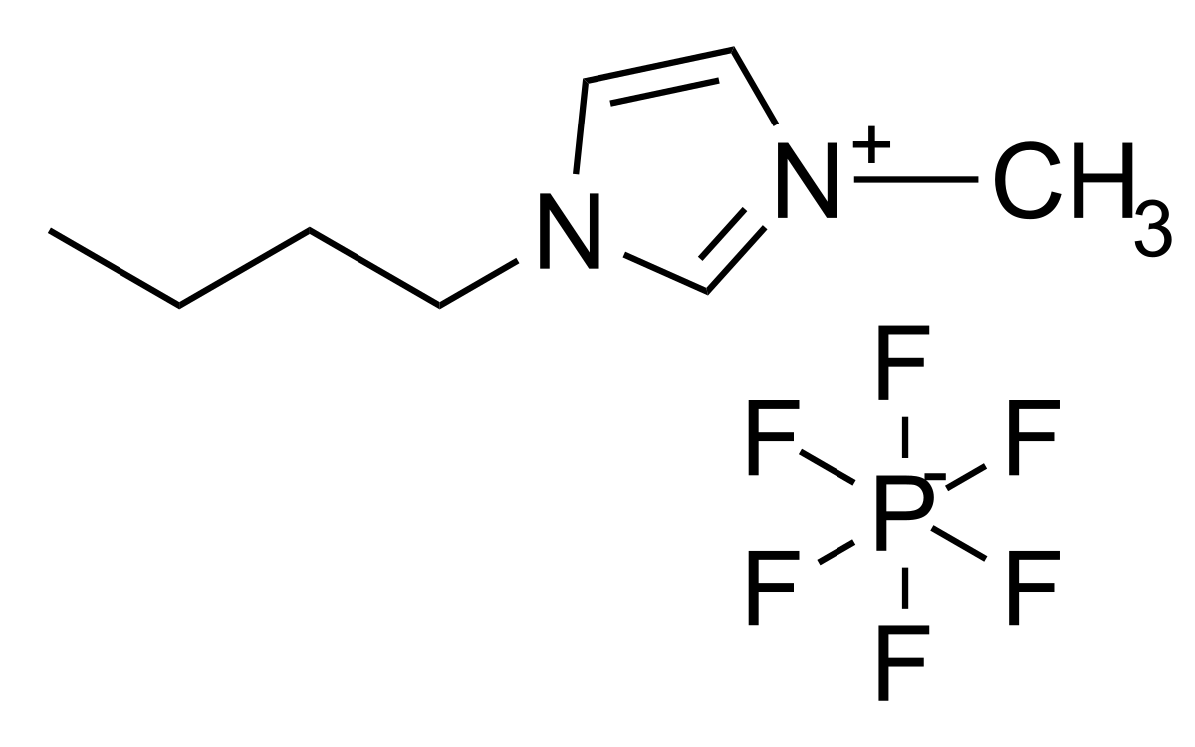
Green Chemistry – 3. Lecture
Ionic Liquids
Ionic liquids are salts that exist as liquid at temperatures below 100°C, and they are usually composed of a combination of organic cations and organic/inorganic anions.
They are non-volatile, highly polar solvents that dissolve several organic, inorganic and metaloorganic compounds.
Dr. Omer Tahir Gunkara

Slide 3
Green Chemistry – 3. Lecture
Ionic Liquids
Ionic liquids are known by several different names like neoteric solvents, designer solvents, ionic fluids, and molten salts.
The essential property of ionic liquids is their zero vapor pressure therefore they are considered as potential solvents for clean chemical processes and possible alternative for supercritical CO₂
Dr. Omer Tahir Gunkara

Slide 4
Green Chemistry – 3. Lecture
Ionic Liquids
Dr. Omer Tahir Gunkara

Slide 5
Green Chemistry – 3. Lecture
Ionic Liquids
Dr. Omer Tahir Gunkara

Slide 6
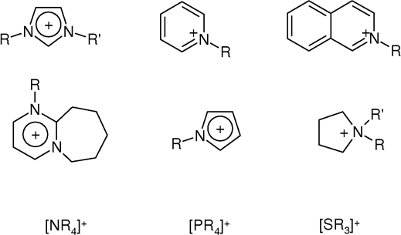
Green Chemistry – 3. Lecture
Cations commonly found in ionic liquids
Dr. Omer Tahir Gunkara

Slide 7
Green Chemistry – 3. Lecture
Anions commonly found in ionic liquids
Dr. Omer Tahir Gunkara

Slide 8
Green Chemistry – 3. Lecture
Ionic Liquids
In order to be liquid at room temperature, the cation should preferably be unsymmetrical; that is, the alkyl groups should be different.
Polarity and hydrophilicity/hydrophobicity of ionic liquids can be tuned by suitable combination of cation and anion. It is this property of ionic liquids which has earned them the accolade “designer solvents.”
Dr. Omer Tahir Gunkara

Slide 9
Green Chemistry – 3. Lecture
Dr. Omer Tahir Gunkara

Slide 10
Green Chemistry – 3. Lecture
Dr. Omer Tahir Gunkara

Slide 11
Green Chemistry – 3. Lecture
Why are ionic liquids “liquids”?
Ionic Liquids-cations are asymmetrically substituted with different Bulky groups- to weaken this ionic interactions
prevents packing of the cations/anions into a crystal lattice
Traditional salts like sodium chloride pack efficiently to form a crystal lattice
Dr. Omer Tahir Gunkara

Slide 12
Green Chemistry – 3. Lecture
Why are ionic liquids “liquids”?
Dr. Omer Tahir Gunkara

Slide 13
Green Chemistry – 3. Lecture
Ionic Liquids
The first room temperature ionic liquid [EtNH₃][NO₃] (m.p. 12°C) was discovered in 1914, but interest did not develop until the discovery of binary ionic liquids made from mixtures of aluminum(III) chloride and N-alkylpyridinium or 1,3-dialkylimidazolium chloride
Dr. Omer Tahir Gunkara

Slide 14
Green Chemistry – 3. Lecture
Dr. Omer Tahir Gunkara

Slide 15
Green Chemistry – 3. Lecture
Ionic Liquids
Ionic liquids come in two main categories, namely;
simple salts (made of a single anion and cation)
and binary ionic liquids (salts where equilibrium is involved).
For example, [EtNH₃][NO₃] is a simple salt whereas mixtures of aluminum(III) chloride and 1,3-dialkylimidazolium chlorides (a binary ionic liquid system) contain several different ionic species, and their melting point and properties depend upon the mole fractions of aluminum(III) chloride and 1,3-dialkylimidazolium chloride present.
Dr. Omer Tahir Gunkara

Slide 16
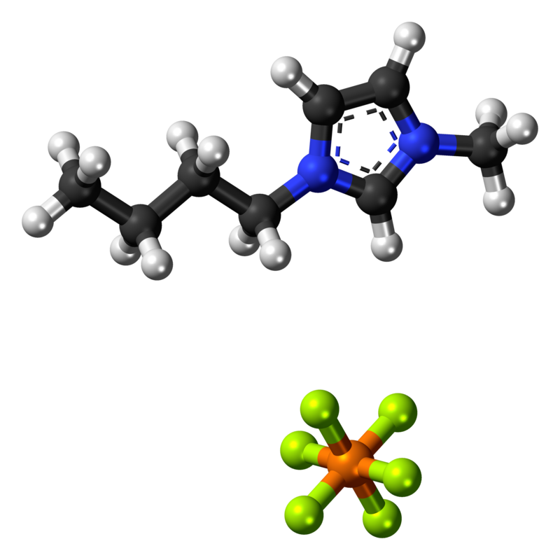
Green Chemistry – 3. Lecture
1-Butyl-3-methylimidazolium hexafluorophosphate
1-Butyl-3-methylimidazolium hexafluorophosphate, also known as BMIM-PF₆, is a viscous, colourless, hydrophobic and non-water-soluble ionic liquid with a melting point of -8 °C. Together with 1-butyl-3-methylimidazolium tetrafluoroborate, BMIM-BF₄, it is one of the most widely studied ionic liquids. It is known to very slowly decompose in the presence of water.
Dr. Omer Tahir Gunkara

Slide 17
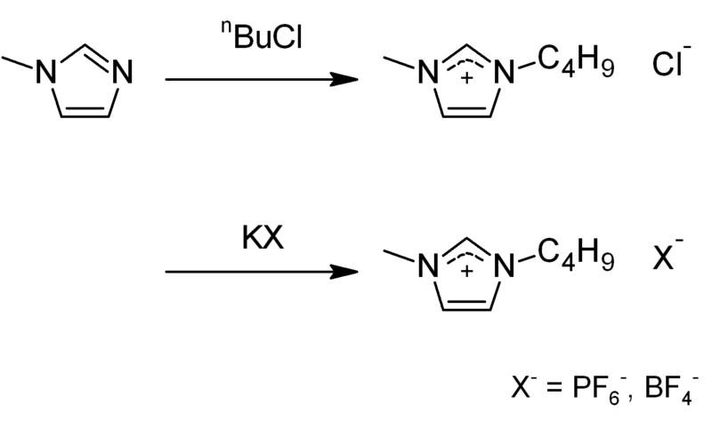
Green Chemistry – 3. Lecture
Preparation
BMIM-PF₆ is commercially available. It may be obtained in two steps: BMIM-Cl is synthesized by alkylating 1-methylimidazole with 1-chlorobutane. A metathesis reaction with potassium hexafluorophosphate gives the desired compound; the tetrafluoroborate may be prepared by analogously using potassium tetrafluoroborate.
Dr. Omer Tahir Gunkara

Slide 18
Green Chemistry – 3. Lecture
Preparation
Dr. Omer Tahir Gunkara

Slide 19
Green Chemistry – 3. Lecture
Dr. Omer Tahir Gunkara

Slide 20
Green Chemistry – 3. Lecture
Commercial applications
Organic synthesis
Pharmaceuticals
Cellulose processing
Nuclear fuel reprocessing
Solar thermal energy
Waste recycling
Batteries
Dispersing agent
Carbon capture
Dr. Omer Tahir Gunkara

Slide 21
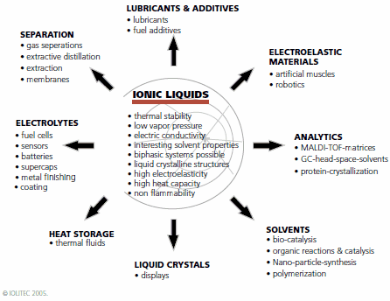
Green Chemistry – 3. Lecture
Dr. Omer Tahir Gunkara

Slide 22
Green Chemistry – 3. Lecture
Organic Synthesis
Prior to the year 2000 ionic liquids that have been used as solvents for polymerization processes were mainly those containing haloaluminate anions (AlCl₄⁻ frequently in conjunction with R_{n}AlCl_{3-n}). Haloaluminate ionic liquids, easily undergoing hydrolysis, were acidic due to the formation of HCl.
Dr. Omer Tahir Gunkara

Slide 23
Green Chemistry – 3. Lecture
Organic Synthesis: (TEMPO oxidation)
Dr. Omer Tahir Gunkara

Slide 24
Green Chemistry – 3. Lecture
Organic Synthesis: (TEMPO oxidation)
Dr. Omer Tahir Gunkara

Slide 25
Green Chemistry – 3. Lecture
Organic Synthesis: (other reactions)
Dr. Omer Tahir Gunkara

Slide 26
Green Chemistry – 3. Lecture
Organic Synthesis: (other reactions)
Dr. Omer Tahir Gunkara

Slide 27
Green Chemistry – 3. Lecture
Organic Synthesis: (other reactions)
Dr. Omer Tahir Gunkara

Slide 28
Green Chemistry – 3. Lecture
Bioscience (Biorafinery)
Dr. Omer Tahir Gunkara

Slide 29
Green Chemistry – 3. Lecture
Bioscience (Biorafinery)
Problem: Cellulose is insoluble in water and common organic reagents.
Dr. Omer Tahir Gunkara

Slide 30
Green Chemistry – 3. Lecture
Bioscience (Biorafinery)
Dr. Omer Tahir Gunkara

Slide 31
Green Chemistry – 3. Lecture
Bioscience (Biorafinery)
Dr. Omer Tahir Gunkara

