Slide 1
Land Information
Management Systems
Prepared by: Ahmet Yılmaz Lecturer: Mehmet GÜR gur@yildiz.edu.tr

Slide 2
Course Objectives
The aim of the course is to define;
the content and components of land information systems,
the functions of land information systems in a spatial data infrastructure,
the methodologies and tools in land information modeling,
the international standards related to land information management.

Slide 3
Course Content
land management, land administration, cadastral systems
spatial data infrastructure
conceptual modeling
modeling methodologies
modeling in land management
unified modeling language (UML)
cost g9 action: modeling of real property transactions
inspire: ISO land administration domain model
social tenure domain model;
land parcel identification system;
mark-up languages in land information management;
GML based application schemas

Slide 4
Course Learning Outcomes
Students;
know the importance and function of SDI in land management paradigm
define business process models related to land management using UML.
define conceptual data models related to land management.
know ISO Land Administration Domain Model.
know INSPIRE data specifications.
know international geographical information standards related to land management.

Slide 5
Course Learning Outcomes
Week | Subjects
1 | The content, purposes, and evaluation criteria of the course
2 | Introduction to land management (Section 1)
3 | Introduction to spatial data infrastructure (Section 2)
4 | Introduction to modeling: Model Driven Architecture (MDA) and Unified Modeling Language (UML) (Section 3)
5 | Unified Modeling Language (UML) (Section 3)
6 | Business process modeling initiatives for land administration: COST G9 Action - Modeling of Real Property Transactions (Section 4)
7 | Domain modeling initiatives for land administration: Land Administration Domain Model (Section 5)
8 | Midterm exam 1
9 | Land Administration Domain Model; Social Tenure Domain Model (Section 5)
10 | Land Parcel Identification System (Section 6)
11 | INSPIRE data specifications: Cadastral parcel, Building, Land use, Addressing, Protected sites, Geographic names, Land cover, Statistical units, Utility and governmental services, Environmental monitoring facilities (Section 7)
12 | Introduction to geographic mark-up languages: GML, LandXML Introduction to GML based application schemas: CityGML, LandGML, xPlanGML (Section 8)
13 | Midterm exam 2
14 | Examples on land information management systems (Section 9)
 | Final exam.

Slide 6
What is Land?
"Land is the part of the earth's surface that is not covered by water"
(The Oxford Dictionary).
"Land is the surface of the earth and all its natural resources"
(The Merriam-Webster Dictionary).
"Land is an area of ground used for particular purpose like farming or building"
(The Cambridge Dictionary).

Slide 7
concepts of land
Land as terra firma
The ground on which we live.
Natural resources - everything living, except people, including wild animals and plants.
Broad meaning - nature including air, water bodies, soil, and subsoil.
Land as a property institution
An institution defining private rights to own land as a basis for trading, established and sanctioned by a society.
Property held by the state on behalf of the people in centralized economies.
terra firma: the solid part of the earth's surface
(Williamson, Enemark, Wallace, Rajabifard, 2010)

Slide 8
concepts of land
Land as physical space
The surface and area upon which life takes place.
Fixed in quantity: cannot be destroyed or increased.
Includes entire surface of Earth: oceans, mountains, valleys, and plains
Includes cubic space: airspace, subsurface space, and associated minerals and gases.
Units of land - in regions or spatial entities, ranging from single parcels to suburbs, countries, up to and including the entire planet.
Land as a factor of production
As a factor in economics along with labor, capital, and management as factors of production.
As a “nature given” source of food, fiber, building materials, minerals, energy resources., and other raw materials used by society.
(Williamson, Enemark, Wallace, Rajabifard, 2010)

Slide 9
concepts of land
Land as a community
The natural ecological community for which individuals have special rights and responsibilities.
The group of individuals living in a particular area with common interests associated with their individual and collective good.
Concepts of “home,” and “fatherland” and “motherland”
Land as a location with respect to land markets, geographic features, other resources, and given names for identification.
Significance of place in determining value and use on the basis of location, accessibility, strategic importance, and so on…
(Williamson, Enemark, Wallace, Rajabifard, 2010)

Slide 10
concepts of land
Land as capital
In classical economics, land is a durable “free gift of nature” and capital is expendable past savings, the stored-up production of people.
Sometimes, land is regarded as capital itself because of the ability to raise capital funds using land as collateral
Land as a consumption good
A consumer good, produced by human enterprise
Parks and recreation sites, developed building lots, a factor of production
(Williamson, Enemark, Wallace, Rajabifard, 2010)

Slide 11
concepts of land
Land as a commodity
A formative commodity in simple land markets. For example, water, minerals, and complex commodities.
A system of wealth acceleration and economic growth
Land as a resource
The sum total of the natural and man-made resources over which possession of land gives control.
A means of support, source of wealth, power, status, and revenue.
Includes human improvements attached to land.
commodity: a financial product that can be traded.
(Williamson, Enemark, Wallace, Rajabifard, 2010)

Slide 12
concepts of land
Land as a human right
Rights in land are fundamental political tools. The formative claim is the Universal Declaration of Human Rights, Article 17: “Everyone has the right to own property ….” (UN 1948).
The Constitution of the Republic of Turkey / Right of Property
ARTICLE 35 - Everyone has the right to own and inherit property. These rights may be limited by law only in view of public interest. The exercise of the right to own property may not be in contravention of the public interest.
(Williamson, Enemark, Wallace, Rajabifard, 2010)

Slide 13
concepts of land
Land as nature
Natural environments, features associated with the workings of nature without human effort.
Access to sunlight, rainfall, wind, climatic conditions, soils, topography, and so on.
Comparative qualities and quantities of natural resources such as mineral deposits, forests, water, fish, sunlight, rainfall.
Land as environment
A place requiring management to preserve its capacity to sustain life, carrying restrictions and responsibilities.
(Williamson, Enemark, Wallace, Rajabifard, 2010)

Slide 14
concepts of land
"Land includes anything;
on the ground (buildings, crops, fences, water),
above the ground (air and space), and
under the ground (minerals), down to the center of the Earth"
(The Business Dictionary).
(Picture: Anka LISEC)

Slide 15
as a summary…
Land can not be increased or consumed.
Land is a resource that has no cost of production.
Land is the basis for development and production.
Land has different values and its usage can be switched from a less to more profitable one and vice-versa.
Land can be a store of value that is most important for the economy of a country or an individual.
These specific characteristic makes the land desirable for different actors and therefore very valuable for everyone.

Slide 16
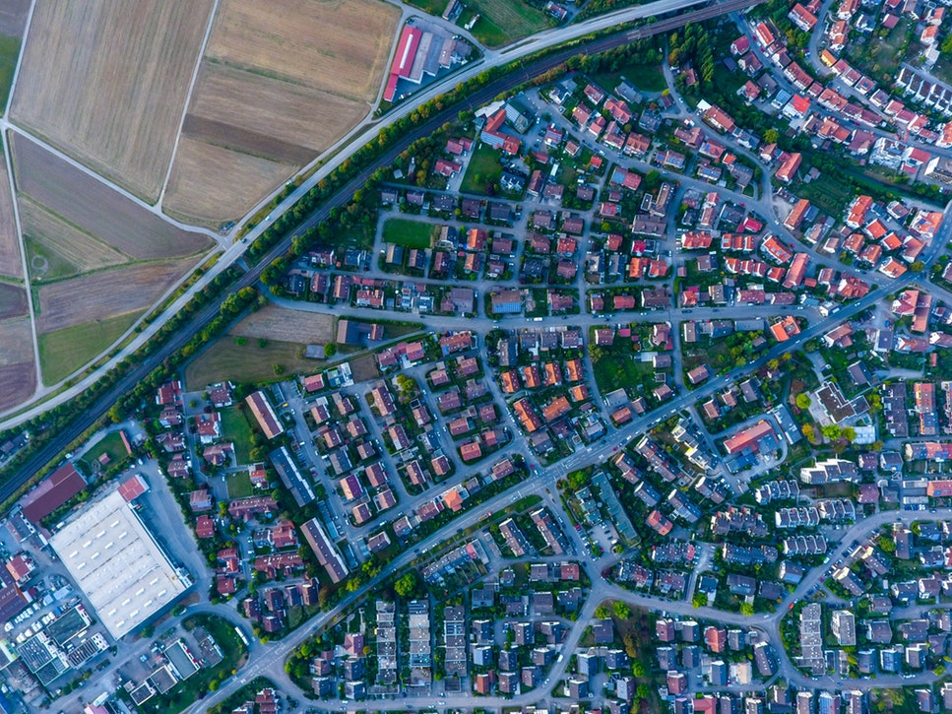
Actors
civil society
(politicians, local government, ministries, media, local associations etc.)
private sector
(estate agents, lawyers, industry, banks, small holders)
individuals
(landowners, leaseholders, squatters, refugees, etc.)
... etc.
Functionalities
housing
infrastructure
agriculture
forest
industry
investment
production
conservation areas
flora & fauna
... etc.
Actors often do not share the same development ideas for land. The interests are generally in conflict with the others and it is hard to satisfy all interests on land.

Slide 17
pressure on land
Therefore, land management should consider all these actors and balance different interests.
In addition, there are further challenges which increases the pressure on land such as;
demographic changes,
inefficient use,
economic growth
climate change/crisis,
and etc.

Slide 18
pressure on land
Therefore, land management should consider all these actors and balance different interests.
In addition, there are further challenges which increases the pressure on land such as;
demographic changes,
  population will reach ten billion by 2050.
  need for additional land for living and food.
  influence on rural and urban structures around the world.

Slide 19
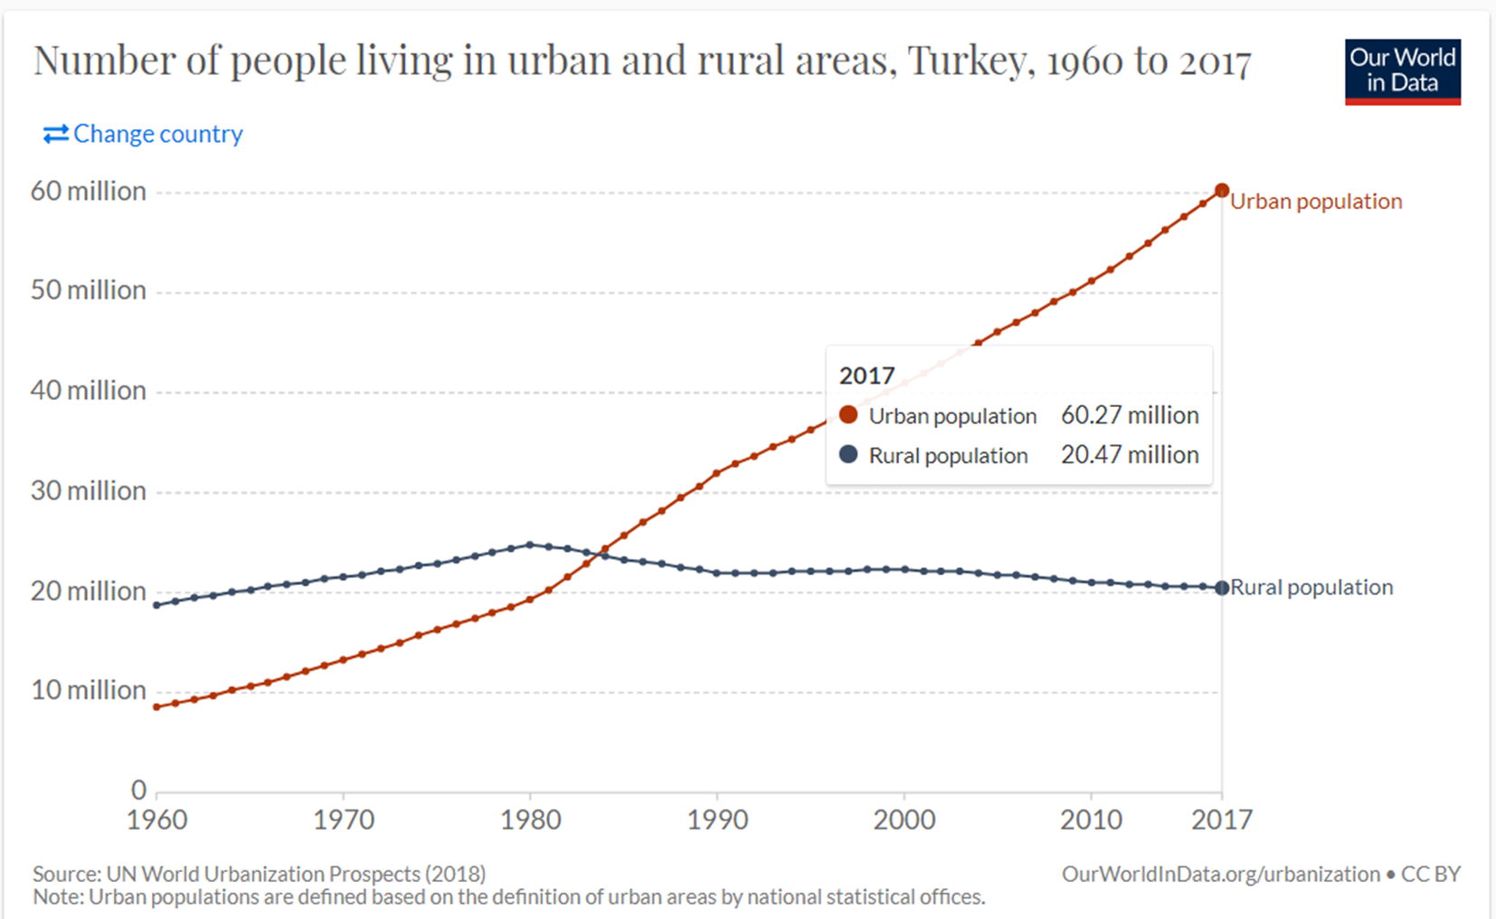
population growth in Turkey

Slide 20
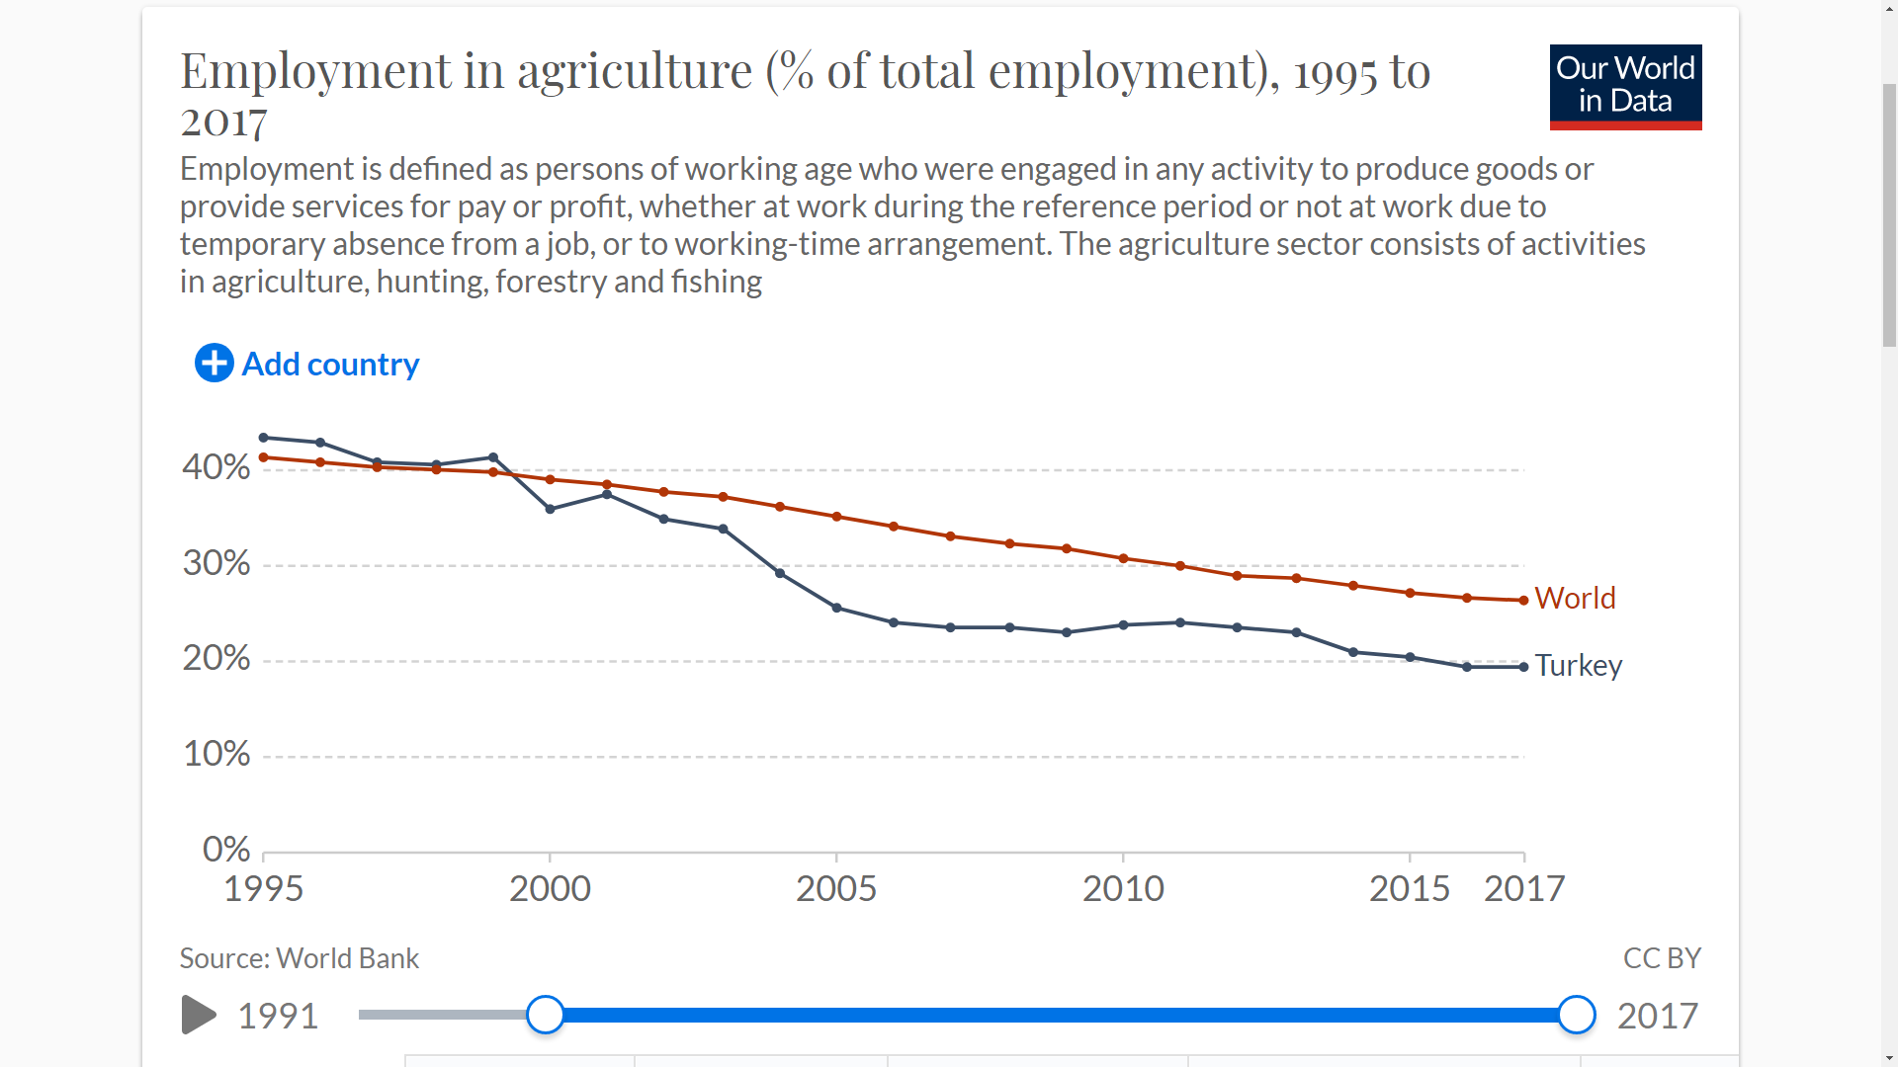
rural population in Turkey

Slide 21
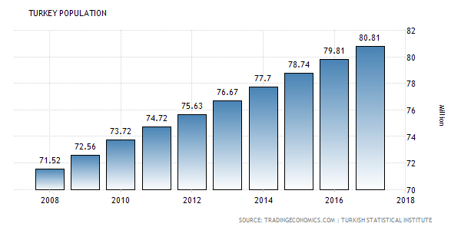
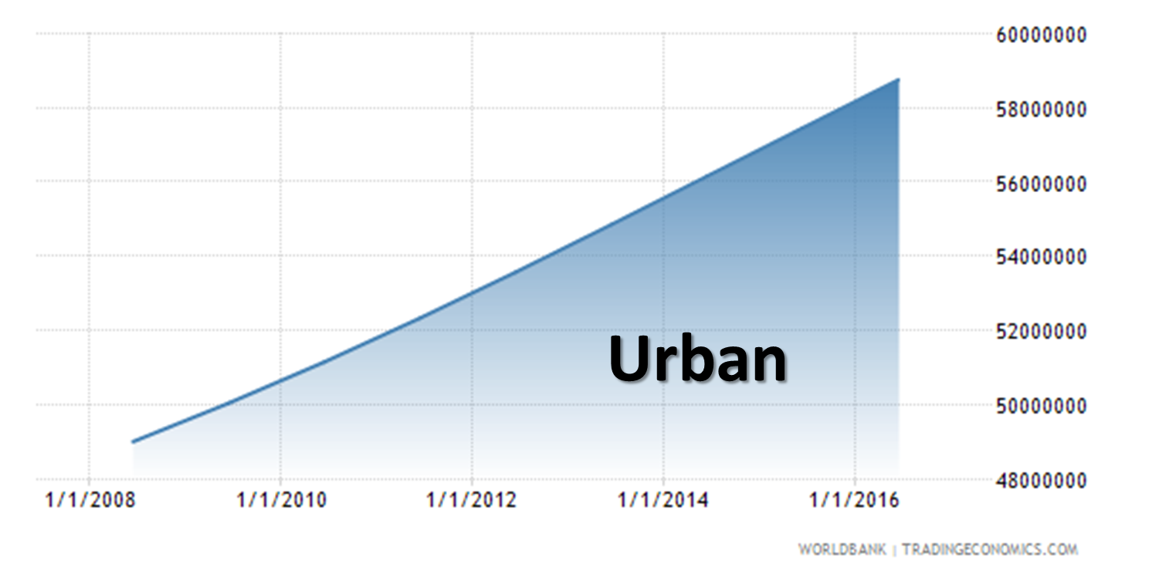
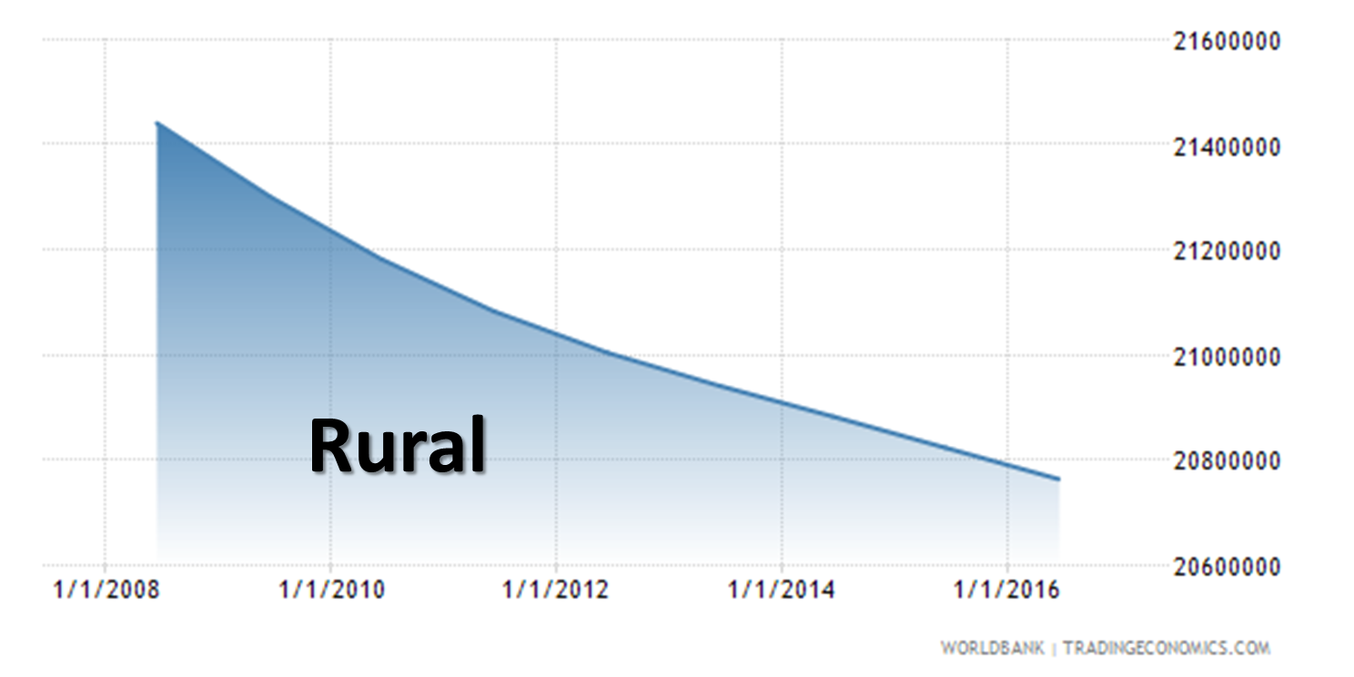
consequences
illegal (but tolerated) housing - slums
more need for infrastructure
insufficient access to sanitary, waste or fresh water,
insufficient infrastructure, transportation, education and work,
insufficient security in these regions and etc.
more migration in rural areas
loss in production
more expensive infrastructure and services
less job opportunities and tax income and etc.

Slide 22
pressure on land
further challenges which increases the pressure on land such as;
demographic changes,
economic growth and inefficient use
  Economic growth and also population growth are linked to search for additional land for industry, extraction of resources and large scale land investment that often takes place in countries with easy accessible property markets.
  Population growth and living standards are also connected to increasing energy demands and technologies that must be produced or extracted on bigger land territories.
  Increasing consumption leads to destruction of valuable natural and cultural land and its resources.

Slide 23
pressure on land
further challenges which increases the pressure on land such as;
demographic changes,
economic growth and inefficient use
climate change/crisis,
  effects the land availability and quality
  through rising sea level, droughts, floods or extreme weather events, land use possibilities are limited or not possible at all.

Slide 24
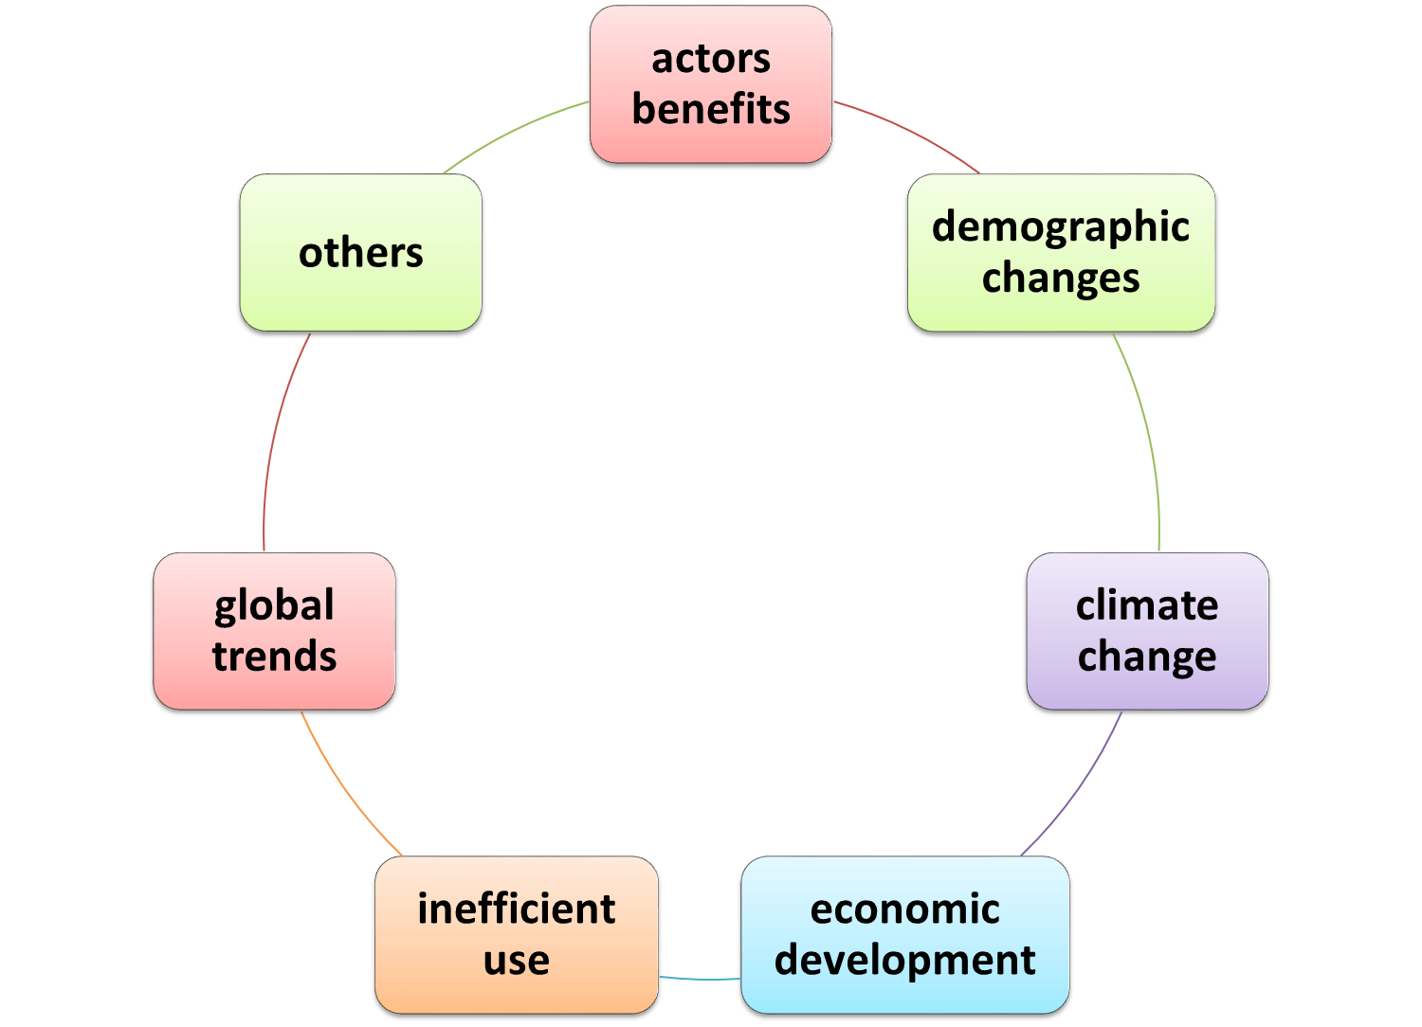
land management
Land management should consider all the actors of land and their changing interests while;
balancing today's and future's social,
economic and ecological needs with respect to the global land trends and problems such as demographic changes, climate change,
inefficient use of land and economic growth in a sustainable manner.
land

Slide 25
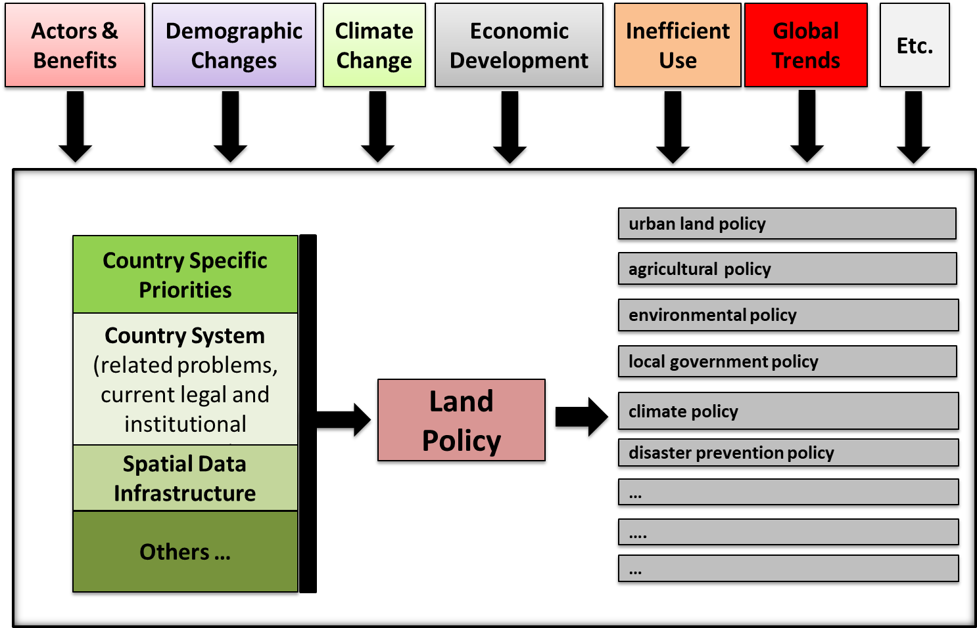
land management

Slide 26
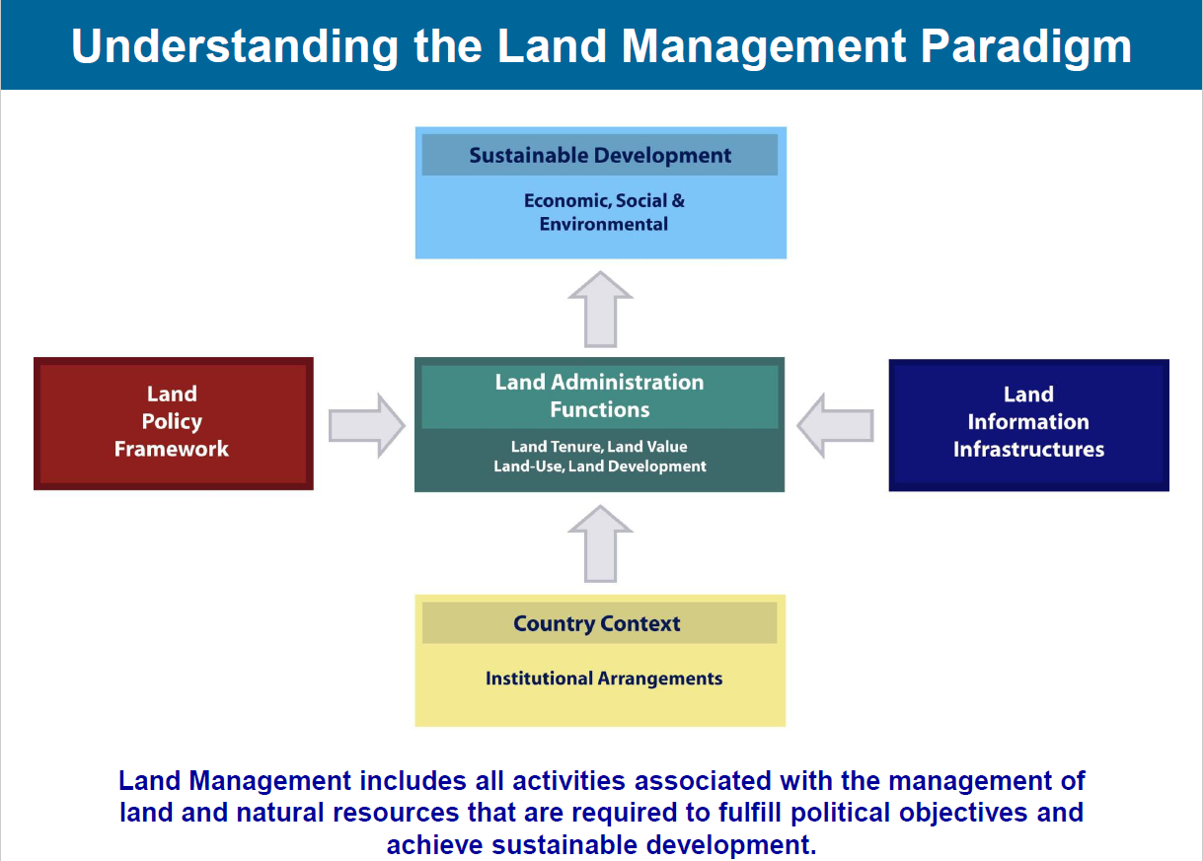

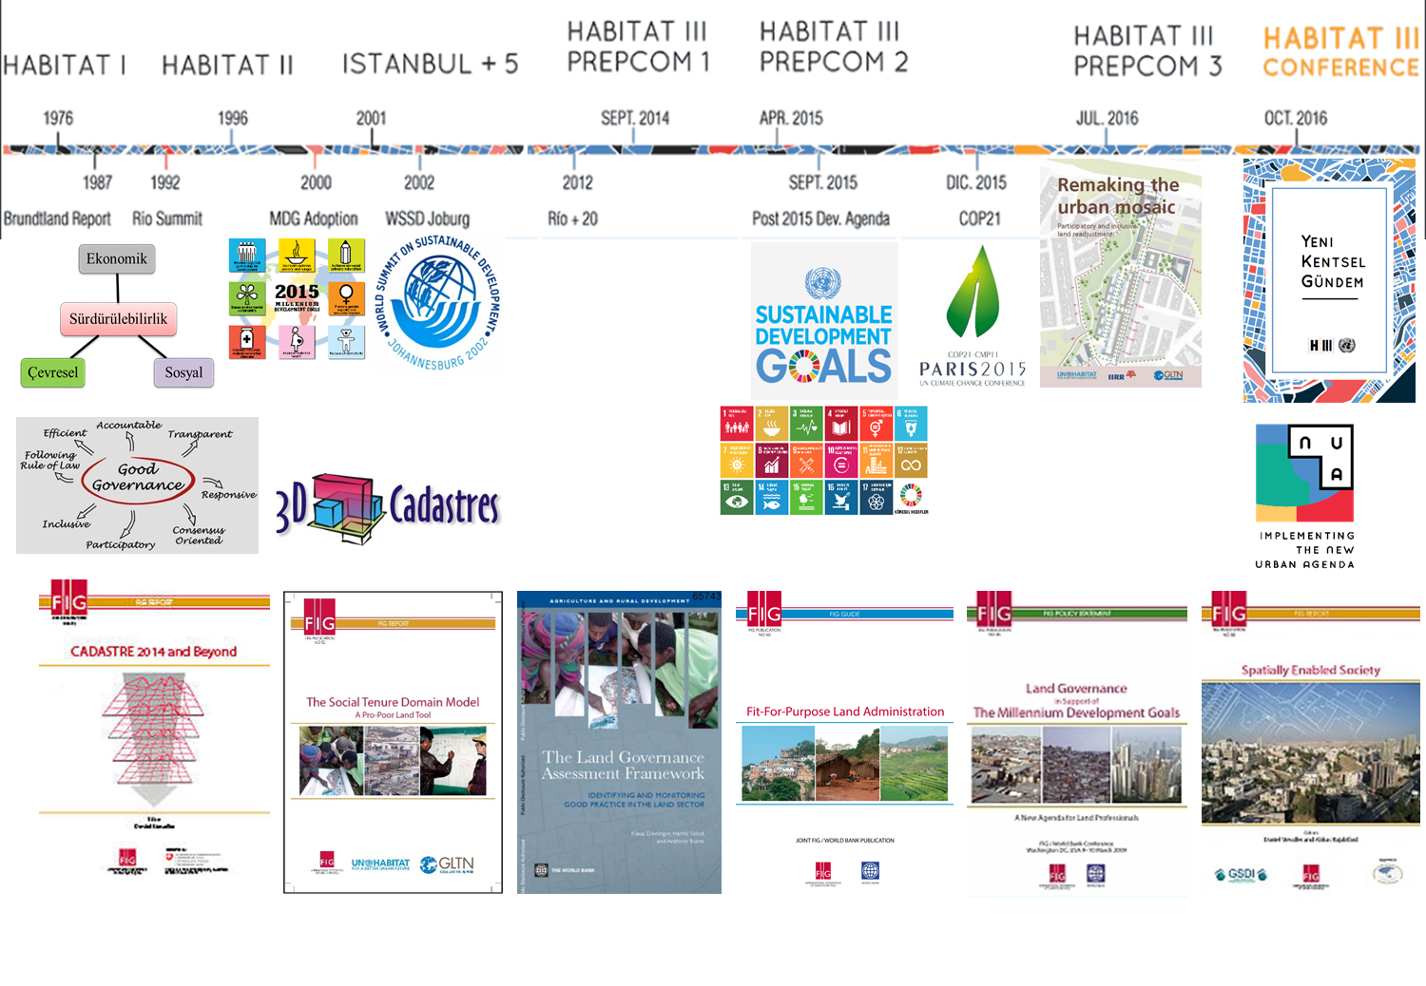
land management paradigm

Slide 27
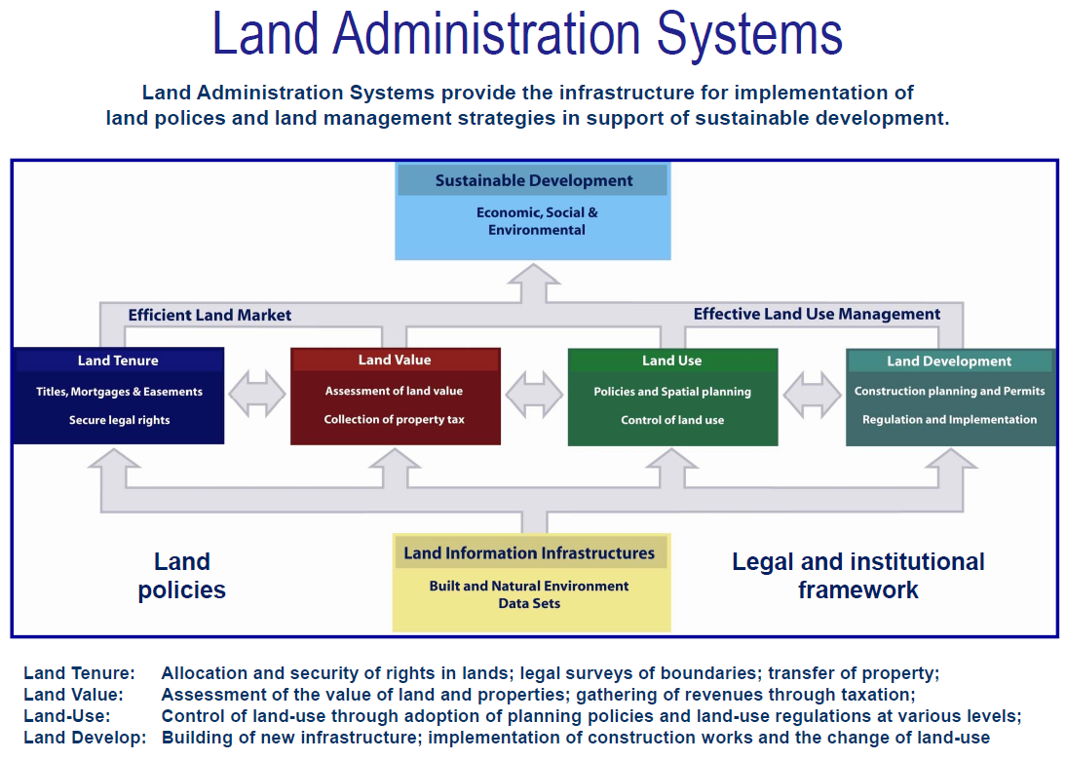

Slide 28
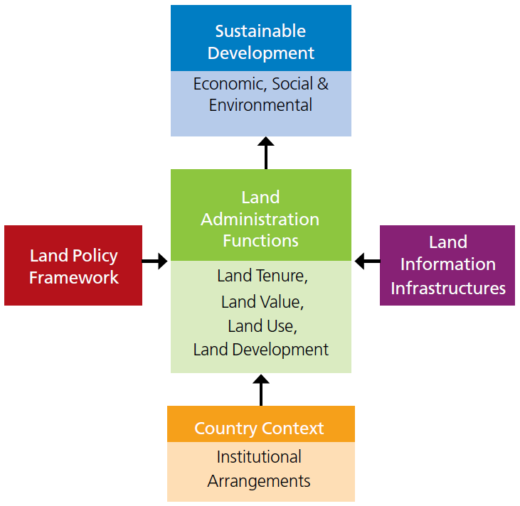
land management paradigm
… provide information to LAS (includes cadastral and topographic datasets and provide access to complete and up-to-date information about the built and natural environment)

Slide 29
LM terminology: land information
The information on land and properties provides the basic infrastructure for running the interrelated systems within the four interrelated LAS functions.
The land information area should be organized to combine cadastral and topographic data and thereby link the built environment (including legal land rights) with the natural environment (including environmental and natural resource issues).
Land information should be organized as a spatial data infrastructure at national, regional/federal and local level based on relevant policies for data sharing, cost recovery, access to data, standards, etc. for interoperability.
Notes:
…

Slide 30
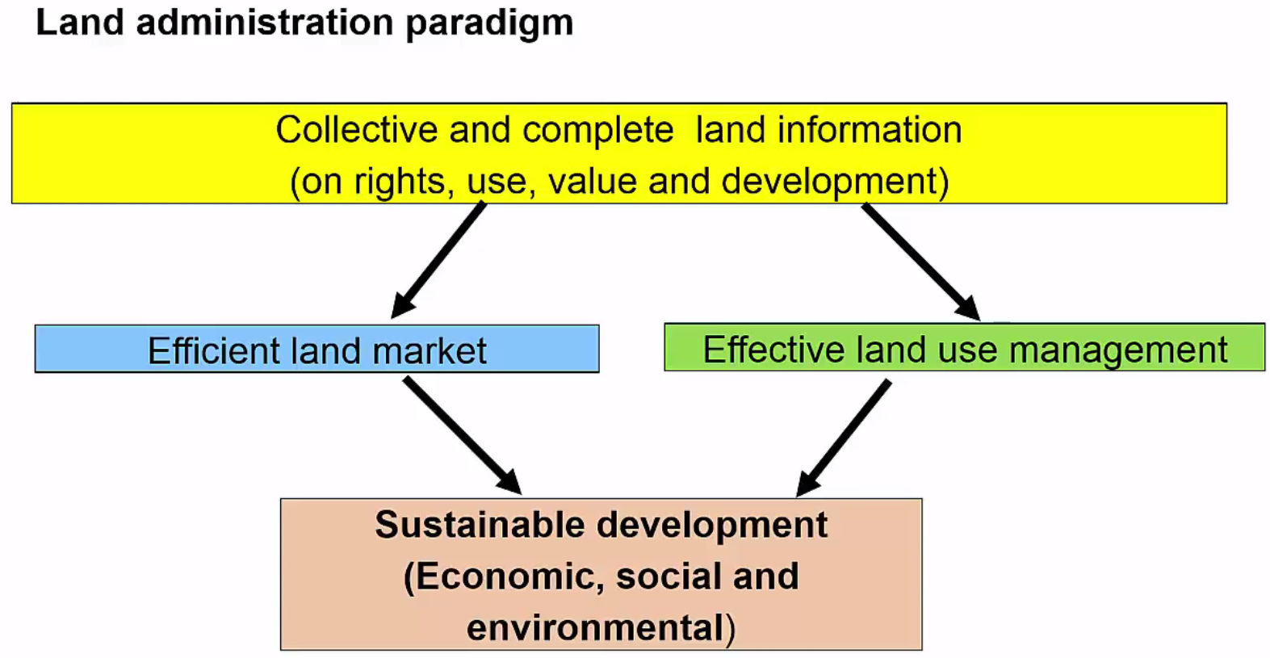
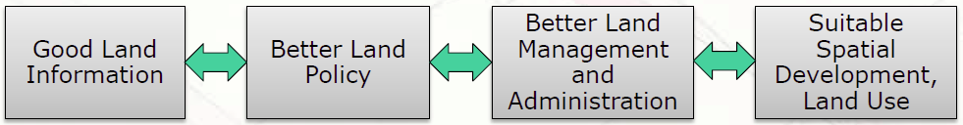
LAS Functions
Notes:
…

Slide 31
summary
Land Policy
Land Management Paradigm
Land Administration System
Spatial Data Infrastructure
Cadastre
Land Parcel
LAND in SOCIETY
Notes:
…

Slide 32
summary
Land Policy
Land Management Paradigm
Land Administration System
Spatial Data Infrastructure
Cadastre
Land Parcel
Land policy determines values, objectives, and the legal regulatory framework for management of a society’s major asset - its land.
Notes:
…

Slide 33
summary
Land Policy
Land Management Paradigm
Land Administration System
Spatial Data Infrastructure
Cadastre
Land Parcel
The land management paradigm drives a holistic approach to LAS and forces their land administration processes to contribute to sustainable development.
The paradigm allows LAS to facilitate overall land management.
Land management activities include the core land administration functions of land tenure, value, use, and development while encompassing all activities associated with the management of land and natural resources that are required to achieve sustainable development.
Notes:
…

Slide 34
summary
Land Policy
Land Management Paradigm
Land Administration System
Spatial Data Infrastructure
Cadastre
Land Parcel
The land administration system provides the infrastructure for implementation of land policies and land management strategies and underpins the operation of efficient land markets and effective land-use management. Cadastre is at the core of a land administration system.
Notes:
…

Slide 35
summary
Land Policy
Land Management Paradigm
Land Administration System
Spatial Data Infrastructure
Cadastre
Land Parcel
The SDI or Land Information Infrastructure provides access to and interoperability of cadastral and other land related information.
Notes:
…

Slide 36
summary
Land Policy
Land Management Paradigm
Land Administration System
Spatial Data Infrastructure
Cadastre
Land Parcel
The cadastre provides the spatial integrity and unique identification of every land parcel, usually through a cadastral map updated by cadastral surveys. The parcel identification provides the link for securing rights in land, controlling the use of land, and connecting the ways people use land with their understanding of land.
Notes:
…

Slide 37
summary
Land Policy
Land Management Paradigm
Land Administration System
Spatial Data Infrastructure
Cadastre
Land Parcel
The land parcel is the foundation of the hierarchy, because it reflects the way people use land in their daily lives. It is the key object for identification of land rights and administration of restrictions and responsibilities in the use of land. The land parcel links the system with the people.
Notes:
…

Slide 38
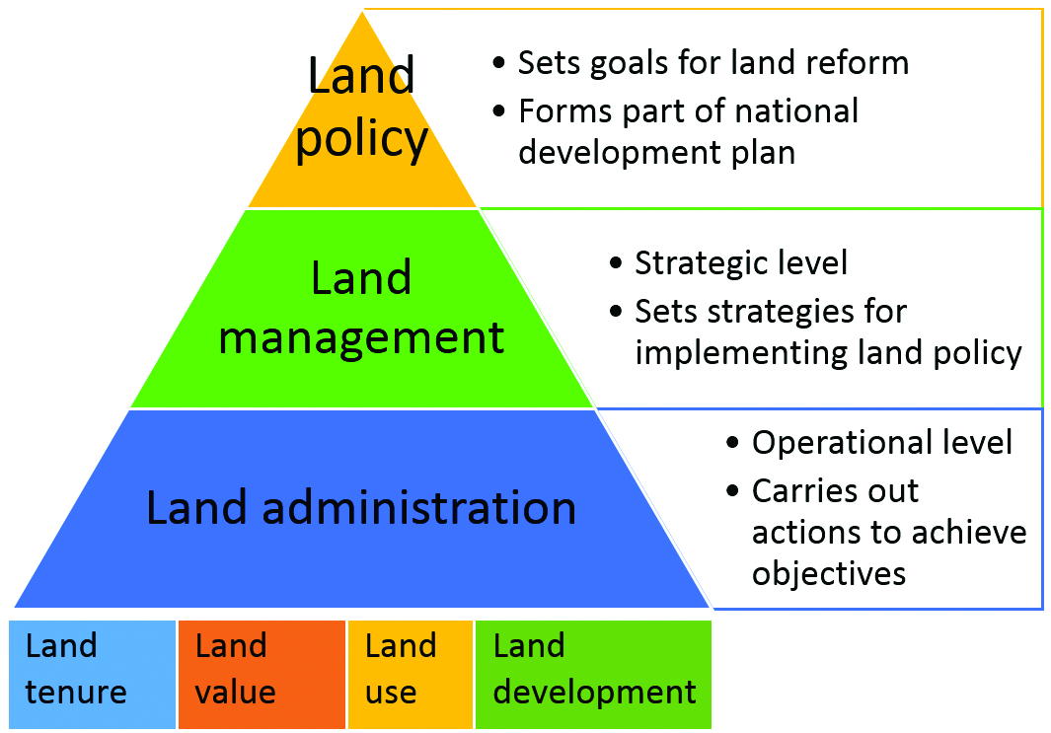
summary
Simon Hull and
Jennifer Whittal, 2018
Notes:
…

Slide 39
Section 2: introduction to spatial data infrastructures (SDI)

Slide 40
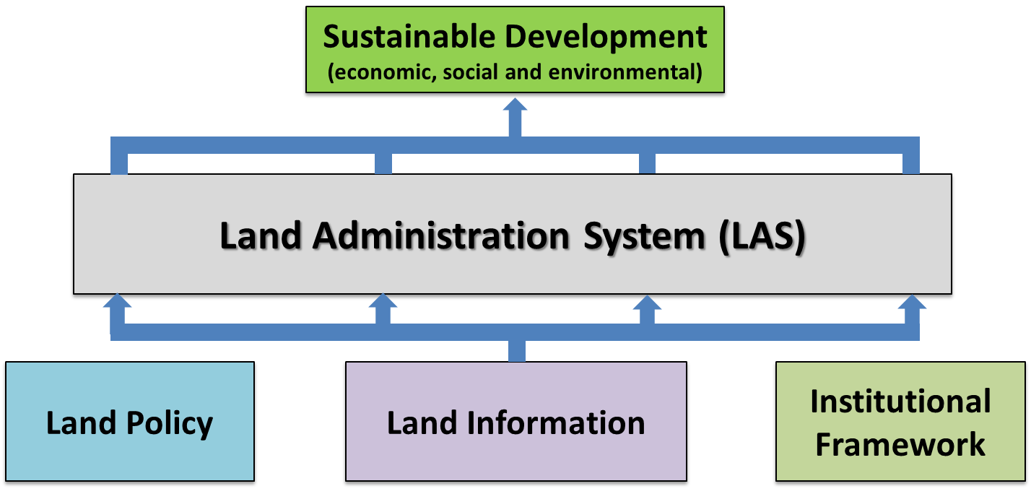
land management paradigm
(Williamson, Enemark, Wallace, Rajabifard, 2010)

Slide 41
spatial data infrastructure (SDI)
Spatial Data Infrastructure (SDI) is defined as a framework of policies, institutional arrangements, technologies, data, and people that enables the sharing and effective usage of geographic information by standardizing formats and protocols for access and interoperability.
The goals of SDI is to;
reduce duplication of efforts,
lower costs related to geographic information,
increase the benefits of using available spatial data,
establish key partnerships between states, counties, cities, academia, and the private sector.
SDI should be seen as part of wider e-Government initiatives.

Slide 42
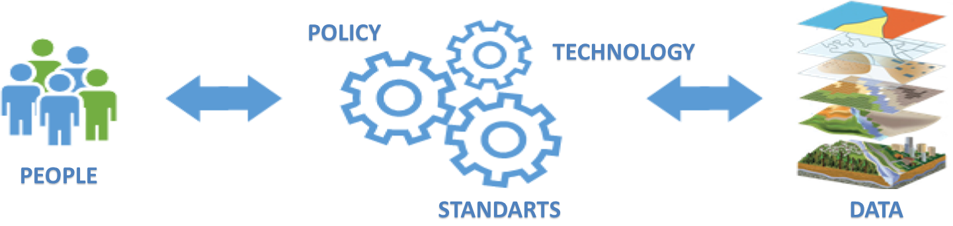
components of SDI
people: users, providers, administrators, public or private
policies & institutional arrangements: administration, coordination, policy, legislation, organizational partnerships and collaboration
standards: data models, metadata standards, spatial data transfer standard, etc.
technology: access distribution networks, clearinghouses, Geoportals, softwares, data acquisition, integration, maintenance, etc.
data: base and thematic maps: statistical, geodetic, cadastre, topography, administration, land use, etc.
takas-değişim

Slide 43
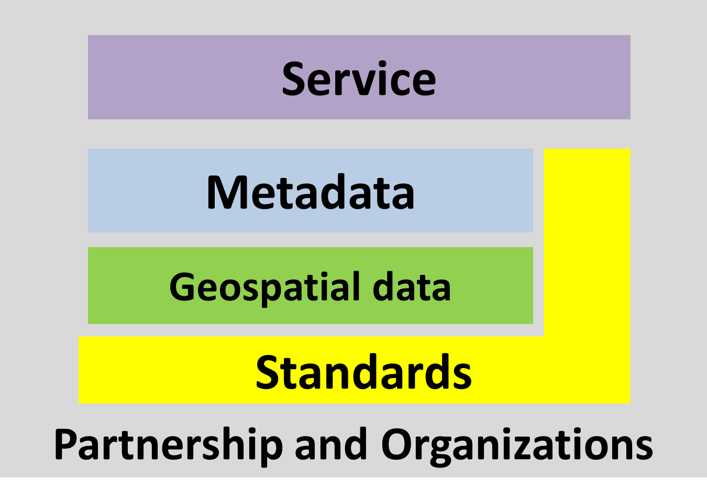
components of SDI
Douglas Nebert, Spatial Data Infrastructure: Concepts and Components

Slide 44
components of SDI
Douglas Nebert, Spatial Data Infrastructure: Concepts and Components

Slide 45
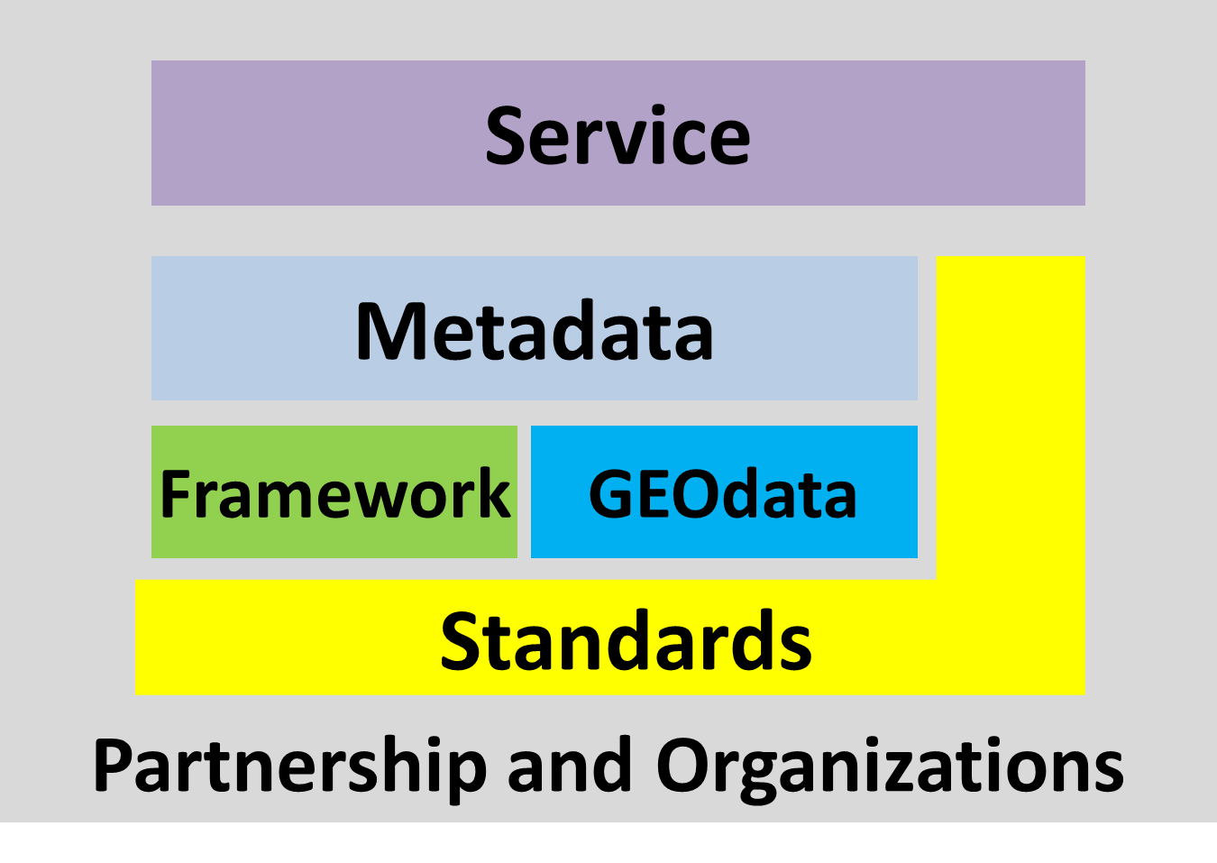
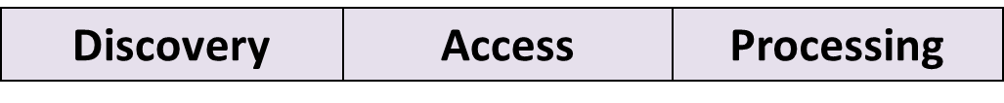
components of SDI
SDI include services to help discover and interact with data
Discovery: discovering resources through metadata in SDI.
Access: provides standardized access to geospatial information (via static files on ftp or via online data streaming services).
Processing: Making processes on geospatial information.
Douglas Nebert, Spatial Data Infrastructure: Concepts and Components

Slide 46
metadata
Metadata is information about data.
Metadata document the who, what, when, where, how, and why of a data resource.
Geospatial metadata describes maps, GIS files, imagery, and other location-based data resources.
ISO 19115/TS19139 provide an international standard for metadata.
Douglas Nebert, Spatial Data Infrastructure: Concepts and Components

Slide 47
metadata
Metadata can apply to data, services, and other resource types
Provides documentation of existing resources of an organization (inventory)
Permits structured search and comparison of held geospatial resources by others (catalog)
Provides end-users with adequate information to take the resource and apply it in an appropriate context (documentation)
Douglas Nebert, Spatial Data Infrastructure: Concepts and Components

Slide 48

components of SDI
Framework datasets are commonly used as a base dataset upon which other datasets can be placed such as topographic datasets, administrative boundary datasets and land ownership datasets.
Douglas Nebert, Spatial Data Infrastructure: Concepts and Components

Slide 49
components of SDI
Standards establish common specifications and practices for:
data content
data models of representation
data processing
data documentation
data exchange
thematic vocabularies and keywords
software interfaces web mapping and feature
services
Standards include specifications (OGC), formal standards (ISO), and documented practices.
Douglas Nebert, Spatial Data Infrastructure: Concepts and Components

Slide 50
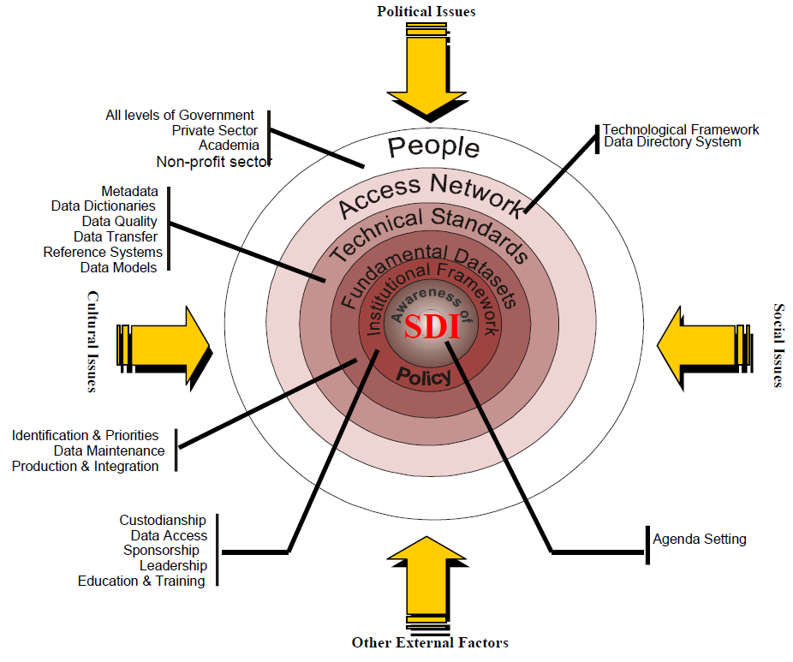
as a summary…

Slide 51
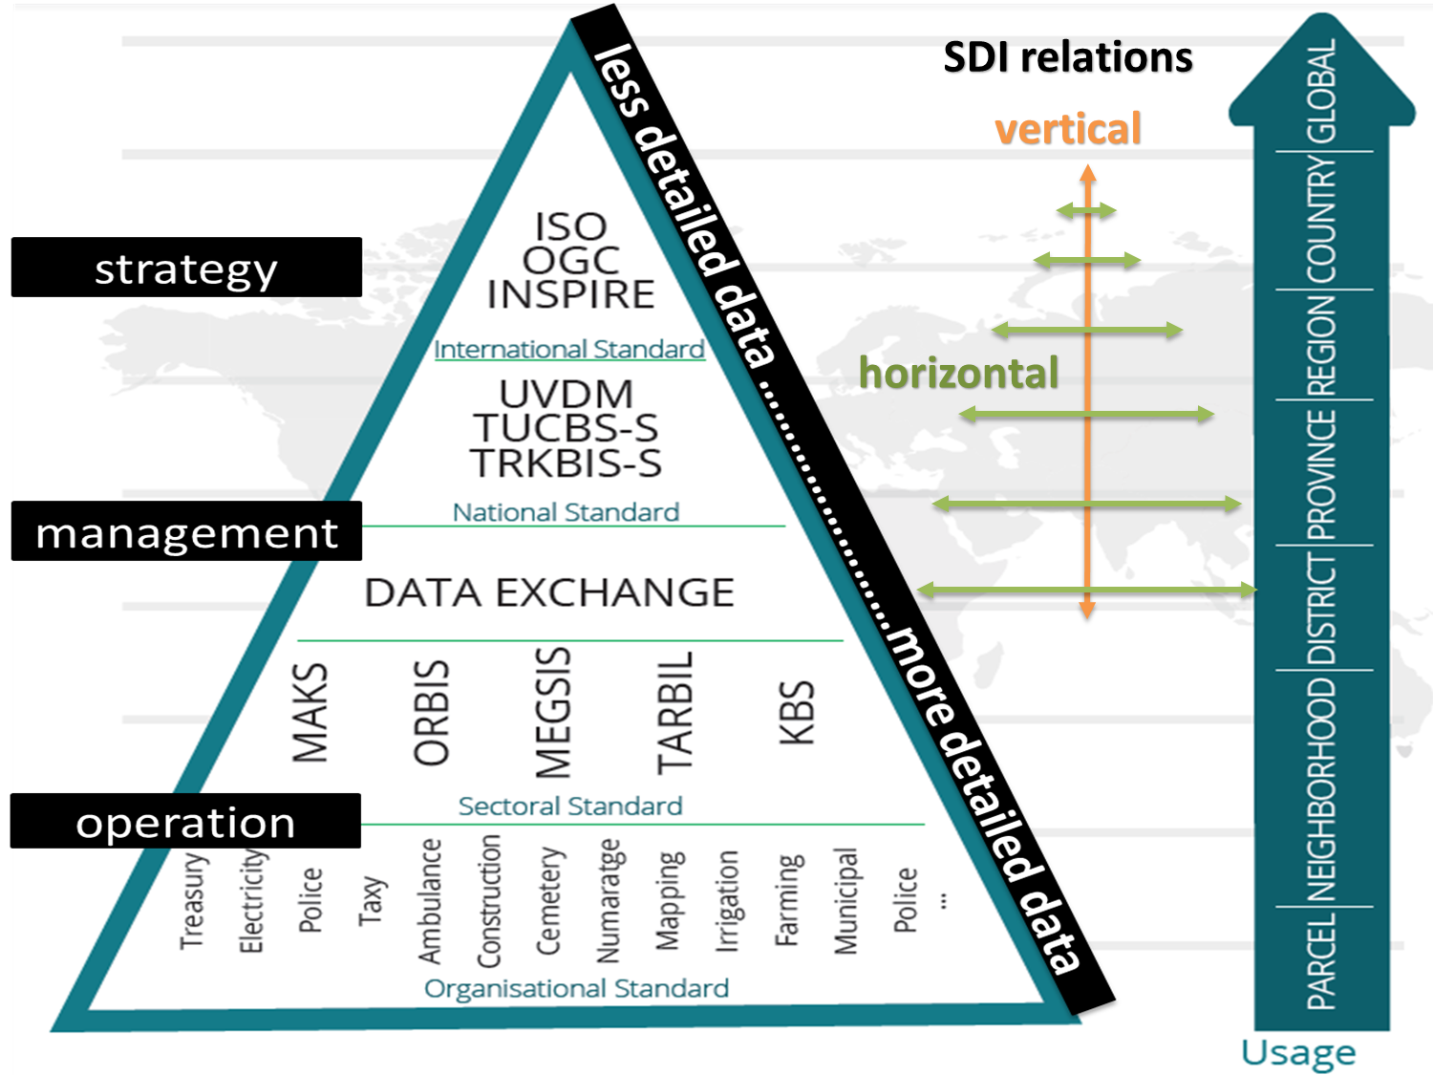

Slide 52
Standardization Organizations
Main standardization activities about SDIs:
Inspire (Infrastructure for Spatial Information in Europe)
International Organization of Standardization (ISO)
Technical Committee 211
World Wide Web Consortium (W3C)
OpenGIS Consortium (OGC)

Slide 53
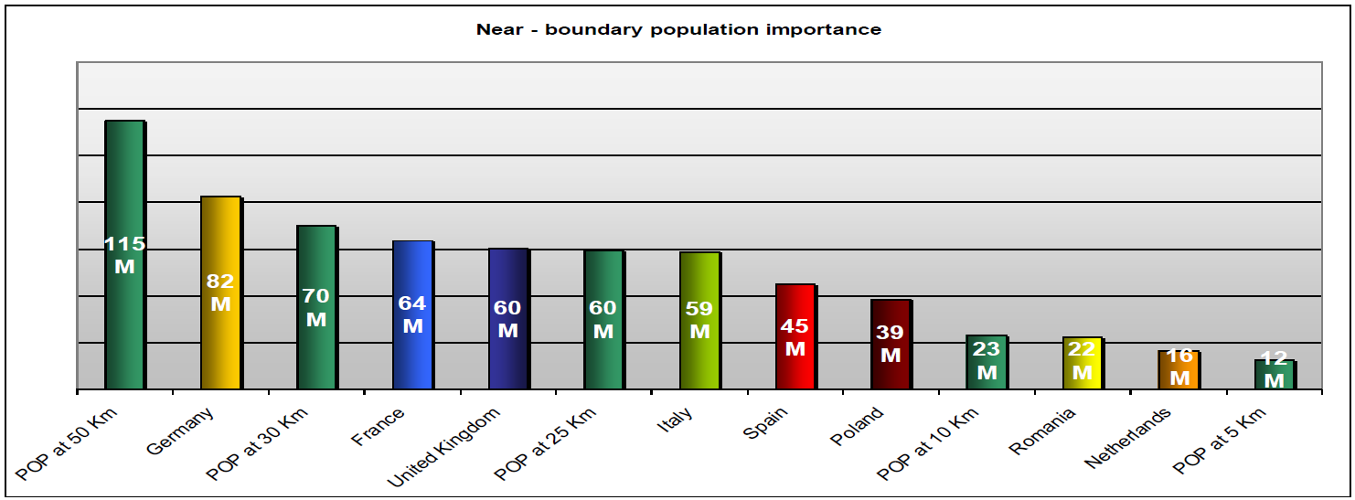
INSPIRE: SDI in EU: WHY?
Many problems do not stop at national borders!
20% of the EU citizens (115 million) live within 50 km from a border.
60 million EU citizens live less than half an hour (25 km) from a border
Danny Vandenbroucke, 2014

Slide 54
SDI in EU
EUROSION Example:
Objective: to provide recommendations on policy and management measures to address coastal erosion in the EU.
Methodology:
By using geographic data and by making analyzes on coastal erosion to define vulnerable areas and monitor indicators in terms of lives at risk, economy at risk and nature at risk
Danny Vandenbroucke, 2014

Slide 55
SDI in EU
main problems:
A large variety of formats exist
Many geographical gaps still remain
Reference systems are not harmonized
Many data sources are not consistent
Scales are not compatible
All data are not interoperable
Costs and access restrictions
Danny Vandenbroucke, 2014

Slide 56
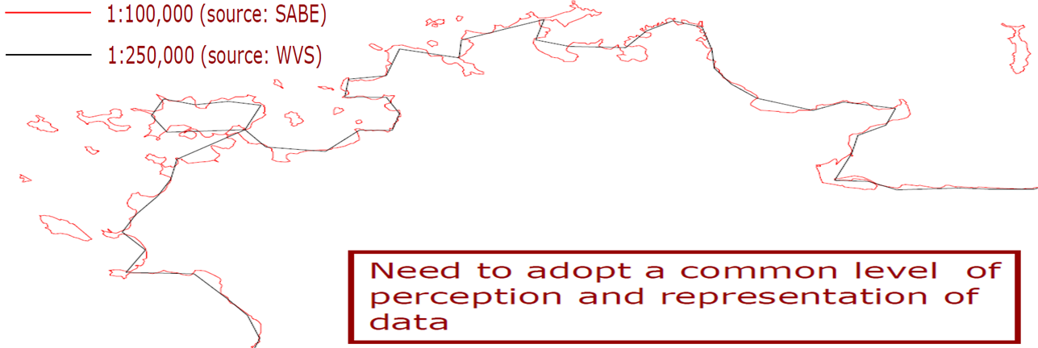
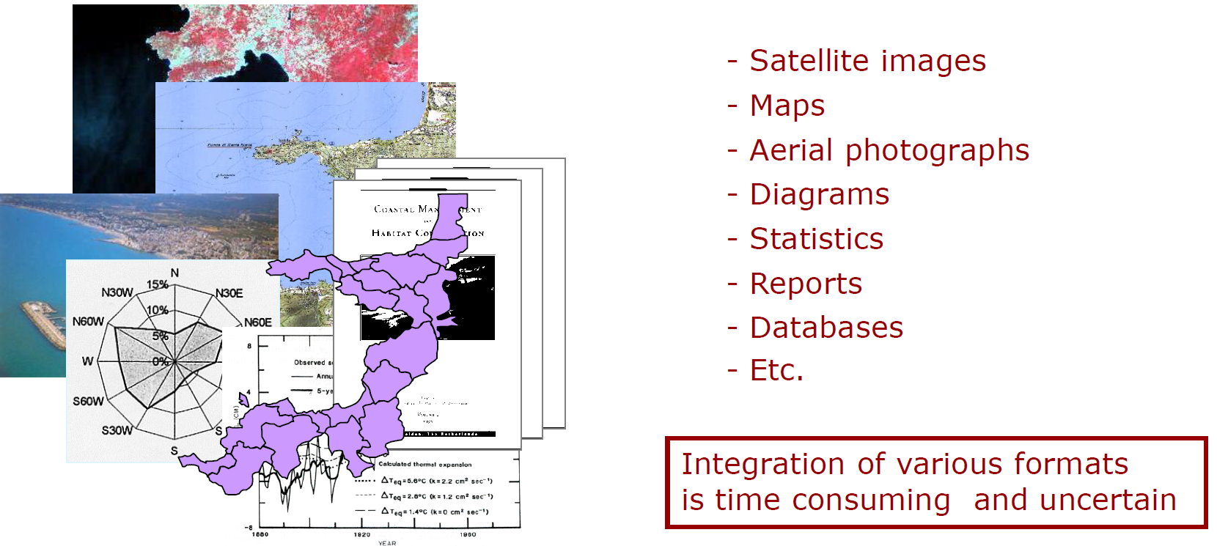
SDI in EU
Different scales results as different
generalization and representation
Countries use different formats
for the same data such as;
Danny Vandenbroucke, 2014

Slide 57
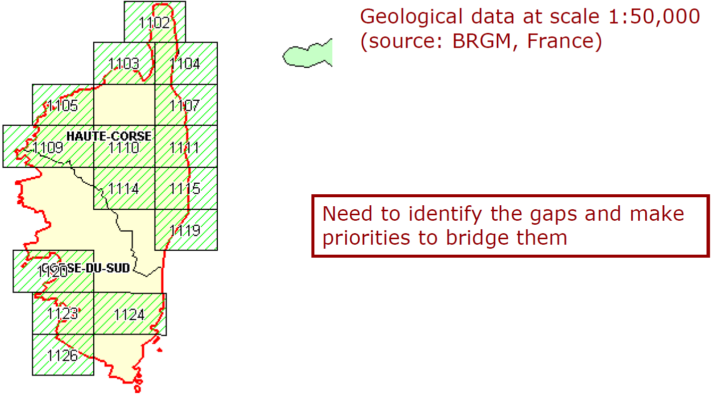
SDI in EU
Danny Vandenbroucke, 2014

Slide 58
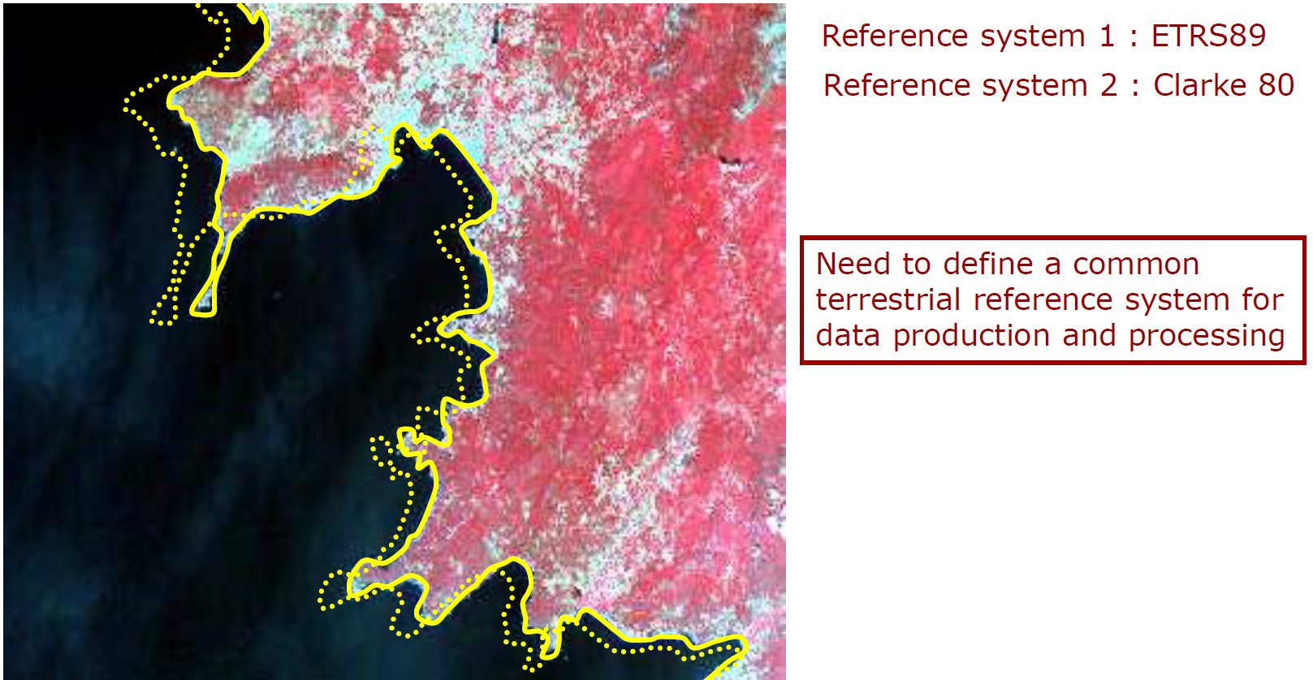
SDI in EU
Danny Vandenbroucke, 2014

Slide 59
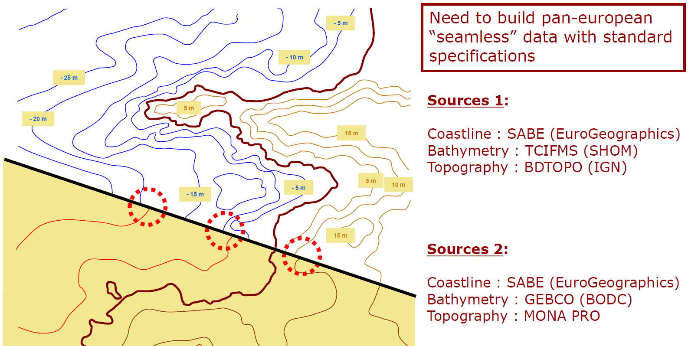
SDI in EU

Slide 60
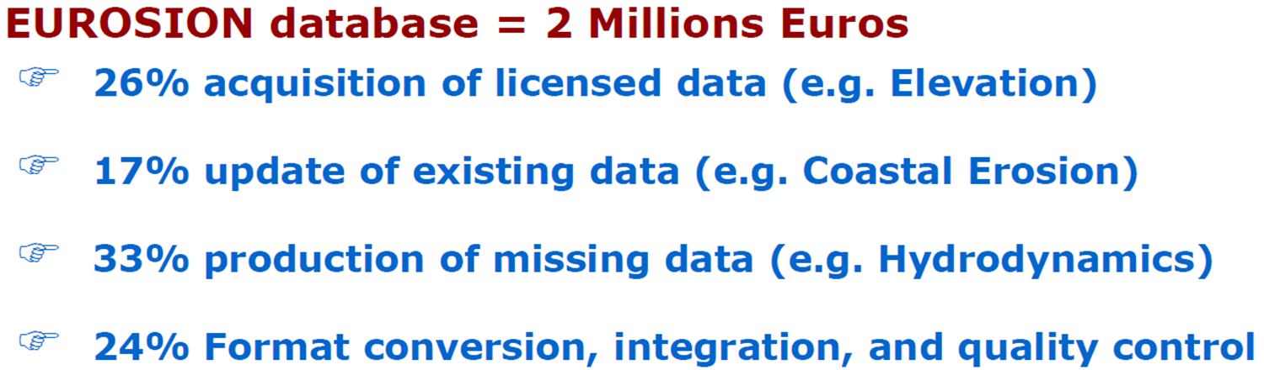
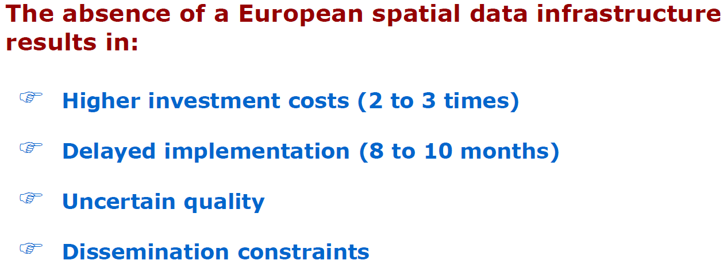
SDI in EU
Danny Vandenbroucke, 2014

Slide 61
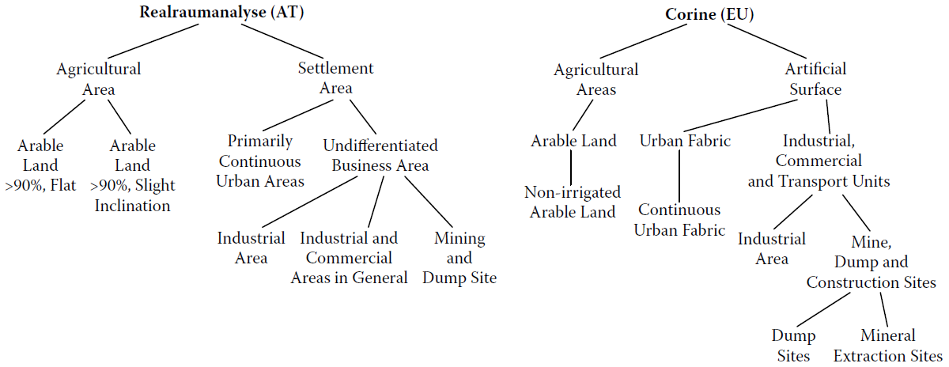
SDI in EU
Austrian Land Cover
Alessandro Annoni, Anders Friis-Christensen, Roberto Lucchi, and Michael Lutz, 2008

Slide 62
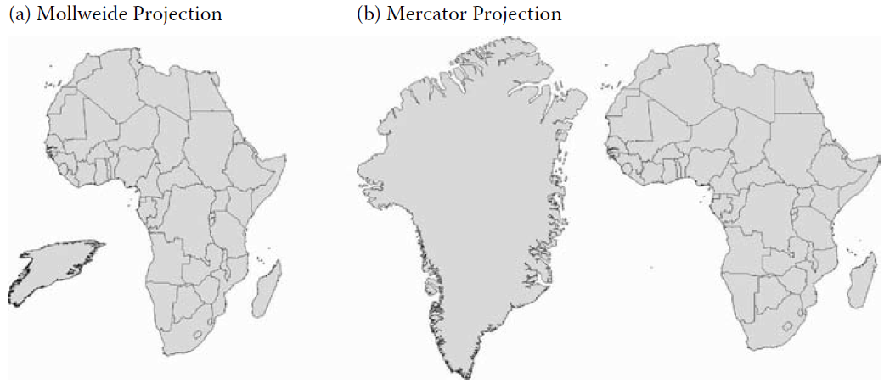
SDI in EU
Greenland and Africa
Greenland and Africa
Alessandro Annoni, Anders Friis-Christensen, Roberto Lucchi, and Michael Lutz, 2008

Slide 63
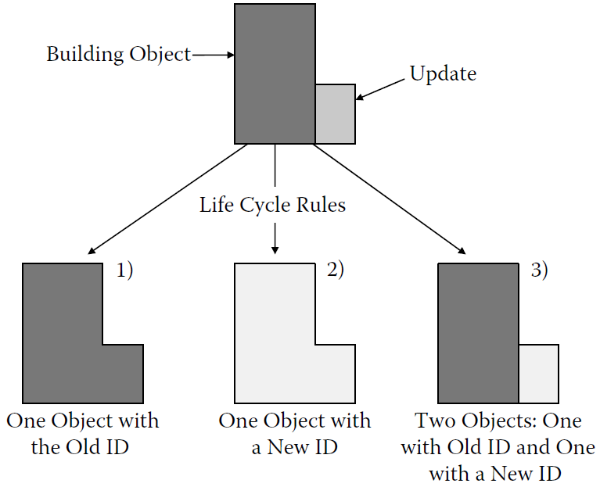
SDI in EU

Slide 64
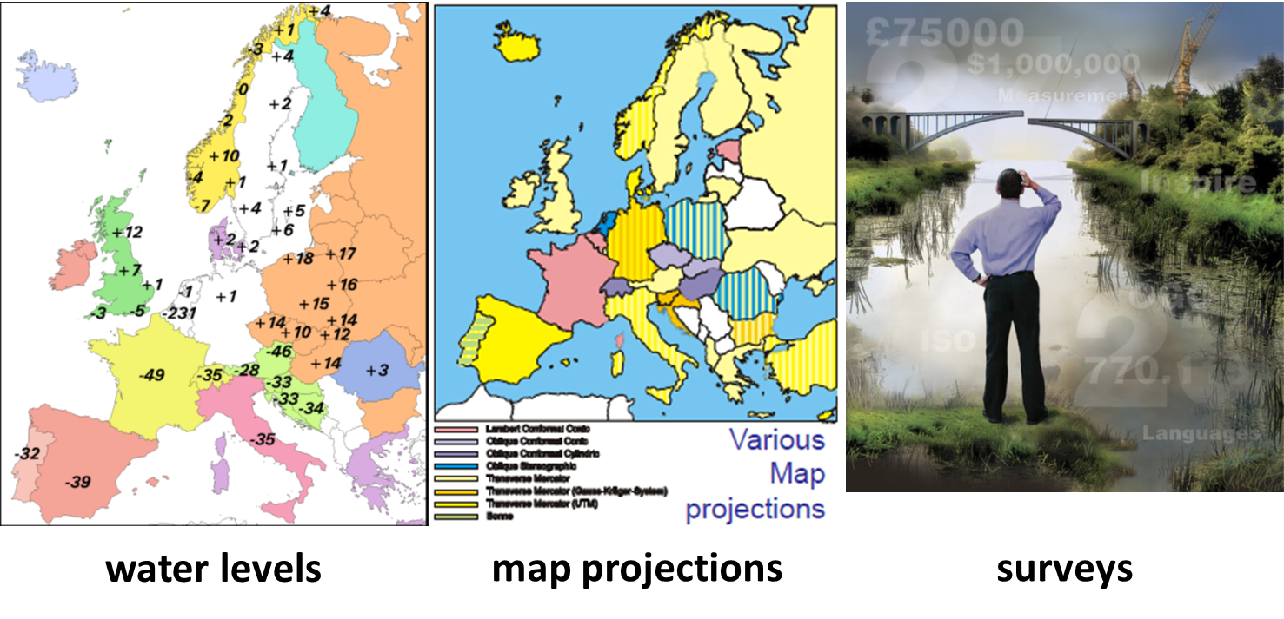
SDI in EU: WHY?

Slide 65
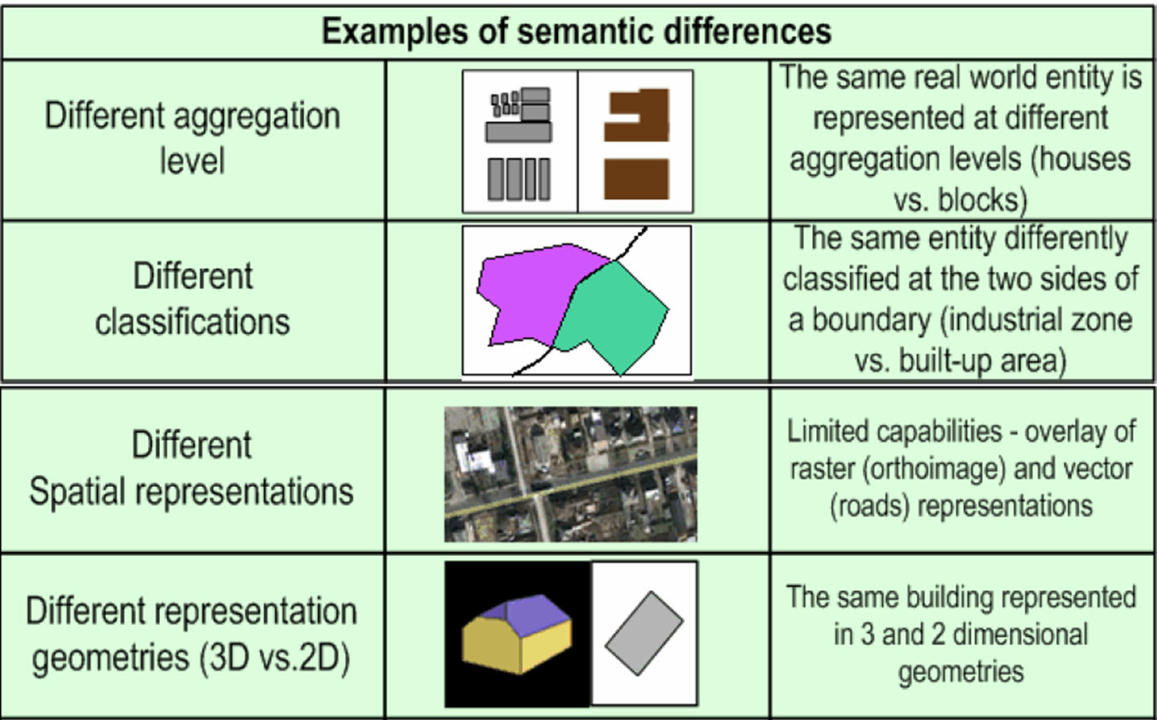
SDI in EU
Katalin Toth, et al. 2012

Slide 66
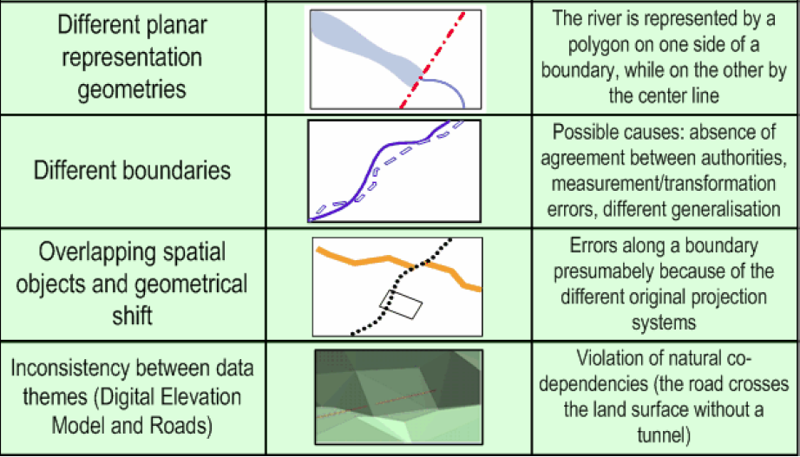
SDI in EU
Katalin Toth, et al. 2012

Slide 67
INSPIRE
Inconsistencies in spatial data collection
spatial data are often missing or incomplete, or the same data are collected twice by different organizations.
Lacking documentation
description of available spatial data is often incomplete.
Spatial data sets not compatible
spatial data sets often cannot be combined with other spatial data sets
Incompatible geographic information initiatives
the infrastructures to find, access and use spatial data often function in isolation only
Barriers to data sharing
cultural, institutional, financial and legal barriers prevent or delay the sharing of existing spatial data

Slide 68
INSPIRE
The infrastructure for spatial information in Europe (INSPIRE) aims to create a European Union spatial data infrastructure for the purposes of EU environmental policies and policies or activities which may have an impact on the environment.
To deliver useful, standardized and high quality data in order to formulate, implement, monitor and evaluate European, National and Local Policy.

Slide 69
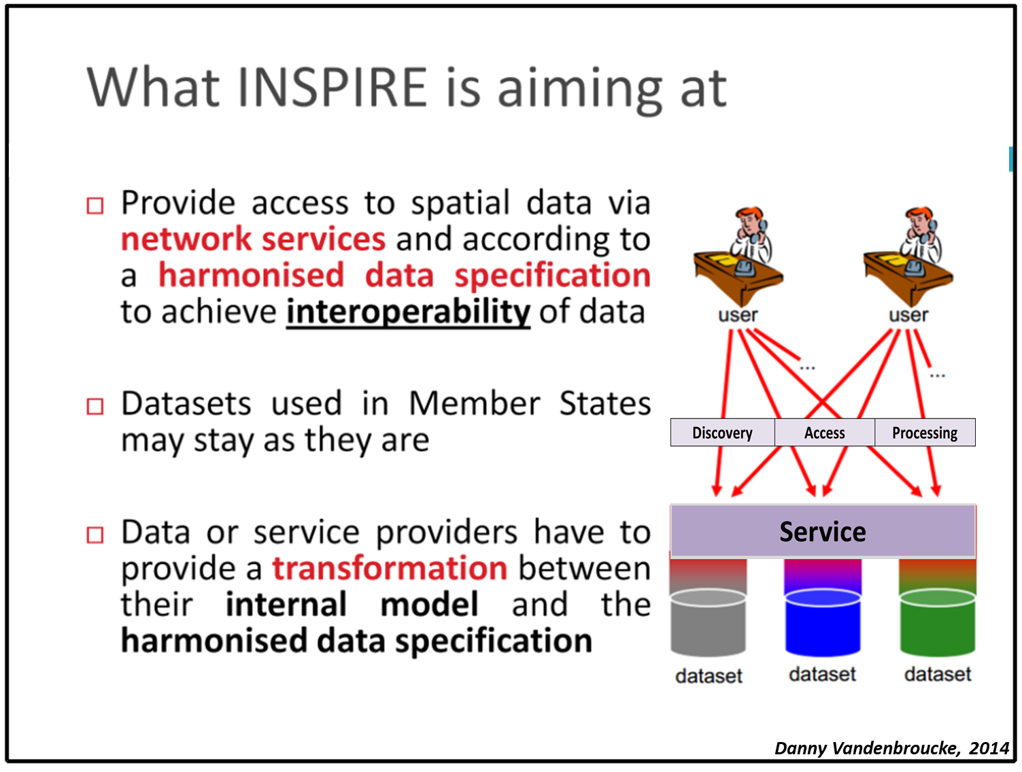
INSPIRE vision:
Data should be collected once and maintained at the level where this can be done most effectively
It should be possible to combine seamlessly spatial data from different sources across the EU and share it between many users and applications
It should be possible for spatial data collected at one level of government to be shared between all levels of government

Slide 70
INSPIRE vision:
Spatial data needed for good governance should be available on conditions that are not restricting its extensive use
It should be easy to discover which spatial data is available, to evaluate its fitness for purpose and to know which conditions apply for its use

Slide 71
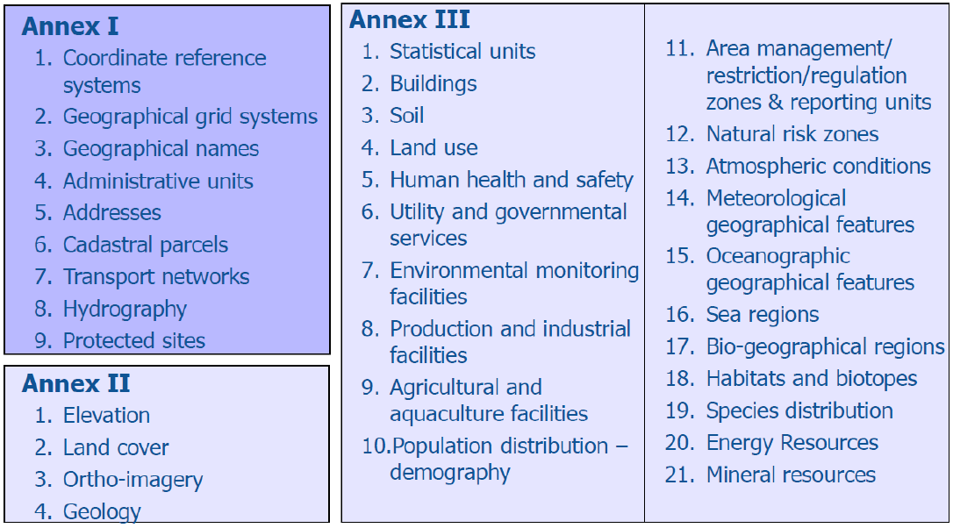

Slide 72
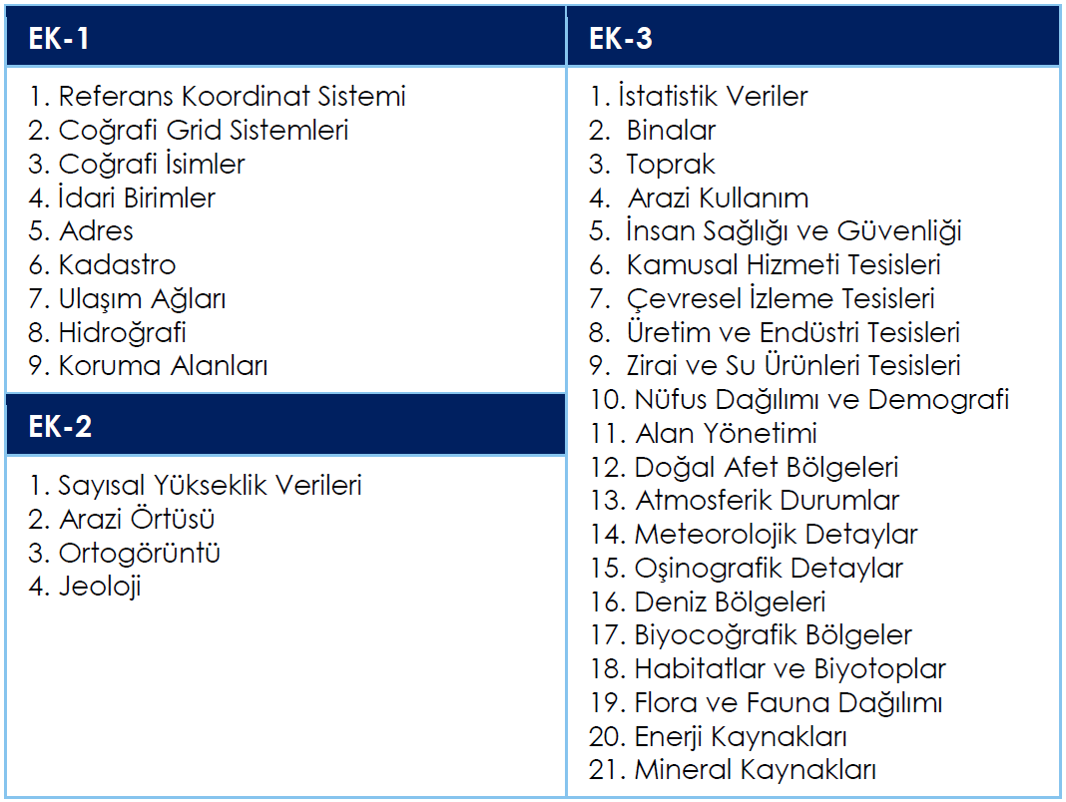
ÇŞB Eğitim Kitabı

Slide 73
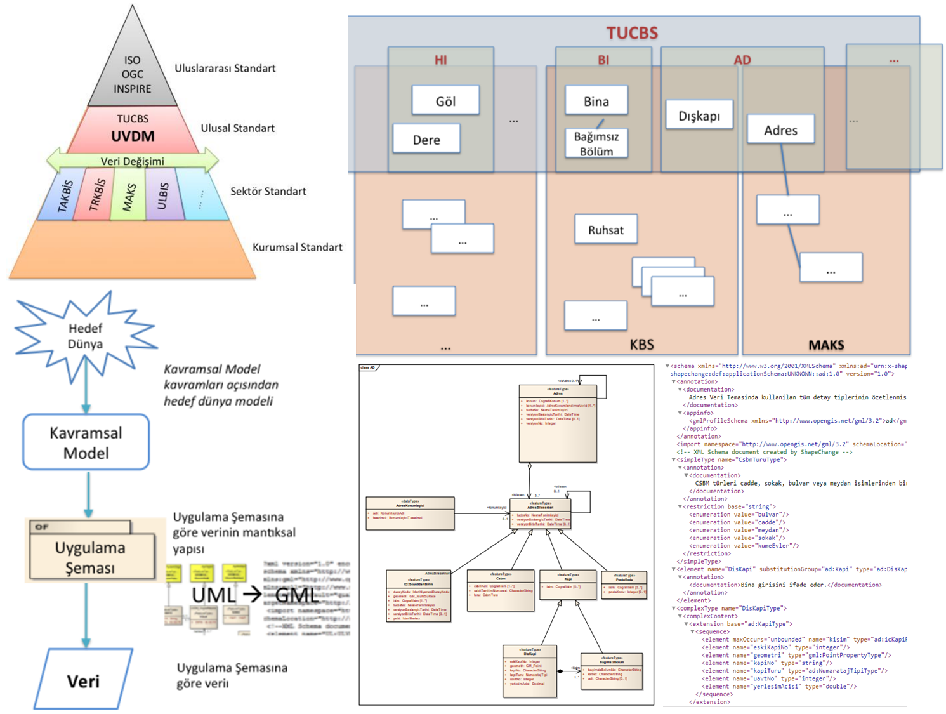

Slide 74
ISO
ISO is the international standard organization responsible for promoting and developing standards that facilitate international exchange of goods and services.
There are technical committees and working groups developing the individual standards within ISO.
ISO/TC 211, aims to develop and implement standards (norms) for geographic information and geomatics.
Many organizations are actively involved in the work of ISO/TC 211.
For example, FIG, European Committee for Standardization (CEN), etc.

Slide 75
ISO/TC211
ISO/TC 211 aims to establish a structured set of standards for information concerning objects or phenomena that are directly or indirectly associated with a location relative to the Earth.
These standards may specify,
for geographic information, methods, tools and services
for data management (including definition and description), acquiring, processing, analyzing, accessing, presenting and transferring such data in digital/electronic form between different users, systems and locations.

Slide 76
ISO/TC211
ISO/TC211 has the objective to develop international standards to:
support the understanding and usage of geographic information
increase the availability, access, integration, and sharing of geographic information,
enable inter-operability of geospatially enabled computer systems
contribute to a unified approach to addressing global ecological and humanitarian problems
ease the establishment of geospatial infrastructures on local, regional and global level
contribute to sustainable development

Slide 77
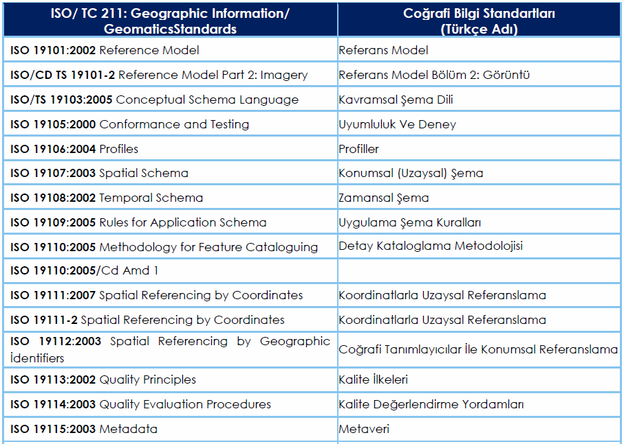
ISO/TC211
ÇŞB Eğitim Kitabı

Slide 78
W3C: World Wide Web Consortium
W3C is an organization for the development of interoperable standards, enabling the exchange of online information, including standards for developing and transmission of Web pages.
Most of common protocols and definitions for the Internet are established and maintained by the W3C, such as;
HTML XML
HTTP XML Query
PNG XML Schema
SOAP/XMLP XPath
SVG XPointer
URI/URL XSL and XSLT
XHTML CSS
Xlink DOM
Douglas Nebert, Spatial Data Infrastructure: Concepts and Components

Slide 79
OGC - Open Geospatial Consortium
The international consortium of more than 400 parties from around the world: commercial organizations, government agencies, non-profit organizations and universities.
The main task of OGC is to develop agreed and accepted specifications for interoperability issues in the field of geoinformation, i.e. the ability of systems to work together and make the geographic information and services available across any network, application, or platform.

Slide 80
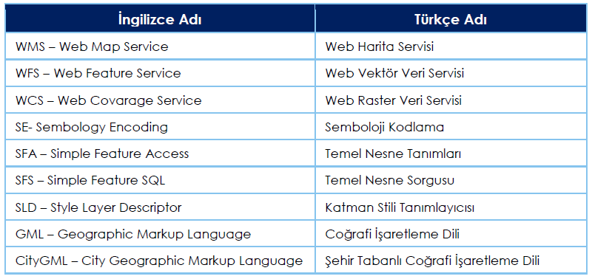
OGC - Open Geospatial Consortium
ÇŞB Eğitim Kitabı

Slide 81
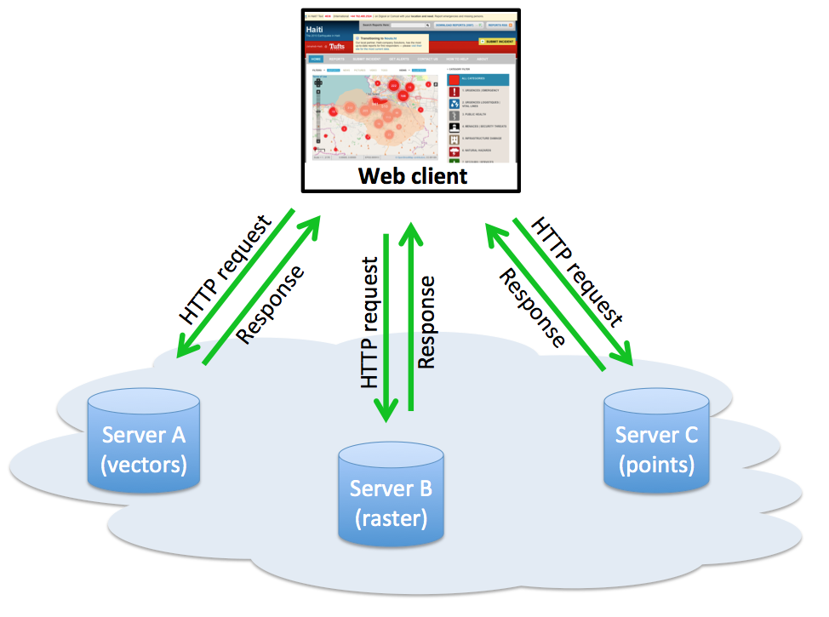
OGC - Open Geospatial Consortium
OGC Web Map Server – Web Harita Servisi
Establishes a common vocabulary for the request and delivery of a raster graphic based on a number of parameters using GET/POST.
Three operations:
GetCapabilities: returns service and layer information
GetMap: returns map based on request arguments
GetFeatureInfo: returns attribute information for the
selected feature(s)

Slide 82
OGC - Open Geospatial Consortium
WFS: Web Feature Service – Web Vektör Veri Servisi
The Web Feature Service (WFS) represents a change in the way geographic information is created, modified and exchanged on the Internet. Rather than sharing geographic information at the file level using File Transfer Protocol (FTP), for example, the WFS offers direct fine-grained access to geographic information at the feature and feature property level.
WCS: Web Coverage Service – Web Raster Veri Servisi
A Web Coverage Service (WCS) offers multi-dimensional coverage data for access over the Internet.

Slide 83
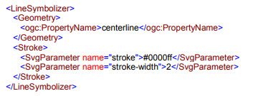
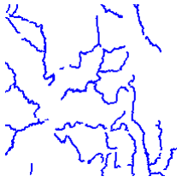
OGC - Open Geospatial Consortium
SE: Symbology Encoding - Semboloji Kodlama
SE is an XML language for styling information that can be applied to digital Feature and Coverage data. A Symbolizer describes how a feature is to appear on a map. The Symbolizer describes not just the shape that should appear but also such graphical properties as color and opacity. Five types of Symbolizers are :
• Line • Polygon • Point • Text • Raster

Slide 84
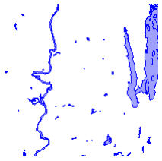
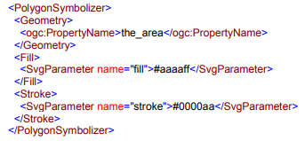
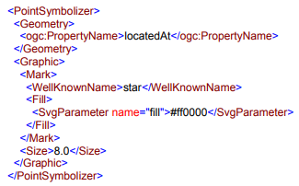

OGC - Open Geospatial Consortium

Slide 85
OGC - Open Geospatial Consortium
GML: Geography Markup Language – Coğrafi İşaretleme Dili
GML is for encoding spatial information. Consist of a set of XML technologies for expressing spatial data on the Internet.
GML serves as a modeling language for geographic systems as well as an open interchange format for geographic transactions on the Internet.
Key to GML's utility is its ability to integrate all forms of geographic information, including not only conventional "vector" or discrete objects, but coverages and sensor data.
Douglas Nebert, Spatial Data Infrastructure: Concepts and Components

Slide 86
OGC - Open Geospatial Consortium
CITYGML – Şehir Tabanlı Coğrafi İşaretleme Dili
CityGML is an open standardized data model and exchange format to store digital 3D models of cities and landscapes.
CityGML is designed as an open data model and XML-based format for the storage and exchange of virtual 3D models of cities and landscapes.
It also defines different standard levels of detail (LoD) for the 3D objects, which allows the representation of objects for different applications and purposes.
Douglas Nebert, Spatial Data Infrastructure: Concepts and Components

Slide 87
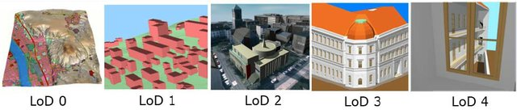
OGC - Open Geospatial Consortium
LOD0 is essentially a two and a half dimensional Digital Terrain Model, over which an aerial image or a map may be draped.
LOD1 is the well-known blocks model comprising prismatic buildings with flat roofs.
LOD2 has differentiated roof structures and thematically differentiated surfaces. Vegetation objects may also be represented.
LOD3 denotes architectural models with detailed wall and roof structures, balconies, bays and projections.
LOD4 completes a LOD3 model by adding interior structures for 3D objects.

Slide 88
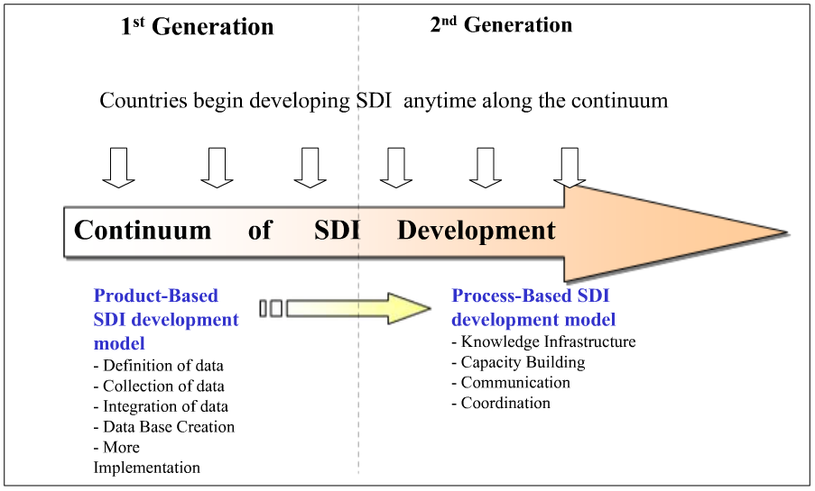
Generational Development of SDIs
Abbas Rajabifard / SDI lecture

Slide 89

Continuum of SDI Development
Abbas Rajabifard / SDI lecture

Slide 90
components of SDI
Partnership and Organizations
Service
Metadata
Geospatial data
Standards

Slide 91
Section 3:
Introduction to modeling:
Model Driven Architecture (MDA) Unified Modeling Language (UML)

Slide 92
SDI and MDA
SDI is a framework of policies, institutions, technologies, data, and people that enables the sharing and usage of geographic information by standardizing formats and protocols for access and interoperability.
Interoperability means that different systems are compatible and are able to exchange information, so that other systems will understand it.
There are many ways to achieve interoperability of computer systems, one of which is the Model-Driven Architecture approach (MDA).
By using MDA models, we are able to better deal with the complexity of large systems and the interaction and collaboration between organizations, people, hardware, software.
Douglas Nebert, Spatial Data Infrastructure: Concepts and Components

Slide 93
model driven architecture
A model is a simplification of reality.
We build models so that we can better understand the system we are developing.
Through modeling, we narrow the problem we are studying by focusing on only one aspect at a time.
Through modeling, we achieve four aims;
1. visualize a system as it is or as we want it to be.
2. specify the structure or behavior of a system.
3. provide a template that guides us in constructing a system.
4. document the decisions we have made.
Booch, G., Rumbaugh, J., Ivar, J., 1998, The Unified Modeling Language User Guide

Slide 94
model driven architecture
Any model needs to be expressed in a way that communicates information about a system among involved stakeholders that can be correctly understood by the stakeholders and supporting technologies.
The modeling language consist of the structure, terms, notations, syntax, semantics, and integrity rules that are used to express a model
A model;
contains no information specific to the platform, or the technology that is used to realize it,
describes the structure and function of a system, but not the specific implementation.
sözdizimi
anlambilim
Object Management Group, Model Driven Architecture (MDA) MDA Guide rev. 2.0

Slide 95




platform-independent model
With the MDA methodology, system functionality is specified as a platform-independent model (PIM) by using an appropriate Domain Specific Language such as the Unified Modelling Language (UML).
UML models can be exchanged among UML tools by using the XML Metadata Interchange (XMI) format.
Code generation
SQL
XML
Java
Object Management Group, Model Driven Architecture (MDA) MDA Guide rev. 2.0

Slide 96



platform-independent model
We can see that the complexity increases from conceptual to logical to physical.
conceptual data model: we understand at high level what are the different entities in our data and how they relate to one another;
logical data model: we understand the details of our data without worrying about how they will actually implemented,
physical data model: we know exactly how to implement our data model in the database of choice

Slide 97
What is UML?
Unified Modeling Language;
is an industry standard language for visualizing, specifying, constructing, and documenting artifacts of a software-intensive system
is a platform-neutral environment for abstract modeling of data and processes
is adopted as the Conceptual Schema Language for ISO TC 211
Çağdaş, V., 2018, Arazi Bilgi Yönetim Sistemleri Yayımlanmamış Ders Notları

Slide 98
UML diagrams
UML diagrams represent two different views of a system model:
Static (or structural) view: highlights the static structure of the system using objects, attributes, operations and relationships.
  class diagrams and composite structure diagrams.
Dynamic (or behavioral) view: highlights the dynamic behavior of the system by showing collaborations among objects and changes to the internal states of objects.
  sequence diagrams, activity diagrams and state machine diagrams.
Çağdaş, V., 2018, Arazi Bilgi Yönetim Sistemleri Yayımlanmamış Ders Notları

Slide 99
UML diagrams
Kullanım durumu ve sınıf çizimleri sistemin durağan yapısını;
Nesne, durum, etkinlik, sonuç ve işbirliği çizimleri ise sistemin dinamik yapısını;
Bileşen ve yayılma çizimleri de fiziksel duruma yönelik çizimlerdir.
Use Case
Diagrams
Class
Diagrams
sınıf
kullanım durumu
Object
Diagrams
Sequence
Diagrams
nesne
sonuç
Component
Diagrams
bileşen
UML
işbirliği
Collaboration
Diagrams
Deployment
Diagrams
yayılma
Statechart
Diagrams
Activity
Diagrams
durum
etkinlik
Çağdaş, V., 2018

Slide 100
Class Diagrams
What is a Class?
Description of a set of objects that share the same attributes, operations, relationships and semantics. Objects in a class are called instances of the class.
Çağdaş, V., 2018, ABYS Yayımlanmamış Ders Notları

Slide 101
class notation
ClassName
A class is a description of a set of objects that share the same attributes, operations, relationships, and semantics.
Graphically, a class is represented as a rectangle, including its name, attributes, and operations in separate compartments.
attributes
operations
Sınıf; aynı özellikleri, işlemleri, ilişkileri ve semantiği paylaşan bir dizi nesnenin açıklamasıdır.
Grafik olarak, bir sınıf ayrı bölümlerde adı, özellikleri ve işlemleri içeren bir dikdörtgen olarak temsil edilir.
https://www.cs.drexel.edu/~spiros/teaching/CS575/slides/uml.pdf

Slide 102
class notation
The name of the class is the only required tag in the graphical representation of a class.
It always appears in the top box.
ClassName
An attribute is a named property of a class that describes the object being modeled. In the class diagram, attributes appear in the second box just below the name.
attributes
operations
Operations describe the class behavior and appear in the third compartment.
https://www.cs.drexel.edu/~spiros/teaching/CS575/slides/uml.pdf

Slide 103
class notation
Person
Attributes are usually listed in the form:
attributeName : Type
Int : An integer (eg, 3). Can be a whole number between -2147483648 and 2147483647.
Float : A fractional (floating point) number (eg, 3.25907).
String : A sequence of characters (eg, "Hello User 6555").
Boolean : A true/false value. Can only contain either the value true or false.
+ name : String
# address : Address
# birthdate: Date
/ age : Date
- ssn : Id
operations
https://www.cs.drexel.edu/~spiros/teaching/CS575/slides/uml.pdf

Slide 104
class notation
Person
Attributes can be:
+ public
# protected
- private
~ package default
/ derived
A derived attribute is one that can be computed from other attributes, but doesn’t actually exist.
For example, a Person’s age can be computed from his birth date. A derived attribute is designated by a preceding ‘/’ as in: / age : Date
+ name : String
# address : Address
# birthdate: Date
/ age : Date
- ssn : Id
operations
https://www.cs.drexel.edu/~spiros/teaching/CS575/slides/uml.pdf

Slide 105
class notation
Person
Operations describe the class behavior and appear in the third compartment.
+ name : String
# address : Address
# birthdate: Date
/ age : Date
- ssn : Id
eat
sleep
work
play
https://www.cs.drexel.edu/~spiros/teaching/CS575/slides/uml.pdf

Slide 106
class notation
PhoneBook
newEntry (n : Name, a : Address, p : PhoneNumber, d : Description)
getPhone ( n : Name, a : Address) : PhoneNumber
You can specify an operation by listing the name, type, and default value of all parameters, and, in the case of functions, a return type.
https://www.cs.drexel.edu/~spiros/teaching/CS575/slides/uml.pdf

Slide 107
class notation
When drawing a class, you needn’t show attributes and operation in every diagram.
Person
Person
Person
name : String
birthdate : Date
ssn : Id
Person
Person
eat()
sleep()
work()
play()
name
address
birthdate
eat
play
https://www.cs.drexel.edu/~spiros/teaching/CS575/slides/uml.pdf

Slide 108
class notation
A class may also include responsibilities in a class diagram.
A responsibility is a contract or obligation of a class to perform a particular service.
SmokeAlarm
Responsibilities
-- sound alert and notify guard station
when smoke is detected.
-- indicate battery state
https://www.cs.drexel.edu/~spiros/teaching/CS575/slides/uml.pdf

Slide 109
Class Relationships
In UML, object interconnections (logical or physical), are modeled as relationships.
There are three kinds of relationships in UML:
dependencies
generalizations
associations
https://www.cs.drexel.edu/~spiros/teaching/CS575/slides/uml.pdf

Slide 110
dependency
A dependency indicates a semantic relationship between two or more elements.
The dependency from CourseSchedule to Course exists because Course is used in both the add and remove operations of CourseSchedule.
depends on
CourseSchedule
Course
add(c : Course)
remove(c : Course)
https://www.cs.drexel.edu/~spiros/teaching/CS575/slides/uml.pdf

Slide 111
inheritance / generalization
A generalization connects a subclass to its superclass.
It denotes an inheritance of attributes and behavior from the superclass to the subclass and indicates a specialization in the subclass of the more general superclass.
Person
kalıtım/genelleme (inheritance/generalization) daha genel bir eleman ile daha özel bir elaman arasındaki ilişkiyi ifade eder.
niteliklerin ve davranışların kalıtımı
özelleşme
Student
https://www.cs.drexel.edu/~spiros/teaching/CS575/slides/uml.pdf

Slide 112
inheritance / generalization
UML permits a class to inherit from multiple superclasses, although some programming languages (e.g., Java) do not permit multiple inheritance.
Student
Employee
Teaching Assistant
https://www.cs.drexel.edu/~spiros/teaching/CS575/slides/uml.pdf

Slide 113

inheritance / generalization
Booch, G., Rumbaugh, J., Ivar, J., 1998, The Unified Modeling Language User Guide

Slide 114

inheritance / generalization
All Vehicles have some common attributes (speed, colour) and behaviour (turnLeft, turnRight).
Bicycle and MotorVehicle are both kinds of Vehicle and inherit from Vehicle. Vehicle is the superclass of both Bicycle and MotorVehicle.
MotorVehicles have engines and license plates. Attributes are added along with some behaviour to examine attributes.
MotorVehicles is the base class of both MotorBike and Car, therefore these classes not only inherit properties (speed, colour) from Vehicle, but also have new attributes and behaviour from MotorVehicle.
And the classes MotorBike and Car have additional attributes and behaviour that are specific to those kinds of objects.
http://www.ldodds.com

Slide 115
association
If two classes in a model need to communicate with each other, there must be link between them. An association denotes that link.
Student
Instructor
İlişki/association: sınıf elemanları arasındaki ilişkileri tanımlamaktadır. düz bir çizgi ile sınıflar birbirine bağlanır ve ilişkinin adı bu çizgi üzerinde yer alır.
sınıfların ilişkideki rolleri de belirtilebilir. kavramsal modellemede olduğu gibi sınıflar arasındaki ilişkinin çoklu olduğunu da belirtilir.
https://www.cs.drexel.edu/~spiros/teaching/CS575/slides/uml.pdf

Slide 116
association: multiplicity
We can indicate the multiplicity of an association by adding multiplicity adornments to the line denoting the association.
Example indicates that a Student has one or more Instructors:
Example indicates that every Instructor has one or more Students:
Student
Instructor
1..*
Student
Instructor
1..*
https://www.cs.drexel.edu/~spiros/teaching/CS575/slides/uml.pdf

Slide 117


association: multiplicity
Multiplicity Example: A Student can take many Courses and many Students can be enrolled in one Course.
https://www.visual-paradigm.com/guide/uml-unified-modeling-language/what-is-class-diagram/

Slide 118



association: rolenames
We can also indicate the behavior of an object in an association by using rolenames.
We can also name the association.
We can specify dual associations.
https://www.cs.drexel.edu/~spiros/teaching/CS575/slides/uml.pdf

Slide 119


association: rolenames
https://www.cs.drexel.edu/~spiros/teaching/CS575/slides/uml.pdf

Slide 120
association: navigability
We can constrain the association relationship by defining the navigability of the association.
Here, a Router object requests services from a DNS object by sending messages to (invoking the operations of) the server. The direction of the association indicates that the server has no knowledge of the Router.
Router
DomainNameServer
erişim-farkındalık (navigability): bir sınıf elamanı ile diğer sınıfın elemanları arasındaki erişebilirlik ilişkisidir. düz bir çizgi ya da tek yönlü ok ile gösterilir. düz çizgi, erişilebilirliğin her iki yönde olduğunu, tek yönlü ok ise erişebilirliğin ok yönünde olduğunu gösterir.
https://www.cs.drexel.edu/~spiros/teaching/CS575/slides/uml.pdf

Slide 121
association: link classes
Associations can also be objects themselves, called link classes or an association classes.
Registration
modelNumber
serialNumber
warrentyCode
Product
Warranty
https://www.cs.drexel.edu/~spiros/teaching/CS575/slides/uml.pdf

Slide 122
self association
A class can have a self association.
kinship
There is a kinship relation between individuals.
All individuals have exactly 2 parents.
Each individual can have no, one or several children.
2
parent
Individual
0 .. *
child
leads
1
captain
Player
10
team member
https://www.cs.drexel.edu/~spiros/teaching/CS575/slides/uml.pdf

Slide 123

association: aggregations
We can model objects that contain other objects by way of special associations called aggregations and compositions.
An aggregation specifies a whole-part relationship between an aggregate (a whole) and a constituent part, where the part can exist independently from the aggregate. Aggregations are denoted by a hollow-diamond adornment on the association.
https://www.cs.drexel.edu/~spiros/teaching/CS575/slides/uml.pdf

Slide 124

association: composition
A composition indicates a strong ownership and coincident lifetime of parts by the whole.
Compositions are denoted by a filled-diamond adornment on the association.
https://www.cs.drexel.edu/~spiros/teaching/CS575/slides/uml.pdf

Slide 125

association: aggregation/composition
toplam (aggregation), bir sınıf elamanı ile diğer sınıfın birden fazla elemanı arasındaki toplam ilişkisidir. ilişki çizgisindeki içi boş baklava şekli, ana sınıfı (toplam sınıfı), bu çizginin diğer ucu ise toplamı oluşturan sınıfı (toplanmış sınıfı) göstermektedir.
oluşum (composition), bir sınıf elamanı ile diğer sınıfın elemanları arasındaki bağımlılık (bileşen) ilişkisidir. ilişki çizgisindeki içi dolu baklava şekli, ana sınıfı (oluşum sınıfı), bu çizginin diğer ucu ise toplamı oluşturan sınıfı (bileşen sınıfı) göstermektedir.

Slide 126

note
UML diyagramı elementine iliştirilen öneri ve kısıtlama notudur.
Bir UML elementi üzerine açıklama yazmak için kullanılabilir.
Örnekte, “Ders” sınıfı üzerindeki çoklu olma durumunun neden “0..*” olarak tanımlandığına ait not girilmiştir.

Slide 127
constrain
Condition or restriction to satisfy. Can be represented in {…} or in a note.
ClassA
ClassA objects should …..
a condition or restriction
{ClassA objects should
be like that}
Kısıtlama (Constraint), “Not” elementi ile aynıdır, ancak bir sınıftaki bir veya daha fazla elemanla ilgili koşul, kısıtlama ve durumları belirtir. Not elementi içerisinde ya da "{…}" parantezleri arasında belirtilir.

Slide 128
interfaces
<<interface>>
ControlPanel
An interface is a named set of operations that specifies the behavior of objects without showing their inner structure.
It can be represented by a one or two compartment rectangle, with the stereotype <<interface>> above the interface name.
Interfaces do not get instantiated. They have no attributes or state. Rather, they specify the services offered by a related class.
<<interface>>
ControlPanel
getChoices : Choice[]
makeChoice (c : Choice)
getSelection : Selection
Arayüz, nesnelerin iç yapılarını göstermeden davranışını belirten adlandırılmış bir işlemler kümesidir; somutlaştırılmaz, özellikleri ya da durumu yoktur. İlgili bir sınıf tarafından sunulan hizmetleri belirlerler.

Slide 129

class diagrams
James Rumbaugh, Ivar Jacobson, Grady Booch, 2005, The Unified Modeling Language Reference Manuel

Slide 130

Shape is an abstract class. It is shown in Italics.
Shape is a superclass. Circle, Rectangle and Polygon are derived from Shape. In other words, a Circle is-a Shape. This is a generalization / inheritance relationship.
There is an association between DialogBox and DataController.
Shape is part-of Window. This is an aggregation relationship. Shape can exist without Window.
Point is part-of Circle. This is a composition relationship. Point cannot exist without a Circle.
https://www.visual-paradigm.com/guide/uml-unified-modeling-language/what-is-class-diagram/

Slide 131
Window is dependent on Event. However, Event is not dependent on Window.
The attributes of Circle are radius and center. This is an entity class.
The operations of Circle are area(), circum(), setCenter() and setRadius().
The parameter radius in Circle is an in parameter of type float.
The method area() of class Circle returns a value of type double.
The attributes and operations of Rectangle are hidden. Some other classes in the diagram also have their attributes and operation names hidden.
https://www.visual-paradigm.com/guide/uml-unified-modeling-language/what-is-class-diagram/

Slide 132

activity diagrams
An activity diagram is essentially a flowchart, showing the flow of control from activity to activity;
to specify, construct, and document the dynamics of a society of objects,
to model the flow of control of an operation.
https://cdn.visual-paradigm.com/guide/uml/what-is-activity-diagram/02-basic-activity-diagram.png
James Rumbaugh, Ivar Jacobson, Grady Booch, 2005, The Unified Modeling Language Reference Manuel

Slide 133


activity diagrams
Activity: Is used to represent a set of actions
Action: A task to be performed
Control Flow: Shows the sequence of execution
Object Flow: Show the flow of an object from one activity (or action) to another.
Initial Node: Portrays the beginning of a set of actions or activities
Activity Final Node: Stop all control flows and object flows in an activity (or action)
https://www.visual-paradigm.com/guide/uml-unified-modeling-language/what-is-activity-diagram/

Slide 134





Decision Node: Represent a test condition to ensure that object flow only goes down one path
Merge Node: Bring back together different decision paths that were created using a decision node.
Fork Node: Split behavior into a set of parallel or concurrent flows of activities (or actions).
Join Node : Bring back together a set of parallel or concurrent flows of activities (or actions).
Swimlane and Partition: A way to group activities performed by the same actor on an activity diagram or to group activities in a single thread
https://www.visual-paradigm.com/guide/uml-unified-modeling-language/what-is-activity-diagram/

Slide 135

James Rumbaugh, Ivar Jacobson, Grady Booch, 2005, The Unified Modeling Language Reference Manuel

Slide 136
sequence diagram
A sequence diagram is an interaction diagram that emphasizes the time ordering of messages. It shows a set of objects and the messages sent and received by those objects.
A sequence diagram displays an interaction as a two – dimension chart. The vertical dimension is the time axis; time proceeds down the page. The horizontal dimension shows the roles that represent individual objects in the collaboration.
Each role is represented by a vertical column containing a head symbol and a vertical line – a lifeline.
During the time an object exists, it is shown by a dashed line. During the time an execution specification of a procedure on the object is active, the lifeline is drawn as a double line.
James Rumbaugh, Ivar Jacobson, Grady Booch, 2005, The Unified Modeling Language Reference Manuel

Slide 137

sequence diagram
James Rumbaugh, Ivar Jacobson, Grady Booch, 2005, The Unified Modeling Language Reference Manuel

Slide 138

ÇŞB, 2012, Kent Bilgi Sistemleri Standartlarının Belirlenmesi Projesi

Slide 139

use-case diagrams
A use case diagram shows a set of use cases and actors (a special kind of class) and their relationships. These diagrams are applied to illustrate the static use case view of a system and are especially important in organizing and modeling the behaviors of a system.
James Rumbaugh, Ivar Jacobson, Grady Booch, 2005, The Unified Modeling Language Reference Manuel

Slide 140

use-case diagrams
1.Actor: A role played by a person, system, or device that has a stake in the successful operation of the system.
2.System: Sets the boundary of the system in relation to the actors who use it (outside) and the features it provide (inside).
3.Use Case: Identifies a key feature of the system. Without these features, the system will not fulfill the user/actor requirements. Each Use Case expresses a goal that the system must achieve.

Slide 141
use-case diagrams
4.Association: Identifies an interaction between actors and Use Cases. Each association becomes a dialog that must be explained in a Use Case narrative.
5.Dependency: Identifies communication relationship between two Use Cases.
6.Generalization: Defines a relationship between two actors or two Use Cases where one Use Case inherits and adds to or overrides the properties of the other.

Slide 142

use-case diagrams
James Rumbaugh, Ivar Jacobson, Grady Booch, 2005, The Unified Modeling Language Reference Manuel

Slide 143

ÇŞB, 2012, Kent Bilgi Sistemleri Standartlarının Belirlenmesi Projesi

Slide 144

ÇŞB, 2012, Kent Bilgi Sistemleri Standartlarının Belirlenmesi Projesi

Slide 145

Packages
A package is a container-like element for organizing other elements into groups. A package can contain classes and other packages and diagrams. Packages can be used to provide controlled access between classes in different packages.

Slide 147


